Slide 1
Licensing the 800 MHz band in Sweden
Göran Marby
Director General, PTS
Regional Seminar Africa
Barcelona
February 16, 2011

Slide 2
Broadband Strategy for Sweden
Adopted in November 2009 by the Swedish Government
Key targets in the strategy:
World Class Broadband
By 2015: 40% of households and businesses access to 100 MBps
By 2020: 90% of households and businesses access to 100 MBps
All households and businesses should have good possibilities to use electronic public services and broadband services
*http://www.regeringen.se/sb/d/11345/a/134979

Slide 3
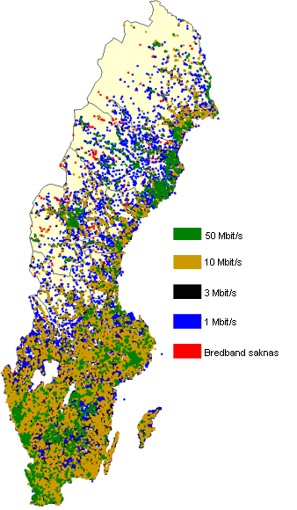
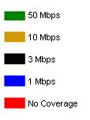
Broadband quality and coverage based on current user patterns
Broadband quality and coverage based on future user patterns (2020)
> 50 Mbps
< 50 Mbps
PTS, 2009

Slide 4
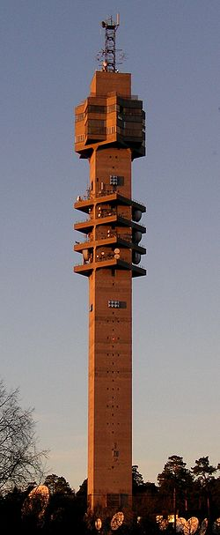
Digital switchover in Sweden
Start of digital terrestrial TV services 1999
Government Bill on switch-over and analogue switch-off March 2003
Analogue transmissions closed down in stages, finalised by October 2007
Government Decision 19 December 2007 to use the 800 MHz band for other services than TV
PTS given the task to fit all TV transmission sub 790 MHz

Slide 5
Timetable award of 800 MHz in Sweden
2007 – Government decision
2008 – Replanning and harmonisation work
2009 – Two hearings and one consultation
2010 – One hearing and consultation of final rules and invitation, public invitation to participate
2011 – Auction starting February 28, licensing and access to spectrum at end of auction

Slide 6
The 800 award in Sweden - License packaging
National licenses
Six licenses (2x5 MHz)
Duration of licenses: 25 years
Service and technology neutral conditions
Technical conditions in line with international harmonisation
Spectrum Cap: One bidder can buy a maximum of two licenses
License conditions to not cause interference to reception of terrestrial TV below 790 MHz
http://www.pts.se/en-gb/Industry/Radio/Autctions/Ansokan-tillstand-800-MHz-bandet/

Slide 7
The 800 award in Sweden - Auction format and coverage obligation
Auction format is a Simultaneous Multiple Round Auction with Switching
Starting bid proposed at SEK 150 M per license
Coverage obligations for one of the licenses:
License holder shall cover households and working places that do not today have basic possibilities for broadband (today approx. 1000 - 1500)
License holder promises to invest in coverage up to a certain level (in the range SEK 150 – 300 M)

