Slide 1
mHealth opportunity in the Middle East
Anna Campbell, Project Manager mHealth Programme GSMA
Notes:
I would like to welcome you to this Mobile Health session and am very happy to see so many people here.
My name is Anna Campbell and I work as a Project Manager in the Mobile Health project team at the GSMA.
I am very honoured to be here and given this opportunity to talk about the great and important subject of mobile health.
Firstly, I would like to thank the GSMA Arab world regional interest group and MACH for setting up this event in such a great place. I have been here since Monday and I really don’t want to leave!
We have a whole morning dedicated to mHealth but I will not be alone in talking on this subject – with me I have a number of co speakers that will help me out.
Dr Al Orifi is the Director of Health Outreach Services Department at the King Faisal Specialist Hospital & Research Center in Riyadh, Kingdom of Saudi Arabia. He also chairs the Examination for Saudi Board of Emergency Medicine. He brings with him a wide experience in Mobile health and will provide insight into this subject from a healthcare perspective.
Mr Faisal Bin Zarah is in charge of the Adjacent Services at Mobily, with main focus on Mobile Health where he works to improve the quality of consumer lives by increasing health and wellness awareness, and provide products and services for chronic disease management. He is going to talk about the Mobily mHealth experience.
VF Egypt:

Slide 2
What is mHealth?
Solutions across the Patient Pathway
Prevention
Diagnosis
Treatment
Monitoring
Healthcare Systems Strengthening
Emergency Response
Healthcare Practitioner Support
Healthcare Surveillance
Healthcare Administration
Source: GSMA PwC February 2012
Notes:
I think it is suitable to start this session with asking ourselves the question: what is mobile health?
Well I have done a bit of research and there seems to be no definite agreed definition around. However,
WHO says it is “The use of mobile and wireless technologies to support the achievement of health objectives” – I think this is as good a definition as any.
Mobile health services can be categorised into two broad areas: Solutions across the Patient Pathway and Healthcare Systems Strengthening.
Solutions across the Patient Pathway can again be defined by 4 areas - Wellness, Prevention, Diagnosis, Treatment and Monitoring, these are areas that entail direct touch-points with patients.
Healthcare Systems Strengthening solutions are things like Emergency Response, Healthcare Practitioner Support, Healthcare Surveillance and Healthcare Administration, things that do not involve direct interactions with patients, but are primarily aimed at improving the efficiency of healthcare providers in delivering patient care.

Slide 3

Why Is There a Need for mHealth?
Reduce Pressure on Resources
More self management and self care results in less visits to the doctor, enables better prevention and delivers other efficiency improvements
Increase Patient Reach
Telecare and Telemedicine are enabling healthcare to be reached by entire populations, even those living in remote areas
More Effective & Efficient Chronic Disease Management
Prevention & wellness solutions, including remote monitoring & self managements for at risk groups will reduce the growing financial burden and improve disease outcomes
Improving Elderly Independence
Enabling the elderly to live at home and independently for longer
Notes:
Why do we see a need and an opportunity for mobile health?
There are numerous reasons based on the situation of health systems both in the developed and the developing world
Reduce Pressure on Resources
More self management and self care results in less visits to the doctor, enables better prevention and delivers other efficiency improvements
Increase Patient Reach
Telecare and Telemedicine are enabling healthcare to be reached by entire populations, even those living in remote areas
More Effective & Efficient Chronic Disease Management
Prevention & wellness solutions, including remote monitoring & self managements for at risk groups will reduce the growing financial burden and improve disease outcomes
Improving Elderly Independence
Enabling the elderly to live at home and independently for longer
All of these areas are where mHealth can be at its most efficient for all stakeholders, including the healthcare providers and patients

Slide 4
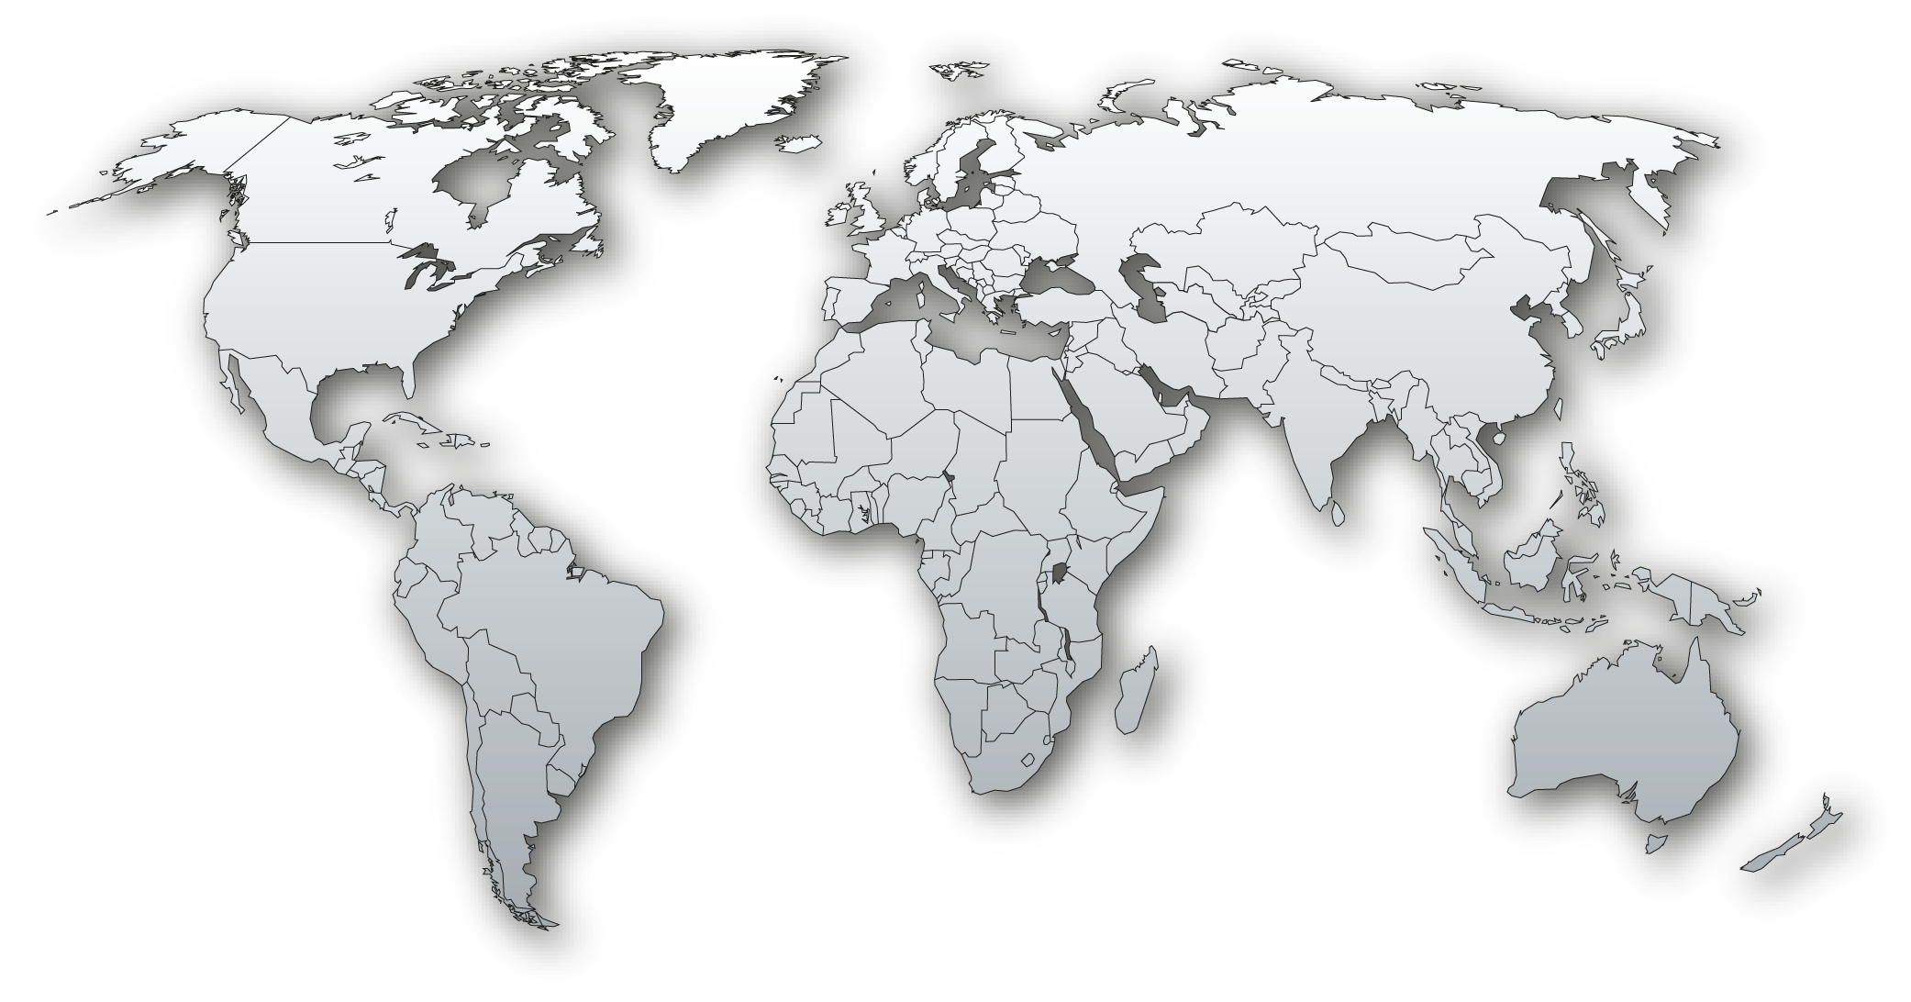
mHealth is Here – 800 deployments worldwide
Europe
119
North
America
168
Asia
Pacific
180*
Africa
257
Latin
America
76
*Including Middle East
Source: GSMA mHealth Tracker, August 2012
Notes:
There are actually a large number of mobile health services already existing in the world. These figures are taken from the GSMA mHealth tracker which is a tool that tracks live and planned mhealth deployments globally. There are currently over 800 deployments and this figure rises every month.

Slide 5
Under The global mobile health market has started taking shape-> Latin America
With over 250 deployments In Middle East and Africa
South Africa: 49
Kenya: 38
UAE: 5
Saudi Arabia: 5
Qatar: 4
Egypt: 5
Morocco: 3
Source: GSMA m Health Tracker, August 2012
Notes:
According to the tracker, there are around 240 deployments in the African and ME areas.

Slide 6

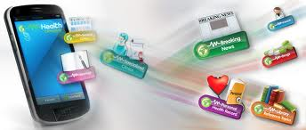

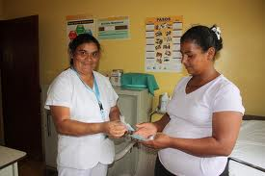

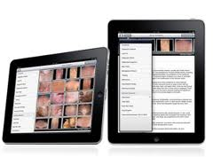

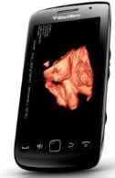
mHealth services in Middle East and Africa
MNO
Description
Wellness
The service provides daily SMS and MMS on a diverse selection of important health issues, chronic diseases and prevention. The service also provides several free interactive services to its subscribers for example, an instant Glucose Level Analysis and BMI calculation.
Prevention
MTN’s CareConnect is designed to offer a professional nurse-assisted service for any day-to-day health-related enquiries from the general public. It aims to make basic healthcare guidance available to all South Africans.
Diagnosis
Medical advice and diagnose by examining photographs of the patient; the diagnoses can be improved further by collecting patient medical history and symptom descriptions.
Monitoring
A complete suite of services enabling birth attendants and midwives to ensure safer pregnancies/deliverie by enabling them to quickly and accurately identify, communicate and act on obstetric emergencies. For example an Ultrasound based remote monitoring service to manage the pregnancy evolution.
Notes:
There are already some examples of mobile health services in the middle east and asia region that cover the spectrum of the different health categories.
Some examples are:
In wellness
Sehhatak Mobile Services
Organisation: VIVA Telecom Kuwait and mHealth Company
Country: Kuwait
Year: 2011
Description: The service provides daily SMS and MMS on a diverse selection of important health issues, chronic diseases and prevention. The service also provides several free interactive services to its subscribers including instant Glucose Level Analysis, BMI calculation and Daily Calorie Requirements, Nutrition Information, and an electronic Personal Medical Record. Pay per request services include Personalized Medical Consultation in the form of questions and answers and access to a diverse library of reference topics that provide a total summary of specific health issues in 5 consecutive SMS. All Services, with the exception of the online Personal Medical Record are completely accessible and operable through Mobile Phone without the need to purchase any additional devices or installations.
In prevention
MTN Care Connect Nurses Line:
Launched: 2011
Country: South Africa
Status: Live
Organisation: MTN, Sanlam
Category: Health Worker Empowerment
Description: A nurses’ advisory line that will assist the public with everyday health queries. MTN CareConnect is designed to offer a professional nurse-assisted service for any day-to-day health-related enquiries from the general public. It aims to make basic healthcare guidance about ailments such as stomach aches, fevers, potential poisoning and general parenting tips related to children’s health, among others, available to all South Africans.
In diagnosis
Tele-Derma:
Launched: 2010
Country: Egypt
Status: Live
Organisation: Mobinil
Category: Diagnosis
Description: Medical advice and diagnose by examining photographs of the patient; the diagnoses can be improved further by collecting patient medical history and symptom descriptions. http://www.mobinil.com/aboutMobinil/socialresponsibility/EventDetails.aspx?MYID=509&id=health
In monitoring
Mobile Baby:
Country: Saudi Arabia
Launched: 2011
Status: Live
Organisation: Etisalat
Category: Monitoring
Description: Tool enabling practitioners to send media to referring physicians for remote monitoring. Complete suite of services enabling birth attendants and midwives to ensure safer pregnancies/deliveries by enabling them to quickly and accurately identify, communicate and act on obstetric emergencies including: Ultrasound based remote monitoring of pregnancy evolution; Step by step protocol to identify and report; Danger signs during labour and delivery; Money on the phone to pay for emergency transportation; and Communication with referral facility. http://www.etisalat.ae/eportal/en/corporate/press-releases-details-04-03-2012.html

Slide 7
Global mHealth business opportunity
Forecast global mHealth revenue
(US$ Billion)
Source: PWC 2012
The rising number of chronic disease patients in the Middle East is expected to drive the take up of mHealth in the region
Monitoring represents 65% of global revenue opportunity
Notes:
However, these are small figures compared to what we believe the mobile health opportunity will be in the future.
In 2011 GSMA commissioned pwC to produce a report on the potential future opportunity for mobile health and the results came to a staggering 23 bn us dollars by 2017. that is what the mobile health market will be worth based on this research.
As you can see, Monitoring represents 65% of global revenue opportunity
And certainly with the rise of chronic diseases such as diabetes and cardiovascular diseases in the ME region, this is expected to drive the take-up of mHealth in the region

Slide 8
Mobile Operator Business Opportunity
Source: PWC 2012
Mobile Operators are the key beneficiaries of the expected growth
Notes:
Mobile operators are expected to be the key beneficiaries of the expected growth in the mobile health market and command about 50% share of the overall market, corresponding to US$ 11.5 billion, in 2017. Further, the pie is large enough to incentivise other ecosystem players to innovate and participate
in the mobile health market and drive it forward. Device vendors, content /application players and healthcare providers can all expect to garner revenues from the mhealth market
(approximately US$ 6.6 billion, US$ 2.6 billion and US$ 2.4 billion
respectively, in 2017.)

Slide 9
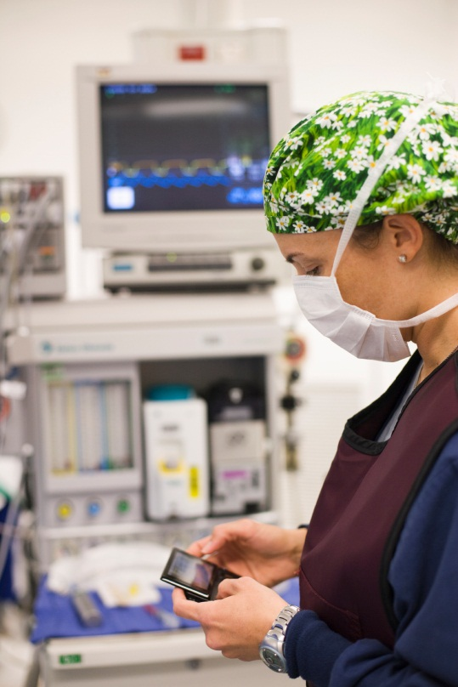
Key Challenges preventing mass market mHealth deployment
Harmonised Regulation - Healthcare & Telecoms have distinct policies and regulation. Clarity is needed on how these combine when applies to mobile health
Achieving Scalability - can only be done with better systems integration, interoperability and simple “plug and play” solutions
Lack of evidence - need for more evidence to convince healthcare stakeholders of economic and healthcare outcomes to be achieved
Reimbursement - there is a need for clear business models that include how mHealth solutions are reimbursed and paid for
Notes:
As you can see there is a huge opportunity here for mobile health to explode and a possible large revenue earner for operators.
However, in order to unlock this opportunity and accelerate the adoption of mHealth services, there are a number of issues that we need to overcome
Harmonised Regulation - Healthcare & Telecoms have distinct policies and regulation. Clarity is needed on how these combine when applies to mobile health
Achieving Scalability - can only be done with better systems integration, interoperability and simple “plug and play” solutions
Lack of evidence - need for more evidence to convince healthcare stakeholders of economic and healthcare outcomes to be achieved
Reimbursement - there is a need for clear business models that include how mHealth solutions are reimbursed and paid for

Slide 10
Collaboration is the key to success
Regulators
  Transnational/
  National Health
  approvers
Providers
End User groups
Mobile Operators/ Vendors
  Healthcare
  Providers
mHealth Solution
Products
Push
Pull
  Healthcare
  Industry
  Patients
Payers
  Governments
  Insurance companies
GSMA WORKS TO BRING ALLTHE ECOSYSTEM STAKEHOLDERS TOGETHER
Notes:
Collaboration is the key.
Grabbing the opportunity for mobile health will depend on all the players in the ecosystem being able to work together for the benefits of all.
There needs to be a push by the healthcare industry and the vendors (ie the operators and device manufacturers) and at the same time there has to be a pull by the patients and the healthcare providers, they must show a need and a want of these products. If healthcare providers such as doctors are willing to use mhealth solutions then the patients will follow.
As mentioned in the previous slide, the regulators and governments must create a friendly regulatory environment for mhealth to flourish in. vendors and providers will produce and create services that have quick to market possibility and can be pushed through the regulatory approvals with relative ease.
Finally the payors need to be on board – reimbursement must be part of the solution in the same way as governments and insurers today reimburses other health solutions.

Slide 11

What ‘value add’ does an Operator bring?
Operators have 25 years experience delivering customer centric solutions over a mobile connection, with core capabilities that enhance a device user’s experience:
Established billing relationships and processes
High level of security
Secure solutions
Remote device management
Customer support
Hosting of data centres
Large established distribution channels
Notes:
So as part of this ecosystem and to play a part in the acceleration of mhealth solutions, what can the operators bring to the table?
Operators have 25 years of experience in delivering customer centric solutions over mobile and have proven capabilities in areas such as
Established billing relationships and processes
High level of security
Secure solutions
Remote device management
Customer support
Hosting of data centres
Large established distribution channels

Slide 12
A huge range of different service
Wellness
Prevention
Diagnosis
Treatment
Monitoring
Chronic Disease Management/Remote Monitoring
Global
Business
Integration
Payments Integration
Cloud Based Health Records/Imaging/Applications
Tele-health
Tele-care
Managed Services
Enterprise
ICT
Enterprise Collaboration
Enterprise Hosting and Storage
Consumer
Voice and
Data
Consumer Health Hotline
Personalised Health Tips
Health Messaging
Leveraging mobile current capabilities
  Security, reliability, authentication
  Data storage and processing
  Billing and revenue mechanisms
  Customer care
  Device management
  Distribution network
  End to end service
  management
Notes:
There is a huge range of services that operators can provide across the patient pathway.
These are across different areas such as business integration; examples of this could be data records, or payments integration, remote monitoring and health applications
Enterprise ict for example managed service, hosting and storage
Voice and data such as health hotlines and health messaging.
All these services leverage the capabilities and the assets that mobile currently has.

Slide 13
GSMA mHealth Programme Objectives
Showcase mobile health solutions and catalyse cross-industry awareness and knowledge
Demonstrate outcomes and impacts on individuals, healthcare systems and society
Foster new relationships and partnering with the healthcare sector and mobile industry
Stimulate scalable, replicable solutions to drive towards interoperability
Promote supportive policy and regulatory principles for growth and innovation
Mission: reduce cost to serve, extend reach and improve quality of care
Notes:
So what is the GSMA doing to enable mhealth to happen?
GSMA are in its 3rd year running an mhealth programme.
Actually the programme is divided into 2 so to speak:
1 mhealth programme is run under the umbrella of one of our major programmes called Connected Living. The Connected Living programme is a market development programme designed to help operators accelerate the usage of wireless connectivity through a wide range of devices and services in different vertical ecosystems such as education, automotive, utilities and health.
The other mhealth programme is run in the GSMA development fund and is more focused on how to roll out mhealth in the developing world, focusing on low income countries in Africa and Asia.
Overall, the GSMA mhealth agenda has a number of objectives that we believe are the right things to do in order to help the operators get into the world of mHealth:
Showcase mobile health solutions and catalyse cross-industry awareness and knowledge – attending events and seminars and showcasing mobile to the healthcare industry
Demonstrate outcomes and impacts on individuals, healthcare systems and society – running trials and producing evidence that show the benefits of mhealth
Foster new relationships and partnering with the healthcare sector and mobile industry – as mentioned, collaboration is the key and GSMA are working on facilitating these relationships
Stimulate scalable, replicable solutions to drive towards interoperability – working with operators and device vendors to produce scalable solutions to achieve economies of scale
Promote supportive policy and regulatory principles for growth and innovation – we lobby governments and regulators to try and encourage a regulatory environment that is innovation friendly and that encourages providers to produce mhealth solutions

Slide 14

Focus on Operator Value Added Services
The Operator Roadmap to successful mHealth deployments
Operators are at different
stages in their development
Use
Reimbursement
Evidence
Operators will require different types of support depending where they are in the development cycle
Certification
Identify market demand
Technology
Notes:
The GSMA realises that all operators are not at the same stage of development and we also recognise the difference in region, culture and state of development. Hence we support operators at different stages of their development and support them through the different stages towards successful deployments.

Slide 15
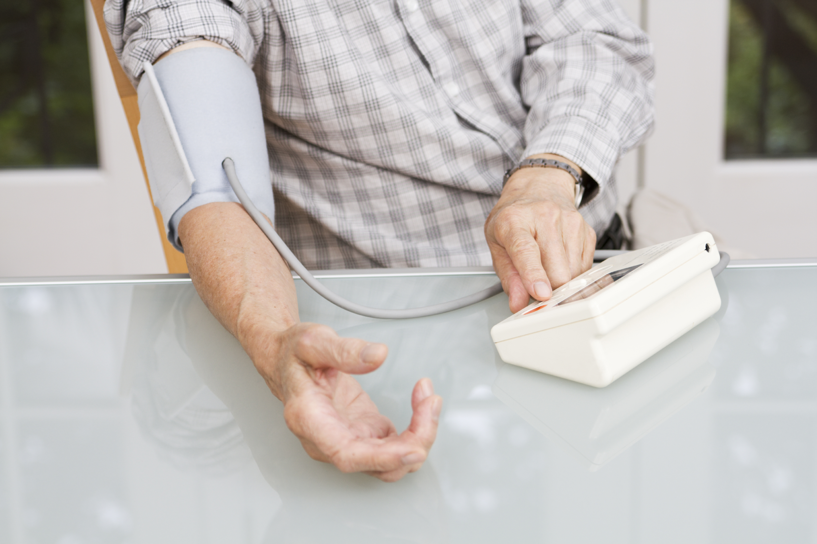
GSMA Diabetes Programme
Diabetes is a major disease that is growing, with huge impact on resources:
360 million people worldwide have diabetes, 8.5% of the world’s population
Diabetes cases will rise 90% in the next 20 years according to WHO
Diabetes prevalence in the Middle East is among the highest in the world
The GSMA has started a diabetes programme to accelerate mHealth solutions in the diabetes area:
Creation of mHealth interest groups in Asia & the Middle East to develop collaboration communities
Development of industry tools to support the industry to develop successful solutions
Showcase the mobile industry’s ability to provide best in class mobile health solutions
A major disease that is growing, with huge impact on resources
Notes:
This year we have started 2 major pieces of work within our mhealth programme.
One is the diabetes programme. Realising that diabetes is a major disease that affects all parts of the world and is becoming an increasing burden on health resources, we deduced this is a sensible area where to encourage trials and deployments of mhealth solutions.
Diabetes is a major disease that is growing, with huge impact on resources:
360 million people worldwide have diabetes, 8.5% of the world’s population
Diabetes cases will rise 90% in the next 20 years according to WHO
Diabetes prevalence in the Middle East is among the highest in the world. Rapid economic development and tremendous changes in lifestyle, have resulted in less exercise, more smoking, unhealthy nutrition and increased obesity. (World diabetes foundation)
We are looking for operators to join this programme so if this is something you would be interested in, please come see me after the seminar or send me an email – we are planning a “diabetes summit” in the middle east region which I believe will happen in October so again, if I have your details I can forward information on this.

Slide 16




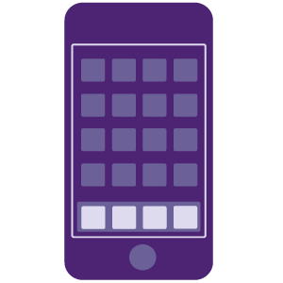
PAN African mHealth Initiative
Creating innovative ways for Operators across Africa to collaborate and partner with governments, civil society and private healthcare providers to significantly impact universal access to health services
IDENTIFY OPPORTUNITY
DIAGNOSE
PARTNER
SUPPORT IMPLEMENTATION
SHARE LEARNING
PRIORITISE operators:
Open to collaborate
Likely to scale
Viable regulation
Sizable market
Identify barriers to universal access
Recommendations
Action planning
Identify credible health partner(s)
Define mHealth service
Validate with global and national stakeholders
GSMA expertise to embed best practices with operators
Build internal capacity
C-level advocacy
Track results
Leverage & share learning’s with industry
The GSMA is helping to ensure harmonisation of operator Health solutions with local and
international regulators, Governments, technical groups and health authorities
The GSMA is working with both health and donor industries to identify opportunities to leverage operator collaborations to achieve universal health access
Notes:
This is a project run by the GSMA development fund mhealth programme – the purpose and aim is to create innovative ways for member mobile operators across Africa to collaborate and partner with governments, civil society and private healthcare providers to significantly impact universal access of health services.
This is done using an engagement framework as described here:
Identify opportunity
Diagnose
Partner
Support implementation
Share learning

Slide 17



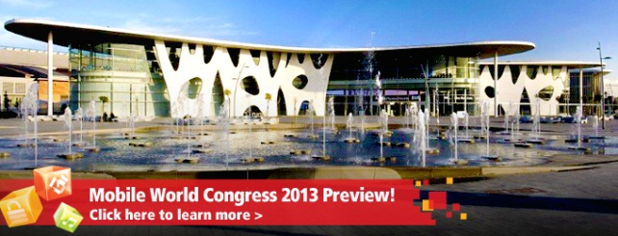
GSMA presence at upcoming events
Medtech Forum,
Brussels 10-12 October
Medica,
Dusseldorf 14-17 November
mHealth Summit,
Washington 3-5 December
Mobile World Congress,
Barcelona 25-28 February 2013
Notes:
To finish off, I just wanted to share with you some events and tools that we are using in the GSMA in order to showcase mhealth and give the whole health ecosystem a view of mhealth.
These are the major events coming up this year:
Medtech forum in Brussels which is the largest health and medical technology industry conference in Europe. We are doing a speaker slot
Medica in Dusseldorf in november is the worlds largest event and tradefair for the medical sector
Mhealth summit in Washington is the largest event of its kind, it brings together leaders in government, the private sector, industry, academia, providers and not-for-profit organizations from across the mHealth ecosystem to advance collaboration in the use of wireless technology to improve health outcomes in the United States and abroad
The MWC in Barcelona is GSMA’s yearly congress, it is the worlds premier mobile event, last year attracting close to 70,000 people

Slide 18
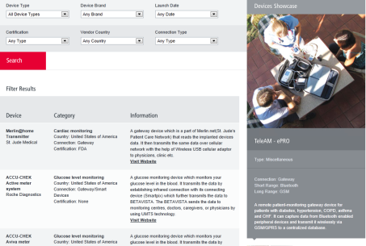
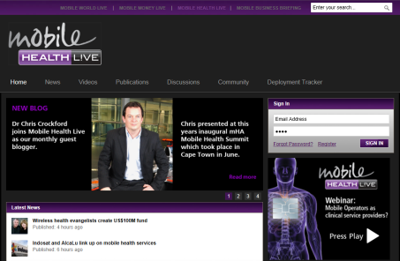
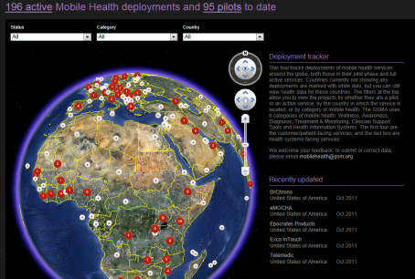
GSMA mHealth Support Tools
GSMA Device Listing
www.gsma.com/documents/Mobile-Health-Device-Listing-January-2011/21537
Industry Portal, including latest news, publications and industry insights
www.mobilehealthlive.org
GSMA mHealth Tracker,
http://www.mobilehealthlive.org/mhealth-tracker/
Evidence Knowledge Bank,
http://www.gsma.com/connectedliving-mhealth-evidence-knowledge-bank/
Notes:
We also have a number of online tools where we share information on mHealth that can be used by all ecosystem players which can all be found via the GSMA web site

Slide 19
Thank You!
www.gsma.com/connectedliving/mhealth/

Slide 20
BACK UP SLIDES

Slide 21
Trial programmes
Accelerating the mHealth market by supporting members to initiate clinically relevant trials and share knowledge.
Member of a Pan EU telehealth programme to generate clinical evidence for mHealth in 9 countries
Supporting MNOs in the region to develop mHeath services inc. EHR platforms, Remote monitoring service, Health info services
In the Middle East - Creation of a regional Diabetes campaign, launch Health hotline services
Working with ATT to sharing learning from their mHealth programme
Pan Africa Programme working with MNO across Africa to collaborate and partner in Maternal and Child and HIV/AIDS management

Slide 22
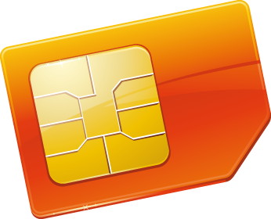
Promoting Mobile Assets : The Power of the SIM
Dialog – Sri Lanka
Continua Health Alliance
Development of a healthcare record that can be accessed via USSD containing basic healthcare information like blood type, allergies, medication
Creation of SIM based application that will the transform a medical device reading into a Continua Health Alliance certified message. Enabling the standardisation and interoperability of healthcare devices without the need to redesign the medical sensor.
Identity and Authentication
mHealth App
MoH in Catalonia
Orange – France
Development of an identity and authentication solution that will enable patients direct access into their personal healthcare record without need secure PC access
Individual Health Records
Implementation of France Healthcare Smartcard used in the healthcare system for authentication and healthcare payment on to the SIM card
Notes:
Continua Health Alliance is a non-profit, open industry organization of healthcare and technology companies joining together in collaboration to improve the quality of personal healthcare. With more than 220 member companies around the world, Continua is dedicated to establishing a system of interoperable personal connected health solutions with the knowledge that extending those solutions into the home fosters independence, empowers individuals and provides the opportunity for truly personalized health and wellness management.

Slide 23




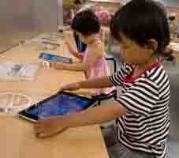
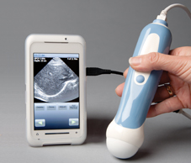




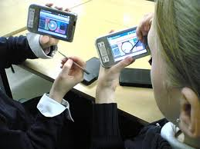
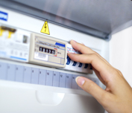

What is Connected Living?
Connected Living
M2M
Internet
of Things
Embedded
Mobile
Notes:
Connected Living is one of the GSMA’s strategic projects - it used to be called Embedded Mobile.
Connected Living is a 3 year market development initiative whose mission is to help mobile operators accelerate the delivery of new connected devices and services. Our target is to assist in the creation of 700 million new mobile connections, whilst stimulating a number of service trials and launches in the Automotive, Education and Healthcare sectors. The Connected Living programme is also working with the city of Barcelona, the Mobile World Capital, to develop and showcase smart city services.

