Slide 1

Digital terrestrial TV Transition
German Experience
Elmar Zilles
Head Broadcasting, Federal Network Agency, Germany
Digital Migration and Spectrum Policy Summit
Nairobi (Kenya), 29th November­ - 1st December 2011

Slide 2
Guideline for the presentation
Basic elements of relevance for the transition are outlined
By this, many different starting situations are covered
(Projection to individual situations per country possible)
Possible conclusions are presented
Examples are given referring to the German situation and
transition path

Slide 3
Content
Basic characteristics for a transition
Strategical aspects
Technical aspects
Aspects of frequency resources
Gains and benefits

Slide 4
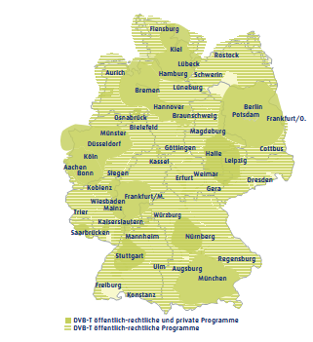
DVB-T supply in Germany
Area: about 357.000 skm (138.000 sqm)
Population: about 82 million people
Switch-over finalised by Nov. 08
Programme configuration varies
from region to region
Public broadcasters provide for about
95 % of the population (analogue:
about 98%)
Private broadcasters provide service in
densely populated areas only
source:
www.ueberallfernsehen.de
4
Notes:
2/10/2012
4

Slide 5
Basic characteristics for a transition
Percentage of terrestrial reception
Primary reception: type of reception of the mainly used TV set
European figures:
< 10% Belgium, Germany (about 5%),
The Netherlands, Austria, Switzerland
> 60% France, Greece, Italy, Spain,
Czech Republik, UK
25-50% Denmark, Finland, Ireland, Norway,
Poland, Hungary, Sweden

Slide 6
Basic characteristics for a transition (2)
Percentage of terrestrial reception (ii)
Competitive situation
    Percentages for
      Satellite distribution (Germany about 40%)
      Cable distribution incl. VDSL (Germany about 55%)
Distribution costs for 5 % much higher than for 95 %
Political decision: alternative costs / different spectrum usage
Rule of thumb:
The lower the percentage of terrestrial reception, the easier the
switch-over … and a terrestrial network the less needed

Slide 7
Basic characteristics for a transition (3)
Receivers
Receiver types:
  Built-in
  Set-top box
  USB
Prices from 10 € (USB) to about 80 € (set-top box with PVR
functionality); TV sets from 250 € (26“ to 32“) include a built-in
receiver
End of 2002 (Germany DVB-T launch): prices from 200 € to 400 €
per set-top box w/o PVR
Sufficient variety of affordable receivers is crucial!

Slide 8
Basic characteristics for a transition (4)
Number of programmes
Aspect 1: the demand of the recipient
  10 programmes may cover 95% of the consumption of
  1 recipient
  30 programmes may cover 95% of the consumption of
  95% of the recipients
Aspect 2: the supply by the providers
  How many programmes are to be transmitted?
  How many networks can be paid for?
German approach: up to 7 networks times 4 programmes in the
most common operational mode, depending on regions/cities
More is possible, depending on individual accessibility demands,
even with less resources (e. g. by different operational modes)

Slide 9
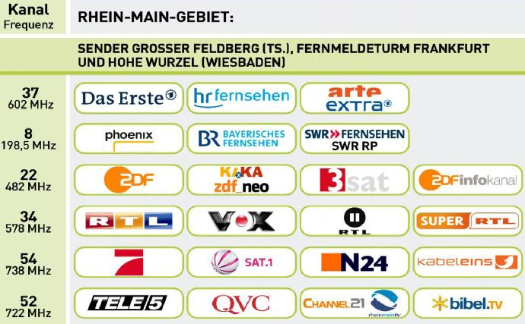
Basic characteristics for a transition (5)
Structures of programme provision
Nationwide programmes in Germany:
  full-time: only 1 bouquet (4 programmes)
  (nationwide public provider)
  part-time: regional public providers have
  some programmes in common
Regional programmes in Germany
  federal states-wide provision by regional public providers AND
  by nationwide private providers being forced to also provide for
  regional content for some time a day („programme window“)
example of Rhein-Main Area
Structure of programme provision delivering options for a switch-over
strategy in countries with a large territory
Germany : “island” by “island”, per “island” commonly by public and private providers

Slide 10
Basic characteristics for a transition (6)
Structures of programme provision (ii)
National structure:
  Primary terrestrial distribution: homogeneous - or not?
    E. g. rural areas up to 3%, urban areas up to 30% in D
Number of programmes per sub-region/city
  Germany: depending on density of population
    Rural areas: regional public providers present upcoming
    interest for local provision even in smaller towns
    Large cities: commercial interest of private providers given
  Result for Germany:
    Rural areas: at least 3 networks times 4 programmes
    Cities: up to 7 networks times 4 programmes operational
  -

Slide 11
Content
Basic characteristics for a transition
Strategical aspects
Technical aspects
Aspects of frequency resources
Gains and benefits

Slide 12
Strategical aspects
Simulcast – yes or no ?
Transition – nationwide or step by step
Institutions to be established
Communication

Slide 13
Strategical aspects (2)
Simulcast
„Rules“
  The higher the percentage of primary reception,
  the higher the political claim for a long simulcast period
  The longer the simulcast period, the higher the costs
  The longer the simulcast period, the higher the demand
  for frequencies and other resources
  The longer in advance the transition is prepared and
  announced, the lower the real need for a (long) simulcast
  period
Conclusion
Try to avoid (long) simulcast periods!!!

Slide 14
Strategical aspects (3)
Simulcast (ii)
Experience:
  First phase of transition (not too much experience
  in advance AND short period of communication):
  simulcast in Berlin 9 months
  Second phase of transition:
  even in Berlin no more than 6 months
  Third phase:
  Berlin and others: no simulcast at all !
Idea:
Similar approach for DVB-T2 transition as well

Slide 15
Strategical aspects (4)
Transition extension
Questions and their background
  Area of the country
  The larger the area, the greater the logistical challenge to
  roll-out and extend networks
  Therefore:
  larger areas  longer roll-out period  stepwise roll-out
  Structure of population density
  Are there “islands” (i. e. capital/large cities,
  densely populated areas), in which the roll-out could be started,
  before touching “outer space” ?
But: avoid “digital divide” in broadcasting !

Slide 16
Strategical aspects (5)
Transition extension (ii)
Questions and their background
  Number of households to rely on terrestrial reception
  How many receivers have to be shipped and sold in a defined
  period of time ?
  Germany: 5 % out of 37 million households = < 2 million
  But e. g. France:
  about 65 % out of about 27 million households
  at least 18 million receivers to be shipped and sold

Slide 17
Strategical aspects (6)
Transition extension (iii)
German experience
  DVB-T launched in Berlin 01/11/2002
  (all in all 5 million potential recipients with about 5 % of
  primary terrestrial reception; Berlin first region worldwide
  w/o analogue TV)
  “Islands” like Hamburg, Munich, Cologne followed step by step
  Experience was transferred from “islands” launched earlier

Slide 18
Strategical aspects (7)
Institutions
Main tasks
  Project management
  Communications
  (treated on a separate sheet because of importance !)
Institutions needed
  Project office (per “island”!)
  Over-all guidance to fit in regional projects
German experience
  Governmental Initiative Group + Regional project offices

Slide 19
Strategical aspects (8)
Communications
Positive experience by:
  e. g. in Berlin 1 million letters sent to households
  official web-site(s) (regional AND over-all)
  flyers
  announcements on TV and radio
  citizen assemblies in towns and villages
  information also to cable network operators
  …

Slide 20
Strategical aspects (8)
“Rules” from experience:
  Information to everyone
  (Manufacturers, importer, whole-salers, retailers, TV network
  providers, recipients)
  Sequential order to be maintained
    Stakeholders and experts first
    Recipients last
  Appropriate timeframe to be maintained
    Recipients not too early, otherwise they lose interest, AND
    Recipients also not too late, otherwise more time, money and resources needed
    Stakeholders and experts about 6 to 12 months in advance of recipients

Slide 21
Content
Basic characteristics for a transition
Strategical aspects
Technical aspects
Aspects of frequency resources
Gains and benefits

Slide 22
Technical aspects
Network topology
DVB-T versus DVB-T2
Coding algorithm

Slide 23
Technical aspects (2)
Network topology
High tower, high power versus low tower, low power network topology
  What type of service will the network transport on the middle
  or the long run ?
  How many networks have to be operated in parallel,
  e. g. if simulcast is intended (frequency resources aspect) ?
  Would there be a return of invest for any kind of dense
  networks ?
German approach:
High tower, high power – broadcast only ☹

Slide 24
Technical aspects (3)
E. g. DVB-T/MPEG-2 versus DVB-T/MPEG-4 versus DVB-T2
When will the service be launched ?
 Availability of inexpensive receivers !
Which type and which technical quality of service will be offered ?
 Can capacity needed be provided by a suitable number of
networks (e. g. HDTV/fixed reception or mobile service also, on
little displays ?
Is it intended to integrate different broadcasting services in
the same network(s) ?
 e. g. common strategy for TV and sound broadcasting
Are scalable network areas needed ?
 allotment extensions are feasible with DVB-T2
Rule of thumb:
Better start with the most up-to-date system, for which unexpensive receivers are available

Slide 25
Technical aspects (4)
German choice
  Transition from 2002 to 2008: only DVB-T available
  Low percentage of primary terrestrial reception,
  return of invest uncertain
   “cheap” networks needed = existing ones
  with high power, high tower stations
  Only MPEG-2 available
Conclusion
  Transition necessary for all aspects mentioned !!!

Slide 26
Content
Basic characteristics for a transition
Strategical aspects
Technical aspects
Aspects of frequency resources
Gains and benefits

Slide 27
Aspects of frequency resources
Starting point: GE-06
  Binding for administrations versus administrations only,
  but not for administration versus operator
   should not be taken as final roll-out plan !!!
  Outer “envelope” of thresholds decisive, not inner
  positioning of allotments
  Conclusion: capacity may be augmented
Amendments by implementation of Digital Dividend !
  Use of 790 MHz to 862 MHz to be harmonised
  Participation in economies of scale for any other country
  possible if going the same way

Slide 28
Content
Basic characteristics for a transition
Strategical aspects
Technical aspects
Aspects of frequency resources
Gains and benefits

Slide 29
Gains and benefits
Examples!!!
More broadcasting for the recipient
  3 nationwide networks DVB-T (public broadcasters)
  up to 4 additional networks region-wise/cities (private broadcasters)
   12 to 30 programmes instead of 3 to 7
Added value within broadcasting
  introduction of DVB-T2
  including plans for HDTV for some programmes
Nationwide provision of 4 programmes
  85 main transmitters, no gap filler (about 93 % of population)
  comparison: 104 main transmitters + >2,000 gap fillers
  for 1 programme (about 98 % of population)
Digital Dividend enabled!
29
Notes:
29

Slide 30
“Assessment”
Digital switch-over (as well as digital dividend) are both necessary steps
towards future provision of services for recipients
Digital switch-over is a necessary step for the future provision of
broadcasting as well as for enabling a digital dividend.
Digital switch-over as well as digital dividend must not be treated
as static. Scarcity of spectrum, quantity of traffic and type of customer
demands will force the integration of services as well as new
approaches for awarding resources .
Conclusion:
These steps are necessary, but work doesn´t end once
they are done!

Slide 31
Thank you very much
for your attention!
Elmar Zilles
Elmar.Zilles@BNetzA.de
www.bundesnetzagentur.de
Digital Migration and Spectrum Policy Summit
Nairobi (Kenya), 29th November­ - 1st December 2011

