Slide 1

A New Global Platform for Conversations, Chatbots & Commerce

Slide 2

Welcome
Henry Calvert
Head of Network 2020
GSMA

Slide 3
Moderator
Stephen Sale
Research Director
Analysys Mason

Slide 4
Petja Heimbach
VP of Next Generation Communications, Deutsche Telekom

Slide 7
UNIVERSAL COMMON ID
COMMUNICATION CHANNELS W/ QOS
Universal Profile
UBIQUITY
REGULATORY & LEGAL

Slide 8




TREND-
SETTER
PRIVATE
PRAG-
MATIC
BRAND
AWARE
UNIVERSAL COMMON ID
COMMUNICATION CHANNELS W/ QOS
Universal Profile
UBIQUITY
REGULATORY & LEGAL

Slide 9


Slide 10
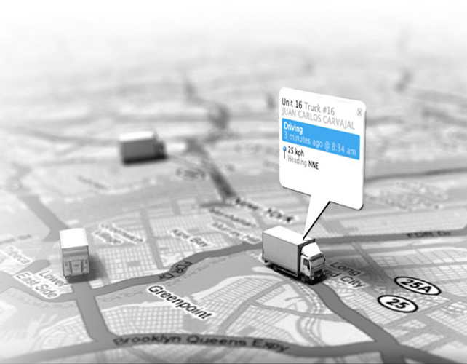




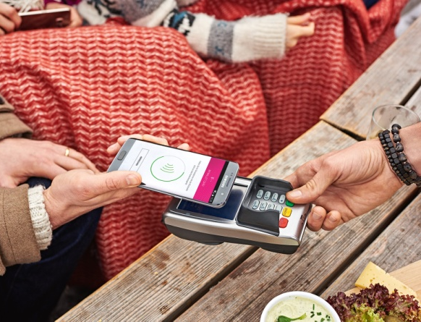
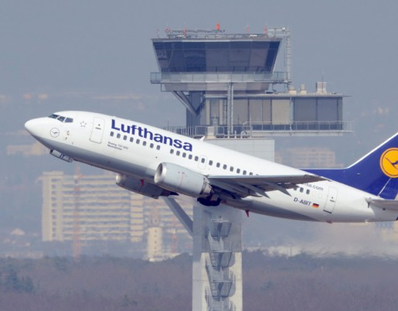







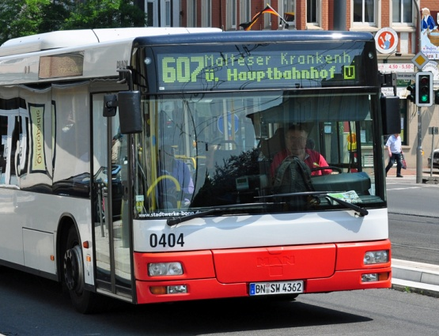




Slide 11
Mathew Oommen
President Network, Global Strategy and Service Development
Reliance Jio
Notes:
STAY ON THE SLIDE (no content slides for Mathew)

Slide 12
Amir Sarhangi
Head of RCS
Google

Slide 13


RCS @ Google
Business Messaging

Slide 14



The carrier messaging opportunity
Huge reach...
...But with challenges
No rich features in SMS
Current RCS implementation is fragmented
4.7B
Requires alignment from 500+ carriers and OEMs
RCS l Android Messages l Jibe
Notes:
-- Today if you want to send a message to someone and require high reliability you send an SMS
-- if you want to share the moment with a high rez photo you would most likely not use SMS

Slide 15






Essential building blocks for RCS
Universal
Native
Global
Rich messaging
Updateable
Monetizable
RCS l Android Messages l Jibe
Notes:
Truly single spec, we collaborated with the industry on achieving Universal Profile --- big achievement! But still more work to be done ….need consistent user experience (supported by GSMA, 60+ carriers and OEMs)
Default and native – out of the box it just works
Interconnected, similar to SMS – the industry has been very slow to interconnect much work to be done here
Table stakes features, needs to be at least as OTT apps
We launched Android Messages + RCS in Play Store in Q4 of 2016……Critical for innovation

Slide 16




Google is working with the industry to accelerate RCS
Built on Universal RCS standards
Android Messages
Jibe Cloud
Jibe Hub
Native Android RCS client
Hosted RCS Platform
RCS interconnect Hub
RCS l Android Messages l Jibe
Notes:
Messenger app is now Android Messages, The Messaging App for Android.
A great native messaging experience for Android. Preloaded and available on the Play store for download. Can work with an Universal Profile compliant backend. Newly launched on Vodafone’s IMS network.
Cloud is on Google for massively scalable and secure, live in 6 countries. Carriers can go live in 6 weeks at very low cost.
Hub is operational for Orange, SFR, DT, Vodafone and soon Sprint / Rogers. Critical aspect of making RCS successful.
All built on Universal Profile and will evolve as Universal Profile does.
Hub is operational for France (SFR - Orange), Slovakia (DT - Orange), Romania (DT - VF) and soon USA/Canada (Sprint - Rogers)

Slide 17







Major carriers are bringing RCS to market with Google
30+
operators
1B+
subscribers
RCS l Android Messages l Jibe
Notes:
Major carriers are launching with RCS with Google
Sprint and Rogers launched last year
Vodafone has launched in 10 countries with Messages
Orange, Telenor and Globe are committed
DT is on cloud and is standardizing on Messages
Huge industry shift representing 1B+ potential users

Slide 18



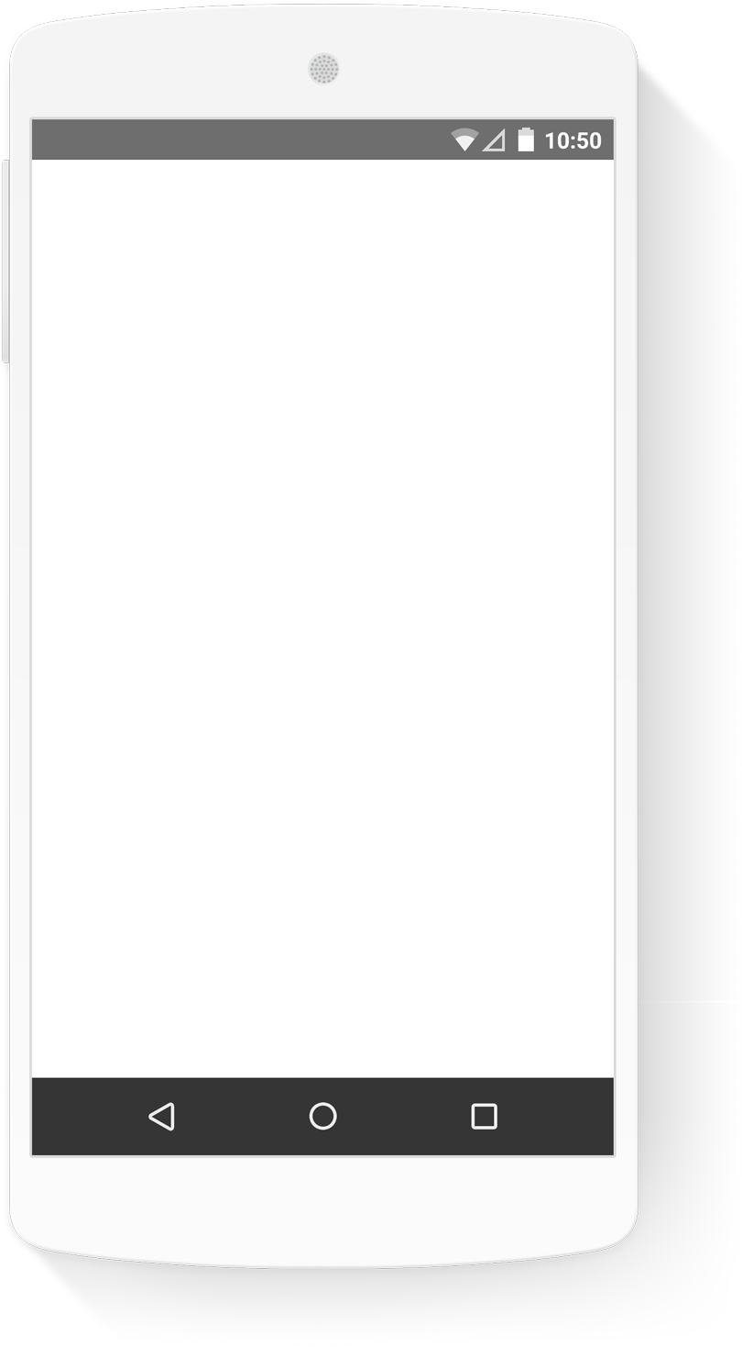
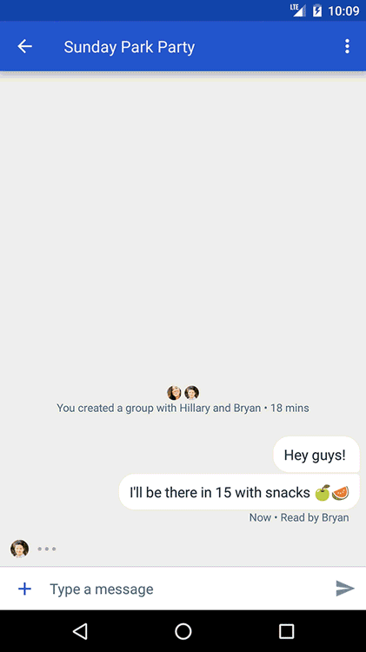






















25+ OEMs are preloading Android Messages
over
300M
devices
RCS l Android Messages l Jibe
Notes:
As part of bringing a great native messaging experience to more users, partnering closely with OEMs to preload Android Messages. Now 25 OEMs including many of the top 10 are committing to Android Messages bringing a great and consistent experience to 300M+ devices annually.
Carrier and Open Market. Bringing this experience to as many users as possible.

Slide 19
What do people value about SMS?
“If everyone had the same app, then
that’s fine. But, if everyone else doesn’t
then you have to figure out who has it and who doesn’t.”
Ubiquitous and universal
“You can have WhatsApp or other apps but you need the connection. In the mountains or on the train you’re stuck.”
Perceived as more reliable
“I would love to be able to reply and talk to businesses.”
Great for business messages
RCS UX research
RCS l Android Messages l Jibe
November 2016
Notes:
So, the technology stack and carrier/OEM adoption are foundational. As RCS gets traction, we’re now focusing on new opportunities. To find the best opportunities for RCS, we started with SMS’s strengths and how RCS can amplify them.
A few months back we conducted an extensive user research on RCS in Europe. We interviewed mobile users in all segments and found that SMS is still used by most users, even those who rely on OTT apps. SMS has 3 unique strengths that we will build on with RCS, particularly around business messaging.

Slide 20
Business SMS represents
30% of all messages
2.21 Trillion
Message sent by 2017
Ovum research
RCS l Android Messages l Jibe
February 2015
Notes:
•When we looked at Business to Consumer SMS, we found lots of good things
•It’s an established model, people are already connected with the businesses they care about
•Opt-in model, example my bank has my phone number and can reach more for urgent news or marketing
•Ubiquitous

Slide 21
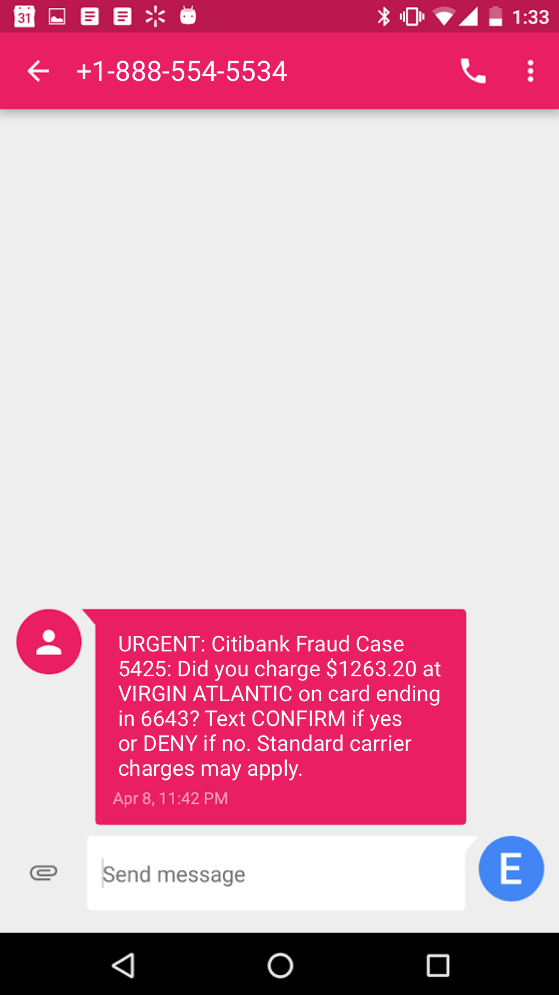
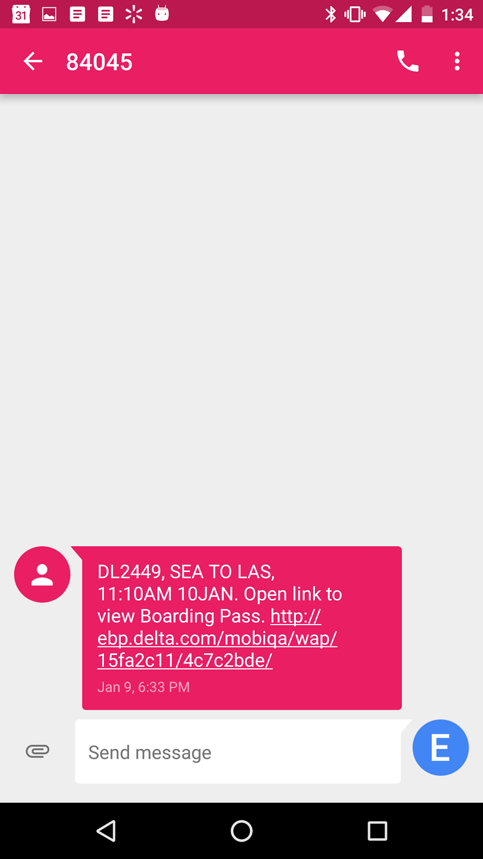
Business SMS is ubiquitous but limited
Ubiquitous...
...But limited
Business SMS today
Text-only
Not interactive
No branding
No read receipts or analytics
Bank
suspicious transaction alert
Airline
boarding pass
RCS l Android Messages l Jibe
Notes:
•When we looked at Business to Consumer SMS, we found lots of good things
•It’s an established model, people are already connected with the businesses they care about
•Opt-in model, example my bank has my phone number and can reach more for urgent news or marketing
•Ubiquitous

Slide 22
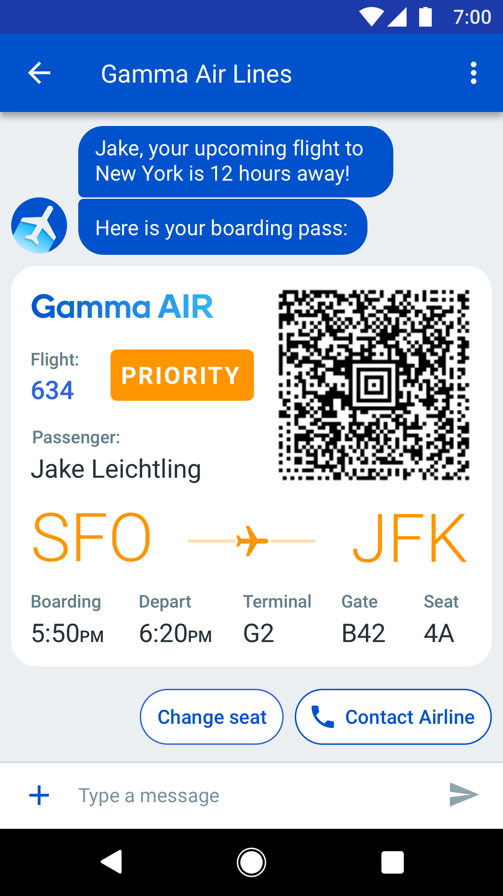
RCS changes all this
RCS l Android Messages l Jibe

Slide 23
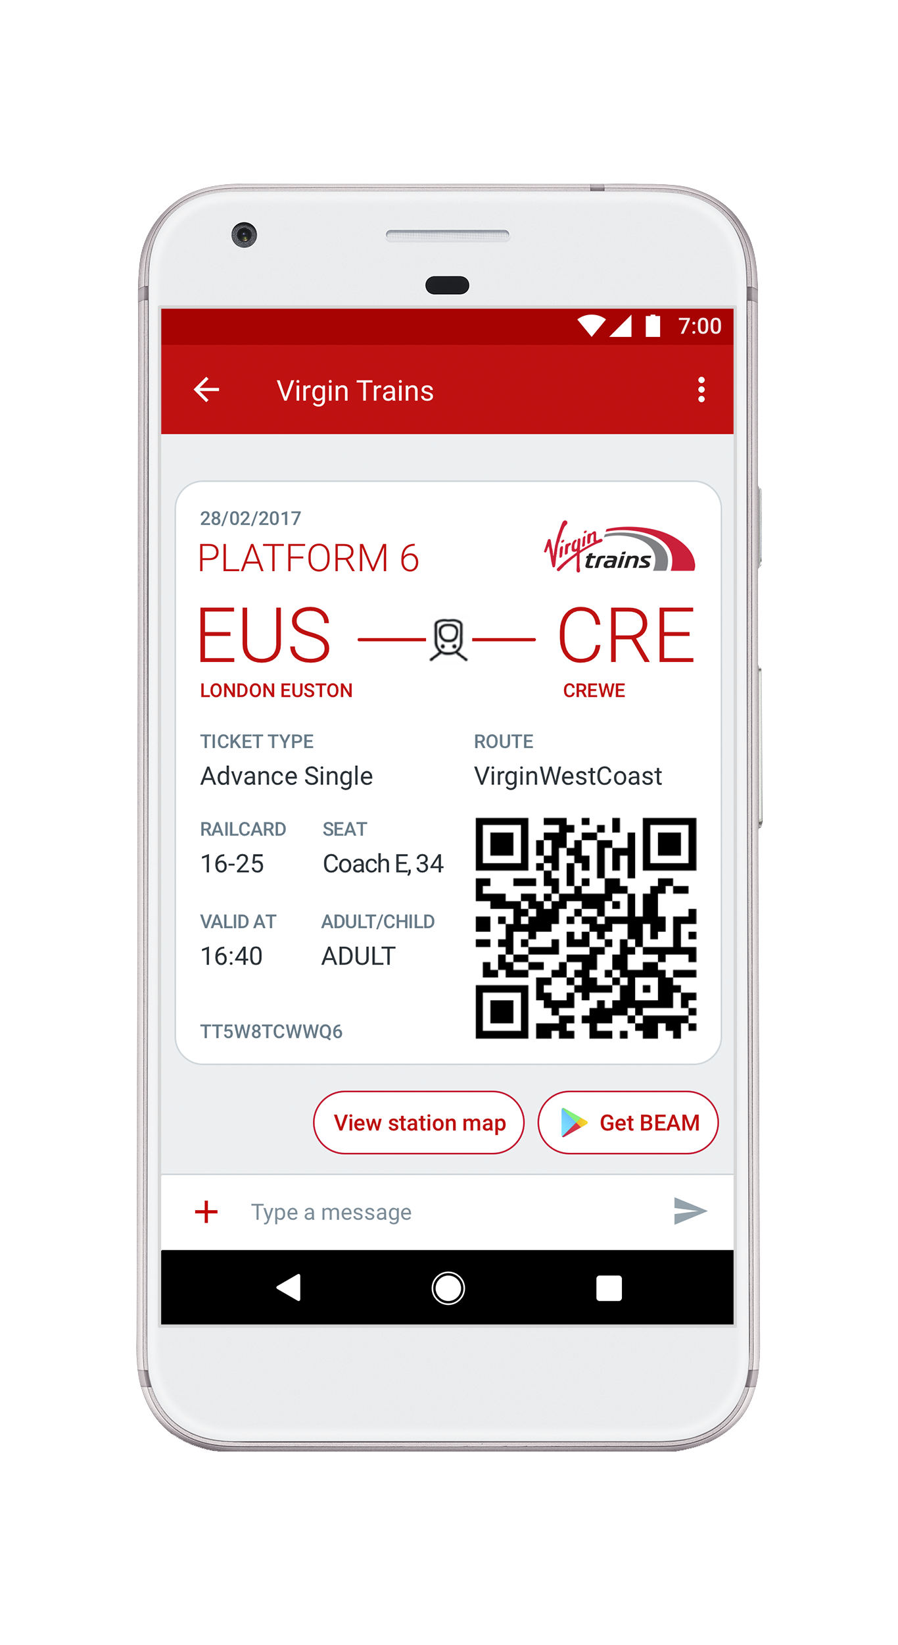
A closer look at RCS business messaging
Verified Sender
Customers have peace of mind
Branding
name, logo, color
QR Codes
For tickets, tracking
and redemptions
Rich Media
images, videos, GIFs,
any color
True Metrics
Client based DLRs
Read Receipts for Brands
Interaction
Suggested replies
and actions
Voice Option
Ability to call out
RCS l Android Messages l Jibe

Slide 24
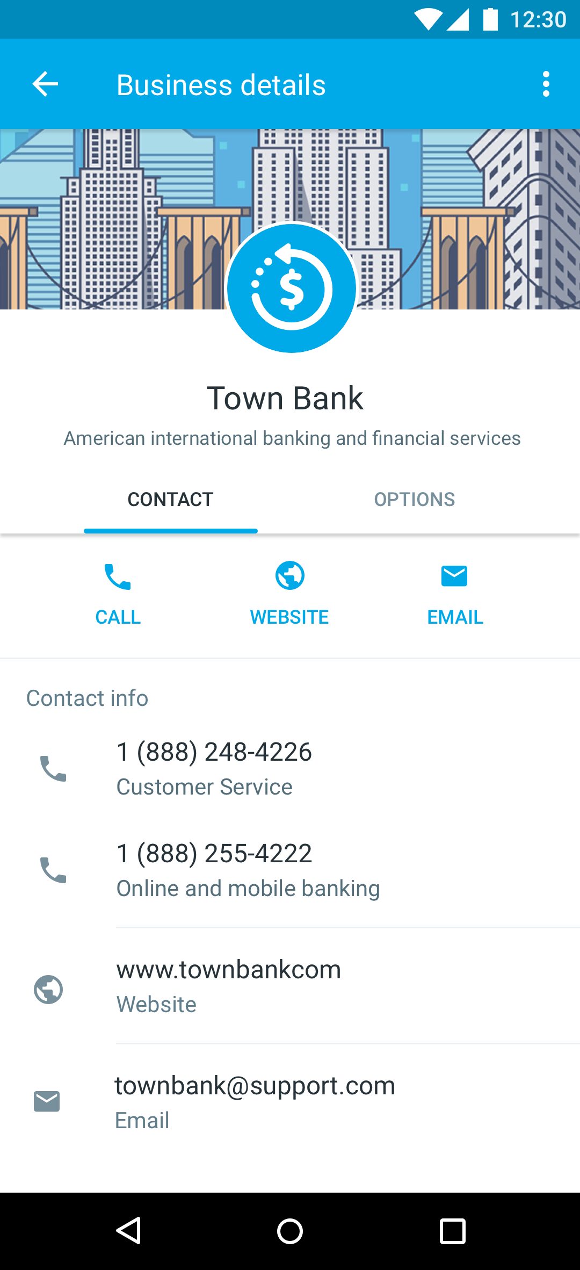
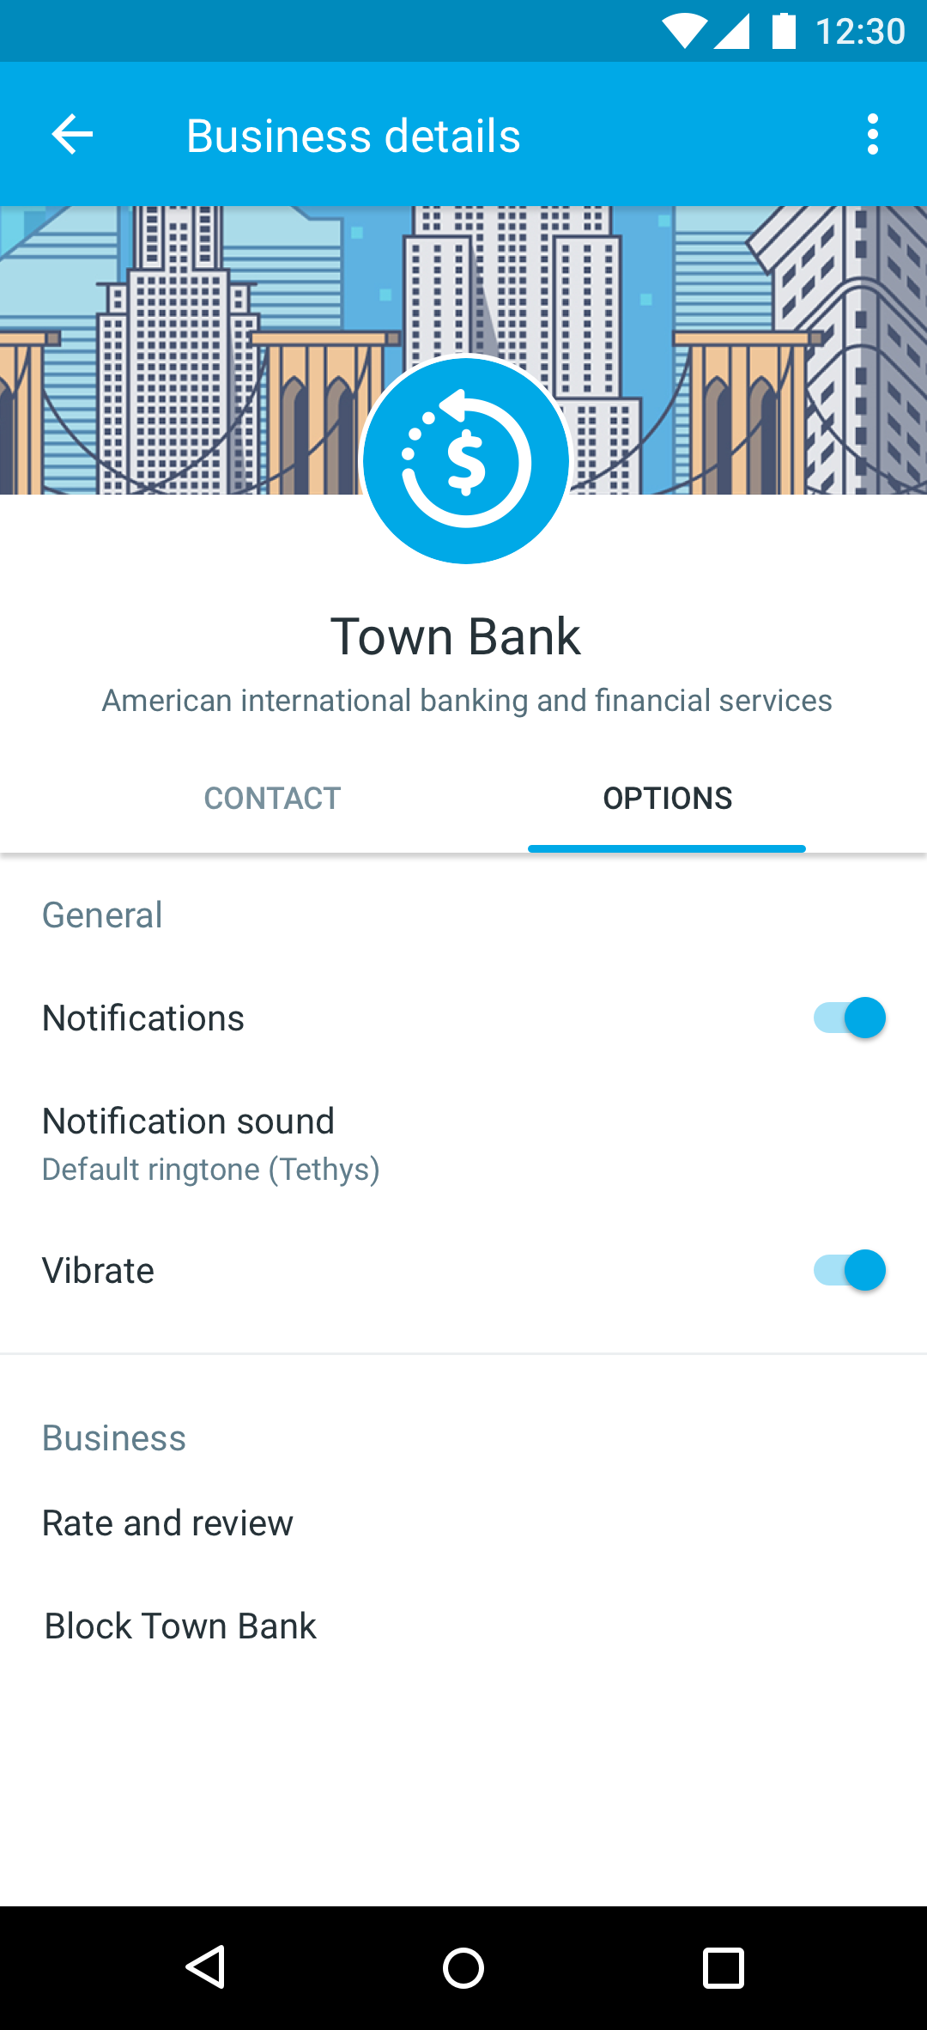
Verified business details give users access and control
Notes:
Gives businesses a much better way to communicate
Users can get a lot more information about the businesses they interact with
Gives users a sense of control and easy access to businesses they care about

Slide 25
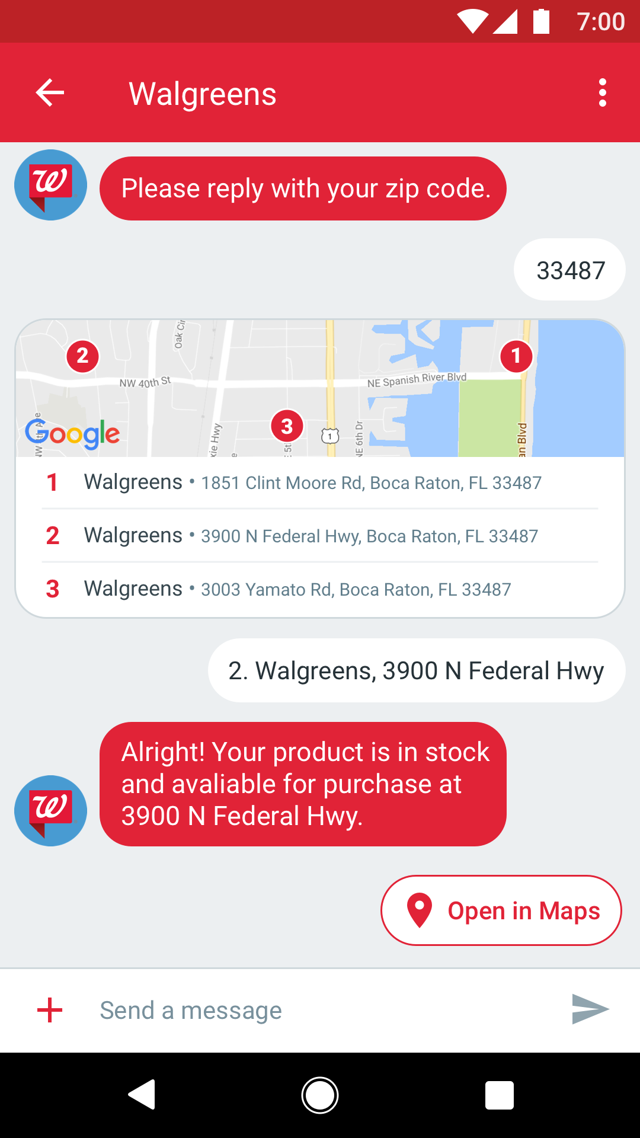
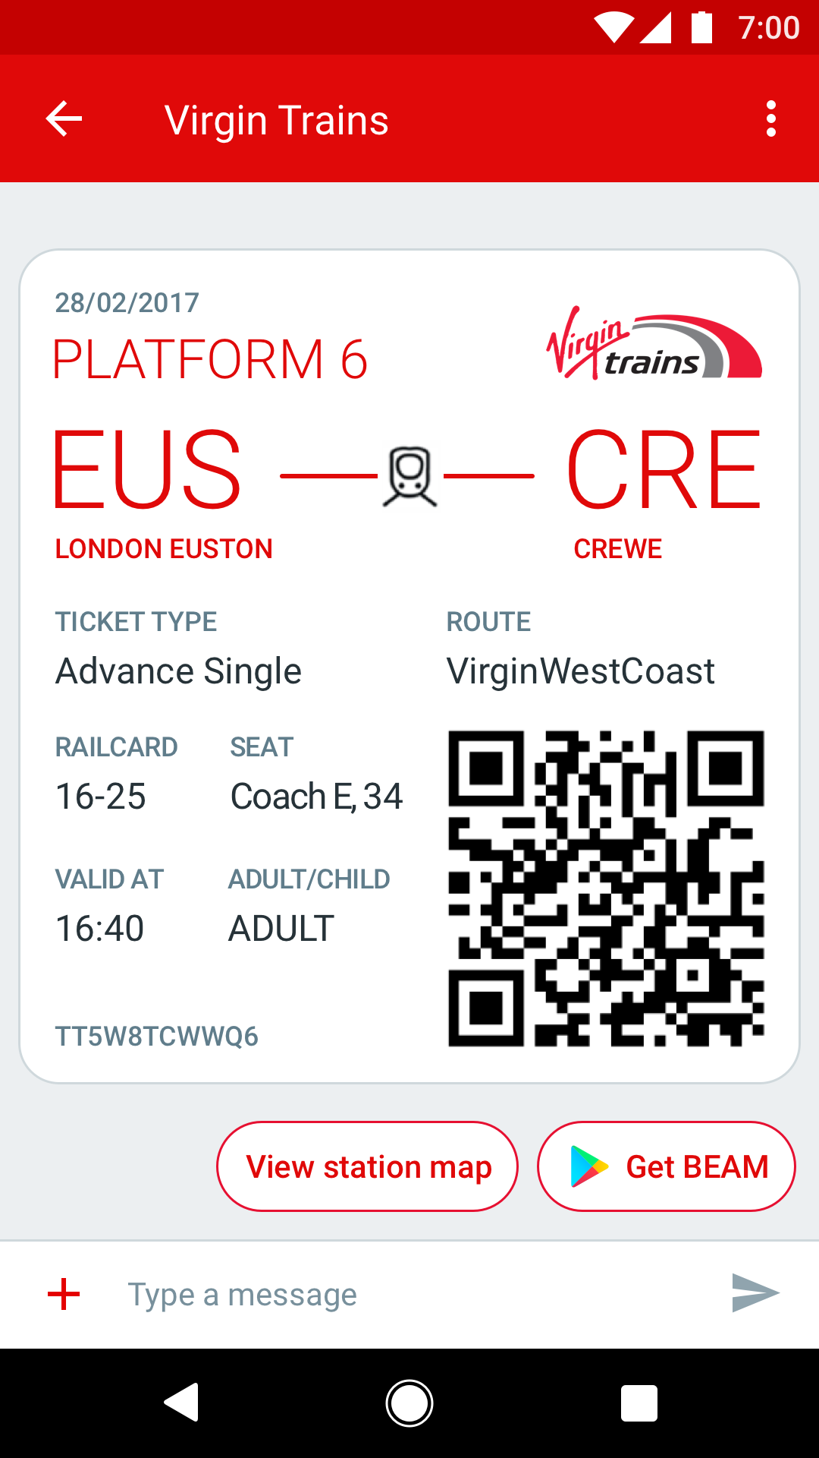
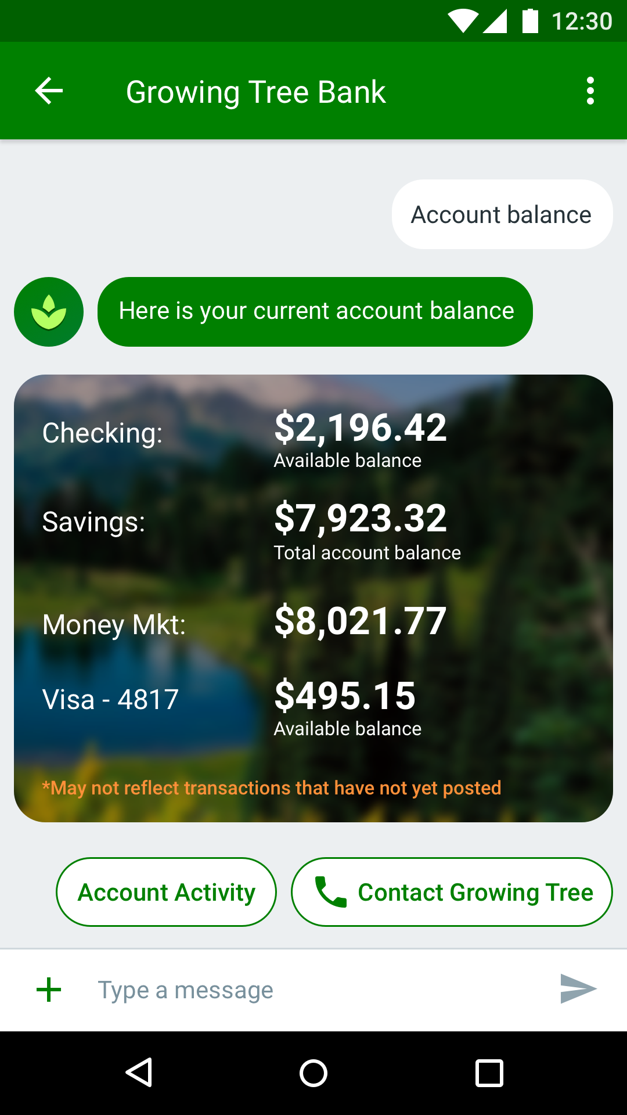
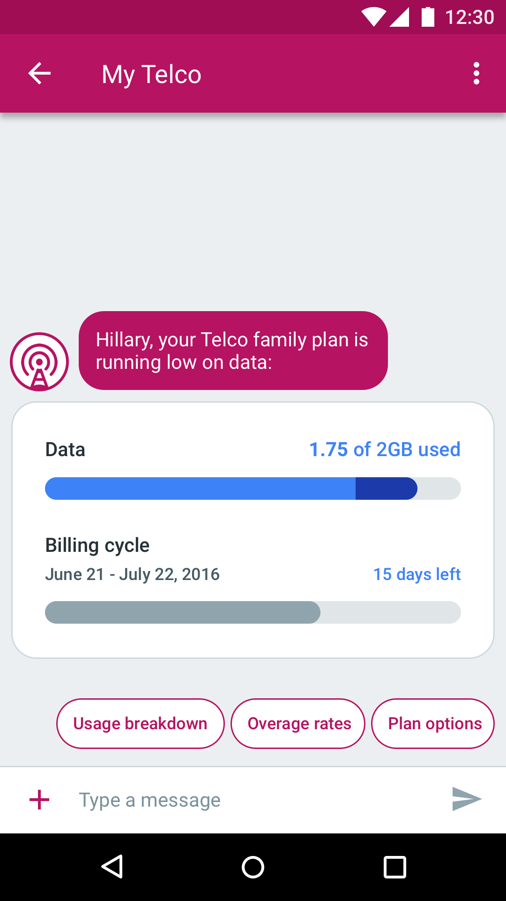
RCS business messaging:
Vertical examples
Retail
Travel
Banking
Telecom
RCS l Android Messages l Jibe

Slide 26

RCS business messaging:
Early Access Program
Early Access Program for messaging solution providers and mobile operators
Learn More
jibe.google.com/business-messaging
RCS l Android Messages l Jibe
Notes:
Brands would work through a messaging partner, either their own who could join our EAP or with one of the ones in our EAP

Slide 27
Up next: Demos
Walgreens
and 3C
Virgin Trains
and OpenMarket

Slide 28
Steve Gooder
Head of Digital Technology
Virgin Trains

Slide 29





Euston, we have a problem
72 million customers
Herd mentality
Multiple pain points
Low customer
satisfaction

Slide 30

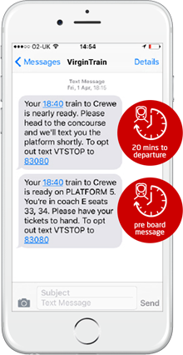


This is one small text for man
Surge solution with SMS
Improved customer satisfaction
Industry first, awards won

Slide 31
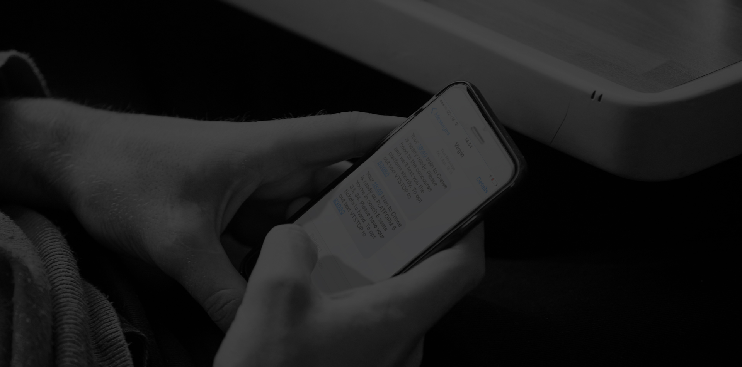




We need a giant leap in technology
Lack of branding & character limitations
Limited analytics
Text only
Lack of interaction & user interface

Slide 32
Insert video here

Slide 33
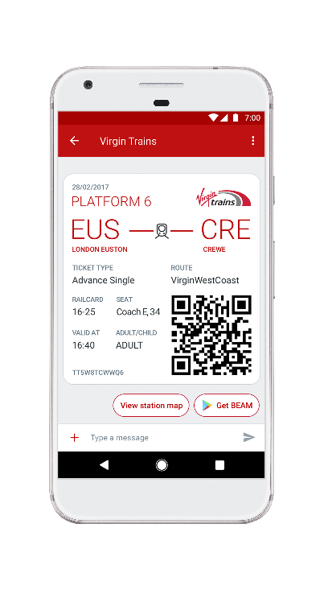
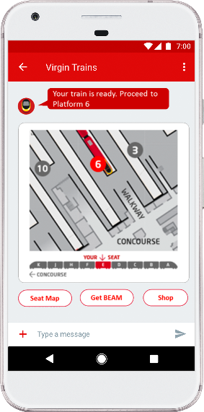
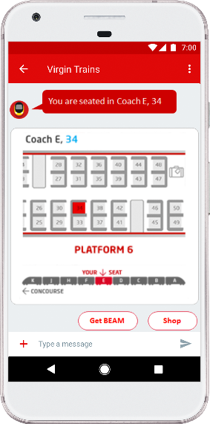
RCS pre-boarding experience
Your ticket
Your train
Your seat

Slide 34
Kartik Subramanian
Director, Mobile Product Management, APIs and Innovation
Walgreens Boots Alliance

Slide 35




Walgreens Mobile Messaging Journey
February 28, 2017

Slide 36

Unparalleled Scale
More than 8100 drugstores
>920M Scripts filled annually
10M Customers/day (online and in-store)
Approx. 75% of the US population lives within 8 km of a Walgreens or Duane Reade store

Slide 37


At Walgreens Mobile, our mission is to transform everyday experiences
37
Notes:
-So you recall I said we used to measure convenience in miles and minutes…
-Well now…
-Today, we like to say in mobile that we measure distance in inches and instants

Slide 38
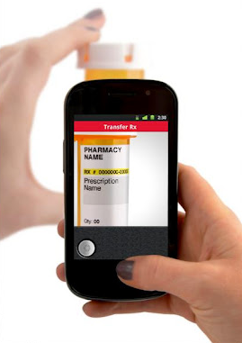
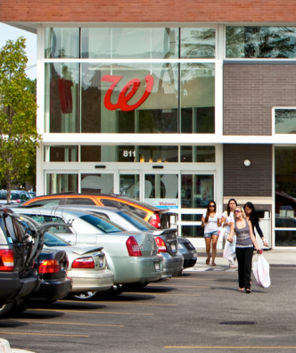










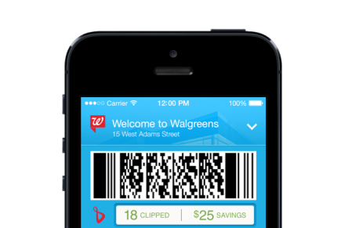




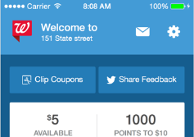







Our strategy, in three topics: Reimagine, Connect, Extend
In-Store-Mode
Clip2Card
RBS, QP
Reimagine
Connect
Extend
Walgreens through mobile solutions
digital experiences to our stores
our greatest assets to the mobile ecosystem
38
Notes:
-We like to talk about our mobile strategy in three buckets
Remimage
Connect
Extend
-Remimagine is all about taking core Walgreens experiences… refill a prescriptions, getting photo prints… and reimagining them through a mobile lens. It’s about taking all the powerful capabilities that come in these devices and building a more seamless and effortess experience for the customer. In fact, we actively seek out friction filled experiences in our stores and in our business, and then try to apply this strategy, and that’s where some of our best innovations come from
-Two, connect. Connect means that everything we build in the mobile space should tie back to our stores. Mobile isn’t about internal competition, it’s about enhancing and augmenting what you can do with a store. A great example of that is our paperless coupons, where we’ve made it possible to browse and clip coupons in app, and have those automatically applied when you check out in the store
-And last, but certainly not least…Extend. Extend is all about taking our greatest assets…like our pharmacies and our 8,000 photo labs… and extending them to developers throughout the mobile ecosystem, and I’ll talk in more detail about this one and why we do it

Slide 39
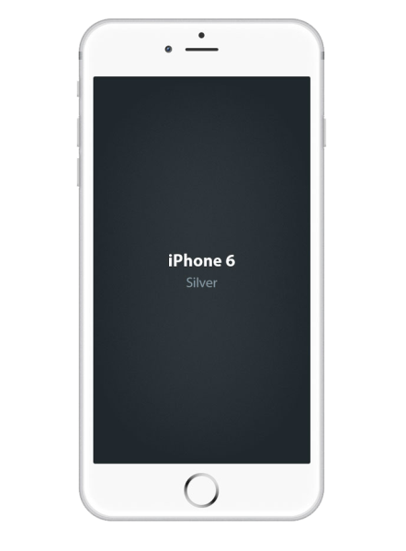

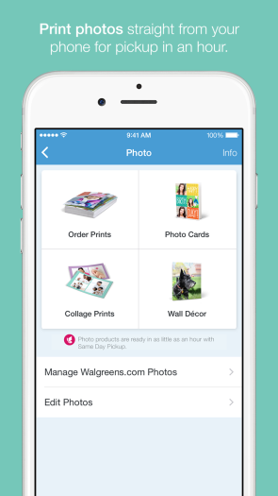
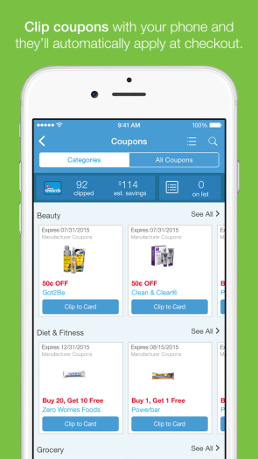
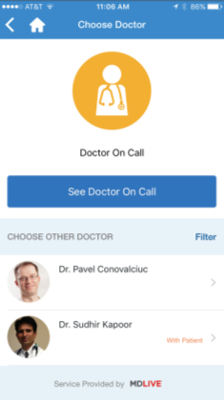
“Re-imagination” across businesses
Mobile drives a significant share of sales & engagement
Rx Refills
Photo Prints
Digital Coupons
Telemedicine
Notes:
So, the first…
-Build relationship with Apple and Google
-You’re wondering, how?
-It’s actually pretty simple
-These guys OWN mobile, and they’re constantly bringing powerful new capabilities to the space each and every year
-Jump on those opportunities, and show how you can leverage them to do amazing things in your business
-Apple and Google love to see great uses of their technology, and nothing gets them more excited
-But to do this, you have to be on top of the news, you have to be at the developer conferences, and you have to have an agile environment that allows you to build fast and scrappy
-A strong relationship means great exposure for your app, which is a must have when these two companies control app distribution
-And its more than marketing… the technology Apple and Google bring to the market each year is really quite powerful, and taking advantage of it means you’re often finding new ways to reimagine and reinvent your own business. I can vouch for that!

Slide 40
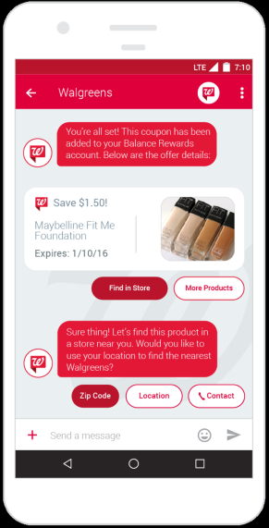
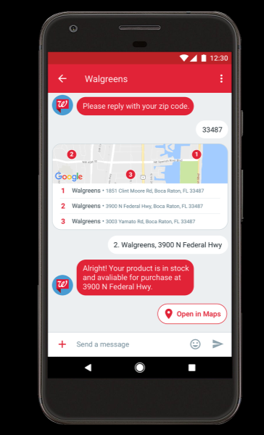
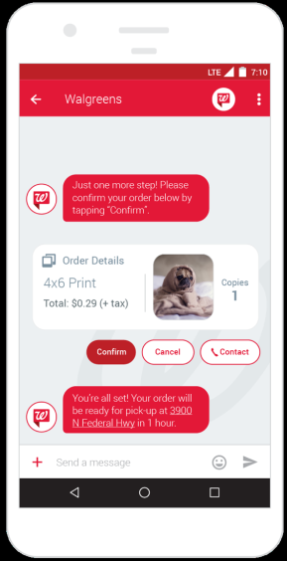


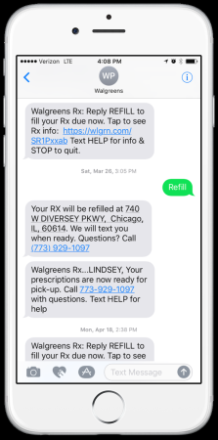
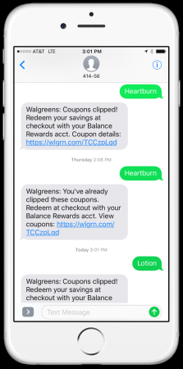
“Re-imagination” of Mobile Messaging
From SMS…
To RCS
Rx Refills
Digital Coupons
Photos, Shopping
Notes:
-So how are we doing that through mobile?
-Let’s talk a bit about strategy

Slide 41
Thank you!

Slide 42
Alido Di Giovanni
President and Co-founder
Summit Tech

Slide 43


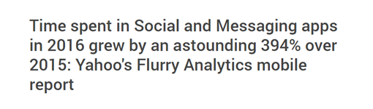
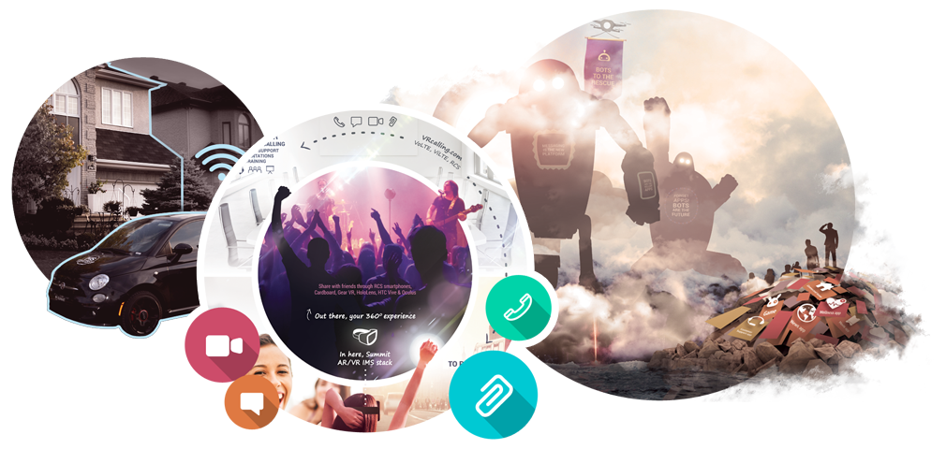
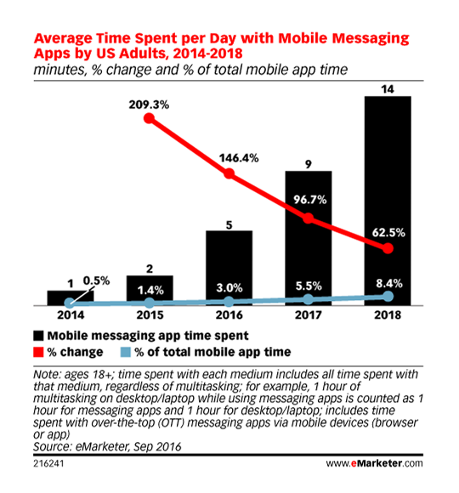
NEW BUSINESS MODELS
90% of the time we spend on our mobile is spent on social/messaging platforms and email
messaging apps more popular than social media apps within 2 years
ComScore
Gartner
disparate technologies maturing and converging at the same time

Slide 44

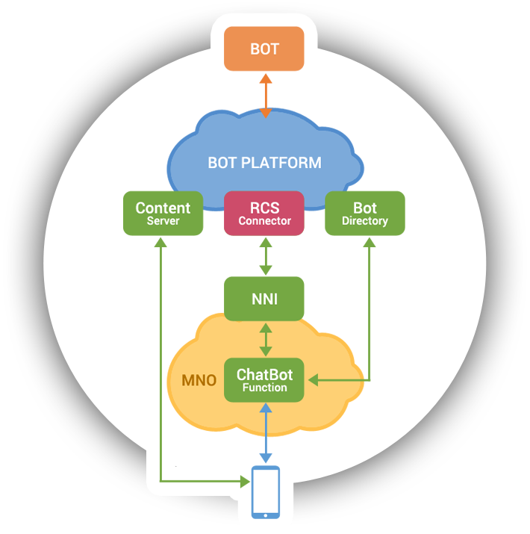
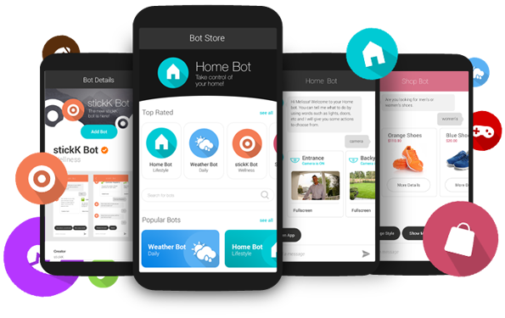
Summit’s MaaP solution
DEMOS
mWellness • Connected Living • Shopping
health
finance
utilities
Internet of Everything
NB-Iot / Cat M1
affiliate models
advertising (LBS)

Slide 45

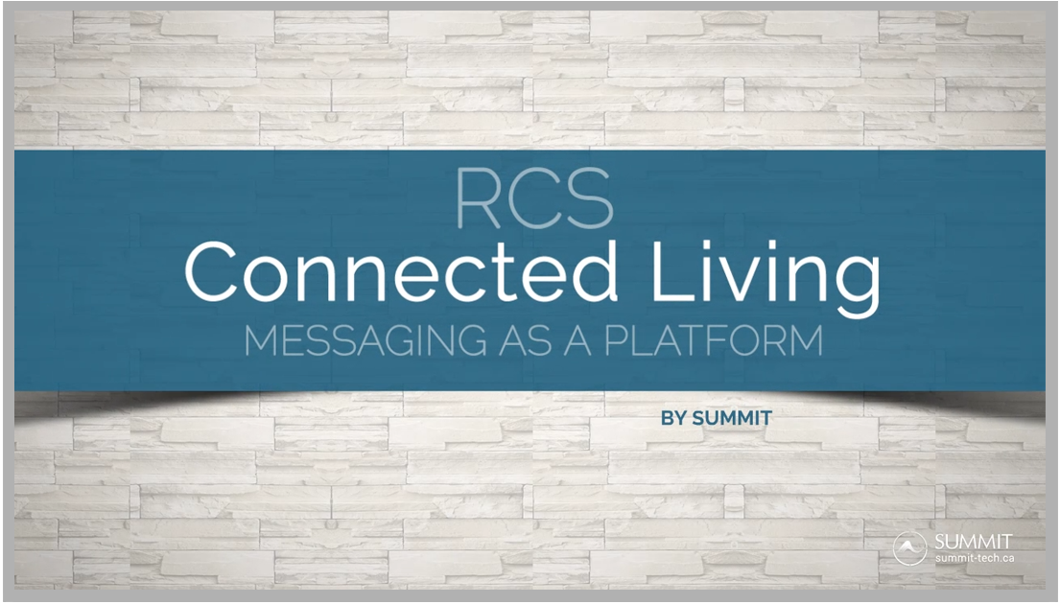

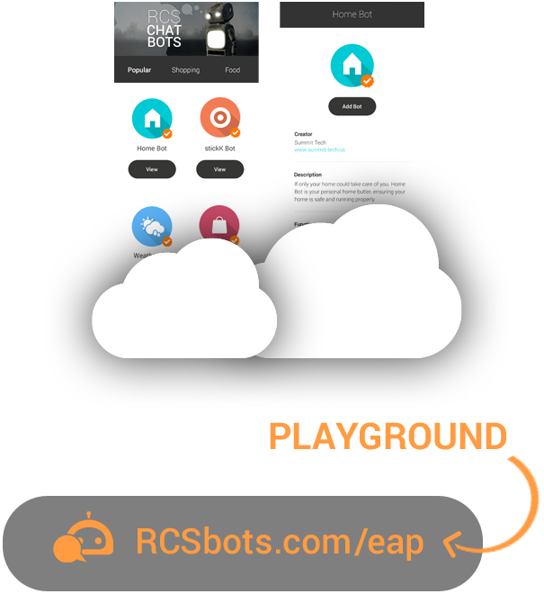
NB-IoT
Cat M1
CONNECTED
LIVING
RCS
CITY
HOME
OFFICE
HUB
IMS
IoE • CHATBOTS • MACHINE INTELLIGENCE
INDUSTRIAL IoT (IIoT) • 5G ...
disparate technologies maturing and converging at the same time
results in a unique opportunity for incredible innovation

Slide 46
Panel debate

Slide 47


Moderator
Stephen Sale, Analysys Mason
Panelists
Petja Heimbach, Deutsche Telekom
Amir Sarhangi, Google
Alido Di Giovanni, Summit Tech
Steve Gooder, Virgin Trains
Kartik Subramanian, Walgreens Boots Alliance

Slide 48
Panel debate

Slide 49
Audience questions

Slide 50
