Slide 1
Michael Morgan-Curran
Diabetes Programme Director

Slide 2
Connected Life…..
25 billion connected devices by 2020
Mobile Health solutions could save $400 billion from healthcare bills in developed countries in 2017
Mobile Health solutions could save 1 million lives in sub-Saharan Africa over the next 5 years
……….world where everything intelligently connects
Source: GSMA/PwC

Slide 3
mHealth benefits
patients,
providers
vendors,
payers,
nations
and the world
Supports cost-effective delivery of better healthcare for everyone
Source: GSMA

Slide 4
Why is Diabetes a global burden
Number of people with type 2 diabetes is increasing in every country
The greatest number of people with diabetes are between 40 to 59 years of age
187 million people (50%) with diabetes are undiagnosed
80% of people with diabetes live in low- and middle- income countries
www.idf.org

Slide 5
Why is Diabetes a global burden
1 person is diagnosed with diabetes every 3 seconds
1 person dies of the complications of diabetes every 7 seconds
1 person loses a limb because of the complications of diabetes every 24 seconds
4.8 million deaths in 2012 - half under 60
www.idf.org

Slide 6
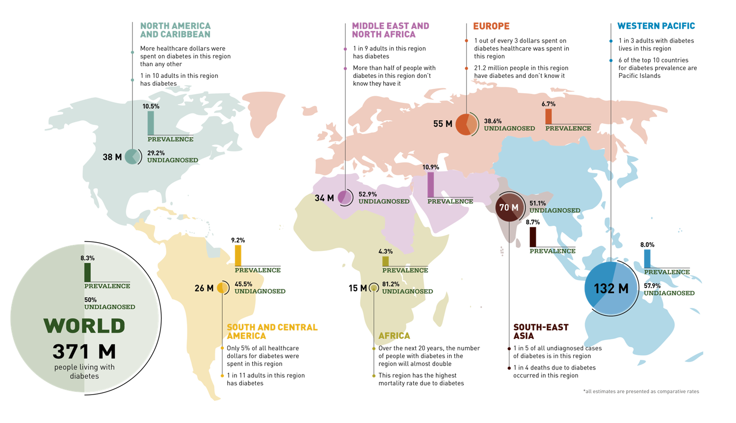
552 million individuals will suffer from diabetes by 2030 up by 150%
www.idf.org
Notes:
AFR: 81% of people with diabetes are undiagnosed ROW half don’t know they have it
EUR: the highest prevalence of type 1 diabetes in children
MENA: 5 of the top 10 countries by diabetes prevalence
NAC: 1 adult in 10 has diabetes
SACA: 12.3% of all deaths were due to diabetes
SEA: almost one-fifth of the world’s people with diabetes live in just seven countries
WP: 132 million adults have diabetes, the largest number in any region

Slide 7
Managing diabetes is expensive
(on top of healthcare costs)
12% of total healthcare expenditures attributable to diabetes
Expenditure will rise by 34%
The cost of prescribing medication for complications of diabetes is around 3 to 4 times the cost of prescribing diabetes medication
Global Diabetes healthcare-related spending
US$ 595 billion
US$ 465 billion
Low-income countries: US$ 1 billion
Low- and middle-income: US$ 10 billion
Upper mid-income countries: US$ 64 billion
High income countries: US$ 387 billion
www.idf.org & Zhang survey 2011
www.idf.orgIDF
Notes:
Compilations preventable & unnecessary death
The US spent $223 billion on diabetes care in 2011 that’s 48 % of global healthcare spend
NCDs cause cumulative economic losses of US$500 b pa
NCDs trap families in poverty, killing breadwinners
NCDs affect people of working age, losing productivity that is vital for development
In Europe we spend over 1/3 of our healthcare on Diabetes. In the UK that is £25,000 per minute
Africa spend the least on diabetes, with 80 % of patients actually undiagnosed African nations know they need to increase substantially over then next few years
Africa is closely followed by South East Asia and The Middle East who need to invest more than the 1 and 2.3 % they are investing

Slide 8
Financial opportunity across the patient pathway in mDiabetes
MNOs are expected to account for 50% of the US$23 billion mHealth market, with monitoring the most attractive
mHealth source of revenue for MNOs, 2017
$ 0.8 bn
$ 1.0 bn
$ 0.9 bn
$ 8.8 bn
Wellness
Prevention
Diagnosis
Treatment
Monitoring
Chronic Disease Management/Remote Monitoring
Global Business Integration
Payments Integration
Cloud Based Health Records/Imaging/Applications
Tele-health
Tele-care
Enterprise ICT
Managed Services
Enterprise Collaboration
Enterprise Hosting and Storage
Consumer Voice and Data
Consumer Health Hotline
Personalised Health Tips
Health Messaging
Source: GSMA and PwC
Notes:
Financial opp
Self management opp
According to a research jointly conducted by the GSMA and PriceWaterhouseCoopers consultancy, the worldwide mHealth revenue is expected to reach about US$23 billion across all stakeholders – mobile operators, device vendors, healthcare providers and content/application players by 2017.
Of this, around 50% will go to Mobile Network Operators. Regionally, Asia-Pacific including the Middle East will comprise 30% share of the market.
There is a huge market opportunity across the patient pathway, although monitoring is going to be the most attractive segment. Monitoring services will be driven primarily by solutions that aid chronic disease management.
Diagnosis services is expected to support developing countries in bridging their healthcare access challenges, and will be split almost evenly between call-centre/IVR based services and mobile telemedicine services.

Slide 9
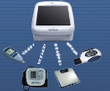
Remote Patient Monitoring
One-way communication
Real-time two-way communication
Data-rich Health management systems
Connection to friends and caregivers
Connection to healthcare advice
Physician
Monitor and manage standard vital signs
Caregiver
Independence
Quality of care and social connection
Safety and friendly environment
Monitor standard vital signs
Friendly check-in mechanisms
Electronic Records
Information sharing
Source: Intel
Notes:
Remote Patient Monitoring systems have also undergone some evolutionary transformation over the years.
Before, because it was only capable of having one-way communication, it was only used to monitor standard vital signs but later on, it has also become capable not only of monitoring but as well as managing standard vital signs.
Now, innovation has allowed real-time two-way communication allowing patients to reach out to physicians and caregivers wherever they may be.

Slide 10
Impact of mHealth 958
Source: GSMA
Notes:
Growth of Services Tracked highest in Africa and North America

Slide 11
mDiabetes is represented
Source: GSMA

Slide 12
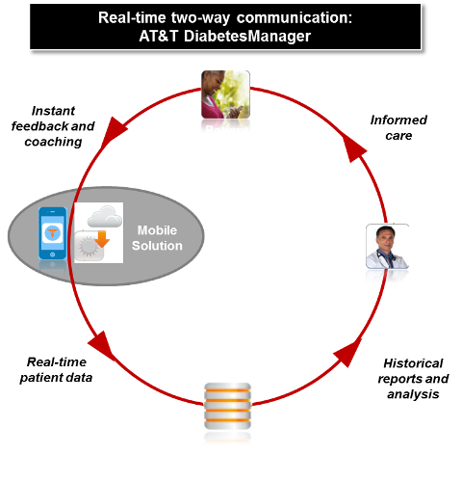
AT&T & WellDoc’s ‘DiabetesManager’
Integrated patient coaching and nurse case management system to improve diabetes care
Solution Features
US FDA approved
Fully scalable solution backed by
Secure network infrastructure
Compliant with HIPAA Privacy and Security Rules
Solution Benefits
Real-time, clinically-based feedback and coaching
Instruction or intervention
Promotes self-care
On-going engagement and drives down costs
Source: WellDoc & AT&T
Notes:
The solution helps disease management organizations and corporate payers provide diabetes patients with tools to help them manage their disease and ultimately help reduce the spiralling costs of chronic disease management.
The innovation in diabetes intervention has truly evolved over the years.
Now, I would like to provide an example of a patient-coaching mHealth solution catering specifically for the needs of diabetes patients.
WellDoc’s Diabetes Manager powered by AT&T – is an example of harnessing the value of clinical and behavioural science and mobility
WellDoc’s platform has been proven to be clinically efficacious and WellDoc’s DiabetesManager is the first mHealth solution to be approved by US Food and Drug Administration that provides automated real-time feedback and behavioural coaching for people with Type 2 diabetes.
AT&T’s implementation of WellDoc’s solution: “AT&T mHealth presents Diabetes Manager” is an integrated solution that allows a patient to get connected real-time to a disease management case worker. The AT&T mHealth presents Diabetes Manager works primarily by:
Using an approved data-enabled mobile device on any cellular network – not just limited to AT&T, but available on Verizon, T-Mobile and Sprint also
The system allows an individual with diabetes to capture, store and transmit in real-time blood glucose data and other diabetes self-management data in a highly secure way.
Real-time feedback based on blood glucose values coaches people on responses to high and low levels and provides education about glucose, food, and medication control.
The comprehensive solution then goes one step further with an expert system – analysing the real-time patient data to identify trends, areas for concern, and teachable opportunities. This expert system further coaches the patients on how to manage various aspects of their disease while also delivering data to the case manager, thus enabling a value-added telephonic transaction between the coach and the patient.
At the system’s foundation is a seamless integration of technology, real-time data, analytics, ease-of-use and collaboration that ultimately is intended to drive improved metabolic outcomes and reduced healthcare costs.
Note that other devices can be incorporated at the mobile solution point, with the AT&T mHealth presents Diabetes Manager taking the role of the “mobile solution”.
Michael –
Hope all is well. I have edited some text both in the slide builds as well as in your notes for a more accurate depiction of what we’re doing with AT&T that you can share at MWC.
For your information, please also note the following speaking notes on commercialization models:
1. There are three commercialization models that mHealth in general should see:
a.Medication Adherence. Here, the business model is to have the mHealth solution sold to a pharmaceutical company to support what they deem to be “compliance” and “persistence” to a drug therapy. Today, regardless of the drug or disease state, compliance (which is the refill rate at the 6th refill point) and persistence (which is the refill rate at the 12th refill point) are abysmal – to the tune of 18% to 23%. Today, pharmaceutical companies are taking a page from CISCO’s playbook – that is, they seek to not just sell the “widget”, but the “solution and value” around the widget. You’ll hear the terms “around the pill”, “beyond the pill”, “pill-plus” to describe these strategies. In fact, Chris Viehbacher – CEO of Sanofi Aventis – declared at EASD in Berlin 2012 that in the future, upwards of 30% of pharma revenue would come from such services. So, the business model for the operator is to work with an mHealth provider that understands clinical and behavioral science, that has demonstrated outcomes, and to sell to pharma on a per-patient-per-month licence model. People such as WellDoc in the US are already doing this quite successfully with pharma, for example WellDoc’s “My Measures for Success” program with Astra Zeneca for Asthma. The ROI here is based on scripts filled, patient days on therapy and increased persistence and compliance. In the case of simple drugs (several hundreds of dollars per month), the ROI is significant – in the case of biologic drugs, the ROI is insane – one additional refill can be as much as $5,000 which clearly pays for a mobile program in perpetuity!
b. Disease Management: This is best described by WellDoc’s program with AT&T in the US – whereby the DiabetesManager solution has been “tailored” to support the patient and the enterprise case manager to provide self-insured employers’ employees with increased engagement with their case managers and thus, improved diabetes outcomes. The ROI here is based on improved case management efficiency and contracts for disease management organizations (DMOs) with self-insured employers.
c. Health-care Provider (HCP) prescribed solutions. Truly the holy-grail of mhealth, this solution in the US – which requires multiple published clinical trials and FDA clearance – has a doctor prescribe software to a patient for the first time in history, and have the health insurance company reimburse the prescription as though it were a drug, device or medical procedure. In wireless speak, the ARPU is now several tens if not hundreds of dollars a month (the value at which drugs and devices are reimbursed today in the US) vs. pennies a month with a mobile app in the iTunes or Google Play on-line store. Clearly, such a business model requires the rigor of a clinical approach, behavioral science, randomized controlled studies and regulatory clearance and is not for the faint of heart – but, those who follow this path such as WellDoc are creating the healthcare models of the future. The ROI here is in reduced healthcare costs and dramatically improved patient outcomes – something that affects the GDP of countries that adopt such policies. In the US, diabetes and its complications affect 20% of the total spend on health ($2.3T) – WellDoc has demonstrated and published the opportunity to remove upwards of 60% of these costs!
2. When properly constructed, mHealth solutions can be de-composed horizontally into modular building blocks – patient medication adherence, symptom tracking, physician communication modules – etc., and such solutions can then scale – as WellDoc has demonstrated – to other chronic conditions such as hypertension, asthma, obesity, etc

Slide 13
With demonstrated success
Cluster-randomised controlled trial 163 patients in 26 primary care practices
Results
A1c levels reduced by 1.9%
Benefits
37% decrease in loosing - limbs/blindness
14% decrease all-cause mortality
Results
58% reduction in hospital stays
100% increase in self management
Source: Progress in Cardiovascular Diseases 53 (2010)
⃰ Stratton IM, Adler AI, Neil HA, et al. Association of glycaemia with macrovascular and microvascular complications of type 2 diabetes (UKPDS 35): prospective observational study.
Notes:
Loose - 1 limb 30 % of living 5 years
Leading cause of Blindness
Launching an mHealth service specially in chronic care, and specifically in diabetes seems to be a daunting task
We are nonetheless seeing some success stories such as in the case of WellDoc, whereby AT&T has worked with WellDoc to create an enterprise offer named as AT&T mhealth presents Diabetes Manager, which I have noted earlier has been approved by USA’s Food and Drug Administration or the FDA
However, despite this approval, WellDoc (the company that actually owns the Diabetes Manager platform) has not stopped from constantly conducting various trials to prove to both patients and healthcare community that the Diabetes Manager delivers impressive outcomes in multiple segments and populations
On top of various pilot studies it has conducted previously, in 2010 until 2011 it has continuously conducted more testing
In partnership with the University of Maryland School of Medicine, WellDoc has conducted a cluster-randomised controlled trial involving 163 patients and 26 primary care practices
Based on the results of that study, which was published in Diabetes Care – the Journal of the American Diabetes Assocation, WellDoc’s solutions have helped patients reduced their A1C levels by 1.9% compared to 0.7% reduction among those who didn’t use the solution
“Each 1% reduction in HbA1c was associated with a 37% decrease in risk of microvascular complications, 14% decrease risk of myocardial infarction, and 14% decrease in risk of all-cause mortality with no threshold effect.”
Stratton IM, Adler AI, Neil HA, et al. Association of glycaemia with macrovascular and
microvascular complications of type 2 diabetes (UKPDS 35): prospective observational
study. BMJ 2000; 321: 405-12. http://www.diabetessociety.com.au/downloads/positionstatements/HbA1ctargets.pdf
Around the same time period, WellDoc in partnership with Washington DC Department of Health which funded the study and along with George Washington University Medical Center, which conducted the study, conducted a test to demonstrate the impact of the solution, which found that patients reduced their number of emergency room visits by 58% and hospital admits by 100% compared to when they didn’t use the solution. Most impressively, this study was conducted for a year, in the US Medicaid population (economically underserved) where nearly 20% were homeless – if it worked for them, it could work for anyone.
The patient’s feedback has also been very positive with:
All saying that they found the instant coaching feedback helpful and that all agreeing that the system helped them increase their glucose testing
And that only 6% found it cumbersome to enter diabetes information in the mobile app and that only 6% were worried about data privacy
http://www.eweek.com/c/a/Health-Care-IT/ATandT-to-Host-Alere-Mobile-DiabetesManagement-Platform-291218/
http://www.businesswire.com/news/home/20111206005830/en/WellDoc%C2%AE-DiabetesManager%C2%AE-Cuts-Hospital-ER-Visits

Slide 14
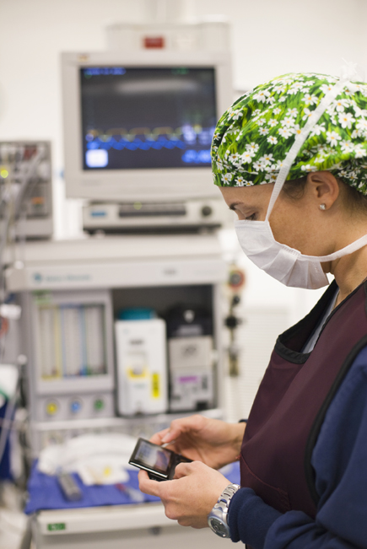
Key success factors
An effective Solution
Alignment & eng’ment
Operators & Healthcare
Alliance
Technical & Organisational support
Industry
Leading Solutions
HCPs & Patient engagement
Source: GSMA
Notes:
Alignment & Collaboration

Slide 15
What challenge lies ahead
Source: GSMA
Notes:
There are significant challenges to creating a thriving mHealth market
Absence of mature regulations, policies and standards
Dearth of interoperable and scalable solutions that can improve health outcomes whilst reducing and containing costs
Market currently lacks
Awareness of mobile health capability
Established business models
Working partnerships
Common goals
Universal acceptance from healthcare providers, payers and patients
How do we overcome the barriers?
Understanding of mobile industry and healthcare sectors capabilities, demands, existing regulatory frameworks and standards
Foster harmonised regulation between the wireless market and the healthcare system to stimulate innovation
Create interoperable and scalable solutions that have buy-in from governments, payers, patients and healthcare providers, to accelerate global deployment of localised products and services

