Slide 1



Digital skills training
materials for mobile internet use
Learner handout
Ghana - English
02
Template slides
In this section you will find templates and examples of
slides you can use for your deliverable presentations.

Slide 2
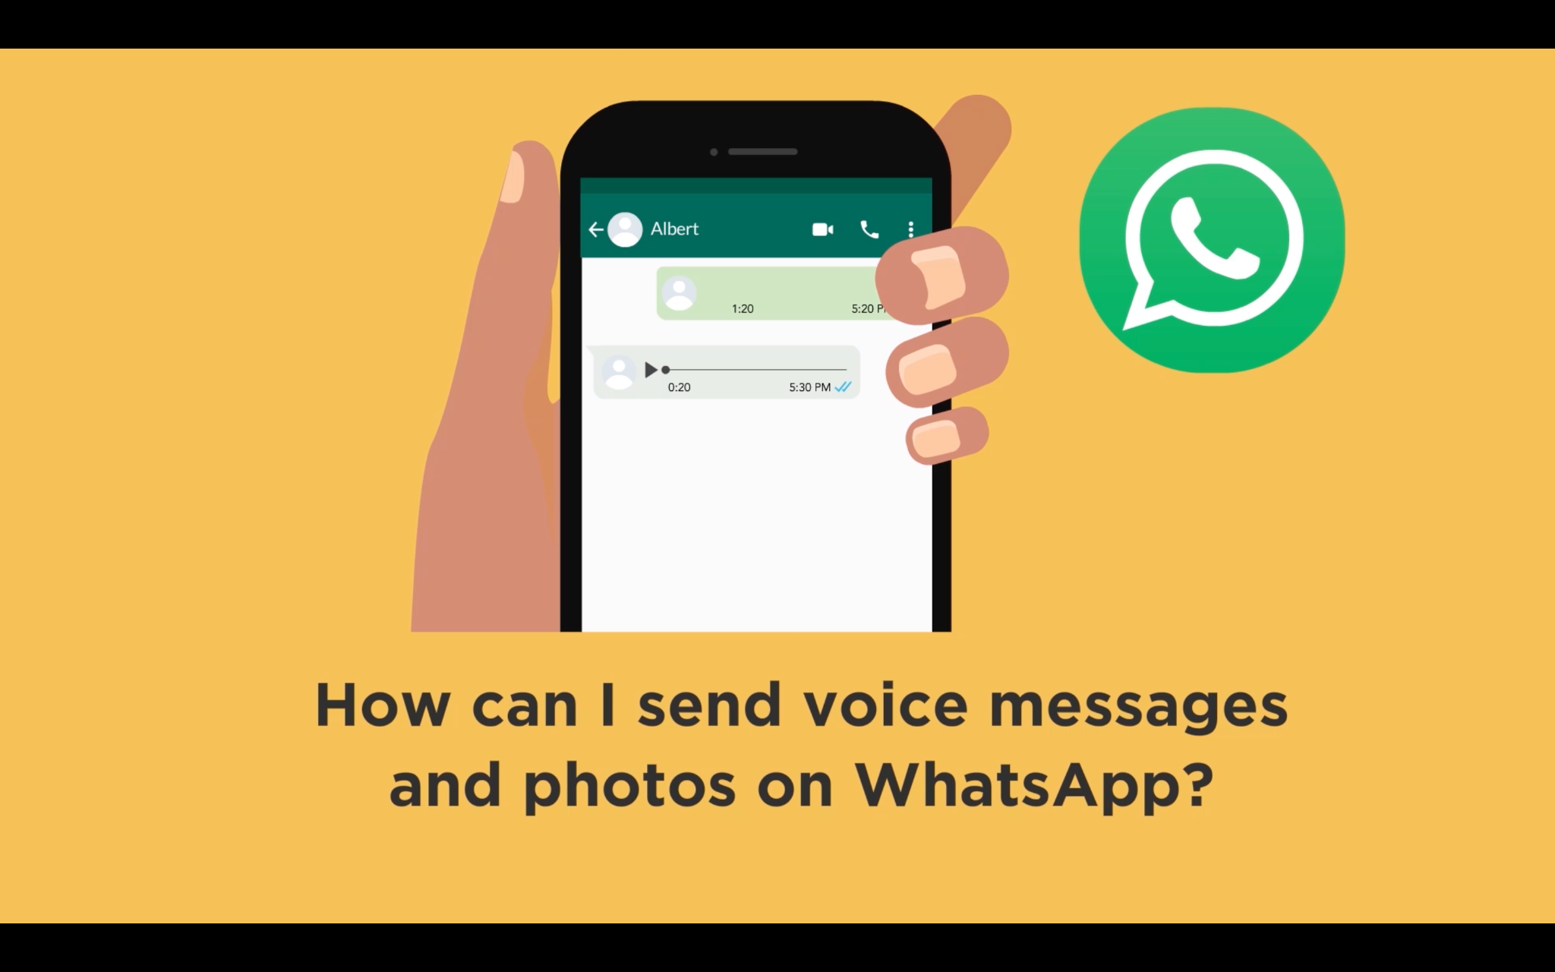
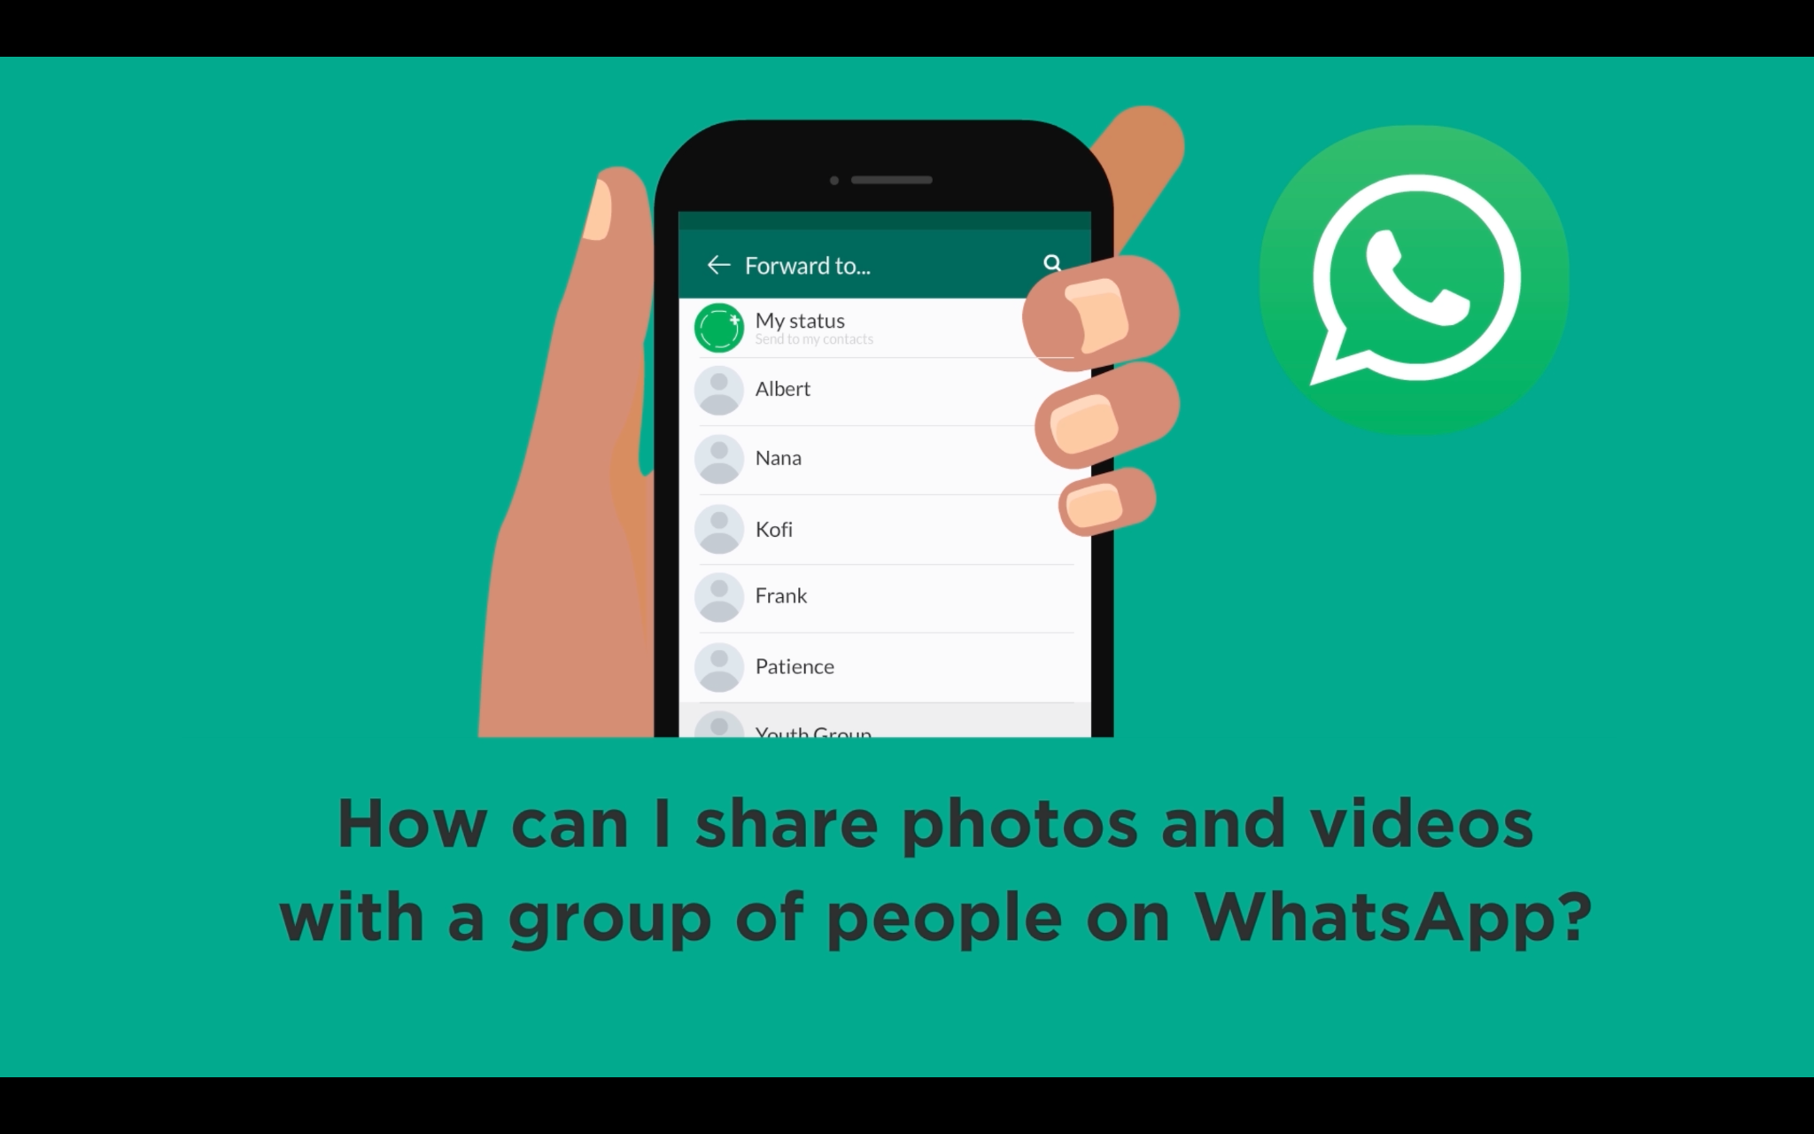
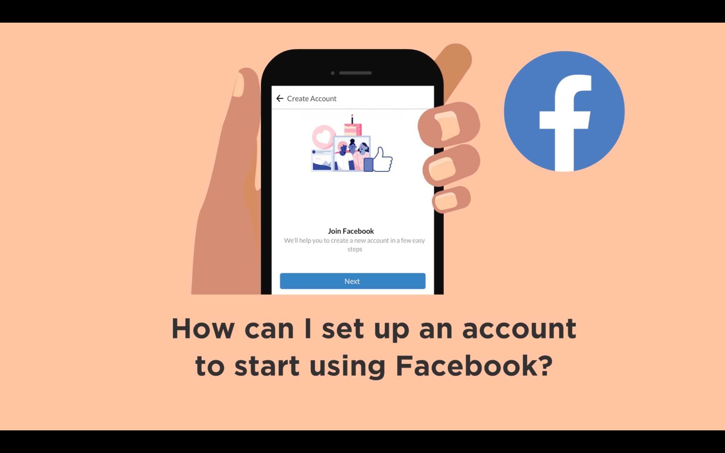

STAYING CONNECTED AND ENTERTAINED

Slide 3
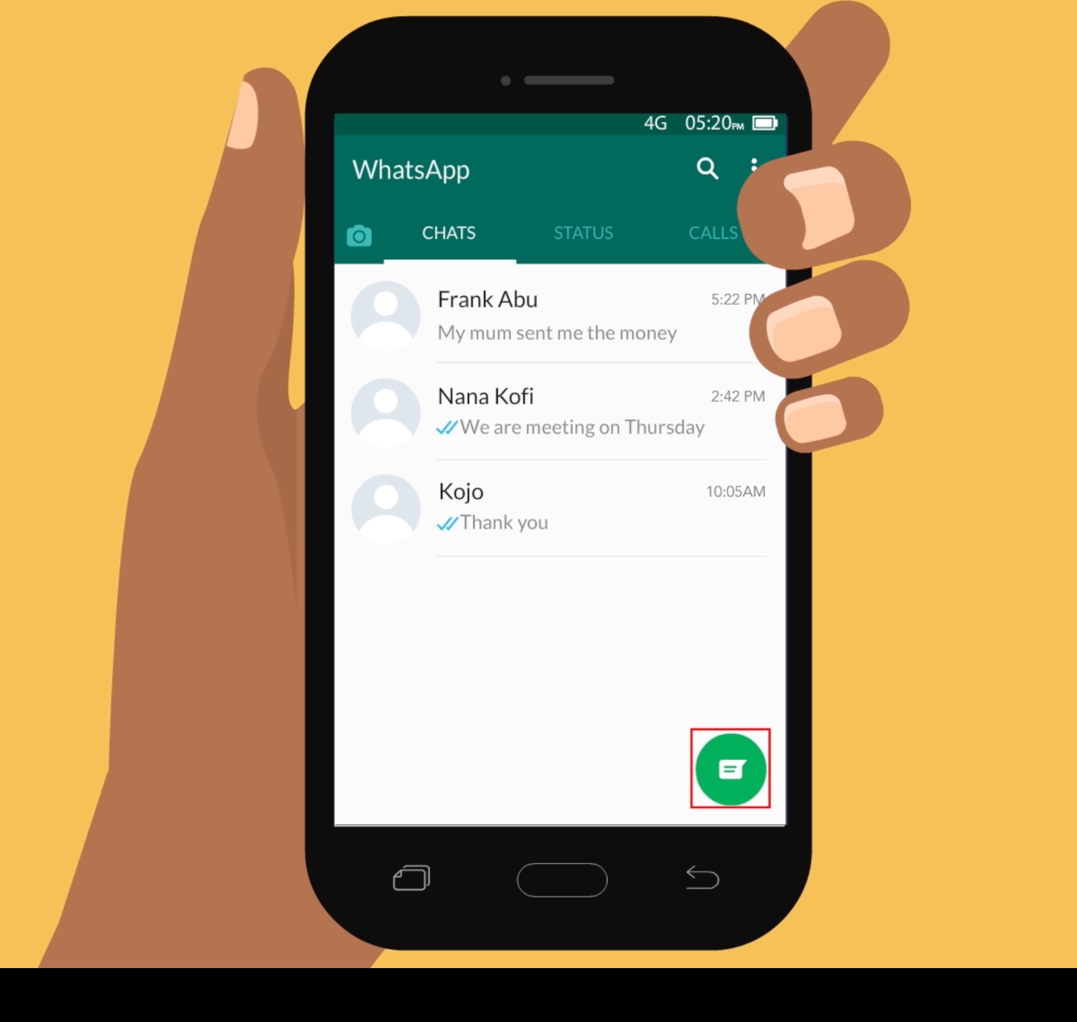
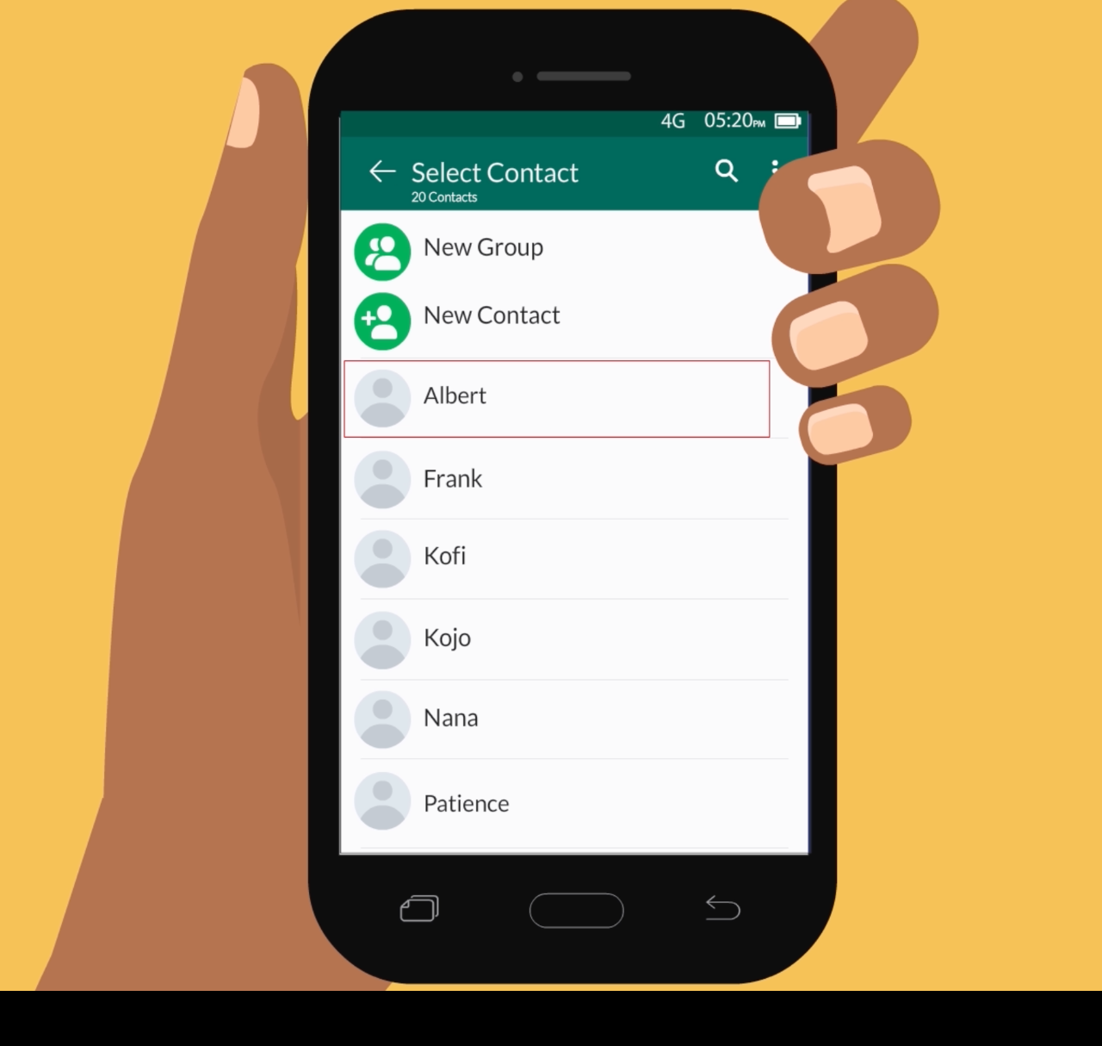

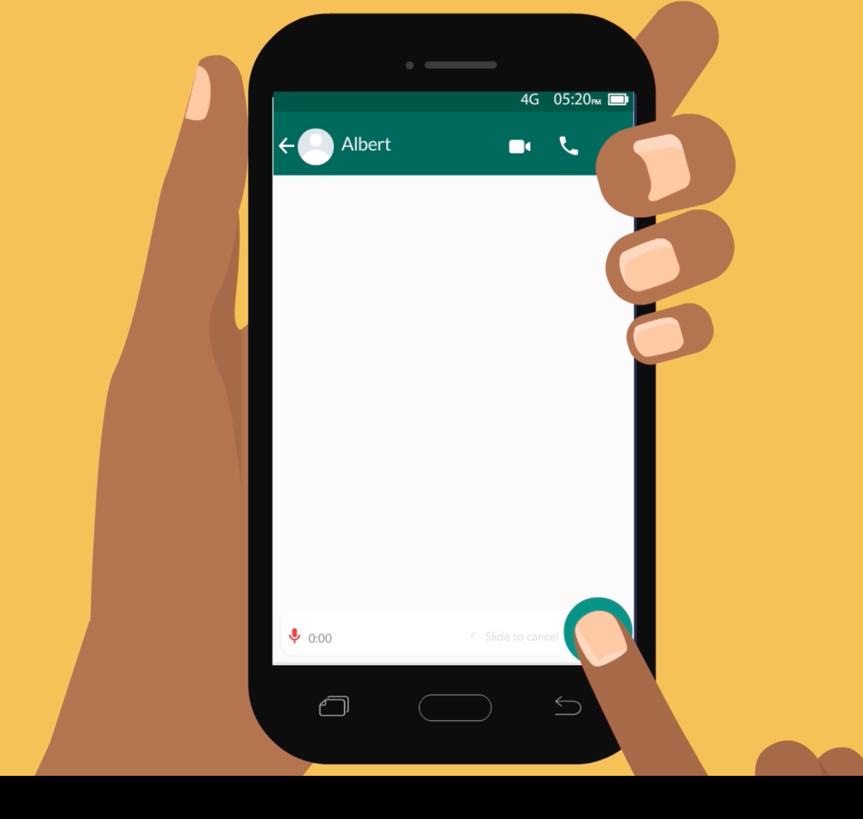
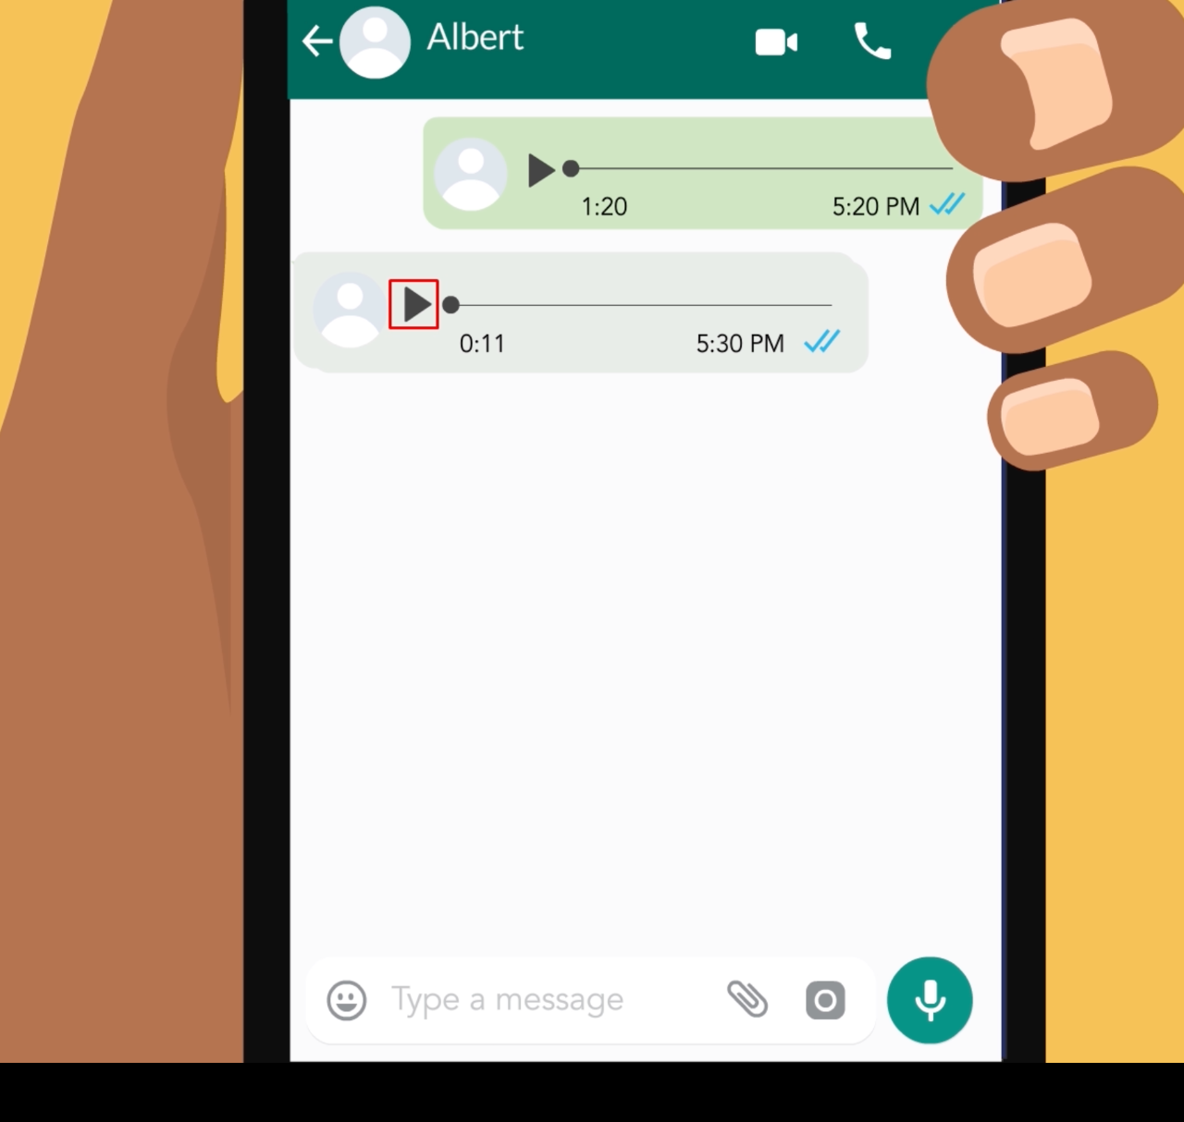

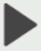
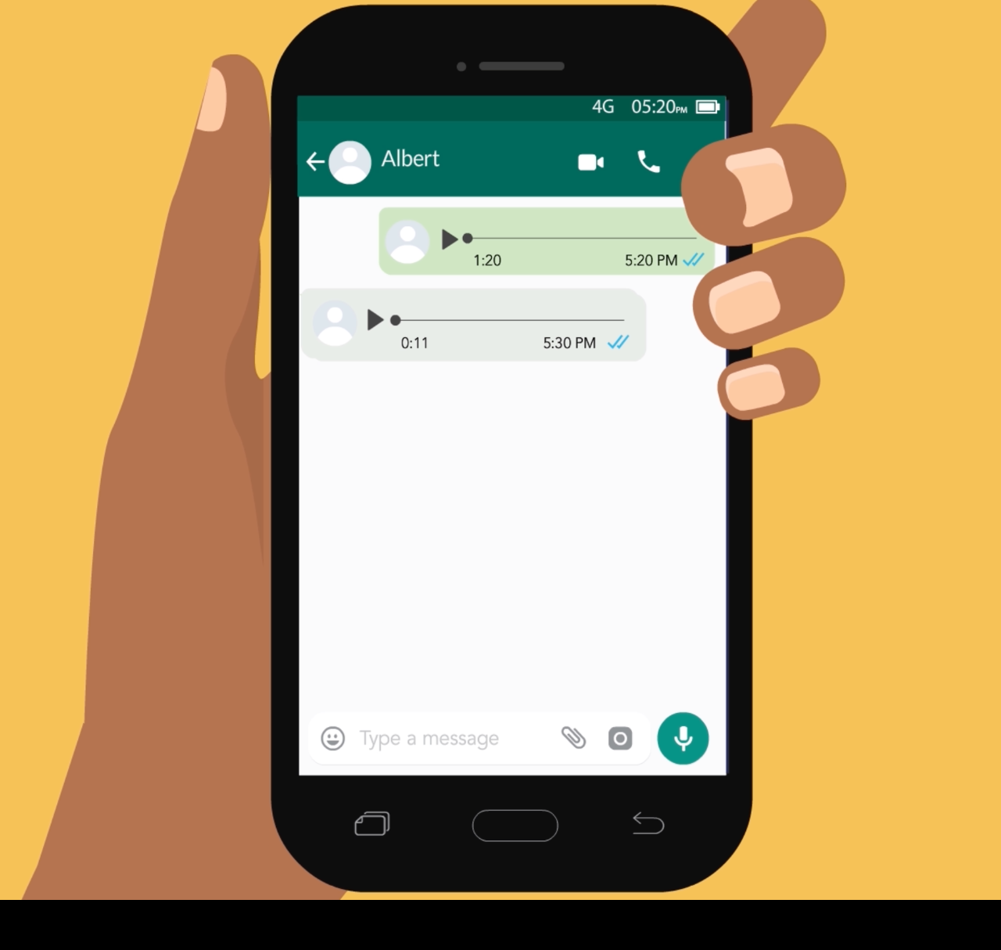
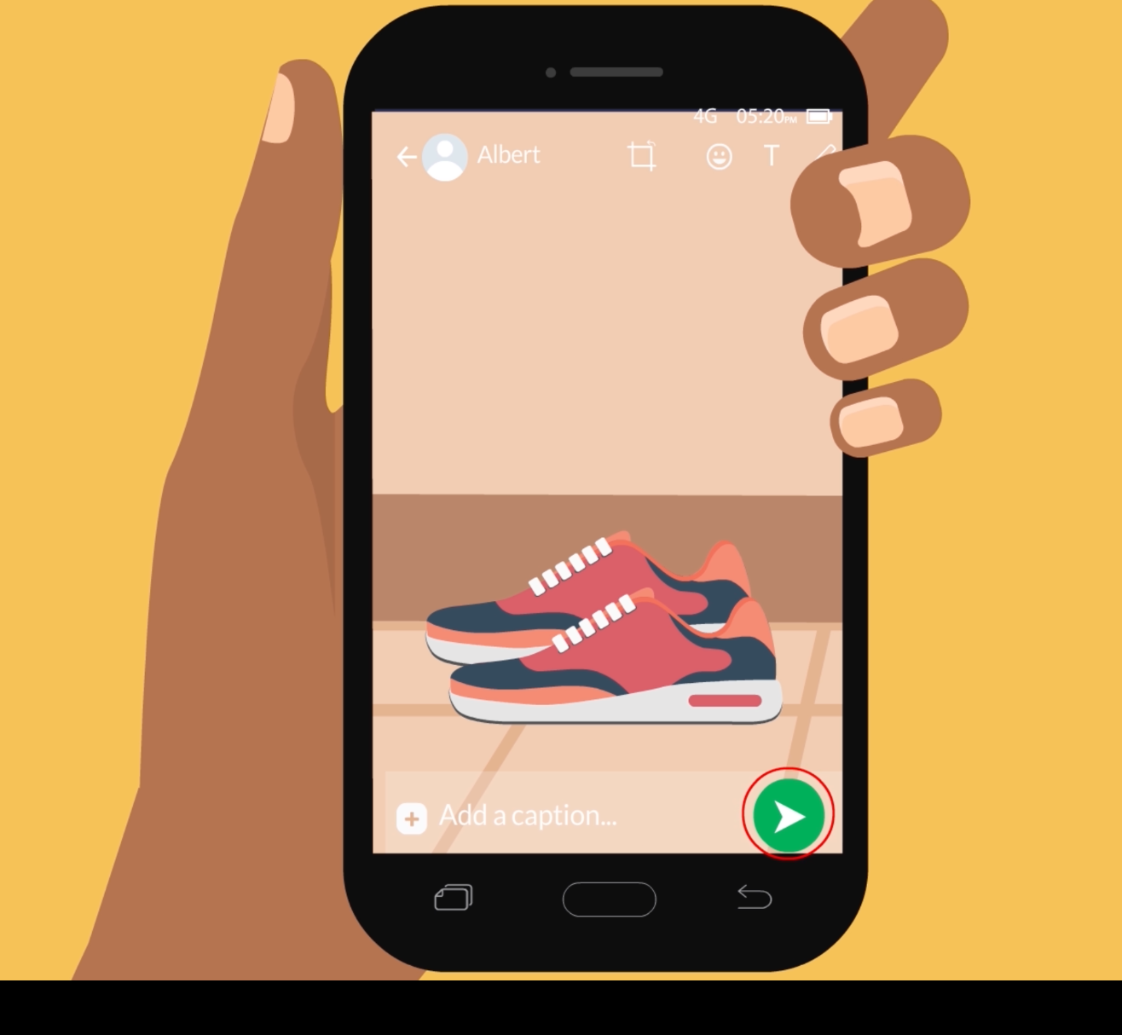


How can I send voice messages and photos on WhatsApp?
1
2
Press the green button to start a new chat.
Press the name you want to chat with.
3
4
Keep the microphone pressed to record a voice message.
Press the arrow button to listen to messages sent to you.
5
6
Press the camera button to take a photo.
Press the green arrow button to send your photo.

Slide 4
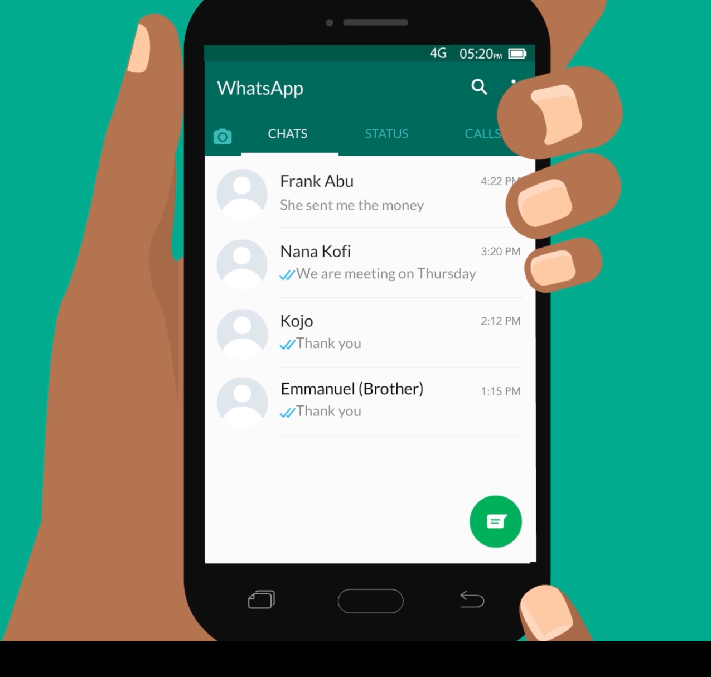
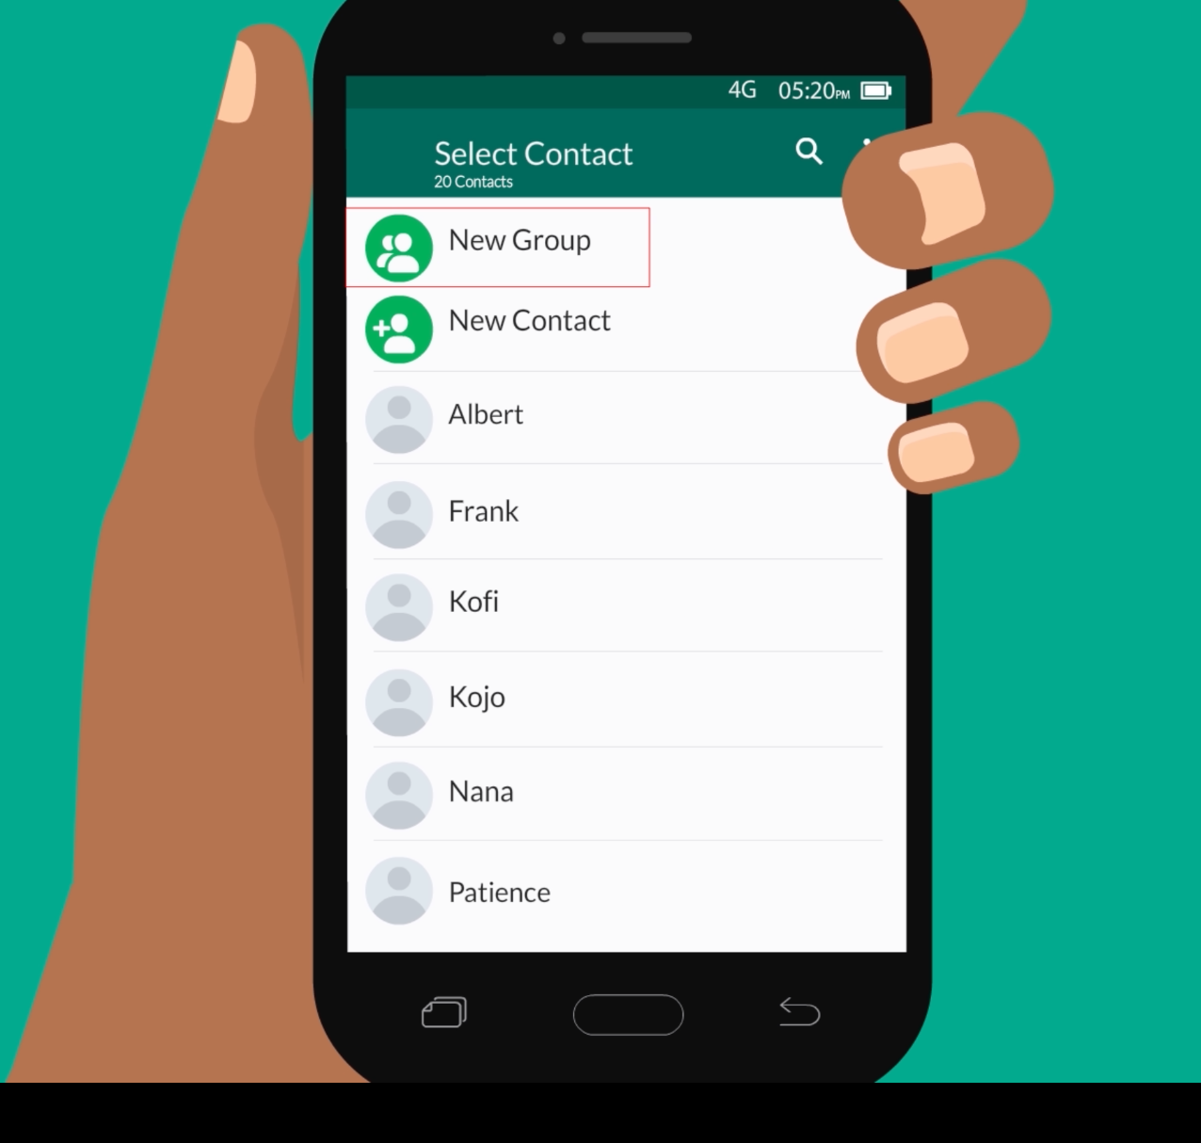
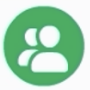
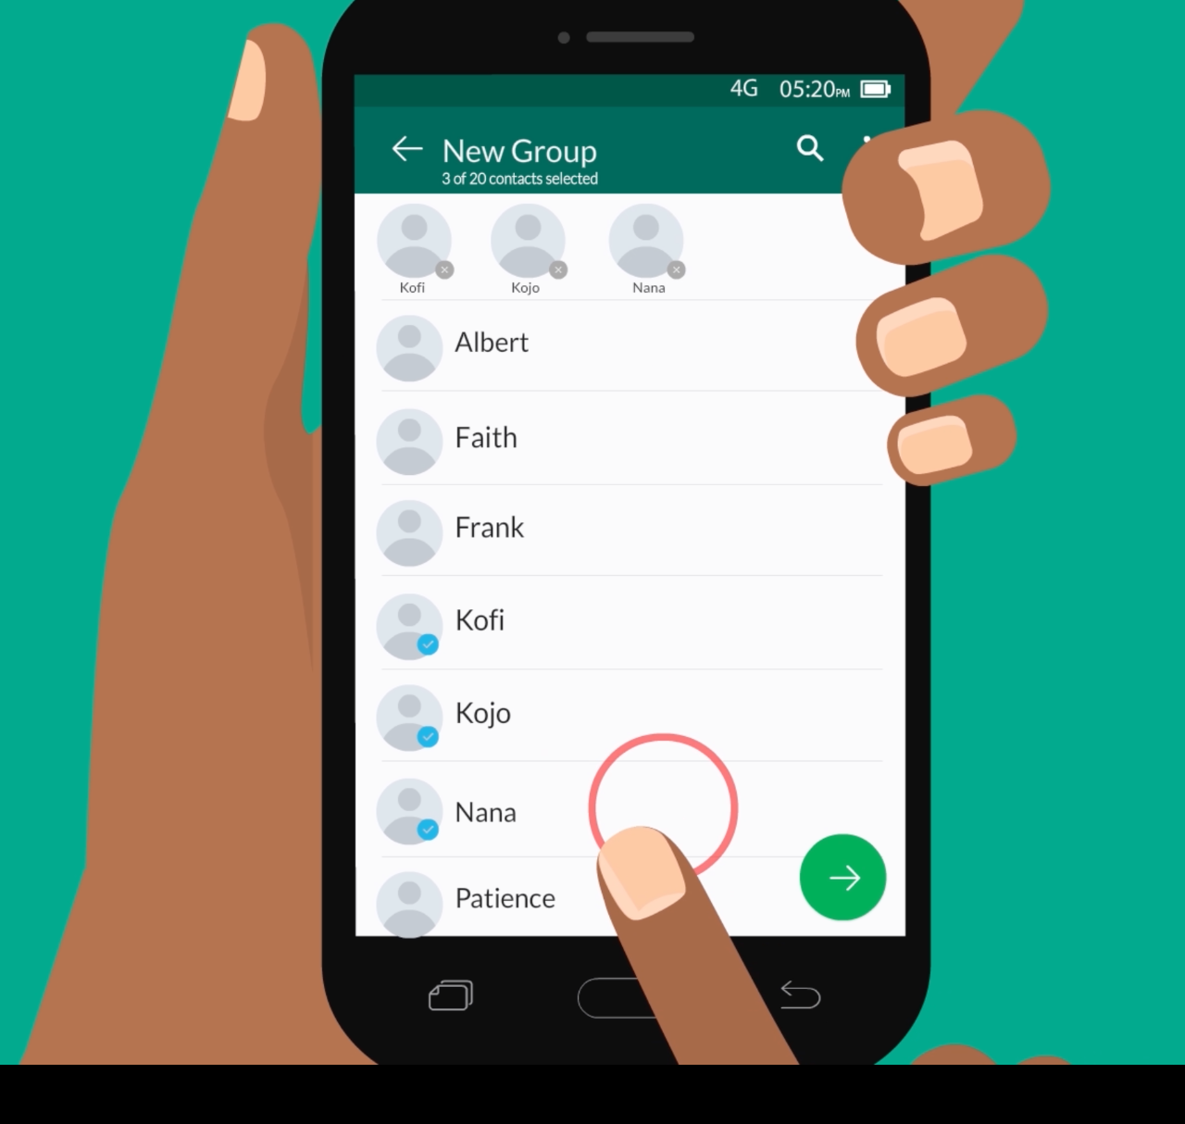
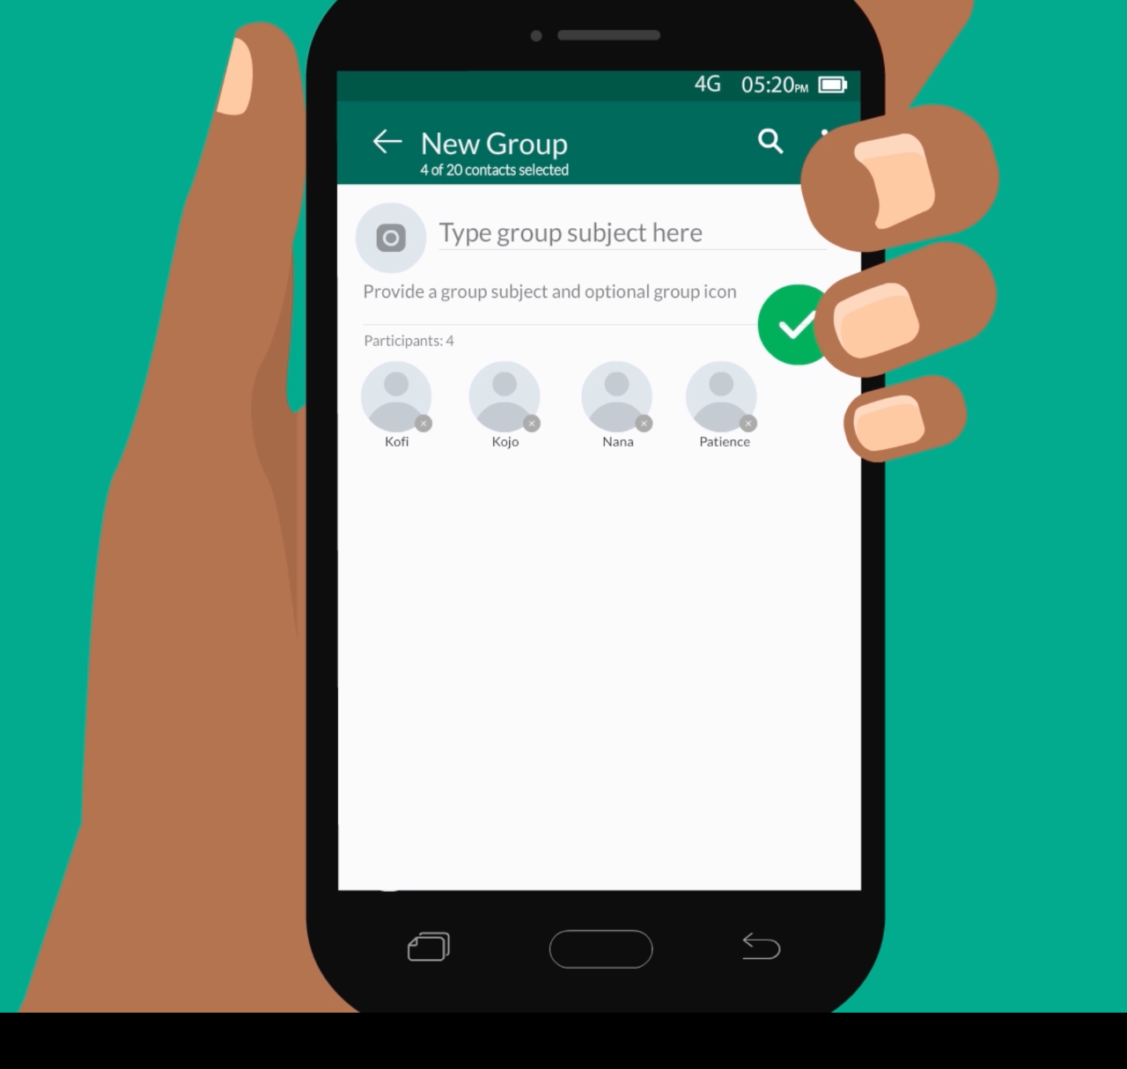

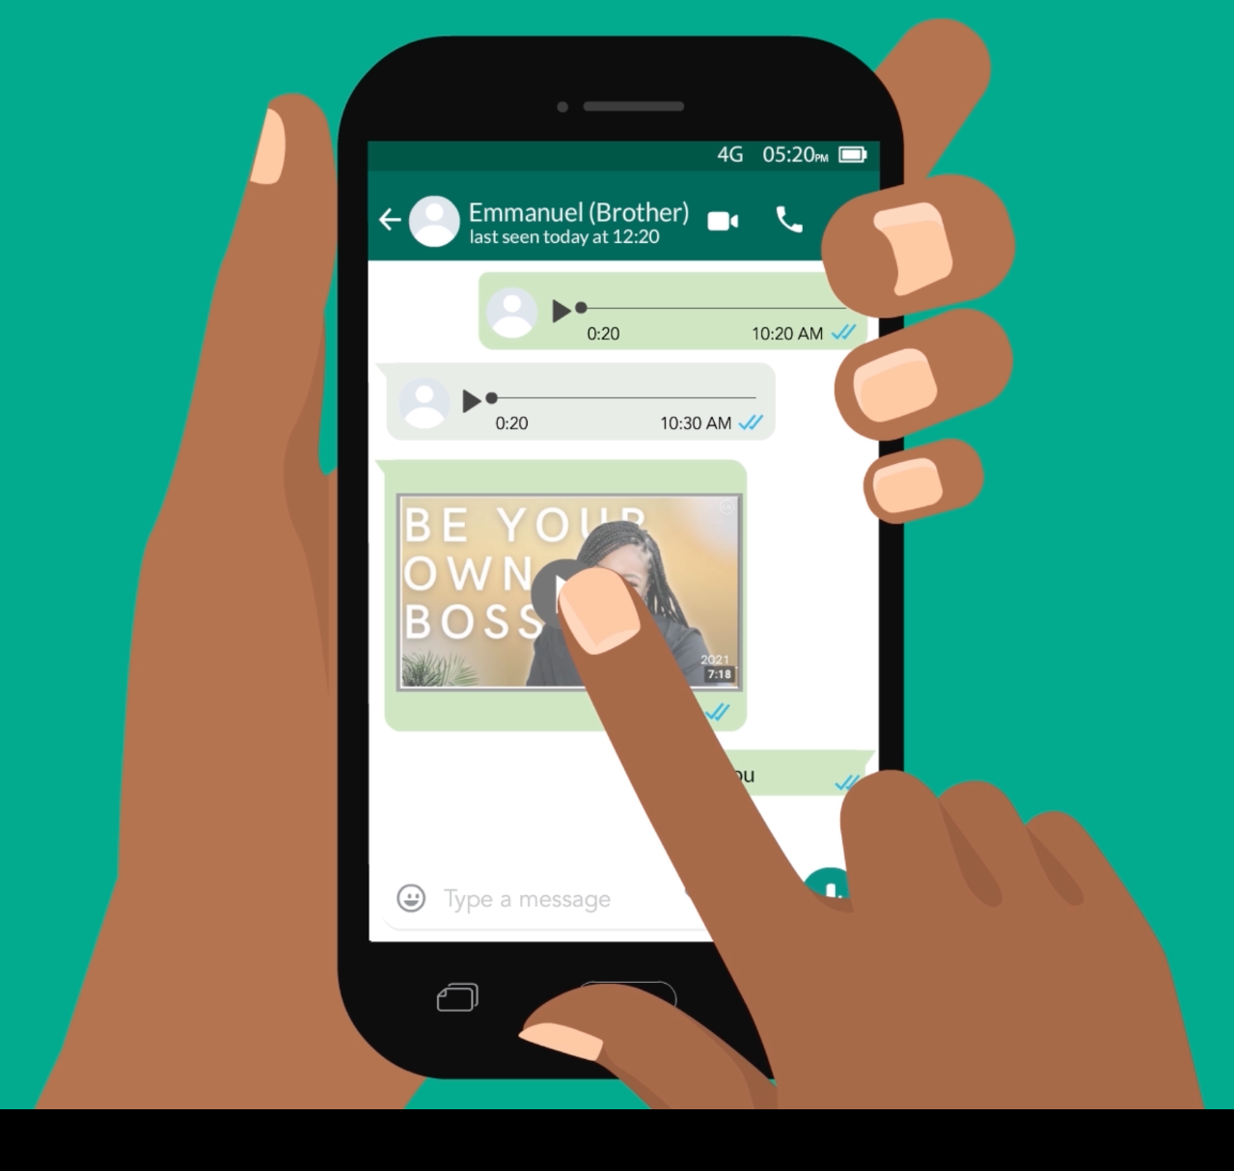
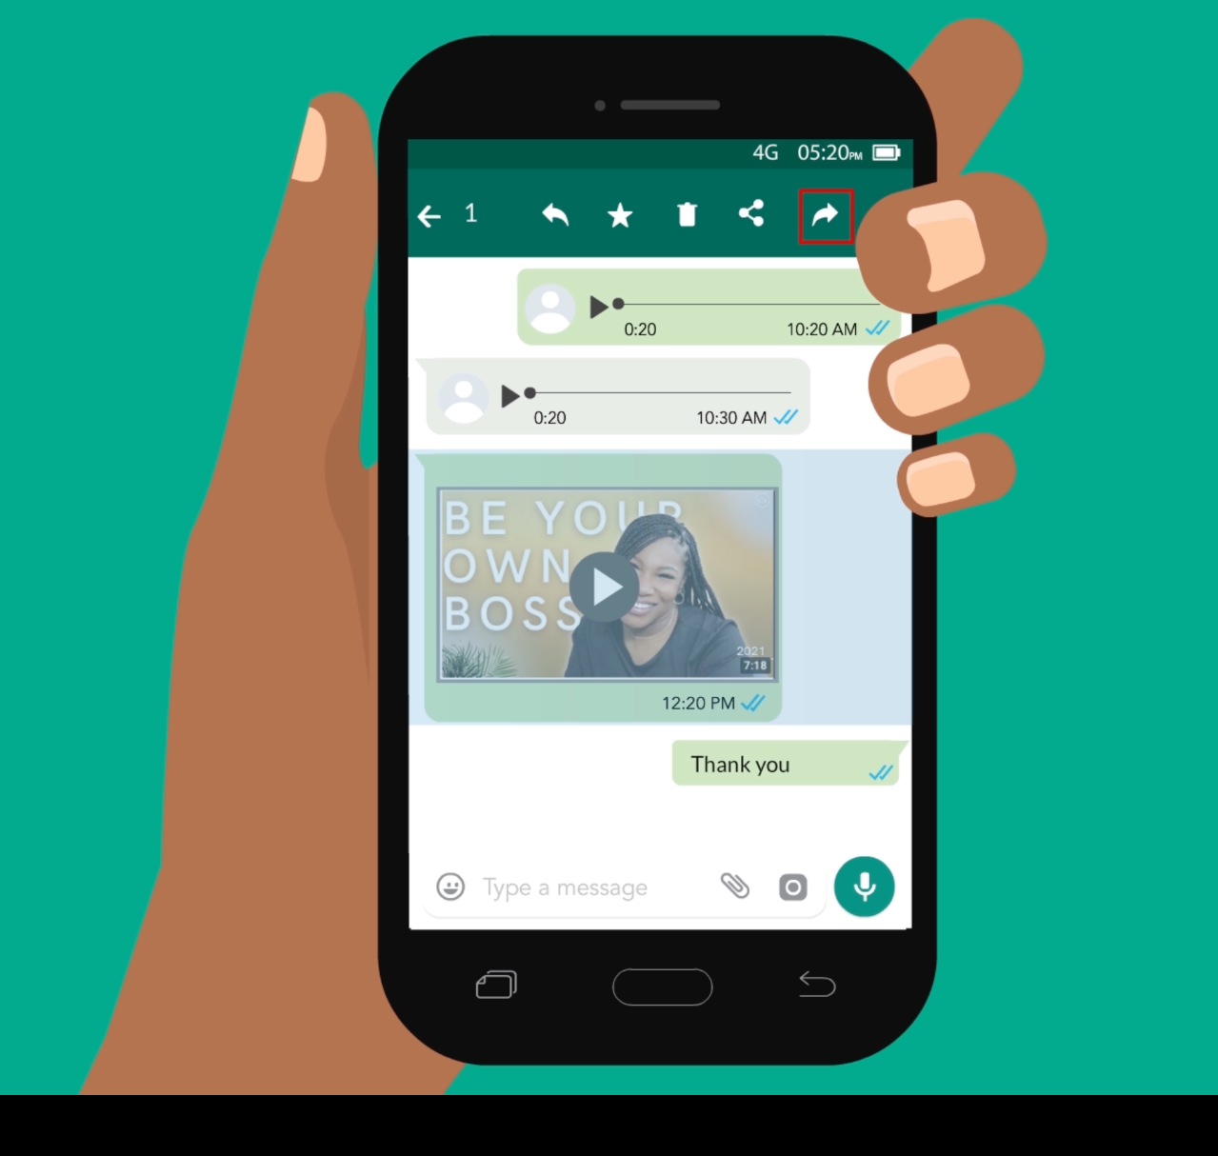

How can I share photos and videos with a group of people on WhatsApp?
1
2
Press the green button to start a new chat.
Press on “New Group” to create a group.
3
4
Press on names to add to your group, then press the arrow.
Type in a group name, then press the green tick.
5
6
Press on the message, image or video you want to forward.
Press the arrow, then pick who you want to forward to.

Slide 5
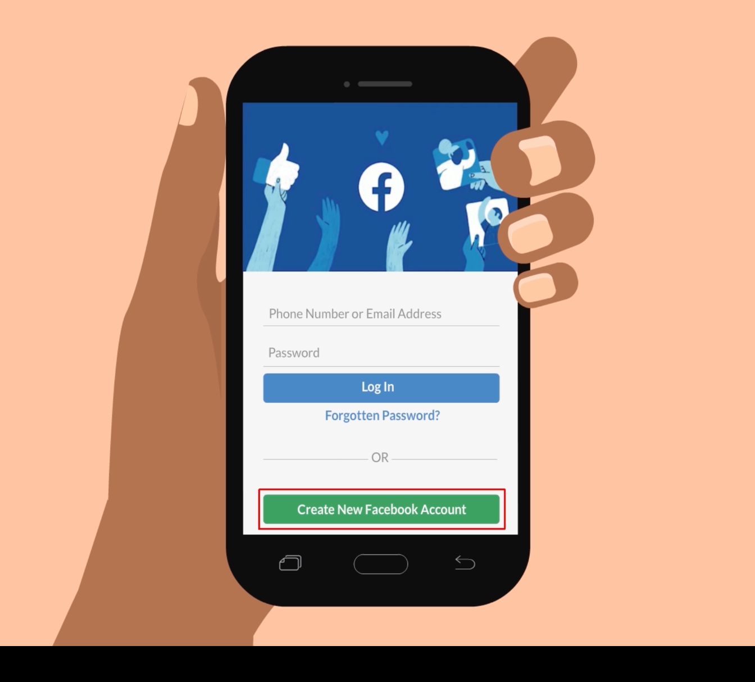
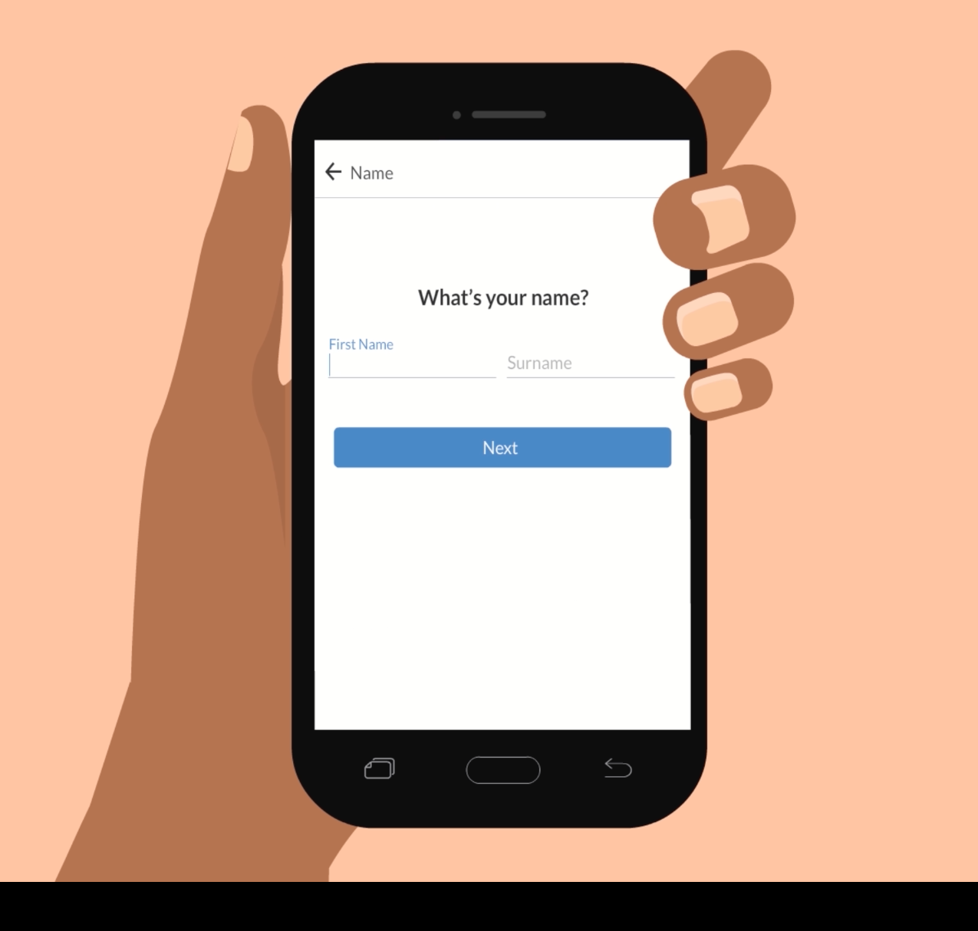
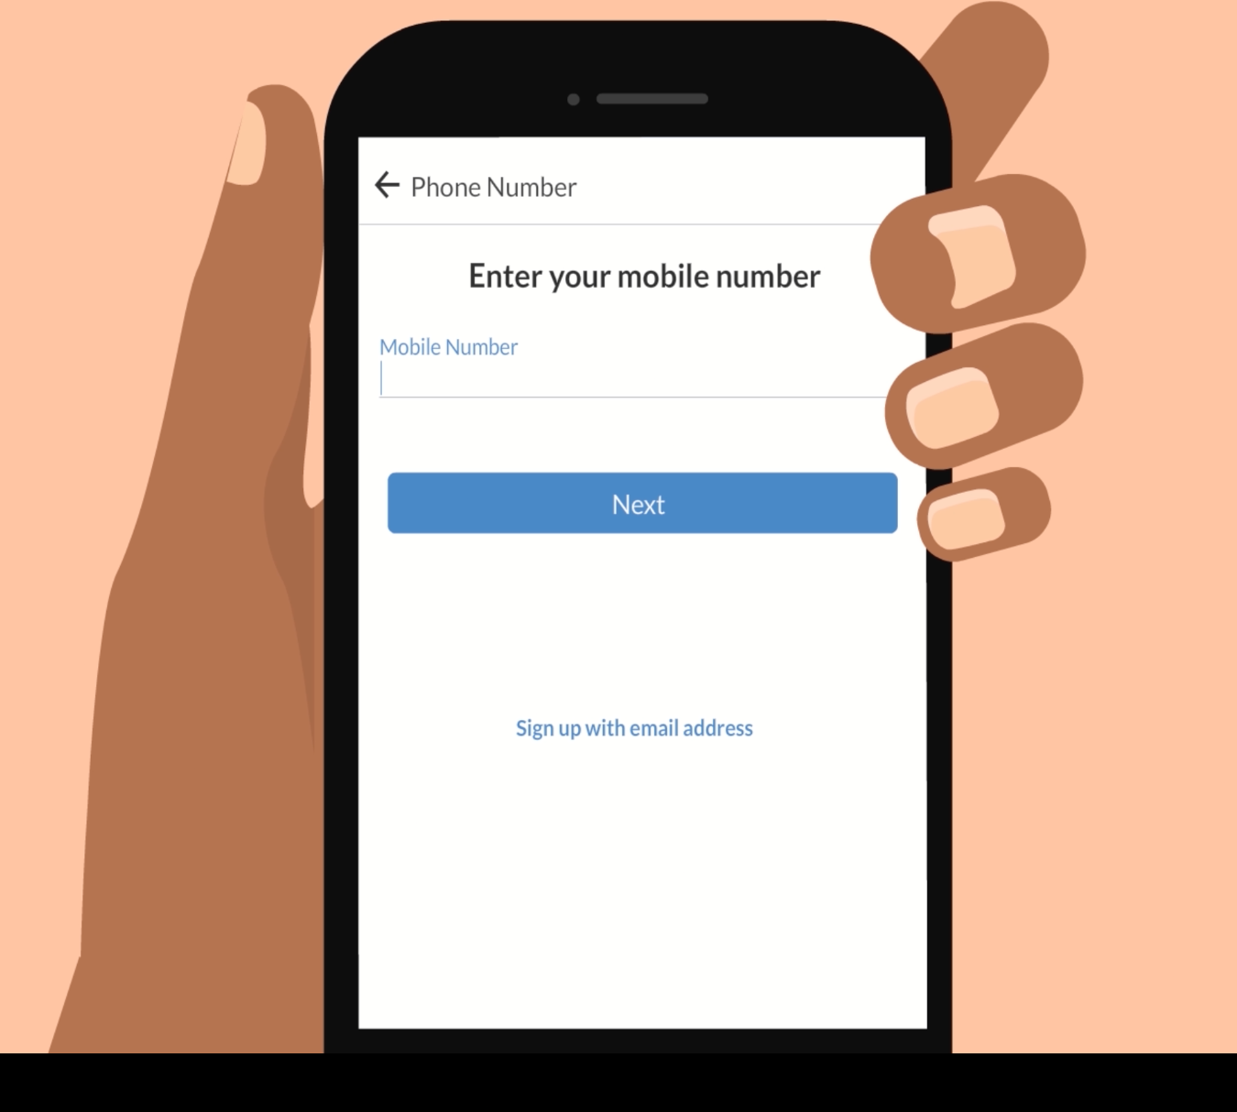
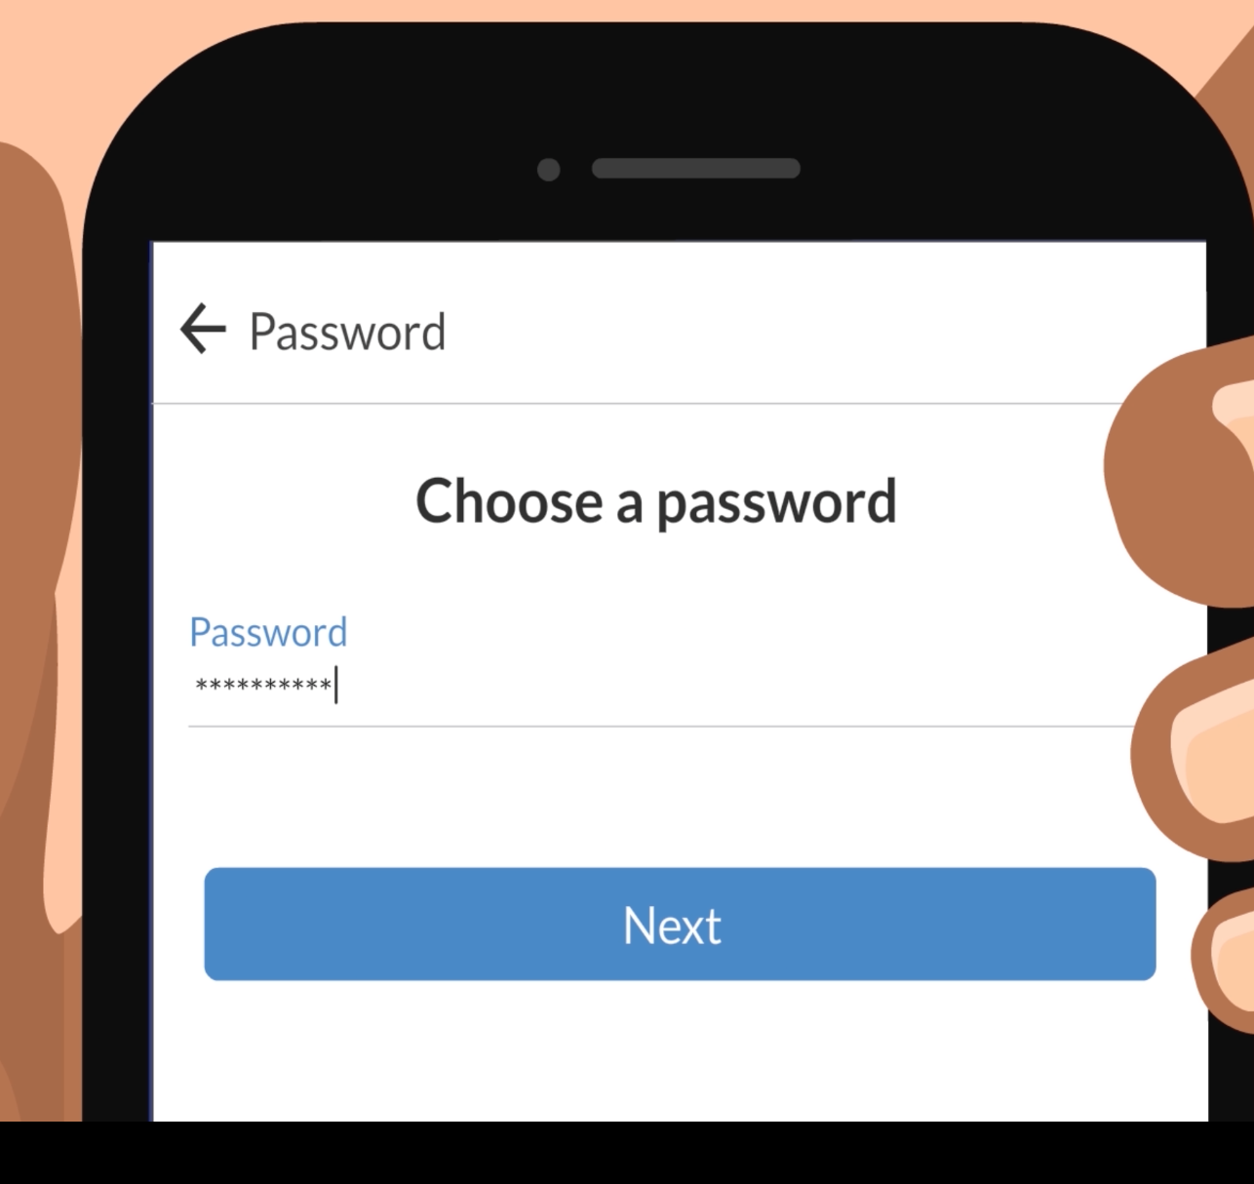
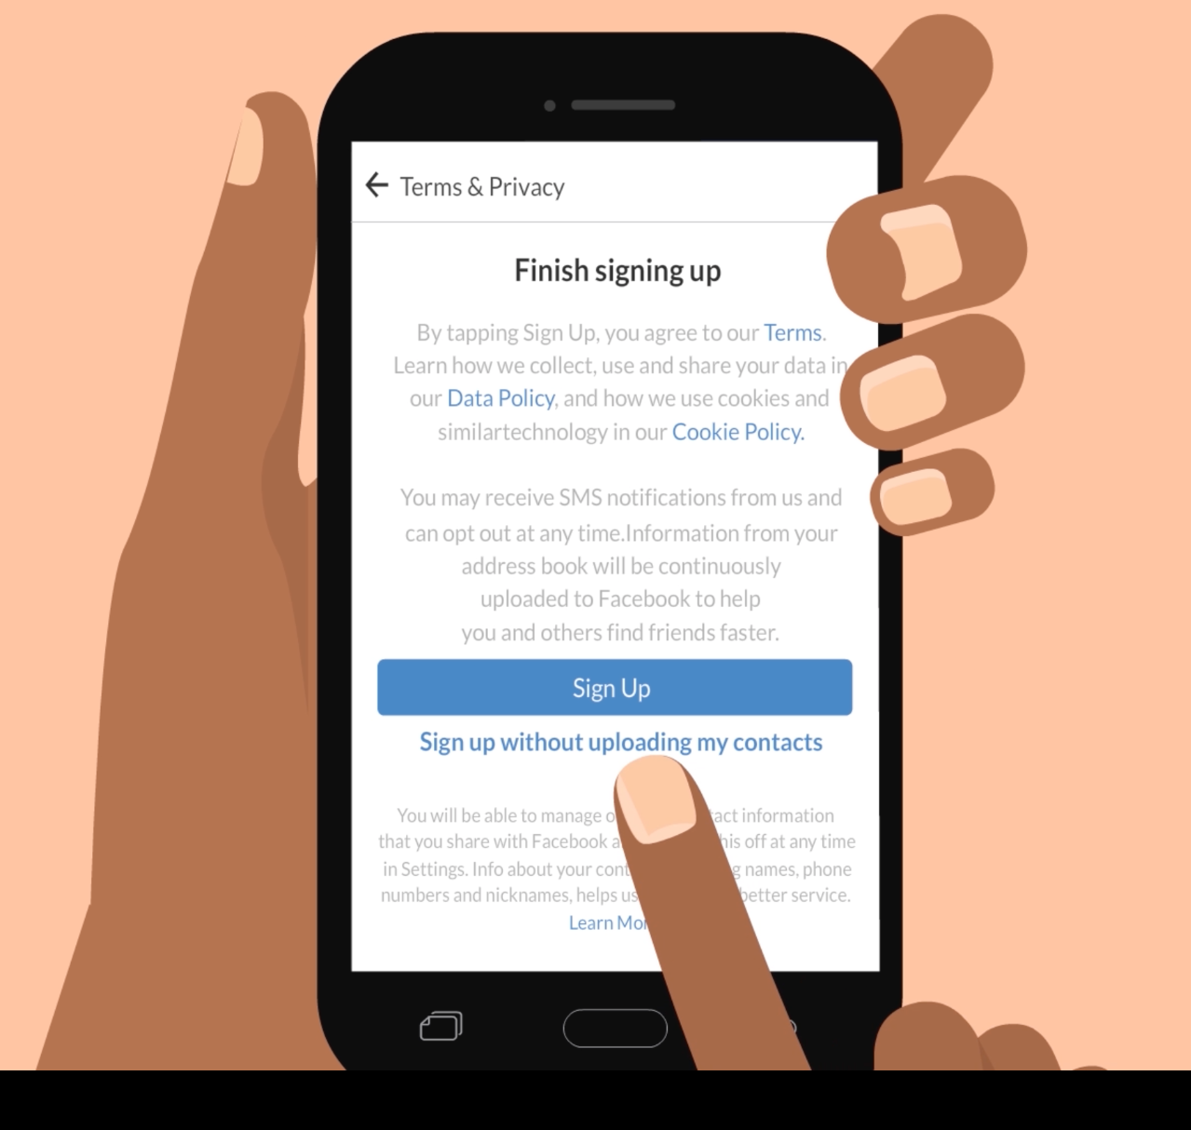
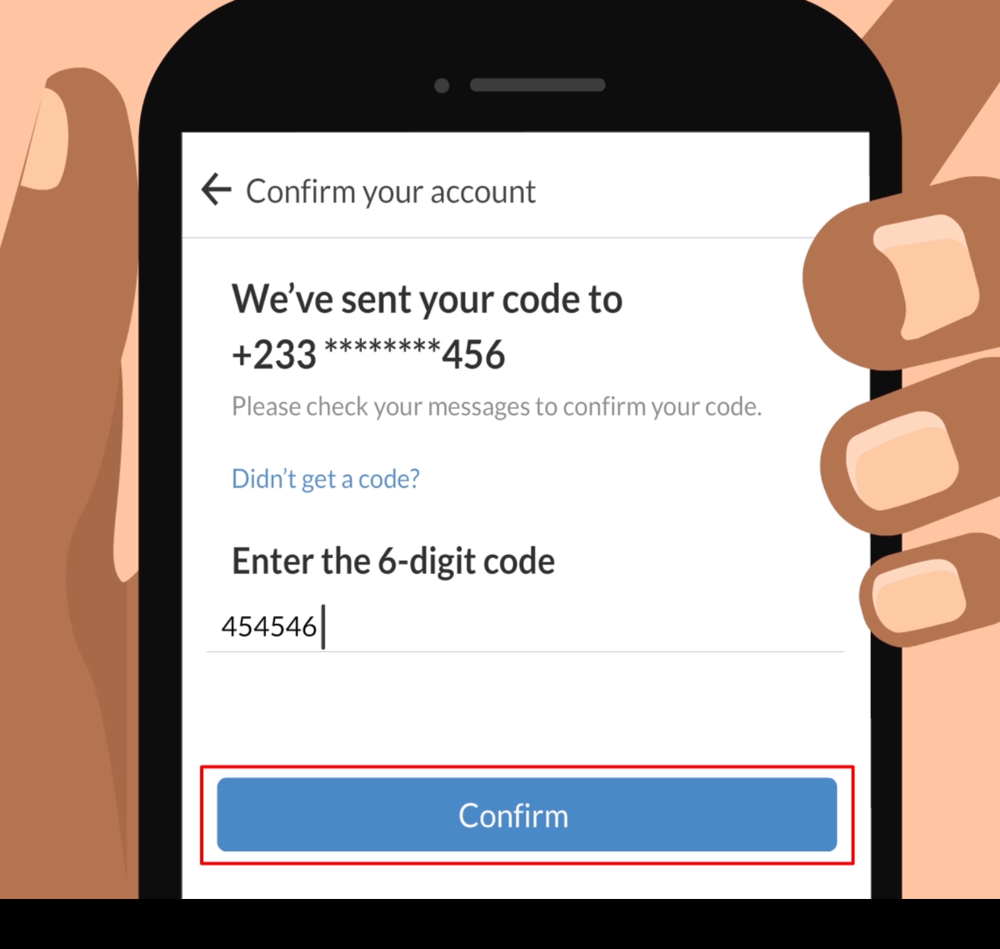
How can I set up an account to start using Facebook?
1
2
Press “Create new Facebook account”.
Add your name, date of birth and gender, then press next.
3
4
Add your mobile number, then press next.
Select a password.
5
6
Press “Sign Up” or “Sign up without uploading my contacts”.
Check your text messages for a code. Enter it to finish setup.

Slide 6
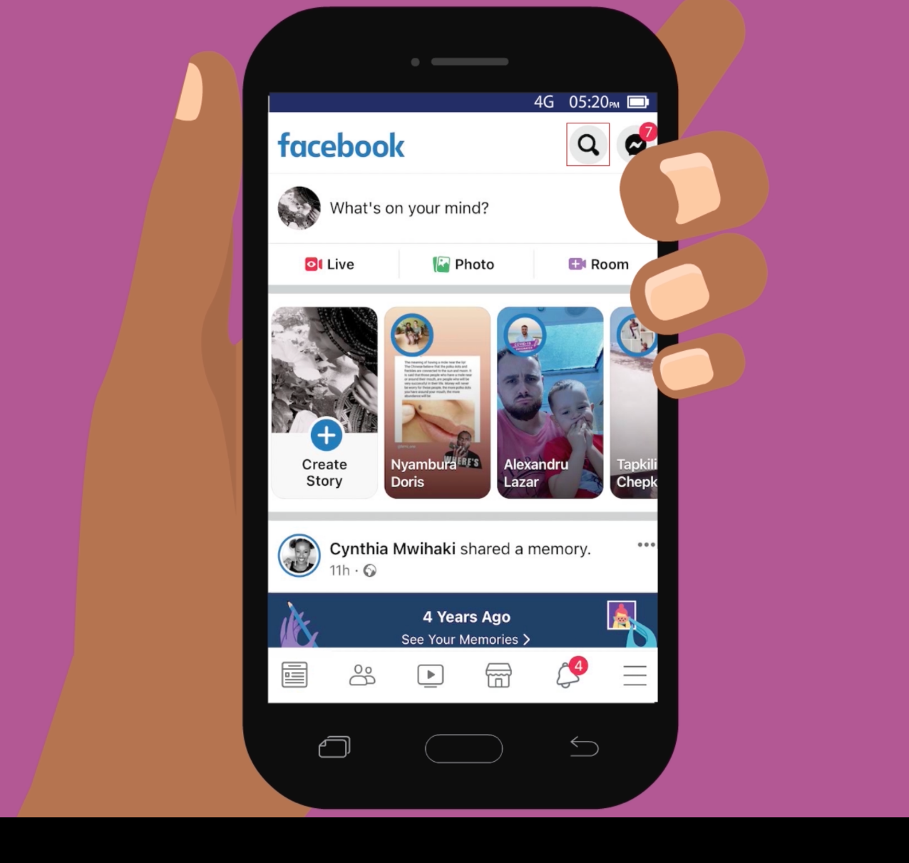
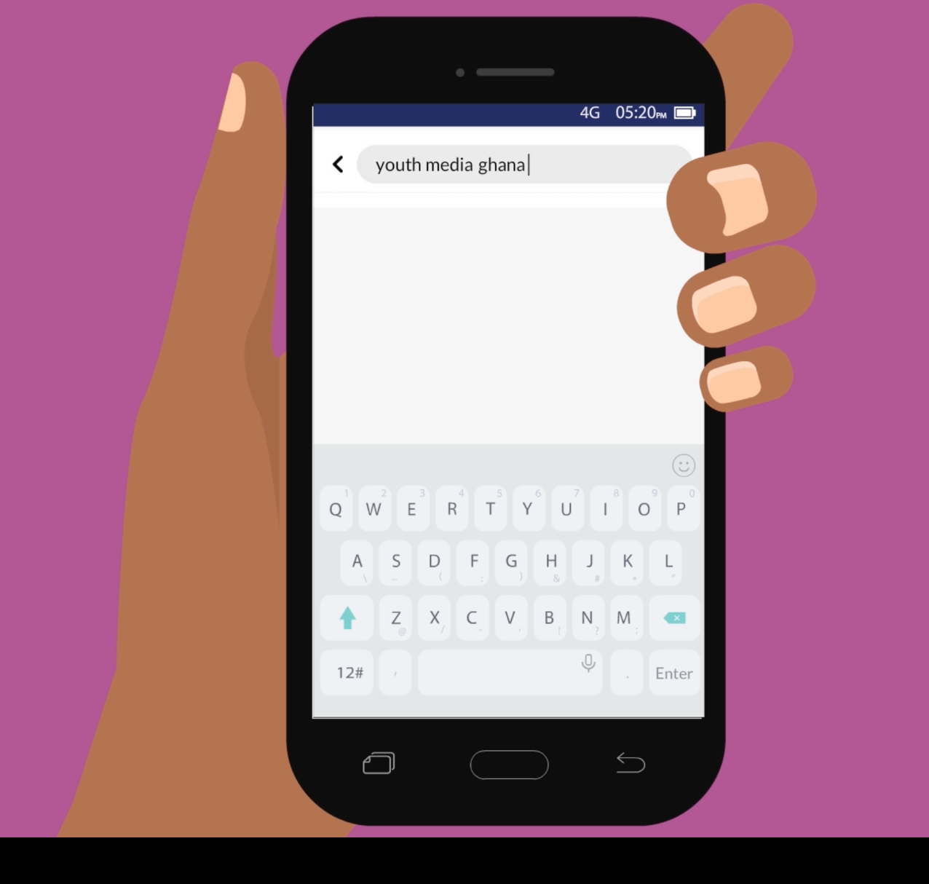

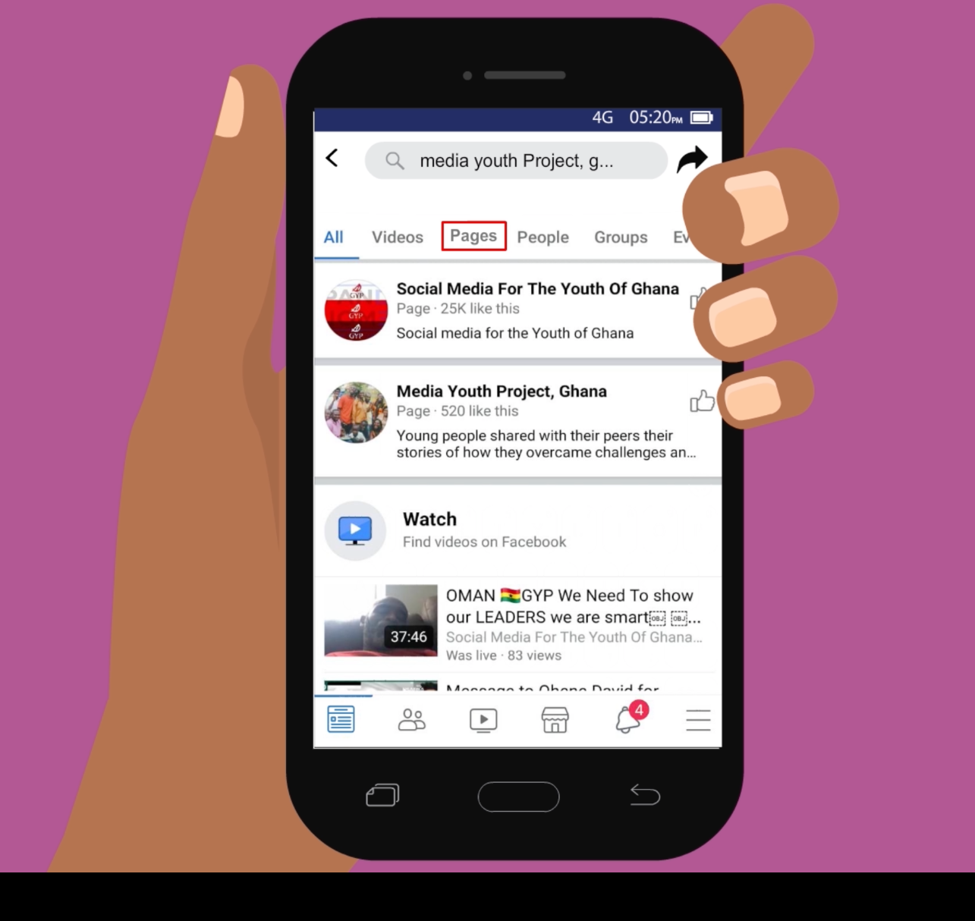
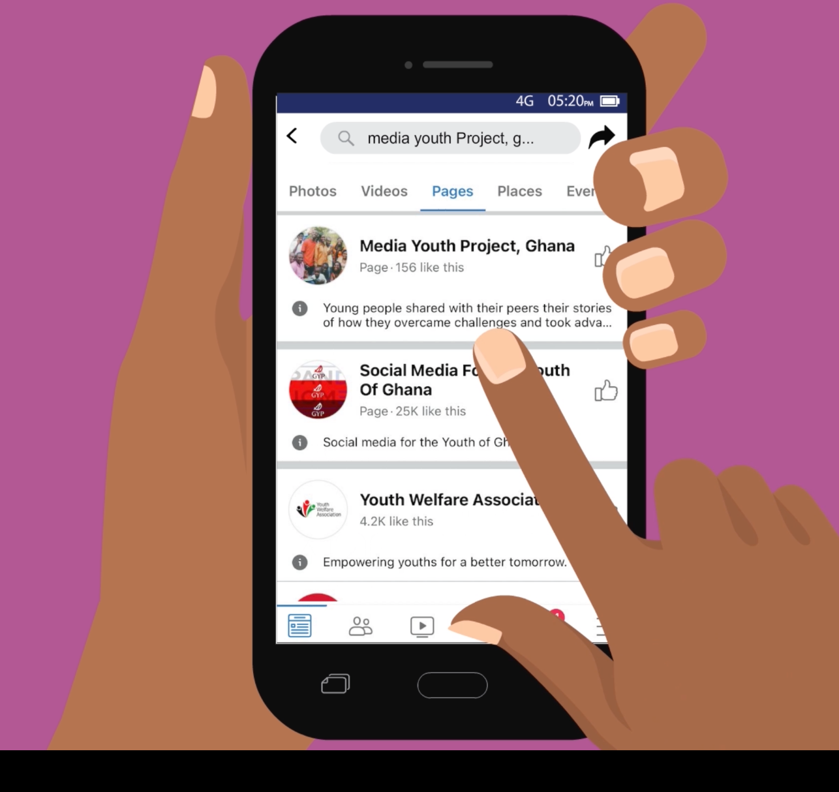
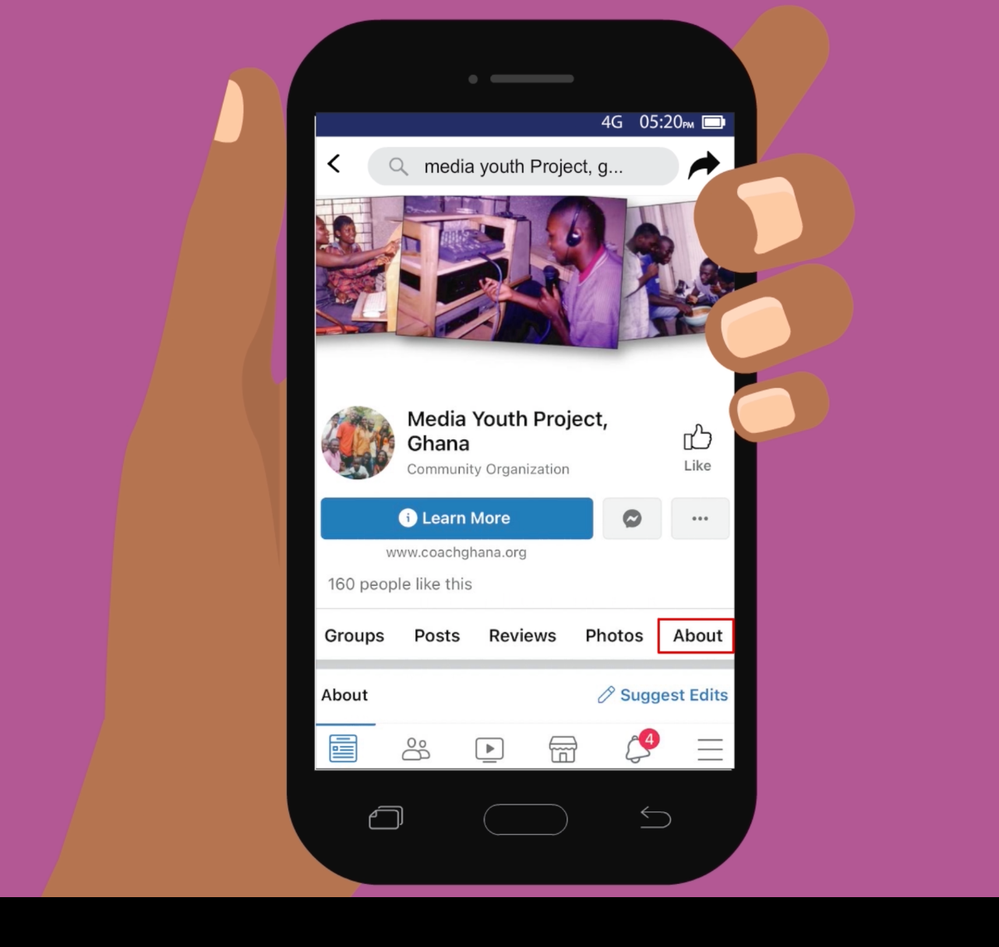
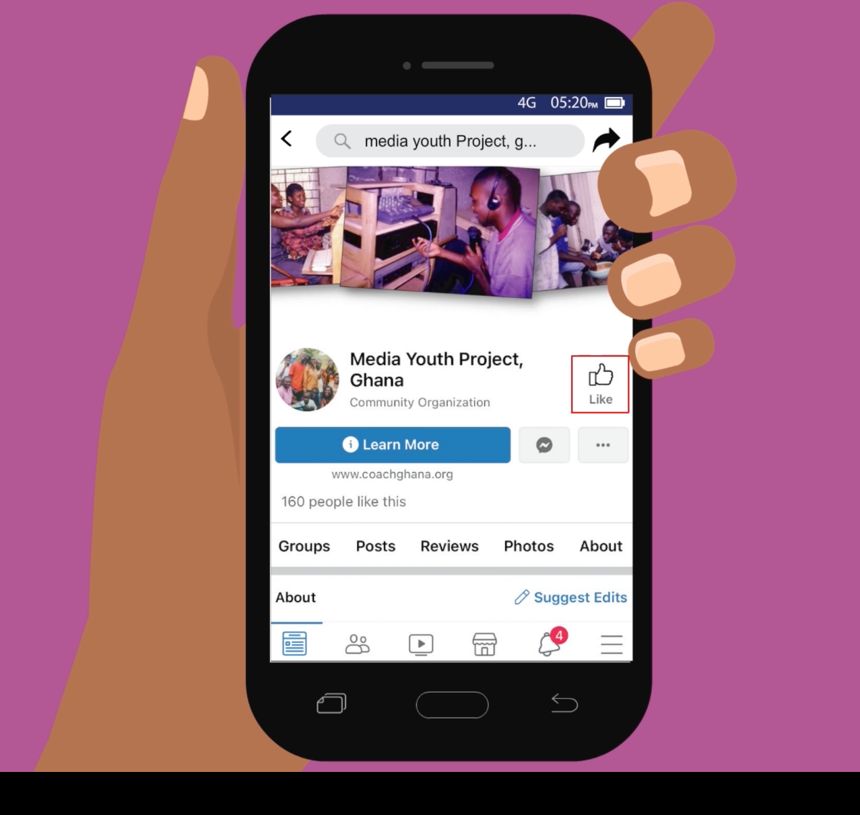

How can I find interesting information on Facebook?
1
2
Press the magnifying glass to search.
Type in what you want to find.
3
4
Press on “Pages” to only see relevant pages.
Press on a page to read it.
5
6
Press “About” to learn more about the page.
Press the “thumbs up” button to follow updates from that page.

