Slide 1
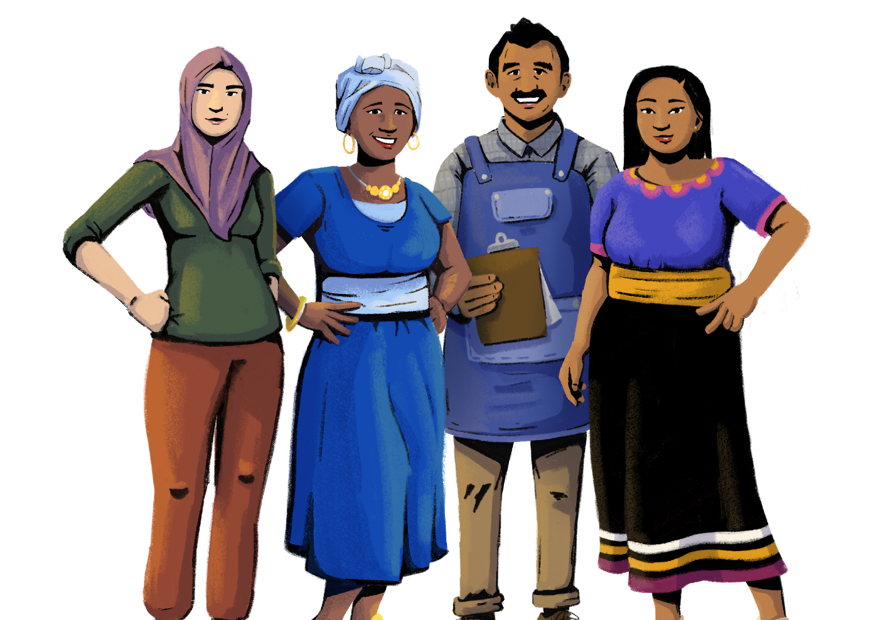
Accessing and Qualifying for Credit
Her Business, Her Future
Business Management and
Digital Literacy for Women
Micro-Entrepreneurs
This module is made possible by the generous support of the American people through the United States Agency for International Development (USAID). This guide was produced under DAI’s Digital Frontiers Project (Cooperative Agreement AID-OAA-A-17-00033) at the request of USAID and in partnership with Mastercard. The contents are the responsibility of XYZ and do not necessarily reflect the views of USAID or the United States Government.

Slide 2
Tips for Customizing This Module
The following list provides helpful tips for customizing the content in this module. You can click the slide numbers to be brought directly to that slide. Each slide with customizable elements includes arrows, text boxes, or highlighted phrases to indicate customizable sections and words.
Topics: This module is broken down into several topics as described in the table of contents. You can delete the topics that are not relevant to you and your group. You can also delete any slide throughout the module that does not apply to you or your group. Additionally, all text in this module is directly editable.
Characters: This module uses a mix of characters from different regions. You can replace any of the characters using the character image files from the creative asset library.
Discussion Questions: Slide 4 contains questions for discussion. You can edit or replace the questions that may not be relevant to your group.
Mobile Wallet Terminology: The terms “mobile wallets” and “mobile money” are used throughout this module. You can replace these terms with a term that resonates best with you and your audience - such as mobile money account, digital wallet, etc. - by using the “find and replace” tool. The terms are also in red text throughout the module.
Interest Rate Examples: Slide 8 gives two examples of calculating interest rates. You can change the terms of the interest rate examples and modify the currency as needed.
Digital Credit Providers: Slide 11 discusses different types of digital credit providers. You can add or eliminate providers depending on the options available in your market.
Alternative Credit Assessments: Slide 24 gives examples of apps that use alternative methods to determine creditworthiness and assign a credit score. You can add, delete, or modify these examples as necessary.
Loan Providers: Slide 26 discusses different places to get a loan. You can add or eliminate providers depending on the options available in your market.
Getting a Loan: Slides 27 describes the general steps to get a loan. You can modify these instructions according to a loan provider or loan product of your choice.

Slide 3
Module Overview
Table of Contents
Objectives
Understand formal credit types and sources.
Learn about methods of assessing creditworthiness.
Appreciate the importance of making loan and credit payments on time.
Part 1: Forms of credit | 5
Part 2: Assessing creditworthiness | 18
Part 3: Where and how to get a loan | 25
Part 4: Managing credit | 29
compare and contrast different types of credit
strategize how to manage your credit payments
In this module, you can…

Slide 4
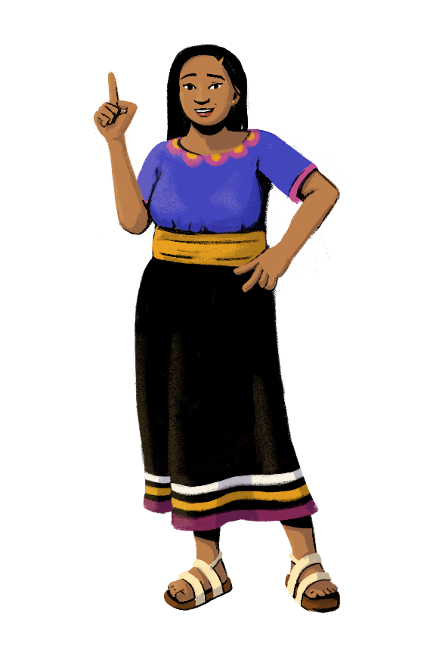
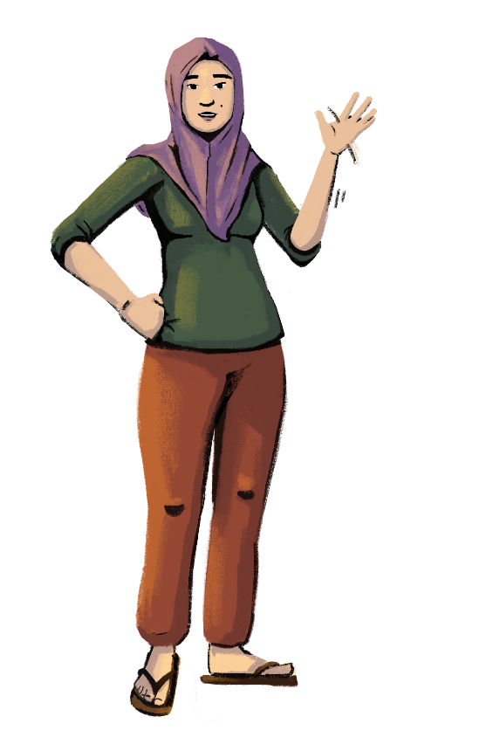
Before you start, let's see how familiar you are with credit!
Customization Tip!
Add, delete, or modify
questions as necessary.
Where can you get a loan?
If you have applied for a loan, what documents or information did you have to provide?
Has anyone struggled to make their loan payments on time?

Slide 5
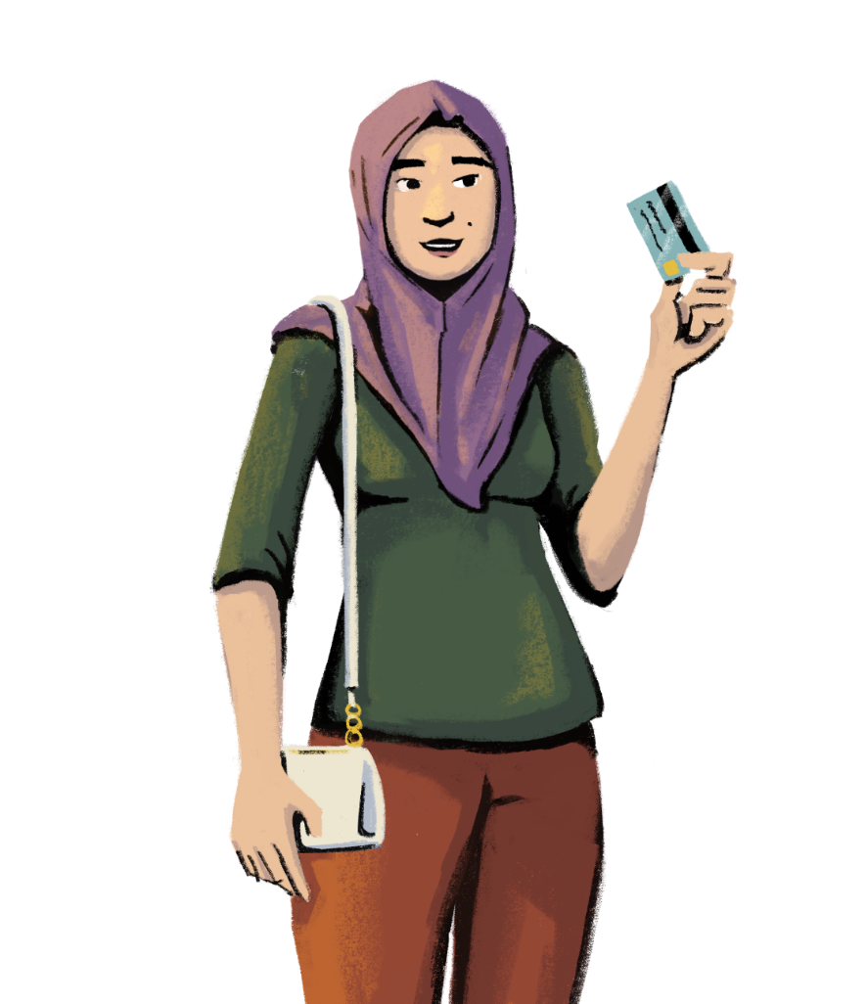
Let’s learn about different forms of credit!
PART 1:
FORMS OF CREDIT
Objectives:
To identify credit options.
To learn the benefits of accessing credit.

Slide 6
Credit is a tool you can use to manage your business finances. There are many types of credit.
Working Capital and Asset Purchase Loans
Digital Loans
Overdraft
Credit Cards

Slide 7
Working Capital and Asset Purchase Loans
Working capital loans are used to fund a business’ daily operations and activities. You can use a working capital loan to cover rent, payroll costs, or debt payments. These loans are not used to buy long-term assets or investments.
Working capital loans are usually short-term loans, and many are used over the span of one year or less.
Asset purchase loans are used to buy or lease assets.
With an asset purchase loan, you can buy long-lasting essentials for your business like machinery, equipment, vehicles, or even acquire property for your shop.

Slide 8
Knowing the Liabilities Associated with Loans
and Repayments
Customization Tip!
Customize the practice examples and currency.
When you take out a loan, you have to pay back the amount you borrowed from the lender plus any additional costs charged by the lender, including interest and fees.
Interest is the price you pay for borrowing the money. Interest is normally expressed as a percentage of the amount you have borrowed. It is usually calculated on an annual or on a monthly basis.
Simple vs. Compound Interest: Loans can have different types of interest. If the loan charges simple interest, you only pay interest on the amount you initially borrowed. With compound interest, you pay interest on the initial amount you borrowed and any unpaid interest.
Example: If you took out a 30-day loan of 100 with an interest rate of 12%, you would pay 12 in interest, in addition to the 100 that you received as a loan. After the 30 days, you would have to pay the lender 112, plus any other fees or charges.
Example: If you took out a loan of 100 with an interest rate of 12% each month for two months, you would owe 112 after the first month. However, in the second month, you would calculate the interest rate on the total amount you owed in the first month, which is 112. So in month two, you would owe 112 + (112 * .12) = 125.44.

Slide 9
Knowing the Liabilities Associated with
Loans and Repayments
Before you take a loan, compare the offers from different financial service providers by considering:
the interest (rate, period, simple vs. compound)
the charges and penalties
If you shop around for the best lender, you could end up getting a better deal with more favorable terms of repayment.
In addition to interest, financial service providers may charge additional fees, such as for loan processing. Before you take out a loan, ask the lender about the total amount you have to pay back over the entire period of the loan and about any additional charges that you may have to pay.
The lender has the responsibility to tell you these terms of the loan. If the lender does not tell you, ask for the terms.
Loans have to be repaid in a timeframe that is specified by the lender. Many loan providers give repayment plans where you do not have to pay back the whole amount at once, but rather in installments.

Slide 10
2. Digital Loans
Digital loans are loans offered through your mobile wallet or from lenders that process your loan through your phone. These loans are easier to get than traditional loans, but can get expensive quickly and make it easy to over borrow.
Digital loans usually have short durations and have to be repaid quickly. Just like with other forms of credit, digital loans may include fees beyond the initial amount borrowed, such as interest and additional charges.
Since digital loans must be repaid quickly, it makes sense to use them when you are short on cash, but you are confident that you will have the money to repay the loan.
Hey Sister Lessons
Lesson 14: How should I evaluate digital loan options?

Slide 11
Digital Credit Providers
Customization Tip!
Add, delete, or modify these providers as necessary.
When determining your eligibility for a digital loan, digital credit providers may look at a number of factors including your credit history, credit score, how often you use your phone to make digital payments, and how often you use mobile phone.
MOBILE WALLET PROVIDERS
Many mobile wallet providers, such as mobile money companies, offer digital loans that you can access through your phone. You will usually need an account with the mobile wallet provider to access a loan.
FINTECHS
Fintechs, short for “financial technology,” are companies that create apps that you can download to access financial services, including digital lending products. You can find a variety of loans that meet different financial needs.
BANKS
Banks can also create apps that provide digital credit. Sometimes these digital credit offerings are only available for customers of the bank, but other times they are accessible to borrowers without a bank account.

Slide 12
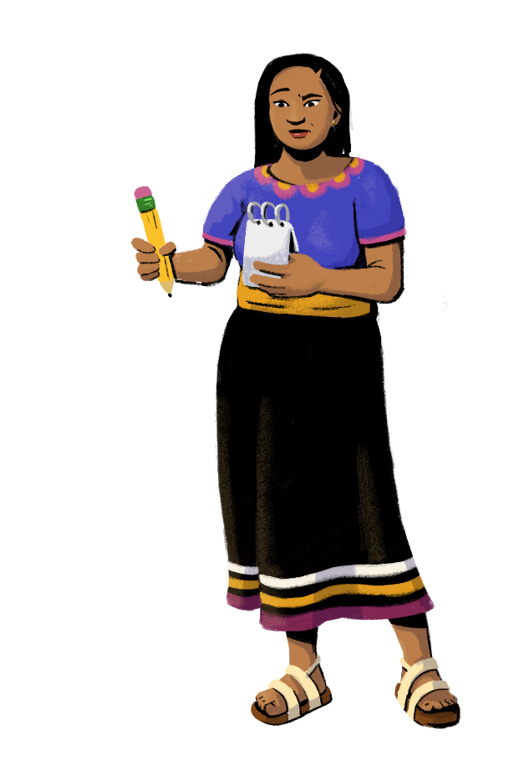
Pros and Cons of Digital Loans
Quicker to get than traditional loans
It’s easy to over borrow
Can be obtained without visiting a financial service provider in person
Fees and interest rates can
get expensive quickly
Maximum lending amount is usually smaller than traditional loans
Good options for customers with limited or no credit histories
Can meet urgent cash needs for emergencies
Not meant for long-term borrowing or finance

Slide 13
3. Overdraft
An overdraft occurs when you don’t have enough money in your account to make a transaction, but the financial service provider lets you make the transaction anyway. Essentially, you get to quickly borrow extra money that you don’t currently have. Overdrafts are meant to take care of emergencies or miscellaneous needs. There is usually a maximum amount that you can overdraft, and you will have to pay interest and fees on the amount you overdraft since it is a type of loan from your financial service provider.
Features of overdrafts:
Overdraft protection is tied to your existing financial account.
Your financial provider sets the terms for the repayment process. It is important to be aware of the overdraft terms before you overdraw your account so that you can be sure to repay the money timely.
You can choose to opt out of overdraft protection. If you try to use your account but don’t have enough money, your transaction will not go through.

Slide 14
Pros and Cons of Overdraft Facility
Helps in managing the cash flow of your business
Higher interest rate
Fulfills urgent cash needs
Additional fees may apply
Interest is paid only on the amount overdrawn
Offered only to account holders
Can be withdrawn at a short notice
Used for short-term borrowing
No collateral required by banks to overdraw
Not suitable for long-term finance

Slide 15
4. Credit Cards
A credit card is a payment card issued by a bank or financial service provider that allows the cardholder to borrow funds to purchase goods and services. When you use a credit card, you accrue a balance each month that must be paid. Depending on the credit card, you may have to pay an annual fee to remain a cardholder.
To get a credit card, you usually need to provide proof of ID, address, and income. Some documents you can provide are your driver’s license, passport, and paychecks. You also need to meet a certain age requirement to get a credit card; usually, you must be at least 18 years old.
Much like how you should have separate personal and business financial accounts, you should also have separate personal and business credit cards. Whereas personal credit cards are used for your household expenses and daily transactions, your business credit card is used specifically for business expenses. Business credit cards often offer unique perks exclusively for businesses, such as higher credit limits.

Slide 16
Credit Card Features
Customized card limit: The credit card limit is the maximum amount you can charge to your card each month. It varies from one cardholder to the next. The limit is decided on by the provider and could be based on your credit history or credit score. Generally, the better the credit score and history, the higher the credit limit.
ATM cash withdrawal: Most credit cards can be used to withdraw cash from ATMs. You may be charged interest and a fee for cash withdrawals, though some providers offer the benefit of no interest on withdrawals.
Discounts and offers: Certain credit cards may come with discounts and offers on different products including accessories, electronics, and clothes. For example, if you use your credit card at a certain store, you may be eligible for a 10% discount on purchases from that store.
Rewards: You can also earn rewards points when you use your card. You can then redeem these points for items like airplane tickets, gifts, or vouchers.
Secure pay: Credit cards are protected using multifactor authentication and in-hand security features. It is a secure means of transacting and reduces the dependency on cash.

Slide 17
Benefits of Credit Products
With the various kinds of credit products available, you can fulfill both short and long-term financial needs to help you grow your business.
Building a credit history is often necessary to access other forms of financial services or make large purchases, such as buying property for your shop or enrolling in an insurance plan.
Remember, all loans have costs. It is important to understand the costs of using the credit product before you decide to use credit rather than your store’s revenue or savings.

Slide 18
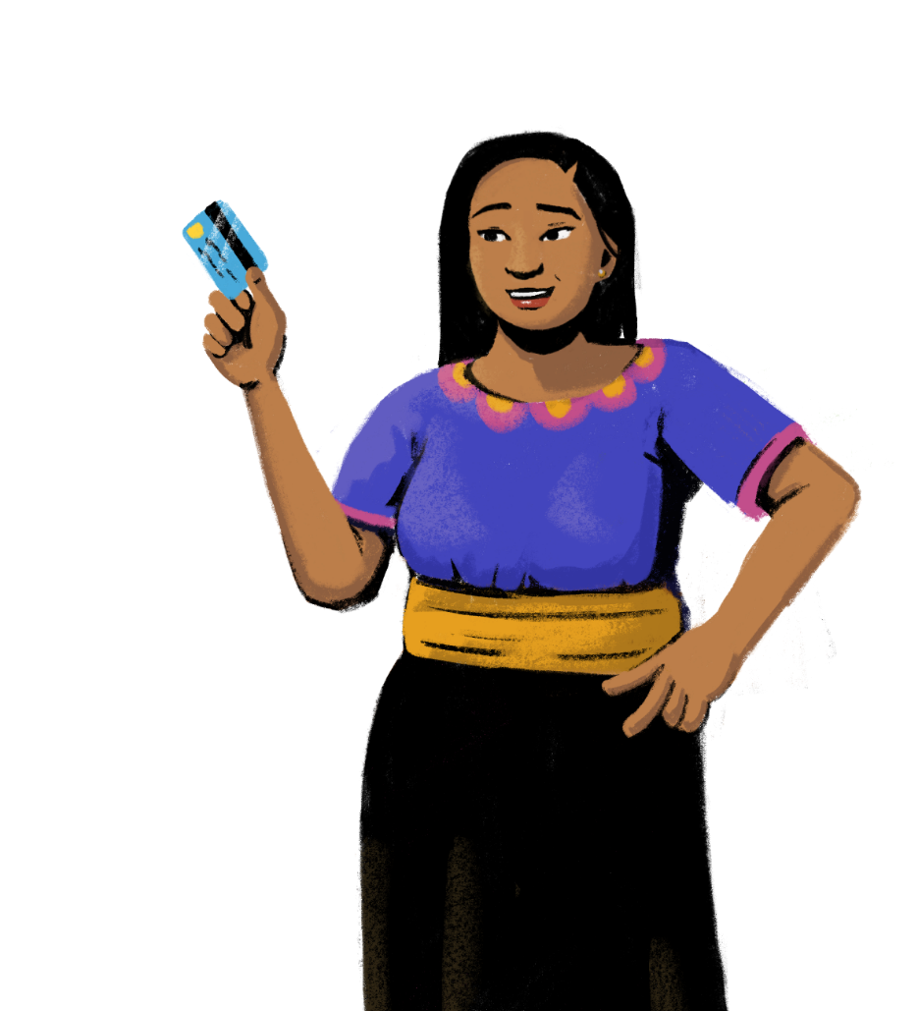
Do you know
how lenders determine creditworthiness?
PART 2:
ASSESSING CREDITWORTHINESS
Objectives:
To understand creditworthiness.
To learn about methods of assessing creditworthiness.

Slide 19
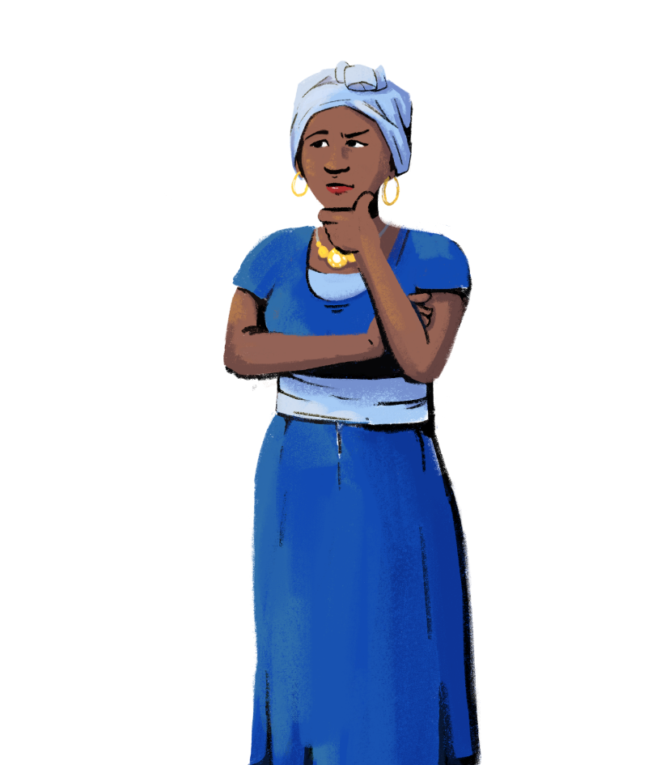
What is Creditworthiness?
“Creditworthiness” is a rating used to measure the risk in giving someone credit.
If a lender is confident that the borrower will repay the loan and fees in a timely manner,
the borrower is deemed “creditworthy.”
Financial service providers use different kinds
of credit ratings to quantify the creditworthiness
of applicants and decide whether the applicant is eligible for credit.

Slide 20
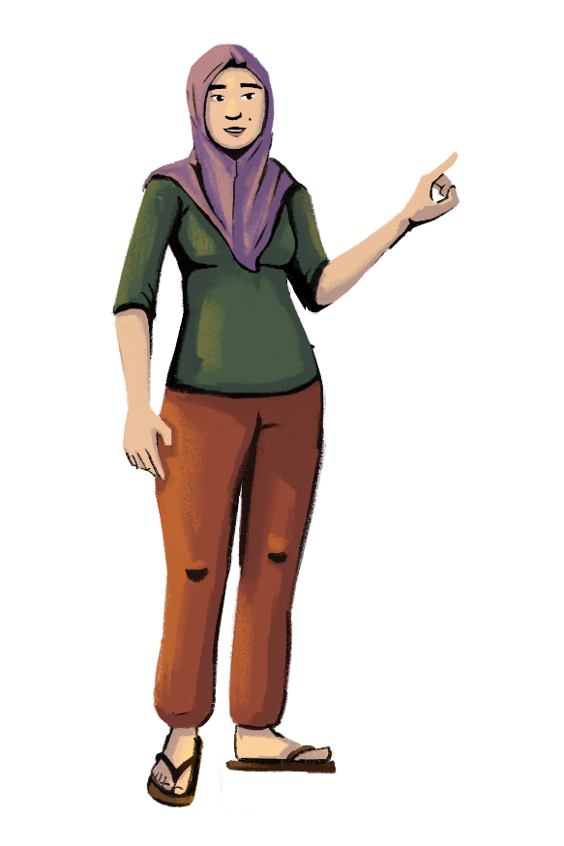
5 C’s of Creditworthiness
The 5 C’s of creditworthiness are how many lenders evaluate credit applicants. Understanding these criteria could help boost your creditworthiness
and qualify you for credit.
Character
The applicant’s credit history
Collateral
An asset that acts as “backup” or security for the loan
Capacity
The applicant’s debt-to-income ratio
Conditions
The purpose of the loan, the amount involved,
and the interest rates
Capital
The amount of money an applicant has

Slide 21
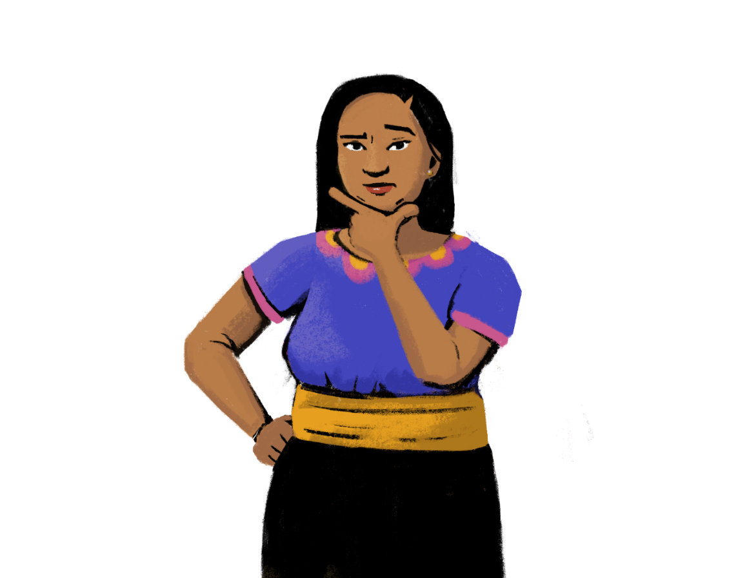
How is creditworthiness calculated, and who does the calculating?

Slide 22
Credit Scores and Credit Bureaus
A credit score is a number that shows your creditworthiness. The higher a credit score, the more creditworthy you are deemed to be by potential lenders. If you have a high credit score, lenders may help you get a loan with a lower interest rate. Your credit score is based on several factors, such as your credit history, the number of open accounts in your name, the amount of debt you have, your credit repayment and transaction history, and more.
A credit bureau is an agency that assigns you a credit score and reports your credit history to lenders. Credit bureaus provide credit reports so you can understand your credit situation better and figure out where you can make improvements. Bureaus will provide information on your credit history, your payment history, and the amount you owe.
Lenders may also have to report to a credit bureau when you miss a payment or if you don’t pay a loan, which can reduce your credit score.

Slide 23
Alternative Credit Data
Credit scores are not the only way to assess your creditworthiness. In fact, there are alternative types of data that lenders can use to determine if you qualify for a loan. This alternative credit data is often used when an applicant does not have a credit history.
Some lenders will use your payment history to assess your creditworthiness. They can look at bill and utility payments, or even your history of paying rent for your store.
Lenders can also look at your employment and income information. If you can demonstrate that you have a stable job and consistent income, your chances of appearing creditworthy are higher.
Your phone can also be a great source of data when determining creditworthiness. Some lenders look at your history of digital payments to assess your creditworthiness. If you open a mobile wallet and start making transactions, you are creating a digital record that can help you meet the standards to qualify for a loan!

Slide 24
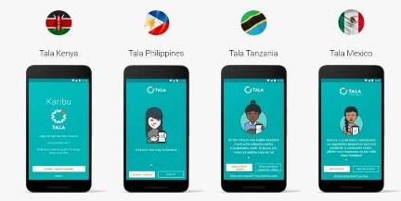
Alternative Credit Data Product Examples
Customization Tip!
Consider adding or deleting examples to be relevant to your market.
M-Shwari in Kenya
M-Shwari is a savings and loan service for users of M-PESA, which is a mobile money service from Safaricom, a mobile network operator. M-Shwari determines creditworthiness using alternative credit data.
To qualify for a loan, you must:
be an M-PESA subscriber for at least six months;
save on M-Shwari;
actively use other services, such as voice, data, or mobile money.
Tala in Mexico, Kenya, India, and the Philippines
Tala is a digital loan app. To determine your credit score, the app analyzes your mobile data use, your mobile bill payment history, how you interact with the app, and more. All you need is an ID to apply for a loan.
Remember — these digital loans are often short-term loans and should not be used for long-term finances.

Slide 25
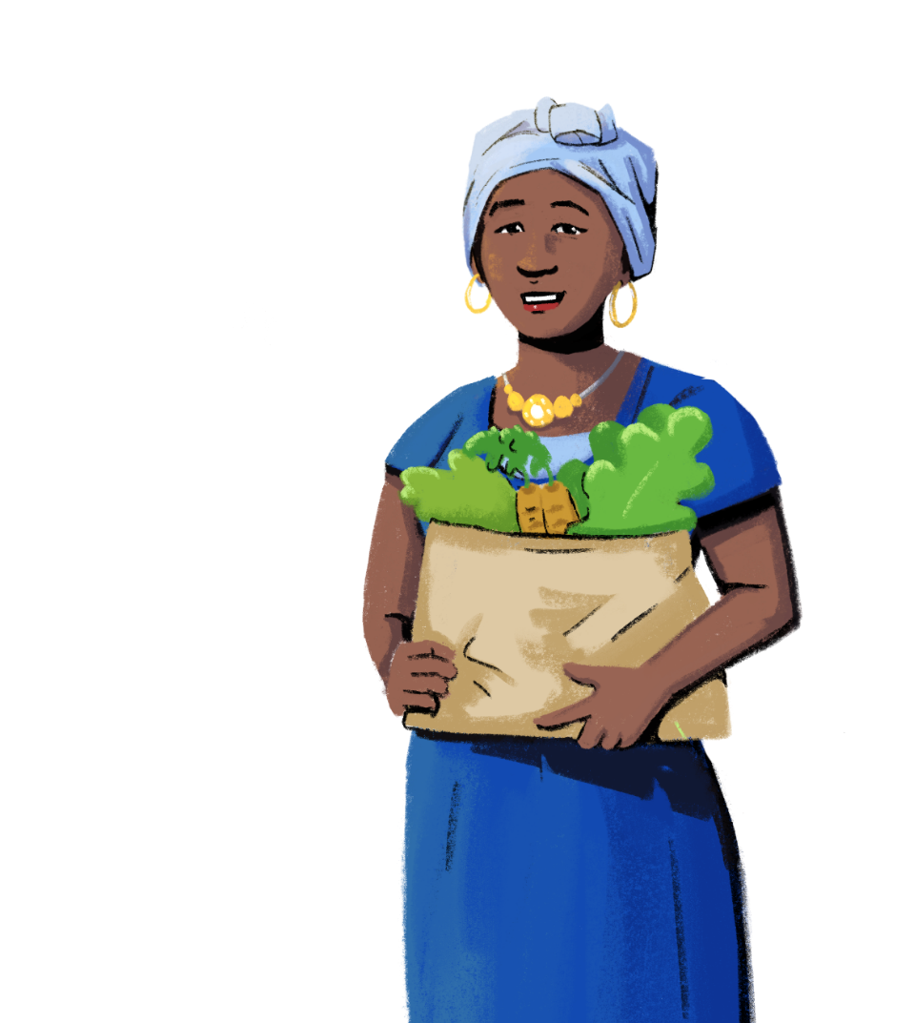
What are some places you can go to get a loan?
PART 3:
WHERE AND HOW TO GET
A LOAN
Objectives:
To learn where you can get a loan.
To understand how to get a loan.

Slide 26
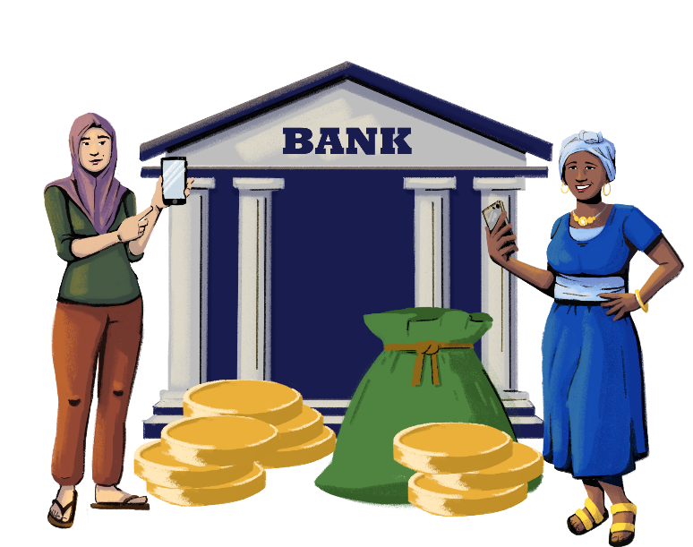
Where to Get a Loan
Customization Tip!
Add, delete, or modify these providers as necessary.
Banks: You can visit your bank’s website or go to a branch to learn more about the types of loans offered. Some banks may also let you apply online or by using your phone.
Micro-Finance Institutions (MFIs): MFIs offer microcredit and other financial services such as insurance and remittances. MFIs also provide non-financial services like individual counselling, training, and support for micro-enterprises.
Credit Unions: A credit union is a type of financial institution that is owned by the people who use the products and services. Credit union members can access many services like loans and deposit accounts.
Non-Banking Financial Companies (NBFCs): NBFCs are financial institutions that do not have a full banking license or are not regulated, but can still provide some financial services, like loan disbursement. Examples of NBFCs include insurance firms, pawn shops, and currency exchangers.

Slide 27
How to Get a Loan
Customization Tip!
Consider modifying these steps to be reflective of a loan provider or loan product in your market.
When getting a loan, you will have to meet certain requirements and standards set by the lender.
These standards are how the lender assesses your identity and creditworthiness.
You will have to provide several documents, such as your passport, ID, proof of income, and business registration.
Once you have all these documents, you can fill out the loan application with your provider. Sometimes, you can even fill out the application online or on your phone.
Be sure to read the terms of the loan agreement carefully before signing any documents!

Slide 28
LEARNING RESOURCE
Loans with Hey Sister and Oye Amiga
Hey Sister Lessons
Lesson 13: What should I consider in taking out a loan?
Oye Amiga Lessons
Lesson 11: What should I consider in taking out a loan?

Slide 29
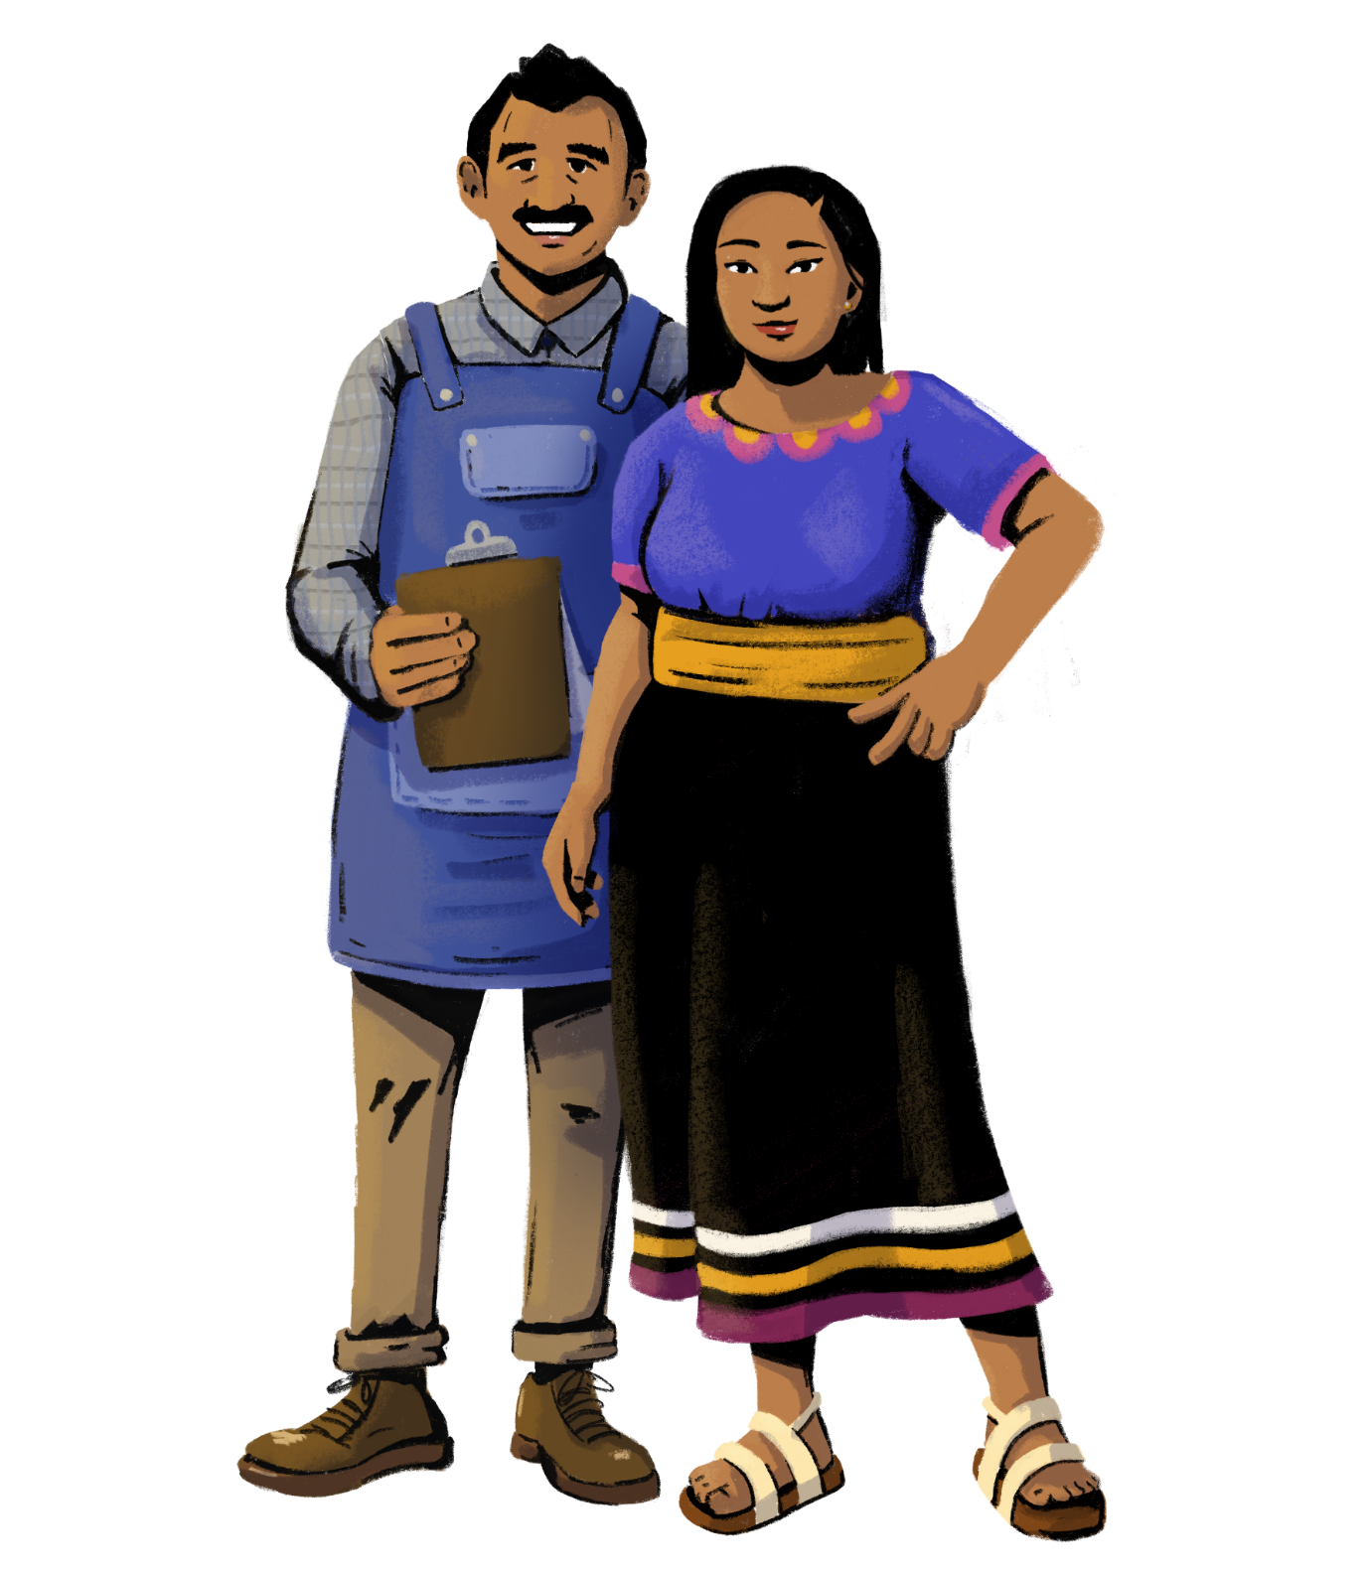
Let’s identify best practices for managing your credit!
PART 4:
MANAGING CREDIT
Objective: To learn tips and tricks on
how to repay loans and credit card
statements on time.

Slide 30
The Billing and Repayment Cycles
Understanding your loan’s billing and repayment cycle can help you make strategic decisions on how to budget for your upcoming payments.
The billing cycle is the time between payments.
Billing cycles may vary in length depending on the product or service. Typically, billing cycles last between 20 and 45 days.
The repayment cycle is your payments schedule. Repayment includes the amounts borrowed and interest.
Managing your billing and repayment cycle is important. If you fail to comply, you could incur more fees, damage your credit, or be taken to court.

Slide 31
Do’s of Managing Credit
Know when your payments are due.
Check your billing statements every month.
Read the terms and conditions of the loan.
Make consistent repayments.
Collect reward
points.
Track your
credit score.
Set a plan to pay
your debts.
Ask for help from a financial advisor
when needed.

Slide 32
Dont’s of Managing Credit
Don’t take out more credit than you can afford to pay back.
Don’t pay your
bills late.
Don’t substitute
credit for income.
Don’t use digital loans for long-term finances.
Don’t reach your credit card’s maximum limit.
Don’t share your
credit card number
over the phone.
Don’t sign documents without reading
them first.
Don’t take out loans
for consumer products.

Slide 33
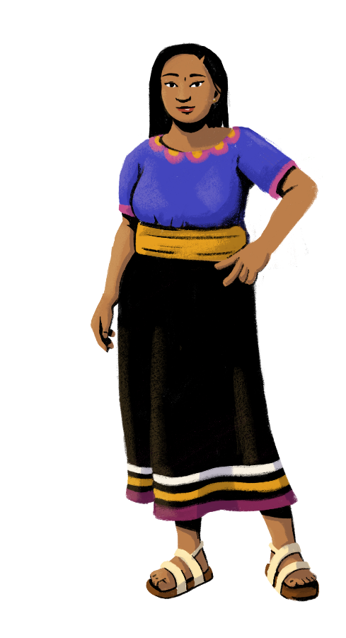
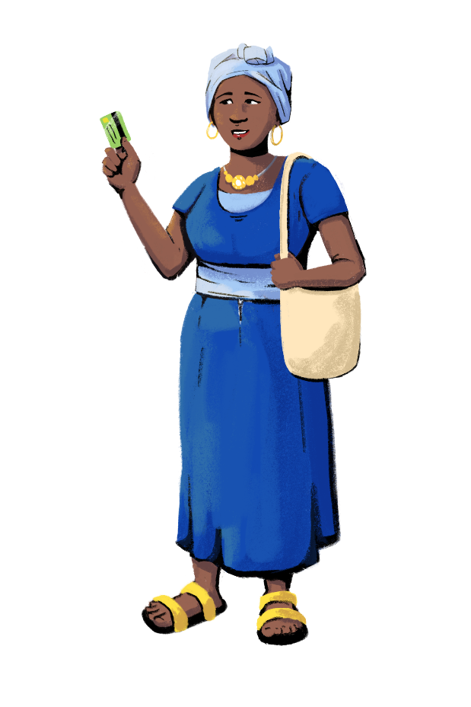
Let’s Recap!
So far,
you have learned:
Types of credit
How lenders assess creditworthiness
Where and how
to get credit
How to manage your credit

Slide 34
Share your doubts and questions!
Did you find the
session useful?

Slide 35
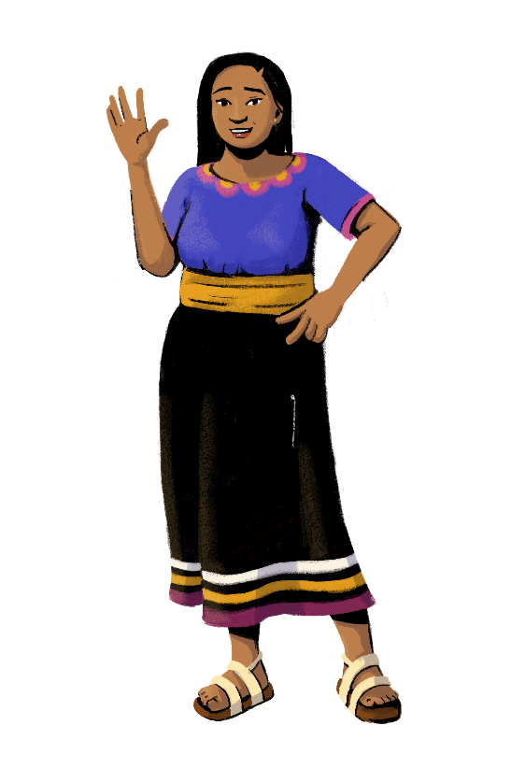
www.siaedge.com
Line Two
Line Three

