Slide 1
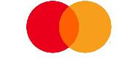
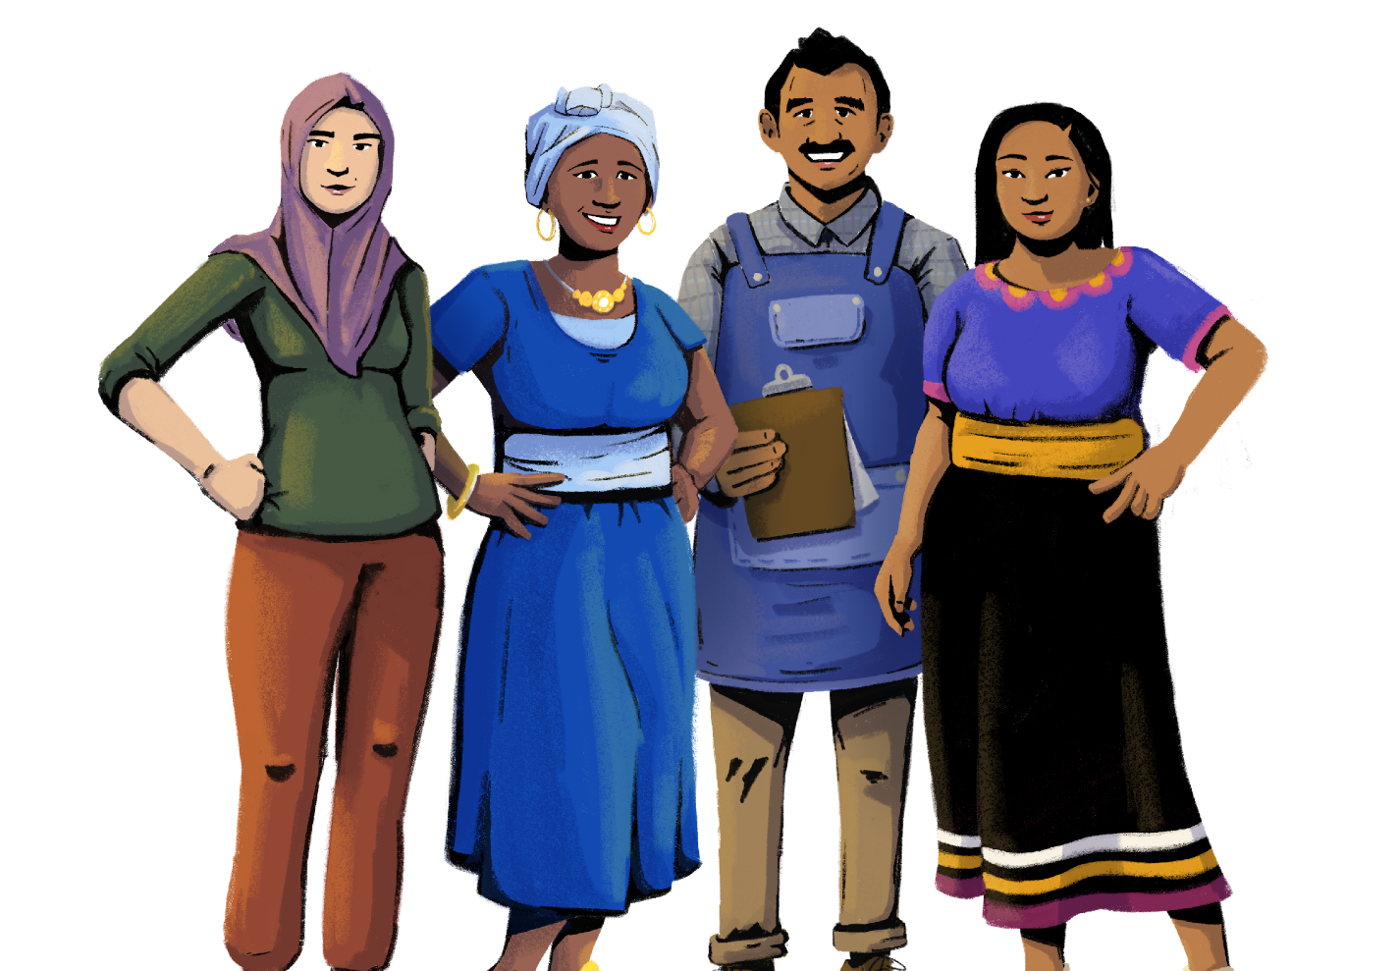
Business Promotion
Her Business, Her Future
Business Management and
Digital Literacy for Women
Micro-Entrepreneurs
This module is made possible by the generous support of the American people through the United States Agency for International Development (USAID). This guide was produced under DAI’s Digital Frontiers Project (Cooperative Agreement AID-OAA-A-17-00033) at the request of USAID and in partnership with Mastercard. The contents are the responsibility of XYZ and do not necessarily reflect the views of USAID or the United States Government.

Slide 2
Tips for Customizing This Module
The following list provides helpful tips for customizing the content in this module. You can click the slide numbers to be brought directly to that slide. Each slide with customizable elements includes arrows, text boxes, or highlighted phrases to indicate customizable sections and words.
Topics: This module is broken down into several topics as described in the table of contents. You can delete the topics that are not relevant to you and your group. You can also delete any slide throughout the module that does not apply to you or your group. Additionally, all text in this module is directly editable.
Characters: This module uses a mix of characters from different regions. You can replace any of the characters using the character image files from the creative asset library.
Discussion Questions: Slides 23, 30, 32, 36, and 46 contain questions for discussion. You can add, edit, or replace the questions as needed.
Scenarios: Slides 4, 7, 10, and 14 contain “scenarios” that are meant to get your group thinking about the material. You can modify these scenarios to be relevant to your group where needed.
Mobile Wallet Terminology: The terms “mobile wallet” and “mobile money” are used on slide 28. You can replace these terms with a term that resonates best with you and your audience - such as mobile money account, digital wallet, etc.
Digital Marketplaces: Slide 34 gives three examples of digital marketplaces. You can delete or add examples depending on your context, as well as adapt the general instructions on how to use a digital marketplace on slide 35 to be reflective of a digital marketplace of your choice.
Google Maps Business Profiles: Slide 37 gives instructions on how to set up a business profile on Google Maps. You can replace the icons and sketches with pictures of businesses on Google Maps in your locality.
WhatsApp Business: Slide 38 describes how to set up a WhatsApp Business account. You can modify the instructions to better reflect the skills of your group, such as adding how to perform different tasks in your WhatsApp Business account.

Slide 3
Module Overview
Table of Contents
Objectives
Part 1: Know your customers | 6
Part 2: Upsell and cross-sell | 13
Part 3: Strategize product placement | 20
Part 4: Diversify your business | 27
Part 5: Use digital marketplaces | 31
Learn ways to grow and promote your business.
Build successful customer engagement strategies.
Identify ways to diversify your business.
Become familiar with digital marketplaces.
In this module, you can…
identify tips & tricks for promoting your products
learn how to add or claim your business on Google Maps
practice using WhatsApp Business
build a digital presence for your business

Slide 4
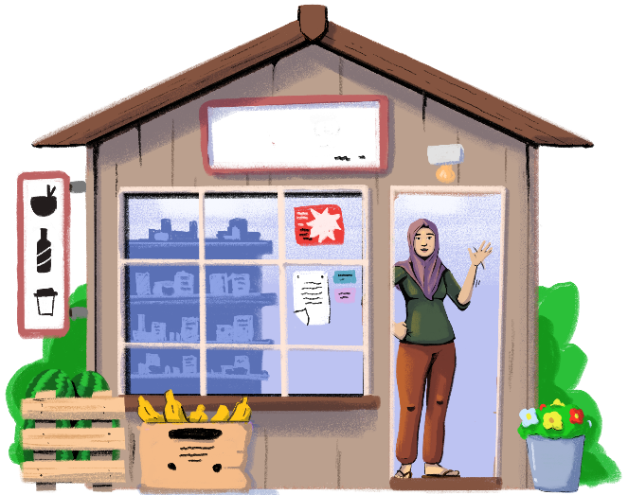
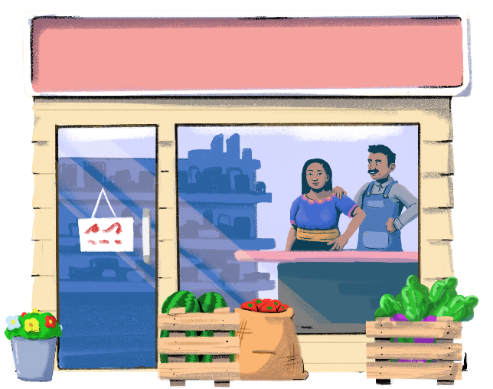
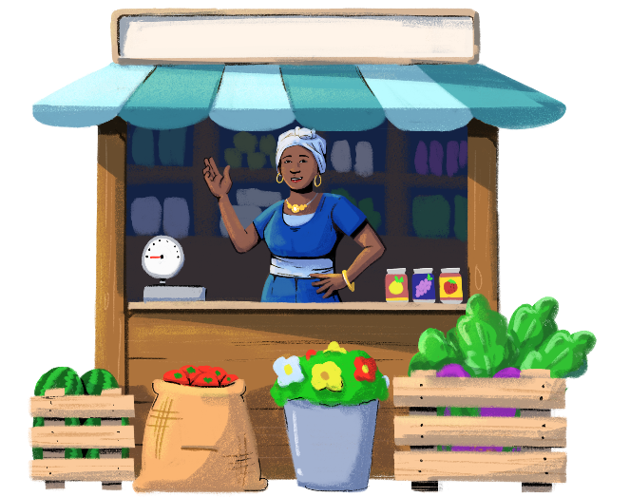
Other than your store, there are two other stores on your street. All three shops sell similar products.
How do you get customers to shop at your store?
What strategies can you use to increase sales, promote your business, and earn more profits?
Picture this!

Slide 5
How to Attract Customers to Your Store
Shops provide a variety of products and cater to a range of customers with different needs.
In order to be successful and get customers to shop at your store, you must have a plan to give you a competitive edge.
You must adopt certain principles to help grow and promote your shop:
Know Your Customers
Diversify Your
Store
Upsell and
Cross-Sell
Use Digital
Marketplaces
Strategize
Product Placement

Slide 6
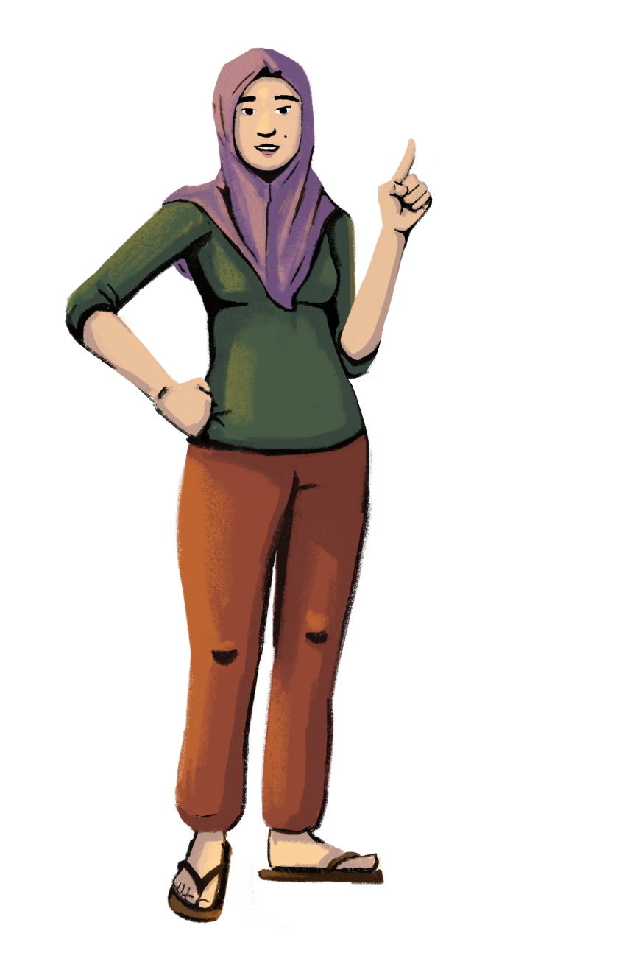
Are you ready?
PART 1:
KNOW YOUR CUSTOMERS
Objective: To learn how to
personalize your business approach.

Slide 7
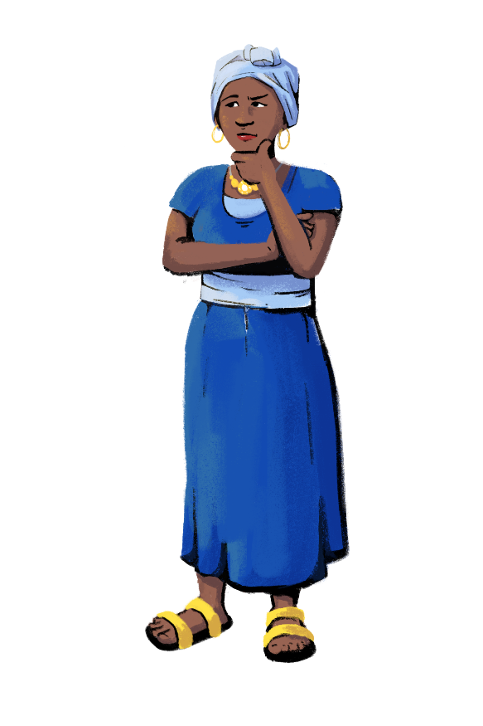
Customization Tip!
Add, delete, or modify questions as necessary. You can also modify the scenario.
Engage With Customers
Imagine walking into a store to buy a packet of biscuits. The store owner is very rude and does not pay attention to you.
Customer engagement is key to
earning higher sales.
Talk to your customers nicely and respectfully, no matter their age. Do not keep them waiting, and give them a unique experience so that they prefer to come to your shop.
A one-to-one conversation with you can give customers a positive experience.
Keep the customer’s best interest in mind, and offer the best or most suitable products at competitive prices.
Offer discounts on various products to help attract customers.
How would
you feel?
Would you
go to the
store again?

Slide 8
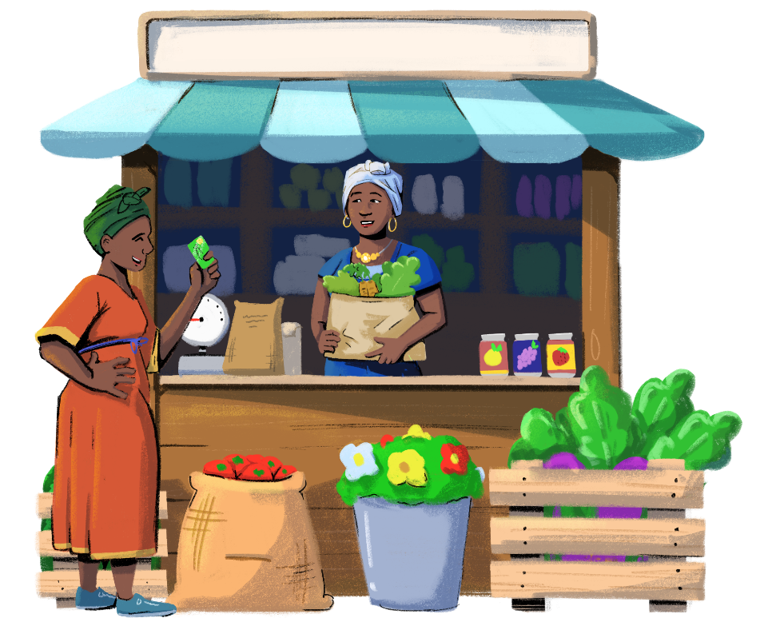
Understand Customer Preference
Business owners must understand the preferences of their customers.
If you understand customer preferences, you will retain customers better and build a loyal customer base.
For instance, know the kind of shampoo they often purchase or the kind of soap they prefer.
If the customer doesn’t know the brands you carry in your store, you can suggest a product based on their prior purchases.
When you show interest in customers’ choices and preferences, they will be more inclined to visit your shop.

Slide 9
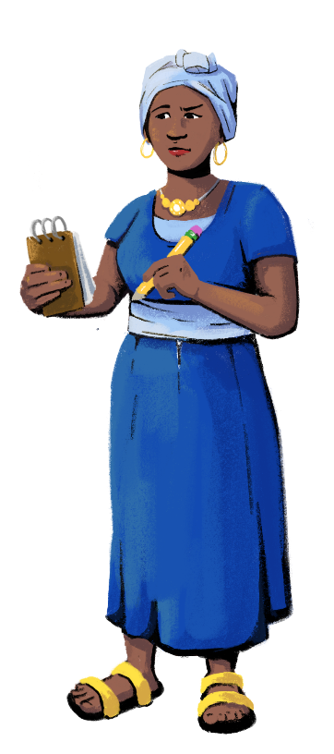
Improve Customer Service
A happy customer is
likely to refer the shop
to their family or friends, which will help to
increase your customer base.
Take remote orders from customers who call, SMS, or communicate with WhatsApp.
Deliver products to customers’ houses.
Ask customers to return products if they are defective, and offer them a refund, a discount, or store credit.
Get customer feedback on new products.
Have special discounts or sales on holidays.
Pass on discounts received from wholesalers to the customers, and place colorful signs to communicate discounts.
Consider hiring someone to open the shop at a time or day when other shops remain closed. For instance, open the shop at 8 AM if others open at 9:30 AM.

Slide 10
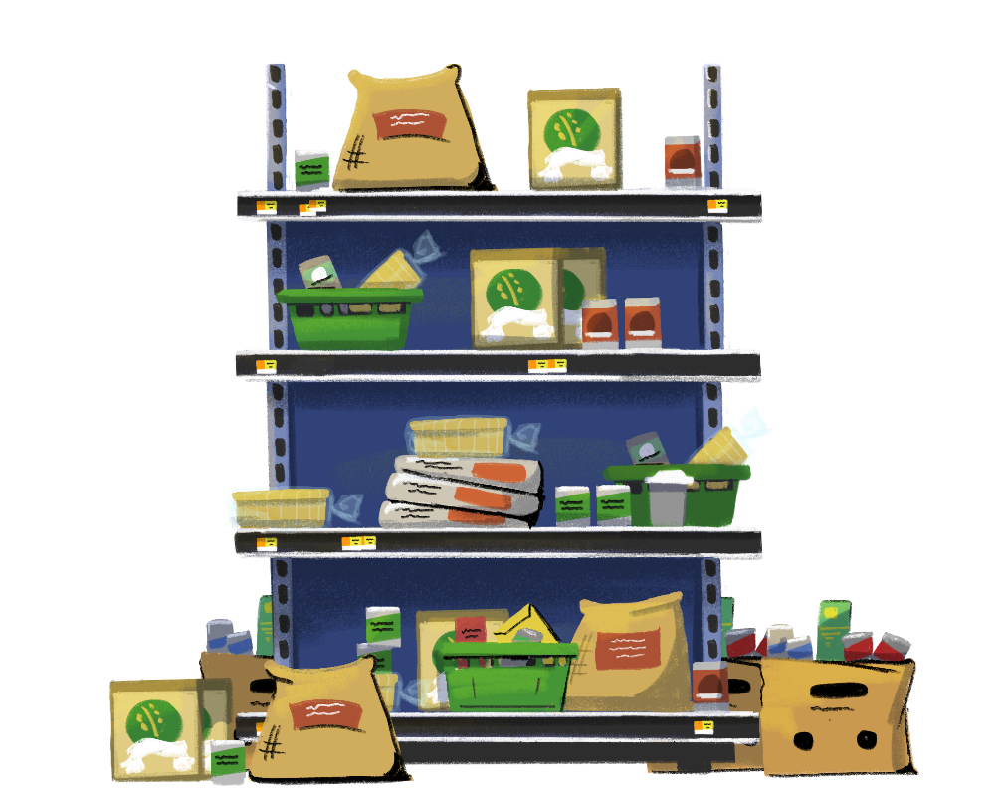
Provide A Positive Customer Experience
Customization Tip!
Add, delete, or modify questions as necessary. You can also modify the scenario.
Imagine you walked into a store to purchase ingredients for a recipe. As you stand in the store, you begin to notice that it is not clean, there are spills on the floor, there seems to be a rotten odor, and many of the products are covered in dust.
Would you purchase the ingredients for your recipe from the store? Why or why not?

Slide 11
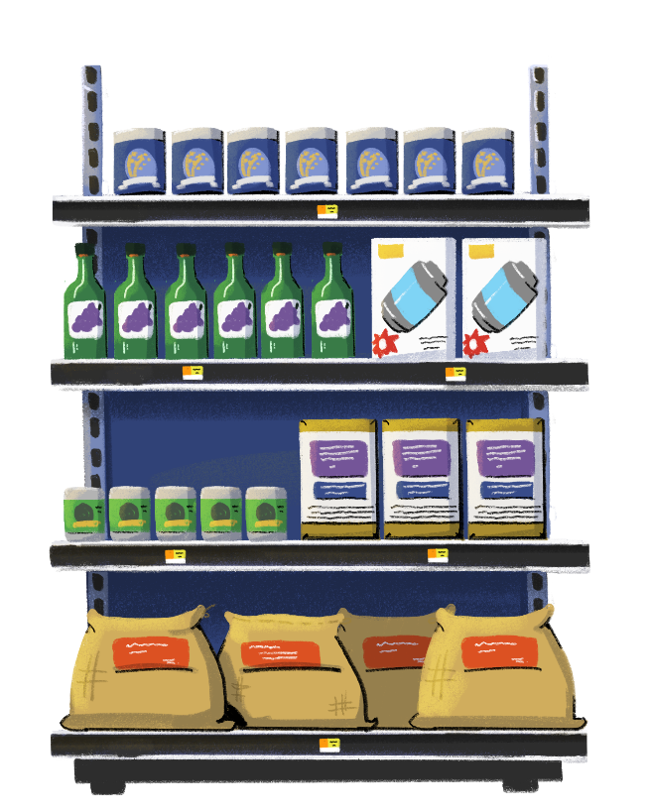
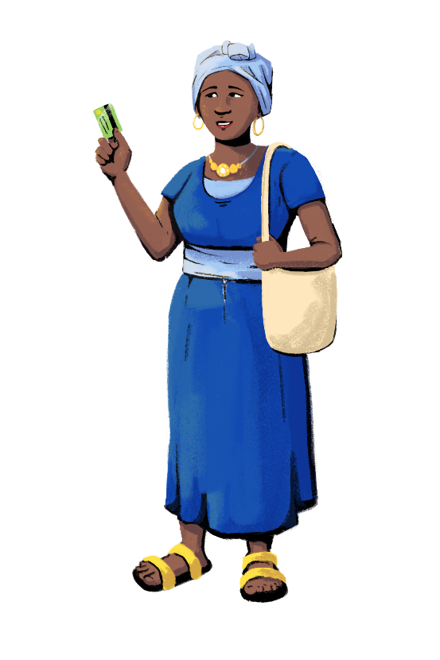
That last store’s appearance and overall experience certainly doesn’t say, “Purchase our fresh and delicious produce and food items!” Instead, it says, “Never come to this store. Our products are bad!”
The appearance of your store directly affects the customer’s overall experience.
Their experience dictates whether they will make a purchase.
Keep your store neat, tidy and beautiful, and watch as your sales continue to grow!
A negative shopping experience might not translate into a sale for your store.
On the other hand, this store’s appearance is inviting! The shelves are neat and tidy, and it appears to be much cleaner than the other store. Would you be inclined to shop here?

Slide 12
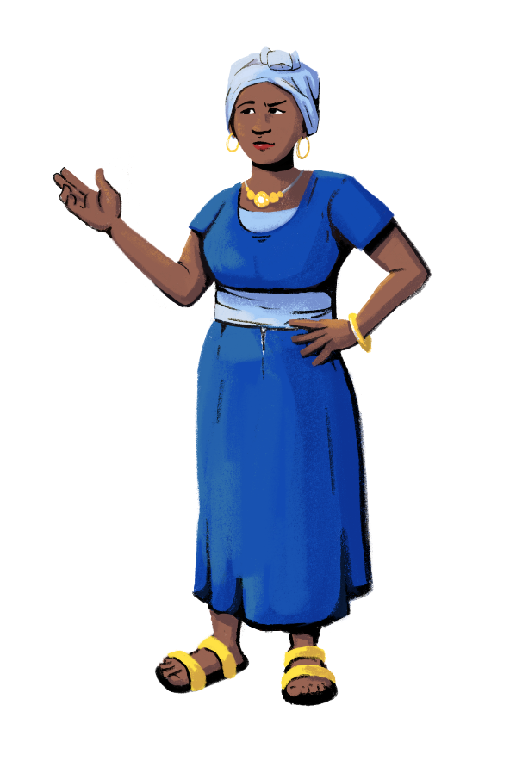
Ask For Your Customers’ Feedback
Your customers can provide you with valuable information on how to improve your customer service and business. Consider developing a way to regularly collect feedback from your customers, so that you can see what they like or dislike about your store.
Your method should be direct and simple, so that customers will have time to give you responses. You can even create incentives to get customers to provide feedback, like entering them in a raffle for a store coupon.
There are several ways to get feedback from your customers:
In your store, you can install a box for suggestions and provide paper surveys.
If you have the email addresses of your customers, you can send out email surveys. You can also post the survey to your online marketplace or website, and read comments on your store’s Facebook or social media page, if you have one.

Slide 13
Let’s get started!
PART 2:
UPSELL AND CROSS-SELL
Objective: To explore strategies for
increasing sales.

Slide 14
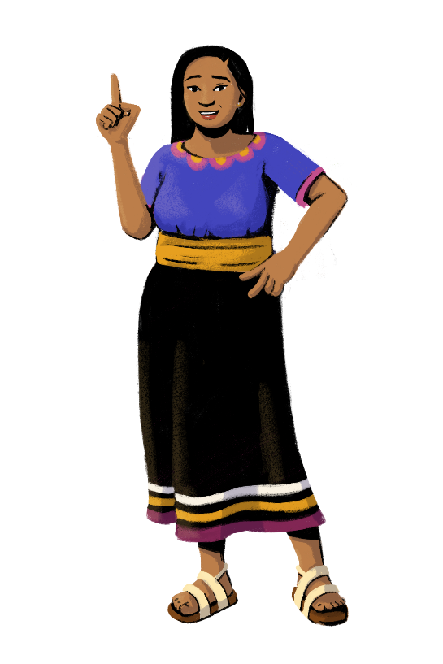
Customization Tip!
Add, delete, or modify questions as necessary. You can also modify the scenario.
Upsell And Cross-Sell A Product
Imagine this scenario…
You are about to close a sale, and the shopper has decided to buy a product. What do you do?
Do you try to find opportunities to encourage her to increase her purchases?
Do you ring up her products and send her
on her way?
OR

Slide 15
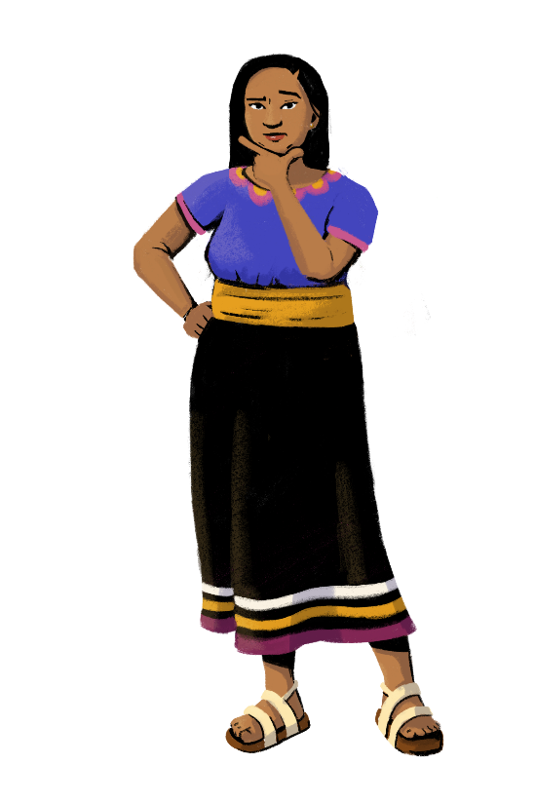
We Can Use Two Strategies To Increase
Individual Customer Sales And Your Sales
Upselling means offering a pricier version or a higher quality version of the item. Think of it as asking shoppers if they want to upgrade their purchase.
Cross-selling means recommending a product relevant to the one that’s already in their basket. An example would be recommending a conditioner to customers buying shampoo.
If you use these strategies at the right time, your sales can increase!
UPSELL
CROSS-SELL

Slide 16
Ask Yourself These Three Questions Before You Try To Upsell Or Cross-Sell A Product
1
Does the product compliment the item that the customer is buying?
Upsells and cross-sells only work when they’re relevant to the original purchase. When you’re upselling or cross-selling an item, make sure that it’s either: a) a better version of what they’re buying, or b) a product that goes with their purchase.
2
Are they open to spending more?
If the customer has made it clear that she is on a budget, or only after one product, then respect her wishes and don’t try to sell her anything else.
3
Will this product really benefit them?
Sometimes, an add-on item may complement another product, but it won’t benefit the customer. For example, while a certain type of moisturizer may go with the face wash your customer just bought, it wouldn’t be a good cross-sell if they don’t have a need for it.

Slide 17
If The Answer Is “Yes” To All Three Questions, Then You Can Proceed To Suggest Upgrades Or Additional Products
Make customers see and visualize the value or benefit that they’re getting. Follow the “Rule of 3.”
Give the shopper three options for their purchase:
Show them the product they requested.
Show an alternative - something that still relates to the requested item, but maybe at a more mid-price point.
Show the dream - something that the customer might love, but that may have a higher price point.

Slide 18
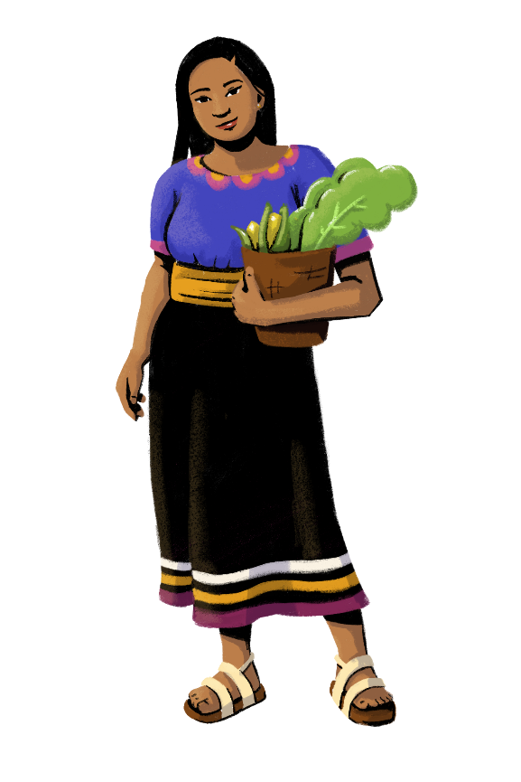
Be reasonable. The suggested item shouldn’t exceed more than a certain percentage of the cost of the original item.
If a customer buys an expensive bottle of shampoo, it makes sense to suggest a cheaper bottle of conditioner; but if a customer buys a cheap conditioner, don’t try to sell her an expensive shampoo.
Add rewards, incentives, or discounts to added purchases.
You can motivate your customers to buy additional products that you’re suggesting by proposing a discount on the bundled products. For example, if a customer buys shampoo and the conditioner you suggest together, she gets a 10% discount on the product bundle. But if she doesn’t buy the conditioner, she pays the regular price for the shampoo.

Slide 19
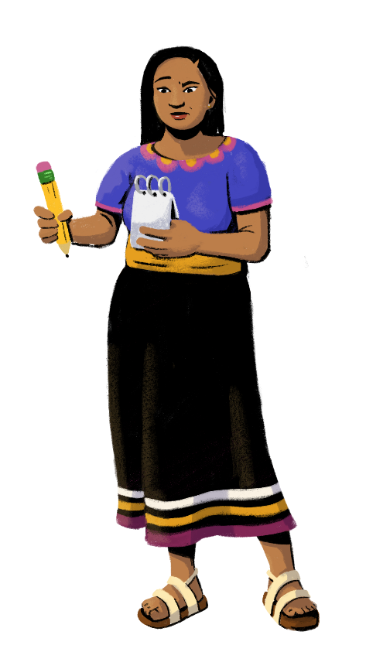
Key Takeaways
Know your products:
Be aware of the products that go well together, so you can pitch them to customers when cross-selling.
Keep in mind the products you could recommend as alternatives or as the “dream” products if you want to upsell.
Know your customers:
Try to understand your customers’ budget and motivations behind buying certain products. This will help you match their needs when you suggest new products to them.
Be innovative:
Introduce several methods that can help you upsell and cross-sell your products. These can be trying new product placements or adding incentives.
Keep it simple:
Don’t overwhelm your customers with too many choices and options. This could discourage your customers from buying your suggested products.

Slide 20
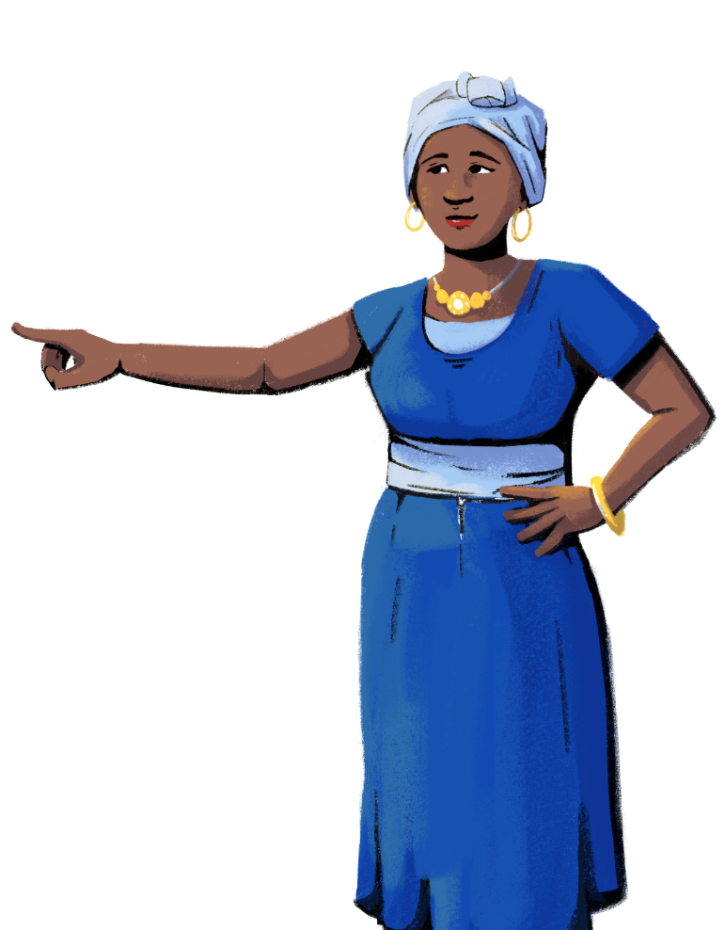
Let’s learn how to arrange your store and products in a strategic way to maximize your profits and increase sales!
PART 3:
STRATEGIZE PRODUCT PLACEMENT
Objective: To understand how to
place products in ways that
encourage sales.

Slide 21
Front Of Store Placement
Keeping popular items or items that are sold quickly in the front of the store makes them easily accessible to customers, leading to fast purchases of these products!

Slide 22
Eye Level Placement
Eye level placement of products is a great method to increase sales. A product will sell significantly more if it is at the eye level of the customers.
A higher value product is often placed on the middle shelf so that people are more likely to see and buy it. This section can also be used for products that are new in the market.
Those looking for value range products will usually find them down at knee level.
Larger items that may be hard to lift, like bags of rice, should be placed lower so that customers don’t have to reach for them.

Slide 23
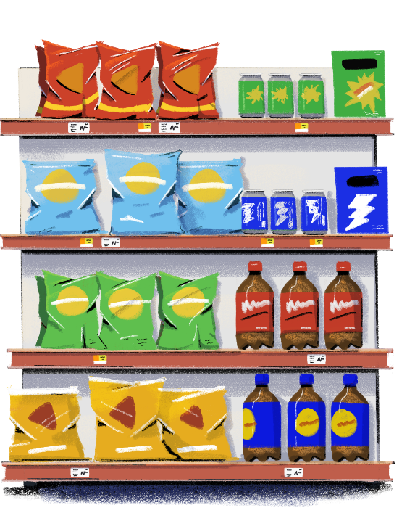
Customization Tip!
Add questions or modify this question as needed.
Side By Side Placement
Can you think of other products that should be placed next to each other?
Some products are placed next to others deliberately.
You’ll often find chips and soft drinks very close, because the purchase of one leads to an increase in sales of the other.
By placing items close to each other, you are suggesting products that complement each other, which is a good way to cross-sell your products.

Slide 24
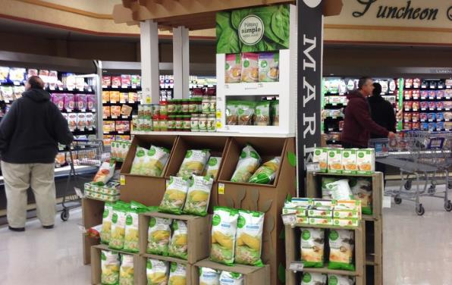
Premium Product Placement
Premium products have subtly different surroundings than everyday products.
Expensive and specialty ingredients are often on differently-colored display units than everyday ingredients.
The location and way in which a product is placed in the store can encourage shoppers to feel like they are making a special purchase!

Slide 25
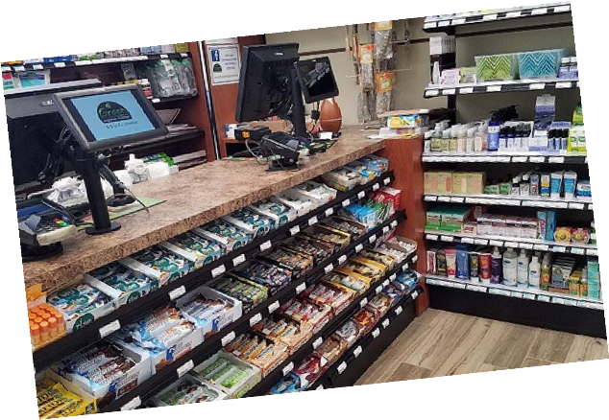
Counter Placement
Stores can place products that shoppers will find most appealing at the counter. Deciding which products to promote can be dependent on the weather or price of the items.
For instance, place cheaper, fast-selling products that do not require the customer to consider the price, such as chewing gum or candy bars, on the counter. On rainy days, place umbrellas at the counter, and on bright sunny days, set out sunglasses.
As the customer stands at the counter to pay the bill, there is usually a selection of sweets, magazines, and easy-to-handle products and literature that grab their attention.

Slide 26
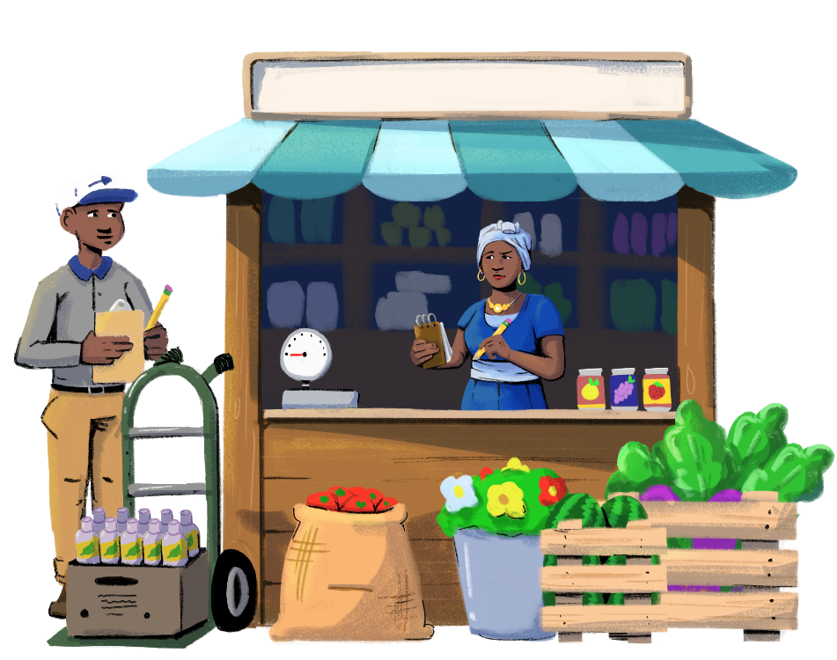
Introduce Innovative Concepts
You can sell products that are close to their expiry date at a discounted price. Similarly, you can propose daily discounts on fresh products that have short shelf lives, such as bread. These discounts can boost the sale of these products towards the end of the day.
Samples of products can be placed at the front of the store or at a convenient place that will grab the attention of the customers.
You can also coordinate with suppliers or brands to organize sale festivals. For this strategy, you need to build relationships with suppliers and wholesalers to get better deals on products.

Slide 27
Let’s explore how you can diversify your products and services!
PART 4:
DIVERSIFY YOUR BUSINESS
Objective: To understand why
offering more products and services
could help your business grow.

Slide 28
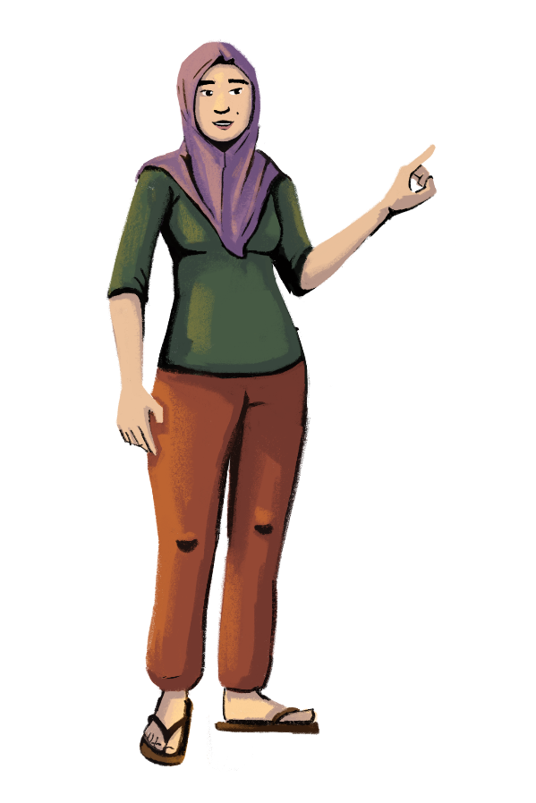
What Is Diversification?
Diversification is when a business adds new products to their stock or offers new services.
Diversifying your business can increase your sales and profits, as you will attract a larger number of customers with different needs and wants. Customers are also more likely to choose your business if they can buy most of the products they need at your store, as this saves them the trouble of visiting multiple stores to buy their items.
Some methods you can use to diversify your business are:
adding new products, or expanding your range of existing products.
offering new services, such delivering purchases to customers or offering curbside pickup.
registering your shop to offer mobile wallet or mobile money services.

Slide 29
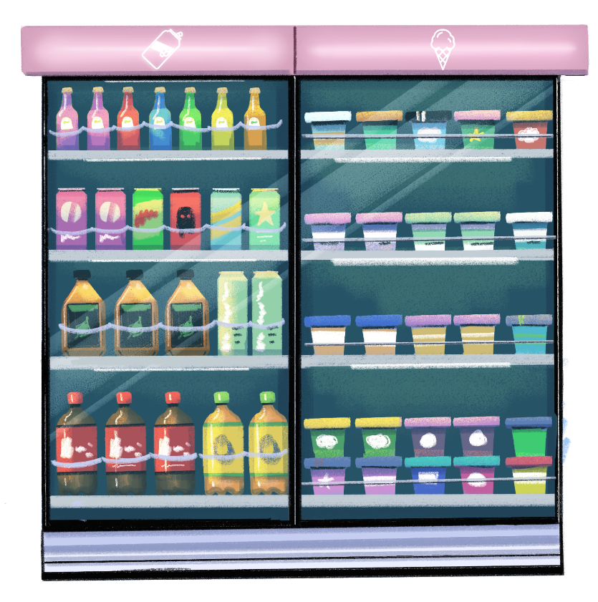
Product Diversification
Before adding any extra products, you can carry out a small survey with your customers to get an idea of their needs, wants, and preferences.
With this activity, you are engaging your customers and suggesting to them that you value their opinion.
When you are looking to diversify your product offerings, you can consider making investments for growth. For instance, you can buy a fridge if your customers indicate that they want to buy cold drinks and ice cream. A fridge would be a worthwhile investment since the products are in demand, and you should see an increase in sales of those items.

Slide 30
Let’s
discuss!
Customization Tip!
Add, delete, or modify
questions as necessary.
How have you diversified your business?
Can you think
of any other ways to diversify your business?
What are some more benefits of business diversification?

Slide 31
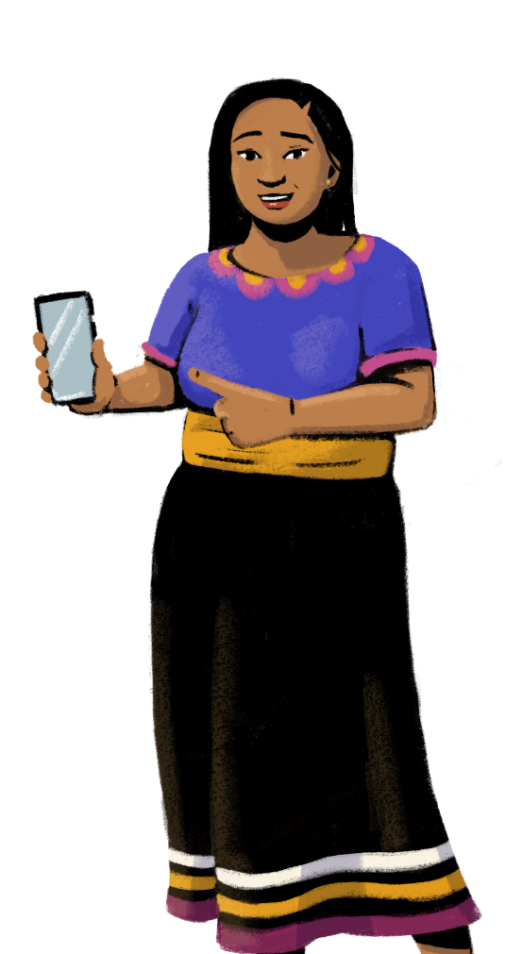
Are you
ready to learn
about digital marketplaces?
PART 5:
USE DIGITAL MARKETPLACES
Objectives:
To learn about the digital opportunities for marketing and commerce.
To identify strategies for competing with large e-commerce platforms.

Slide 32
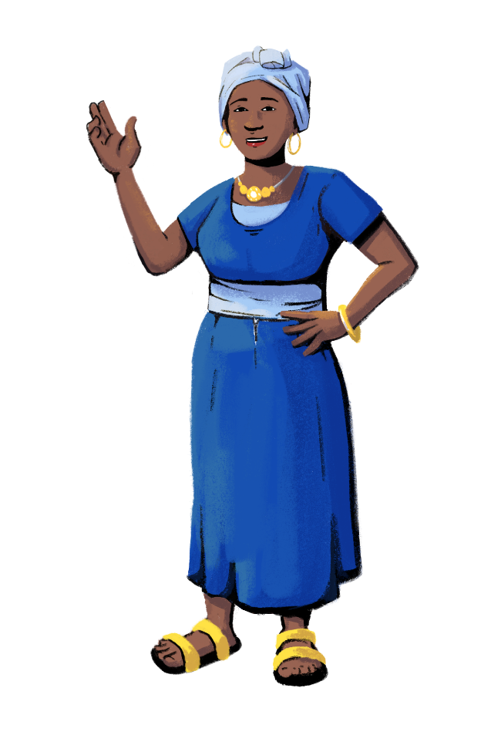
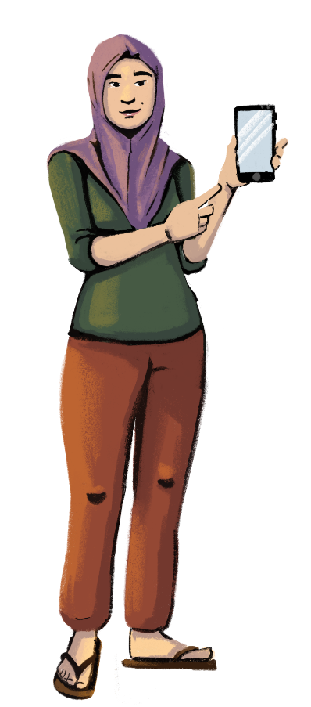
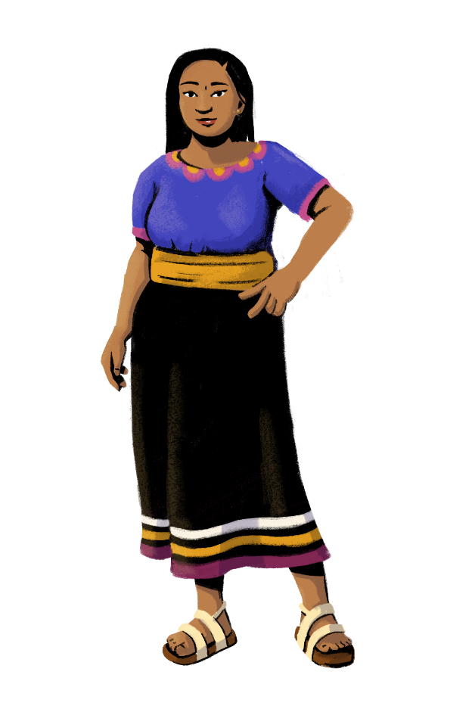
Let’s
discuss!
What digital marketplaces are you familiar with?
Customization Tip!
Add, delete, or modify
questions as necessary.
Does anyone have a social media page for their business?
Can anyone think of any benefits of using digital marketplaces?

Slide 33
Digital Marketplaces
Digital marketplaces can be a powerful tool for your business. These marketplaces connect you to your customers through an online platform where you can advertise your products. Your customers can also browse your products, order them, and sometimes even get them delivered to their doorstep.
You can capture customers who otherwise wouldn’t have time to come to your business, or wouldn’t be able to due to other circumstances.
Going online gives you a competitive edge against other businesses that don’t have an online presence.
Having an online presence will make your business less vulnerable to unforeseen circumstances, like natural disasters or pandemics, where you might not be able to physically be in your store.
Digital marketplaces can come in various formats. Some are available as apps, and some are websites. You can usually use either your smartphone, tablet, or computer to access these platforms.

Slide 34
Customization Tip!
Click on the name of each marketplace to access their website. You can delete or replace marketplaces to best fit your market context.
Examples of Digital Marketplaces
Jumia
Lazada
Mercado Libre
REGION | Africa | Southeast Asia | Latin America
DESCRIPTION | Jumia is a popular digital marketplace in Africa, with operations in over 10 countries including Nigeria, Kenya, and Tanzania. | Lazada Group is Southeast Asia’s leading digital marketplace and has a presence in Indonesia, Malaysia, the Philippines, Singapore, Thailand, and Vietnam. | Mercado Libre is the largest digital marketplace in Latin America, operating in over 18 countries including Mexico, Argentina, Brazil, Colombia, and Chile.
LEARNING RESOURCES | Video: How to register a sellers’ account | Article: How to add products and customize profiles | Article: A detailed guide on how to sell on the platform

Slide 35
How To Use Digital Marketplaces
Customization Tip!
Consider modifying these steps to be reflective of a digital marketplace of your choosing.
CHOOSE THE RIGHT PLATFORM.
REGISTER AS
A SELLER.
REFINE YOUR
PROFILE.
Start by doing research on the digital marketplaces that are available in your region and are popular with shoppers. Consider which platform fits best with the types of products you are selling.
Most platforms have a detailed guide on how to register as a seller. This is usually a different process from registering as a buyer.
You typically need an email address and a phone number to verify your seller account.
Make sure to include basic information about your store, such as the operating hours and location. Enter all of your products for your customers to see. You can also take and post photos of your products.
Turn on notifications from the marketplace so that you never miss an order.

Slide 36
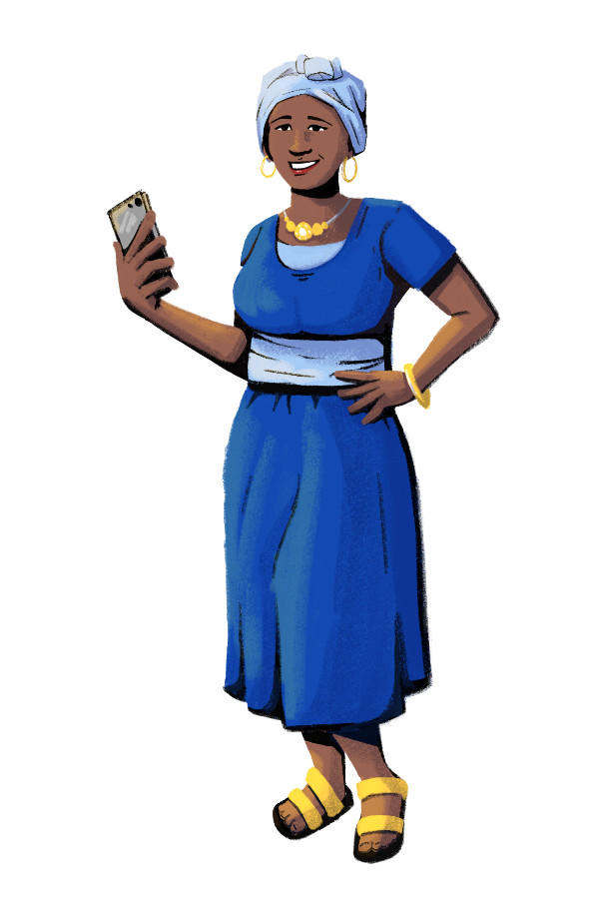
Customization Tip!
Add, delete, or modify questions as necessary.
Use Social Media To Promote Your Business
Do you have a social media account dedicated to your business?
Which social media platforms
do you use?
Social media is a powerful tool to promote your business.
Through social media apps, you can interact with customers, advertise your business, and share updates, such as the arrival of new products or the start of a new sale.
Consider choosing a platform that’s popular in your region and among your customers, like Instagram, Facebook, Pinterest, or WhatsApp.
Start by creating a dedicated profile for your business and build up followers by being active on the platform. Be sure to post content regularly and engage with customers. Also, monitor the comment sections on your posts and respond to comments regularly.
You can also see if your competitors are using social media to advertise their products. Doing competitor research can help you get new ideas for your own social media page.

Slide 37
Create A Business Profile On Google Maps
Google Maps provides information on where stores are located, when they are open, and what products they have. Many customers look at Google Maps to decide which business to shop at. Having your business shown on Google Maps gives you a lot of visibility and can help attract customers.
3
4
Visit https://www.google.com/business/ and either log into your existing Google My Business account or create a free account.
Next, use the search bar to type in the name of your business. If your business shows up, then it is already listed. Anyone can add a business on Google Maps, which is why yours might already be listed.
If your business shows up, you will need to claim it and verify that you own the business.
If your business doesn’t show up, click “Create a business with this name.” You will then be prompted to enter your business name, category, location, service areas, and contact details. Once you have filled in these details, Google will give you a couple of options to verify that you are the owner of the business, such as sending a verification code through the mail, email, or a phone call.
Once the business is verified, you will be able to customize your business page further and add items like your opening hours, a description, and photos.

Slide 38
Using WhatsApp Business
WhatsApp is one of the most popular messaging applications in the world, and it even gives you the option of having a WhatsApp Business Account. With this account, you can advertise and sell your products, interact with customers, and post status updates about your business.
5
To get started, download the WhatsApp Business app from the app store. If you don’t have an existing account, create a new one. If you have an existing account, you can transfer your chat history and media. You will then be prompted to provide your business name, business category, and a profile picture.
Next, start building your business profile. You can add a description of your business, hours of operation, address, and contact information.
Once your profile is complete, visit the catalog to upload photos and descriptions of your products and share pricing information.
Now that your profile and catalog are complete, you can begin promoting your products to your contacts and start accepting orders!
Start using your account. Once your application is approved, you can start using your account for all your financial needs!

Slide 39
Digital Business Promotion Tips
On digital platforms, your profile should be just as inviting as your physical store. Here are some tips to consider:
Take and upload high-quality pictures
of your products.
Set up your digital store
to automatically suggest items to customers that are frequently bought together.
Include brief and accurate descriptions
of your products.
Build a brand image
that is clean and unique.
Update information regularly about opening hours, products and promotions.
Offer coupons to customers who refer friends to your online store.
Post regularly to your social media page so that your posts will land in customers’ feeds.
Include contact information on your page so that customers can reach you.

Slide 40
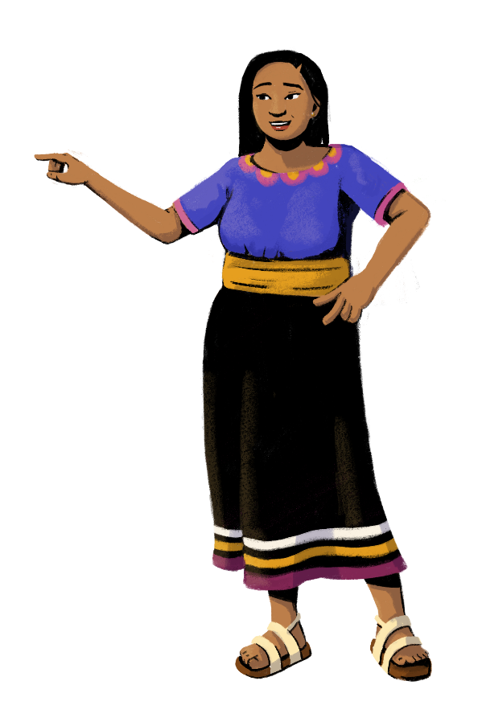
Using E-Commerce Successfully
While selling on big e-commerce sites can be advantageous, these sites can also make it difficult for
small businesses to grow online since they feature many competing businesses.
However, there are several strategies that you can use as an entrepreneur to make your business stand out from the crowd, whether you choose to sell online or just in your physical store.

Slide 41
How to Make Your Business Stand Out
Improve customer retention. As a small business, your competitive advantage is that you can develop closer relationships with your customers. Improving customer service and regularly interacting with shoppers can help you build a loyal customer base who will continue to choose your business.
Know your competitors. Research the platforms that are mainly used by customers in your area. Analyze their prices, the products they have and lack, their shipping services, and the overall user experience. This can help you identify the areas you can outperform the competition, such as by providing different products.
Develop a niche. A niche market is a segment of customers with unique needs and preferences. You can develop your niche by focusing on a specific customer demographic or on certain product categories. By offering a service or a product that customers can’t find elsewhere, you can secure a competitive edge against sellers who don’t offer those items.

Slide 42
How to Make Your Business Stand Out
Emphasize your social or environment considerations. Nowadays, customers are more and more aware of the environmental and social impact of their shopping choices. You can be more conscious by choosing eco-friendly products and local, sustainable suppliers. You can also highlight these choices in your store or on your website so that your customers will know that these topics are important to you and your business.
Improve negotiation with suppliers. One way to reduce costs is to improve your negotiation skills with suppliers. First, you have to gather information on prices offered by other suppliers and compare them to the prices offered by your suppliers. Next, build a rapport with your suppliers. Frequent communication and an overall good business relationship can make your suppliers more willing to reconsider their prices. Prepare an ideal, acceptable, and unacceptable price that you are willing to pay, and try to understand what these prices are for your suppliers. Use the information you have strategically; you don’t need to disclose everything you know right away.

Slide 43
Tips For Using Digital Marketplaces Safely
Digital marketplaces can present an excellent and safe opportunity to grow your business. However, you must take precautions when using them to ensure that you and your business are protected:
Don’t share your passwords for your accounts and platforms. You should also use different passwords for different platforms and accounts, and regularly update them.
If a customer places a large order, you can ask for a deposit or payment upfront (if the platform doesn’t already have this requirement).
Don’t share your personal information with customers on these platforms. Always use your business’ address, email addresses, and phone numbers.

Slide 44
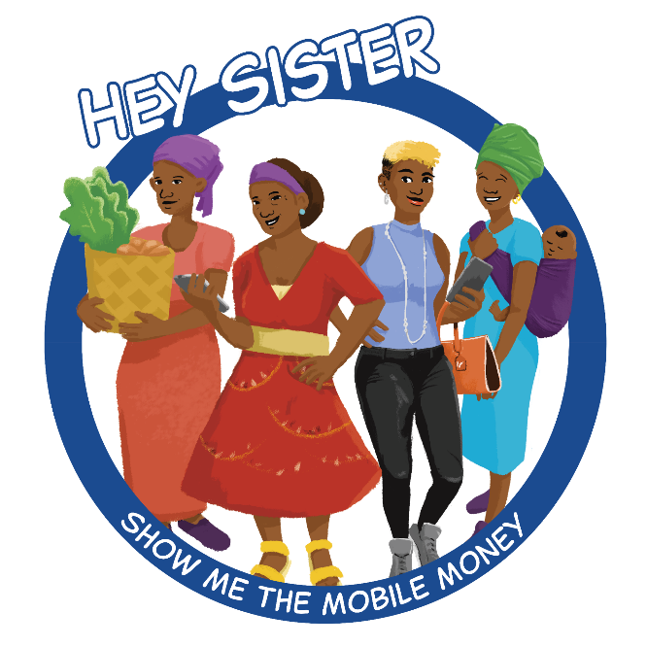
LEARNING RESOURCE
Learn about Digital Marketplaces with Hey Sister and Oye Amiga
Hey Sister Lessons
Lesson 25: How can I use digital / my phone to expand sales?
Oye Amiga Lessons
Lesson 20: How can I use digital / my phone to expand sales?

Slide 45
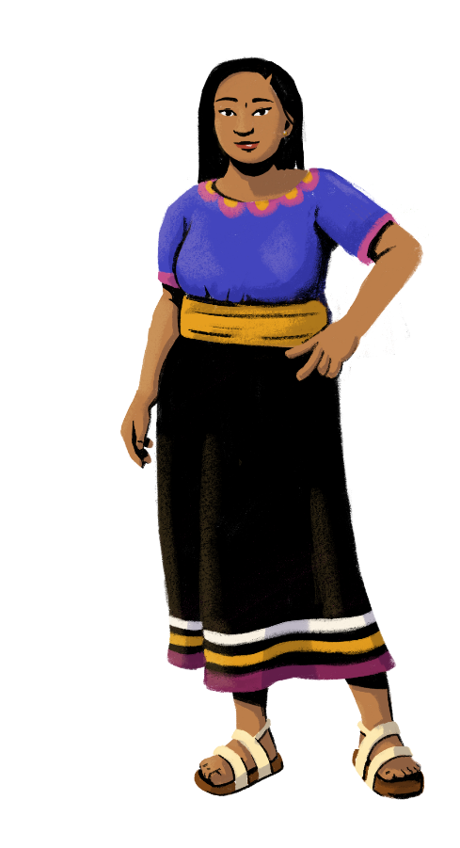
Let’s Recap!
Let’s list your learnings.
How to promote your business:
Know your customers
Upsell and cross-sell
Strategize product placement
Diversify your business
Use digital marketplaces

Slide 46
Customization Tip!
Add, delete, or modify
questions as necessary.
Share your doubts
and questions!
Did you find the session helpful?
Will you be putting any of
the ideas taught today
into practice? If yes,
which ones?

Slide 47
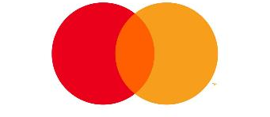
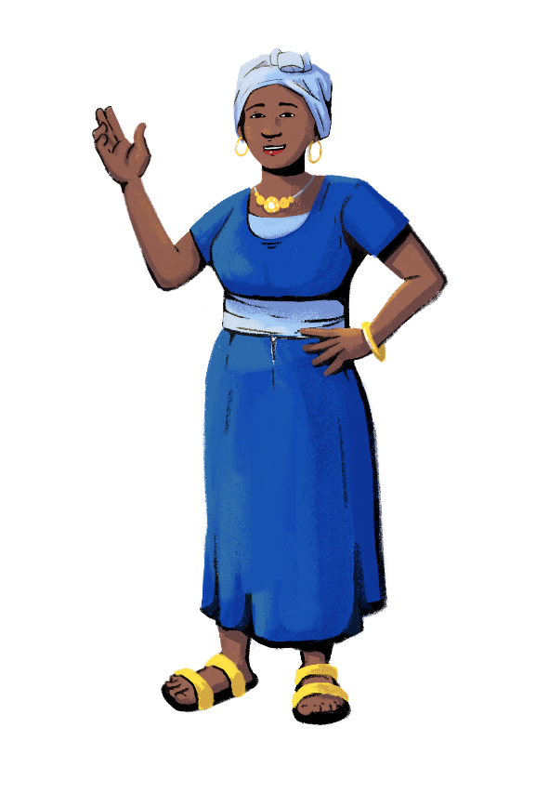
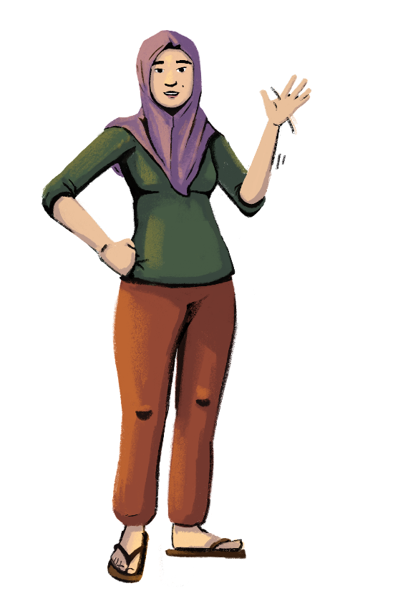
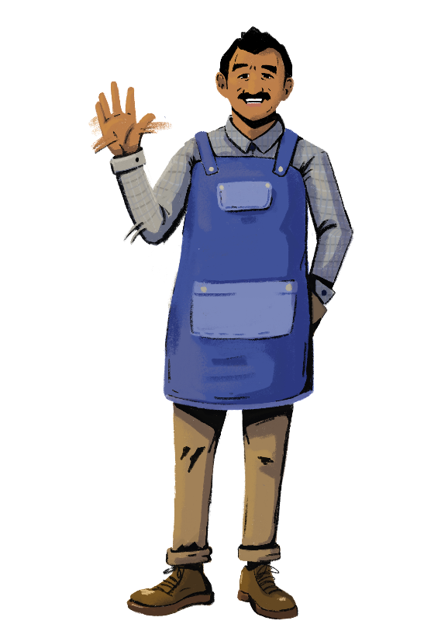
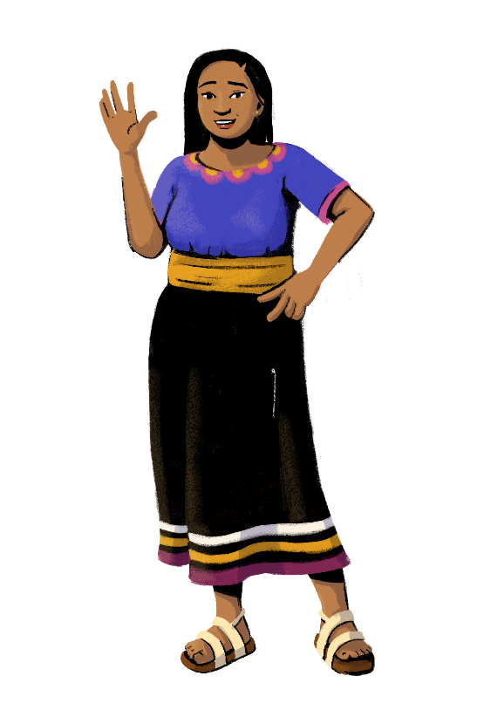
www.siaedge.com
Line Two
Line Three

