Slide 1




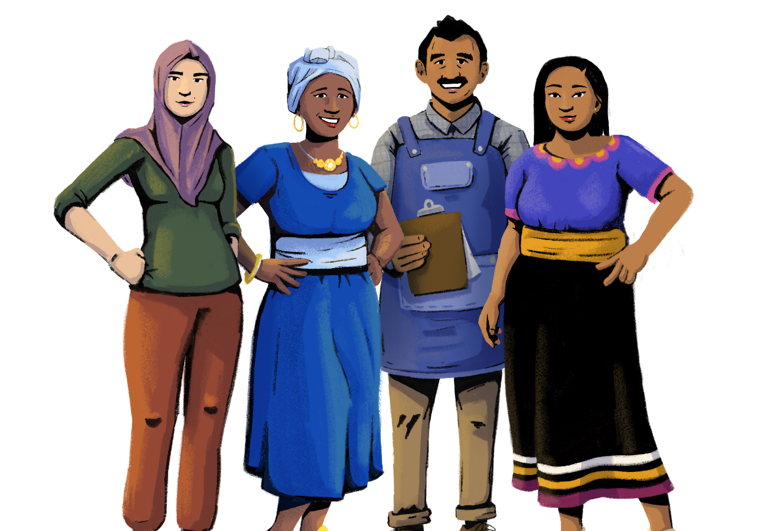
Financial Literacy
Her Business, Her Future
Business Management and
Digital Literacy for Women
Micro-Entrepreneurs
This module is made possible by the generous support of the American people through the United States Agency for International Development (USAID). This guide was produced under DAI’s Digital Frontiers Project (Cooperative Agreement AID-OAA-A-17-00033) at the request of USAID and in partnership with Mastercard. The contents are the responsibility of XYZ and do not necessarily reflect the views of USAID or the United States Government.

Slide 2

Tips for Customizing This Module
The following list provides helpful tips for customizing the content in this module. You can click the slide numbers to be brought directly to that slide. Each slide with customizable elements includes arrows, text boxes, or highlighted phrases to indicate customizable sections and words.
Topics: This module is broken down into several topics as described in the table of contents. You can delete the topics that are not relevant to you and your group. You can also delete any slide throughout the module that does not apply to you or your group. Additionally, all text in this module is directly editable.
Characters: This module uses a mix of characters from different regions. You can replace any of the characters using the character image files from the creative asset library.
Discussion Questions: Slides 4, 9, 24, 27, 34, and 44 contain questions for discussion. You can add, edit, or replace the questions as needed.
Mobile Wallet Terminology: The term “mobile wallet” is used on slides 4, 6, and 17. You can replace “mobile wallet” with a term that resonates best with you and your audience - such as mobile money account, digital wallet, etc.
Account Opening: Slide 7 describes the general steps to opening an account. You can modify these instructions according to a provider or a specific account of your choice.
Types of Formal Savings Accounts: Slide 18 lists examples of savings accounts. You can delete or add examples as necessary.
Formal vs. Informal Savings: Slide 20 compares and contrasts formal and informal savings. You can add or delete points as needed.
Budgeting Practice: Slides 25 - 26 give an example of budgeting for a character. You can change the scenario, character, and budgeting amounts.
General Insurance: Slide 37 describes two types of general insurance: shop and health insurance. You can modify or change these examples depending on your market context.

Slide 3




Module Overview
Table of Contents
Objectives
Understand how to save, spend, or grow your money.
Part 1: Financial account opening | 5
Part 2: Savings | 11
Part 3: Budgeting | 22
Part 4: Investments | 29
Part 5: Insurance | 33
Part 6: Credit | 40
In this module, you can…
  compare and contrast different types of financial accounts and providers
  build your own budget
  identify investment opportunities for your business
  weigh the costs and benefits of insurance
  learn about the role of credit in business

Slide 4





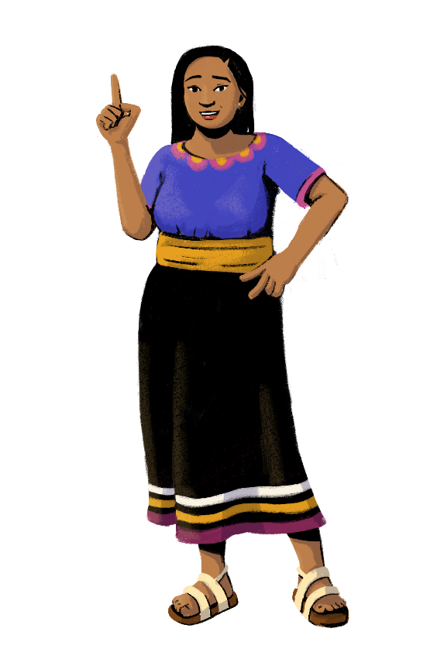
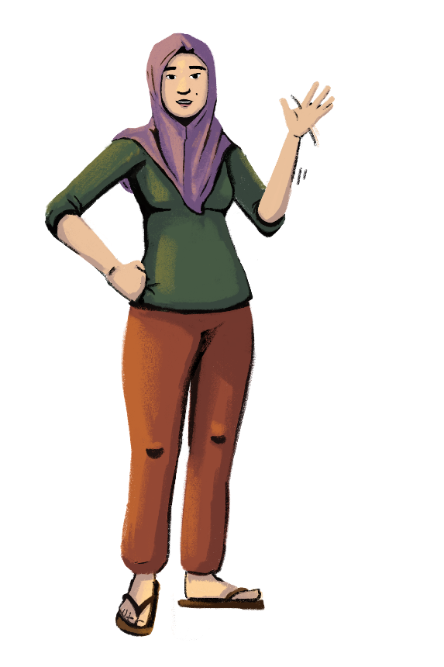
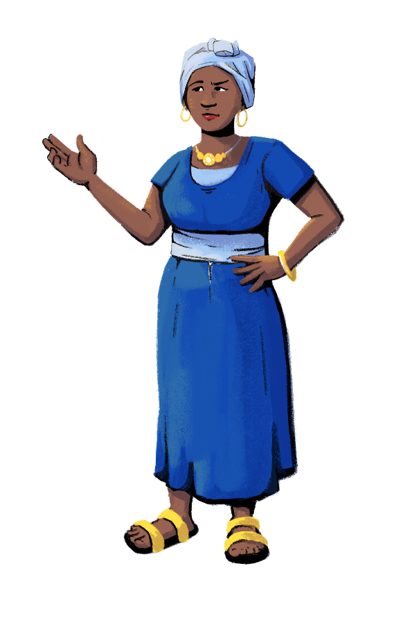
First, let’s assess how you manage your finances!
Customization Tip!
Add, delete, or modify
questions as necessary.
Does anyone here
have a savings account at a bank or save in your mobile wallet? If not, what do you do with your money?
What types of insurance are you familiar with?
How many
of you make budgets for your business finances?

Slide 5


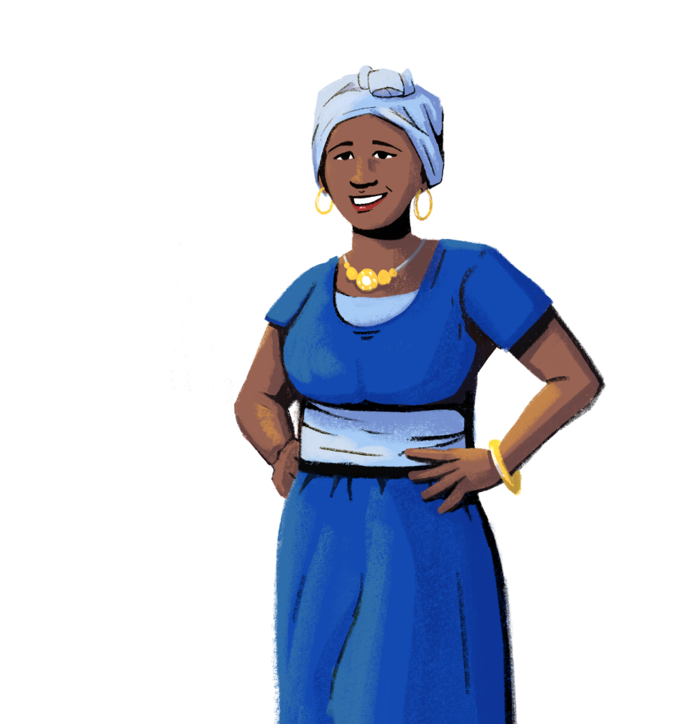
Are you ready to learn how to open your own account with a financial service provider?
PART 1:
FINANCIAL ACCOUNT OPENING
Objectives:
To understand how to open an account with a financial service provider.
To learn about the types of documents typically required to open an account.

Slide 6


Accounts with Financial Service Providers
Opening an account with a financial service provider - like a bank or mobile wallet provider - offers many advantages to your business. You can use the account to save or invest money, track your income and expenses, pay your suppliers, and even gain access to credit.
With an account, you will have records of your financial transactions to manage your business and predict your future revenue.
You can open different types of financial accounts to meet your needs. For example, a savings account to safely accumulate money for a specific goal - such as buying a fridge for your store - or a checking account for day-to-day expenses, like paying bills or purchasing stock.

Slide 7

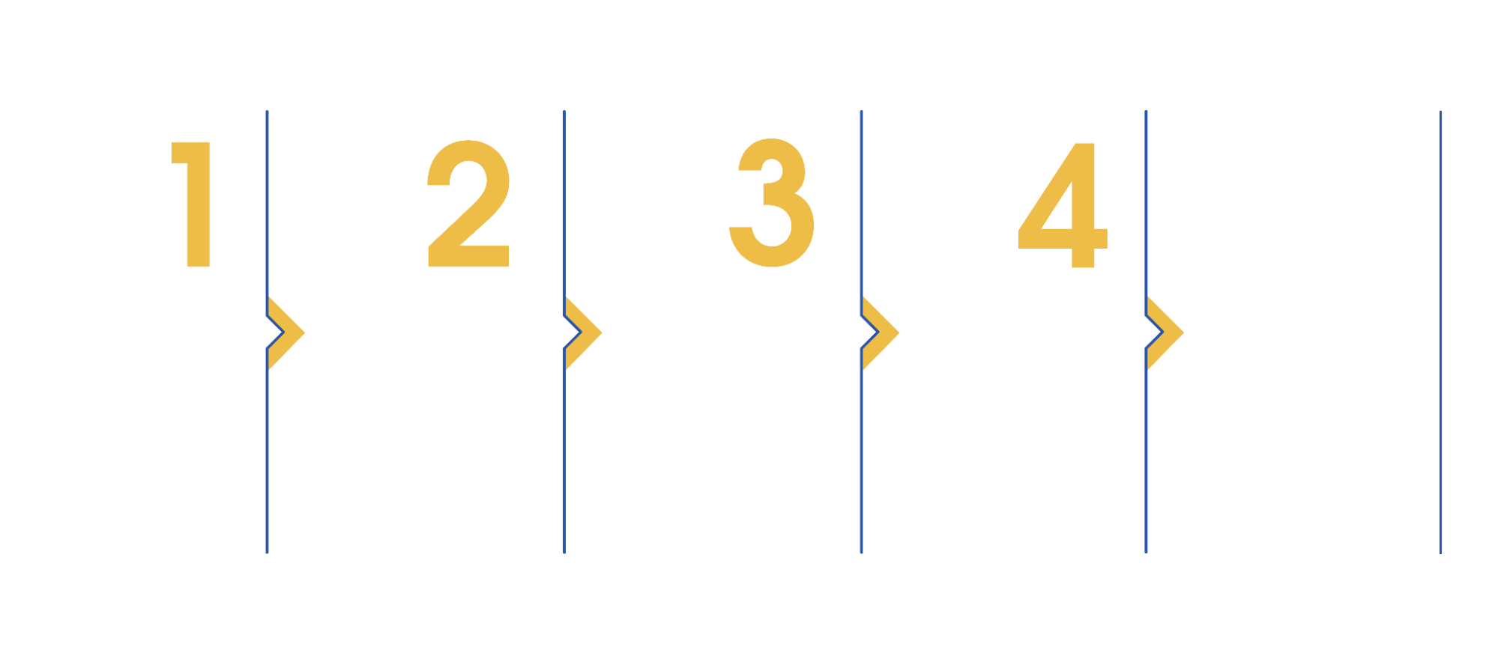
How Do I Open An Account?
Customization Tip!
Consider modifying these steps to be reflective of a specific provider in your market.
5
Research your options. Not all financial service providers offer the same products
and services. It’s important to familiarize yourself with your options before choosing a provider and the type of account you want to open.
Determine where you need to go to open the account. Sometimes, you can apply for an account online or on your mobile phone. Some providers might require you to apply in-person.
Gather the necessary documents. The documents needed can depend on your financial service provider. Typically, you will need some form of identification and proof of address.
Fill out the
application. Once you have the necessary documents, you can finish filling out your account application.
Start using your account. Once your application is approved, you can start using your account for all your financial needs!

Slide 8



Business vs. Personal Accounts
As an entrepreneur, you should keep separate accounts for your business and personal finances. Here are some reasons why:
Track your business cash flow easily and accurately. With separate personal and business accounts, you get a more accurate picture of the state of your business finances. This will help you understand how your business is doing at any moment, and predict your future
cash flow.
Keep your personal assets protected. Having separate accounts can help you treat your business as an independent entity, while safeguarding your personal assets against problems in the business.
Take advantage of tax benefits. All your invoices and financial transactions impact
how you will file your taxes. Business owners and entrepreneurs may be eligible for certain
tax benefits, so having all the information related to your business in one place can save
you a lot of time and hassle down the road.

Slide 9

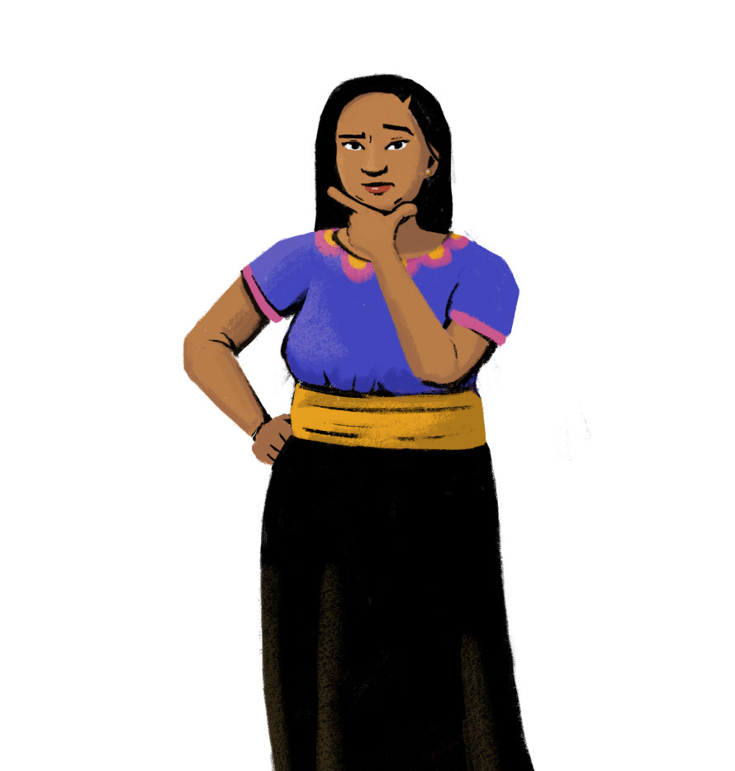


Should every
woman have an individual bank account?
Customization Tip!
Add, delete, or modify
questions as necessary.
How many of you
have your own
bank account?
What do you use it for?
Do you operate
it yourself?
What are the risks if a woman does not have her own account?
How many of you share or operate a bank account with someone else?

Slide 10


Why Should I Have My Own Account?
Although some of you may not have your own account at a financial service provider, let’s explore the benefits of opening an account in your name.
1
Manage your personal and business finances.
Opening an account in your name lets you separate your personal and
business finances. You will be able to receive your salary from your business and
payments from others into your account.
2
Build your financial skills.
Building your financial skills is important as an entrepreneur, because you need to be familiar with different financial terms and strategies. Opening your own account will build your confidence in using different products and services.
3
Establish financial independence.
With your own account, you have the freedom to decide how to save, spend, and
invest your money. You can also take steps to protect yourself in the event of a
disaster or a sudden event - like by creating your own emergency fund.

Slide 11

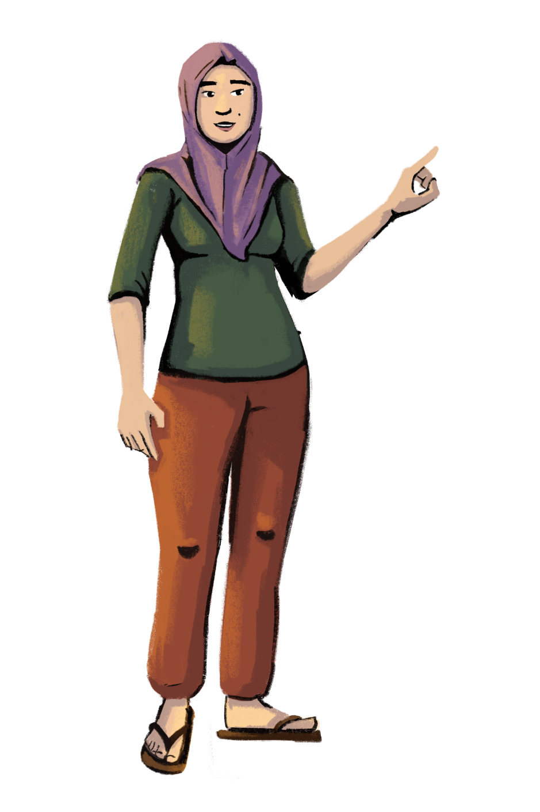
Let’s talk about savings!
PART 2:
SAVINGS
Objectives:
To gain an appreciation of the value of savings.
To learn how to make strategic decisions on how much and where to save.

Slide 12














Let’s Talk About Savings
Savings are what is left over from your earnings after all your essential and non-essential expenses are paid.
INCOME
NON-ESSENTIAL EXPENSES
ESSENTIAL EXPENSES
SAVINGS

Slide 13

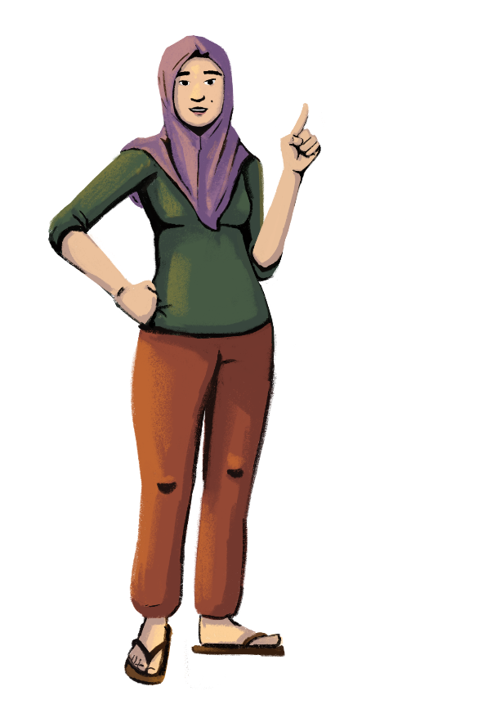



Why Is It Necessary to Have Savings?
Think about how these also apply to your store!
Planning future expenditures
Creating emergency
funds
Building your wealth

Slide 14

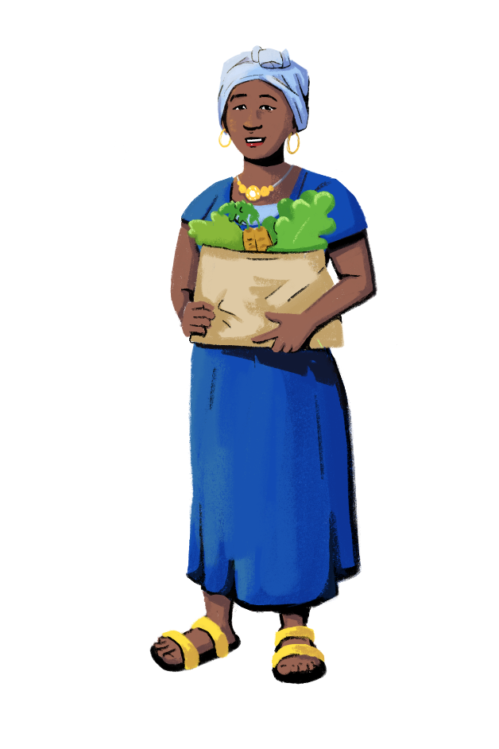
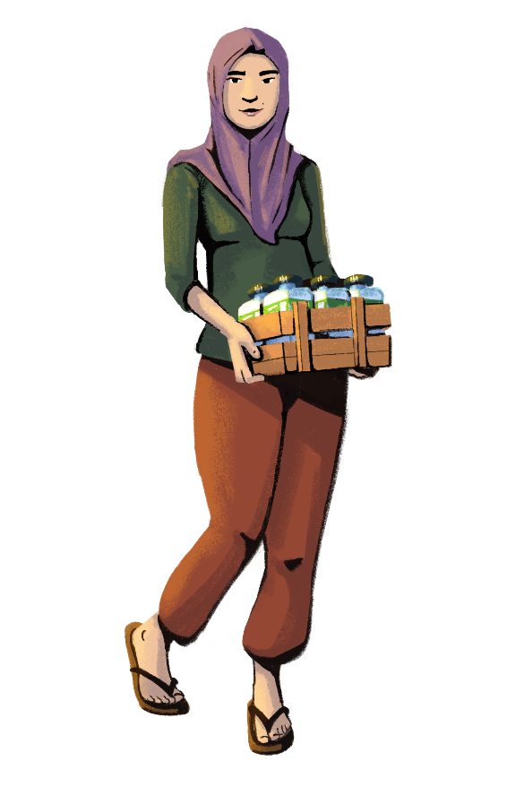
Needs vs. Wants
ESSENTIAL VS. NON-ESSENTIAL EXPENSES
NEEDS are something you must have, like food or rent for your home or business. They are required for your physical and mental wellness.
NEEDS are essential.
WANTS are something you wish to have, like designer clothes or paint for your store. They are purchases that are not required to survive, but you’d like to make them.
WANTS are non-essential.

Slide 15

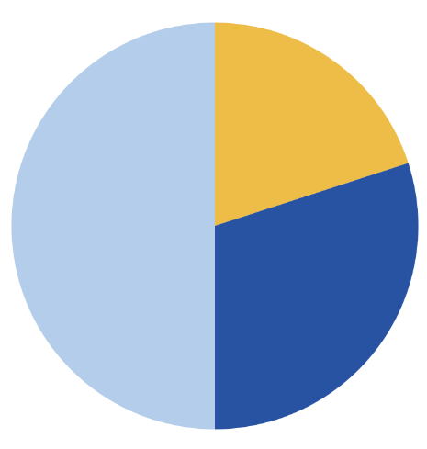



How Much Should I Save?
Experts suggest that a family must have in their savings, at any point in time, an amount that can meet at least six months of essential expenditures.
It is considered good practice to save at least 20% of family income, assuming that 50% goes towards meeting essential expenditures (such as food and rent) and 30% goes for discretionary expenditures.
You also need to consider saving for your business expenses. Businesses need to save in case they have to cover unexpected expenses, such as needing to replace a refrigerator or cash register in the store.
Savings 20%
Essential expenses 50%
Other expenses 30%

Slide 16
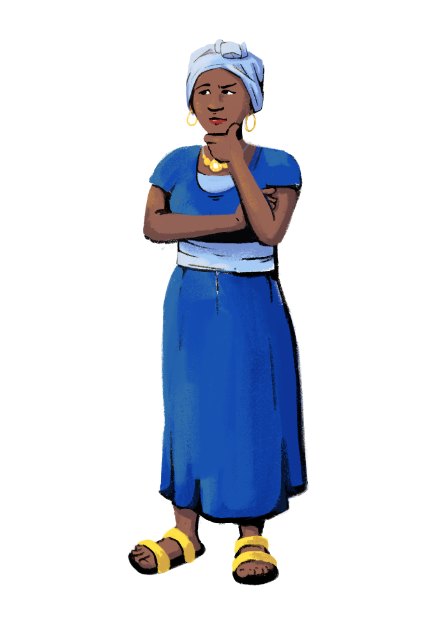


How Can I Save With Limited Income?
Start by saving a small amount.
Make saving a regular habit.
Put your savings in a safe and secure place.
Choose a savings account that will accumulate interest.
Review your expenses and cut back on non-essentials.

Slide 17


Formal Savings
Savings can be of two types: formal and informal.
When you put your savings with firms or institutions, such as a bank, you are saving in the formal financial system.
Examples of formal financial institutions are banks, microfinance institutions, mobile wallet providers such as mobile network operators, and credit unions.
If you use a formal savings scheme, your money will be more protected. Governments and other entities pass policies and regulations that require the formal institution to keep your money safe.
Formal savings are productive, meaning that you can also earn some interest on your money. Just watch out for fees!

Slide 18



Types of Formal Savings Accounts
Customization Tip!
Add, delete, or modify these examples as necessary.
There are many types of savings accounts to choose from. Let’s explore a few options that may be available to you!
Traditional savings accounts. Traditional savings accounts are basic savings accounts! These accounts are what you typically find at banks or credit unions. Traditional savings accounts are good options for those entering the formal financial system for the first time.
Commitment savings accounts. A commitment savings account allows you to restrict access to your savings until you reach a certain date or savings goal of your choosing. These accounts incentivize you to save, since you can’t access your funds until your goal is met.
Specialty savings accounts. Specialty savings accounts are designed to help you reach different savings goals you may have. For example, you can set up a specialty savings account that is designed for your child’s education or for your own retirement.

Slide 19

Informal Savings
Informal savings mechanisms are a set of different ways that people save money outside the formal financial system. Unlike formal savings, informal savings mechanisms are usually unregulated.
Examples of informal savings mechanisms are village and loan associations, rotating savings and credit associations, and self-help groups. Saving in a jar is also a method of saving informally!
The rules of participating in an informal savings group are usually decided by the members. They can be adapted and changed over time, depending on members’ needs.

Slide 20
Which Saving Mechanism Should I Choose?
Both informal and formal savings mechanisms are widely used around the world. Here are some things to consider when deciding which type of savings is right for you.
INFORMAL SAVINGS | FORMAL SAVINGS
Informal savings often fit nicely into people’s lives; if you save with a savings group, the rules will reflect the group’s culture and needs. Members can restructure the group’s operations when needed. Informal savings often provide value beyond financial services. For many people, meeting with their savings group is a form of socialization. Informal savings groups may lack reliable record keeping of savings activities. There are less security features to protect your money in informal mechanisms than in formal mechanisms. | Formal savings schemes sometimes can’t offer the flexibility and non-financial benefits offered by informal savings mechanisms. Formal financial institutions can offer services that informal mechanisms sometimes can’t, such as saving privately, saving larger amounts, saving over longer periods of time, and the protection of your money. Your formal financial institution will keep a documented record of your transactions and accounts, which you can access and use when needed.
Customization Tip!
Add, modify,
or delete
these points
as necessary.

Slide 21




LEARNING RESOURCE
Savings with Hey Sister and Oye Amiga
Hey Sister Lessons
Lesson 15: How much should I save?
Lesson 16: Where should I save?
Oye Amiga Lessons
Lesson 8: Where should I save?
Lesson 9: How much should I save?

Slide 22

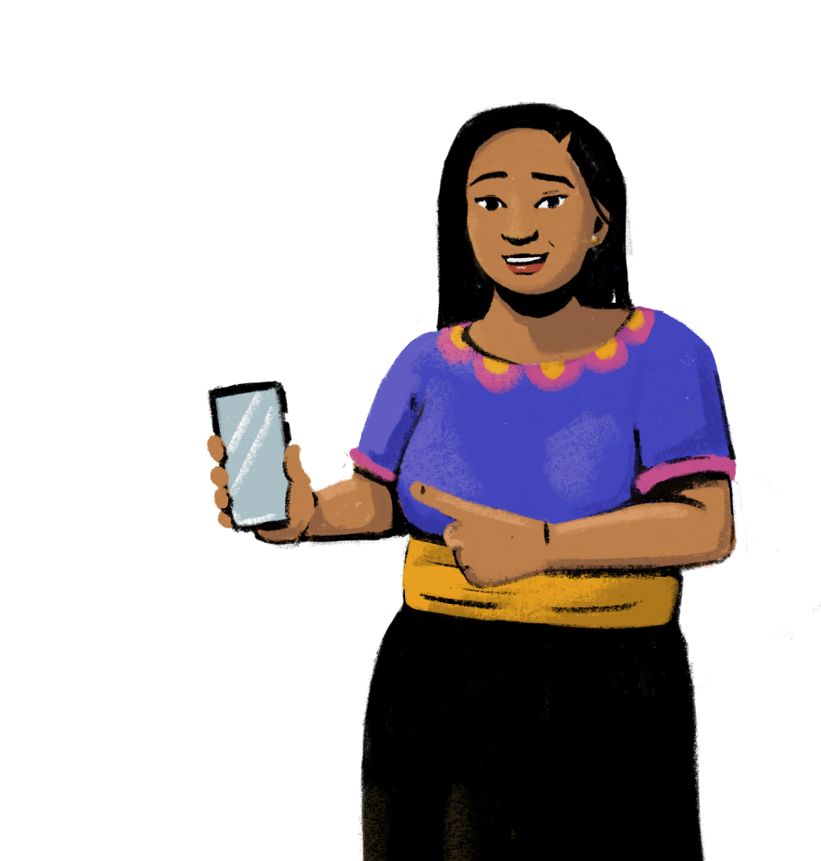
Let’s build your own budget!
PART 3:
BUDGETING
Objectives:
To become familiar with tips to use in budgeting.
To build your own basic budget.

Slide 23


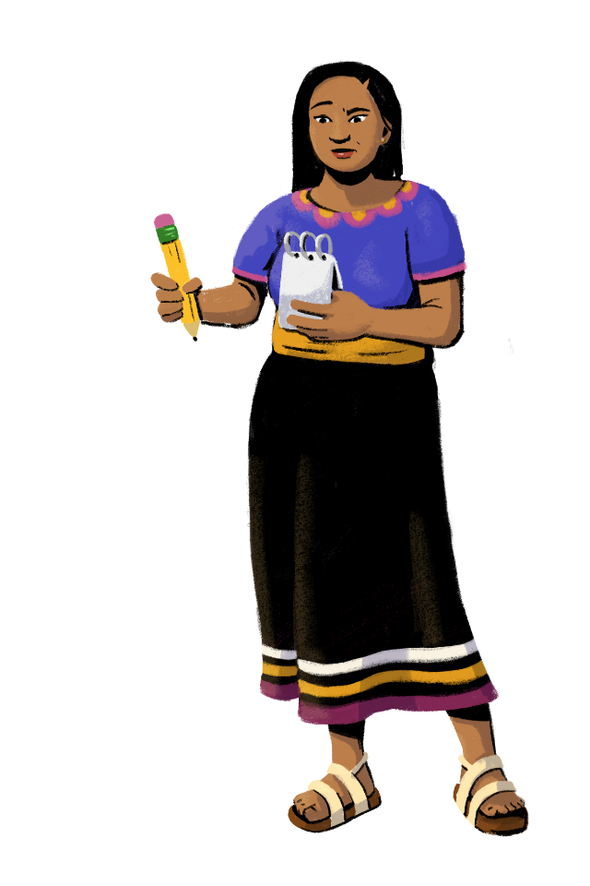
Budgeting
Budgeting is the process of tracking your income and expenses.
Building a budget helps you decide where your money should go. Usually, you make a budget for your income and expenses each month, but you can also create weekly or even yearly budgets.
As an entrepreneur, budgeting can help you keep track of your finances for your household and your business. You can also create a budget to help you meet short and long-term financial goals.

Slide 24



Financial Planning: Short-Term and Long-Term Goals
Let’s prioritize and budget!
What are your goals?
Short-Term Goals
Long-Term Goals
Example: Buying a fridge for your store.
Example: Buying your own shop instead of renting.
What is the nature of your goal? Is it an expenditure or is it an investment in your future?
How much money will you need to achieve your goal? How do you plan to raise this money? Have you created a budget to follow?
Customization Tip!
Add, delete, or modify questions as necessary.

Slide 25
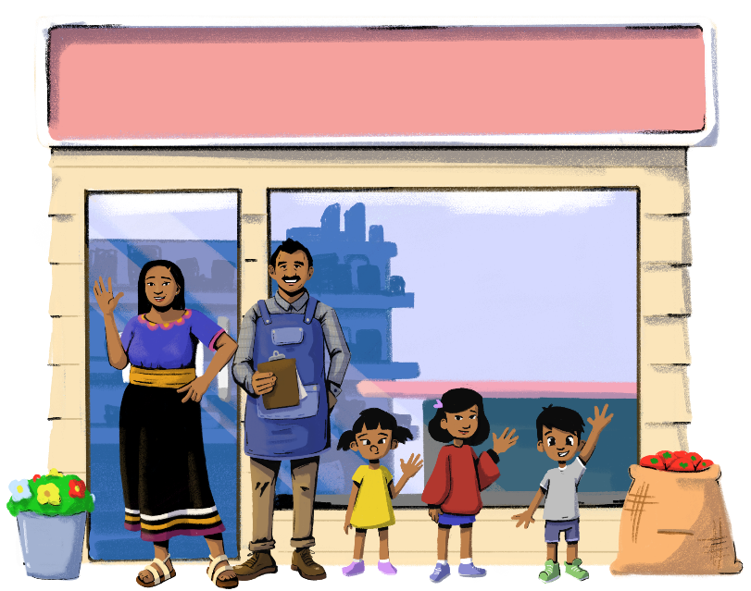
Monthly Budgeting for the Family
Customization Tip!
Modify the character and scenario to be reflective of your context when needed.
Sofía works in a store with her husband Mateo. Mateo is the primary owner of the shop. Both earn a salary from the shop.
They have a family of five; they have two daughters and one son. Both of their children are enrolled in school and play sports.
Let’s look at the budget Sofía has created for her family…

Slide 26
Monthly Budgeting for the Family
Customization Tip!
Modify the currency and numbers to be reflective of your market.
Now, prepare your own budget.
Try to ensure that your expenses are within your income.
If your expenses are more than your income, you have to:
  cut down on expenses.
  increase your income.
INCOME |  | EXPENSES
Salaries Shop income Government cash transfer | 6,000 20,000 500 | Mortgage (shop + house) Food Health School Activities Utilities (shop + house) Misc. Expenses | 10,000 2,000 500 1,000 1,000 2,000 500
Total income | 26,500 | Total expense | 17,000
Need some budget templates? Visit this link to download various free Google Sheets budgeting templates.
Savings = Income-Expense = 26,500-17,000 = 9,500

Slide 27


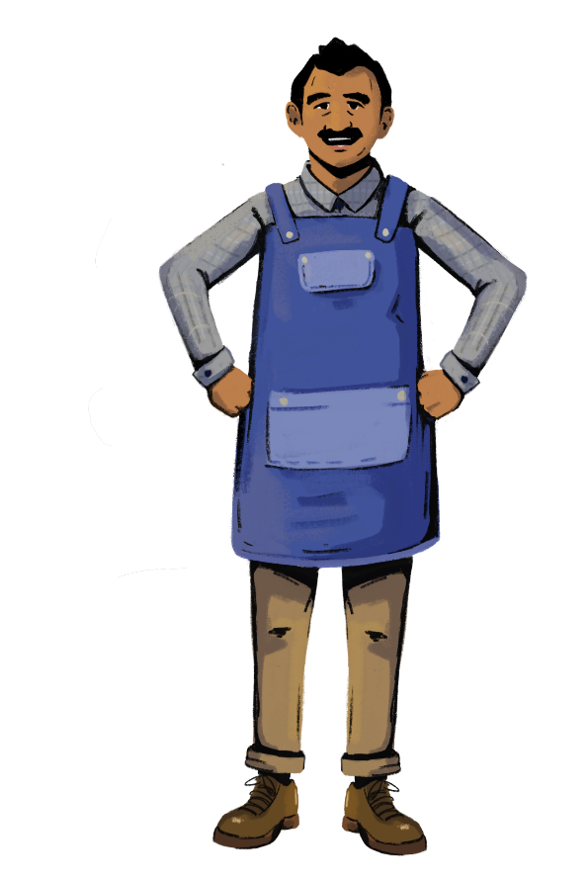

Did you gain any insights by doing the budgeting exercise?
Customization Tip!
Add, delete, or modify
questions as necessary.
Do you now have a clearer idea of your expenses?
Did you identify any expenses you could cut down?
How much can you save?
What can you
do with the savings you will accumulate?

Slide 28
LEARNING RESOURCE
Budgeting with Hey Sister and Oye Amiga
Hey Sister Lessons
Lesson 18: How can my household manage our finances better?
Oye Amiga Lessons
Lesson 10: How can my household manage our finances better?

Slide 29


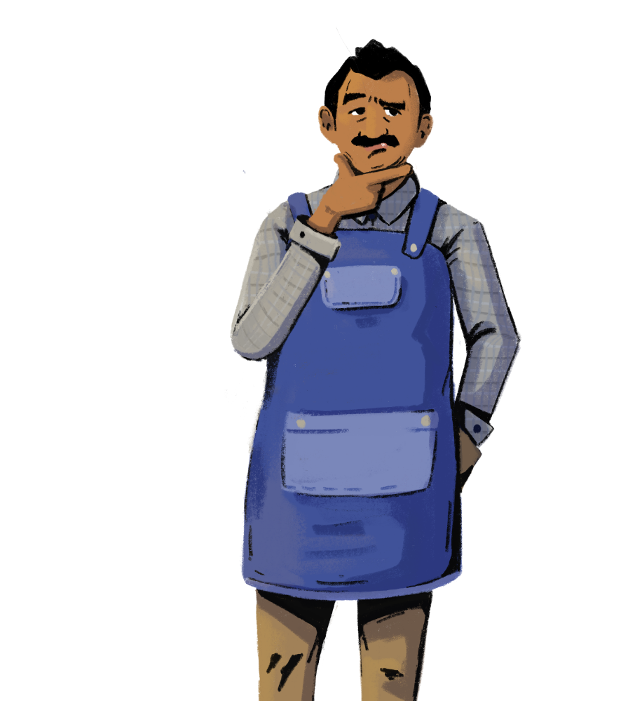
Do you know the difference between saving and investing?
PART 4:
INVESTMENTS
Objectives:
To learn the difference between savings and investments.
To understand how investments can help generate income for your business.

Slide 30

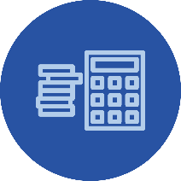
Let’s Talk About Investments
Investing is the process of using money to buy something that can grow in value.
You can invest in purchasing a physical asset, such as a store, or invest in financial instruments (like stocks or bonds) that provide a return but carry some risk.
Investments may
generate income for you
in one of two ways:
If you invest in a salable
asset, you can earn
money by selling it at a profit or by renting it out.
If you invest in a financial instrument, you earn income when bonds pay interest, or when a company whose stock you buy does well.

Slide 31


Investing vs. Saving
Let’s look at some scenarios to see if saving or investing is the right move!
How is investing different from saving?
A key difference between saving and investing is the level of risk.
Saving is usually safer than investing, but investing allows you to potentially earn a higher return than saving.
You should consider saving if…
you don’t yet have an emergency savings fund.
you’ll need the money in the next few years.
you have debt to pay off.
You should consider investing if…
you have built up your emergency savings fund.
you have a consistent and stable income stream.
you don’t have high-interest debts.

Slide 32

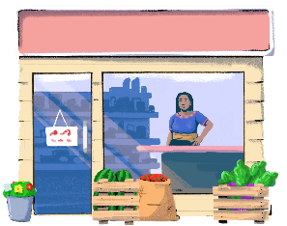
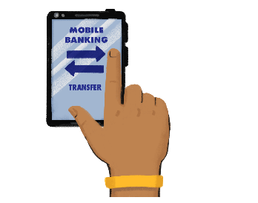
What Can I Invest In?
Let’s look at some ideas for what you, as an entrepreneur, can invest in!
Yourself
Your Finances
Investing in your skill set is one
of the best things you can do
as an entrepreneur.
You can enroll in courses related to your industry or take training programs
(like this one!).
There are many options for
financial investing, such as
stocks and bonds.
You can also
invest in a financial advisor to
guide you on a financial
investment strategy.
Your Store
If it is getting difficult to run the
store by yourself or if you want
to sell more products, consider
investing in employees for your
shop! Adding extra hands can
help you sell more products
and items, which can generate
more profit for your store.
Property
If you aren’t planning to move
your business anytime soon,
consider investing in property
for your business. Buying property can save
you on rental costs.

Slide 33


As an entrepreneur, it is important for you to learn how insurance can protect you and your business.
PART 5:
INSURANCE
Objectives:
To understand the concept of insurance.
To learn about different types of insurance.
To weigh the costs and benefits of insurance.

Slide 34



Let’s Talk About Insurance
Customization Tip!
Add, delete, or modify questions as necessary.
What are your major financial worries?
How do you plan for unforeseen events?
Consider insurance.
Insurance provides financial protection against unexpected losses or unforeseen expenses.
There are two broad types of insurance:
life insurance
general insurance
Health expenses?
Mounting debt?
Death of earners?
Theft at shop?

Slide 35

Life Insurance
Life insurance pays the family members of the policyholder (insured) after their death. The payment is made to the person named in the insurance as the "beneficiary.”
When purchasing the life insurance policy, the insured can either pay the total amount or make periodic payments, known as premiums, to the insurer. In exchange, the insurer promises to pay an assured sum to the insured when the policy matures, or to the beneficiary in the event of the death or disability of the insured.

Slide 36

General Insurance
General insurance is a risk management strategy which offers financial compensation in the event of any loss other than death. It covers the loss or damages caused to assets, as well as liabilities.
The insurance company promises to pay an assured sum to the insured to cover the losses experienced.
Some examples of general insurance include health, vehicle, shop, agriculture, and travel insurance.

Slide 37



General Insurance Examples
Customization Tip!
You can change these examples depending on the insurance products in your market.
SHOP INSURANCE
HEALTH INSURANCE
Shop insurance protects your business against risks such as theft, fires, or accidents. Without shop insurance, you might have to pay out-of-pocket for costly damages and claims.
Health insurance covers part or all of your health and medical expenses. This insurance can cover major and minor health incidents. Health insurance acts as a safety net for you and your family.

Slide 38

Things to Consider About Insurance
Remember, there are benefits and costs to having insurance plans.
You might pay higher or lower premiums depending on your insurance plan. Also, with most insurance products, you will not get your premium payments back even if no unexpected event or accident happens.
Not all risks can be covered by insurance, or even planned for, which is why it is always important to have savings. When deciding if you want to add on insurance, you can consider the following:
Risks: How likely is a risk to occur? If a risk did occur, how much money would you lose, and how much would you need?
Insurance products: What is covered under the product? Can you afford the premiums? How much would you get paid if an accident occurs? Do you face other risks that aren’t covered by the insurance products?

Slide 39
LEARNING RESOURCE
Insurance with Hey Sister and Oye Amiga
Hey Sister Lessons
Lesson 17: Should I buy insurance?
Oye Amiga Lessons
Lesson 12: Should I buy insurance?

Slide 40

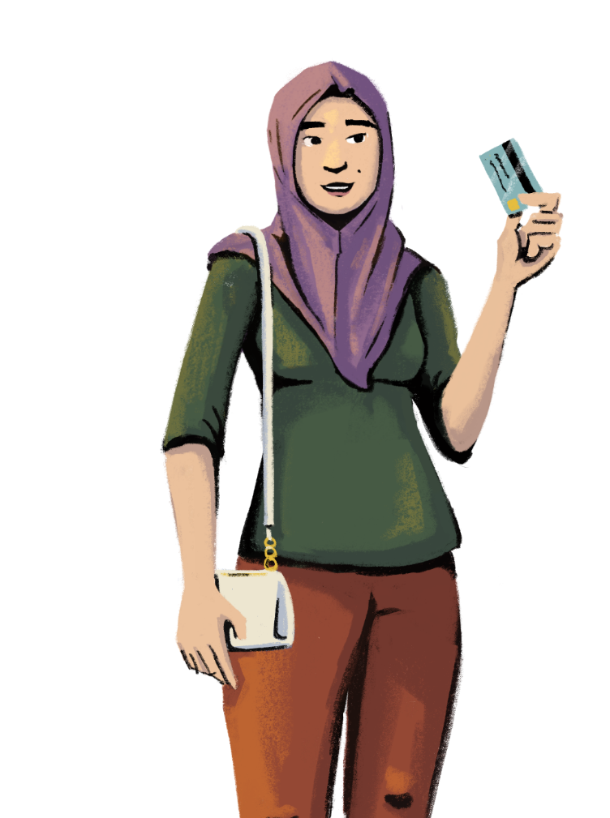
Let’s learn
how credit
can help grow
your business!
PART 6:
CREDIT
Objective: To become familiar with
credit, the terms of loans, and how
credit can be used in business.

Slide 41


What is Credit?
Credit means someone loans you money — called principal — in exchange for your promise to repay it, usually with interest.
Interest is the cost of borrowing someone else’s money.
The higher the interest rate, the higher the total amount you pay to buy something on credit.
The main advantage of using credit is that it lets you buy something – like a car or a house – without having to pay for it all at one time.

Slide 42
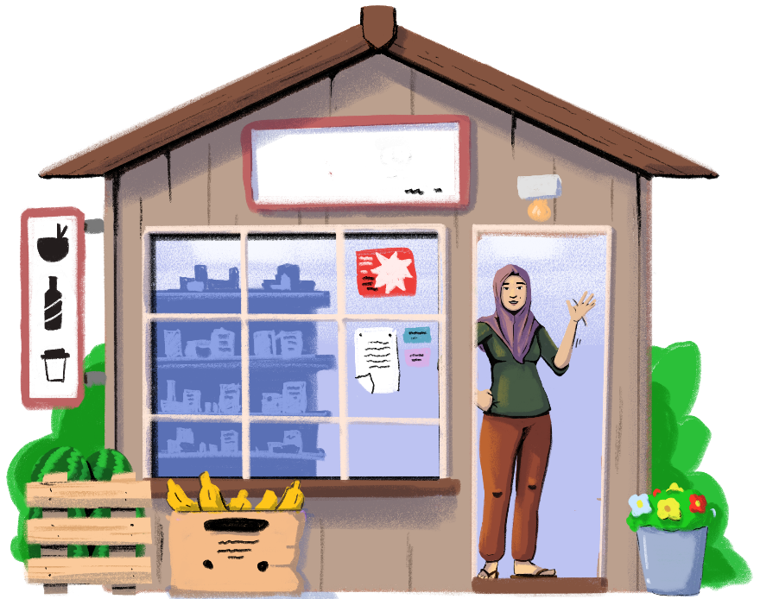
The Role of Credit in Business
Business credit allows you to access items you need to grow your business.
A business that is unable to borrow might not be able to buy the goods or pay the employees it needs to make products and profit.
Credit also makes it possible for businesses to make investments they need. Items such as infrastructure for the shop are too expensive for most people to pay for all at once. With credit, it becomes possible to pay over time, while accessing essential products and services when you need them.

Slide 43
Why and When to Borrow
You borrow money when your expenditure is more than your income or when there are emergencies.
You also borrow when you need money for undertaking business activities or investments.
A common mistake that people make with loans is they use them for meeting consumption expenses, such as organizing lavish events or buying costly consumer products. If you have to spend money on these items, the expenditure should be from your income or accumulated savings. You should avoid taking loans to meet these expenditures.
  For example, you may take a loan to buy a refrigerator for your store that will allow you to stock a new line of products in demand, such as cold beverages, ice cream, and dairy items. You will be able to enhance your sales and turnover, and earn profits that will enable you to repay the loan.

Slide 44



Let’s
discuss!
Customization Tip!
Add, delete, or modify
questions as necessary.
Has anyone here accessed credit? Why did you take out the loan?
Who gave you credit?
Did you sign documents when you took out the loan? Did you read the documents you were signing?
If you are hesitant to take out credit, tell us why.

Slide 45
Let’s Talk About Loans
A loan is taken out under certain conditions and guidelines. These guidelines detail what’s expected of both the borrower (you) and the lender.
Reviewing the loan terms before signing off on a loan is very important.
First, you need to know what your payment obligations are. You will want to know if your loan payment is due on a specific date each month to avoid a late payment.
Understanding the loan terms can also help you determine whether a loan is a good fit for you before you enter into a repayment agreement with the lender. If there’s something in the loan terms that you don’t agree with, such as a penalty fee, you can reject the loan offer.

Slide 46
Terms of a Loan
When applying for a loan, the lender should specify what the loan terms are before finalizing any borrowing agreement.
It’s important to review loan terms carefully to check for any hidden clauses or fees that could potentially cost you money.
“Terms of a loan” refers to the terms and conditions involved when borrowing money.
This can include:
The loan’s repayment period and frequency.
The interest rate and fees associated with the loan.
The amount you pay every time your repayments are due.
How much you will repay in total compared to the loan amount you originally get.
Penalty fees.
And any other special conditions that may apply.

Slide 47
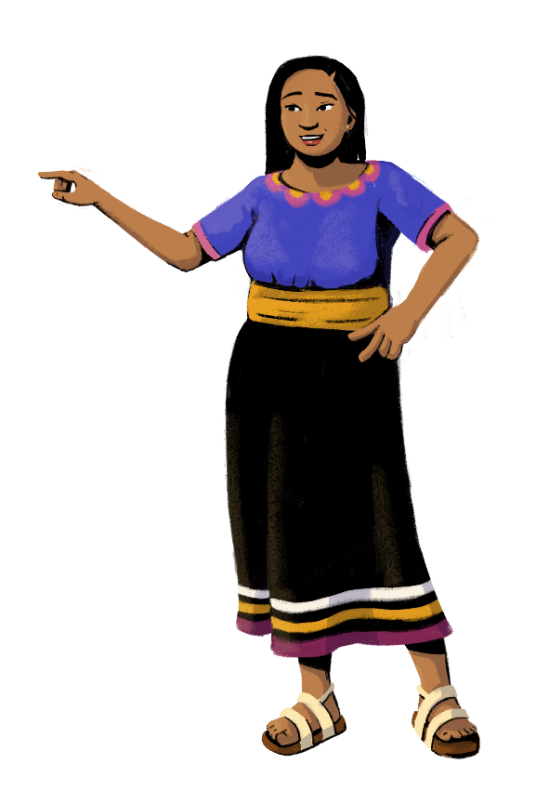
Key Takeaways From This Module
Research your options. There are many kinds of savings accounts, credit products, loans, and insurance plans on the market. Researching each financial product or service you are considering will help you choose one that is right for you.
Read documents carefully. Using financial products and services means reading and signing a lot of documents. Before you sign anything, make sure that you read the documents carefully. These documents will tell you important information about the terms and conditions of the product or service you chose.
Think about the future of your business. There are different types of financial products and services specifically made to help protect or grow your business. When considering loans or investments, think about your business goals for the future, and how these products can help you meet those goals.
Establish financial independence. Setting up your own financial account, choosing an insurance plan, and building a budget will help you become financially independent. You get to make your own decisions about your personal and business finances.

Slide 48




Any doubts and questions?
Ask away!

Slide 49



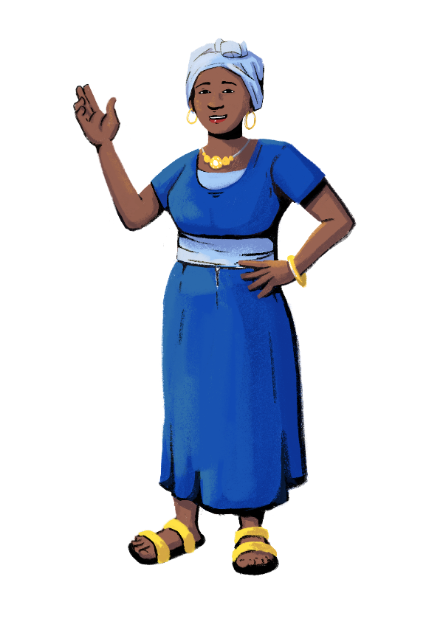

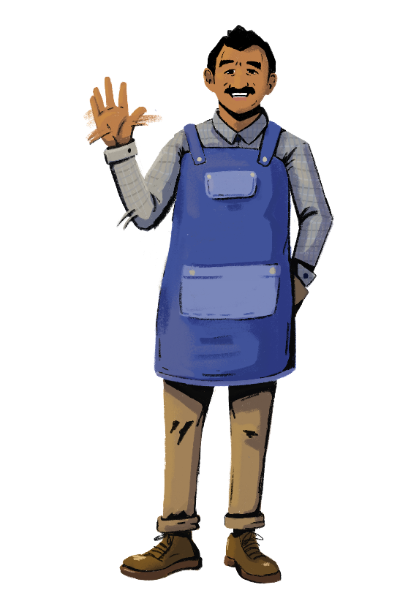
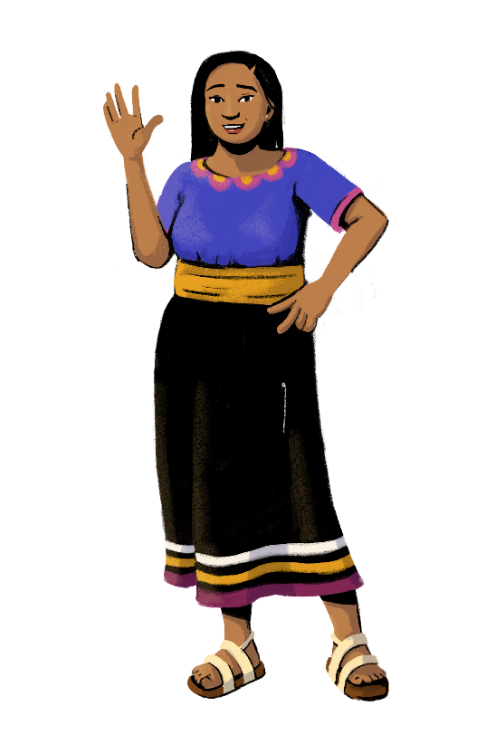
www.siaedge.com
Line Two
Line Three

