Slide 1





Financial Management
Her Business, Her Future
Business Management and
Digital Literacy for Women
Micro-Entrepreneurs
This module is made possible by the generous support of the American people through the United States Agency for International Development (USAID). This guide was produced under DAI’s Digital Frontiers Project (Cooperative Agreement AID-OAA-A-17-00033) at the request of USAID and in partnership with Mastercard. The contents are the responsibility of XYZ and do not necessarily reflect the views of USAID or the United States Government.

Slide 2

Tips for Customizing This Module
The following list provides helpful tips for customizing the content in this module. You can click the slide numbers to be brought directly to that slide. Each slide with customizable elements includes arrows, text boxes, or highlighted phrases to indicate customizable sections and words.
Topics: This module is broken down into several topics as described in the table of contents. You can delete the topics that are not relevant to you and your group. You can also delete any slide throughout the module that does not apply to you or your group. Additionally, all text in this module is directly editable.
Characters: This module uses a mix of characters from different regions. You can replace any of the characters using the character image files from the creative asset library.
Discussion Questions: Slides 5, 10, 11, 14, 16, 19, 39, 40, and 52 contain questions for discussion. You can add, edit, or replace the questions as needed.
Mobile Wallet Terminology: The terms “mobile wallet” and “mobile money” are used on slide 30. You can replace these terms with a term that resonates best with you and your audience, such as mobile money account, digital wallet, etc. These terms are also in red text.
Business Expenses: Slide 15 has an editable chart listing business expenses. You can delete, add, or modify expenses as necessary.
Digital Bookkeeping: Slide 22 describes the concept of using your smartphone for bookkeeping. You can add a digital bookkeeping app or website that is common in your market as an example.
Day Books: Slide 28 includes an editable example of a day book. You can edit the dates, sales, purchases, and expenses to be relevant to your group. Slides 30 - 31 also provide a scenario followed by an editable day book for practice. You can modify the scenario and numbers in the day book as necessary.
Credit Registries: Slide 33 has editable customer and supplier credit registry tables. Slides 35 - 38 also give two credit registry scenarios to walk through. You can modify the scenarios and text in the credit registry tables.
P&L Statement: Slide 42 provides an editable P&L statement table. Slides 44 - 49 are a practice exercise for making a P&L statement based on a day book. The text in the day book and P&L statement can be changed as needed.

Slide 3




Module Overview
Table of Contents
Objectives
Learn how to create a financial plan.
Identify the types of records and books you should keep for your business.
Understand how your phone can help you with bookkeeping.
Part 1: Creating a financial plan and applying financial discipline | 4
Part 2: Defining your role in financial management | 9
Part 3: Understanding your business expenses | 13
Part 4: Understanding the why and how of bookkeeping | 17
In this module, you can…
  reflect on your role in financial management
  identify your business expenses
  practice record keeping and bookkeeping

Slide 4

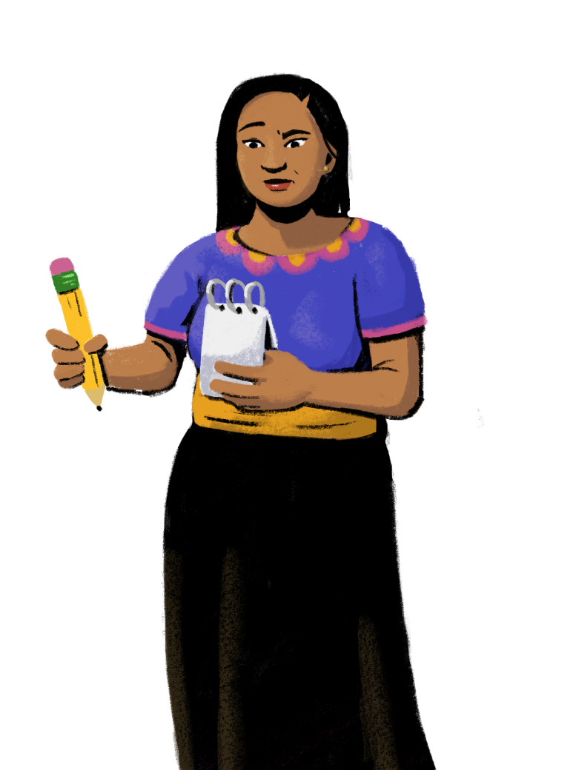

PART 1:
CREATING A FINANCIAL PLAN AND APPLYING FINANCIAL DISCIPLINE
Objectives:
To understand why you need a financial plan.
To appreciate the benefits of following a financial plan using financial discipline.

Slide 5




Your Business Needs a Financial Plan
Customization Tip!
Add, delete, or modify questions as necessary.
If you don't have a financial plan in place, it's really hard to be disciplined about how you spend your money.
When creating a plan, look at both your short-term and long-term dreams.
Financial discipline will help you manage your business’ finances.
What is
financial discipline?
Why is financial discipline important to run
a business?
SAVINGS

Slide 6


Financial Discipline
Financial discipline refers to understanding your store’s finances. It involves taking steps to make more money in sales than your expenses, managing your expenses, and saving money for unexpected expenses.
With a regulated spending pattern and a monthly budget plan, you can apply strategies to reach your business goals and growth.
EXPENSES
SALES
SAVINGS

Slide 7
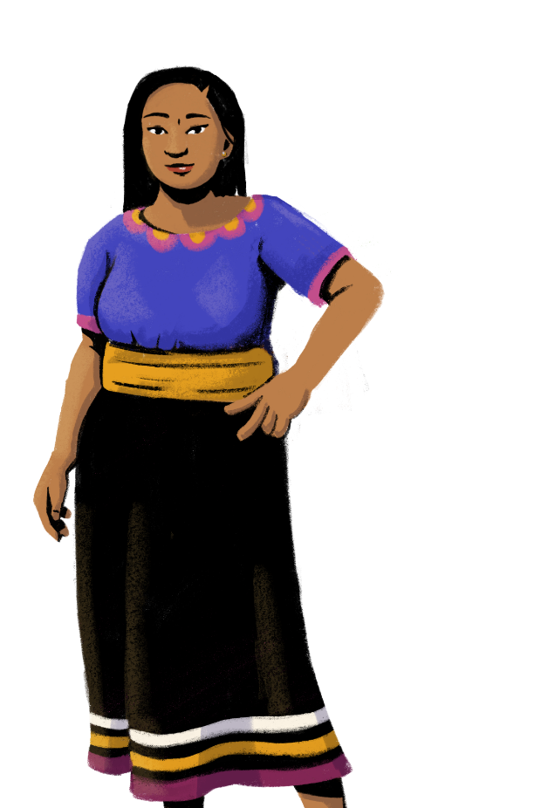






A Good Financial Plan and Financial Discipline Helps With…
Tracking and managing expenses
Tracking
inventory
Maintaining a positive cash flow
Paying bills
on time
Receiving prompt payment
by customers
Improving efficiency and negotiation skills

Slide 8
Be Accountable for Your Spending
Tracking your spending keeps you accountable for managing your money. If you know that you're going to review your spending each week, you can motivate yourself to think twice before buying something that is not in your plan. As you build your financial discipline, you can see how following the plan helps meet your goals.
Rewards of Financial Discipline
It might not seem like fun to turn down spur-of-the-moment purchases, but having financial discipline pays off in the long term.
Living within your means can reduce your stress levels and make sure you have the money for the things that you really want to buy.

Slide 9

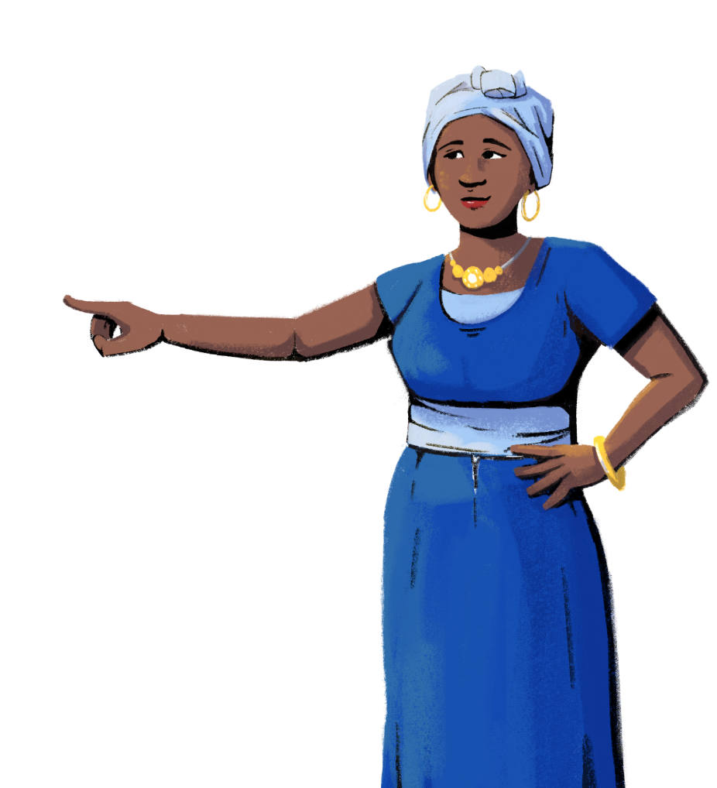
Men and women can both play a role in managing finances for the business!
PART 2:
DEFINING YOUR ROLE IN FINANCIAL MANAGEMENT
Objective: To explore how women
and men can share decision-making
in the business.

Slide 10

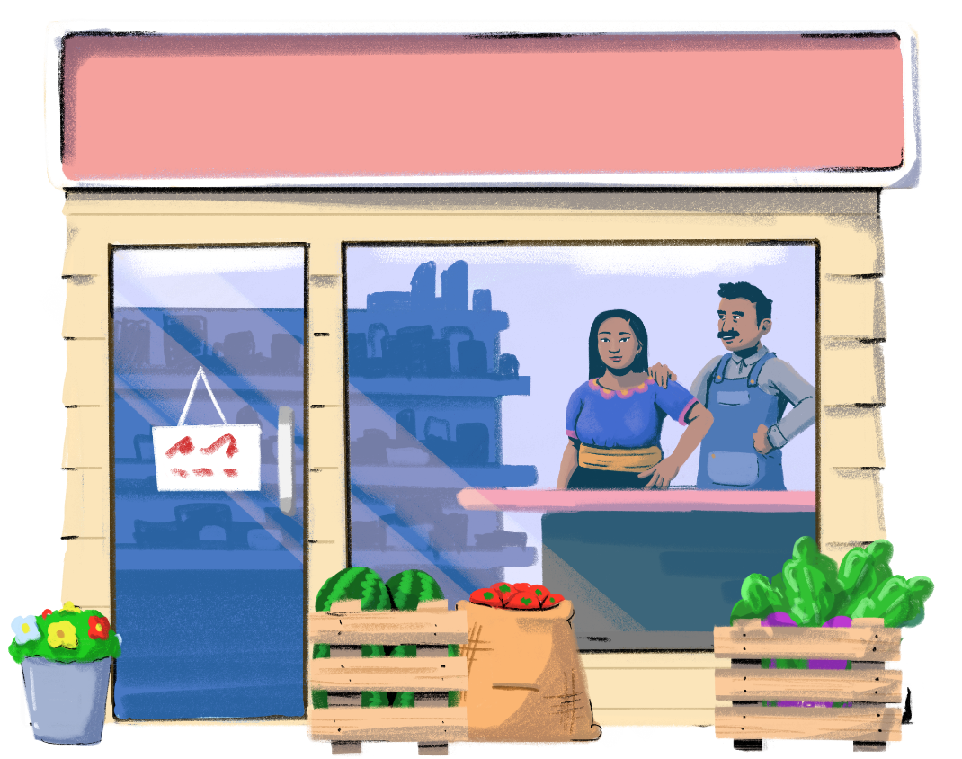

Customization Tip!
Add, delete, or modify questions as necessary.
Who handles
the finances of your business?
How do you keep track of the cash going in and out of your business?

Slide 11
What Is Your Role in Managing The
Money In The Business?
Customization Tip!
Add, delete, or modify questions as necessary.
Do you manage any of the financial matters for your business or at home?
As a woman, do you face any barriers in accessing information or understanding information related to finances at home or in your business?
Are there gender-based divisions in financial decision-making for the business? If yes, why do these divisions exist?
Do you agree with those divisions, or would you like to change them?
What are the benefits for the family and a business when a woman participates in decision-making?
Does your role
as a woman influence your role in the business?

Slide 12



When women help manage finances, there is an increased opportunity for the business to grow and flourish.
Change
is possible!
Women’s participation in the shop’s finances and operations will bring diverse skills to the business.
Women’s participation in business will also provide additional human resources for the business.
When you work in the store, you can decide how money is spent — and consider paying yourself a monthly salary or putting money aside for the family.

Slide 13

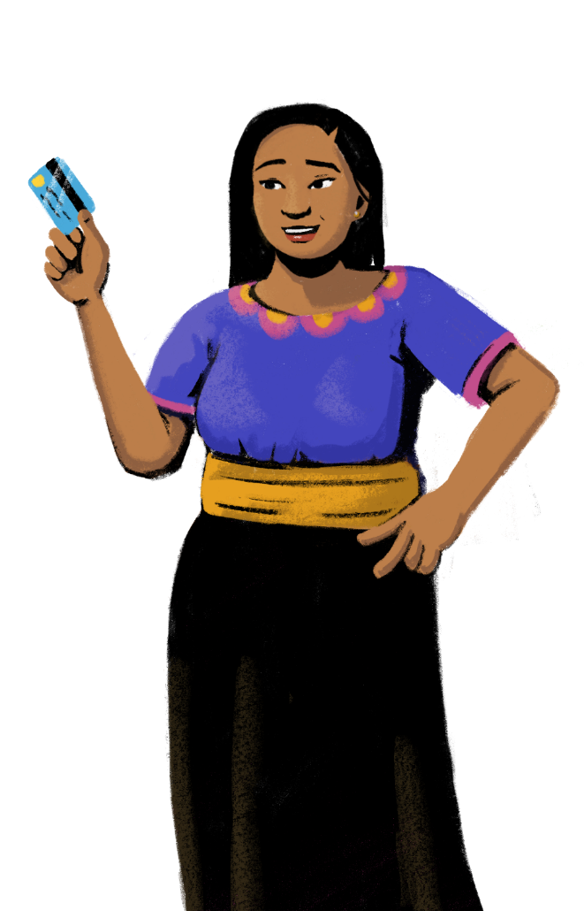
Let’s identify your business expenses!
PART 3:
UNDERSTANDING YOUR BUSINESS EXPENSES
Objective: To identify different types
and amounts of expenses in your
business.

Slide 14
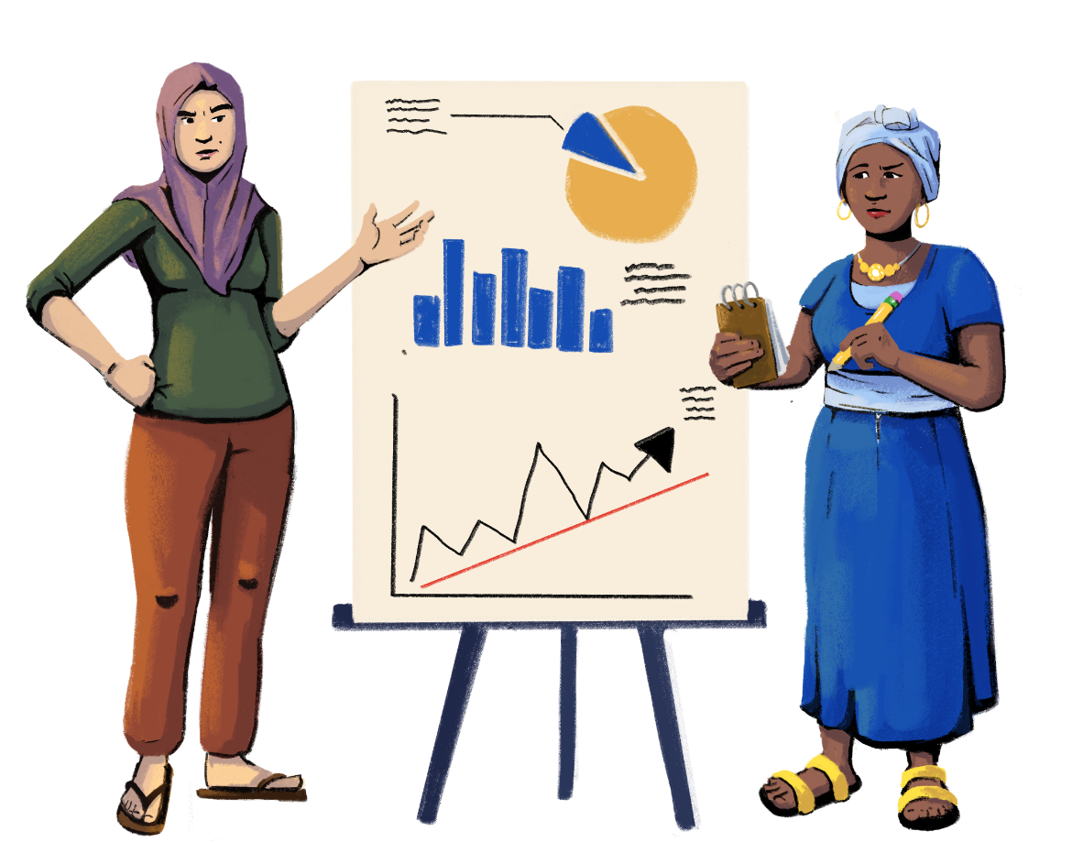
Why Do You Need Money For Your Business?
Customization Tip!
Add, delete, or modify this question as necessary.

Slide 15

Tracking Your Business Expenses
Customization Tip!
All text in this table is editable. Edit the expenses as needed.
My Business Expenses
Rent
Loan Payment
Supplies/Stock
Electricity
Repairs to building or equipment
Travel and Freight
Wages
Taxes
Mobile phone
Insurance

Slide 16
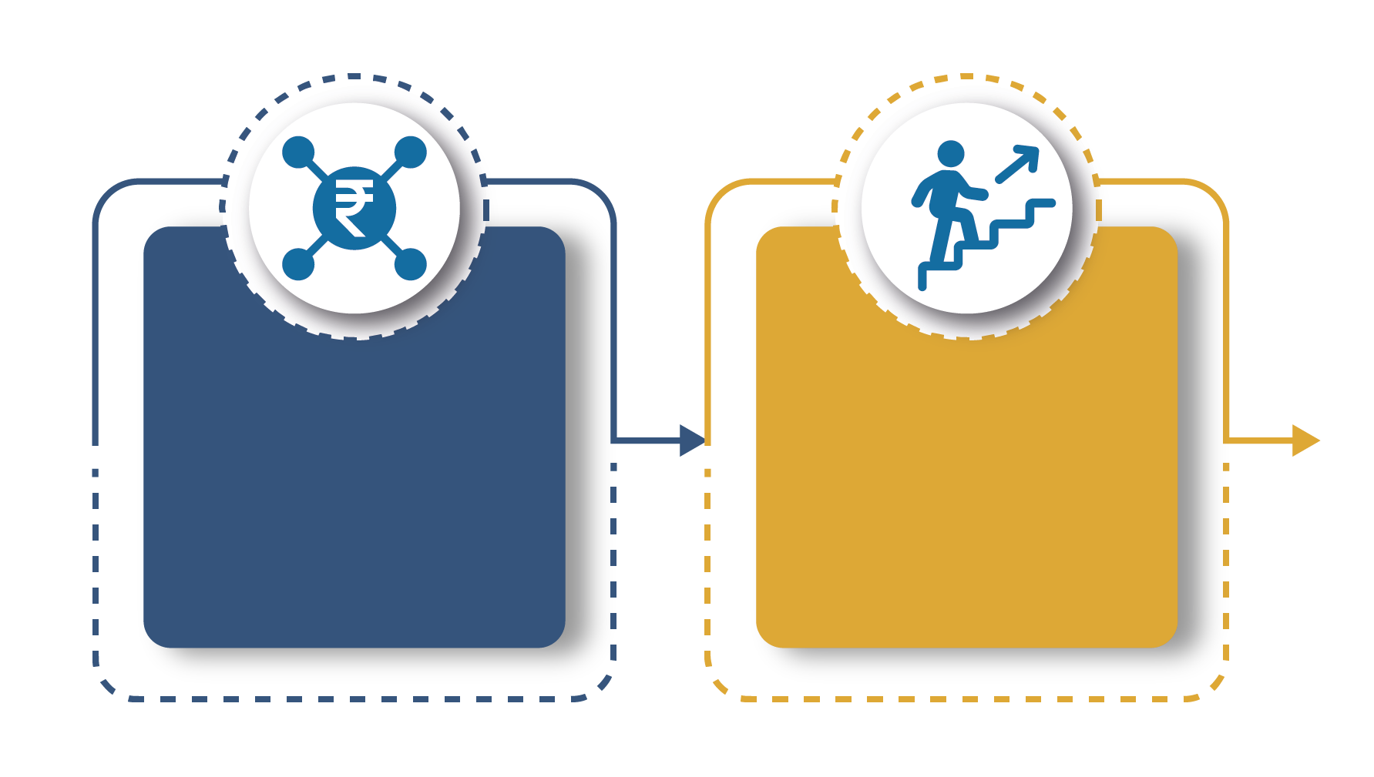


Customization Tip!
Add, delete, or modify questions as necessary.
What are your sources of income to meet these expenses? How do you plan for these expenses?
What are the challenges you face in meeting these expenses?

Slide 17


Are you ready to practice bookkeeping?
PART 4:
UNDERSTANDING THE WHY AND HOW OF BOOKKEEPING
Objectives:
To understand how to keep formal books to track your business finances.
To learn tips for using your phone for bookkeeping.
To develop your bookkeeping skills through practice exercises.

Slide 18




Keeping Formal Records of Your Business:
The Importance of Bookkeeping
1
To know your shop’s income and expenses at any point of time.
2
To account for your monthly expenses such as rent, electricity, phone costs,
and wages.
3
To understand if your shop is making a profit or not.

Slide 19




Let’s
discuss!
Customization Tip!
Add, delete, or modify
questions as necessary.
How do you keep track of your business's finances?
I keep track of it in my head or by keeping receipts.
I write down my sales and expenses in a notebook.
I use my phone or computer to record sales and expenses.
How often do you review how much you’ve sold and your expenses?
Daily
Weekly
Monthly
I look at the money in my till or merchant account frequently.

Slide 20


Anyone Can Do
Simple Bookkeeping;
You Do Not Need To
Be An Accountant!
You can keep books by using
paper or apps:

Slide 21


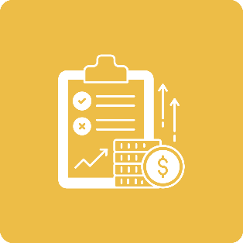
Types of Books
DAY BOOK:
To capture your ‘end of day’ sales and purchases.
CREDIT REGISTER:
To track the debt you owe and who owes you.
PROFIT & LOSS STATEMENT:
To calculate whether your business is making a profit or losing money.

Slide 22


Using Your Smartphone For Bookkeeping
Customization Tip!
Consider adding in examples of digital bookkeeping apps in your market.
Companies have developed apps for small stores that may be available to help you track your sales and expenses. You need a smartphone to download apps. Some apps are accessible on a computer or tablet.
By downloading the app to your smartphone, you can enter customer sales and expenses, and create records right on your phone. This allows you to see how your business is doing in real time.
Track your expenses.

Slide 23
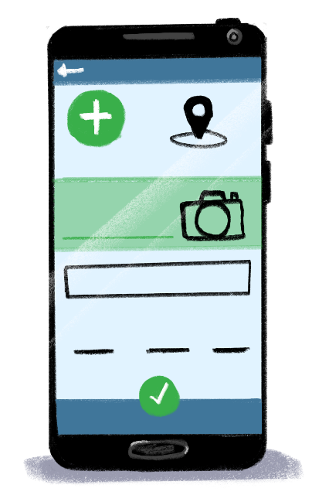

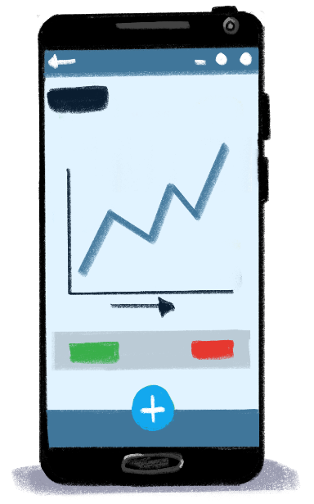
Enter a transaction each time you make a sale or expense.
Stay on top of who owes you money and send them payment reminders.
View your app’s dashboard to see your shop’s performance and cash balance!

Slide 24

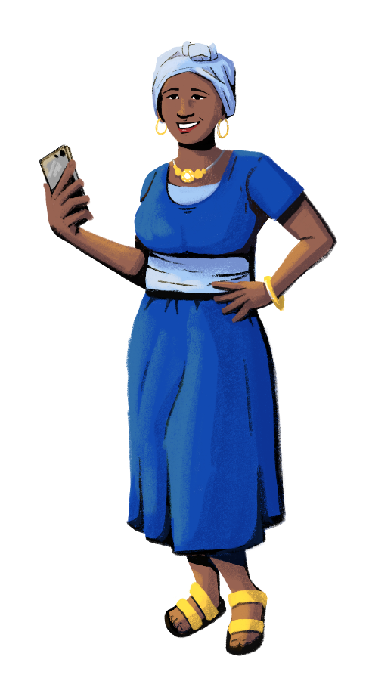
Benefits Of Going Digital With Your Bookkeeping
Can you think of any more benefits of using apps for bookkeeping?
1
If you use your phone for bookkeeping, you will be able to access your records just by logging into the app from any device. You can’t lose your records like you can lose a notebook.
Regularly tracking your business transactions on your phone helps you create records of your business. You can use these to prove your business’ track record to help qualify for credit with suppliers or lenders.
Companies offering bookkeeping apps may link you to sources of credit or give you a “credit score.”
Others in your business can access the app to record and analyze transactions if you give them permission to use the app.
2
3
4

Slide 25




LEARNING RESOURCE
Managing Your Finances with Hey Sister and Oye Amiga
Hey Sister Lessons
Lesson 23: How should I manage finance for my business?
Oye Amiga Lessons
Lesson 21: How should I manage finance for my business?

Slide 26



Recording Sales and Expenses
In Your Day Book
Recording each transaction in a book or digitally will help you document how your business is performing for yourself and for others, like banks or suppliers.

Slide 27



Advantages of Maintaining Books Daily
Maintain information about daily sales and purchases in one place.
Keep track of your cash.
Verify sales and take stock of sold goods.
Keep track of the money withdrawn from the shop for your salary.

Slide 28

What To Include In A Day Book
Customization Tip!
All text in this table is editable. Edit the fields as needed.
Date | Sales |  |  |  | Purchases |  |  | Miscellaneous Expenses
 | Cash in hand | Cash in bank (ATM/ Digital) | Credit |  | Cash purchase | Credit
 |  |  | Credit sales | Cash received |  | Credit purchase | Cash paid
01/01/2022 | 1,500 | 500 | 200 |  |  |  |  | 200-travel
02/01/2022 | 1,300 |  | 400 | 200 | 1,500 | 400 |  | 400-electricity bill
Monthly Total

Slide 29


Practice Session

Slide 30

Customization Tip!
Edit the numbers and scenario as needed.
On 01/03/2021, Sofía and Mateo sold goods for a total of 3,000. Their customers paid in different ways. Customers paid 2,000 in cash, 500 with digital payments (i.e. mobile money), and one customer bought 500 worth of goods on credit.
On 02/03/2021, one of Sofía and Mateo’s customers paid back her credit of 300. Sofía and Mateo also sold 2,500 of goods to customers who paid in cash. Sofía and Mateo agreed to use 300 of their store’s income to buy more supplies.
On 03/03/2021, a regular customer bought 1,000 of goods, and Sofía and Mateo agreed to let her purchase on credit. Sofía also talked to a supplier and purchased goods worth 500 on credit from the supplier.
On 03/03/2021, Mateo paid the store’s monthly rent of 5,000 and Sofía used the store’s mobile wallet account to pay the electricity bill of 400.
On 04/03/2021, Mateo and Sofía used 500 to pay back a supplier who let them purchase on credit the previous month.
Fill in the Day Book based on this information.

Slide 31
Customization Tip!
All text in this table is editable. Edit the fields as needed.
Date | Sales |  |  |  | Purchases |  |  | Miscellaneous Expenses
 | Cash in hand | Cash in bank (ATM/ Digital) | Credit |  | Cash purchase | Credit
 |  |  | Credit sales | Cash received |  | Credit purchase | Cash paid
01/03/2021 | 2,000 | 500 | 500
02/03/2021 | 2,500 |  |  | 300 |  |  |  | 300-supplies
03/03/2021 |  |  | 1,000 |  |  | 500
04/03/2021 |  |  |  |  |  |  | 500 | 5,000-rent, 400-electricity
Monthly Total | 4,500 | 500 | 1,500 | 300 |  | 500 | 500 | 5,700

Slide 32

Credit Registers
There are two types of credit registers: customer credit registers and supplier credit registers.

Slide 33

Types of Credit Registers
Customization Tip!
All text in this table is editable. Edit the fields as needed.
Customer Credit (Accounts Receivable)
Customer Name | Date | Supplier Name | Description | Value of item sold/purchased on credit | Amount repaid | Balance
Max | 03/04/2021 | AB Wholesaler | Ration: Rice, Sugar (1 kg each) | 500 | 300 | 200
Emma | 19/04/2021 | AB Wholesaler | Soap, Shampoo, Biscuit, Salt, Oil | 300 | 150 | 150
Supplier Credit (Accounts Payable)
Date | Supplier Name | Description | Value of item sold/purchased on credit | Amount repaid | Balance
03/03/2021 | AB Wholesaler | Rice, Flour | 500 |  | 500
04/03/2021 | AB Wholesaler | Rice, Flour |  | 500 | 0

Slide 34
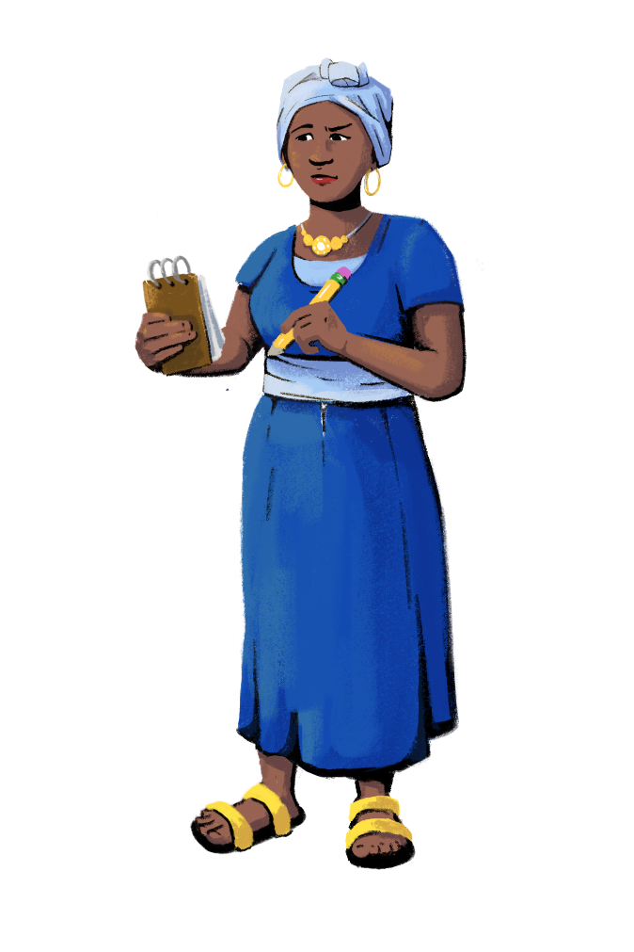
Practice Session

Slide 35
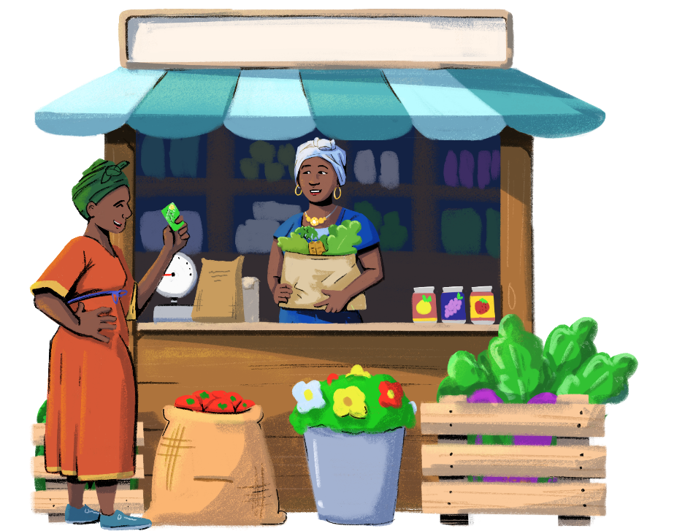
Case 1
Customization Tip!
Edit the numbers and scenario as needed.
On 05/03/2021, Grace bought the following from your store.
  1 kg rice for 40
  1 kg beans for 80
  1 kg sugar for 70
On 07/03/2021, Grace purchased,
  5 kg wheat for 100
  On the same day, she paid 200 in cash too.
Fill in the credit register as on 07/03/2021 based on this information.

Slide 36

Customization Tip!
All text in this table is editable. Edit the fields as needed.
Customer Credit Registry (Accounts Receivable)
Date | Customer | Description | Value of item sold/purchased on credit | Amount repaid | Balance
Grace | 05/03/2021 | Ration: Beans, Rice, Sugar (1 kg each) | 190 |  | 190
Grace | 7/03/2021 | 5 kg Wheat | 100 | 200 | 90

Slide 37
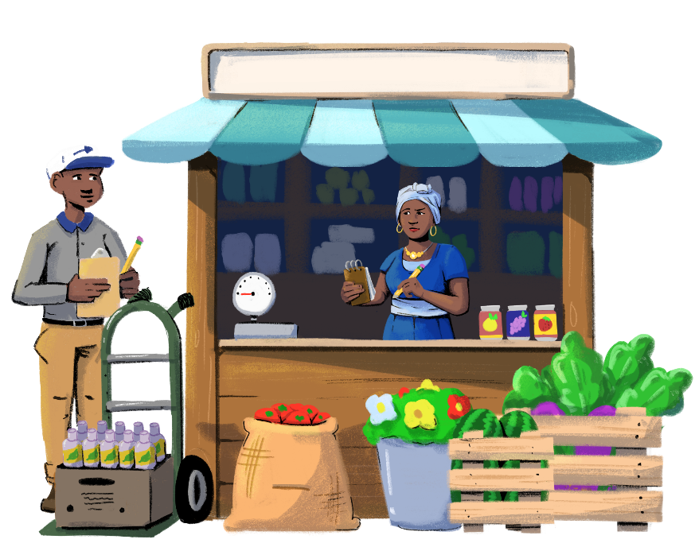
Case 2
Customization Tip!
Edit the numbers and scenario as needed.
On 07/04/2022, you purchased supplies from AB Wholesaler on credit.
  20 kg rice for 1,000
  Ten jars of 100 gm Nescafé Classic Coffee for 1,000
On 11/04/2022, you purchased more supplies on credit.
  40 Dove Soap bars for 1,200
  Ten 100 ml bottles of Pantene Shampoo for 2,000
On 15/04/2022, you paid 600 to AB Wholesaler to pay down your credit.
Fill in the credit register based on this information.

Slide 38

Customization Tip!
All text in this table is editable. Edit the fields as needed.
Supplier Credit Registry (Accounts Payable)
Date | Supplier | Description | Value of item sold/purchased on credit | Payment | Balance
07/04/2022 | AB Wholesaler | 20 kg rice for 1,000 Ten 100 gm bottles of Nescafé Classic Coffee for 1,000 | 2,000 |  | 2,000
11/04/2022 | AB Wholesaler | 40 Dove Soap for 1,200 Ten 100 ml bottles of Pantene Shampoo for 2,000 | 3,200 |  | 3,200
15/04/2022 | AB Wholesaler |  |  | 600 | 4,600

Slide 39


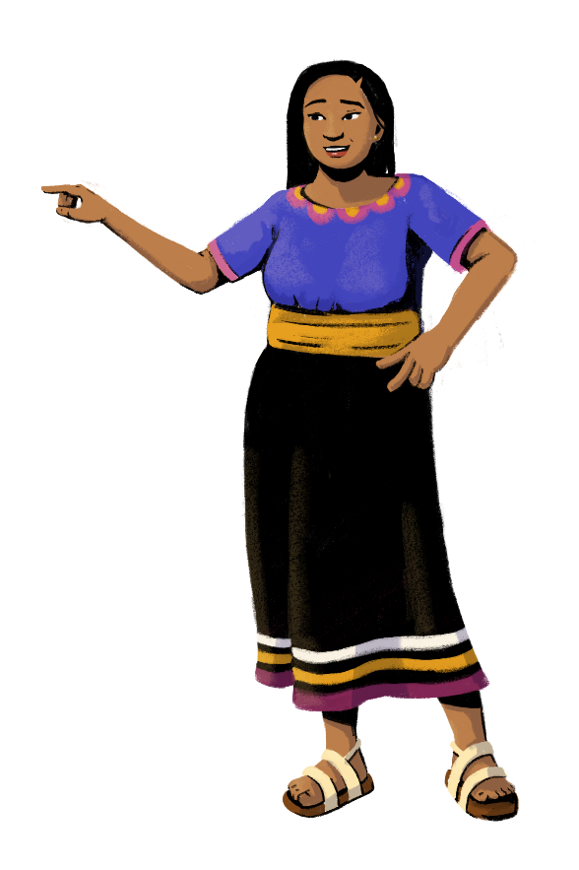
Customization Tip!
Add, delete, or modify questions as necessary.
Use financial discipline to
manage
supplier credit.
When you purchase supplies from wholesalers on credit, pay the wholesaler on time to ensure your goods are always supplied.
What will happen if you do not pay your wholesaler on time?
What do you do if you do not pay your wholesaler on time?

Slide 40

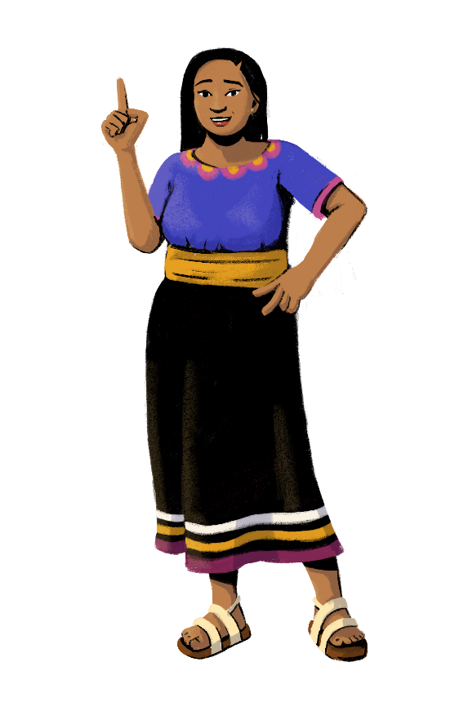

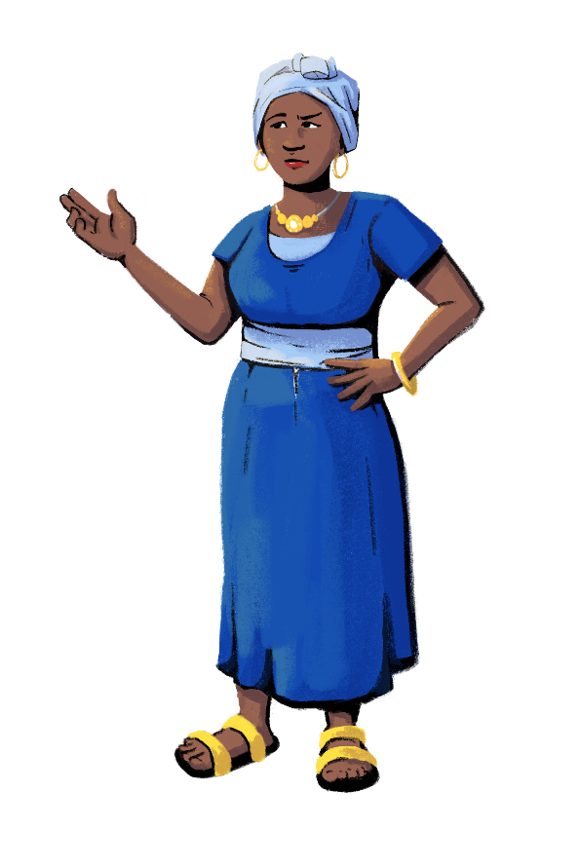

Let’s discuss!
Do you think filling in the day book and credit registers each day will help you with your business?
Customization Tip!
Add, delete, or modify
questions as necessary.
What are the advantages and limitations you see in maintaining these books?

Slide 41

Monthly Profit & Loss Statement
A P&L statement is a financial statement that provides a summary of a business’ revenues, costs, and expenses incurred over a period of time.
The P&L statement shows a business’ ability or inability to generate sales and manage expenses.

Slide 42

Monthly Profit & Loss Statement
Particulars | Entry in the P&L
Cash sales | (cash + digital payments)
Credit sales
Total Revenue | Cash Sales + Credit Sales
Total cost of item/s sold | = opening stock + cash purchase + credit purchase – closing stock
Total transportation cost
Total amount paid for store rent
Total amount paid for electricity
Total amount paid to workers
Total amount withdrawn by the owner(s) for personal use
Total mobile phone costs
Other expenses incurred
Total Cost
Net Profit – To be Calculated | Total Revenue – Total Cost
Customization Tip!
All text in this table is editable. Edit the fields as needed.

Slide 43


Cost of goods sold:
Cost of goods sold = opening stock + cash purchase + credit purchase – closing stock
How to find closing stock?
A stock register has to be maintained in the shop where the purchase and sale of items are recorded. From this, the value of closing stock can be calculated. If a stock register is not maintained, the physical stock of the inventory has to be taken.
Net Profit = Revenue – Cost

Slide 44
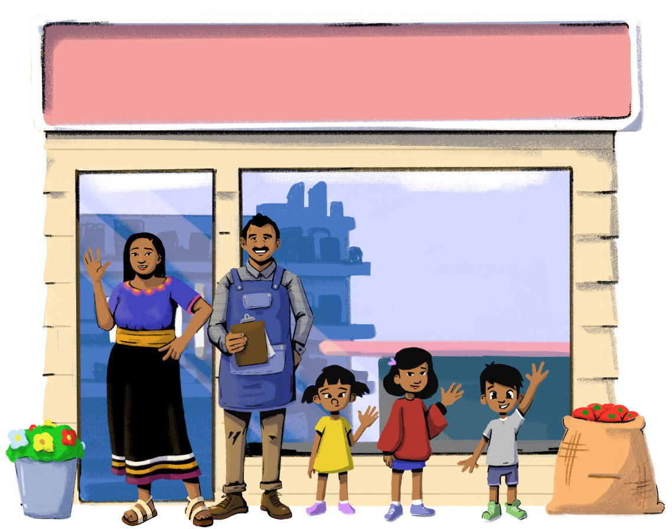

Make A P&L Statement For Sofía and Mateo’s Store

Slide 45
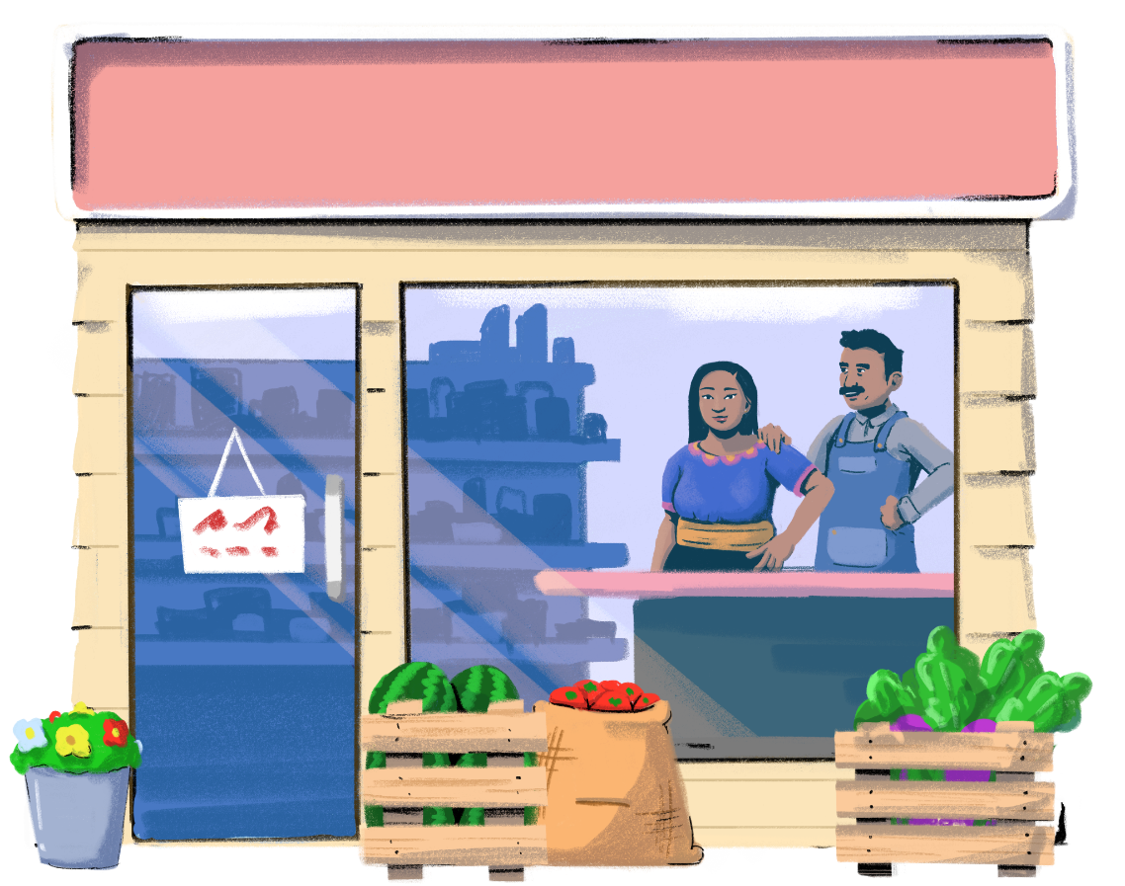

Day Book For Sofía and Mateo’s Store

Slide 46
Date | Sales |  |  |  | Purchases |  |  | Miscellaneous Expenses
 | Cash in hand | Cash in bank (ATM/ Digital) | Credit |  | Cash purchase | Credit
 |  |  | Credit sales | Cash received |  | Credit purchase | Cash paid
01/01/2021 | 645 |  | 110
02/01/2021 | 486 |  | 45 |  |  |  |  | 200-travel
03/01/2021 | 768 | 500 | 65 | 60 | 1,250
04/01/2021
05/01/2021 | 984 |  | 132 | 80 |  |  |  | 400-electricity
06/01/2021 | 648 |  | 230 | 50 | 2,500
07/01/2021 | 864 |  | 117
08/01/2021 | 1,045 | 200 | 28 | 120 |  |  |  | 800-owner withdrawal
09/01/2021 | 987 |  | 45 | 100
10/01/2021 | 459 |  | 458 | 220 |  |  |  | 200-mobile phones
11/01/2021 | 855 |  | 128 | 60
Customization Tip!
All text in this table is editable. Edit the fields as needed.

Slide 47
Date | Sales |  |  |  | Purchases |  |  | Miscellaneous Expenses
 | Cash in hand | Cash in bank (ATM/ Digital) | Credit |  | Cash purchase | Credit
 |  |  | Credit sales | Cash received |  | Credit purchase | Cash paid
12/01/2021 | 1,290 |  | 35 | 123 | 2,580 | 700
13/01/2021 | 980 |  | 235 | 80
14/01/2021 | 1,239 |  | 335 | 115
15/01/2021 | 1,453 |  | 25 | 85 | 1,480
16/01/2021 | 1,267 |  | 231 | 45
17/01/2021
18/01/2021 | 910 | 300 | 443 | 278 | 650
19/01/2021 | 1,576 |  | 34 | 135 | 3,275 |  | 400
20/01/2021 | 1,086 |  | 543 | 328
21/01/2021 | 987 | 1,000 | 245
22/01/2021 | 110 |  | 453 | 225 | 875
Customization Tip!
All text in this table is editable. Edit the fields as needed.

Slide 48
Date | Sales |  |  |  | Purchases |  |  | Miscellaneous Expenses
 | Cash in hand | Cash in bank (ATM/ Digital) | Credit |  | Cash purchase | Credit
 |  |  | Credit sales | Cash received |  | Credit purchase | Cash paid
23/01/2021 | 1,286 |  | 354 | 55
24/01/2021
25/01/2021 | 786 |  | 435 | 288 | 2,470 | 800 | 200
26/01/2021 | 1,453 |  | 334 | 145
27/01/2021 | 1,208 |  | 234 | 254
28/01/2021 | 897 |  | 434 | 650 | 5,200 | 900 | 750 | 2,000-asset purchased
29/01/2021 | 1,234 |  | 45 | 35
30/01/2021 | 876 |  | 320 | 425 | 4,580 |  | 500 | 1,000-wages
31/01/2021 | 987 |  | 136 | 125 |  |  |  | 2,000-store rent
TOTAL | 27,366 | 2,000 | 6,229 | 4,081 | 24,860 | 2,400 | 1,850 | 6,600
Customization Tip!
All text in this table is editable. Edit the fields as needed.

Slide 49

Monthly Profit & Loss Statement
Particulars | Entry in the P&L
Cash sales | 29,366
Credit sales | 6,229
Total Revenue | 35,595
Total cost of item/s sold | 27,260
Total transportation cost | 200
Total amount paid for room rent | 2,000
Total amount paid for electricity | 400
Total amount paid to workers | 1,000
Total mobile phone costs | 200
Total amount withdrawn by the owner(s) | 800
Other expenses incurred (assets purchased) | 2,000
Total Cost | 33,860
Net Profit (35,595 – 33,860 = 1,735) | 1,735
Customization Tip!
All text in this table is editable. Edit the fields as needed.

Slide 50

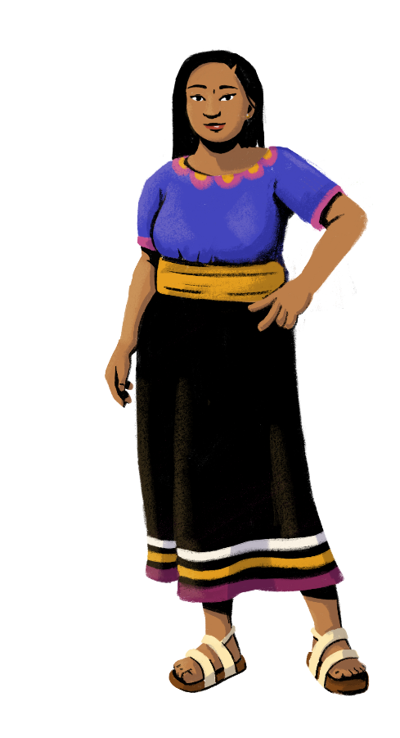
Let’s Recap!
So far,
you have learned:
How to maintain the following books:
Day book
Credit registers
P&L statement
The importance of keeping records of your business finances

Slide 51





Things to Remember
1
Keep your personal and business finances separate.
2
Know your expenses and
sources of income.
3
Practice simple bookkeeping:
Record your transactions.
Plan and budget for your business.
Steadily grow your business.

Slide 52
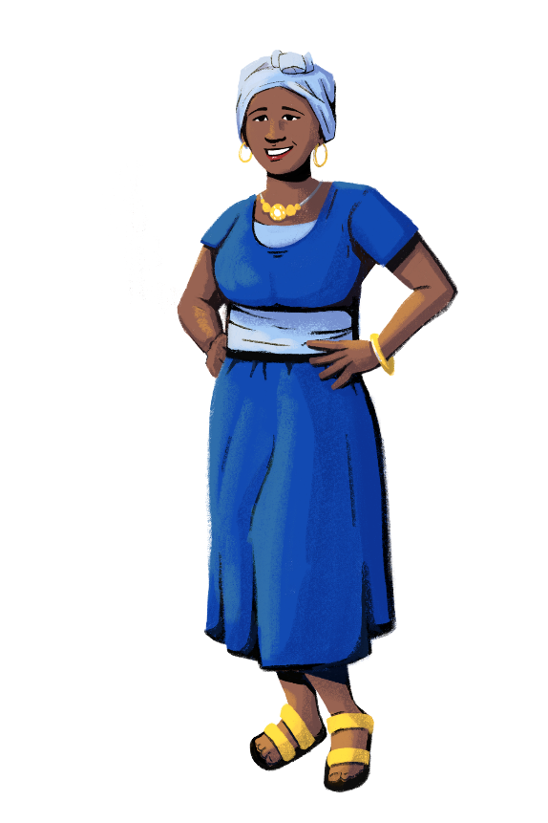

What did you learn today?
Customization Tip!
Add, delete, or modify
questions as necessary.
What did you find useful that you will apply in managing your finances?
Will you use the bookkeeping methods we explored in your business?

Slide 53



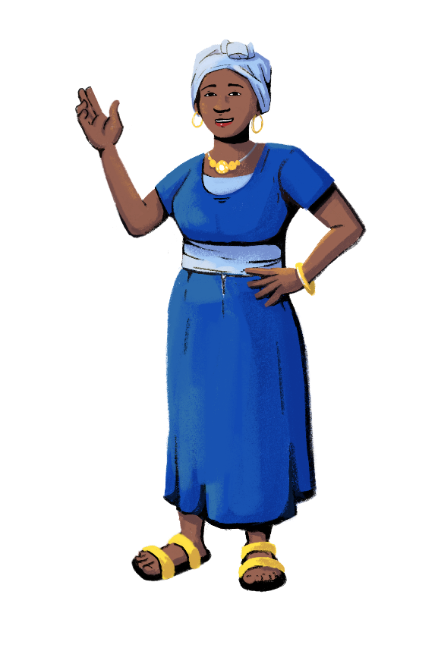


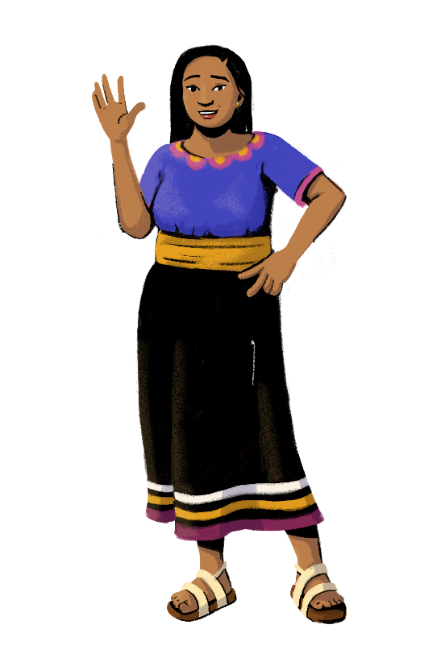
www.siaedge.com
Line Two
Line Three

