Slide 1





Inventory Management
Her Business, Her Future
Business Management and
Digital Literacy for Women
Micro-Entrepreneurs
This module is made possible by the generous support of the American people through the United States Agency for International Development (USAID). This guide was produced under DAI’s Digital Frontiers Project (Cooperative Agreement AID-OAA-A-17-00033) at the request of USAID and in partnership with Mastercard. The contents are the responsibility of XYZ and do not necessarily reflect the views of USAID or the United States Government.

Slide 2

Tips for Customizing This Module
The following list provides helpful tips for customizing the content in this module. You can click the slide numbers to be brought directly to that slide. Each slide with customizable elements includes arrows, text boxes, or highlighted phrases to indicate customizable sections and words.
Topics: This module is broken down into several topics as described in the table of contents. You can delete the topics that are not relevant to you and your group. You can also delete any slide throughout the module that does not apply to you or your group. Additionally, all text in this module is directly editable.
Characters: This module uses a mix of characters from different regions. You can replace any of the characters using the character image files from the creative asset library.
Discussion Questions: Slides 16 and 40 contain questions for discussion. You can add, edit, or replace the questions as needed.
Scenarios: Slides 18 - 19 and 35 feature two characters having a conversation for the group to read. These scenarios can be modified to be reflective of situations your group faces. Alternatively, these conversations can be used to help frame questions for discussion.
Manual Inventory Management Systems: Slides 32 and 34 have examples of manual inventory management systems in a table format. You can edit the text to be reflective of your context, such as the supplier name, items, and purchasing price.
Digital Inventory Management Systems: Slide 37 lists examples of digital inventory management systems. You can delete examples that are not relevant to your context and add systems that are available in your market. Slide 38 features instructions on how to use a specific digital inventory management system. You can replace these instructions with a digital inventory management system of your choice.

Slide 3



Module Overview
Table of Contents
Objectives
Understand the basics of inventory management.
Learn about inventory management systems.
Part 1: What is inventory management? | 7
Part 2: How to manage your inventory | 15
Part 3: Inventory management systems (manual and digital) | 29
In this module, you can…
identify and practice strategies to manage your inventory
practice using manual and digital inventory systems

Slide 4









What Challenges Do You Face In Your Shop?
Let’s share our experiences!
You are not able to
keep track of your
stock.
You have
too much or too little stock.
You don’t know
what to reorder and when.
You can’t spot the best and worst selling items.
Your items often go bad or spoil.
You can’t decide which items to stop selling and which items to sell at a discount.
You lose customers because there are long lines to enter your store.

Slide 5


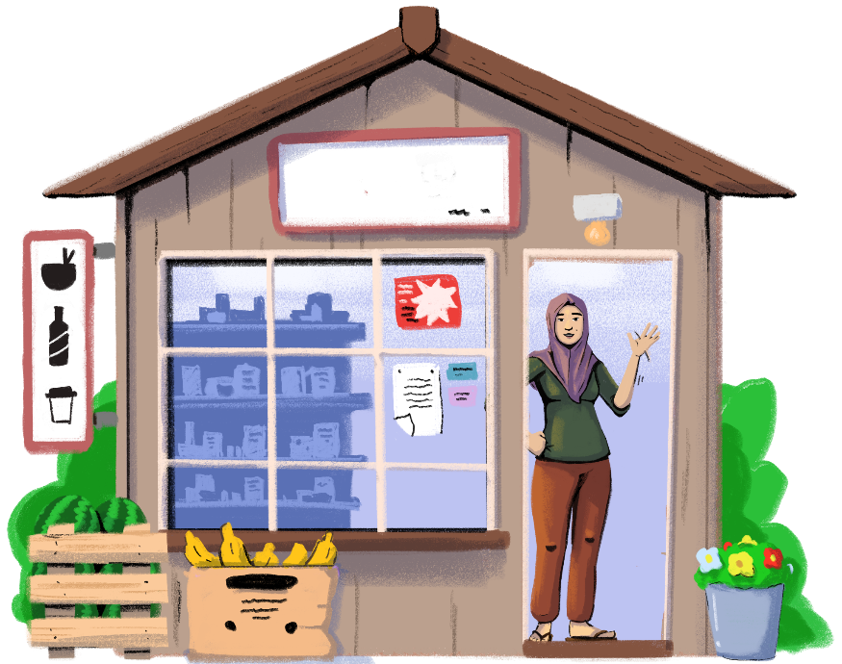
Picture
this!
What do you understand from this scenario? How could Ratana have avoided this situation?
Ratana owns a store. During the dry season, she removes certain products from her shop that aren’t in high demand, like umbrellas. However, one day a customer asked her for an umbrella, and she couldn’t find any in storage. Later, she discovered that the box of umbrellas in storage had fallen over, damaging all the umbrellas.

Slide 6





RATANA
Lost customers
Missed sales
Had money tied up
Ratana could have avoided this situation if she had an inventory management system.

Slide 7



Are you familiar with inventory management?
PART 1:
WHAT IS INVENTORY MANAGEMENT?
Objectives:
To learn about inventory management.
To understand the benefits of inventory management.

Slide 8
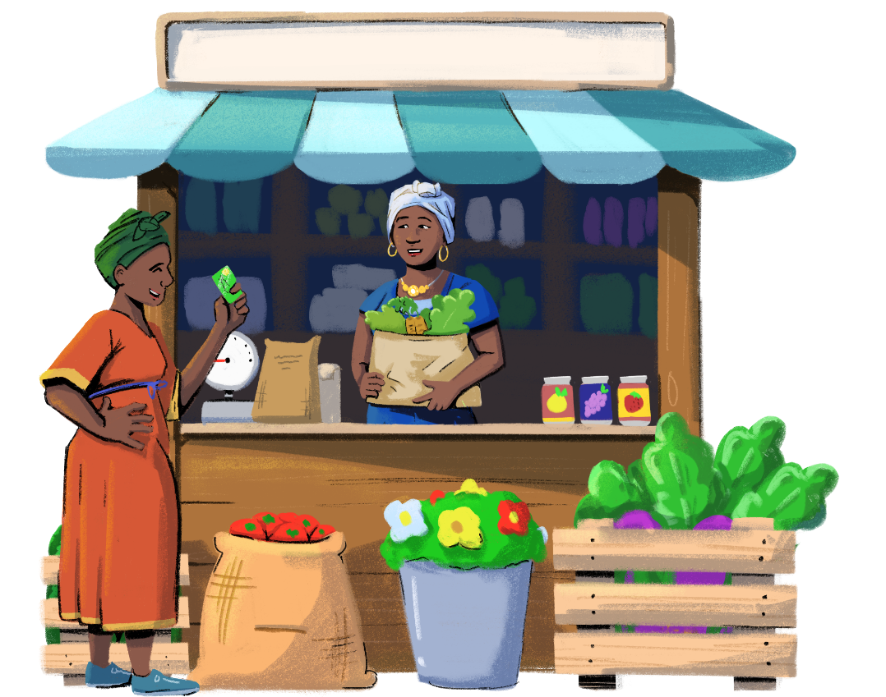

What Is Inventory?
Inventory is the stock of goods that your business must keep in your store today and in the future.

Slide 9


Inventory Management
Governs the flow of goods
Inventory management is how you track and control your business’ stock as it is bought, stored, and sold.
An inventory management system helps make sure you have the right quantities of the right items in the right locations at the right time.
from purchase
to sale

Slide 10





In Other Words…
Inventory management helps you to…
Track your
stock.
Know when
to order.
Know what and how much to order.

Slide 11



Benefits of an Effective Inventory Management System
RUN YOUR BUSINESS SMOOTHLY
EFFICIENTLY MANAGING INVENTORY
If your store doesn’t manage its inventory properly, your business will suffer.
For instance, Ratana needs to match her supply to customer demand.
If she purchases more than she can sell, she’ll need somewhere to store the excess, and she will have to wait to recover her own purchase costs, which could cut into her profits.
If she runs out of any products, she will lose potential revenue on that product.
SUPPLY
DEMAND

Slide 12



2. KEEP CUSTOMERS HAPPY
How quickly can you get products to your customers?
Aim to have requested products in stock. This means you have to keep track of when to reorder products.
How reliable are you?
Your customers should be able to count on you to have what they need in stock.
All your products should be fresh and undamaged. Slightly damaged products and products close to their expiry date should be sold at a discount.
How fast can you adapt to the needs of your customers?
Order new products or brands if there is customer demand for it.
Customers will be much more likely to come back for more if they know your store consistently has the goods they need.

Slide 13



3. MANAGE GROWTH IN YOUR BUSINESS
As your business grows, your inventory management needs to get more organized as well.
It is important to get control over your physical stock from day one if you plan on scaling. Putting an effective inventory system in place early is key to managing your stock.

Slide 14

4. ANALYZE THE PERFORMANCE OF YOUR BUSINESS
Establish some indicators that you can analyze on a monthly basis so that you can track the trends in your business. Let’s review some sample indicators:
How much loss did you have from unsold stock? Identify if there are specific products that tend to drive these losses.
How much loss did you have from stock that expired? Try to improve the system in place for discounts on perishable items.
Are there products that are consistently out of stock? Make sure to boost the amount you order.
You can also analyze the channels of your inventory:
Which suppliers are reliable, and which are not? If there are suppliers that don't meet their orders on time, it might be time to find new ones.
If you have established a good business relationship with your supplier, you can ask for discounts.
Do you have suppliers charge you more than their competitors? Ask them for a better deal or change suppliers.

Slide 15

Let’s learn how to manage your inventory!
PART 2:
HOW TO MANAGE YOUR INVENTORY
Objective: To become familiar with tips and tricks to manage your inventory.

Slide 16







Now that you know what an inventory management system is…
Customization Tip!
Add, delete, or modify
questions as necessary.
Who handles inventory management in your business?
Can you list some
of the advantages of both men and women handling inventory management?

Slide 17

Who Should Manage the Inventory?
Inventory management is a learned skill and has very little to do with what gender you are. Anyone given the opportunity to learn and practice this skill, be it a man or a woman, can be successful!
Men and women may have more experience using different products that you sell in your store. For example, women may use different household products than men in their daily lives, which means they have more knowledge about what kinds of household products they can sell in their stores.
A woman will be able to recommend products based on her experience, and can also appeal to other women, thereby increasing sales and profit of the business.
Having women who can manage the inventory management process makes great business sense!

Slide 18








Customization Tip!
You can modify these characters and the scenario when needed.
Sofía, I have to leave for that appointment at the bank. The new dairy supplier is late...Can you talk to him about his prices in case he arrives while I’m out?
Hmm.. The last time I was alone negotiating with a new supplier, he was quite pushy about offering us really high prices. Once you entered the shop, his behavior changed, and he lowered the prices.
That is disrespectful! Why didn’t you tell me?
I didn’t think much about it, but looking back, I’m sure that he treated me differently because I am a woman. Can you maybe cancel the bank appointment and talk with the supplier?
I didn’t realize these things before! I will meet the supplier with you, but I think it is important to challenge people who think this way.
Well, I do have to keep interacting with male business partners. You’re right; if I see that he’s trying to take advantage of the situation, I’ll call him out on his behavior!
And I will be there to support you during the conversation!

Slide 19




Have you ever been in a similar situation as Sofía? If so, how did you act? Would you have done something differently?
Customization Tip!
You can modify the scenarios, characters, and questions.

Slide 20
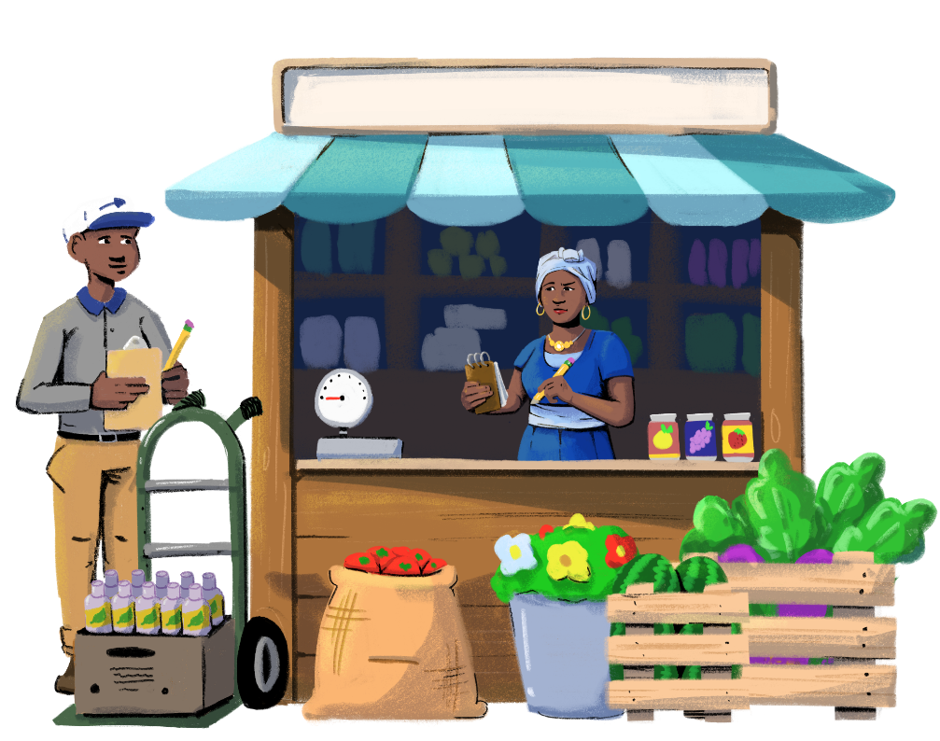
How Can You Manage Your Inventory?
ORGANIZE PRODUCT AND SUPPLIER INFORMATION
List all product-specific information, like product name, quantity, brand, purchase price, selling price, expiration date, and location of the stock.
Record supplier details, such as the supplier and vendor names, contact details, wholesale cost, and minimum order amount.

Slide 21


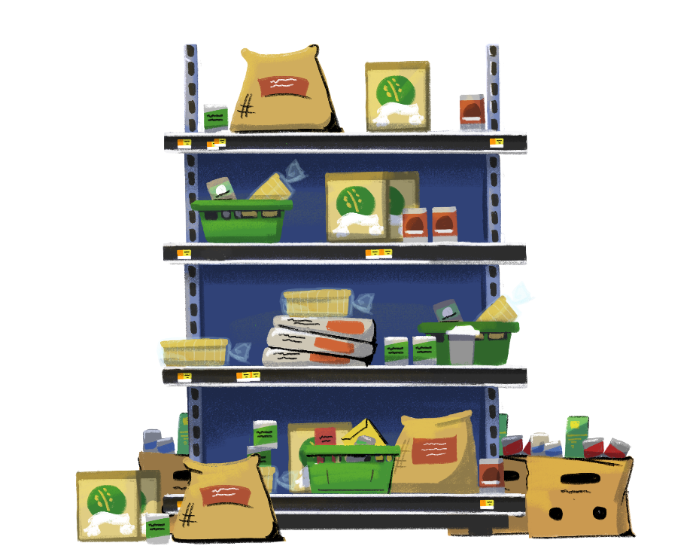
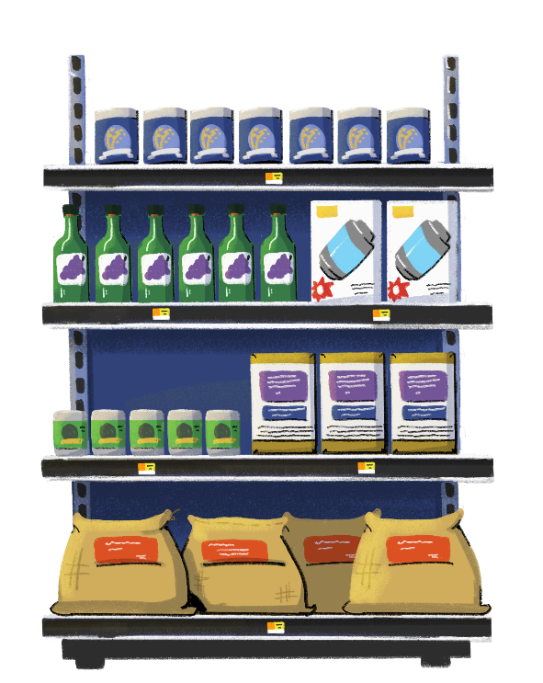
What is the difference
between the shelves in these
two stores?
2. SET UP STOCK

Slide 22

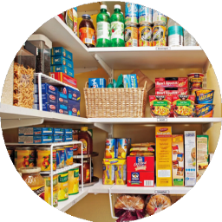


Display all items in an organized manner. Misplaced and overlooked products represent missed sales and lost revenue.
Follow the first-in, first-out method. Display older products in the front of the store to make sure that they are sold first, before they expire.
Identify which items sell quickly, which have average sales, and which have low sales.
Keep the top-selling items in stock. Consider offering discounts on items that don’t sell well.

Slide 23

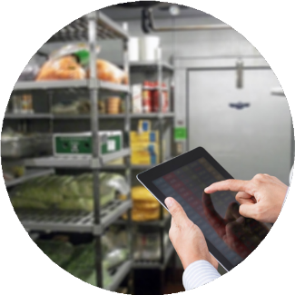
3. TAKE A PERIODIC COUNT OF STOCK
Periodic counting of your stock will ensure an accurate and up-to-date record, adjusting for damage, defects, and returns.
Counting will help you understand which items are selling faster and which aren’t, and based on that information, you can plan when and how much of each item to reorder.
Counting can be done at regular intervals, such as every one to two weeks. But remember, doing a physical count may take a lot of time and resources.
A digital inventory management system makes the counting process easier and quicker. If you have high sales or are planning to scale your business, you can consider adopting a digital system.

Slide 24
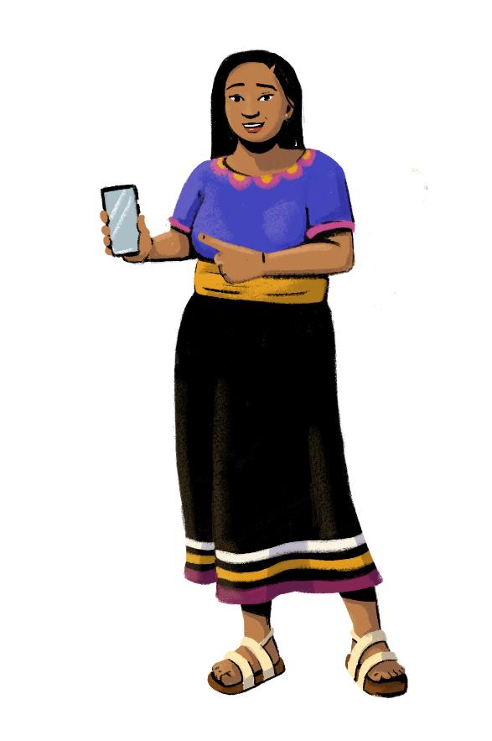

4. CREATE A PURCHASING PROCESS
Based on your current stock balance, list the items that are sold out or low and need to be reordered.
Using this list, place a purchase order with your supplier.
If you adopt a digital system, you can set low-stock alerts and notifications, so you know it's time to reorder.

Slide 25


5. BUILD A STOCK RECEIVING PROCESS
It is important to check all received items against the purchase order to minimize losses due to errors by the supplier, delivery of expired products, damaged items, or items lost in transit.
When you receive your stock, you should count and unpack all packages and check the packing slip, invoice, and items received against the original purchase order.

Slide 26



6. ESTABLISH A PROCESS FOR DISCOUNTS AND PROMOTIONS
If product sales are low due to seasonal factors or trends, you can offer markdowns and discounts to generate sales. For instance, Ratana put umbrellas in storage during the dry season. She could have offered discounts to incentivize purchases.
For promotions, you need to ensure that you have enough stock on hand to meet the demand.

Slide 27


7. DETERMINE A PROCEDURE FOR RETURNS
When a customer returns an item that is damaged or defective, it should be repaired or returned to the vendor.
If the item is repairable but the customer no longer wants it, add it to your inventory count and put it in the proper place for sale.
You can also dedicate space in your storeroom for damaged or returned products.

Slide 28

Key Takeaways
Men and women can both handle inventory management. With practice, anyone can handle inventory management! Also, women can use their knowledge of certain products to make recommendations to women customers.
Keep your information and products organized. With all the products you have in your store, it can get difficult to keep track of important information. Take extra time to record key details about your inventory, and make sure you thoughtfully display your products to make your store look inviting.
Make an inventory management routine. Tracking and managing your stock must be done frequently so that you always have up-to-date information. Try establishing a routine for receiving your products and counting stock so that inventory management becomes a habit.
Get creative. If you find that certain items aren’t selling well, think about different ways to incentivize customers to buy those products. For example, what kinds of discounts can you offer? How can you display these products to encourage sales?

Slide 29
Do you use a manual or digital inventory management system?
PART 3:
INVENTORY MANAGEMENT SYSTEMS (MANUAL AND DIGITAL)
Objective: To understand manual
and digital methods to to manage
your inventory.

Slide 30

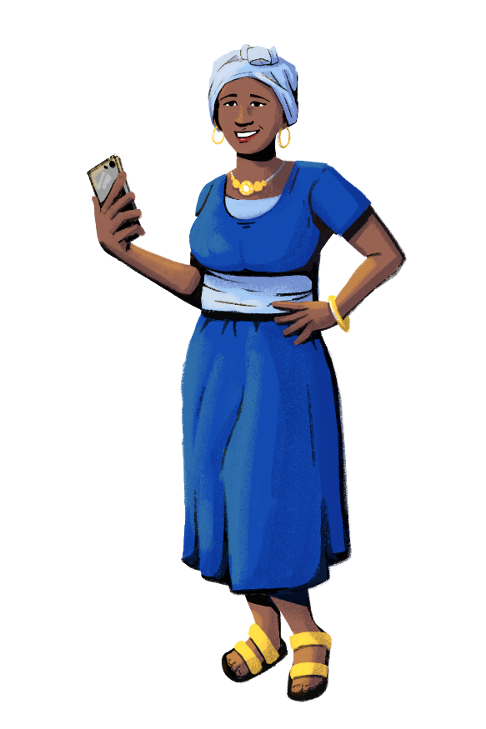



Keeping track of your stock can feel overwhelming. You must adopt an efficient system to handle your inventory.
INVENTORY MANAGEMENT SYSTEMS
Do it
manually
Go digital
Purchase register
Stock
register

Slide 31


Do It Manually
PURCHASE REGISTER
A purchase register can help you keep a detailed account of the items that were purchased from a supplier, on which day, in what quantity, and for what price.
You can also update the register to list:
Product details – such as product name, quantity, brand, purchase price, selling price, expiration date, and location of the stock.
Supplier details – such as name, contact, wholesale cost, and minimum order amount.

Slide 32

Customization Tip!
All text in this purchase register table is editable. Consider changing the fields to be reflective of your market.
PURCHASE REGISTER
Date | Name of the Supplier | Item(s) Purchased | Quantity Purchased (A) | Purchasing Price of the Item (B) | Total Amount (A*B) | Sale Price of the Item
01/07/2022 | ABC Supplier | Soap | 100 | 20 | 2,000 | 23

Slide 33

Do It Manually
B. STOCK REGISTER
Stock taking can be done at regular intervals, such as every one to two weeks, using a stock register.
Based on the balance of the stock, you can understand which goods sell faster, which don’t, and can plan when and how much of each item to reorder. The register can also be updated to reflect the amount of damaged, defective, and returned goods.

Slide 34
Customization Tip!
All text in this stock register table is editable. Consider changing the fields to be reflective of your market.
B. STOCK REGISTER
Date | Item(s) | Number of Items Available in Stock: Quantity (A) | Number of Items Sold: Quantity (B) | Balance of Stock (A-B)
01/07/2022 | Pepsi | 100 | 25 | 75

Slide 35



Customization Tip!
You can modify these characters and the scenario when needed.
I’m worried that if I manage my inventory manually, I will lose track of all the information I need! Imani, do you know if there’s an alternative that can help me?
Well, of course! I recommend trying digital inventory systems. They not only log information but also notify you when you should reorder items.
That sounds very useful! Do you know of some of these systems? And what equipment do I need for this?
For many, it is enough to have a smartphone! Let me show you some examples of digital inventory systems!

Slide 36

Digital Inventory Systems
Digital inventory systems electronically track goods, materials, and merchandise through computer software in real-time. These systems can help you make decisions and predictions on inventory allocation or restocking.
Both digital and manual inventory systems can help you stay organized, but digital inventory systems are usually more efficient. With manual inventory systems, some things might escape your memory, like when to restock certain products. Digital inventory systems keep you up to date with regular notifications.
While manual inventory systems can get lost or damaged, digital platforms store your information. If you memorize your account log-in information, you will be able to access your system from any computer or smartphone.
While some digital inventory systems may not be free, you can get a return on investment, as they can help you boost sales with their efficiency.

Slide 37


Customization Tip!
Click on the name of each system to access their website. You can delete or replace systems to best fit your market context.
Go Digital
Let’s
do it!
DIGITAL INVENTORY MANAGEMENT SYSTEMS
Odoo
ShipBob
Sortly
Tally
Zoho
TECHNOLOGY REQUIRED | Smartphone/ Computer | Smartphone/ Computer | Smartphone/ Computer | Computer | Smartphone/ Computer
COSTS | Free | Starting from 5.38 USD per month | Tiered pricing options available | 360 USD per year | Free (conditions apply)
OTHER FEATURES | All are password protected.

Slide 38









Customization Tip!
You can replace these instructional videos and articles with a digital inventory management system of your choice.
Spotlight: How To Use Zoho
Let's look at what's included in the digital inventory system Zoho.
ADD ITEMS
MANAGE VENDORS
PURCHASING ORDER
PRICE LISTS
BARCODING
REPORTS
FULL TUTORIAL

Slide 39



Let’s Recap!
Let’s list your learnings.
What is inventory management?
How to manage your inventory
Inventory management systems
Manual systems (books and registers)
Digital inventory management systems

Slide 40




Customization Tip!
Add, delete, or modify
questions as necessary.
Share your doubts and questions!
What did you find useful? What did you learn today?
Which inventory management system will you adopt?

Slide 41







www.siaedge.com
Line Two
Line Three

