Slide 1





Know Your Phone
Her Business, Her Future
Business Management and
Digital Literacy for Women
Micro-Entrepreneurs
This module is made possible by the generous support of the American people through the United States Agency for International Development (USAID). This guide was produced under DAI’s Digital Frontiers Project (Cooperative Agreement AID-OAA-A-17-00033) at the request of USAID and in partnership with Mastercard. The contents are the responsibility of XYZ and do not necessarily reflect the views of USAID or the United States Government.

Slide 2

Tips for Customizing This Module
The following list provides helpful tips for customizing the content in this module. You can click the slide numbers to be brought directly to that slide. Each slide with customizable elements includes arrows, text boxes, or highlighted phrases to indicate customizable sections and words.
Topics: This module is broken down into several topics as described in the table of contents. You can delete the topics that are not relevant to you and your group. You can also delete any slide throughout the module that does not apply to you or your group. Additionally, all text in this module is directly editable.
Characters: This module uses a mix of characters from different regions. You can replace any of the characters using the character image files from the creative asset library.
Discussion Questions: Slides 4, 6, 9, and 13 contain questions for discussion. You can add, edit, or replace the questions as needed.
Mobile Wallet Terminology: The term “mobile wallets” is used in this module. You can replace “mobile wallets” with a term that resonates best with you and your audience - such as mobile money account, digital wallet, etc. - by using the “find and replace” tool. The term is also highlighted throughout the module.
Phone “How-Tos”: Slides 11 - 34 of this module give instructions on how to perform different actions on your phone. Depending on the type of phone that most people in your group have, or the level of familiarity your group has with their phones, you might consider skipping over some of these exercises. Some of these exercises include instructions for all types of phones, whereas some are specific to smartphones. You can modify or delete instructions as necessary. You can also replace the instructional photos with screenshots using the type of phone that is most used in your group.
Mobile Data Costs: Slide 16 introduces the concept of mobile data. Consider showing GSMA’s poster on mobile data costs as an additional resource.
Recap Exercises: Slides 36 - 37 give practice exercises. You can modify these exercises to be reflective of the skills that your group needs to practice, or the types of phones your group has.

Slide 3



Module Overview
Table of Contents
Objectives
Part 1: Phone types | 5
Part 2: Phone “how-tos” | 10
Part 3: Ways to protect your data and information online | 38
Appreciate the value of owning a phone.
Learn how to use your phone.
Understand how to protect your data and information online.
In this module, you can…
identify the features of basic phones, feature phones, and smartphones
practice using different apps and features on your phone
build strategies for protecting yourself online

Slide 4



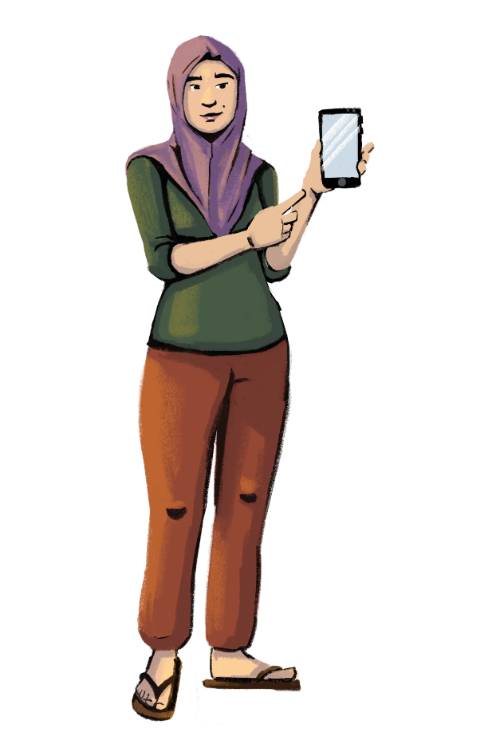

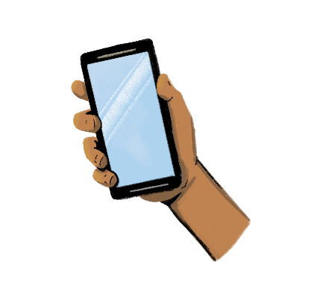
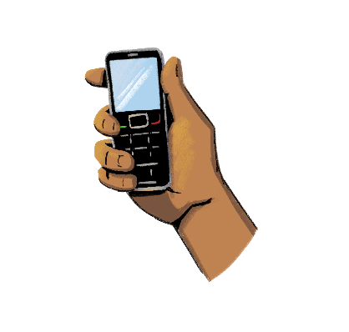
Before you start, let’s discuss!
Customization Tip!
Add, delete, or modify
questions as necessary.
What is the difference between a basic phone and a smartphone?
Which one is better for
your business?

Slide 5



Let’s learn about the different types of phones.
PART 1:
PHONE TYPES
Objectives:
To differentiate between phone types.
To appreciate the value of owning your own phone.

Slide 6



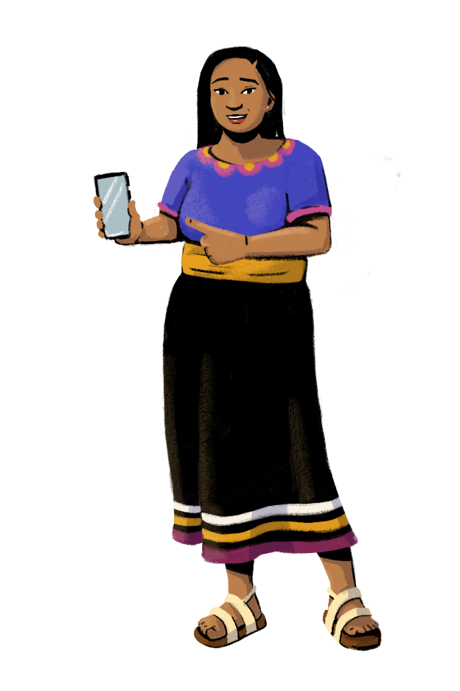

Let’s
create
groups!
Customization Tip!
Add, delete, or modify
questions as necessary.
Group 1: How many of you own and use a basic phone?
Group 2: How many of you own and use a smartphone?
Group 3: How many of you do not own a smartphone but know how to use one?

Slide 7

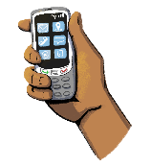

What Are The Different Phone Types?
BASIC PHONE | Basic phones are the simplest type of mobile phone. They usually have a small screen and a keypad with numbers and letters. With a basic phone, you can make voice calls and send messages, but you can’t connect to the internet or download apps. Basic phones usually cost less than feature phones or smartphones.
FEATURE PHONE | Feature phones can do more than basic phones, but not as much as smartphones. You can make calls and send text messages, but also access the internet and use apps like WhatsApp. Some feature phones even include basic digital cameras. The applications available to download are limited when compared to smartphones.
SMARTPHONE | Smartphones are the most advanced type of phone. They are essentially a mini computer that fits in your pocket! There are different kinds of smartphones with varying levels of storage, speed, and more. Most smartphones don’t have a keypad, and you touch the screen to use it. They also have higher-quality cameras than feature phones. To use most smartphone features, you have to download applications, or “apps” for short. Apps that you could use in your business include Facebook, YouTube, and digital payment apps. You can also use your smartphone to access the internet. However, it is important to remember that browsing the internet and using apps may require you to buy data, unless you are connected to Wi-Fi, or the app doesn’t use data.

Slide 8







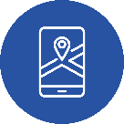
Benefits Of Smartphones
Stay connected with friends, family, and customers.
Use your camera to take pictures of your products to advertise online.
Post your goods on online marketplaces to connect
with buyers.
Download productive apps, like Facebook and WhatsApp.
Browse the internet, download information, and expand your knowledge.
Use your phone for entertainment, like watching videos or playing games.
Manage your business finances by accepting mobile payments or payments via QR codes.
Use navigation apps.

Slide 9




Why You Should Have Your Own Phone
Customization Tip!
Add, delete, or modify questions as necessary.
Use your phone in your business. Phones can be used for personal and business purposes. Having a phone can help you run your business more efficiently. You can use a phone to contact your customers and suppliers, accept mobile payments, and check your email - all while on the go.
Be more involved with decision-making at your store. With your own phone, you can have a larger role in managing your store’s operations. For example, you can oversee calling your suppliers, managing the store’s email account, or taking promotional pictures for advertising your products online.
Stay connected with your store. You can use your own phone to stay in contact with your shop’s employees, customers, and suppliers. You can connect in many ways including calling, messaging, or video conferencing. Plus, you can communicate from nearly anywhere - as long as a phone signal is available!
Build your digital capabilities. Having your own phone will help you build your digital skills. The more you use your phone, the better you will become at using different apps and sites - like mobile wallet apps or digital marketplaces.
Expand your business knowledge. If your phone connects to the internet, you can surf the web to research your competitors, compare product prices, and discover trending products. Essentially, you have access to a knowledge library at your fingertips!
How many of you own
your own phone? How many of you share a phone
with someone else?

Slide 10

Let’s explore all the ways you can use your phone!
Customization Tip!
This section includes instructions on how to perform different actions on a phone. Consider modifying the instructions to be reflective of the type of phone your group has. You can also skip lessons that are not applicable to your group.
PART 2:
PHONE “HOW-TOS”
Objective: To learn how to perform
different functions on your phone.

Slide 11
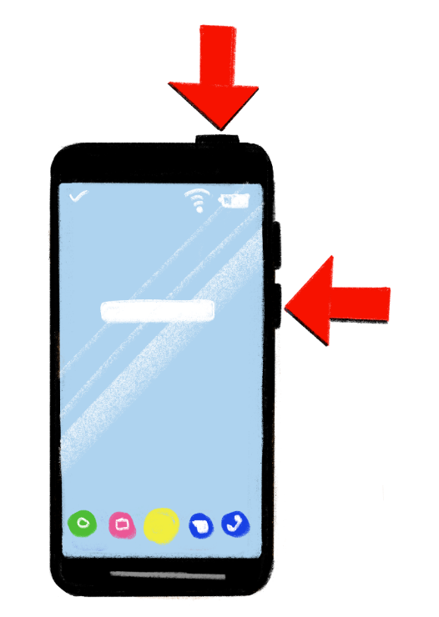
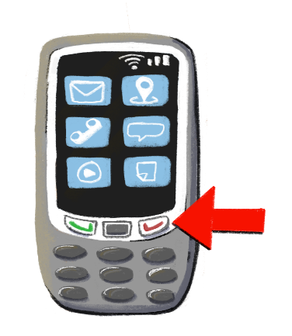
Switching Your Phone ‘On’ And ‘Off’
To turn on your phone, look for a button on the top, bottom, left, or right side of the phone.
Press the button for a moment. You will see your screen light up.
To turn off the phone, select the power button or swipe.
On a basic or feature phone, you may have to press a red “hang-up” button, and then select “power off” from the menu.

Slide 12
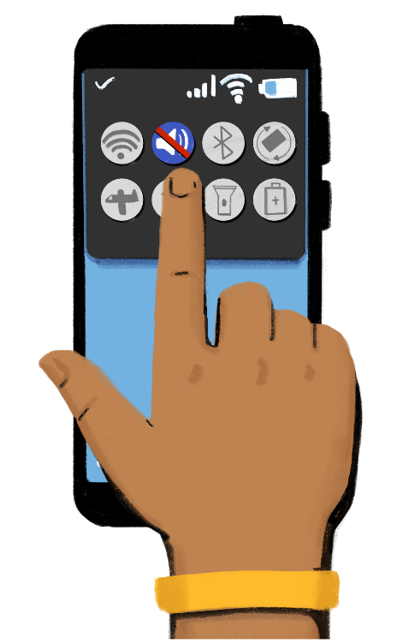



Making Your Phone Silent
Find the mute icon on your screen or in your phone’s settings.
Tap on the mute icon. Now your phone is on silent mode.
Touch the same button to unmute your phone.
With a basic or feature phone, navigate to the menu to choose the mute icon. You will be asked to change the volume of your phone.

Slide 13



Setting A Phone Password
Customization Tip!
Modify these practice exercises as needed.
Let’s practice!
Is “ABCDE” a good password? Why or why not?
How about “GTf519”?
Should you make your password the same number as your birthday? Why or why not?
A good way to protect your phone is by setting a phone password. With a phone password, the information on your phone will be protected if someone steals it or if it gets lost.
Your password should be easy enough for you to remember, but strong enough so that strangers will not be able to guess it. For example, “1234” is a weak password, and “As201!@” is a strong password.
To set a password on your smartphone, navigate to the settings app, and click “password.” You will be asked to create a password and to verify the password you have chosen.

Slide 14
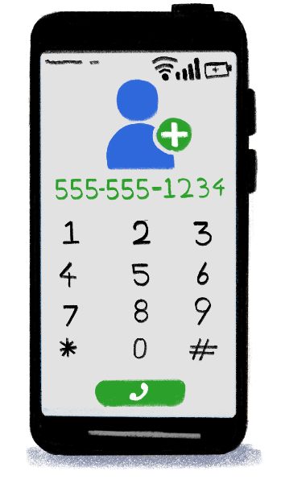


Saving Contacts
Step 1: Use the phone keypad to enter a number and tap on “new contact.”
Step 2: In the “new contact” screen that opens, enter the contact’s name and add other information, such as a photo or their email.
Step 3: Contact details are now saved in the phone. You can use the "edit" option to make any changes. An alternative method is to add the new contact directly from the address book app that comes installed on your phone.
Step 4: You can also “block” or ignore people and contacts you don’t know or who are bothering you. To block an existing contact, visit your phone’s settings and find “blocked contacts.” You can then add contacts to your list of blocked contacts. You can also click on the phone icon, tap on the caller you wish to block, and select “block this caller.”
With a basic or feature phone, select the address book to add a new contact.

Slide 15
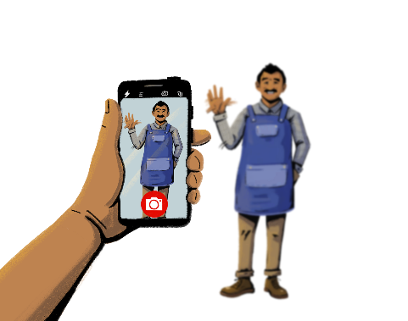
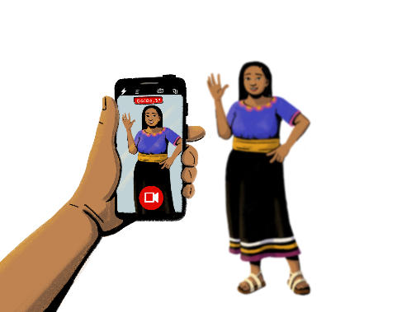


Using The Camera
You can use the camera to take pictures and videos!
TO TAKE A PICTURE
TO TAKE A VIDEO
Step 1: Tap on the camera icon. The camera app will open.
Step 2: Focus on an image that you want to take a picture of.
Step 3: Click on the circular button at the bottom of the screen to take the picture. You can also add a filter to your image once it is taken.
Step 1: Tap on the camera icon. The camera app will open.
Step 2: Tap on or swipe to the video option.
Step 3: To start recording the video, tap on the circular button. A timer will start.
Step 4: Tap on the same button again to stop the video.

Slide 16
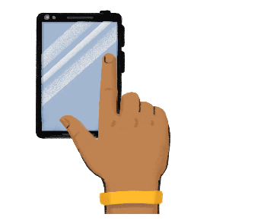


Mobile Data
Customization Tip!
Consider bringing in GSMA’s poster on data costs.
When you access the internet or certain apps, you have to use either Wi-Fi or mobile data.
Mobile data like airtime costs money. You need to buy mobile data from a mobile network agent, a shop that sells phone credits, or using your mobile money account or mobile wallet.
Some activities you do on the internet, like watching videos and downloading music, use more data, which will cost you more money.
To use data, find the data icon on your phone’s home screen or in your phone’s settings.
Tap the icon. It will turn bright when switched on.
To turn the data off, touch the same icon. The icon will go dark when it is turned off.

Slide 17




LEARNING RESOURCE
Mobile Data Costs with Hey Sister and Oye Amiga
Hey Sister Lessons
Lesson 21: How can I figure out airtime and data costs?
Oye Amiga Lessons
Lesson 17: How can I figure out airtime and data costs?

Slide 18
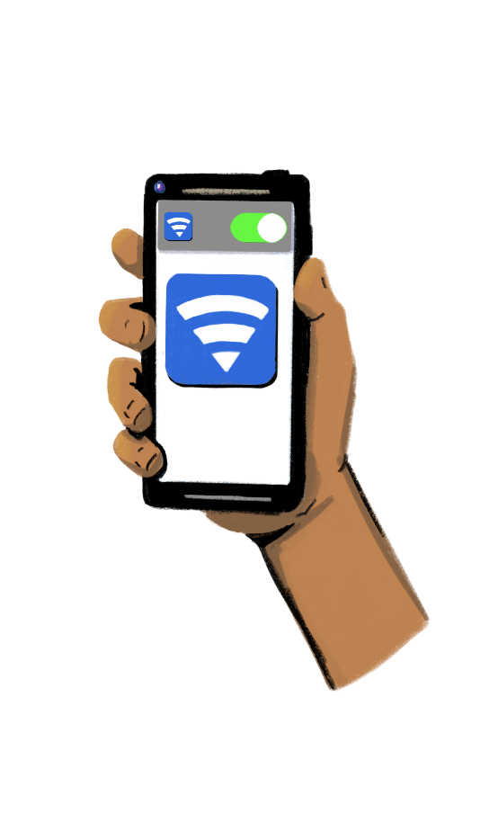
Connecting to Wi-Fi
Wi-Fi is wireless technology that connects phones, computers, tablets, and other devices to the internet.
You use Wi-Fi to access the internet on your device, and to download and use apps. When you are connected to Wi-Fi, you don’t have to use your mobile data. This means you can save your data for situations where a Wi-Fi network may not be available.
Some Wi-Fi networks may be accessible without a password, and some may be password-protected. In general, Wi-Fi networks that are password-protected are more secure. When you use a network without a password, other people may be able to see what you’re doing on your phone. If you don’t want your activity to be visible, you might not want to use that network.
Sometimes, you can ask the Wi-Fi network owner to share the password, but other times you may have to pay a fee to access their network.

Slide 19



Connecting to Wi-Fi
STEP 1:
Tap on the settings icon on your phone.
STEP 2:
Tap on the Wi-Fi icon.
A list of Wi-Fi networks will pop up.
A lock icon next to a network name means that the network is password-protected.
STEP 3:
Tap the network name and enter the password if needed. A Wi-Fi symbol should pop up at the top of your phone screen, indicating that you are ready to use the internet.

Slide 20
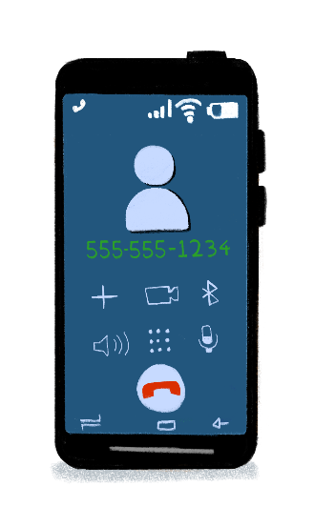

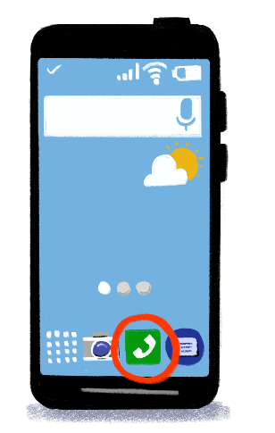
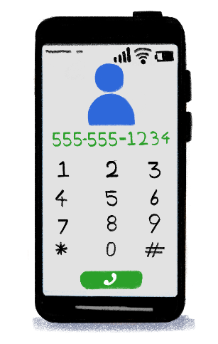

Making A Call
With a basic or feature phone, the process for making a call is similar:
Open your phone and type the number using the numeric keypad.
Alternatively, navigate to the “contacts” book and select the contact you wish to call. Press the green key to dial the number.
You can make phone calls by pressing the telephone icon.
When you tap the icon, a keypad to dial the number will open.
Dial the number or touch the “contacts” button to dial a saved number.

Slide 21
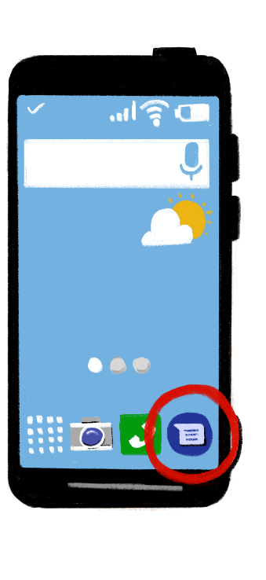


Messaging
Step 1: Tap on the “messaging” icon.
Step 2: A new screen will open. Click on the new message icon or select the “new message” option.
Step 3: In the new message window, enter the contact’s name or number that you are sending the message to in the "address box”.
Step 4: Using the touch keypad, type the message. Click on send.
If you have a basic or feature phone, you will have to type your keypad for each letter. Sometimes, you will have to type a key multiple times to get the letter that you want.

Slide 22
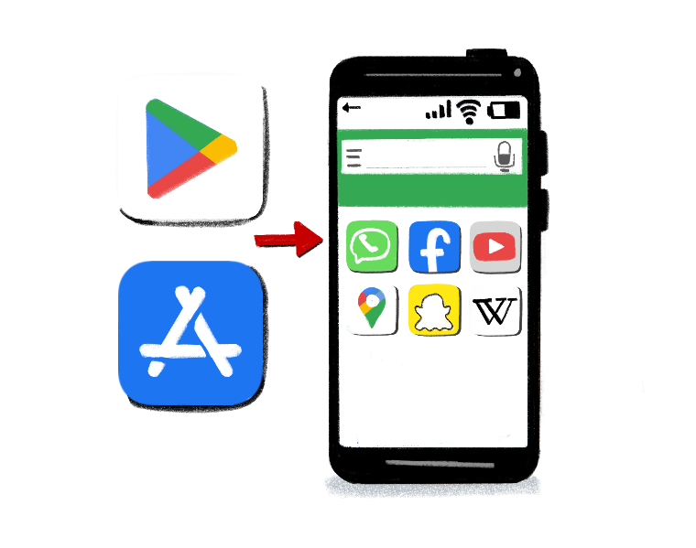
Using App Stores
All smartphones will come with an app store, where you can browse for apps and download ones that interest you.
Some apps are free, but some apps cost money. Sometimes, you have to pay a one-time fee to download an app, while others may have a monthly fee like a subscription service. Some free apps also might give you the option to unlock more advanced features at a price.
To view pricing information, click on an app that you are interested in. You will then be able to see if the app is free, or if it costs money. You will also be able to read the app’s terms and conditions, which gives you information about payment processing for the app, expected user behavior, and how to contact customer support.

Slide 23

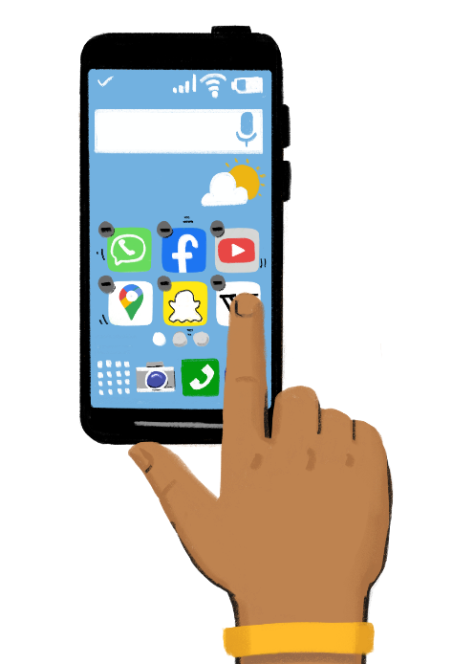
Use App Stores
Step 1:
Tap on the app store icon to open the app.
Step 2:
In the search box, type the name of the app you want to download. A drop-down with all the suggestions will appear. You can also search for apps based on their category, such as finance, travel, and business.
Step 4 :
To delete an app, hold down on the app icon. The apps will begin to shake. Select the “minus” button to delete the app.
Step 3:
After tapping on the search icon, all the apps related to the searched app will appear. Choose the one that you want to download and tap on it. It will download and appear on your home screen.

Slide 24
LEARNING RESOURCE
Learn About Apps with Hey Sister and Oye Amiga
Hey Sister Lessons
Lesson 22: How do I use apps?
Oye Amiga Lessons
Lesson 18: How do I use apps?

Slide 25
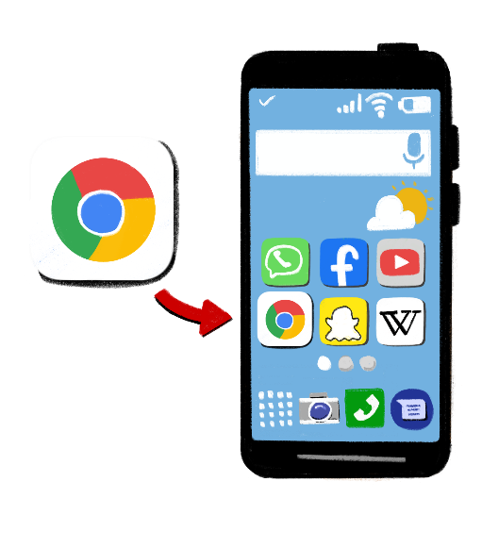
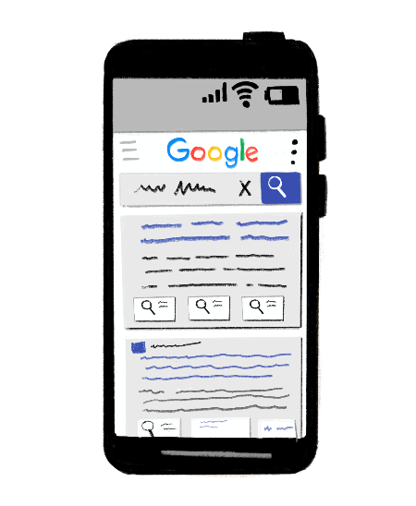
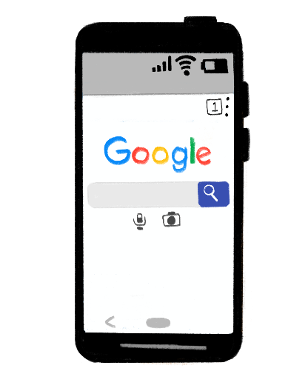

Browsing The Internet
Now you can see all the information related to the topic! Click on any link - highlighted in blue - to open the page.
But remember: Make sure you are careful with what you are reading; not everything you read on the internet is true.
Step 1:
Tap on the web browser icon on the screen. Web browsers allow you to search the internet for information.
Step 2:
In the screen that opens, tap on the search bar to search the topic or enter a web address. There are many search engines, such as Google, Yahoo, and Bing.
Step 3:
In the search bar, type in the topic that you want to search. Suggested topics related to the typed word will appear. Click on “search.”

Slide 26

Watching Videos
You can watch videos from many apps on your phone, such as YouTube, Vimeo, and Dailymotion.
Step 1: Open your video app of choice.
Step 2: Go to the search box and type in the desired video name or topic.
Step 3: Select the video you want to watch. You can change the volume, speed, and turn on subtitles if available.
On some platforms, you can subscribe to the creator’s channel by clicking the subscribe button. This way, you will be notified when they post a new video.
If you find content on your video platform that is dangerous, you can “report” it. The platform will then look at the video and see if it needs to be taken down or if the creator needs to be removed from the platform. To report a video on YouTube, click the icon of the three dots in the top right corner of the video. Select “report” or the flag icon. You can then select the reason for reporting the video.

Slide 27
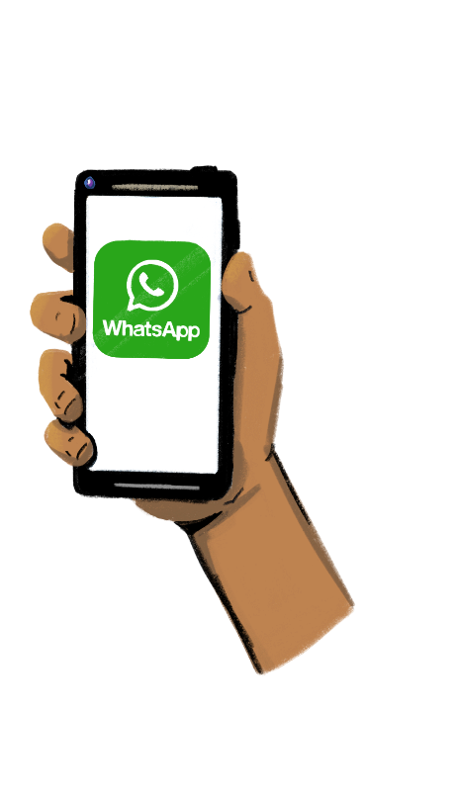






Using WhatsApp
WhatsApp Messenger, or simply WhatsApp, is a messaging and voice-over-IP (VoIP) service.
It allows users to send text messages and voice messages, make voice and video calls, and share images, documents, user locations, and other content.
WhatsApp is not restricted to smartphone users. If your feature phone uses the KaiOS operating system, you can enjoy
this app!
Download the app from your phone’s app store and follow the instructions for signing up to the platform.
Tap on the WhatsApp icon.
Look for the contact you want to message.
Type the message in the text box. You can also add symbols to your message.
Touch the right arrow to send the message.
You can record an audio message by holding the “mic icon.”
You can also take and send photos, locations, and documents by clicking on the “+” sign.

Slide 28




Understanding WhatsApp Ticks
A single grey tick means that the recipient is not online.
Double grey ticks mean that the recipient is online and has not seen your messages yet.
Double blue ticks mean that the recipient has opened the chat, but might not have time or interest to reply to the message right away.

Slide 29
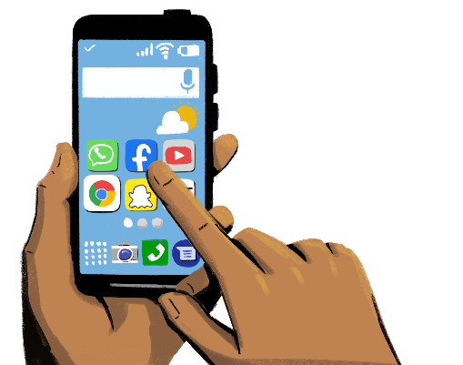

Using Facebook
Facebook is a social networking platform that connects you with people around the world. You can post status updates, upload videos, and share pictures on Facebook. You can also see what your friends and family are up to, and even post advertisements for your business!
There is a lot of information on Facebook. Make sure you are careful with what you are reading or clicking on; not everything you read on Facebook is true.
Tap on the Facebook icon.
Follow the steps to create an account and customize your profile.
Add your friends, and “like” your interests.
Post status updates, upload photos, and share life events.
You can change the privacy settings of your account to manage who sees your activity. You can make your profile and your posts private to only your friends, or you can make them public.
You can also report pages or block people on Facebook who are posting harmful content. To report a page, click the three dots icon, select “find support or report page,” and choose the reason for reporting. To block a person, click on their profile, select the three dots icon, and choose “block.”
Remember! There are countless apps and websites that you can access and use via the internet. Facebook is just one of these apps — the options are endless!

Slide 30
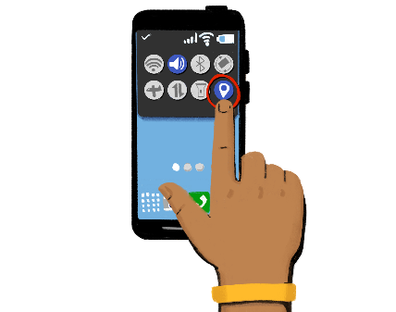
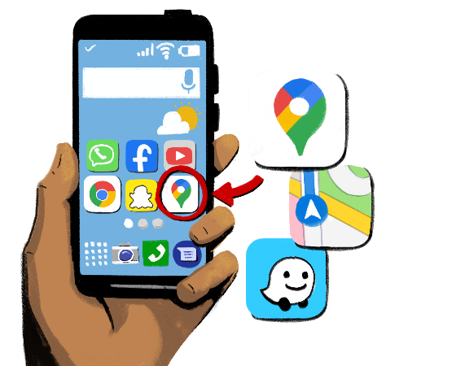
Using Navigation Apps
Navigation apps give you directions.
You can also use these apps to help customers navigate to your store. There are many types of navigation apps, such as Google Maps, Apple Maps, and Waze.
To use navigation apps, you have to turn on
location sharing with the app in your settings.
Next, open your navigation app and search
for a place of interest using the search bar.
Tap “directions.” You can change the start
and end points at the top of the screen if desired.
Choose one of the following options,
depending on your app and preferred transit
method: Driving, Transit, Walking, Rides, Cycling
Optional: to add additional destinations along your route, you can select “add a stop.” When you are finished, tap “done” or “go.”

Slide 31
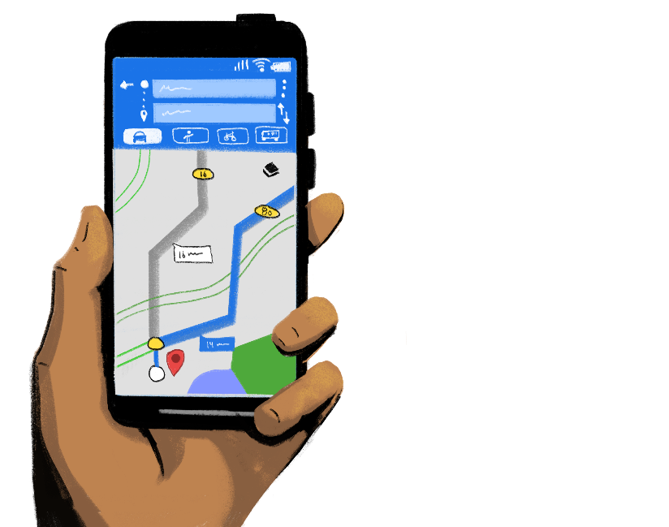
Using Navigation Apps
You may be shown multiple route options that have different travel times.
You can also sometimes filter your routes to avoid tolls or highways.
To start navigation, tap “start.” If you see “searching for GPS,” or the directions are not loading, your phone is trying to get a GPS signal. This can happen if you are in or near a tunnel, parking garage, or another location where there is no GPS signal.
To stop or cancel navigation, tap “close” or “end route” at the bottom of the screen.
You can also use navigation apps to send the location of your store to a customer. Type in your store’s address in the search bar and tap “share.” You can then share the address with your customers through messaging apps or email. When they click on your message, your store’s location will open in their navigation app.

Slide 32






Accessibility Features
Smartphones come with many accessibility features that make using your phone easier! You can customize these to meet your needs.
Changing Text Size and Display
In your phone’s accessibility settings, you can make the text on your screen appear bolded, and you can even change the size of the text to be larger or smaller. You can also change the contrast of the colors to make things easier to read.
Set Up Captioning
In the accessibility settings, you can also turn on and customize closed captioning and subtitles. You can change the font, size, and color of the subtitles to make them easier for you to read.
Turn on VoiceOver
VoiceOver, also known as TalkBack on some devices, reads the text and images on your screen out loud. You can turn on this feature in the accessibility settings and can customize many features, such as the talking speed and the pronunciation.

Slide 33


Using Voice Assistants
A voice assistant is a device or app that uses technology to respond to humans. These voice assistants can help you perform many tasks on your phone, such as sending a message or browsing the internet. There are many voice assistants available, such as Google Assistant or Apple’s Siri.
To activate Google Assistant on your phone, you can say “Hey Google” or press and hold the home button. You can also download the Google Assistant app or the Google app to enable the voice assistant. If you have an iPhone, you can turn on Siri in your phone’s settings. Once you have the voice assistant enabled, you can use it for various tasks, including:
Sending messages. You can use your voice assistant to send a message to one of your contacts. Simply say “Hey Google” (or the name of your voice assistant), followed by a command, like “send Imani a text.” You will be asked to relay your message to the voice assistant, and then it will be sent!
Browsing the internet. You can also use your voice assistant to search the web instead of typing. Call out the name of your voice assistant, followed by the command or question you wish to search. You can also tap the microphone icon next to the search bar on some browsers, and then speak your search request.

Slide 34





Safety Features
Location sharing. If you are traveling somewhere and want someone to know your location, you can enable “location sharing” on your phone. On some phones, there is a “find my friends” app where you can share your location with contacts of your choice. You can also share your location with friends through your Google account on Google Maps. Head over to the Google Maps app, click your profile in the top right corner, and click “location sharing.”
Remember to only share your location with people that you trust, or only when you want people to know where you are. You can disable location sharing for certain apps in “location services” in your phone’s settings.
Emergency calls. If you ever need to make a call in case of emergency, just swipe up on your lock screen and tap the “emergency call” button. You will be taken to the keypad to enter your desired number.
Flashlight. Most smartphones also come equipped with a built-in flashlight! To access the flashlight, swipe down on your home screen and tap the flashlight icon. Tap the icon again to turn the flashlight off.
Our smartphones come with many features that can help keep us safe!

Slide 35


LEARNING RESOURCE
Additional Digital Skills Resources
GSMA: Mobile Internet Skills Training Toolkit
GSMA: Mobile Internet Skills Training Videos
GSMA: Mobile Skills Toolkit
Mozilla Foundation: Digital Skills Observatory

Slide 36

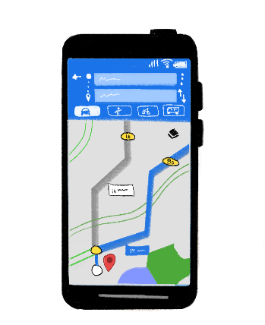


Let’s Recap!
Customization Tip!
Modify these exercises depending on the skills your group needs to practice.
Open your messaging app and send a message to your friend.
Open your navigation app and search how to get from the training center to the nearest shop.
Save a fellow trainee’s contact info to your address book.
Take a picture
with your phone.

Slide 37
















Let’s Guess The Correct Logo!
Customization Tip!
Modify these logos depending on the skills your group needs to practice.
WIFI:
POWER BUTTON:
VOLUME:
BACK:
LOCATION:
SETTINGS:

Slide 38


You must learn how to protect yourself when using your phone!
PART 3:
WAYS TO PROTECT YOUR DATA AND INFORMATION ONLINE
Objectives:
To identify different kinds of scams and risks online.
To learn tips for protecting your personal data and information.

Slide 39

Risks To Women and Girls
Not all people use phones for good. Some people may target women and girls by phone or online to hurt them or damage their reputation. People call this cyber violence, because it happens online or by phone. It is important to learn how to protect yourself from cyber violence.
Cyber violence is a growing threat for women and girls who use the internet. If you are experiencing cyber violence, block the users and report them for harassment to your phone provider or the app’s customer support center.
Scammers may also target women and girls to try to steal their personal information or get them to send money from their mobile wallets. It’s very important to not share your personal information, like your address or your bank details, with anyone on the internet. More tips and tricks are on the following slides.

Slide 40

Tips and Tricks to Practice Online Safety
Here are a few tips to make sure your personal information is protected:
Use unique passwords for your devices and do not share them with anyone:
Make sure to use a password to help keep your apps, accounts, computers, and personal information protected. Do not share passwords. Change your passwords regularly for better protection, and use a combination of letters, numbers, and special characters.
Use free Wi-Fi with caution:
Do not log into your bank account or enter a credit card number while on public Wi-Fi. Save transactions for when you’re on a secure network. If you must log in or transact online while using public Wi-Fi, try using a VPN (virtual private network), which encrypts your activity so that others on the same network can’t see what you’re doing.
Check to see if the site is secure:
Before entering personal information into a website, look at the top of your browser. If there is a lock symbol and the URL begins with “https,” that means the site is secure. There are a few other ways to determine if the site is trustworthy, such as if there is a website privacy policy, contact information, or a “verified secure” seal.
Watch out for links and attachments:
Don’t click on any links or open any attachments unless you are sure who you are receiving them from. They may contain malware or are attempts to steal your personal information. If there are misspelled words, bad grammar, a lot of text and numbers, it’s probably a scam.

Slide 41
Get your news and information from trusted sources:
When surfing the web and reading the news, verify that the information is coming from a reputable source. See if you can find credentials for the authors if you are unsure about the source. Avoid sharing personal information or clicking links on news sites that might not be trusted.
Download trusted apps:
Make sure to download trusted apps. Do not download an app without researching it first. Apps often have customer reviews in the app store, where you can see how users like it or if there are any complaints.
Block and report:
On sites like Facebook and YouTube, you can block people or report content that is dangerous or inappropriate. On these sites, look for the flag icon. Choose “block” or “report.” This action tells the platform to review the person or page.
Do not give out your personal information:
Know who’s asking! Banks don’t send emails or text messages that ask for personal information, such as account numbers. Never share any personal information, especially tax details, account numbers, or login information via email or text.
Contact customer support in the event of a scam:
If your personal information has been compromised, contact the appropriate channels. For example, you can contact your bank or mobile wallet provider if your account was hacked. Also, make sure to change your passwords right away.

Slide 42

LEARNING RESOURCE
Practice Cyber Hygiene with Hey Sister and Oye Amiga
Hey Sister Lessons
Lesson 19: How can my personal information be used?
Lesson 9: How do I know what news is true?
Lesson 10: How do I protect myself from scams?
Lesson 20: How can I avoid different types of scams?
Oye Amiga Lessons
Lesson 13: How can my personal information be used?
Lesson 14: How do I know what news is true?
Lesson 15: How do I protect myself from scams?
Lesson 16: How can I avoid different types of scams?

Slide 43




Share your doubts
and questions!

Slide 44







www.siaedge.com
Line Two
Line Three

