Slide 1


GSMA Long and Short Term Targets
April 2012 to March 2015
July 2012 Confidential

Slide 2

“What gets measured gets done”
July 2012 Confidential

Slide 3


Short Term Measures
Short term Objectives | Objective & target | Target Full year
Industry Projects | 50%
RCS | Market launches and commitments to launch Number of distinct RCS installed devices | 5 country launches 6 new countries committed 18 plus iOS / Android
NFC | Market launches and commitments to launch Number of NFC SIMS shipped plus number of distinct SIM NFC devices available | 10 markets globally (2 with significant scale) 3 new committed markets 50m SIMs shipped over 50 devices
Connected Living | Number of Roaming agreements Number of Service trials and / or launches | Minimum of 2 agreements 21 service trials or launches
Spectrum | Target bands agreed by members Release of Digital Dividend Spectrum | At least 50% of SSMG* support target bands representing 300 MHz minimum 3 positive market announcements
Roaming | Manage impact of ITU international Telecommunications Regulations Manage impact of WTO and GATS instruments, specifically roaming *ITR (International Telecommunications Regulation) * WTO (World Trade Organization) * General Agreement on Trade in Services | No roaming price regulation Maintaining status quo of WTO / GATS instruments
Balanced Scorecard | 50%
Financial | £30.1m of Net Profit from GSMA Ltd Membership income Group consolidated expenditure | £30.1m £21.8m £99.3m
Members | Positive Average on Member Survey (Does GSMA play a pivotal role in the development of the industry) | 84% (82.8% as of end 2011)
Governance | Chairman assessment of general effectiveness in Governance management Establish ‘fast track projects’. Establish new Chief Regulatory Officer Groups (CROG) | Chairman assessment 2 x approved & active 2 x new CROGs active

Slide 4

Tier 1 Monthly Progress Against 2012/13 Objectives - September 30 2012
Rich Communications Services | Progress
Commercial launch in 5 committed countries (2 by 30 Sep) | 1 Country Launch
Commitments from 6 new countries to launch Rich Communications (2 by 30 Sep) | 2 Commitments to Launch
RCS embedded in at least 18 devices (5 by 30 Sep) | 5 RCS Devices (provisional accreditation)
11.6% smartphone user penetration of RCS in 6 key markets by 2014 (including: Spain, Germany, South Korea) | 0% using RCS (Data currently being sourced)
Mobile NFC Services | Progress
10 markets launches globally (2 with scale, 3 by 30 Sep) | Korea with scale, France, Singapore
3 new markets committed to commercial launches (1 by 30 Sep) | Brazil
50 million NFC SIMs shipped globally (12 million by 30 Sep) | 28 Million Handsets Sold
50 models of NFC enabled handsets available (38 by 30 Sep) | 53 Handset models
Connected Living Programme | Progress
Agreement to change the roaming model, between at least 2 Operators (0 by 30 Sep) | 0 Operator Agreements
Stimulate/ follow 21 service trials or launches in Health, Automotive and Education (7 by 30 Sep) | 7 Trials/ Launches Underway
700 million embedded mobile connections by March - 13 excluding handsets (1.4 billion by 2015) | 553 Million non-handset Connections
3 demonstrator proposals adopted - Mobile World Capital | 0 Proposals
0
5
0
6
0
18
0% 0.38% 3.82% 11.6%
2011 2012 2013 2014
0
10
0
3
0
50
0
50
0
2
0
21
523
Mar 2012
700
Mar 2013
0
3
KEY = 30 Sept 2012 target = Progress to 31 August

Slide 5
Tier 1 Monthly Progress Against 2012/13 Objectives - September 30 2012
Mobile Identity | Progress
Produce 6 market case studies on Mobile Identity services. | 1 case study
GSMA support to 4 pre-planned Mobile Identity pilots. | 0 pilots
6 Operator commitments to launch Mobile Identity. | 0 commitments
Global Roaming |  | Progress
Manage impact of ITU internet regulations – No mention of Roaming pricing |  | On Track
Manage impact of WTO and GATS instruments, specifically roaming. Maintaining status quo of WTO / GATS instruments |  | On Track
Spectrum |  | Progress
Target bands agreed by members At least 50% of SSMG* support target bands representing 300 MHz minimum (30% by 30 Sep) |  | Completed
Release of Digital Dividend Spectrum - 3 positive market announcements (1 by 30 Sep) |  | Completed
MHz identified for mobile against 2011 baseline, in specific bands, in 15 priority markets |  | MHz identified for Mobile
0
6
0
4
0
6
5044MHz 5284MHz 5617MHz
2011 Current Tracking 2012
KEY = 30 Sept 2012 target = Progress to 31 August

Slide 6
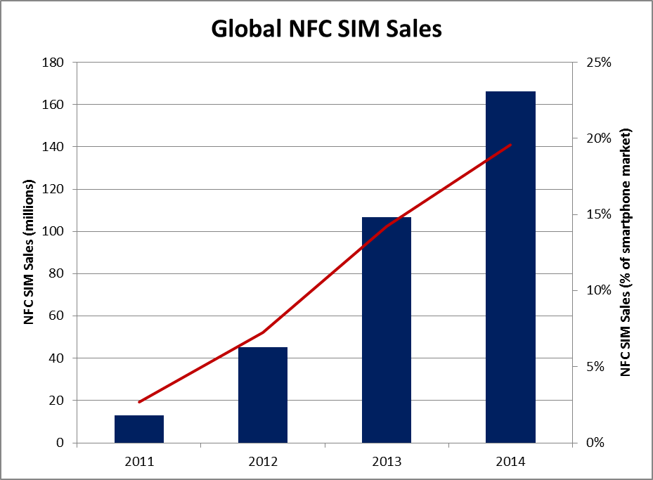
Mobile NFC
Measure
Industry Target
Global shipments of NFC SIMs
Definition
Wholesale shipments of NFC SIMs from SIM Alliance members to mobile operators - defined by total number of units
Rationale
Measurement
Wholesale NFC SIM shipments is a lead indicator of future market growth – the total addressable market for mobile operator NFC services. Calendar year end December.
Industry Target
166m NFC SIMs sold annually by 2014 represents over 50% of NFC device volumes – an increase from 25% of the market in 2011. NFC SIMs shipped as share of smart phone market will also be tracked
Data source: Strategy Analytics (Projections)
Data Source
Frequency
SIM Alliance – aggregated wholesale NFC SIM shipments
Quarterly – delayed by a quarter

Slide 7
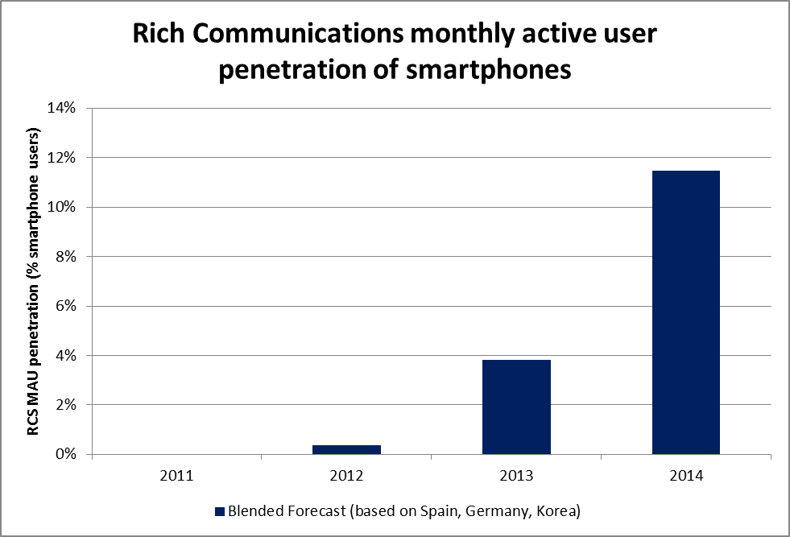
Rich Communications
Measure
Industry Target
RCS monthly active users
Definition
Monthly active RCS users as percentage of smartphone base in 6 major markets – Spain, Germany, South Korea and 3 others*.
Active defined as 1 message sent per user, per month
Rationale
Measurement
MAU is a standard indicator of service adoption and valid over three years. Usage can be measured in both embedded and downloaded clients. Selected markets are large and reflect programme focus. Calendar year end December.
Industry Target
Non-weighted average of targets for three key markets = 11.47% penetration of smartphones. Spanish estimates agreed with Vodafone and Telefonica. Germany estimates agreed with DT and Vodafone – launch six month after Spain. South Korea estimates based on 2012 data point (KakaoTalk 37m users after 2 years / 98% smartphone penetration)
Source: GSMA and Operator estimates
* Additional three markets to be added based on operator commitments to launch RCS and achieve at least 10% smartphone penetration by December 2014.
Data Source
Frequency
Mobile operators will provide MAU data to Wireless Intelligence for aggregation and anonymisation
Monthly from committed operators

Slide 8
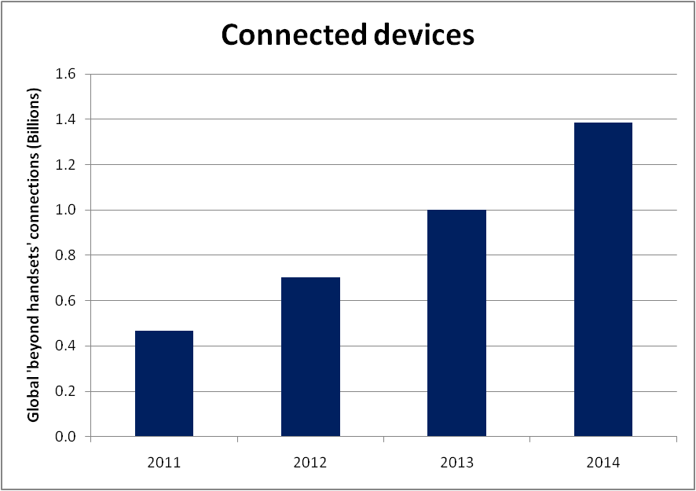
Connected Living
Measure
Industry Target
Total number of connections (beyond handsets)
Definition
Total number of global mobile data connections across all device types except handsets
Rationale
Measurement
Total number of mobile connections, beyond handsets, defines the growth of the embedded market in all sectors. Calendar year end December.
Industry Target
Target is 1.4bn connected (non-handset) devices by 2014, based on industry forecasts for global growth – this represents growth from 7% to 17% of the total mobile device market
Data source: Machina Research
Data Source
Frequency
Machina Research
Quarterly

Slide 9
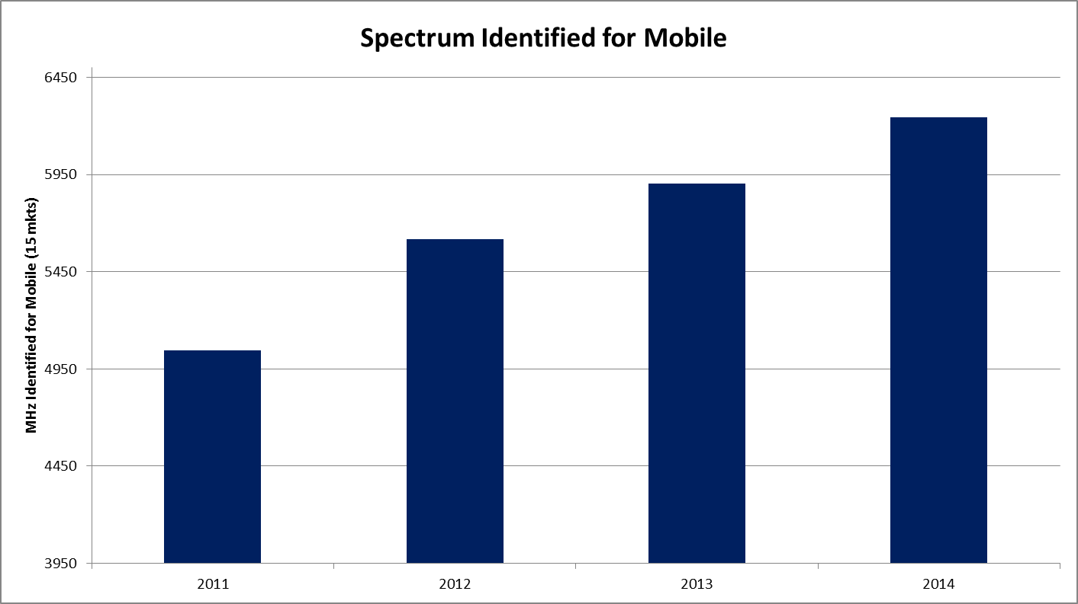
Spectrum
Measure
Industry Target
MHz of spectrum identified for mobile in 15 priority markets**
Definition
Total MHz identified* for mobile against 2011 baseline, in specific bands, in 15 priority markets**
Rationale
Measurement
The release of additional spectrum for mobile broadband and the maintenance of currently assigned spectrum is a key objective for the programme – this metric captures current identifications, and projects additional spectrum identifications over the next three years. Calendar year end December.
Industry Target
Target is based on Plum Consulting’s assessment of total potential spectrum gains for mobile service providers to 2014, with forecasts reduced by multiplying the total for each market by a confidence factor ranging from 0 to 1
* “Identified” spectrum refers to spectrum where a government has taken a formal decision that it will be made available for mobile
** Bulgaria, Greece, Turkey, Serbia, Romania, Indonesia, Malaysia, Kenya, South Africa, Saudi Arabia, Nigeria, Brazil, Columbia, Mexico, Chile
Data Source
Frequency
Plum Consulting
Annually, with updates as spectrum identification decisions announced

Slide 10
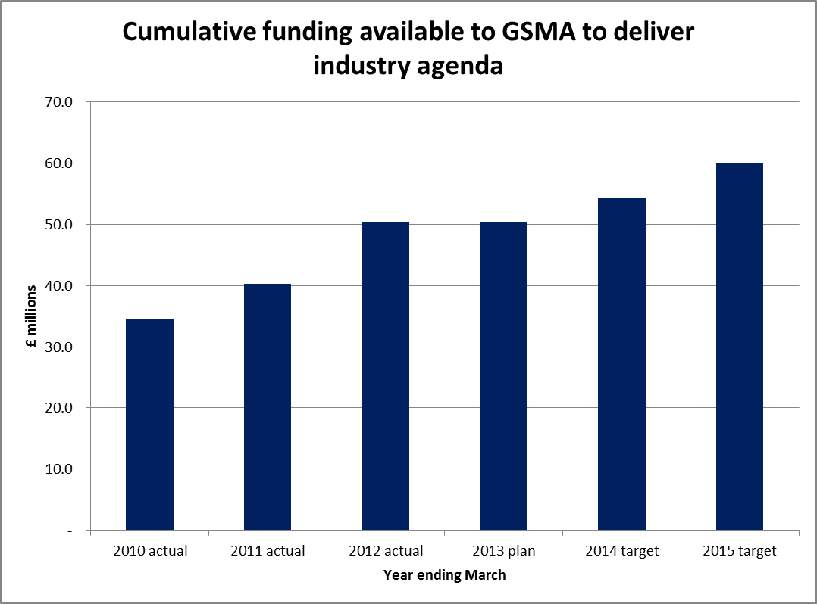
GSMA Funding
Measure
GSMA Target
3-year cumulative GSMA funding
Target total 2013-2015 £164.7 million
Definition
Total 2010-2012
£125.2 million
Total GSMA Ltd profit after tax plus total membership dues recognised over 3 years
Rationale
Measurement
Funding from membership and GSMA Ltd profits represents the capacity/ability for GSMA to support the industry. Financial year end March.
Industry Target
The targets is based on 5 % core growth of funding after taking into account WAC costs within A Ltd. WAC is planned to break even in 14/15.
Data Source
Frequency
GSMA Finance
Quarterly forecasts and annual audited accounts

Slide 11
Long Term Measures
Long term Objectives | Summary | Target For 2015
Weighting % age of total | 50% Weighting
NFC | Global shipments of NFC SIMs Wholesale shipments of NFC SIMs from SIM Alliance members to mobile operators - defined by total number of units | 166m SWP SIMs sold annually by 2014 This represents over 50% of NFC device volumes an increase from 25% of the market in 2011.
RCS | RCS monthly active users %age penetration Monthly active RCS users as percentage of smartphone base in the most engaged major markets – Spain, Germany, South Korea – plus three additional markets to be confirmed based on operator commitments to launch RCS and achieve >10% penetration by December 2014. Active defined as 1 message sent per user, per month | Average smartphone penetration of key markets = 11.6% South Korea – 20% Spain – 8.5% Germany – 6.4% 3 others to be confirmed
Connected Living | Total number of connections (beyond handsets) Total number of global mobile data connections across all device types except handsets | 1.4bn connected (non-handset) devices by 2014 Based on industry forecasts for global growth this represents growth from 7% to 17% of the total mobile device market
 | 25% Weighting
Spectrum | Cumulative MHz of spectrum identified for mobile in 15 priority markets MHz identified for mobile against 2011 baseline, in specific bands, in 15 priority markets | 6245 MHz (representing 24% increase from 2011)
 | 25% Weighting
Financial | Funding available to deliver industry agenda Total GSMA Ltd profit after tax plus total membership dues recognised less WAC integration costs | £165m cumulative industry funding in three year period (versus £125m in previous period).

