Slide 1
Digital skills training
materials for mobile internet use
Learner handout
Ghana - English
02
Template slides
In this section you will find templates and examples of slides you can use for your deliverable presentations.

Slide 2
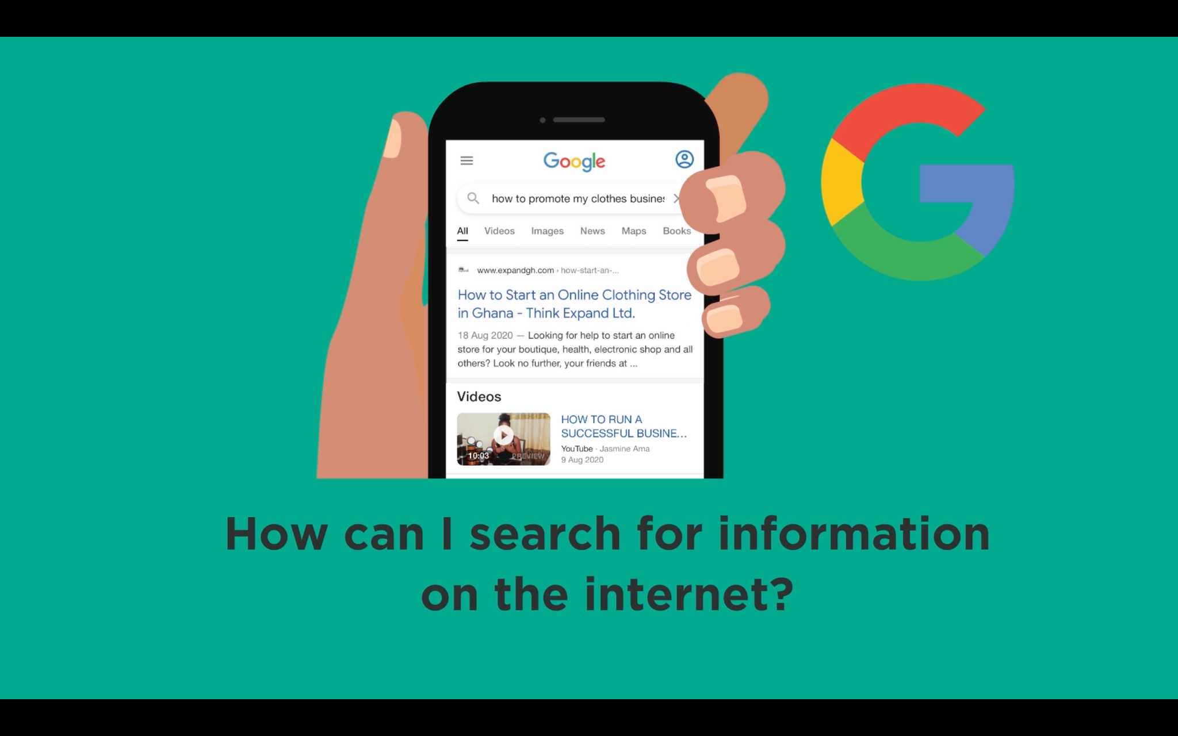
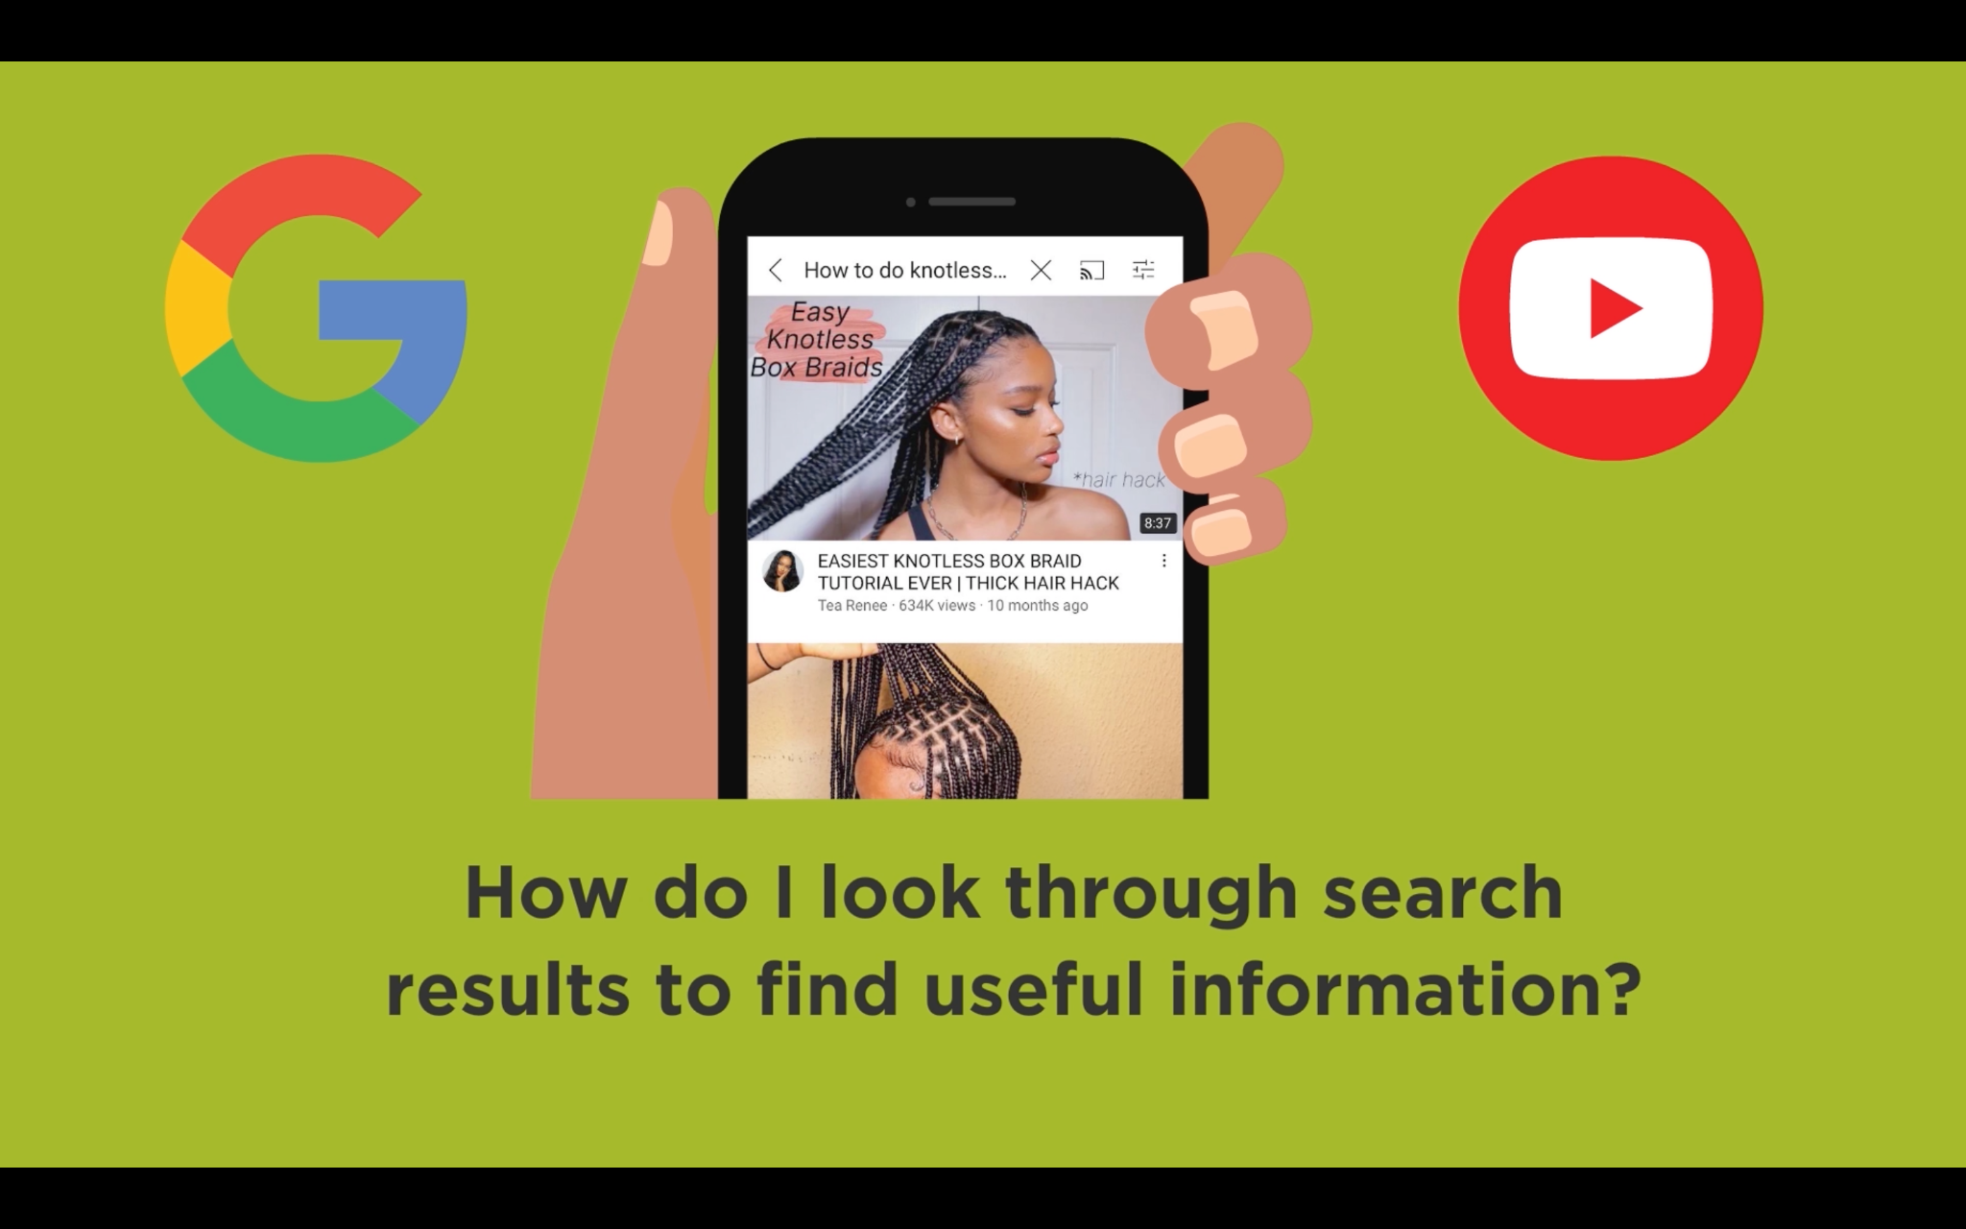
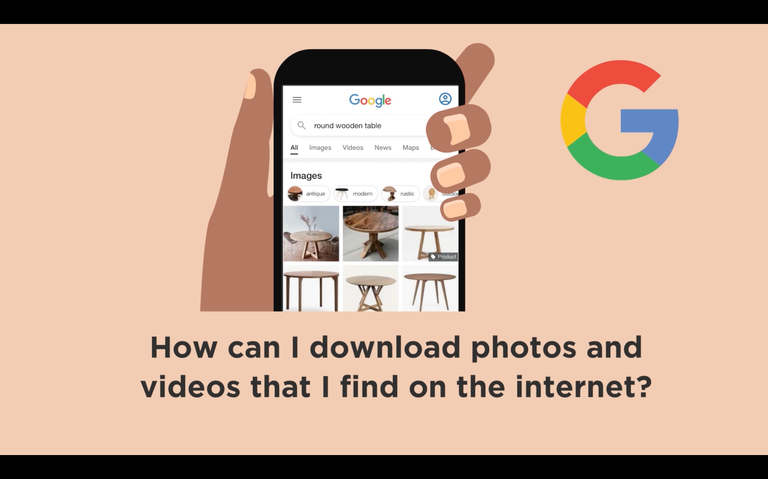
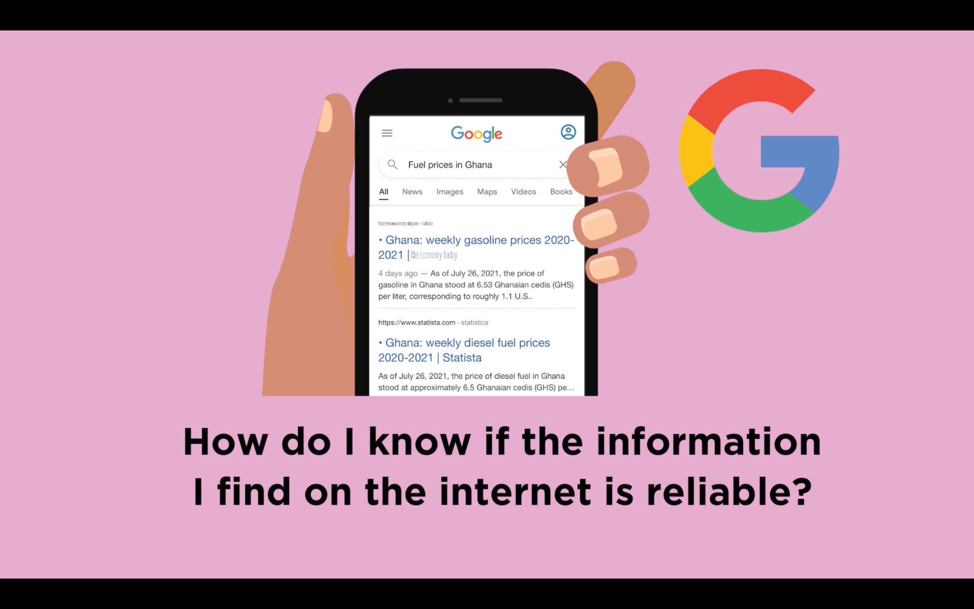
BUILDING SKILLS TO BOOST YOUR BUSINESS

Slide 3
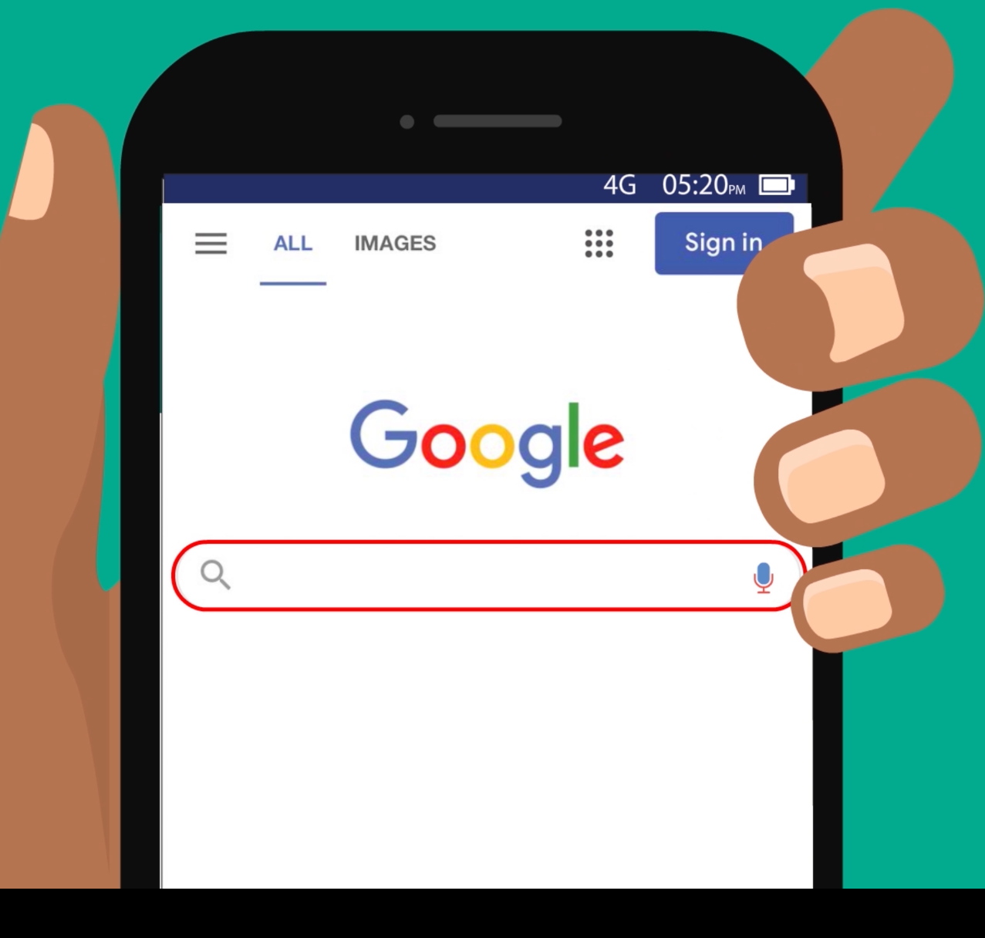
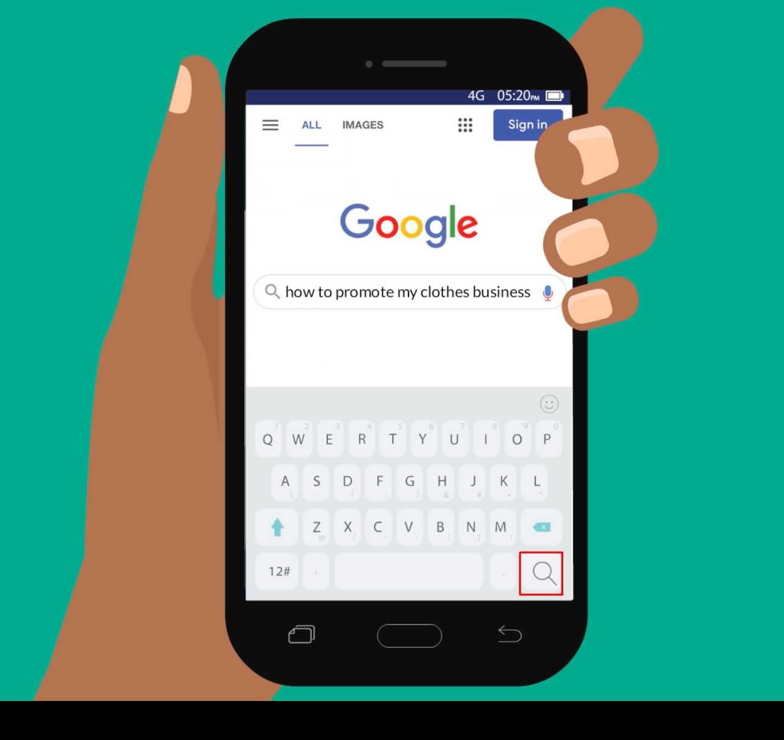
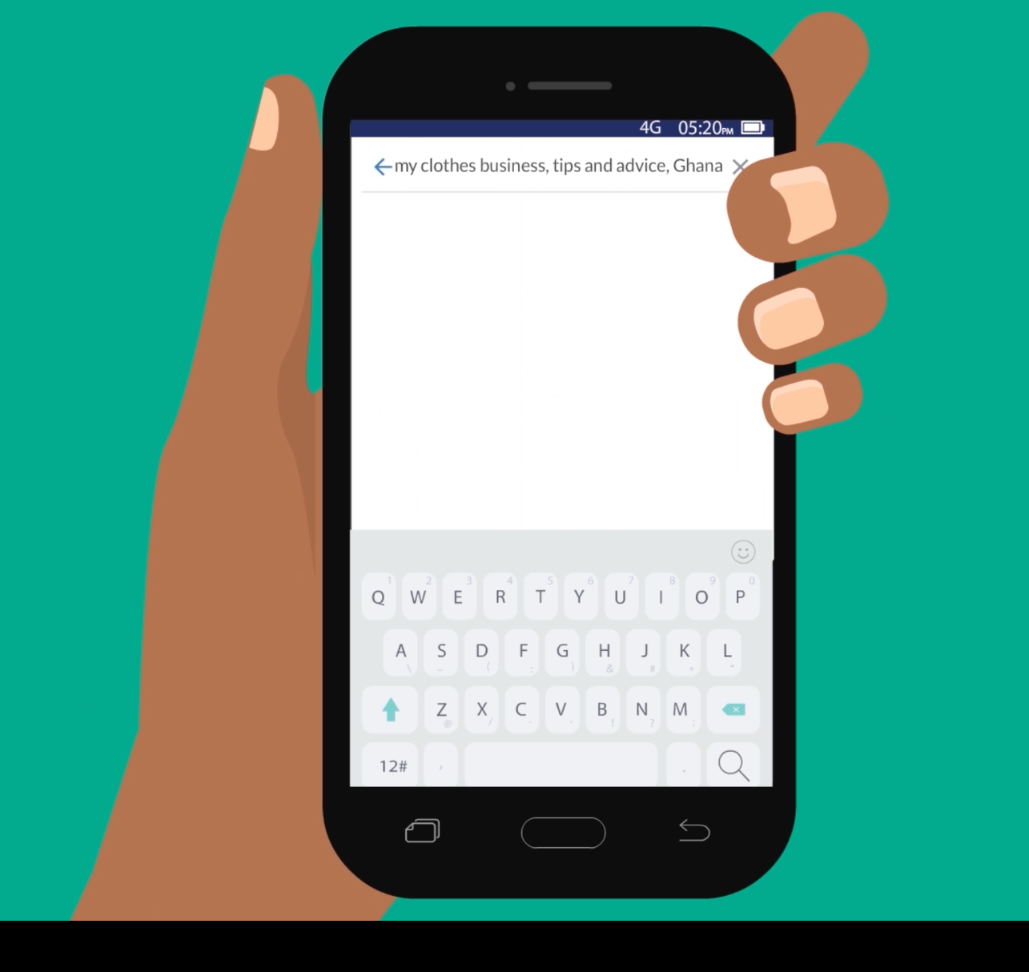
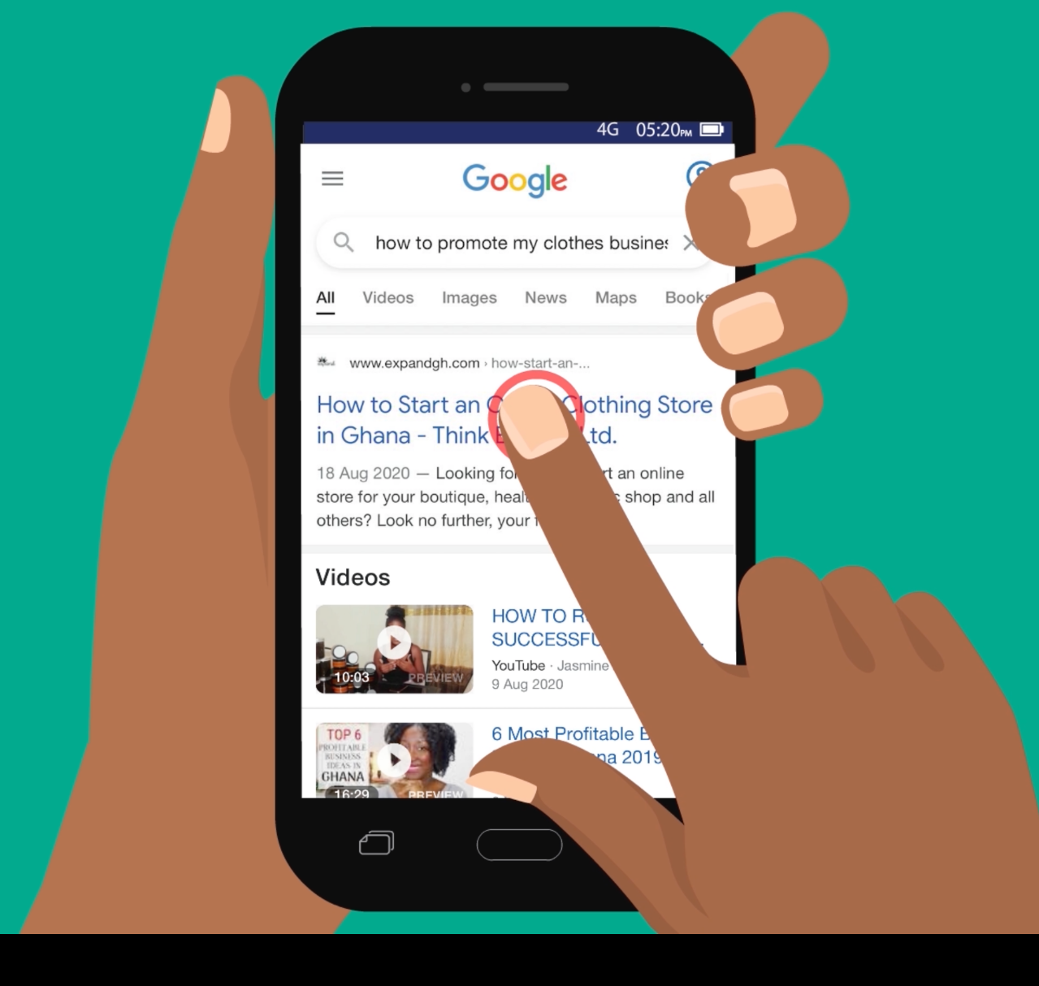
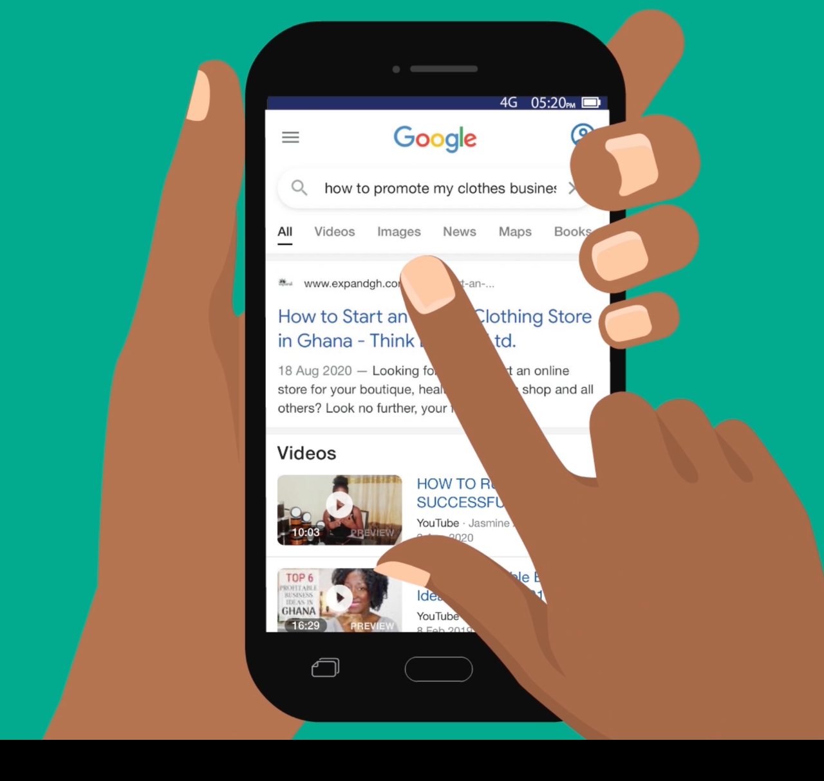
How can I search for information on the internet?
1
2
Press the search bar.
Press and hold the microphone. Say what you’re searching for.
3
4
Press the magnifying glass button to search.
Add more words to your search.
5
6
Look through what Google has found for you.
Click on the word “Images” to only see pictures.

Slide 4
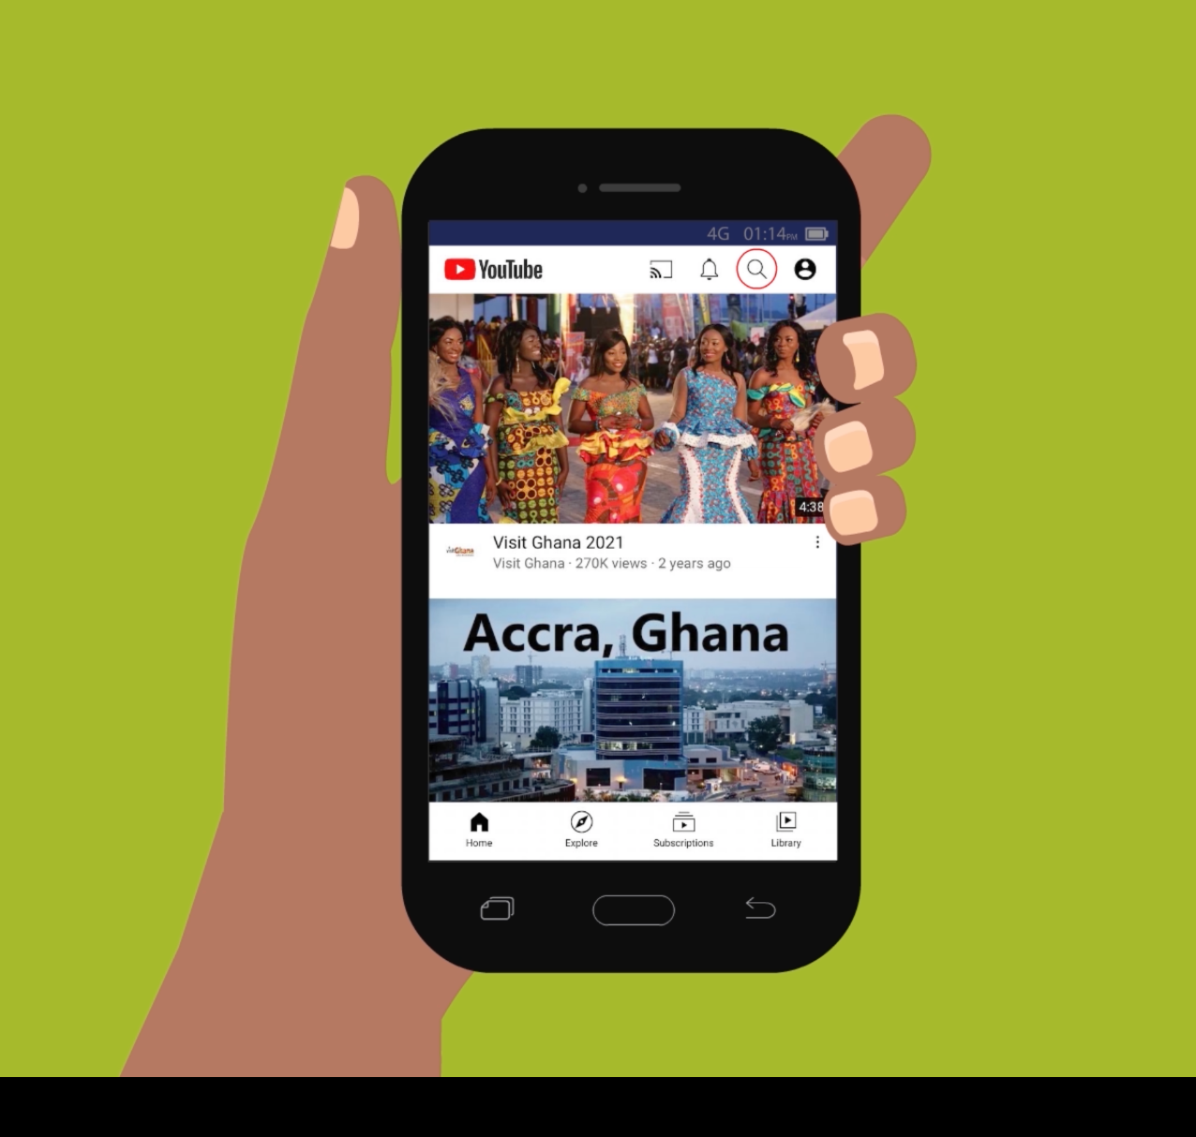
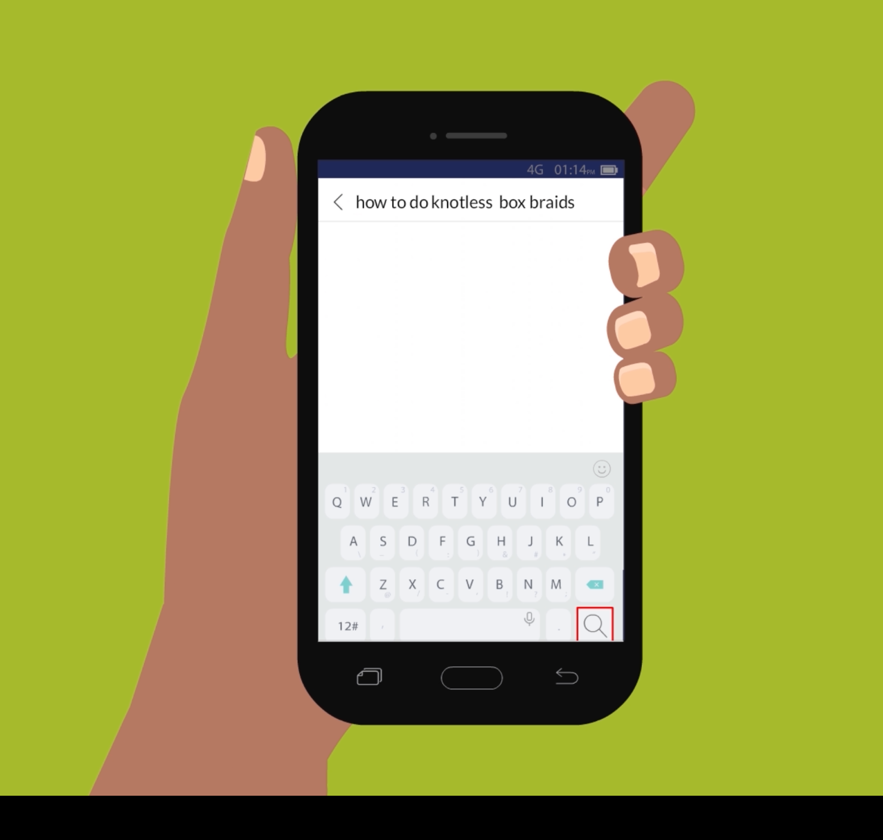
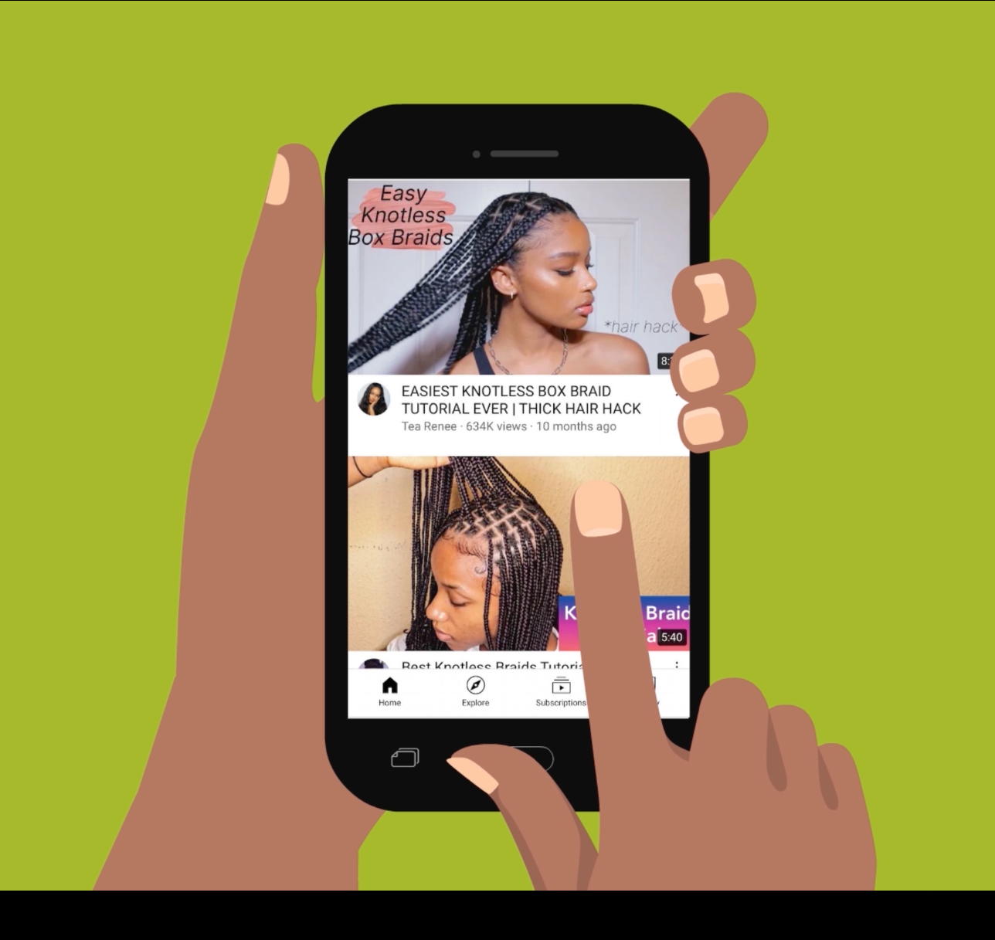
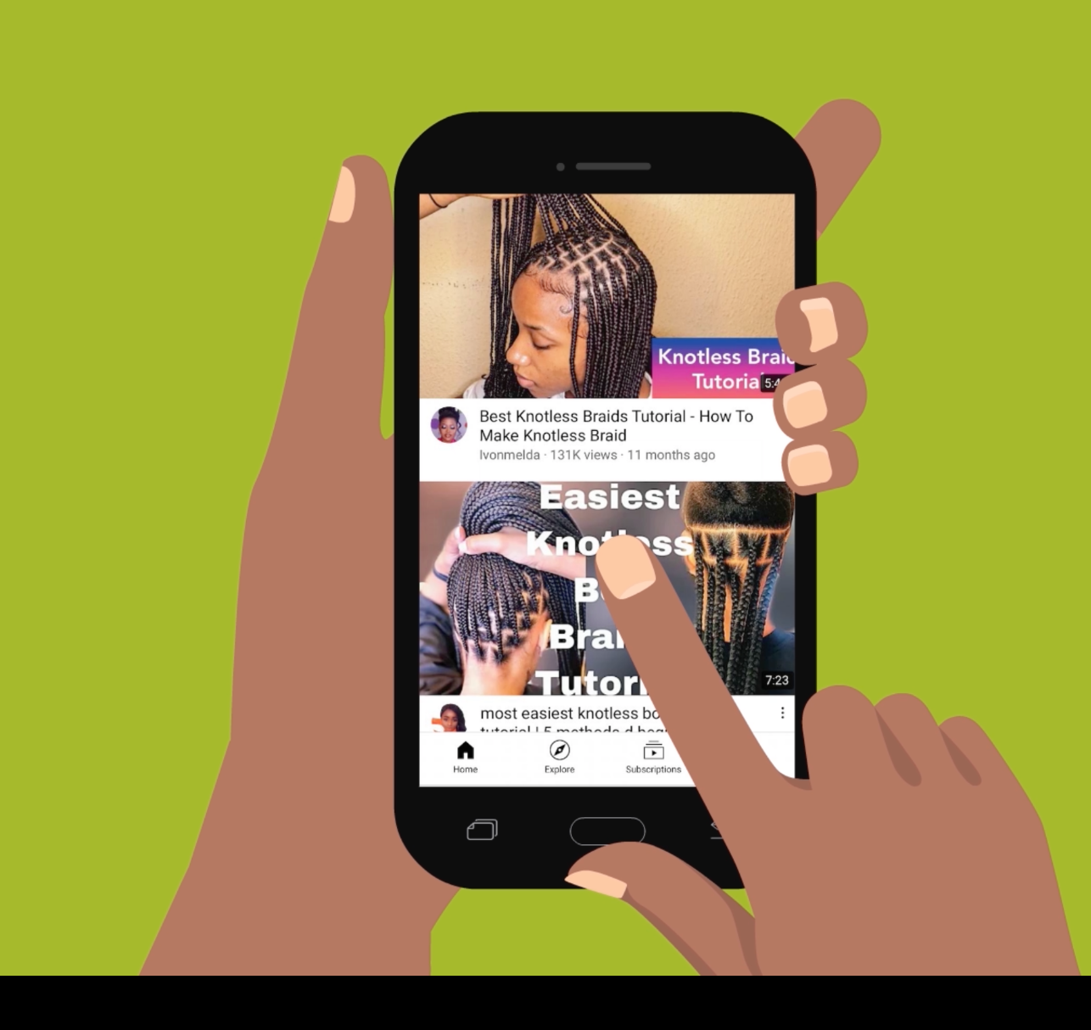
How do I look through search results to find useful information?
1
2
Press on the magnifying glass at the top.
Type or say what you’re searching for.
3
4
Look through the videos that YouTube has found.
Press on a video to open it.
5
6
Start watching the video.
Scroll through parts of the video to see if you like it.

Slide 5
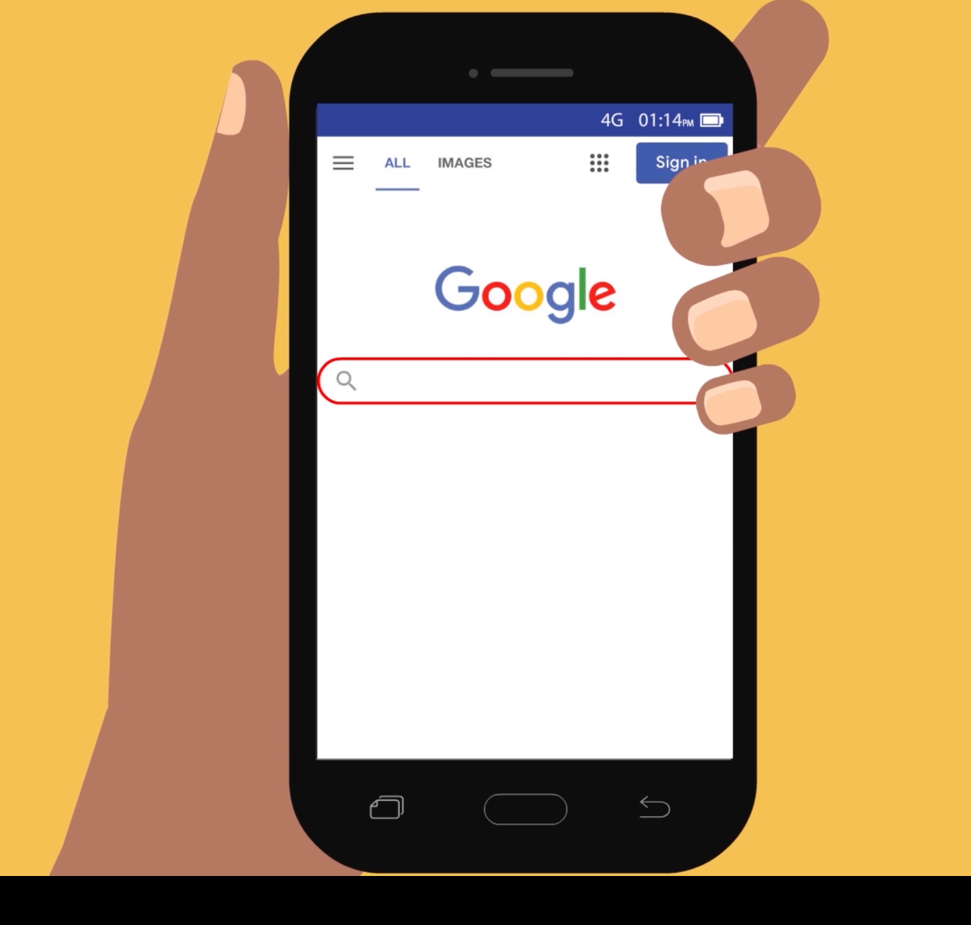
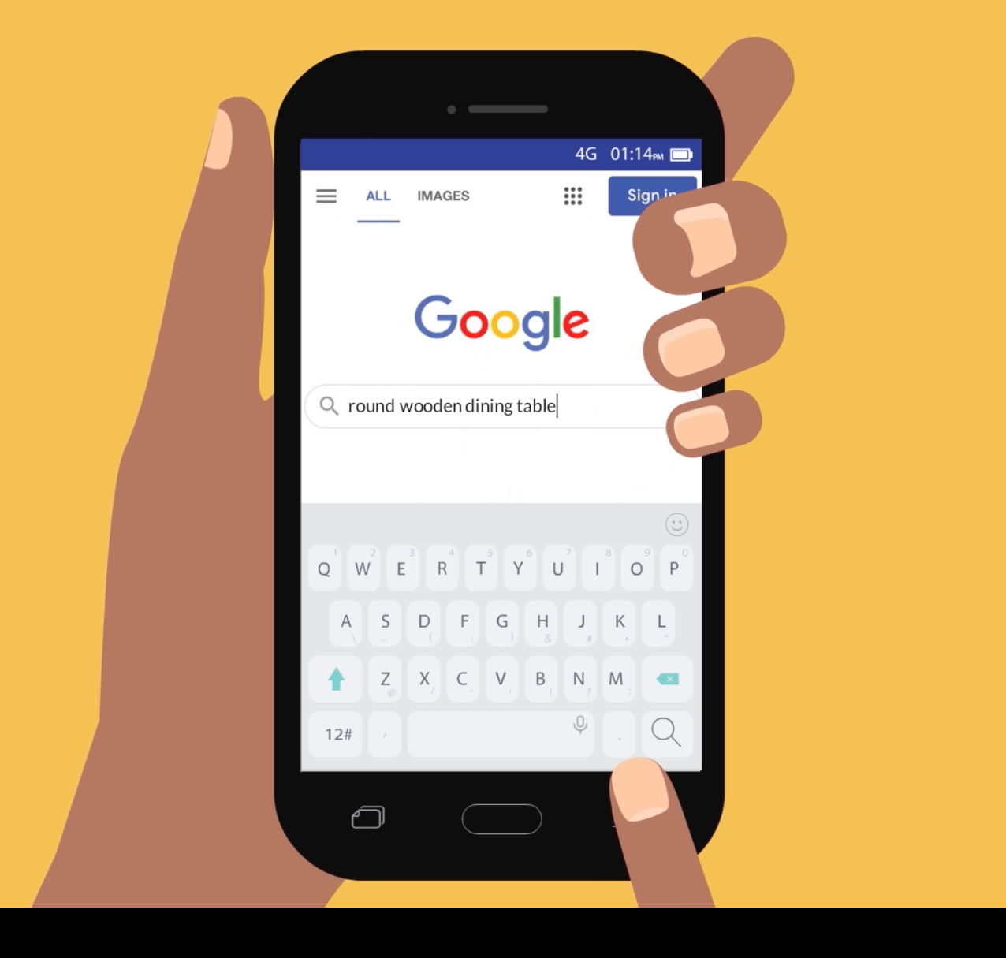
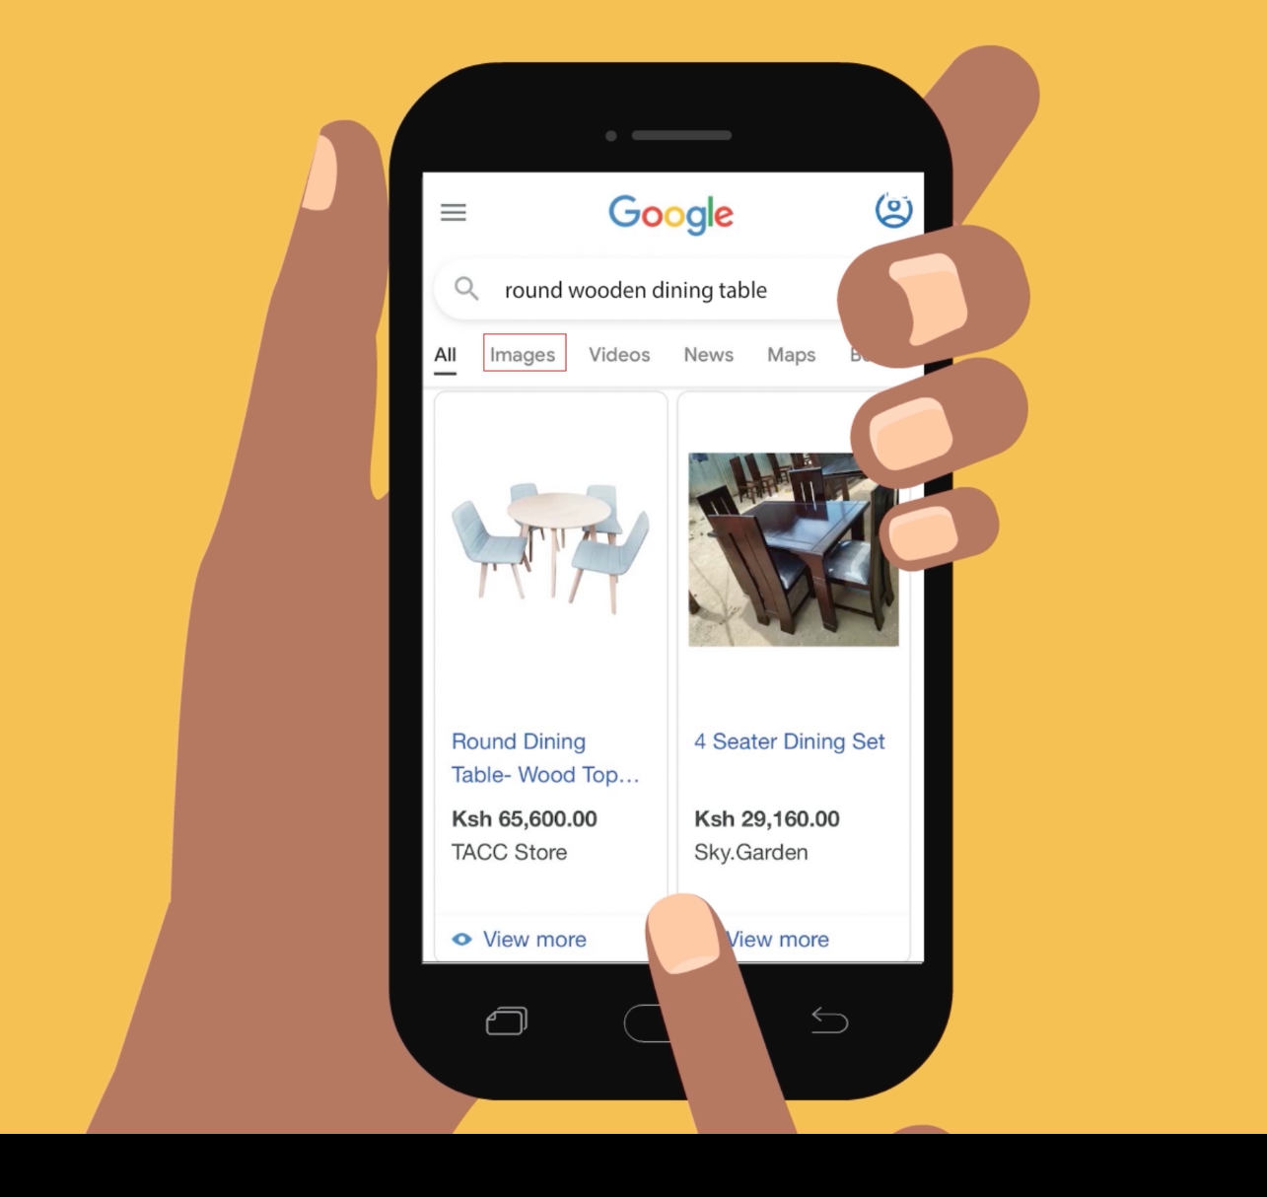
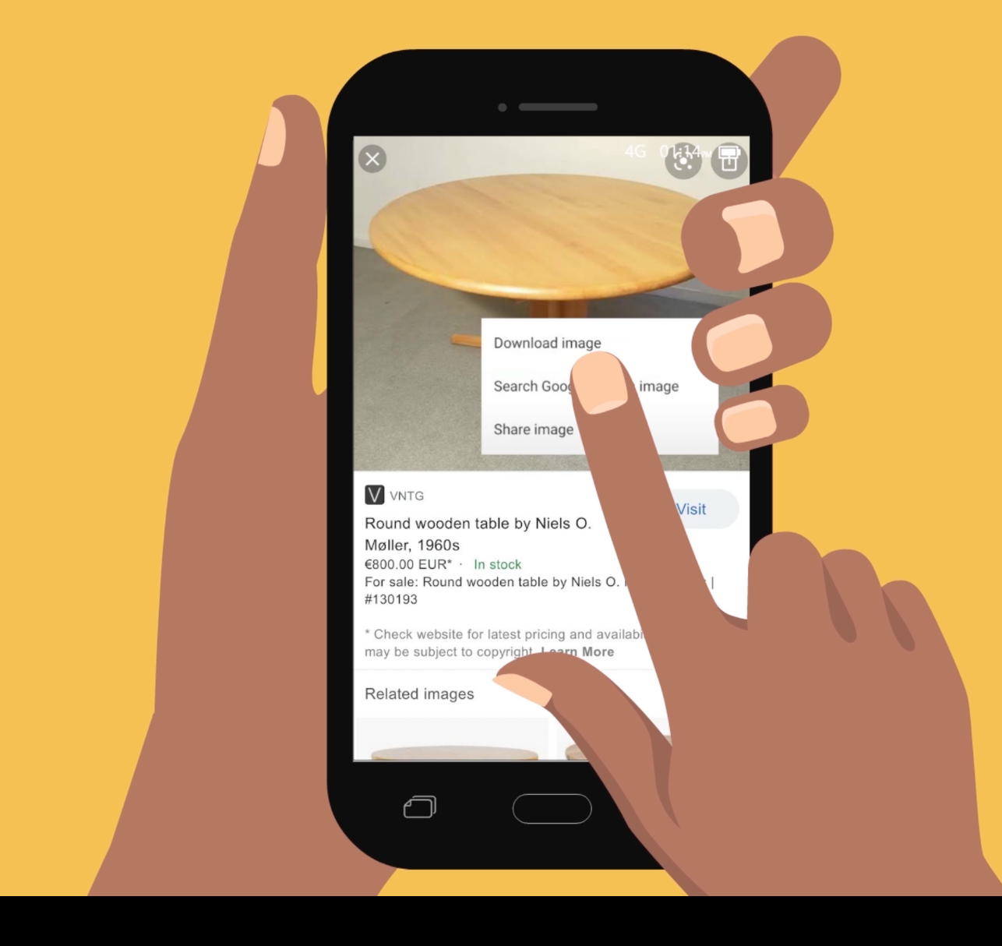
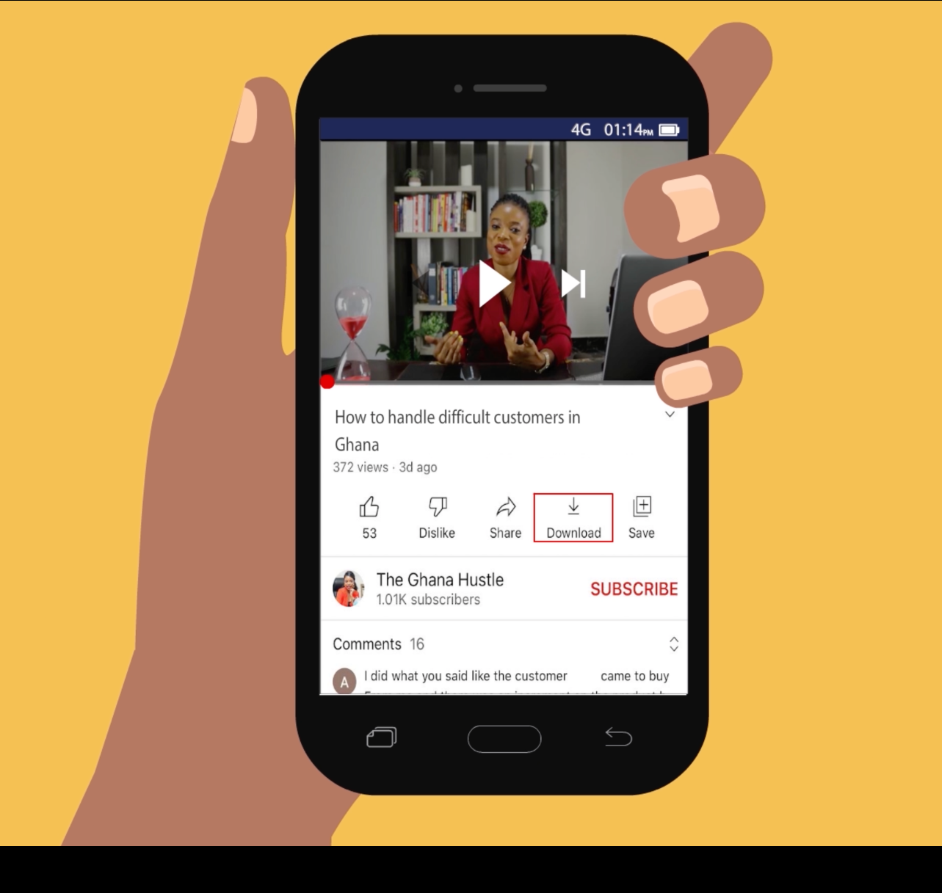
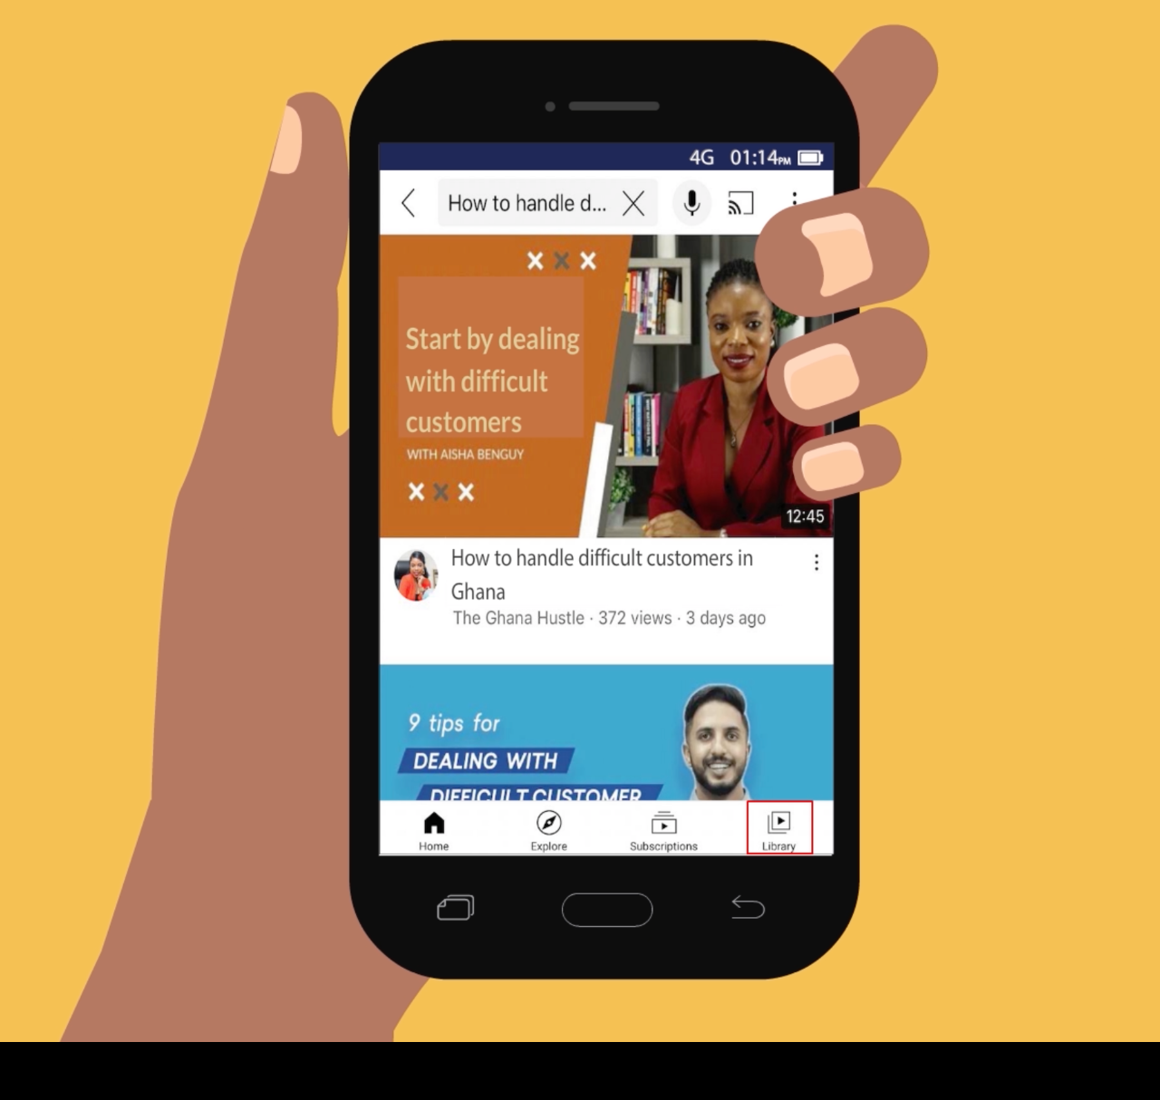
How can I download photos and videos that I find on the internet?
1
2
Press the search bar.
Type or say what you’re searching for.
3
4
Find a picture you like, then press down on it.
Press “Download image” to save the picture in your gallery.
5
6
On YouTube, press “Download”, then select “Low” quality.
Press “Library” to see your downloaded videos.

Slide 6
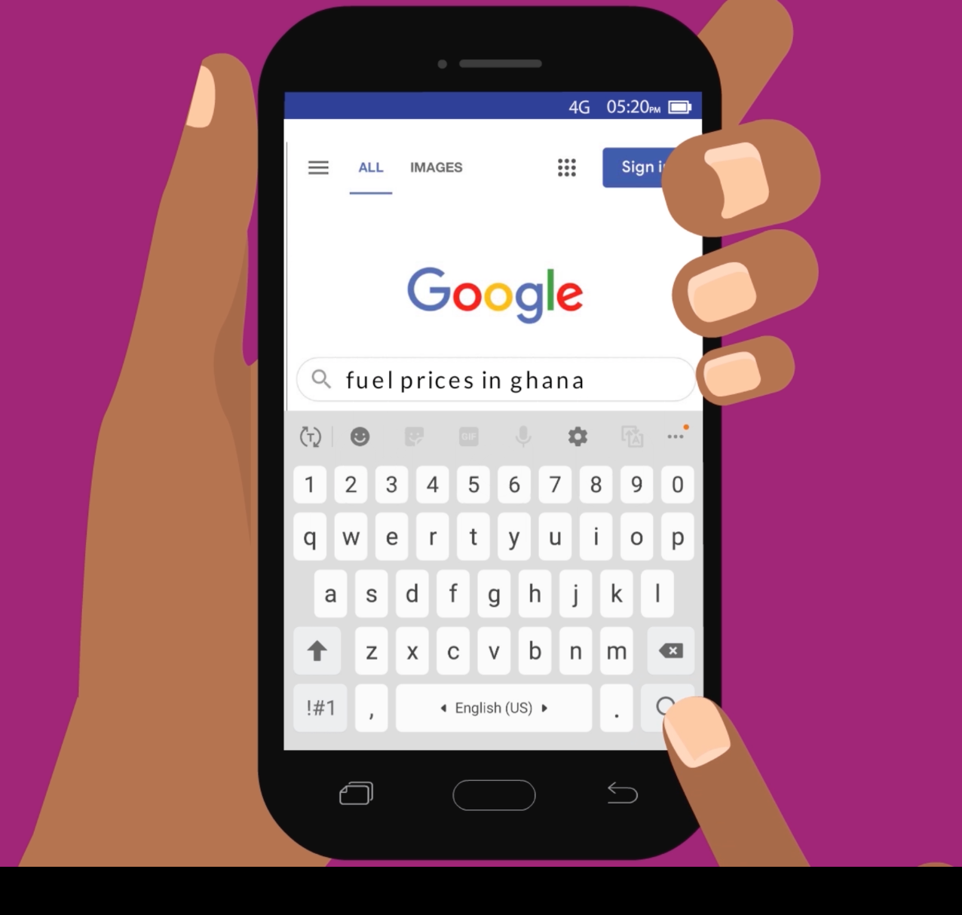
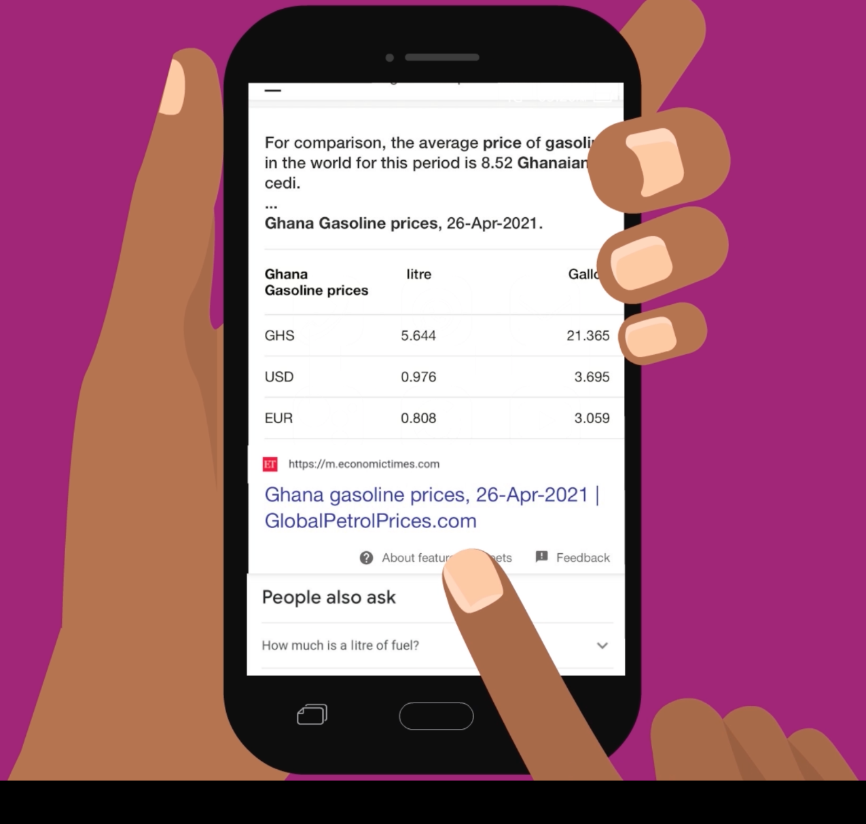
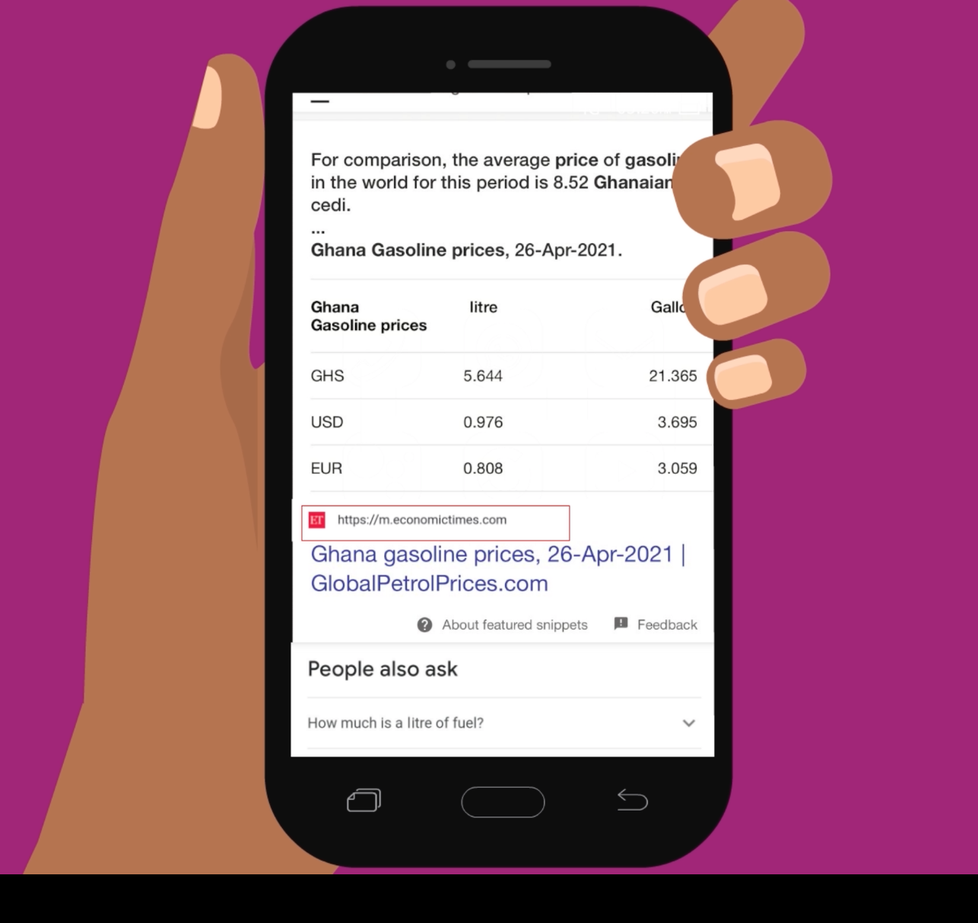
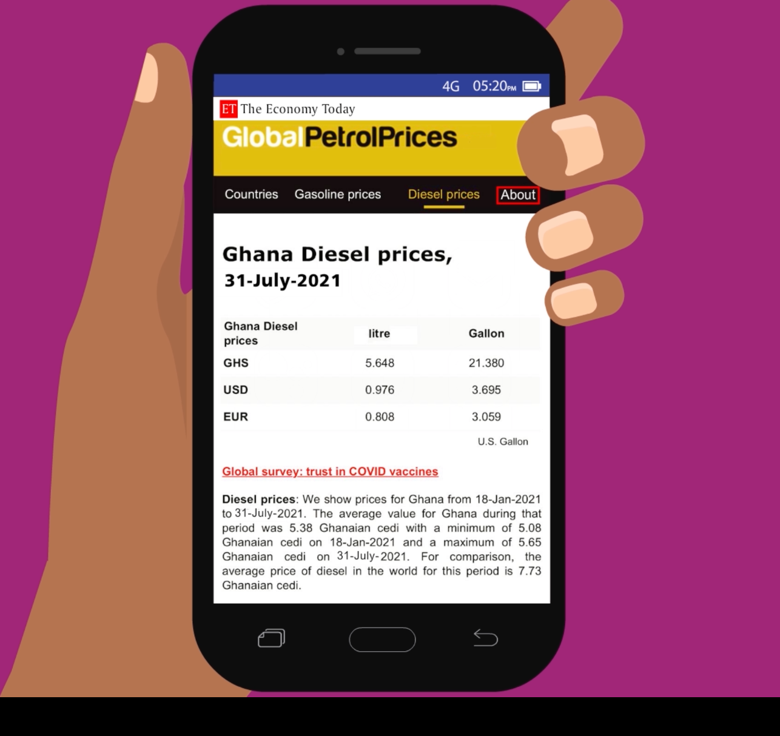
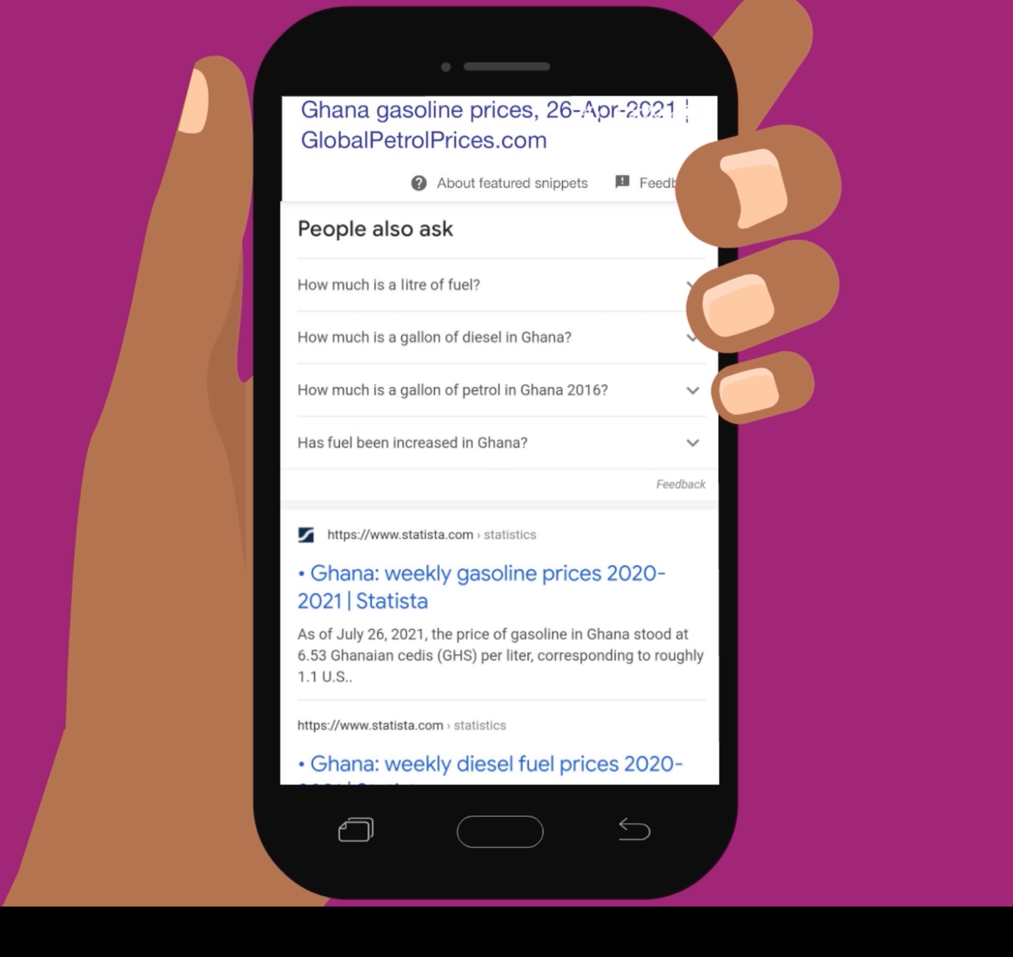
How do I know if the information I find on the internet is reliable?
1
2
Type or say what you’re searching for.
Browse through search results.
3
4
Look for well-known, trusted names.
Read the “About” section to learn more.
5
6
Check the date to ensure the information is current.
Look at different websites to learn more.

