Slide 1
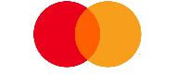
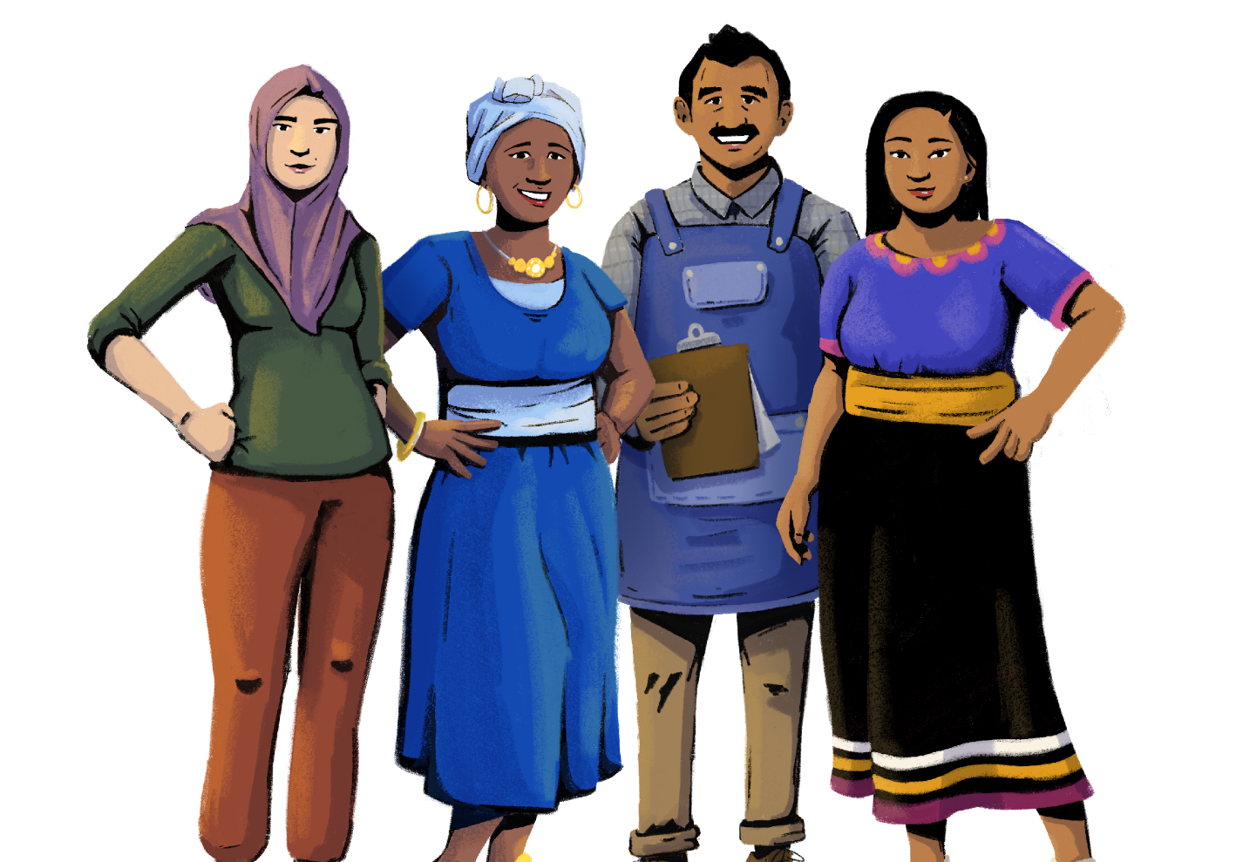
Digital Payments
Her Business, Her Future
Business Management and
Digital Literacy for Women
Micro-Entrepreneurs
This module is made possible by the generous support of the American people through the United States Agency for International Development (USAID). This guide was produced under DAI’s Digital Frontiers Project (Cooperative Agreement AID-OAA-A-17-00033) at the request of USAID and in partnership with Mastercard. The contents are the responsibility of XYZ and do not necessarily reflect the views of USAID or the United States Government.

Slide 2
Tips for Customizing This Module
The following list provides helpful tips for customizing the content in this module. You can click the slide numbers to be brought directly to that slide. Each slide with customizable elements includes arrows, text boxes, or highlighted phrases to indicate customizable sections and words.
Topics: This module is broken down into several topics as described in the table of contents. You can delete the topics that are not relevant to you and your group. You can also delete any slide throughout the module that does not apply to you or your group. Additionally, all text in this module is directly editable.
Characters: This module uses a mix of characters from different regions. You can replace any of the characters using the character image files from the creative asset library.
Discussion Questions: Slides 4, 17, and 24 contain questions for discussion. You can add, edit, or replace the questions as needed.
Scenarios: Slides 8, 13, and 22 feature two characters having a conversation for the group to read. These scenarios can be modified to be reflective of situations your group faces. Alternatively, these conversations can be used to help frame questions for discussion.
Mobile Wallet Terminology: The terms “mobile wallets” and “mobile money” are used throughout this module. You can replace these terms with a term that resonates best with you and your audience - such as mobile money account, digital wallet, etc. - by using the “find and replace” tool. These terms are also in red text throughout the module.
Mobile Wallet Providers: Slide 11 discusses different types of mobile wallet providers. You can add or eliminate providers depending on the options available in your market.
Mobile Wallet Transaction Fees: Slide 14 describes the fees associated with a mobile wallet. To help trainees understand what these pricing sheets look like, consider printing out a mobile wallet tariff sheet from a provider in your market.
Mobile Wallet Account Opening: Slide 15 describes the general steps to opening a mobile wallet. You can modify these instructions according to a provider or a specific product of your choice.
Merchant Account Opening: Slide 25 describes the general steps to opening a merchant account. You can modify these instructions according to a provider or product of your choice.
QR Codes: Slides 26-27 include photos of QR codes. You can insert a photo of a QR code to a site of your choice to have the group practice scanning a QR code together.

Slide 3
Module Overview
Table of Contents
Objectives
Learn how to accept digital payments in your store.
Understand the benefits of digital payments.
Part 1: The value of going digital for women in business | 5
Part 2: Introduction to mobile wallets | 9
Part 3: Introduction to digital payments | 18
Part 4: Dos and don’ts of digital payments | 29
practice opening a mobile wallet and merchant account
learn how to scan a QR code
discuss the benefits of digital payments
In this module, you can…

Slide 4
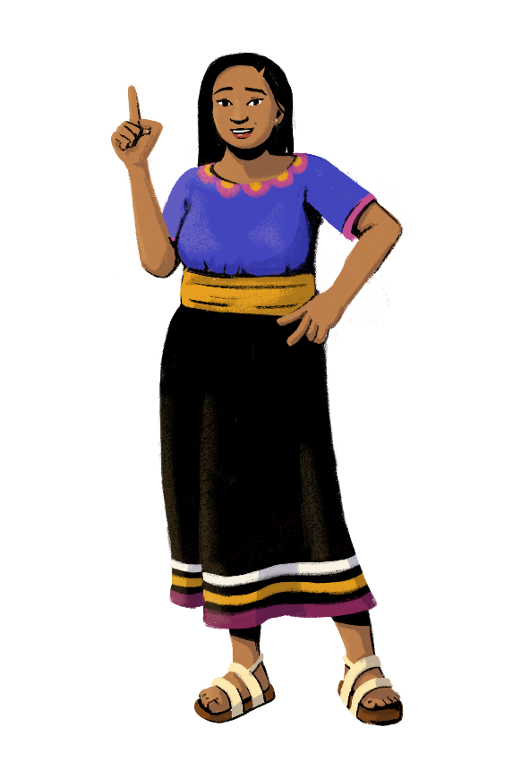
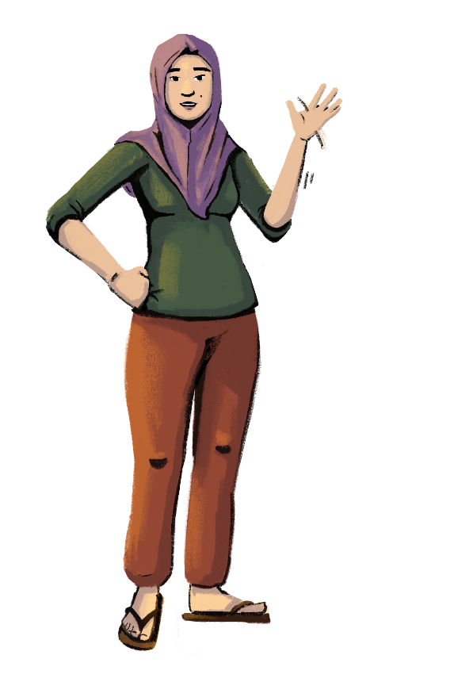
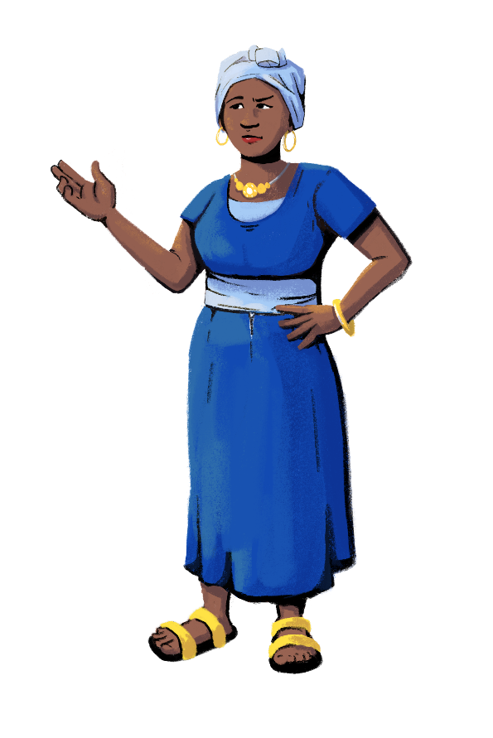
Before you start,
let’s see how familiar you are with digital payment technology!
Customization Tip!
Add, delete, or modify
questions as necessary.
Do you use
your phone for business purposes?
How?
How many of you accept digital payments in your store?
How many of you own and use a mobile wallet?

Slide 5
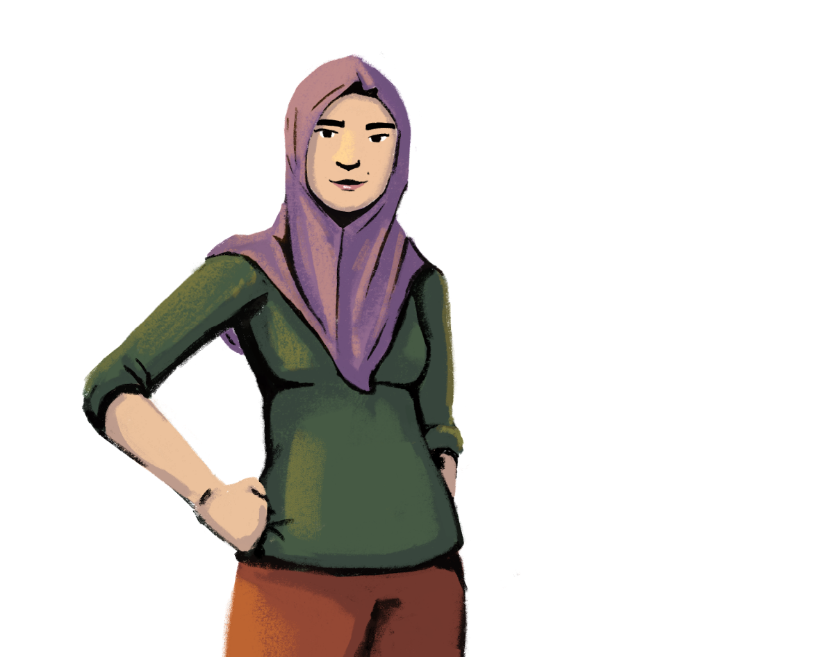
Let’s discuss why you should use technology in your businesses!
PART 1:
THE VALUE OF GOING DIGITAL FOR WOMEN IN BUSINESS
Objective: To understand the value
and benefits of women using digital
tools in business.

Slide 6
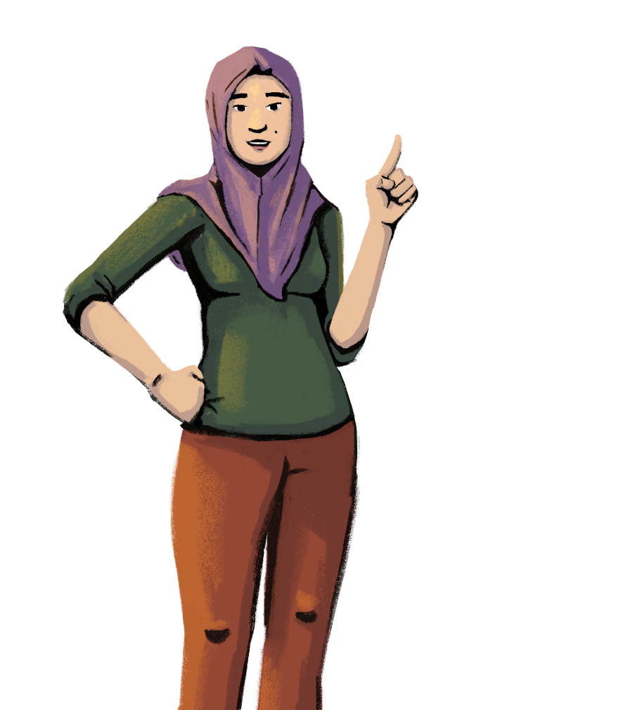
The use of technology is not restricted to a particular gender.
Efficiency and skill comes from practice and opportunities.
Anyone can learn how to use technology. It’s just a matter of practice!

Slide 7
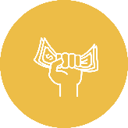
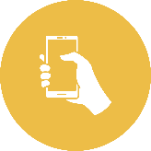
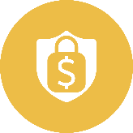
Why You Should Have Your Own Mobile Wallet
1
Gain greater financial independence.
With your own mobile wallet, you will be able to control when and how you spend money.
2
Become more savvy with digital technology.
Practice makes perfect! You will become more familiar with digital tools and technology if you have your own mobile wallet.
3
Transact efficiently and securely.
With a mobile wallet, you do not have to spend time traveling and waiting at the bank. You get to carry out your transactions securely and privately from your phone, home, or business.
4
Play a greater role in the finances of your shop.
With control over your own mobile wallet, you decide how you want to use it in your business. You can also use transaction data to help make decisions about your shop, such as what products to stock based on their sale records.

Slide 8
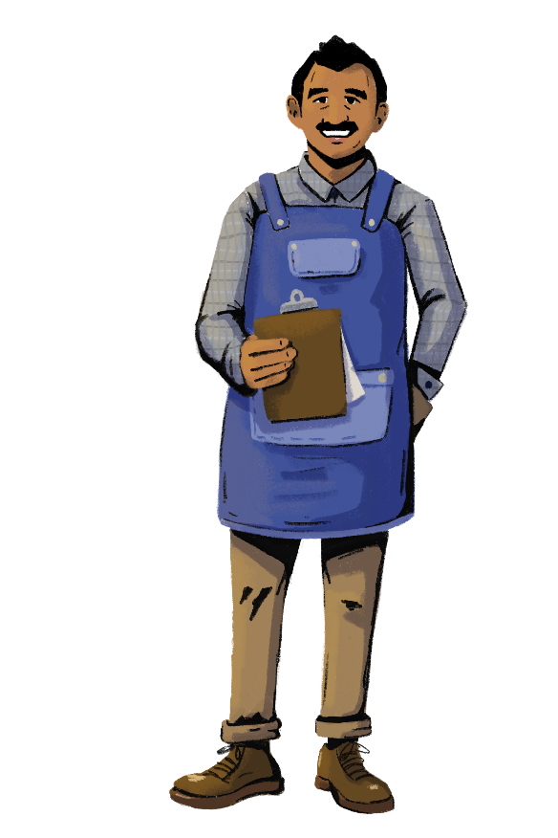
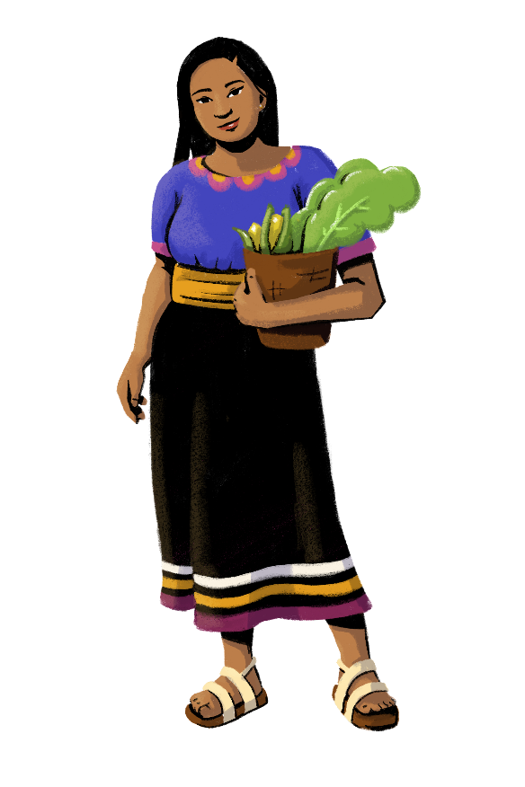
Customization Tip!
You can modify these characters and the scenario when needed.
Hi Mateo! This morning, a customer left the store without buying anything because she forgot her cash at home. I think we should start accepting digital payments in the shop so that customers can pay us even if they forget their cash.
Sofía and her husband Mateo both work at a shop. Although Mateo is the primary owner, Sofía has equal decision-making power and contributes towards the management of the shop’s operations and finances. Mateo is happy to have Sofía work with him in the shop. She brings helpful ideas to the table and even teaches him new things. He couldn’t run the shop without her!
Wow, I have never heard of that before. How does it work?
I hadn’t either until recently. We have to open a mobile wallet for our business. Then, customers can send us payments using our merchant ID number.
That sounds so convenient! We should look into opening mobile wallets. Thanks for always teaching me new ideas!

Slide 9
Are you ready
to learn about mobile wallets?
PART 2:
INTRODUCTION TO MOBILE WALLETS
Objectives:
To learn what a mobile wallet is, and why and how to use it.
To understand how to set up a mobile wallet, and the information needed to open one.

Slide 10
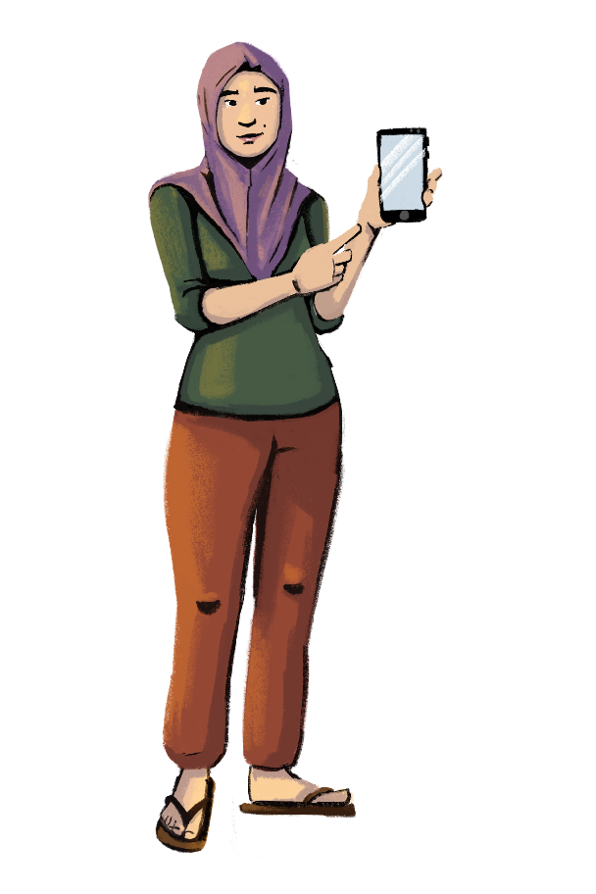
What Are Mobile Wallets?
A mobile wallet is a virtual wallet that lives on your phone. You can use your mobile wallet for many things, such as sending money, receiving payments from customers, paying your utility bills, purchasing items at a shop, buying stock for your store, and more!
Mobile wallets are a type of digital financial service (DFS) - no physical cash is involved.
Mobile wallets can have different names. They can be called “digital wallets,” “electronic wallets,” or “digital purses.” The list goes on!

Slide 11
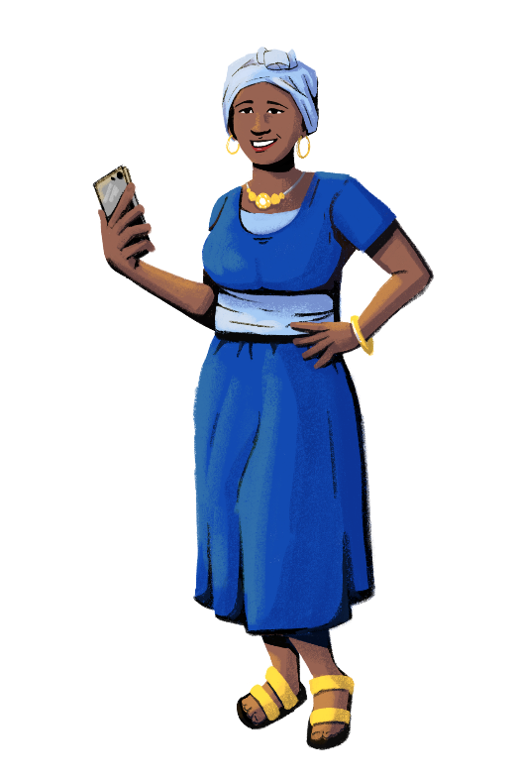
Types of Mobile Wallet Providers
Customization Tip!
Add, modify, or delete these providers as necessary.
Mobile Phone Companies. In many countries, mobile phone companies offer “mobile money services” which allow users to send, save, and receive money using their mobile phone. You have to open a mobile money account or a mobile wallet, but a bank account is not required. You just need a basic mobile phone! Sometimes you can even use your mobile money account to move money into your bank account, if you have one.
Banks. Banks can offer mobile banking services, which allows users to use their phone to manage their bank accounts. In some countries, banks also offer mobile money services where owning a bank account is not required.
Fintechs. Many fintech companies, short for “financial technology,” create platforms and services that allow users to perform financial transactions. Sometimes they work with your bank account, but you don’t always need a bank account to use them.
Mobile wallets are offered by various providers. Different providers may call their mobile wallets by a different name. One country could have many mobile wallet providers, or simply a small number.

Slide 12
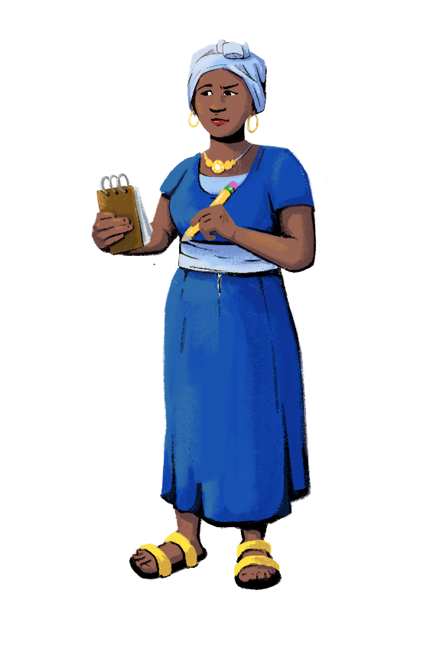
Benefits of Mobile Wallets
Mobile wallets are often more convenient than a traditional physical wallet. They can save you time by allowing you to receive and make instant payments, even from customers who are not in your store. You don’t have to visit a bank to deposit your earnings; instead, you can make transactions in the privacy of your home and shop! You also won’t have to worry about carrying adequate cash on hand to make change or pay your suppliers.
Mobile wallets can protect you. Whereas your physical wallet can be stolen, your mobile wallet is equipped with security features that reduce the risk of theft.
Mobile wallets have a wide range of uses. You can use them to pay your suppliers, contribute to your rotating savings and credit association (ROSCA) or savings account, pay bills, send money to your friends and family, receive money from customers, buy groceries, pay for transportation, and more! Also, providers are coming out with more uses all the time. The uses keep growing!
Can you think of any more benefits of mobile wallets?

Slide 13
Paying for Supplies
Customization Tip!
You can modify these characters and the scenario when needed.
Hi Imani! How are things going at your shop?
Hi Sofía! The shop is doing well. We are always so busy during this time of year.
That’s great to hear! I’m actually having a bit of trouble in my shop. I have a large inventory order coming at the end of the week, and I’m worried about keeping all that cash in the store to pay my supplier.
Ah, I see! Have you considered paying your suppliers with your mobile wallet? It is fast, easy, and convenient! Plus, you don’t have to worry about having enough cash on hand.
.
Wow! I didn’t know you could do that with your mobile wallet.
Isn’t it great? I pay my produce and beverage suppliers using my mobile wallet. I also pre-order my supplies so that they come on time!
.
Thanks Imani, I’m going to try this method when the suppliers come!

Slide 14
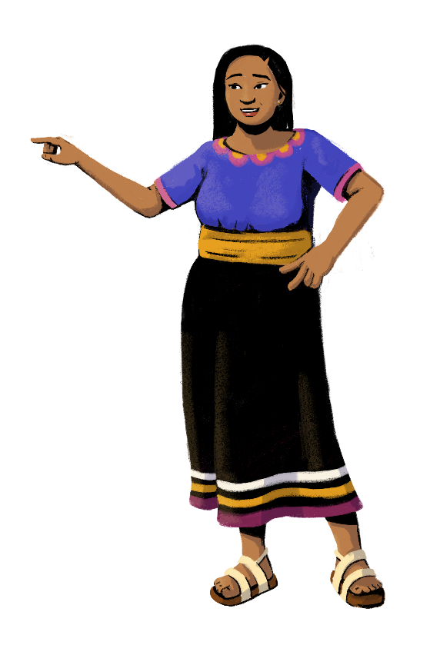
Mobile Wallet Transaction Fees
Customization Tip!
Consider showing your group an example of a mobile wallet or mobile money tariff sheet.
Remember: fees may be different depending on
your country and your provider.
Some mobile wallet transactions are free of charge, such as depositing money to your wallet. Checking your balance is usually free too! However, not all mobile wallet transactions are free. Usually, you will have to pay a fee when you withdraw your electronic money and turn it into cash. It is also common to pay a transaction fee when you send money to another person.
It is important to check the fees associated with your mobile wallet! You can check your provider’s website or visit an agent to see your mobile wallet fees. An agent is a person who acts on behalf of a phone company, bank, or fintech to perform mobile wallet transactions. Sometimes, you might even get a notification or message displaying the fees in your mobile wallet!

Slide 15
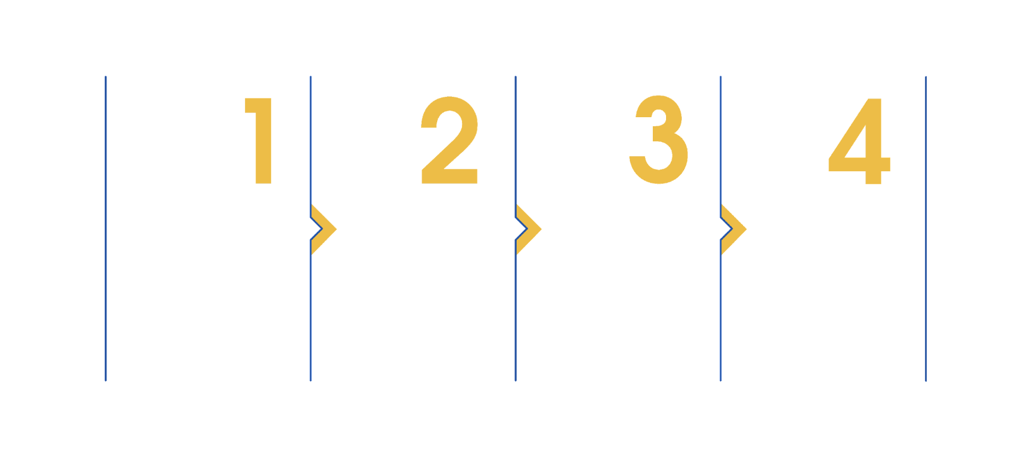
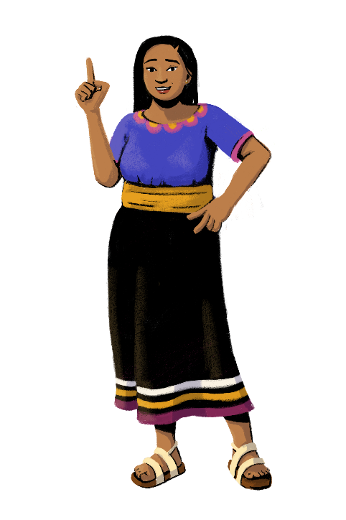
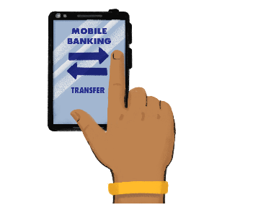
How to Set Up a Mobile Wallet
Customization Tip!
Consider customizing these steps to be reflective of a specific provider in your market.
Remember: providers may require different information and have different steps to open a mobile wallet.
Now you should be registered and can start using your mobile wallet to send and receive money!
First, choose your mobile wallet provider.
Second, download the provider’s app or visit their website, and choose the option to begin registration. If you have a feature phone, you will need to visit an agent to complete the registration process.
Fill in the required fields. Usually, you will have to enter your name, address, and provide proof of identity, such as your national or state-issued ID card, driver’s license, or passport.
Next, create your PIN code or your password. Your PIN or password is how you will access your mobile wallet. It is important to keep this number a secret!

Slide 16
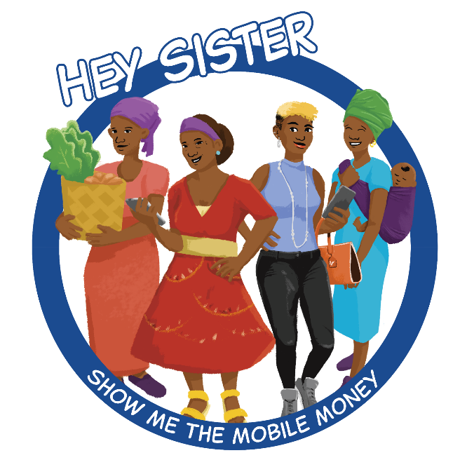
LEARNING RESOURCE
Mobile Wallets with Hey Sister and Oye Amiga
Hey Sister Lessons
Lesson 2: How do I set
up a mobile money account?
Oye Amiga Lessons
Lesson 1: How do I set
up a mobile wallet?

Slide 17
Is anyone planning on opening their own mobile wallet after this session?
Let’s
discuss!
Customization Tip!
Add, delete, or modify
questions as necessary.
What other benefits of having your own mobile wallet can you think of?
How would you use your mobile wallet for your business?

Slide 18
Are you ready?
PART 3:
INTRODUCTION TO DIGITAL PAYMENTS
Objectives:
To learn about digital payments and their benefits.
To understand how to use digital payments in business.

Slide 19
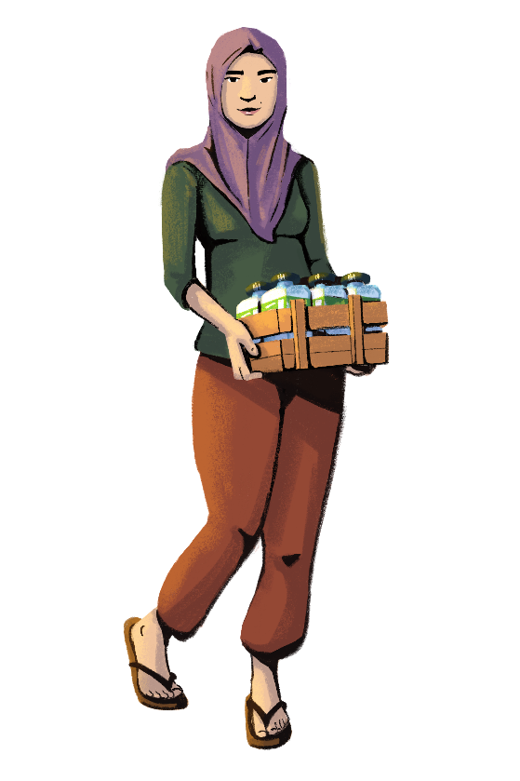
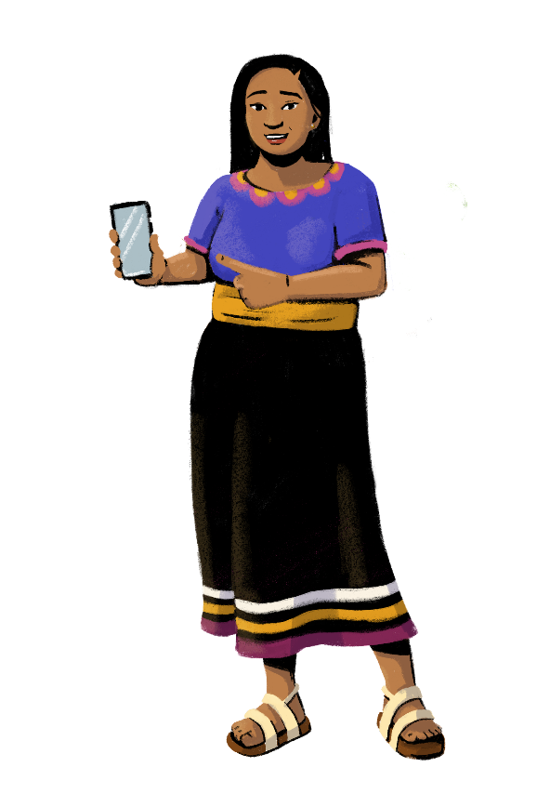
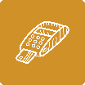
Introduce Technology to Your Store
There are many ways to introduce technology to your stores.
In this section, you’ll learn about how you can introduce digital payments into your business!
Enable digital payments
Get a merchant ID and QR code to enable customers to pay you faster and easier
Have a Point-of-Sale (POS) machine to improve store and inventory management and to capture data to track your business growth
Take orders through calls, SMS, or
WhatsApp

Slide 20
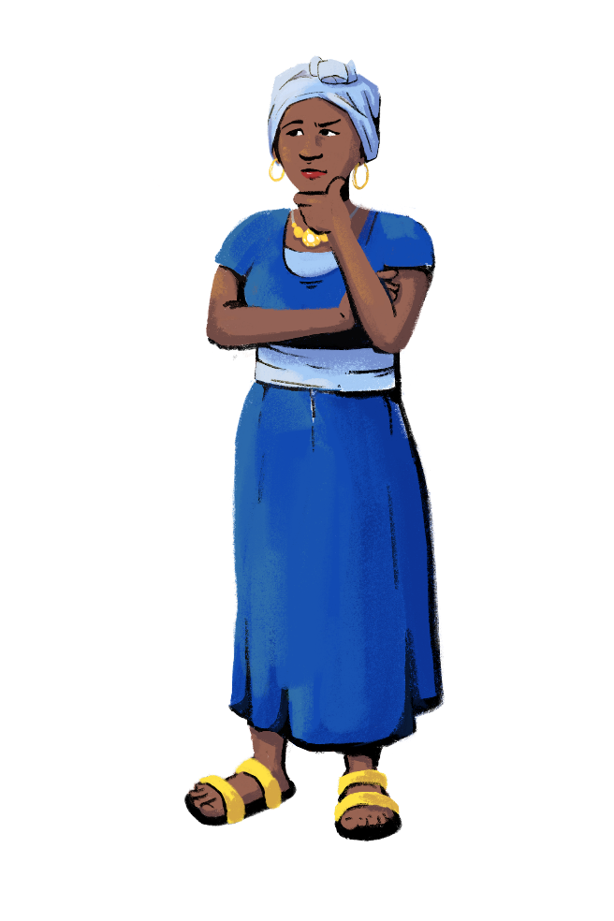
What Are Digital Payments?
A digital payment is a transaction that takes place via online or “digital” modes, such as over your phone or on a device connected to a mobile network.
Digital payments are also known as cashless payments, since no physical cash is involved.
Digital payment systems use technologies to facilitate sales and purchases instead of cash.
Some digital payments services are: POS, QR codes, payment wallets, and USSD.

Slide 21
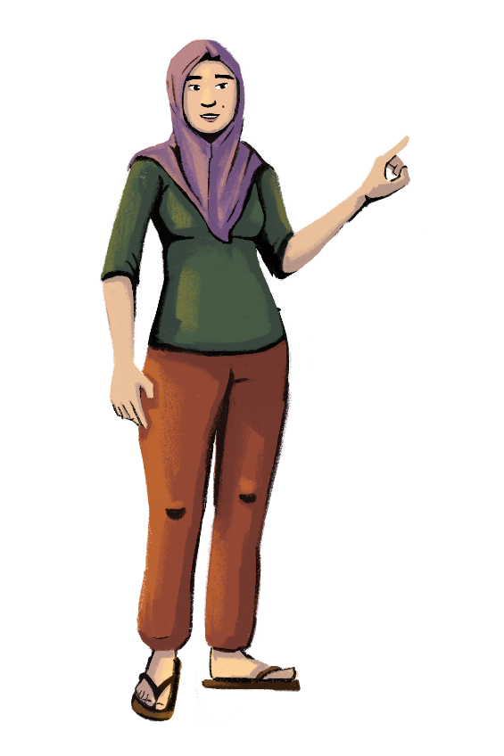
Benefits of Digital Payments
Transact more conveniently
Have greater control over your income
Build a credit history and improve your access to credit from the formal sector
Collect payments from customers and suppliers remotely
Manage your accounts effortlessly
Earn cashback or reward points
Save money
Gain better insights into cash flow, spending trends, and cash management
Transact at a lower risk than when paying with cash

Slide 22
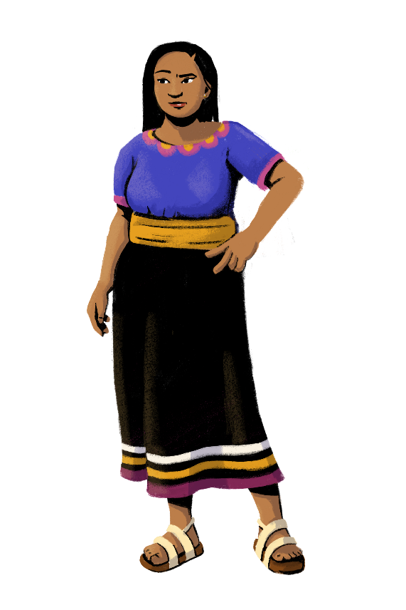
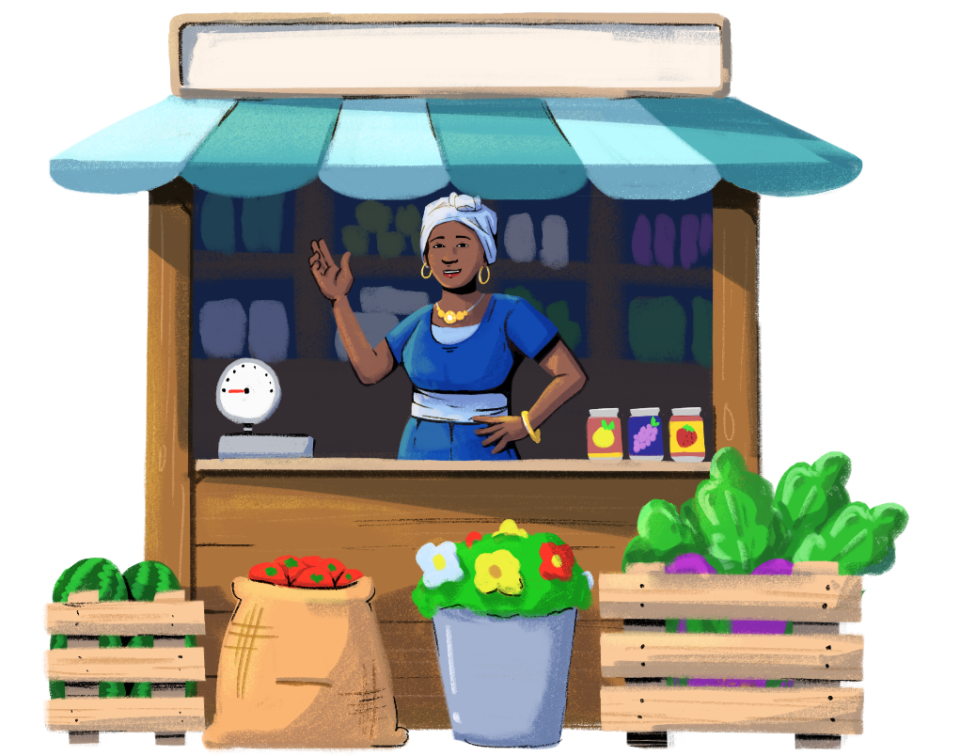
Paying Bills Digitally
Customization Tip!
You can modify these characters and the scenario when needed.
Imani, lately I have been spending so much time at the shop paying my bills! It takes me hours to sort through all of my bills and get enough cash. Do you know of any easier ways to pay bills?
Have you tried paying your bills digitally? I always pay my bills online or through my mobile wallet. I pay for the store’s utilities and rent each month digitally.
Wow! I think I will start paying bills digitally too. I am going to suggest it to my husband, Mateo!
I also set up automatic bill payments through my mobile wallet so that I never miss a payment! It helps me be more organized, and now I am much more efficient in paying bills each month.

Slide 23
Understanding Digital Payments
Digital payments can be safer than paying with cash. Usually, you have to confirm your digital payment with a PIN or a passcode. Also, governments publish regulations that require the mobile wallet provider to keep your money safe.
Digital payments are unsafe and risky.
FACTS
Digital payments are complex to set up and maintain.
MYTHS
Once you know how to do it, digital payments are easy to use and can be facilitated through the press of a few buttons.
Digital payments are expensive.
The cost of digital payments can vary. While there may be fees, some transactions are free. You also may save time in paying bills and be able to reach more customers.

Slide 24
Let’s
discuss!
Customization Tip!
Add, delete, or modify
questions as necessary.
What questions do you have about digital payments?
Does anyone want to set up digital payments for your business?
Can you think of any other benefits of digital payments?

Slide 25
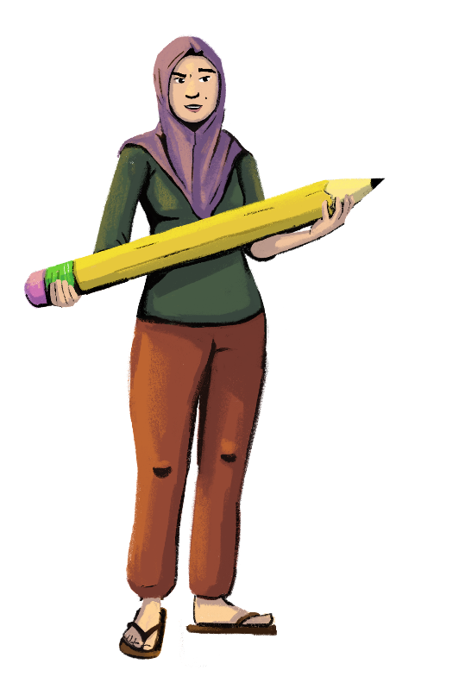
How to Set Up A Merchant Account for Your Business
A merchant account is an account specifically for business activities. I use my merchant account to collect digital payments from customers.
Visit your payment provider’s website or visit an agent to begin registration.
Enter the necessary information, such as your name, business registration number, email, address, and ID.
After registering, it may take some time for your application to be approved.
That’s it! Once you’re approved, you will get a merchant ID number and a QR code so that customers can pay you.
Customization Tip!
Consider customizing these steps to be reflective of a specific provider in your market.

Slide 26
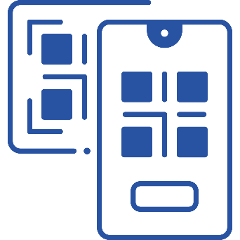
Getting to Know QR Codes
Customization Tip!
Consider including a photo of a QR code that directs trainees to a website of your choice.
“QR code” stands for “Quick Response Code.” It is a type of 2D barcode that is readable by smartphones.
QR codes enable a fast and simple transfer of money between accounts.
QR codes use safe technology for transferring money.
No bank details need to be entered to use a QR code.
Physical cards are not required to use a QR code.
Convenient Digital Payment Technology
Once you have generated your unique QR code, print it out and hang it up at the payment counter of your store. Now, customers can easily pay by scanning your QR code.

Slide 27
How to Pay Using a QR Code
Customization Tip!
Consider including a photo of a QR code that directs trainees to a website of your choice.
Making a payment via a QR code is extremely quick when compared to other modes of payment!
That’s it!
Your payment was made
in a few seconds
Open your camera app
Scan the QR code
Confirm to process the payment

Slide 28
LEARNING RESOURCE
Digital Payments with Hey Sister and Oye Amiga
Hey Sister Lessons
Lesson 5: How do I set up a merchant account for my business?
Lesson 24: How can a digital footprint grow opportunities for my business?
Oye Amiga Lessons
Lesson 19: How do I set up a merchant account for my business?
Lesson 22: How can a digital footprint grow opportunities
for my business?

Slide 29
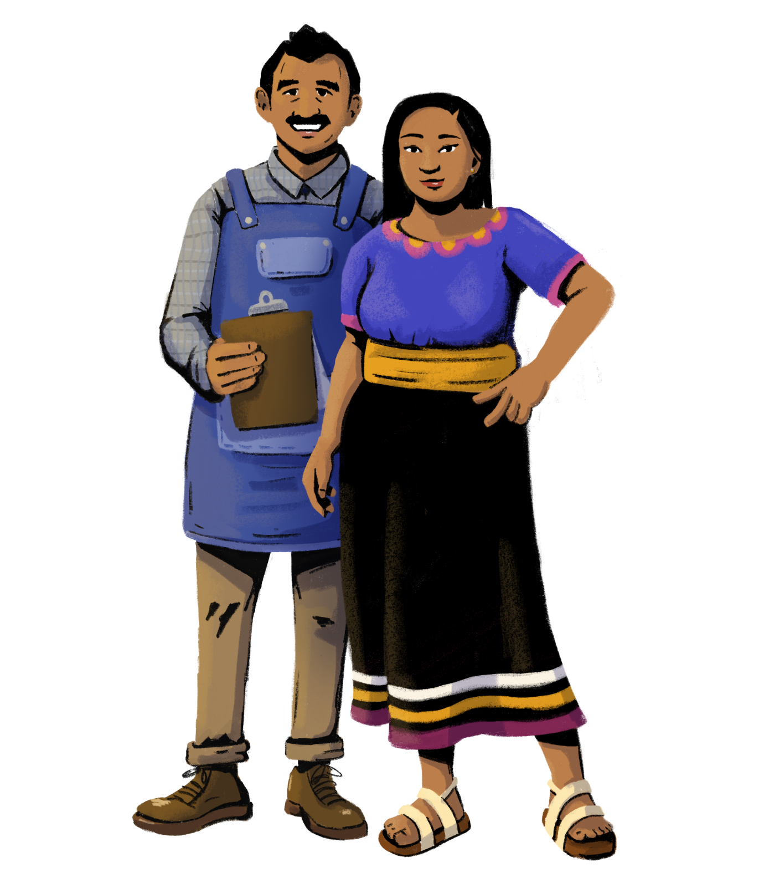
While digital payments can make your
store more efficient, it’s important to use all technology safely.
PART 4:
DOS AND DON’TS OF DIGITAL PAYMENTS
Objective: To learn tips and tricks to protect
your online information.

Slide 30
Dos of Digital Payments
Set strong login passwords for your apps and accounts.
Download authentic and official apps.
Keep an eye on your account balance and transaction history.
Log out of your apps and accounts when not using them.
Always lock your phone to prevent unauthorized use.
Change your passwords regularly.

Slide 31
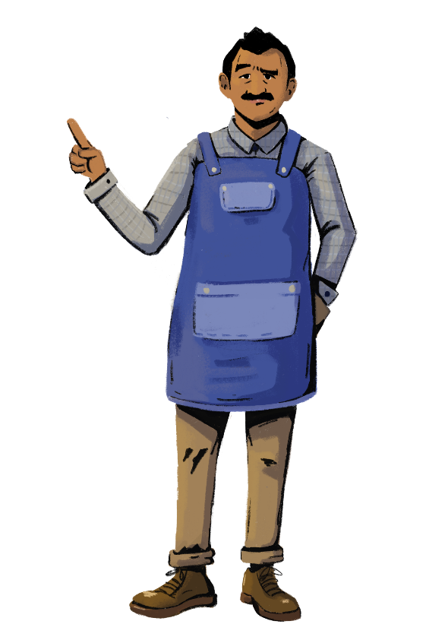
Dont’s of Digital Payments
Never leave your phone unattended and logged into a mobile banking app.
Don’t use the same password for all of your apps and accounts.
Don’t save your mobile banking login and password on your phone. Memorize it or write it down and store it somewhere safe.
Do not share passwords, PINs, or any other confidential details with anyone.
Don’t use unsecured Wi-Fi networks at train stations and airports.

Slide 32
Terms and Conditions
Digital payment providers usually provide “Terms and Conditions” on their websites, which contain important information regarding your mobile or digital wallet.
They can contain information about what to do and who to contact when your mobile phone, PIN, or your SIM card are lost or stolen.
It’s important to check your provider’s terms and conditions to see all the different ways you can be protected when using digital payments.

Slide 33
LEARNING RESOURCE
Learn About Your Rights With Hey Sister and Oye Amiga
Hey Sister Lessons
Lesson 12: What are my rights under mobile money terms and conditions?
Oye Amiga Lessons
Lesson 3: Where can I look for information about my rights under mobile wallets?

Slide 34
Key Takeaways From This Module
Mobile wallets and merchant accounts give you greater control over your finances. Opening your own mobile wallet or merchant account for your business will give you more financial freedom. You can decide where to allocate your money, and how you use your digital wallets.
Digital payments offer convenience, privacy, and accessibility. With digital payments, mobile wallets, and merchant accounts, you no longer have to travel to your bank and wait in line to make your transactions. With these tools, you can transact securely and privately from anywhere, including your shop or your home.
Using digital tools gives you records of your cash flow and transactions. Adopting digital payments will give you a digital trail of your transactions, which can help you make important decisions about your business, such as what products to stock.
Digital tools can make your business more efficient when used safely. It’s important to take precautions when using mobile wallets and accepting digital payments. Remember to check your transactions regularly, use passwords on your devices, and refrain from sharing confidential information with anyone.

Slide 35
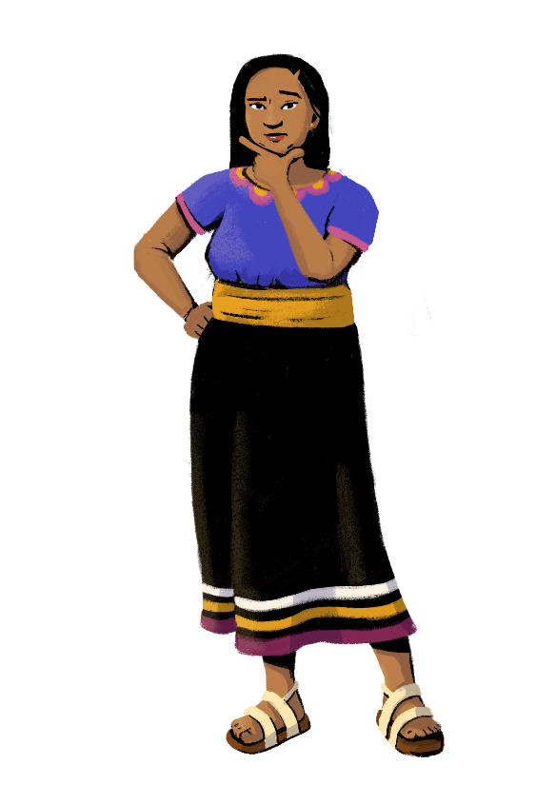
Share your doubts and questions!

Slide 36
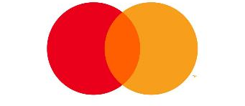
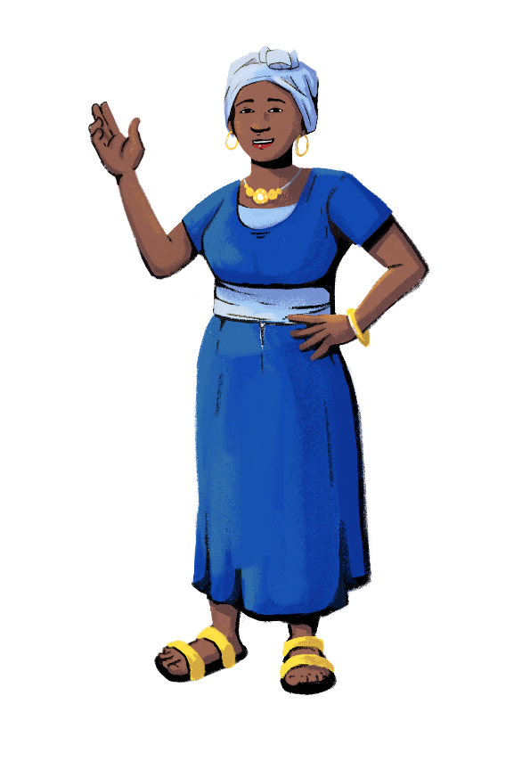
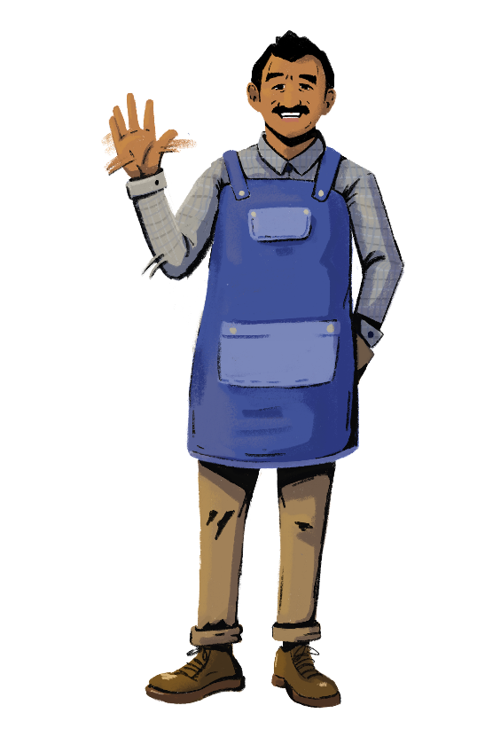
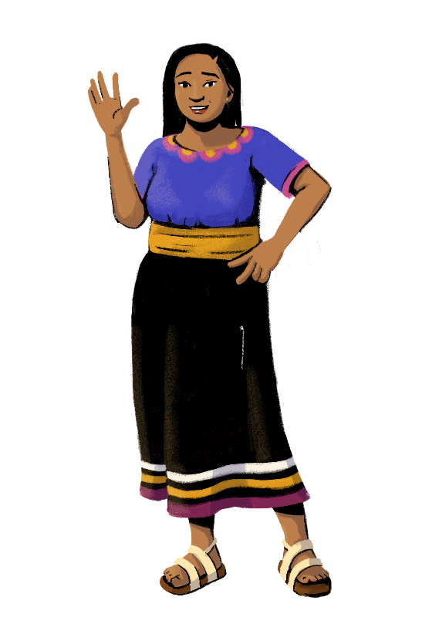
www.siaedge.com
Line Two
Line Three

