Slide 1
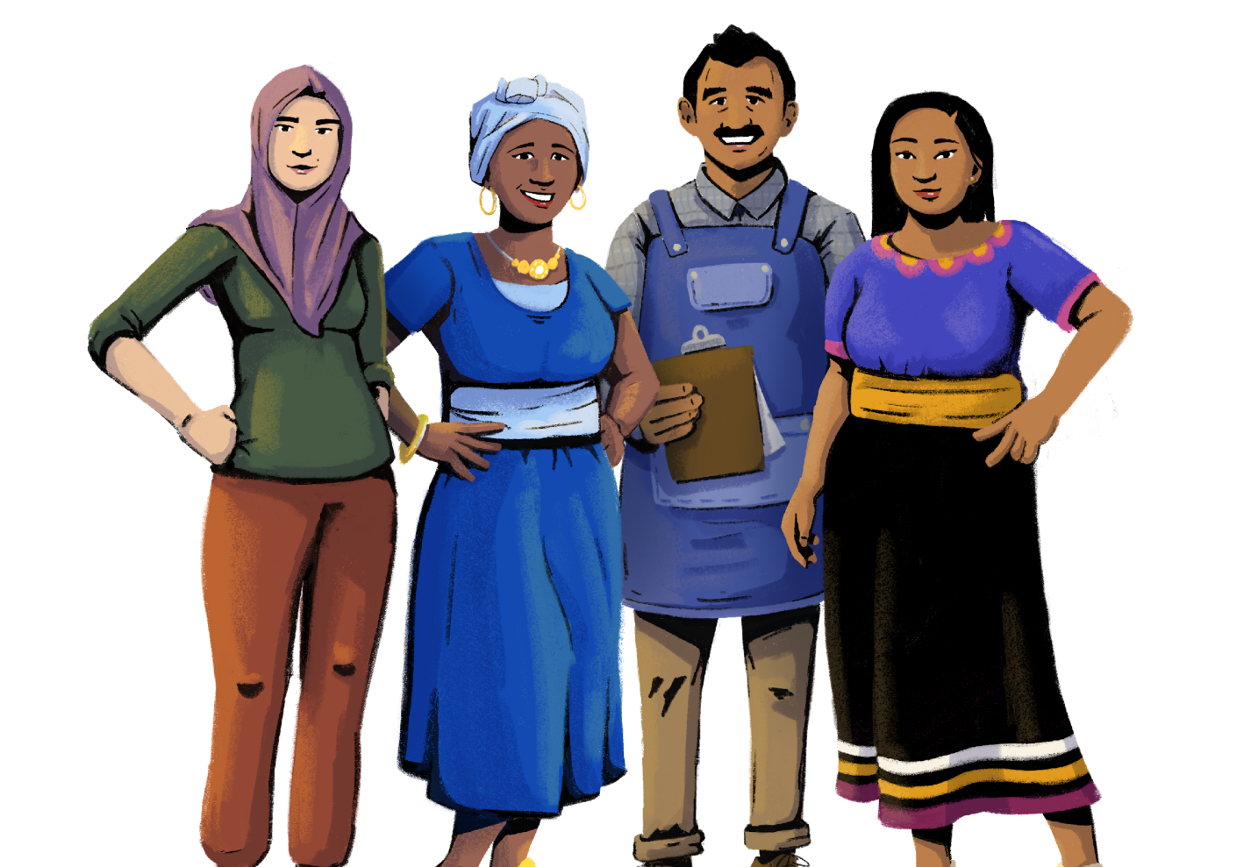
Orientation
Her Business, Her Future
Business Management and
Digital Literacy for Women
Micro-Entrepreneurs
This module is made possible by the generous support of the American people through the United States Agency for International Development (USAID). This guide was produced under DAI’s Digital Frontiers Project (Cooperative Agreement AID-OAA-A-17-00033) at the request of USAID and in partnership with Mastercard. The contents are the responsibility of XYZ and do not necessarily reflect the views of USAID or the United States Government.

Slide 2
Tips for Customizing This Module
The following list provides helpful tips for customizing the content in this module. You can click the slide numbers to be brought directly to that slide. Each slide with customizable elements includes arrows, text boxes, or highlighted phrases to indicate customizable sections and words.
Topics: This module is broken down into several topics as described in the table of contents. You can delete the topics that are not relevant to you and your group. You can also delete any slide throughout the module that does not apply to you or your group. Additionally, all text in this module is directly editable.
Characters: This module uses a mix of characters from different regions. You can replace any of the characters using the character image files from the creative asset library.
Order of Content: Slides 6 and 37 provide an overview of the remaining seven modules in this training. You can delete modules that are not relevant to you and your audience, or change the order of the modules to best meet your needs.
Discussion Questions: Slides 9, 21, 23, 24, 25, 26, 28, 35, and 36 contain questions for discussion. You can add, edit, or replace the questions as needed.
Character Scenario: Slides 10 - 20 follow a character, Imani, as she introduces herself and her store. You can change the character and modify her scenario to be more relevant to your group where needed.
Registrations and Licenses: Slide 31 gives information about business and trade licenses. You can modify the documents needed for these licenses depending on your market context. You can also replace the kinds of licenses to be more relevant to your group.
Financial Subsidies: Slide 33 lists examples of financial subsidies available to women. You can add relevant examples based on your context, and delete examples as necessary.

Slide 3
Module Overview
Table of Contents
Objectives
Learn about the lessons covered in this training.
Understand the current state of your business.
Develop a vision for your business.
Identify the knowledge and skills you need to grow your business.
Part 1: Introduction to the training and characters | 4
Part 2: Creating a vision | 22
Part 3: Understanding formal vs. informal businesses | 29
Part 4: Conducting a gap assessment on your store | 34
In this module, you can…
get to know the training characters and your training group
analyze the status of your business
brainstorm areas for improvement

Slide 4
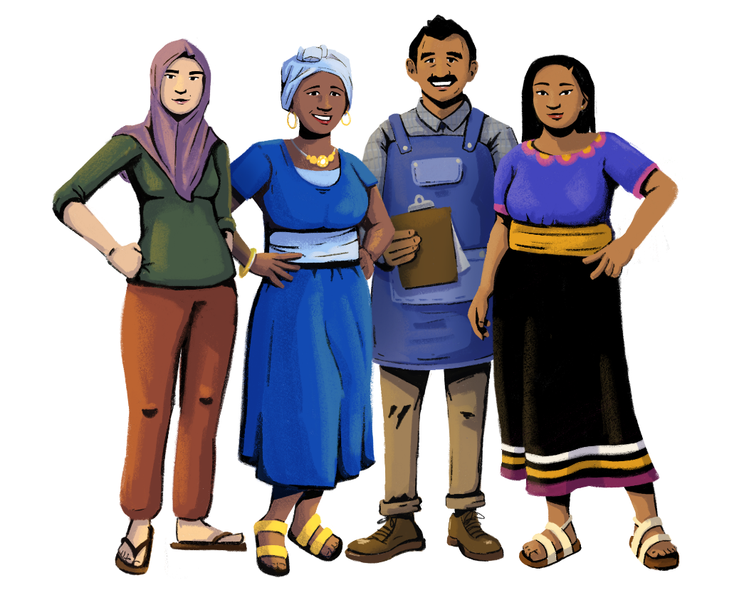
Let’s get started!
PART 1:
INTRODUCTION TO THE TRAINING AND CHARACTERS
Objectives:
To learn about the goals of this training.
To understand the skills you can gain from this training.
To get to know the training’s characters and your training group.

Slide 5
Objectives of This Training
To grow your customer base and revenue by improving your business management skills.
To build your entrepreneurial drive, capacities, and skills through trainings on business and digital literacy.
To learn how to use financial services and your phone in your business operations and transactions.

Slide 6
Training Modules
Customization Tip!
You can pick and choose the modules that are most relevant to your audience, and change the order that they are presented.
Accessing and Qualifying for Credit
Financial Literacy
Business
Management
and Digital Literacy
for Women Micro-Entrepreneurs
Business
Promotion
Know Your Phone
Inventory
Management
Digital Payments
Financial Management

Slide 7
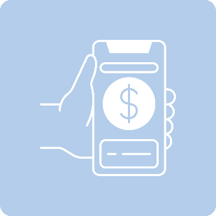
After This Training, You’ll Be Able to:
Use bookkeeping
and financial management to track and document your business performance.
Establish your role in the management of your business.
.
Increase your awareness and adoption of digital tools and payments.
Increase your access to financial services, such as credit and insurance.

Slide 8
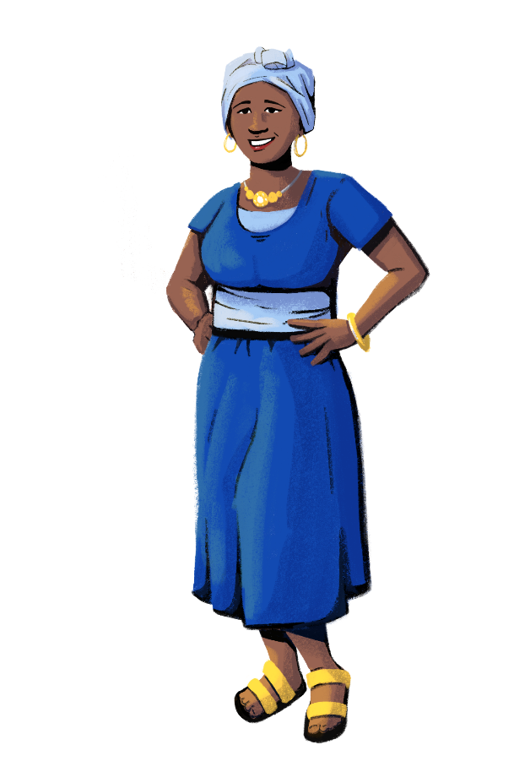
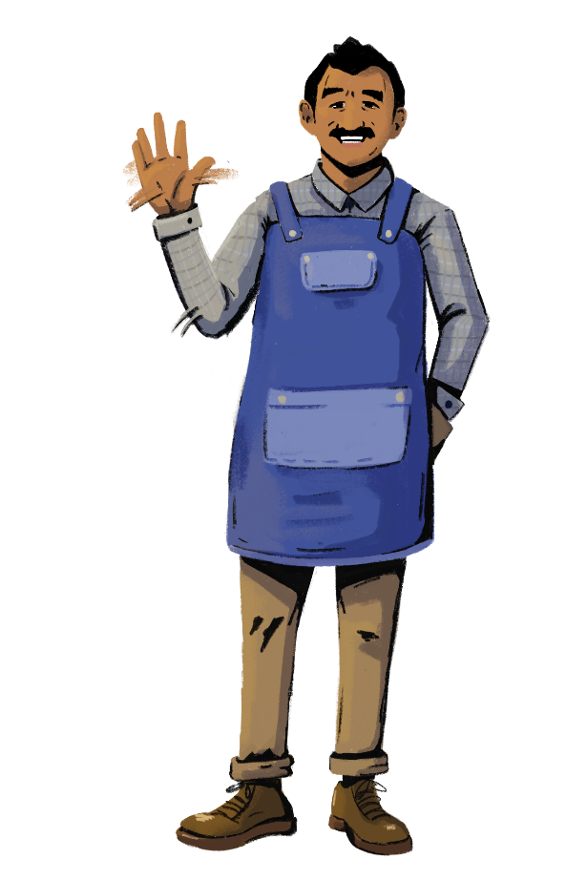
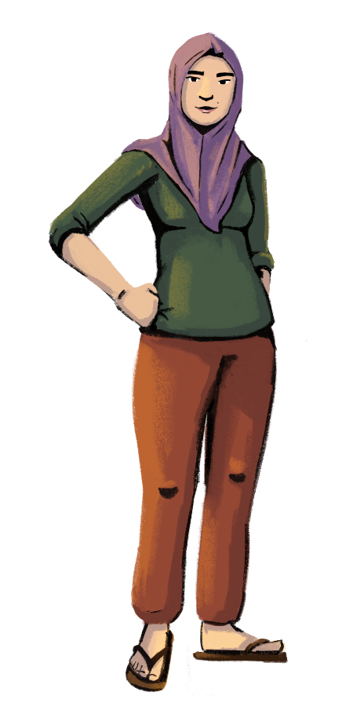
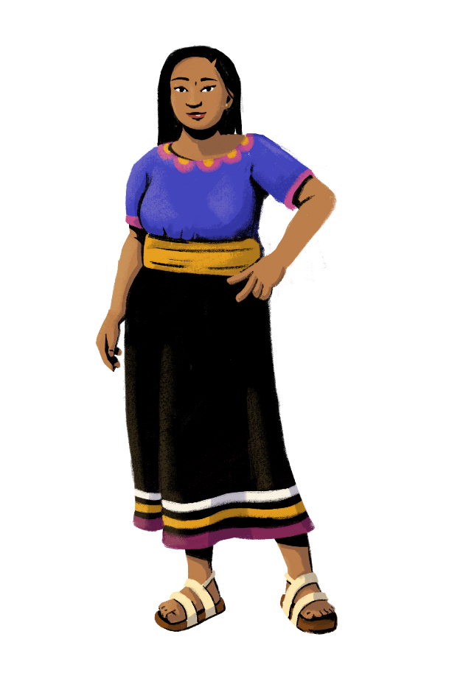
Let’s Get to Know Each Other!

Slide 9
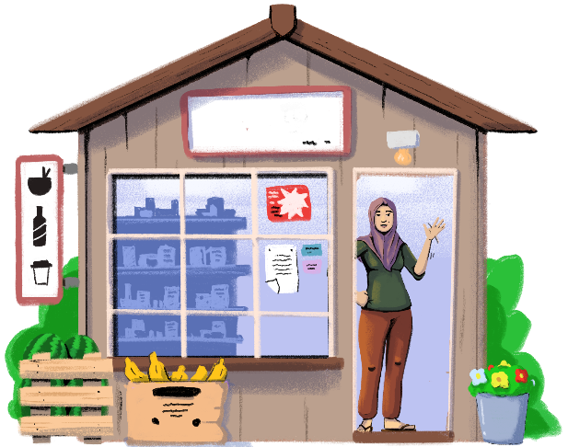
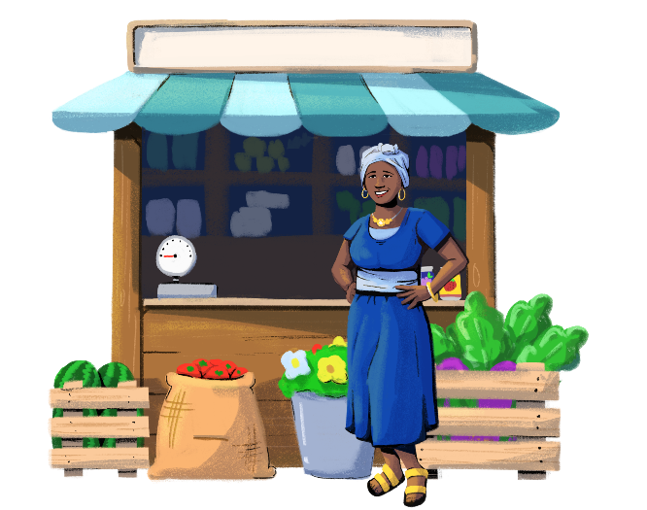
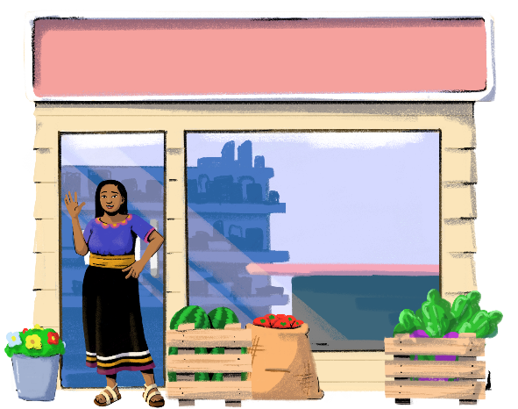
Customization Tip!
Add, delete, or modify questions as necessary.
How many people live in your household?
Are you married? Do you have any children?
What kind of shop do you run?
How many products do you sell a day?
What are your most popular goods?
Is your business registered with the government? Do you have a trade license? (optional)

Slide 10
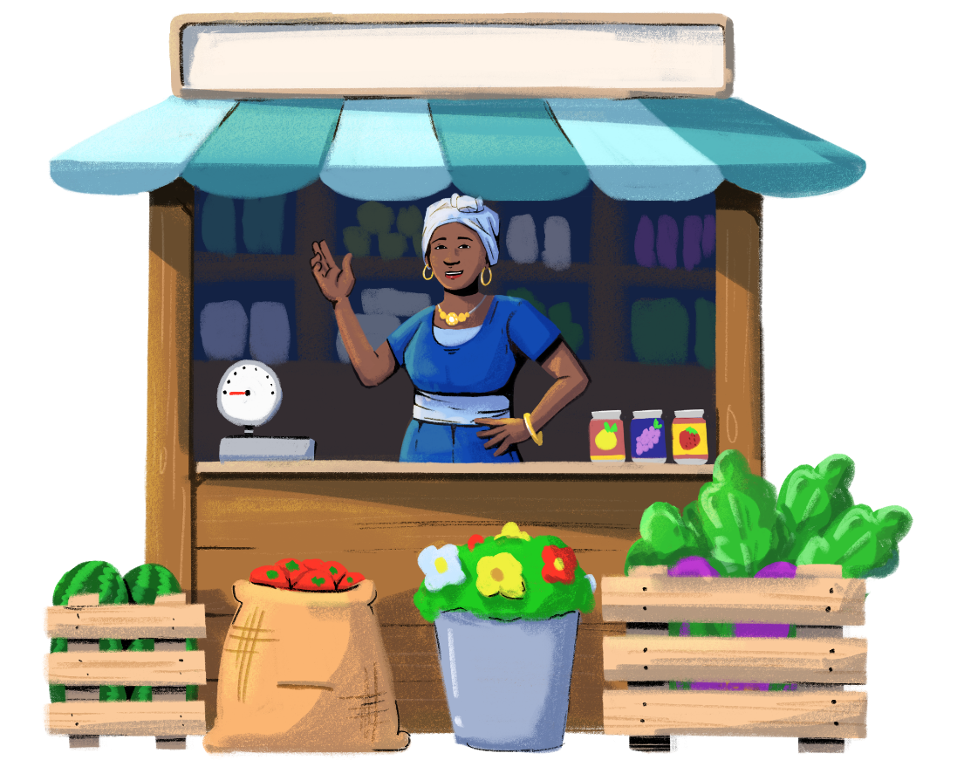
Customization Tip!
You can change the main character or modify the story where needed in the following slides.
SCENE 1
Let’s meet Imani and follow her on her journey as she applies the skills she learned in this training to improve and grow her business.

Slide 11
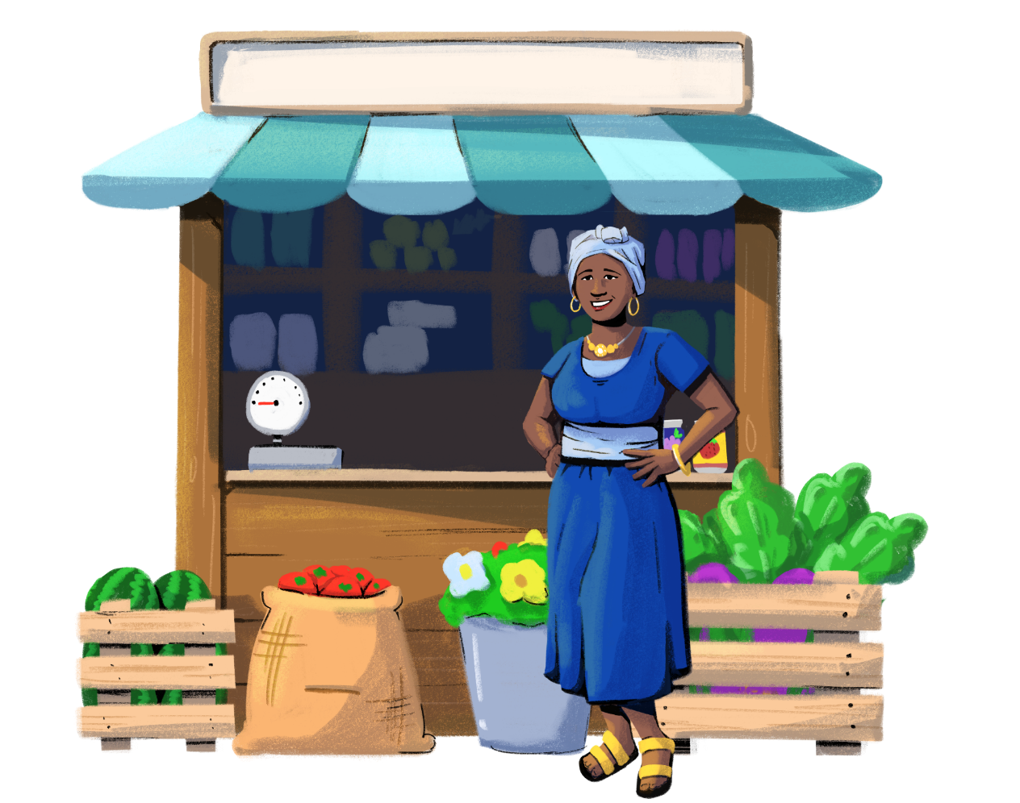
SCENE 2
Hi! My name
is Imani. I own and run this store.

Slide 12
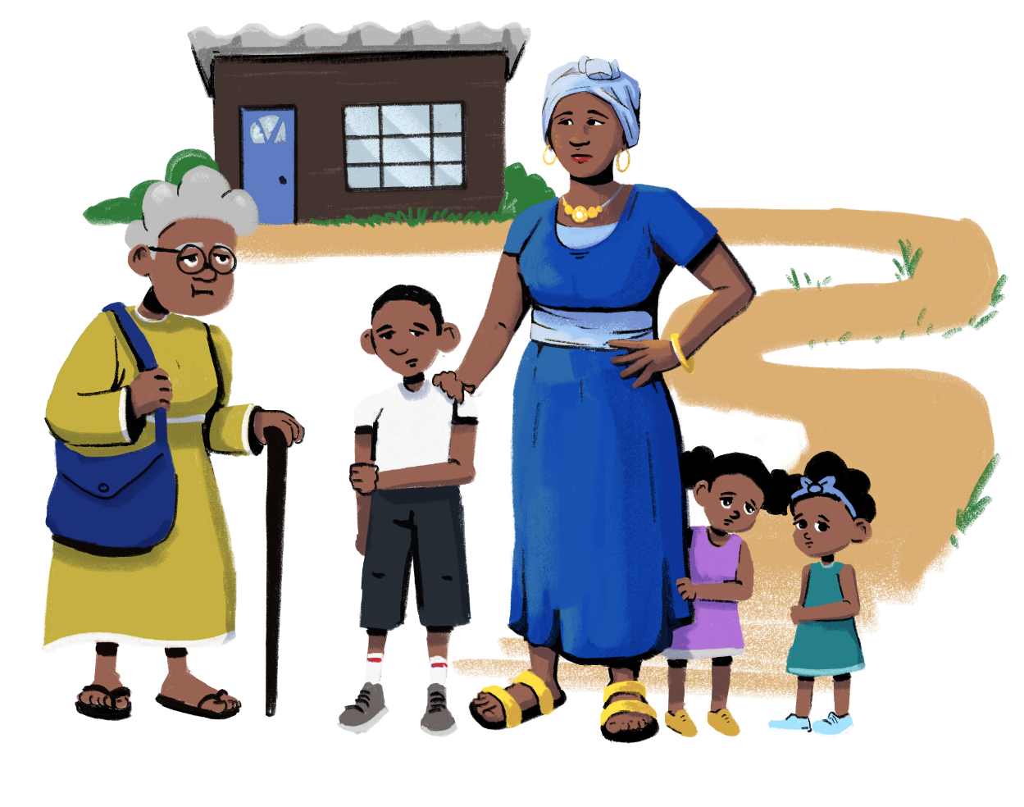
Five years ago, my husband fell ill. I suddenly had the responsibility of looking after my three children and elderly in-laws. I had to juggle my household duties with running my store. Every day was a struggle.
SCENE 3

Slide 13
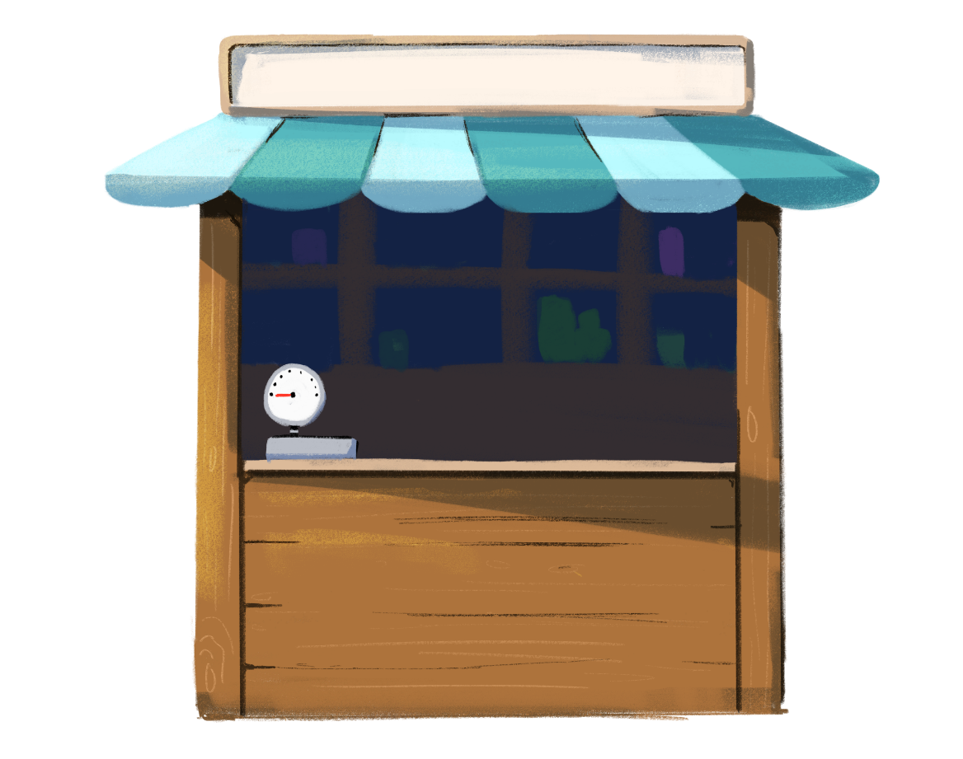
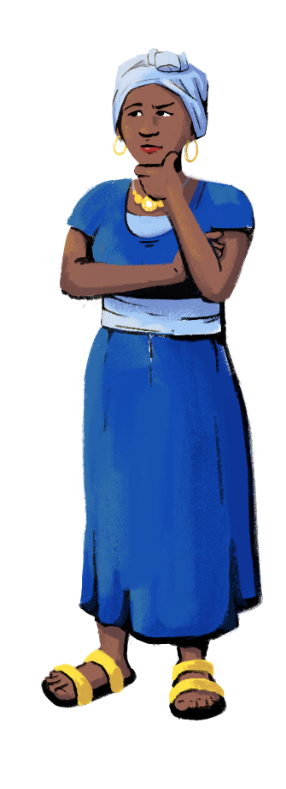
When I took over, the shop was losing money. Sales were limited, and each day, fewer customers came to my store. I did not know how to keep track of my goods or how to manage my bills. I didn’t know what to do to grow my business.
SCENE 4

Slide 14
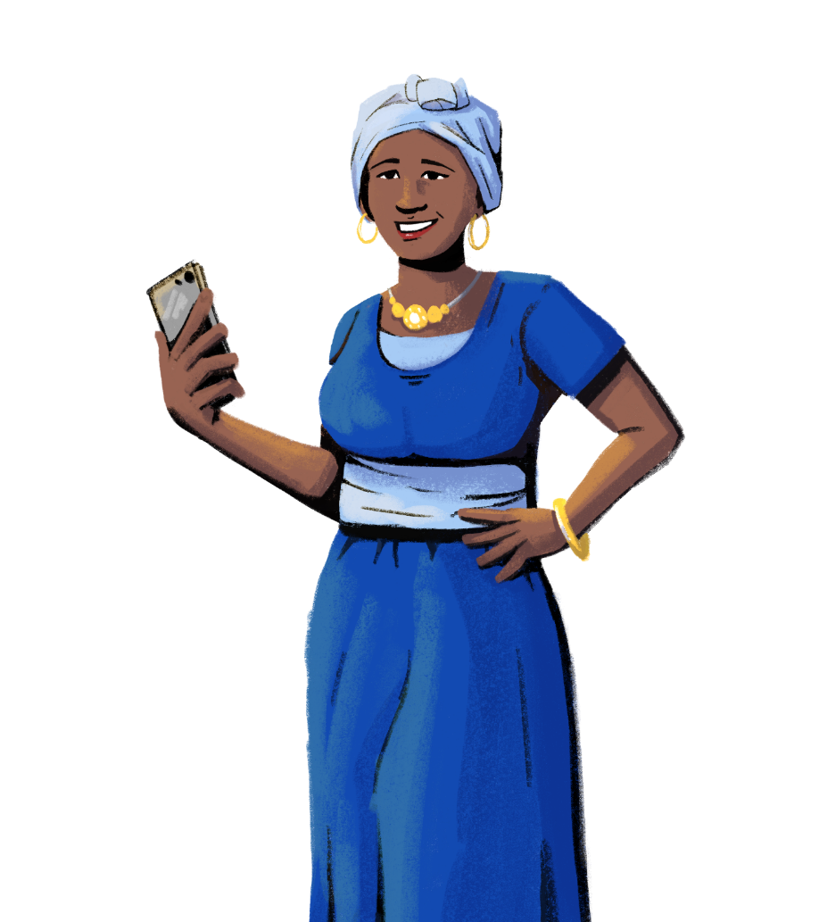
SCENE 5
Then I decided to take this training. It gave me information on ways to manage my business finances and operations, and helped me develop new skills that I now apply to run and grow
my business.

Slide 15
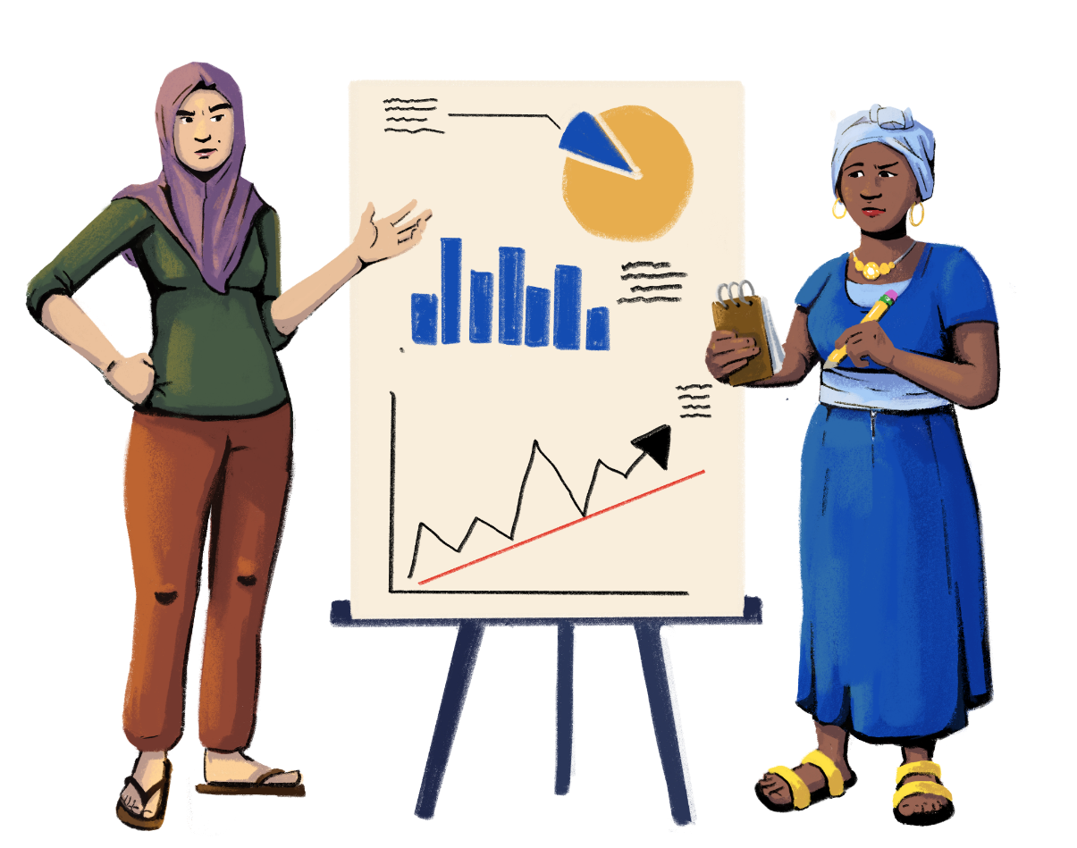
I attended business trainings with other businesswomen in my community. Even after the training, we continue to help each other.
SCENE 6

Slide 16
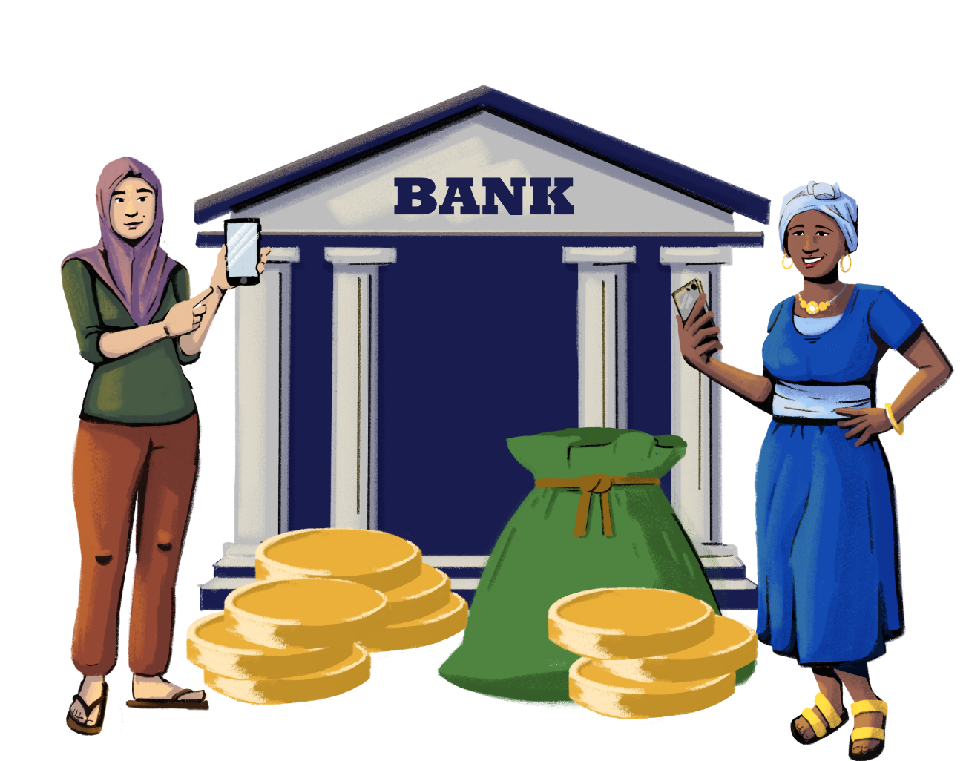
SCENE 7
I even applied for and got a loan!

Slide 17
I revamped my store, diversified my stock based on customer needs, started accepting digital payments, and improved my customer interactions and financial management.
SCENE 8

Slide 18
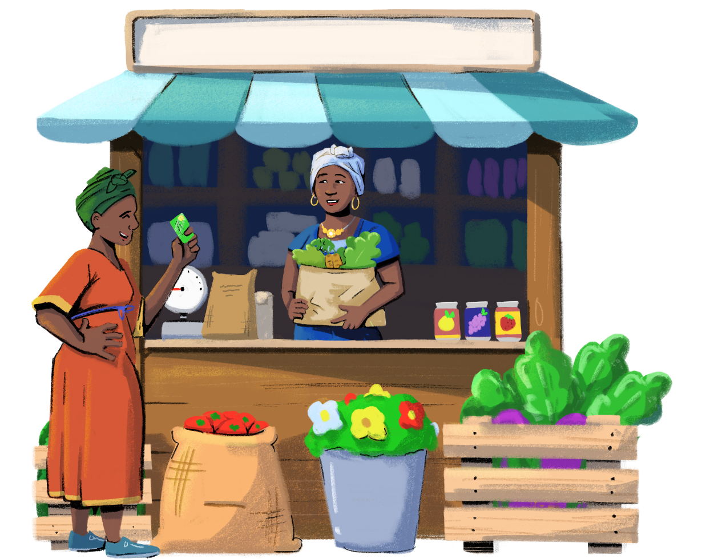
Slowly, more customers started to come to my store to buy items, and my store started to earn a profit.
SCENE 9

Slide 19
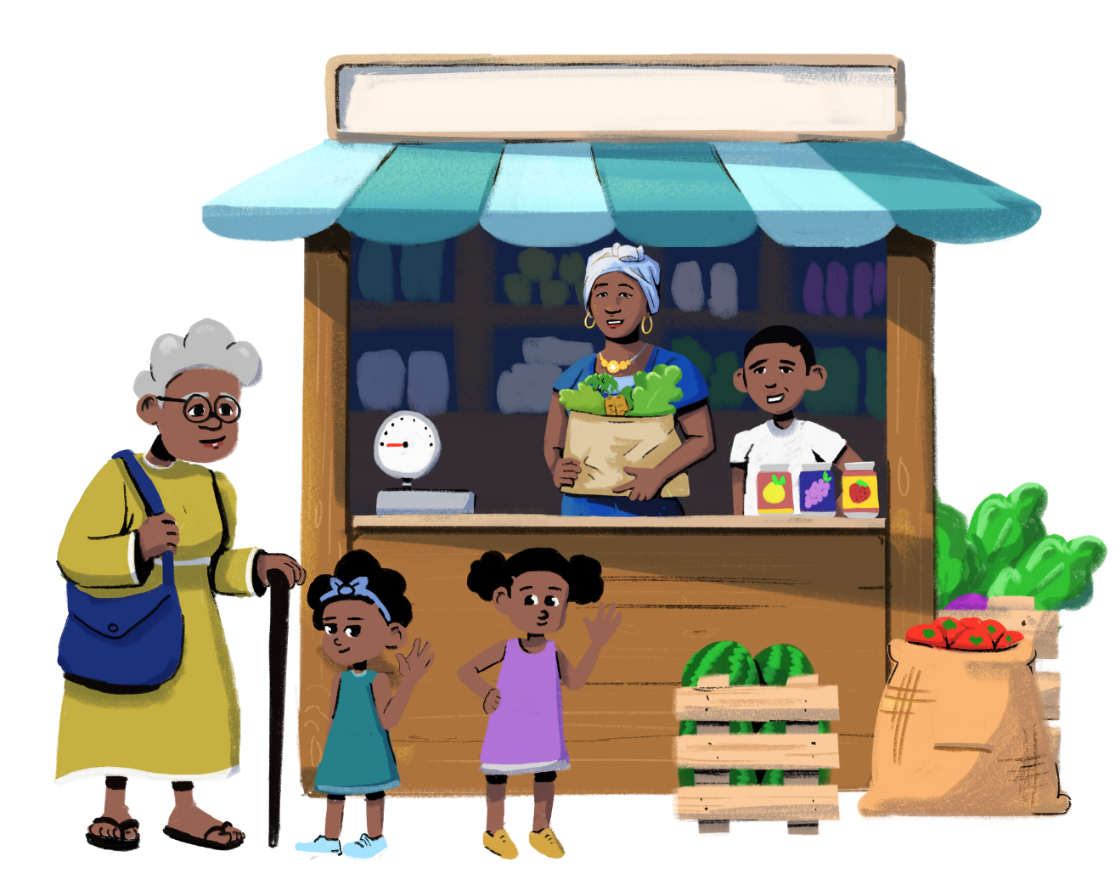
SCENE 10
Now, my family and I share the workload in the house and in the store.

Slide 20
This was my journey. This training has helped me run and grow my store. If I can do it, so can you!
SCENE 11

Slide 21
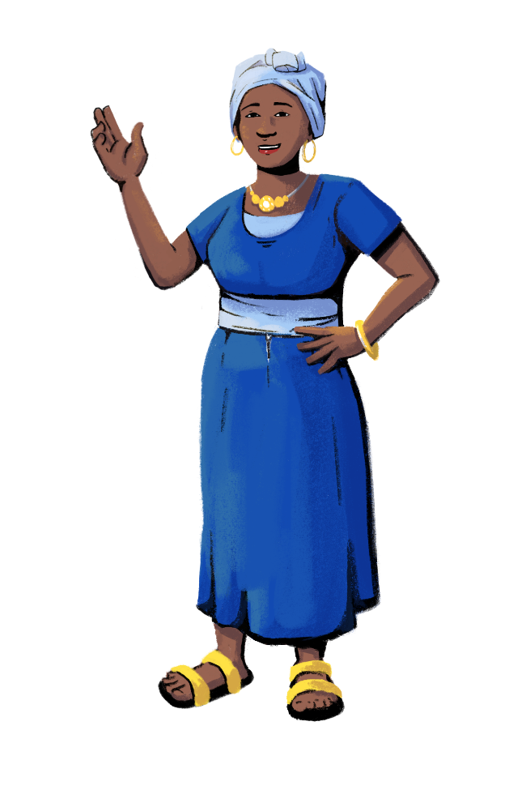
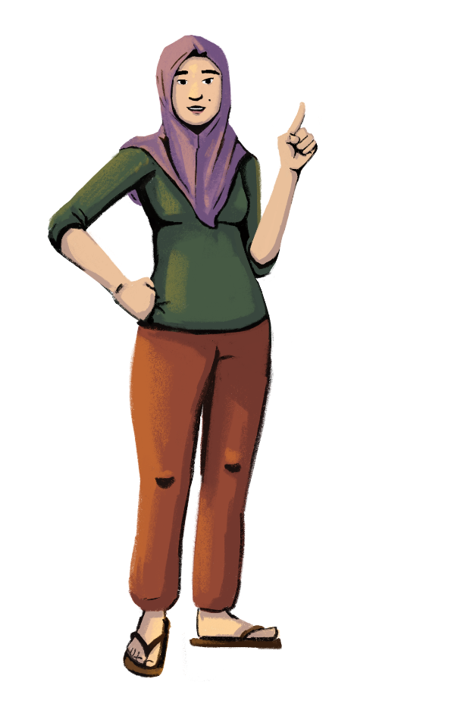
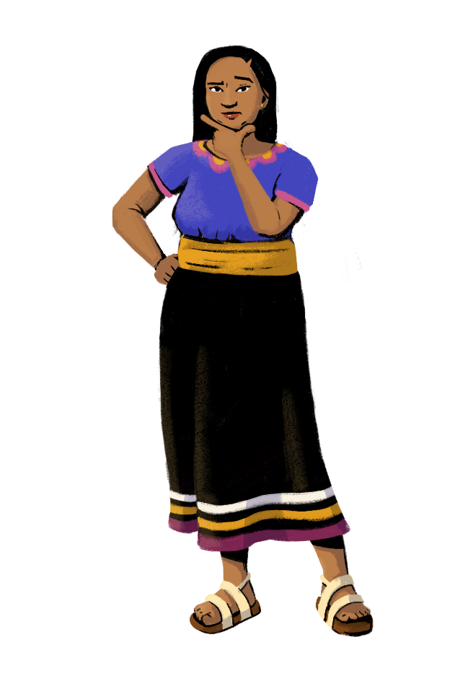
Let’s
discuss!
Customization Tip!
Add, delete, or modify
questions as necessary.
What caught your attention?
What elements in the story could you relate with, and why?
What parts of the story were different from your own life?

Slide 22
Are you ready?
PART 2:
CREATING A VISION
Objectives:
To learn how to create a vision for your business.
To understand how to define your role in your business.

Slide 23
What does your store look like now?
Customization Tip!
Add, delete, or modify questions as necessary.
How many customers come to your store each day?
Do you sell a variety of products?
What payment systems do you use?
Have you ever used credit? Do you allow customers to pay on credit?
What bookkeeping methods do you use?
Is your store registered with the government?

Slide 24
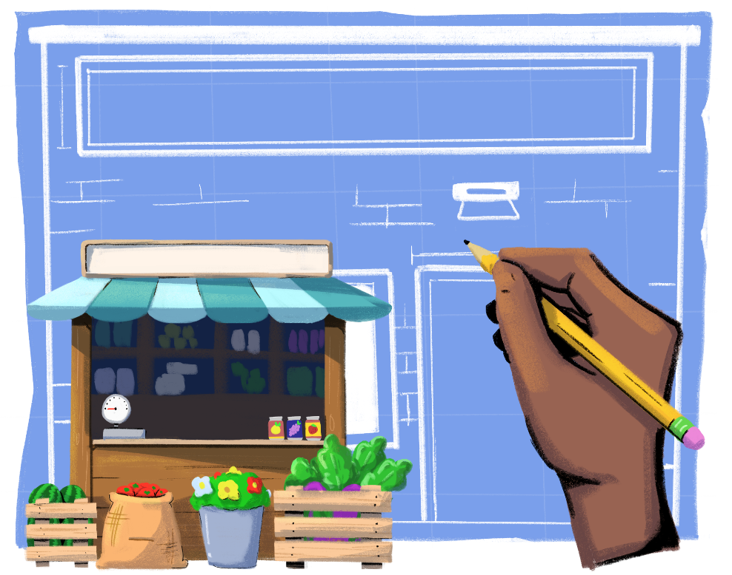
Where do you want your store to be in five years?
How will you run the business?
Customization Tip!
Add, delete, or modify questions as necessary.

Slide 25
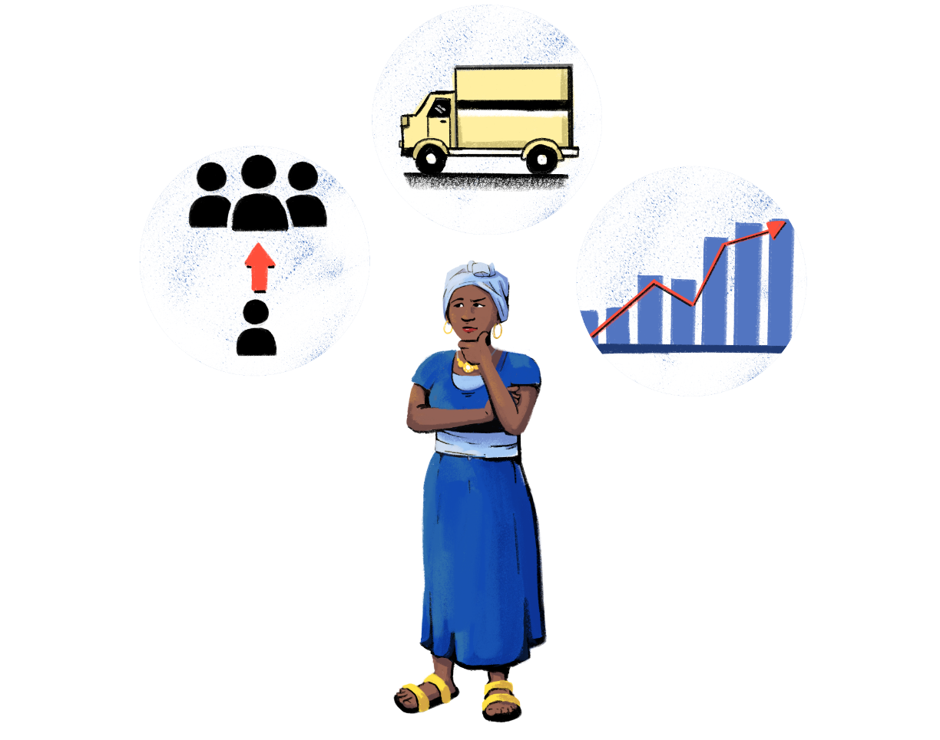
What is your vision for your store?
What is your vision for your role in running the store?
Customization Tip!
Add, delete, or modify questions as necessary.

Slide 26
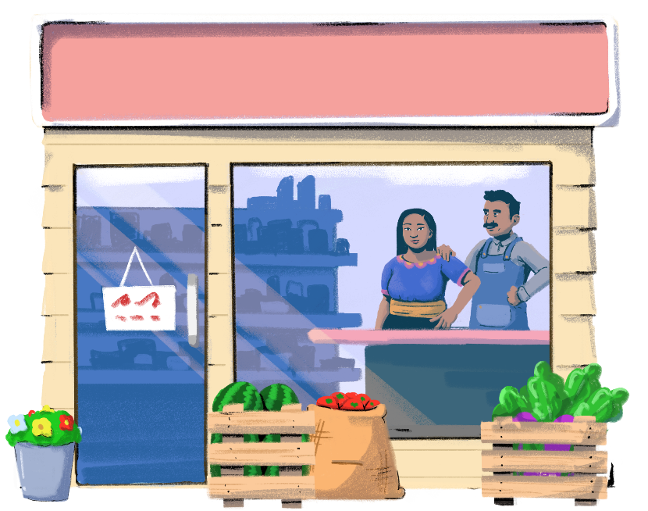
What Influences Your Role In The Business?
Customization Tip!
Add, delete, or modify questions as necessary.
Are you involved in the decision-making in your business? Would you like to be more involved?
Do you feel limited as a woman in what you can do for the business? What would need to happen to change those limits?
Does your gender impact how customers perceive your store? How?

Slide 27
Do you see a gendered division of decision-making in your business and home life?
Let’s look at decisions men and women make to see if they are different.
Here are some decisions made by women and men at the household level and in business:
What food is cooked in the home
How or if the children should go to school
Whether to sell or buy land, houses, and property
What brands are stocked at the shop
How to decorate or arrange the shop
Who manages the shop’s accounts
How or when to use the phone
Who manages the household finances and financial transactions
Whether to make investments and save

Slide 28
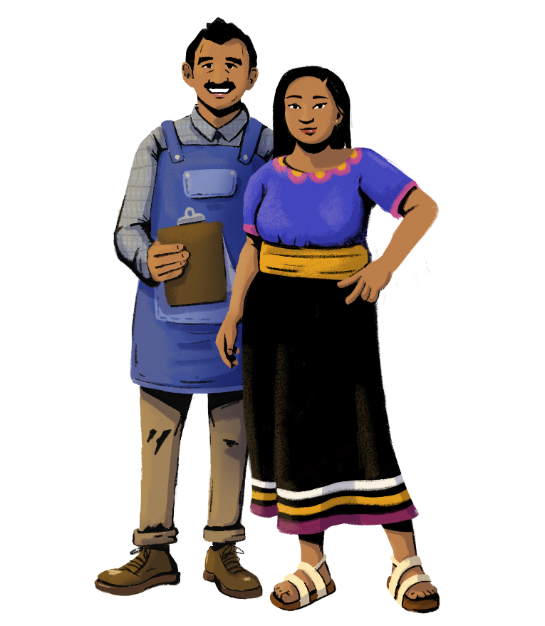
Customization Tip!
Add, delete, or modify questions as necessary.
Does this list reflect your own behaviors in your family and in running the shop?
How does it feel to look at this list of decisions as a man or woman? Is it fair? Why? Why not?
Do you wish your role in your family and business was different? Why?
How can we work to bring about change?

Slide 29
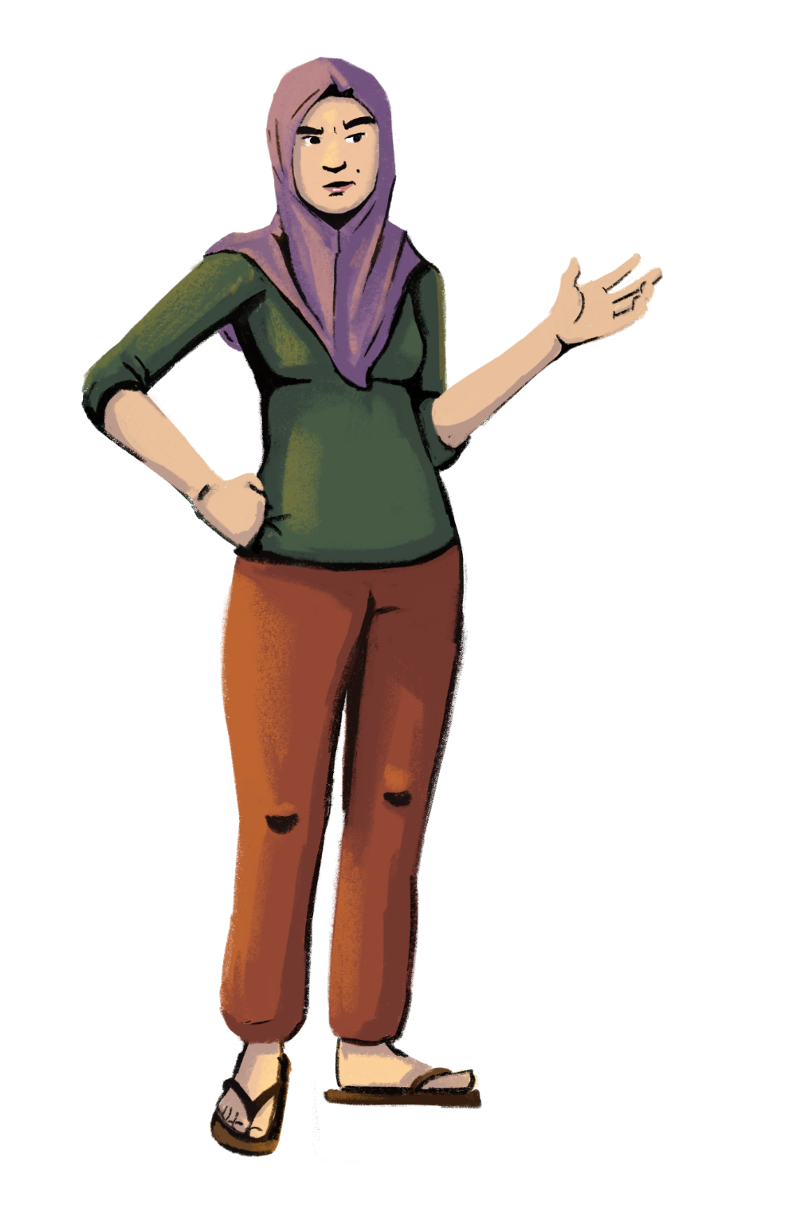
Are you
ready?
PART 3:
UNDERSTANDING FORMAL VS. INFORMAL BUSINESS
Objectives:
To identify the steps needed to create a formal business.
To understand what taxes apply to your business.
To learn about government support offered to small businesses.

Slide 30
Do You Want To Register Or Get A License
For Your Business?
Business can be classified as informal or formal. Let’s explore what that means, and which type of business is best for you.
FORMAL BUSINESS | INFORMAL BUSINESS
Established as a legal entity – separate from your household Registered and licensed by the government Eligible to get a business loan for the shop Establishes a clear separation between you and the business Eligibility for government programs and support for small businesses, such as grants Ability to insure your business Must pay taxes and fees | Run by you or your family without a separate legal organization Not registered or licensed by the government Business loans or credit need to be taken out by you personally No separation between you and the business May not be eligible for government programs that offer taxpayer benefits

Slide 31
What Do You Need To Do To Register
Or License Your Business?
Customization Tip!
Consider customizing the documents required for business and trade licenses to be reflective of your context.
Business License
Register your shop by submitting an application along with the required fee to the responsible authority. Documents required might include:
information about yourself, such as ID, passport, proof of address, and tax certificates.
information about your planned business activities, such as statements of purpose, company name, rental agreements, or ownership certificates.
Be sure to keep track of the requirements to keep your business license active. These requirements may include:
annual filings.
paying taxes.
Trade License
Your type of business may require a trade license to ensure that your store abides by all standards, regulations, and ethical and safety norms. Documents required might include:
information about yourself, such as ID, passport, tax certificate, and residence certificate.
information about your business, such as a registration certificate, tax receipts, rental agreements, and proof of a business address.

Slide 32
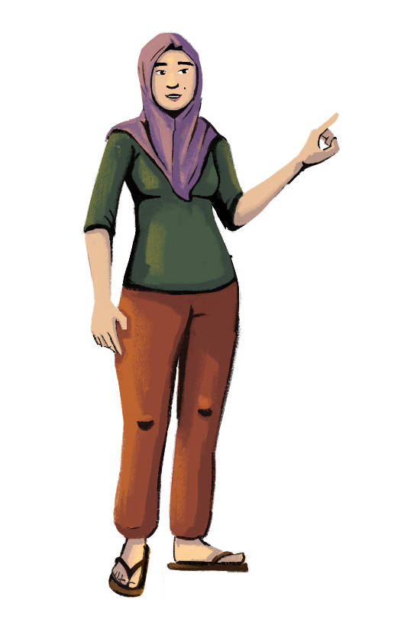
Paying Taxes
Businesses are required to pay and file taxes. This may include paying income taxes on the revenue from your business and collecting sales tax from your customers.
Filing taxes can benefit your business, and paying sales taxes will keep you compliant with government rules.
BENEFITS OF TAX FILINGS:
Provides your business with a tax ID
Provides proof of income and address
Provides a summarized record of finances without much paperwork
Qualifies you for tax savings
Allows you to set off or carry forward losses
Provides documents for loan approval
Helps you qualify for credit card processing
Helps you avoid penalties

Slide 33
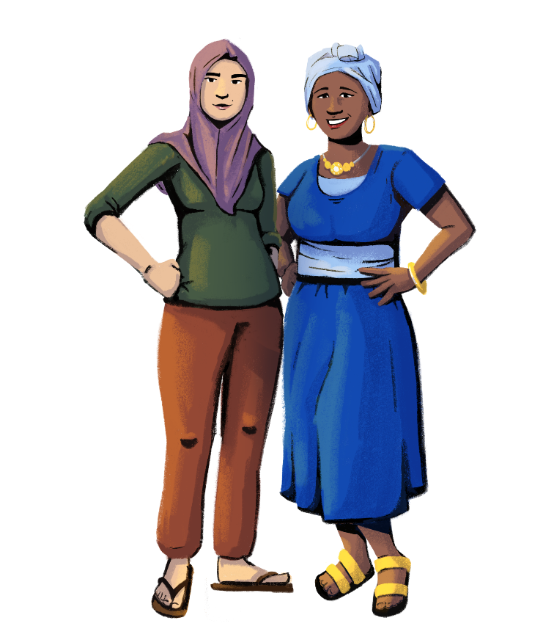
Financial Subsidies Available To
Women Business Owners
Customization Tip!
Consider adding financial subsidies for women that are applicable to your context.
There are many examples of financial subsidies available to women business owners, such as:
lower interest rates on loans.
property tax rebates.

Slide 34
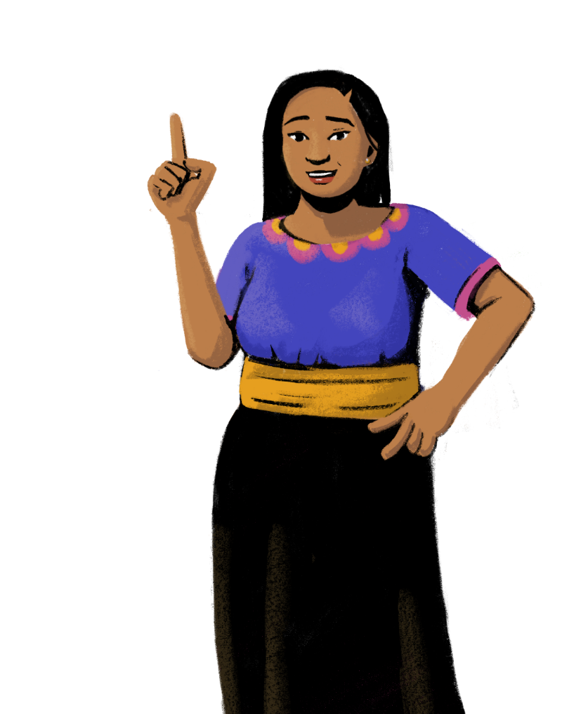
Let’s assess your skills!
PART 4:
CONDUCTING A GAP ASSESSMENT ON YOUR STORE
Objectives:
To understand the necessary skills needed to run a store.
To learn how women and men can both develop the skills needed to run a store.

Slide 35
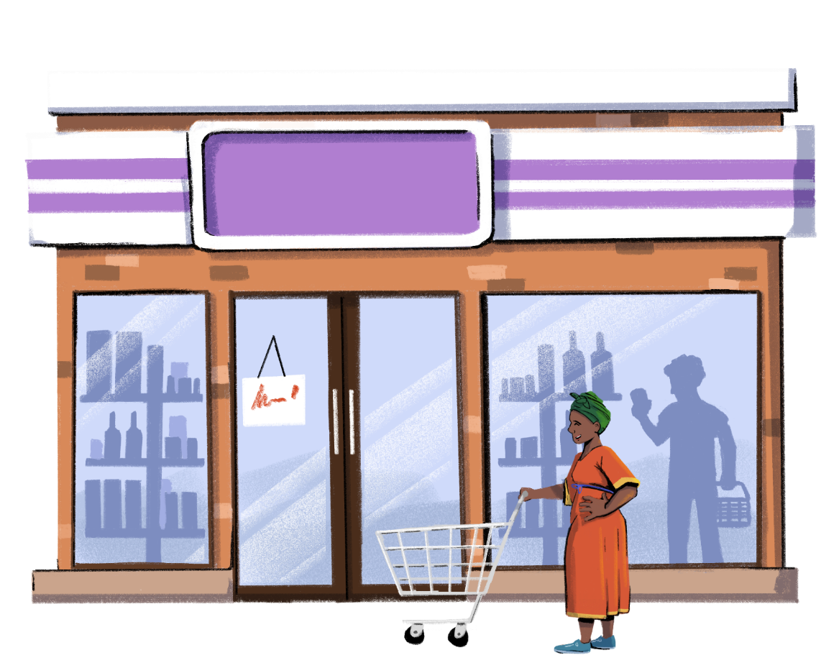
Customization Tip!
Add, delete, or modify questions as necessary.
Gap Assessment
What is stopping you from transforming your vision for your store into reality?

Slide 36
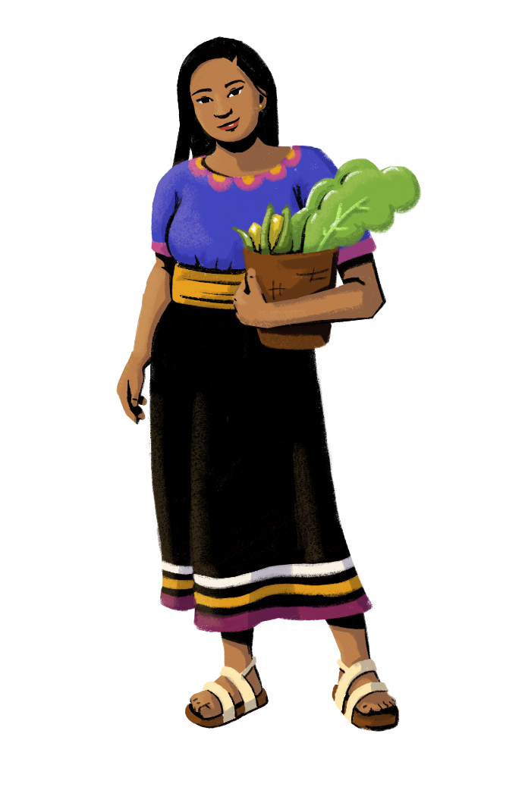
Customization Tip!
Add, delete, or modify questions as necessary.
By taking this training, you can build your skills to make and participate in decisions for your store.
Both women and men are capable of making decisions for their business. Good decision-making skills are not a biological trait. They can be developed with information and practice.
If you want to change your role in your business, what needs to happen?
Where are the gaps in your skills?

Slide 37
What Skills Do You Want To Build In This Training?
Accessing and Qualifying for Credit
Financial Literacy
Customization Tip!
You can pick and choose the modules that are most relevant to your audience, and change the order that they are presented.
Business
Promotion
Know Your Phone
Inventory
Management
Digital Payments
Financial Management

Slide 38
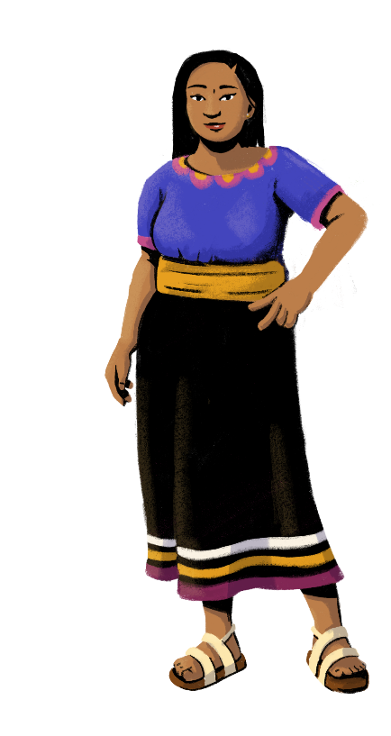
Let’s get started!

Slide 39
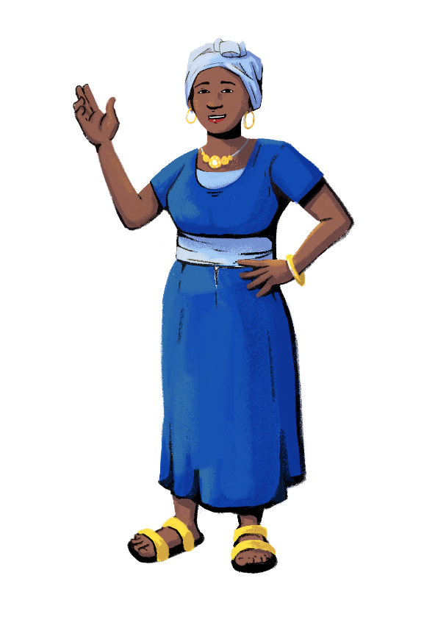
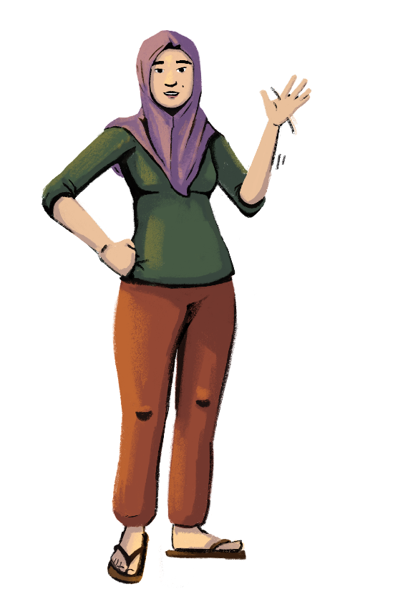
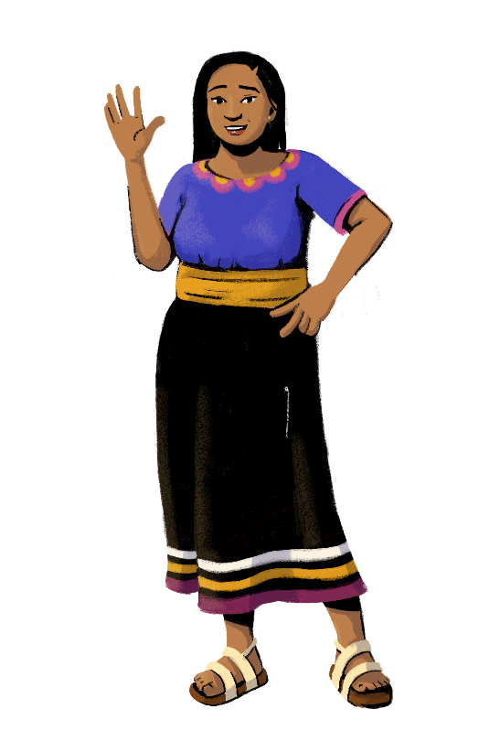
www.siaedge.com
Line Two
Line Three

