Slide 1
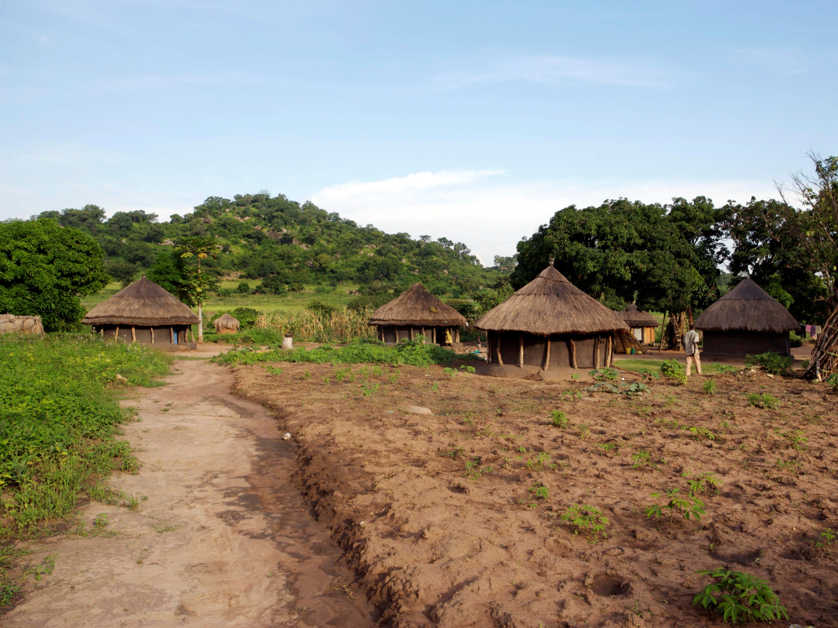
GSMA Development Fund
Community Power from Mobile
November 2010

Slide 2
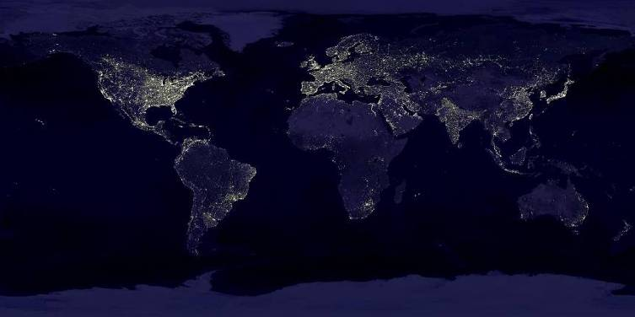
1.6 billion people live off-grid, creating barriers for economic development and mobile industry growth
Barrier to economic growth ‘None of the Millennium Development Goals (MDGs) can be met without major improvement in energy access’¹
Lack of grid drives use of diesel generators for base stations and these sites typically have 5kW of unused power²
500 million off-grid subscribers pay one third of their monthly mobile spend at charging shops, average US$3²
1 – United Nations
2 – GSMA

Slide 3
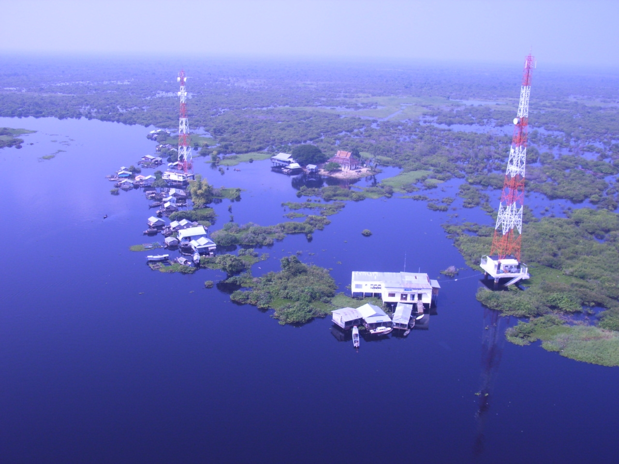
The mobile industry has succeeded in deploying powered infrastructure to remote, off-grid regions
  In 2007 there were 290k off-grid base stations, by 2012 there will be 640k¹
Only 60% of roads are paved in India² and 40% in sub-Saharan Africa³ after centuries of investment
50% of people in South Asia don’t have access to clean water⁴, but 81% have access to a mobile signal⁵
1 – GSMA
2 – Indian Gvmt
3 – World Bank
4 – WHO
5 – GSMA

Slide 4


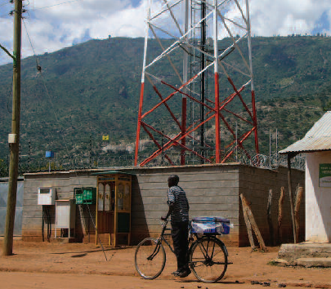


An opportunity exists for operators to provide or sell excess power to the local community
1 site in off-grid Sichuan province, provides 10kW of excess power to local village
20 Safaricom sites providing power to street lighting, schools, clinics & businesses
Site in Dertu, Northern Kenya
Vaccine fridge powered by excess power from the site
Charging station for handsets
Site in Niger
Health clinic powered by excess solar

Slide 5
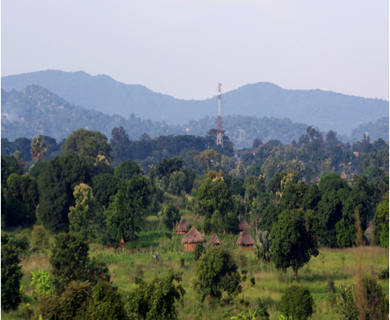
Scale is possible due to the amount of power infrastructure already deployed
  Two to three kilometres distance between rural base stations is typical, within walking distance
  5kW of excess power is enough to charge 5000 handsets, provide electricity to 40 homes, power 10 vaccination fridges or 2 clinics¹
  Therefore, a large scale, distributed power grid in the developing world exists and can be utilised
  Developing world communities spend US$433 billion on off-grid energy²
Off-grid base station
Off-grid rural cell tower
Walking distance, max 2-3km
Typical rural, off-grid village
1 – GSMA estimates
2 - World Resources Institute

Slide 6
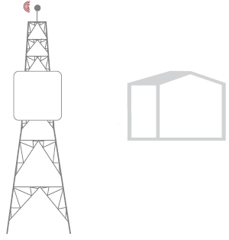
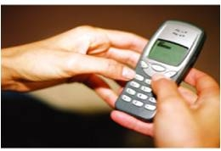
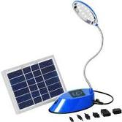
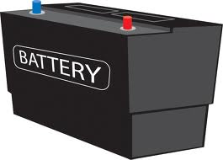
Example Pilot Setup
  Operator sells power to 3rd party off-grid energy company at site
  3rd party builds/runs charging shop
  Benefits to operator:
    Sale of excess power and rent
    Increased local ARPUs
    Integrate payments with mobile money
    Increased security at site
    Improved branding/marketing
    Improved advocacy with governments
Operator Tower
Handsets
Charging Station
Lanterns
Batteries

Slide 7
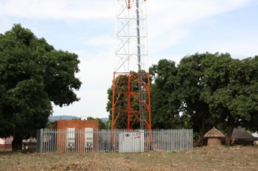
Sample CPM Pilot Model
Telecom tower with excess power owned by a mobile operator or tower company
Local off-grid community with no access to electricity
Charging station owned and operated by third party; uses telecom tower’s excess power
Charging station provides mobile phone, lantern, battery charging services; Community pays through a mobile payment platform

Slide 8
Community Power from Mobile – Next Steps
  The International Finance Corporation (IFC – World Bank Group) have identified this as a scaleable opportunity for improving the business case for off-grid mobile networks and in parallel providing energy access in the developing world
IFC grant for 18 month project launched at Mobile Asia Congress November 2010 - http://www.gsmworld.com/newsroom/press-releases/2010/5713.htm
Pilot projects in East Africa and India will be launched in Q1 2011
Primary objective of the pilots is to identify scaleable, revenue driven business models for MNOs and tower companies
Case studies, pilot reports and business cases will be published by GSMA

Slide 9
GSMA Community Power from Mobile: Vision & Objectives
Vision
By mid 2012, Community Power from Mobile will have…
Part 1
Objective 1
… identified commercially viable business model(s) for charging services …
3 year return on investment demonstrated
Part 2
Objective 2
…assisted 10 MNOs to expand their rollouts across the developing world…
10 MNOs or tower companies planning 10-500 site rollouts
Notes:
8

Slide 10




GSMA/IFC Partnership
Publicly launched on 17th November 2010 at the Mobile Asia Congress in Hong Kong
The end goal is to demonstrate a scalable, revenue driven business model for charging services from excess power at off-grid towers
Initial scope will focus on charging a of devices such as mobile handsets, lanterns and household batteries, but longer time looking to power, businesses, clinics, vaccination refrigerators, schools and homes

Slide 11
Project structure
Barrier – Awareness & Ecosystem
Provision of Community Power at base stations is a nascent concept within telecoms and MNOs have limited understanding of the opportunity, the case studies, business models and the required partners.
Barrier – Business Case
As Community Power is a nascent concept within telecoms the financially viable business models require identification and demonstration. Attractive financial returns must be identified for all stakeholders of the value chain to enable scaling.
Barrier – Expertise and Capacity
In order to deploy Community Power, MNOs require new skills and expertise, and in many cases, MNOs will require direct support in scoping, planning and executing a Community Power implementation.
Workstream – Knowledge Sharing & Convening
Updated Community Power white paper
Integration with GPM Working Group
Community Power Website
Integration with GPM Bi-annual report
Partner landscape
Workstream – Community Power Pilots
Pilots in East Africa and India, at least 2 per region
Publication of pilot case studies and close out reports
Case studies of non-GSMA pilots
Workstream – Technical Assistance and Training
Feasibility Studies
Training materials
Implementation Support
Community Power RFP Design
Technical designs
Replication guides

Slide 12
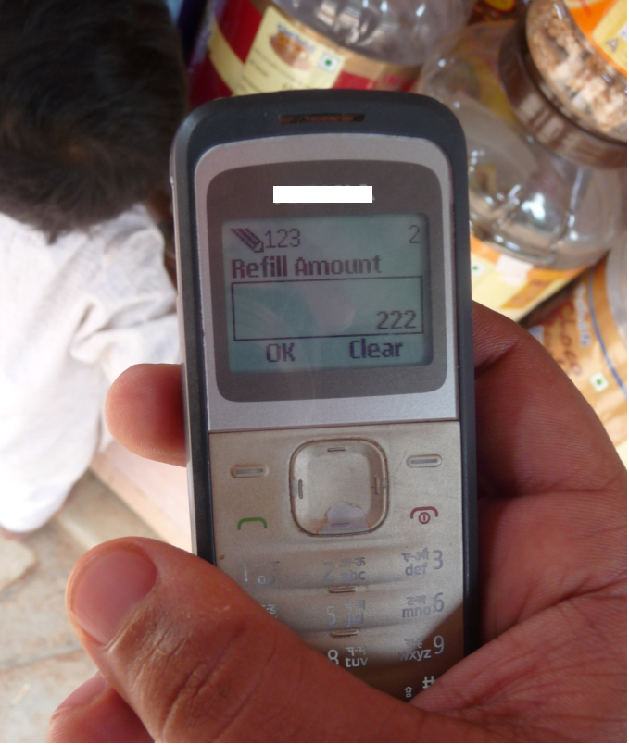
CPM Pilot Objectives – India and East Africa
Demonstrate a scaleable, revenue driven business model for charging services
Integrate charging services into mobile banking and payment platforms
Improve the business case for off-grid base stations, thus enabling expansion of network coverage
Identify and list high potential vendors/ESCos
Monitor and evaluate multiple CPM models and technologies

Slide 13
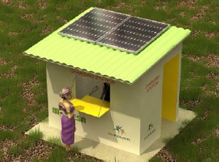
Integration with mobile banking and payment platforms
Use excess base station power instead of solar
Payments automated by mobile banking
Sell airtime AND charging services

Slide 14
CPM Pilots Implementation Timeline
Setup/Design
Technical Assistance & Training
Build
Monitoring & Evaluation
Activity | Q4 2010 | Q1 2011 | Q2 2011 | Q3 2011 | Q4 2011 | Q1 2012
GSMA-IFC CPM Programme Formal Launch
Finalise & Sign Contracts with Pilot Partners
Pilot Technical Designs & Business Models
India Working Group
Select Pilot Site & Customise Design
East Africa Working Group (Tentative)
Installation & Operational Setup
Report Key Technical Learnings from Pilots
Report Key Business/Engagement/Delivery Model related learnings
Pilot Case Studies, Handover, Evaluation & Close Out Reports
Working Group
Develop CPM Methodology, Standard Designs & Replication Guides
?
?

Slide 15
Questions?

Slide 16
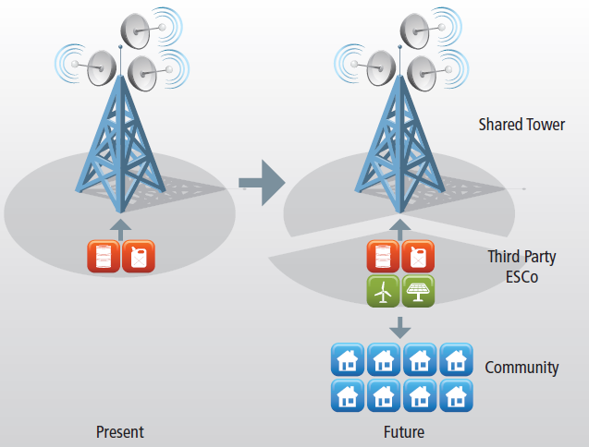
Future Opportunity: For Discussion
Adaptation of the OPEX model for solar powered BTS in India
Operator or tower company sells their diesel generators to a 3rd party Distributed Utility Company
The 3rd party constructs a mini-grid to the BTS and the community and sells power at reduced cost due to economy of scale
Diesel generator could remain within the BTS site for a rental fee
Operator/tower company receives cheaper energy, earns rent, releases capital from genset sales, outsources non-core business and enables community to be powered

