Slide 1
Rapid deployment of Community Power as a strategy to cheaper BTS power
March 2011 – Mombassa
Declan Murphy, Founder
Owenroe Lemass, Renewables Engineer
Clive Gilmore, Technical Director

Slide 2
Who has the problem?
Operator Issues
carbon footprint
Diesel hastle
Capex burden
Maintenance
Cost / Bal Sheet / hastle
every BTS off reliable grid Community = communmity off grid.

Slide 3
Our Solution
GSMA – TEF - MNO
Step 1 2011 - 2012
Create the platform for the community to use & pay for electricity
Step 2 2012 - 2014
Grow the community demand, and use their revenue base to co-pay for distributed power gen, located at BTS. Distributed Utility!

Slide 4
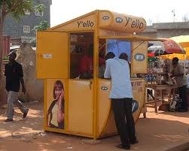


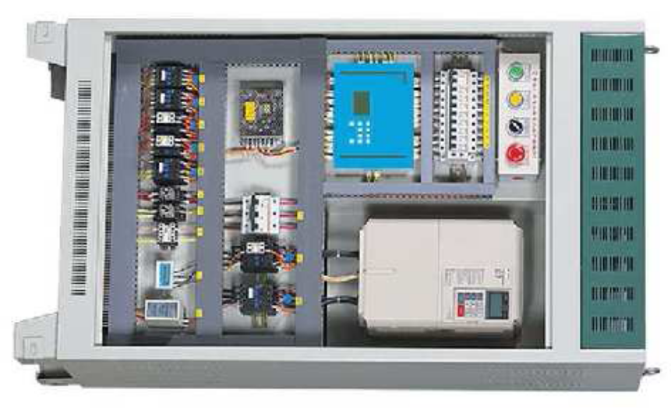
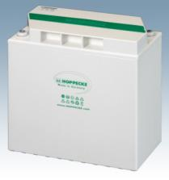
Step 1
BTS
Uses existing BTS surplus gen capacity to seed electrification in community.
MNO gets $14,000 return in each community ($4800 pa)
Community gets reliable affordable power. Ability to grow

Slide 5
Pricing to Customers
Phone charging service (free if bundled with airtime) | Free - US$0.20
Airtime sales service | Market Rates
Household battery service | US$5.00 / month (12 charges / month)
Ancillary (phone sales, phone service, light device sales, etc.) | Cost + 35%

Slide 6
Rapid Rollout – No MNO Cost
2011 …… 200 + sites (min 54 per operator)
2012 …… 4000 sites
Standardised (2 hour BTS installation)
Zero Pain to MNO
Zero Cost to MNO
Live airtime support only
399% ($9,000 – 14,000 MNO return)

Slide 7

Step 2
Use community demand for power to underwrite new TEF power facility ( assume 30kv ++ solar)
TEF system serves BOTH community & BTS.
Community power /kwhr higher than BTS
Estimate ($3,50 / watt installed )
MNO solar PPA @ us $0.60 – 70c / kwhr
    Community PPA @ us $1.20 – 1.50 / kwhr
    Win Win Win

Slide 8
Step 2 growth….
Initial provide 30 – 50 % of BTS power demand from Tef community system. Co power BTS with Diesel, shared battery bank
Add extra central TEF capacity as community house hold users grow, & mini grid establishes.
Finally TEF community PPA supplies the majority of BTS power, leaving Diesel gen set backup.

Slide 9
Rapid deployment
2011 200 + pilots
2012 4000 community power sites (excess)
2012 pilot community solar to BTS (40-60% capacity)
2013 2000 BTS + Community co gen Solar sites
2014 1000 pa solar rollout
MNO gets lowest kwhr price – no upfront cost – single power partner – diesel backup – seamless rollout
Community gets power = bigger airtime market

Slide 10
Win MNO
Win Community
Win Environment

Slide 11
399 % Return to MNO over 30 months
( $3 ARPU rural, 200 regular users per BTS)
Return to MNO | 10% - 20% ARPU increase existing users ($7,500 per BTS) 5% increase in local mobile ownership ($3,700 per BTS) US$0.40 per kWh revenue ($3,000 per BTS)
Total return per BTS | US$14,000 per BTS after 30 months
1000 BTS | US$ 9 M at 30 months
399% return on $3,600 airtime support
Plus dramatic social impact

Slide 12
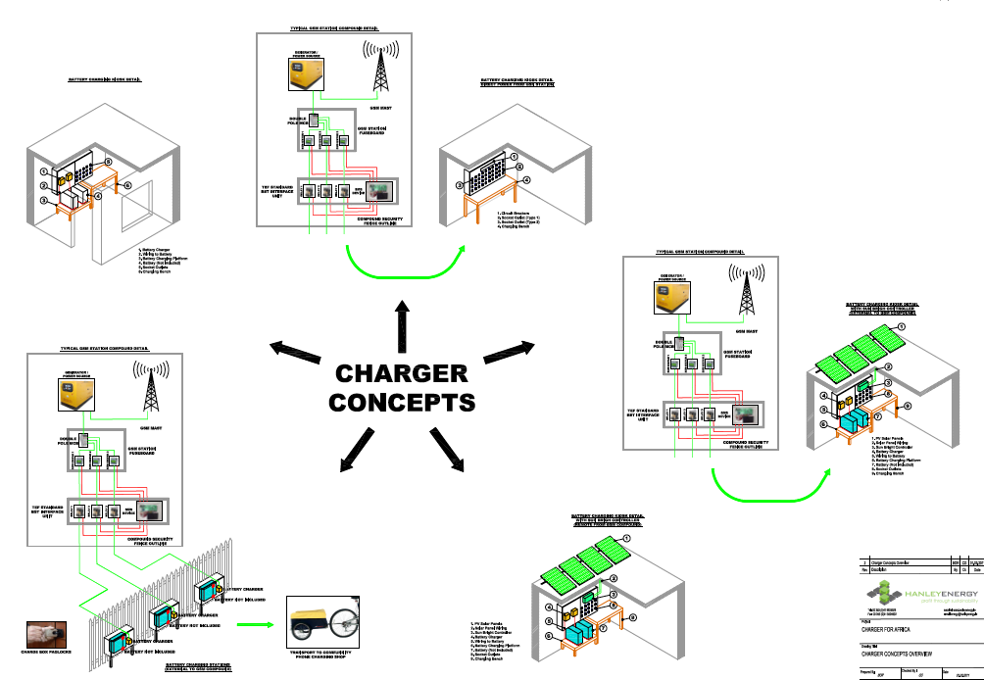

Slide 13
Component # 1 – TEF BTS Interface Unit
Programmed for Permitted Excess Power (PEP)
When power usage reaches PEP, e.g., 1.5kW, no more power can be drawn
Has communications functionality for remote switch on/off
  GSM device can be added.

Slide 14
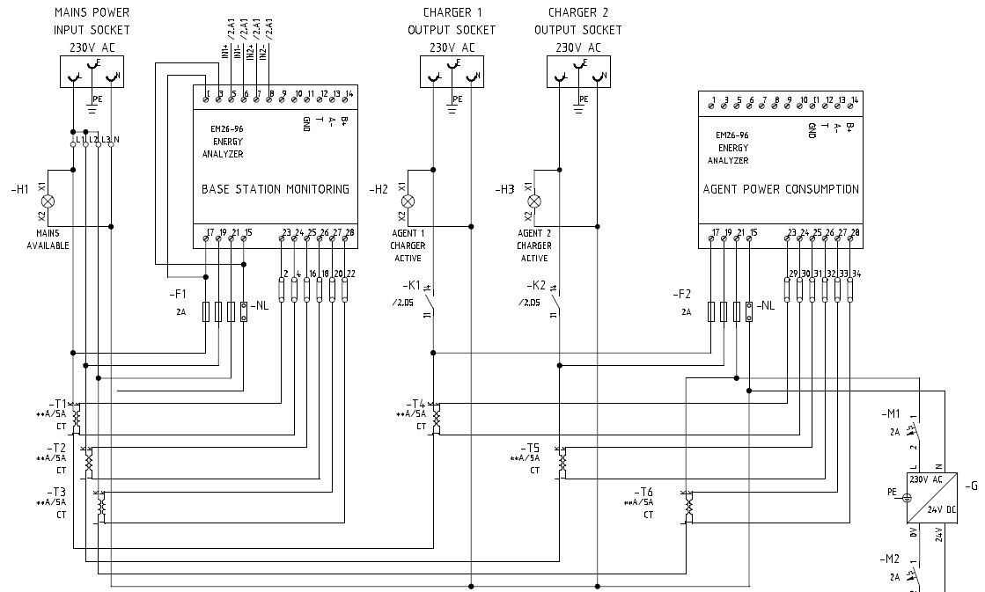
Control System circuits

Slide 15
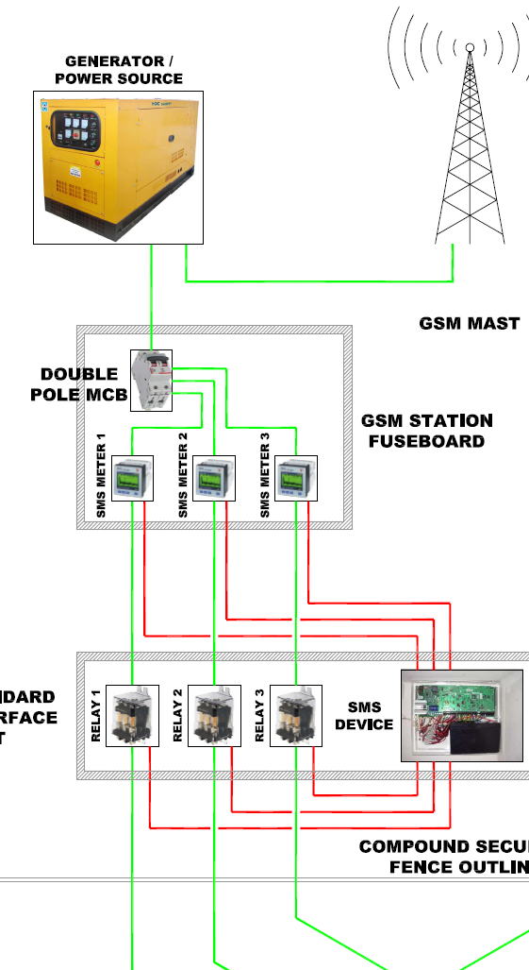
Component # 1 – BTS Interface Unit
Installation
  Single connection to BTS distribution board
  Meter connection from AC distribution board to charge point power take-off
  Mounted anywhere in BTS compound (ideally on inside perimeter fence)
  Single cable through perimeter wall / fence
  Install time 2-3 hours, no down time
  Sealed unit; minimal maintenance
Shut-off 1 - Permitted excess exceeded
Shut off 2 – Deny agent power.
Manual in pilot phase
  inside BTS.
Automatic in implementation phase
Complete protection to BTS equipment

Slide 16
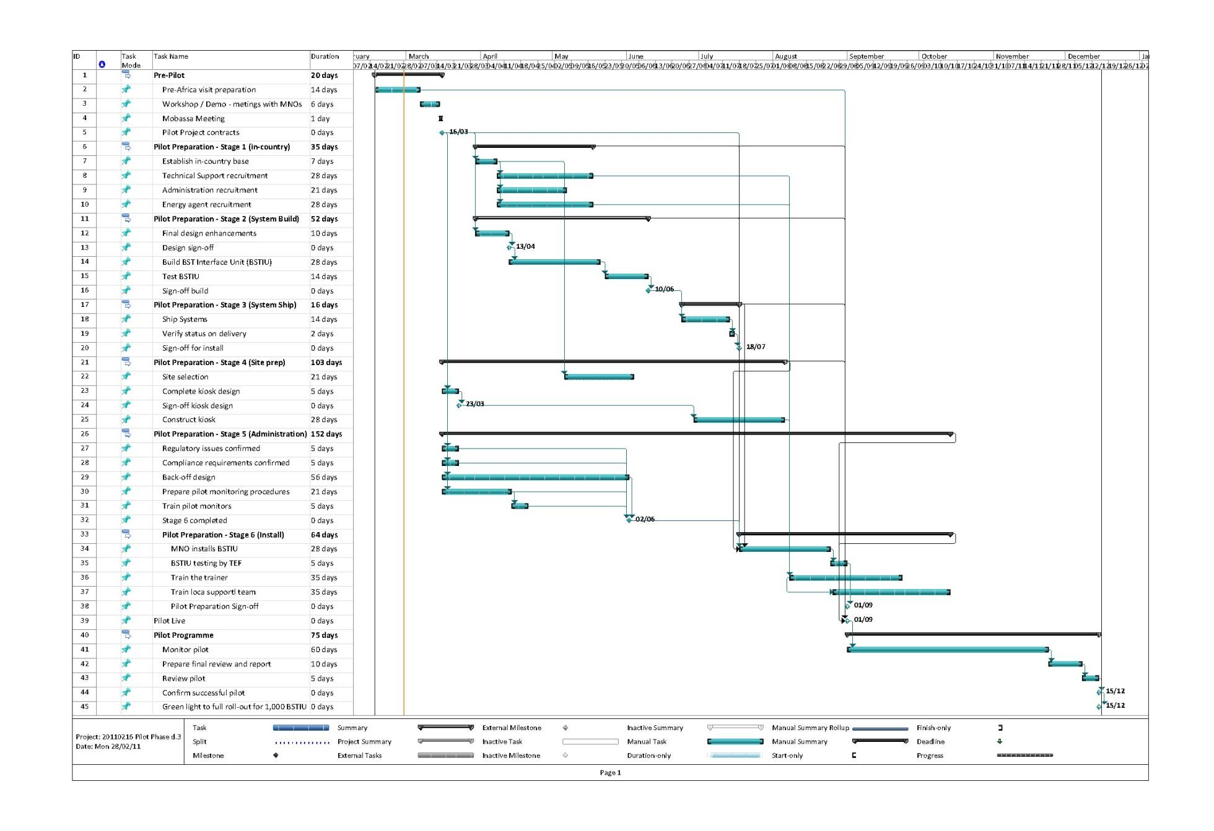
Pilot Plan

