Slide 1
Green Power For Green Mobile
Notes:
As we know, nowadays, more and more enterprises aware the importance of environment protection and energy saving.
But we heard so much, we said so much, and at same time we do less. Why? The reason is simple. Because many methods will cost the enterprise a large sum of money, but the payback (gain ) is not much good nevertheless. Are there exist many energy saving methods will bring great benefits to operators? These slide will show you Huawei how to help operators to improve their energy efficiency, to save energy, and also to get a better return on it.

Slide 2
Content
Huawei Green Power Technology
Case Study
Roadmap
Notes:
2

Slide 3
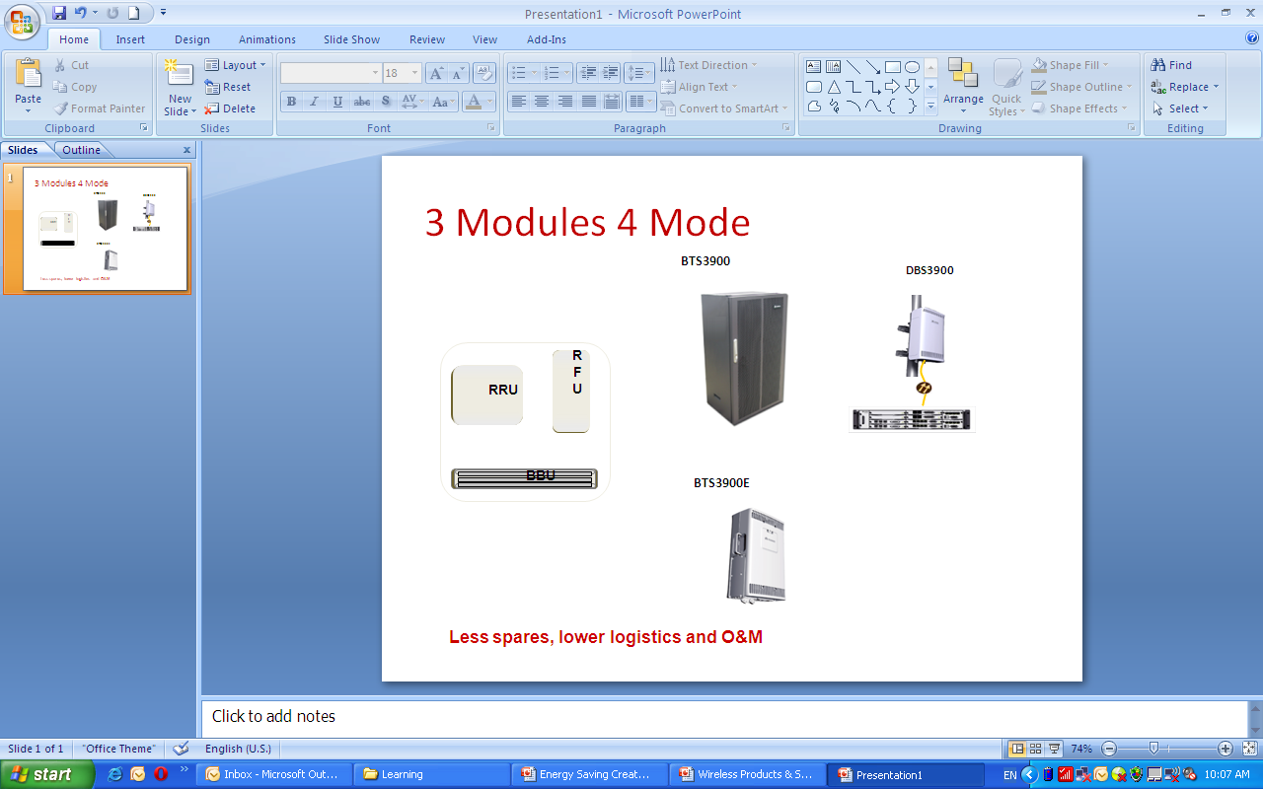
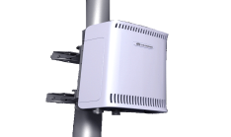
Green BTS, Make It Possible To Use Green Energy
Lower power consumption
Better environment compatibility
High integration
Typical power consumption of S4/4/4
DBS3900
40 %
56 %
-40ºC~+55ºC
IP65
1600W
64 %
950W
710W
570W
07 industry
07 Huawei
08 Huawei
10 Huawei
Smaller power consumption make it possible to use renewable power widely in wireless site
Active cooling is unnecessary
Natural cooling can be used
SingleRAN: 2G, 3G, LTE
2U height for BBU
Smaller equipment room
Page 3
Notes:
3
3

Slide 4
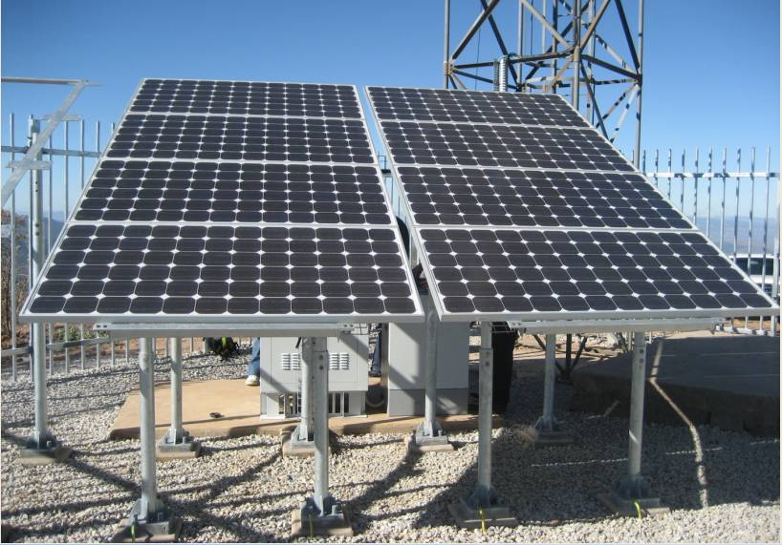
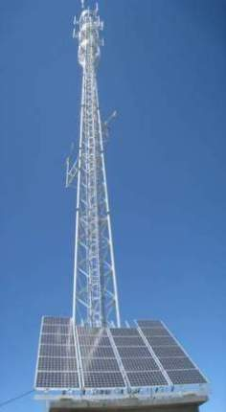
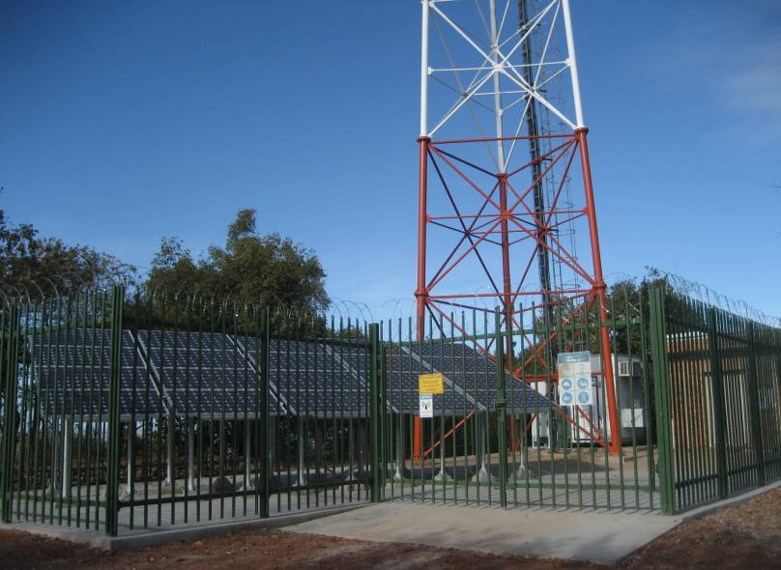
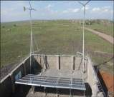
Huawei Green Power Solution For Different Scenario
Solar power solution
Solar-wind hybrid
power solution
Solar-D.G. hybrid
power solution
Solar-Wind-D.G. hybrid
power solution
Application scenario：
Diet BTS, Site load =130 W
Sun availability hours > 4Hours/Day
ROI = 1.61 Years
Reference: Vodacom SA
Application scenario：
DBS3900, S4/2/2, Site load=520W
Sun availability hours> 4Hours/Day
Annul Avg. wind speed > 4 m/s
ROI < 2.5 Years
Reference: CMCC
Application scenario：
BTS3012 S2/4/4 (GSM 900), S4/4/4 (GSM 1800), site load < 1.15KW
Sun availability hours > 4Hours/Day
ROI < 2.69 Years
Reference: Vodacom SA
Application scenario：
BTS 3012, site load=1.65KW
Sun availability hours/day > 5.6Hours/Day
Annul Avg. wind speed > 6.7 m/s
ROI < 3Years
Reference: Safricom Kenya
Page 4

Slide 5

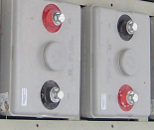






High Reliability And Easy Management
Carrier-class Controller, Higher Reliability
Hot plug
Fault Tolerance
Remote upgrade
Smooth expansion
Lightning proof
For expansion
Reverse cabling
Software upgrade
Capacity expansion
Class C lightning proof
ON
ON
ON
Every single module anti-lightning
ON
ON
ON
ON
V1.0
For change
Solution optimization
ON
ON
ON
Off
SSU
Whole controller anti-lightning
Alarm but no damage
V2.0
ON
ON
ON
ON
SSU
WSU
Page 5
Battery group
Solar Controller

Slide 6
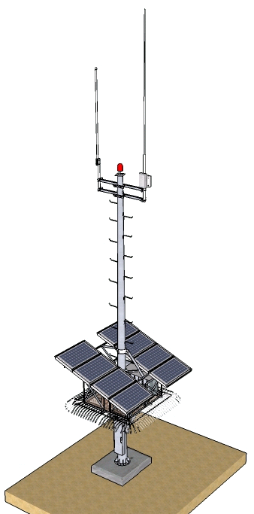
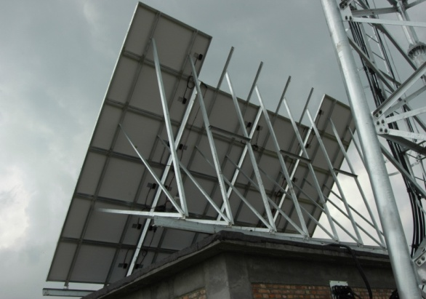
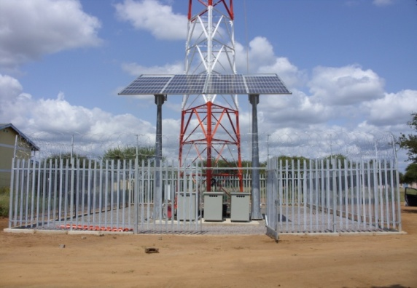
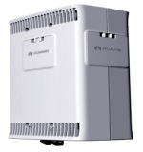
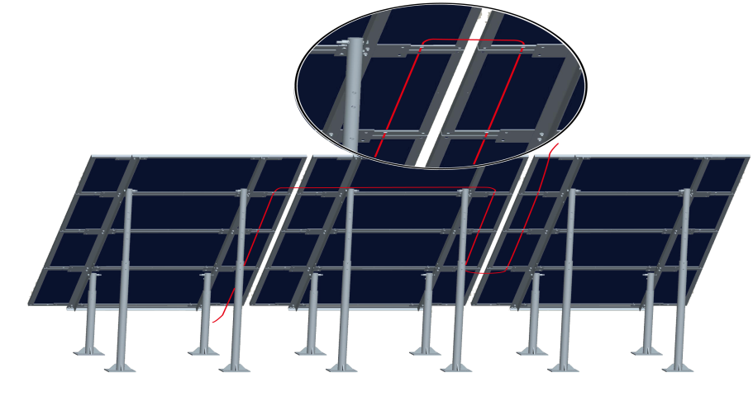
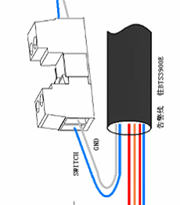
Proposed Anti-theft Solution For Green Site
Lightning rod
Antenna
WiFi
Pole
BTS3900E
Solution 2: Soldering
Solution 3: High Support Structures
Power
BTS3900E
Foundation
Foot platform
Solution 1: All-in-one pole for Greenfield
Dry Contact cable
Solution 4: Dry contact alarm
Page 6

Slide 7

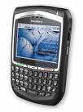




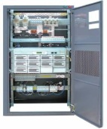
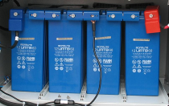
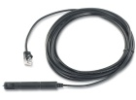



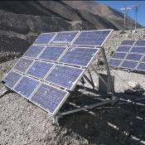

Site Monitor Improving Management Efficiency
SMS
Central NMS Server
Remote Web Browser
Central level
IP/E1/GPRS/SMS
Site level
All-in-One Monitor and control
Optional USB Camera
Power system
battery
Environment detect
Cooling equipment
Power supply
Page 7
Notes:
7
7
Power system: Voltage measuring;Current measuring;PSU temperature measuring;DC power consumption;SPD status;Loads on/off control and power consumption supervision; Alarms and events record;PSU sleeping mode control;Load balancing control
Battery: Total Voltage;Cell voltage;Current;Surface temp.;Discharging test;Capacity mgmt
Environment: Temperature;Humidity ;Door;Smoke;User defined DI;3rd party alarms
Cooling: Fan control;HEX, A/C control;Relay outputs
Power Supply: Voltage/Current;Power generated;Power consumption;Battery capacity;Fuel level

Slide 8

AFTERSUN : Well Balanced The CAPEX And Service Quality
  Forecast generation of solar power.
  Balance energy consumption and energy generation
  Reduce the probability of low-voltage shutdown
  Controlled by the operator on well balanced the shutdown BTS / service quality (including coverage and service time)
Adjust energy generation
Weather forecast
Weather certain factor
Meteorology record
PV panel number
Battery capacity and status
……
Forecast energy generation
BTS configuration
BTS TX power level
BTS power consumption
Traffic record
DTX
……
Forecast load consumption
BTS power control
Adjust load consumption
Page 8
Notes:
8

Slide 9
Content
Huawei Green Power Technology
Case Study
Roadmap
Notes:
9

Slide 10

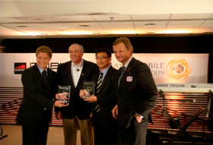
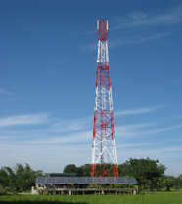
GSMA Mobile Award—Huawei & GP
'Green Mobile Award' at the GSMA Mobile Awards 2009
One solar site of "Building a Greener Mobile Network“ project
'Grameenphone is very committed towards the 'Green' revolution in everything it has been doing over the last few years. This award is only indicative of the role that a mobile company can play in the development of low carbon economies, industries and lifestyles.' —— from Mr. Frode Stoldal, CTO, GP
Will be a Win-Win success for our cooperation in green mobile service!
Page 10
Notes:
10
节约能耗在给运营商带来经济效益的，也会带来品牌效益。运营商履行自己的企业社会责任，会给他们带来积极的社会影响力。在09年11月香港举行的GSMA 移动大会上，GP和华为因为过去几年致力于“打造绿色移动网络“项目，而获得‘绿色移动大奖’的 殊荣。
节能创造价值！让我们行动吧！绿色站点！绿色通信！绿色世界！
Reducing power consumption brings operators economical benefits as well as brand benefits. While fulfilling their social responsibilities, operators can successfully improve their public images as well. At the GSMA Mobile Congress held in Hong Kong in November 2009, GP and Huawei won the Green Mobile Award for their joint devotion to a project named "Building a Greener Mobile Network".
Reducing power consumption creates values. Let's take actions now to build green mobile sites, green telecommunications, and a green world!

Slide 11
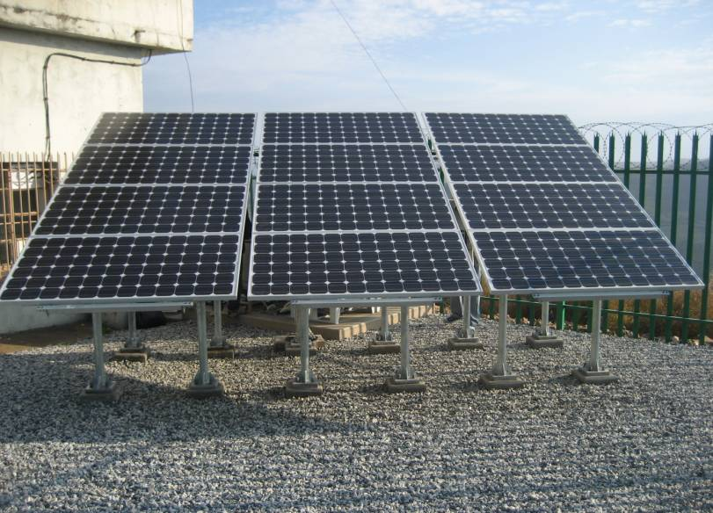
Smallest Green Sites Deployed In SA Vodacom
Site : Brooklands / BTS 3900E O2
Power consumption: 200W (250 W measured)
Backup time: 6*24Hours;
Batteries Recharging time:15 days
Battery capacity: 800AH in 2 Batteries Bank;
PV panels: 12PCS*165W
system set-up : 30.03.2009
Site : Rooywal / BTS 3900E O2
Power consumption: 147W (130 W measured)
Backup time: 3*24Hours;
Batteries Recharging time:10 days
Battery capacity: 400AH in one Batteries Bank;
PV panels: 8PCS*165W
system set-up Date : 18.05.2009
Site : Maruhla Estate BTS3012 S2/4/4 (GSM 900), S4/4/4 (GSM 1800)
Power consumption: 2 KW (measured 1,15 KW)
Batteries backup time: ~14Hours;
Battery capacity: 980AH
PV panels: 20 PCS*165W
Diesel Generator: 12,5 KVA, 1000 L Tank
Cooling: Free Cooling Box
system set-up Date : 27.06.2009
Page 11

Slide 12

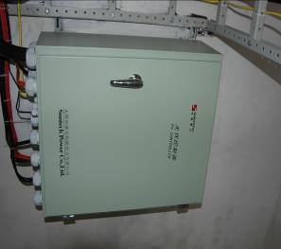
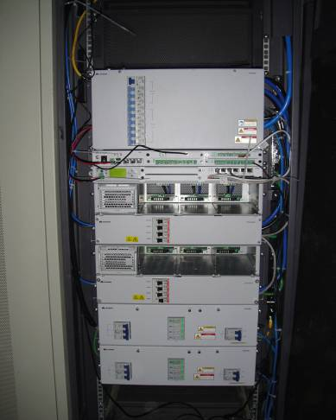
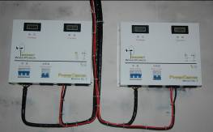
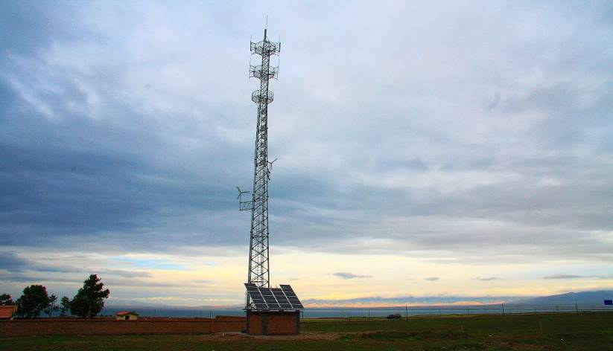
Continued Optimization For CMCC Green Site
Solar controller
All in one controller
Item | Before upgrade | After upgrade
BST Type | GSM DBS3900
TRX Configuration | S4/2/2
Site Load | 600W | 520W
PV Panel | 22PCS | 12PCS
Solar Controller | On/Off | MPPT
Wind Controller | Wall-mounted | Embedded, made by Huawei
Controller logic | On/OFf | Hybrid intelligent control
Monitoring | None | HPMU
Wind controller
MPPT Controller: increase efficiency 14.7%, reduce PV panel 3PCS
Optimize wind energy utilization: from 30% to 46.85%, reduce PV panel 2PCS
Optimize system design tool: reduce PV panel 1PCS
Actual site load: from 600W to 520W, reduce PV panel 4PCS
Total PV panel reduced: 10PCS
Page 12
Notes:
12

Slide 13

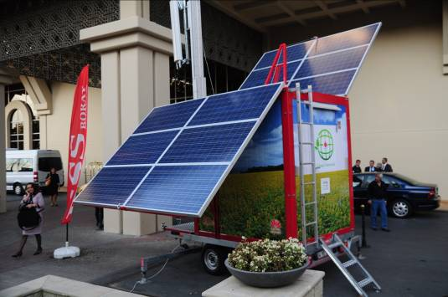
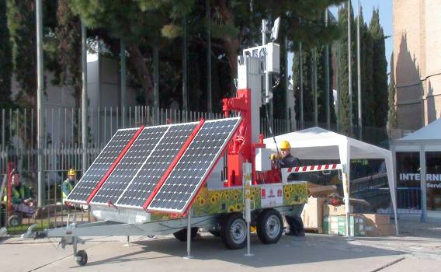
Green Innovation Cooperation With VDF
Green Mobile Site with VDF Turkey
Green Site at the MWC 2010
Page 13
Notes:
13

Slide 14
Content
Huawei Green Power Technology
Case Study
Roadmap
Notes:
14

Slide 15





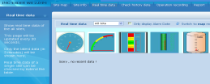

Green Power Roadmap
OSS
Alternative Power CAPEX/site/yr , Site Load Consumption 1.0KW
* predicted value
40%
50%
60%
70%*
2008
2009
2010
2011
2012
CVT/PWM controller
All-in-one controller
MPPT solar controller
Monitor integrated with M2000
After Sun
Solar battery, cycle life 3000@30%DOD
Intelligent network management
Advanced Solar battery, 4000@30%DOD with half weight and dimensions at temperature 40 ℃
Page 15
Notes:
15
15
2010-4-14 Revised by Duan according to Fabio’s comments
参考主设备S4/4/4的站点功耗降低，自08～09预计降低8%；
太阳能组件占CAPEX约80%；
MPPT技术在太阳能组件减配上的收益约为15%～30%，
采用Solar/wind/D.G./Battery hybrid配置在太阳能组件减配上的收益约为15%～30%
最终08～09 不考虑组件成本的降低，CAPEX预计降低最少40%；
最终09～10 不考虑组件成本的降低，CAPEX预计降低最少15%，同比08年最少55%；
10～11 采用Intelligent interaction of BTS TRX，在太阳能组件减配上的收益约为10%～20%，
最终10～11 不考虑组件成本的降低，CAPEX预计降低最少10%，同比08年最少65%；
For 600w load, reference configuration: It changes according to local climate conditions
600*10/180w = 32 Panels Area required = 30*1.28 = 38.4m2
Wind turbine is additional feature, not the main feature.
CVT：constant-voltage transformer
PWM：
MPPT：Maximum Power Point Tracking
太阳能，风能等清洁能源的应用是节能降耗最有效的能源解决方案，太阳能板和控制器效率的不断提升使清洁能源有着广泛的应用前景。
风能的应用局限主要是维护工作繁琐和成本高昂
Application of renewable energy is the most effective way of energy saving, especially with solar and wind. With the promotion of the efficiency of solar board and controller, application of renewable energy meet bright future.
Compared with 1+1 D.G. solution, solar power solution can save fuel over 9.2kL per year for a 500W site, and the saving range will keep improving with the development of intelligent management and long life battery.

