Slide 1
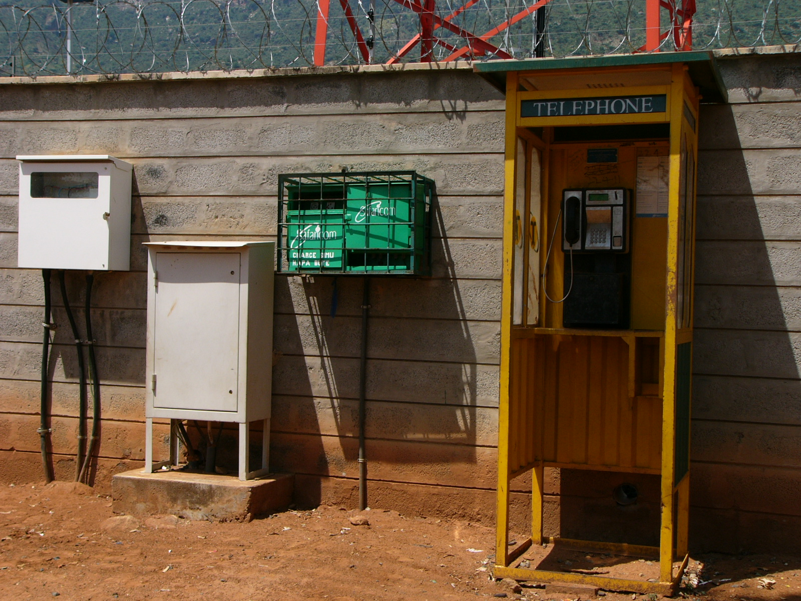
Charging Services
Community Power from Mobile (CPM) - Using Mobile to Extend the Grid

Slide 2
Agenda
CPM: Problem and Opportunity Statements
Off-grid Charging Services: Demand and Existing Solutions
The Telecom Tower based Charging Services Opportunity
CPM Charging Services Implementation Models

Slide 3
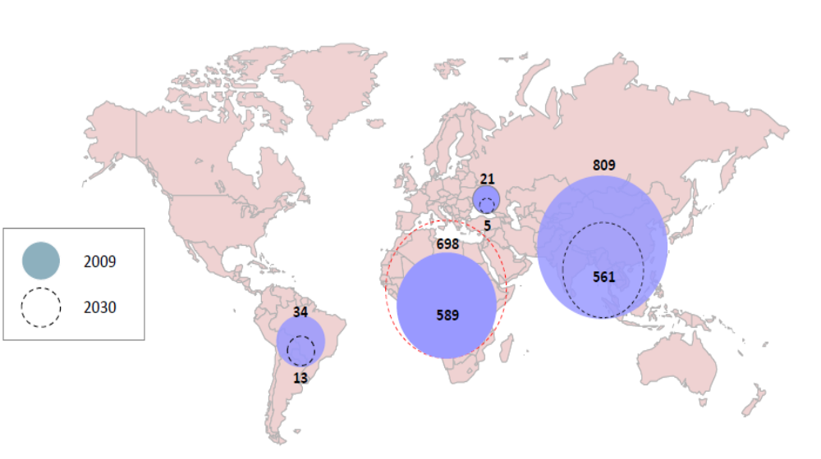
Nearly 1.6 Billion People are Currently Off-grid and Nearly 1.3 Billion Will Still be Off-grid in 2030

Slide 4
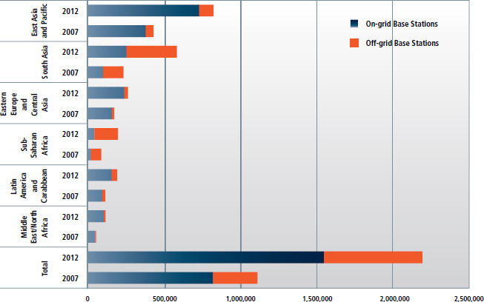
639,000 Off-grid Telecom Towers by 2012
Source: GSMA Research

Slide 5
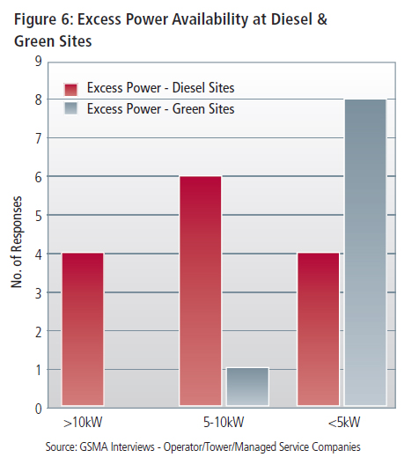
Significant Amount of Excess Power in Off-grid Telecom Towers
Standalone diesel sites have about 5 kW of excess power
Green power sites have limited excess power availability
The amount of excess power available in these sites is enough to provide services to charge mobile phones, lanterns and household batteries
Source: GSMA Research

Slide 6
Agenda
CPM: Problem and Opportunity Statements
Off-grid Charging Services: Demand and Existing Solutions
The Telecom Tower based Charging Services Opportunity
CPM Charging Services Implementation Models

Slide 7
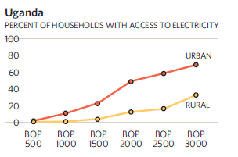
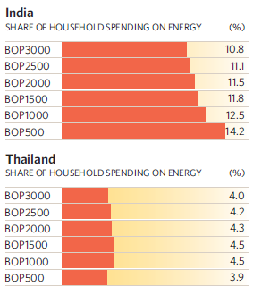
Expenditure on Energy Services in Off-grid Areas
Total BoP household energy market worldwide is estimated to be $433 billion, representing the spending of 3.96 billion people*
BoP households devote an average of 9% of their expenditures to energy
The lower BoP tends to spend more (in value) on energy than households with higher income
Source UN
* Source The next 4 Billion report

Slide 8
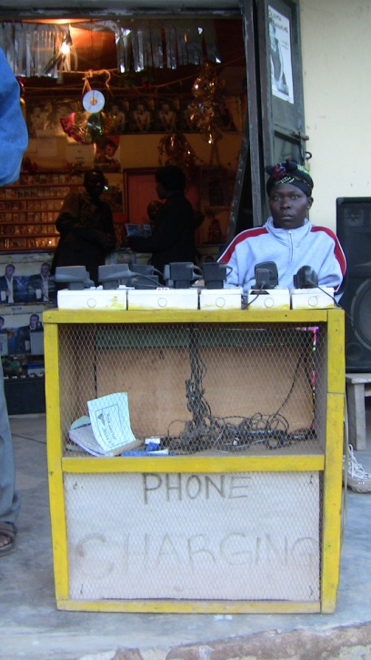
Mobile Phone Charging: Demand
6 billion mobile phone subscribers by mid-2012 with a majority of new subscribers living in off-grid areas
Lack of energy access limits the usage of mobile phone services in off grid areas
GSMA research in East Africa indicates that subscribers spend US$ 0.1 to 0.25 per mobile phone charging cycle, for a total of US$ 1 to 3 per month (up to 30% of monthly mobile expenditure)
Subscribers living in remote areas travel up to 20 km to reach phone shops offering charging solutions, spending an additional US$ 25 per month

Slide 9
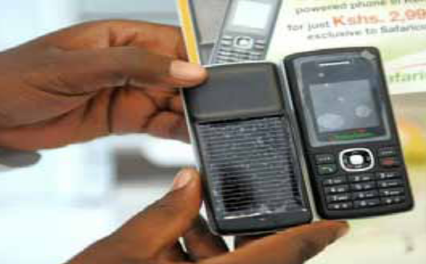

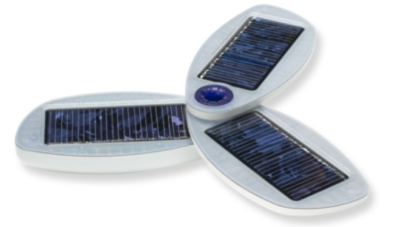
Mobile Phone Charging: Existing Solutions
Solar Phones introduced by operators such as Safaricom, Uganda Telecom and Digicel, are moderately successful
Concerns remain over high cost, low efficiency and limited durability
Handset
External Charger
External chargers can be useful in remote communities since they can charge multiple low power devices
Most external chargers available today are either solar (ex: Solio solar charger) or kinetic (ex: Nuru pedal charger)
Concerns remain on their cost (typically US$ 30 to 100) and efficiency

Slide 10

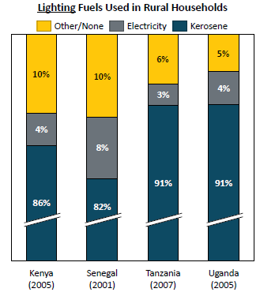
Lighting Solutions: Demand
Off-grid customers spend an estimated US $8 to 12 per month on lighting solutions such as candles, kerosene, dry cells or battery charging
Off grid households spend US$ 5-20 per kWh for lighting compared to US$ 0.15 per kWh spent by those connected to the grid.
A total of US$ 38 billion is being spent each year by poor households on fuel based lighting - African BoP spending alone at US$ 10 billion.
Major concerns over these sources of energy: fumes are poisonous and efficiency is low

Slide 11
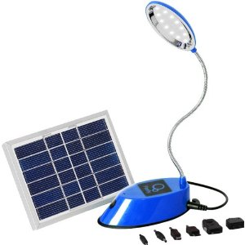
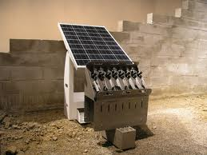
Lighting Solutions: Existing Solutions
Several companies are now providing rechargeable lanterns and torches in off-grid areas of India and Africa: Barefoot Power, D.Light Designs, Nuru Lights, OSRAM etc
  Programmes are being developed to provide light and mobile phone charging services from solar-based energy hubs
  Ericsson’s Millennium Villages in Africa,
  OSRAM’s O-Hub in Kenya
  TERI’s Lighting a Billion Lives in India
  However service cost is rising due to the solar panel high cost

Slide 12
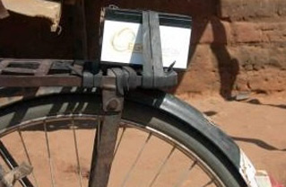

Household Battery Solutions: Demand & Existing Solutions
Average off-grid household expenditure on kerosene and AA batteries (lights, radios,..): US$8 per month
Concerns: these options are expensive, inconvenient and hazardous
Household batteries are becoming popular in off-grid areas – can provide energy to many low power devices.
  Companies such as EGG Energy based in Tanzania provides a household battery (12V, 12Ah) subscription service

Slide 13
Agenda
CPM: Problem and Opportunity Statements
Off-grid Charging Services: Demand and Existing Solutions
The Telecom Tower based Charging Services Opportunity
CPM Charging Services Implementation Models

Slide 14
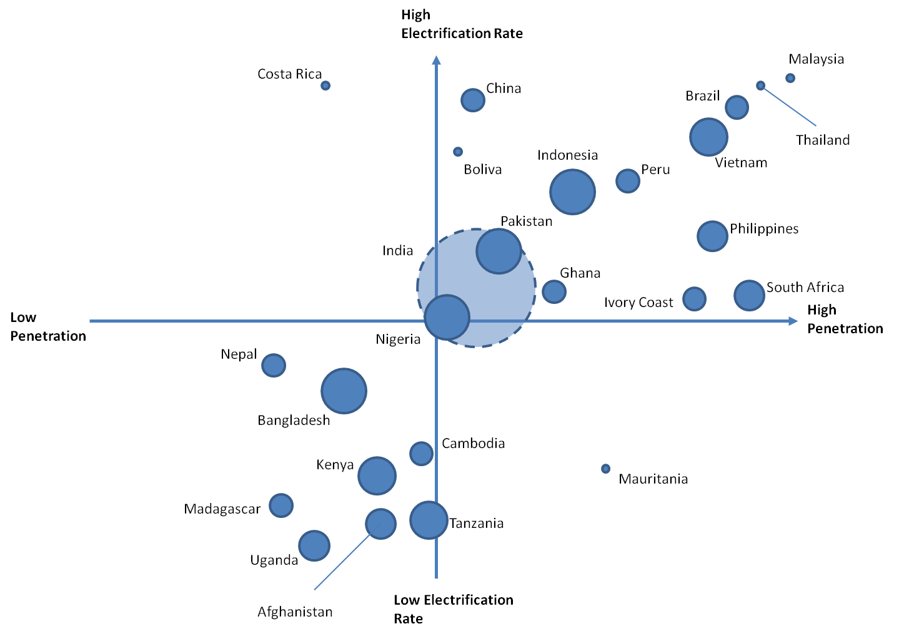
Off Grid Base Stations by country
Market sizing based on the electrifying rates and mobile penetration variables
Size of circle is proportional to the number of off-grid base stations by country

Slide 15
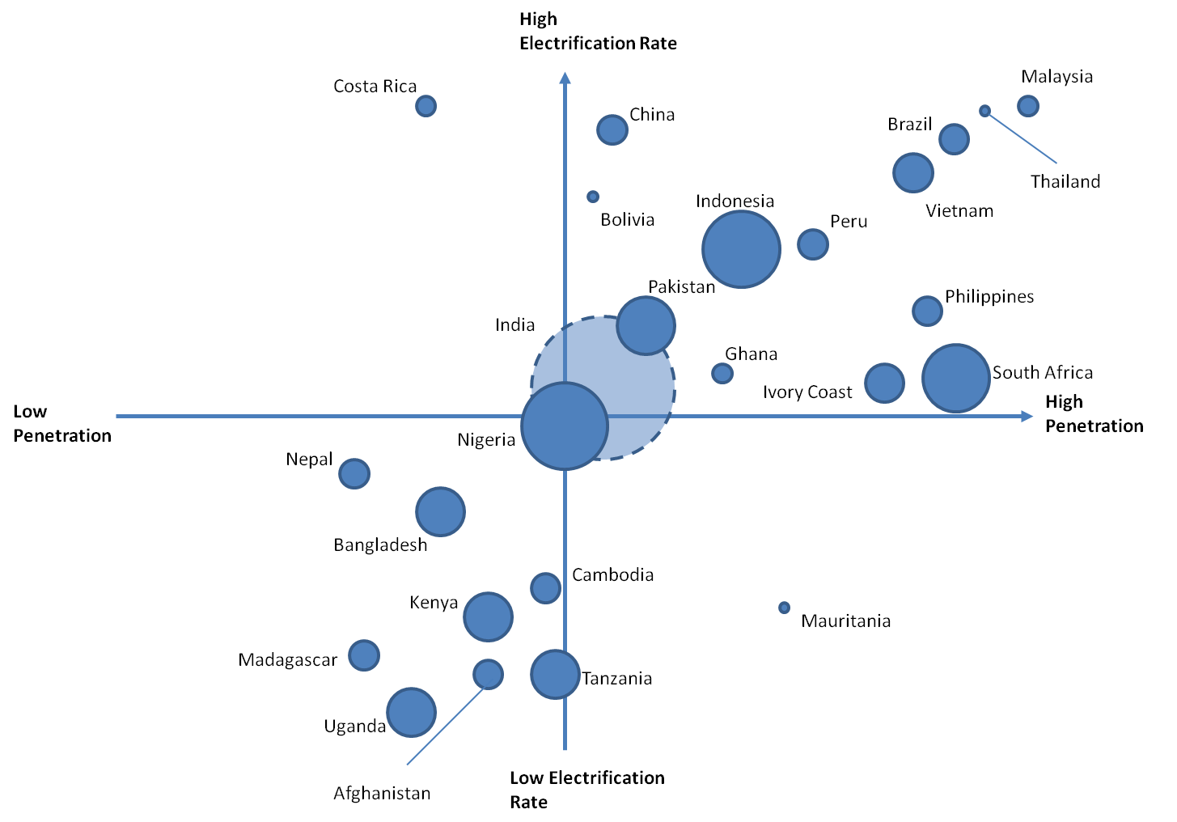
Off Grid Market Sizing by country
Market sizing based on the electrifying rates and mobile penetration variables
Size of circle is proportional to the off grid market value by country (based on number off grid subscribers and average ARPU)

Slide 16
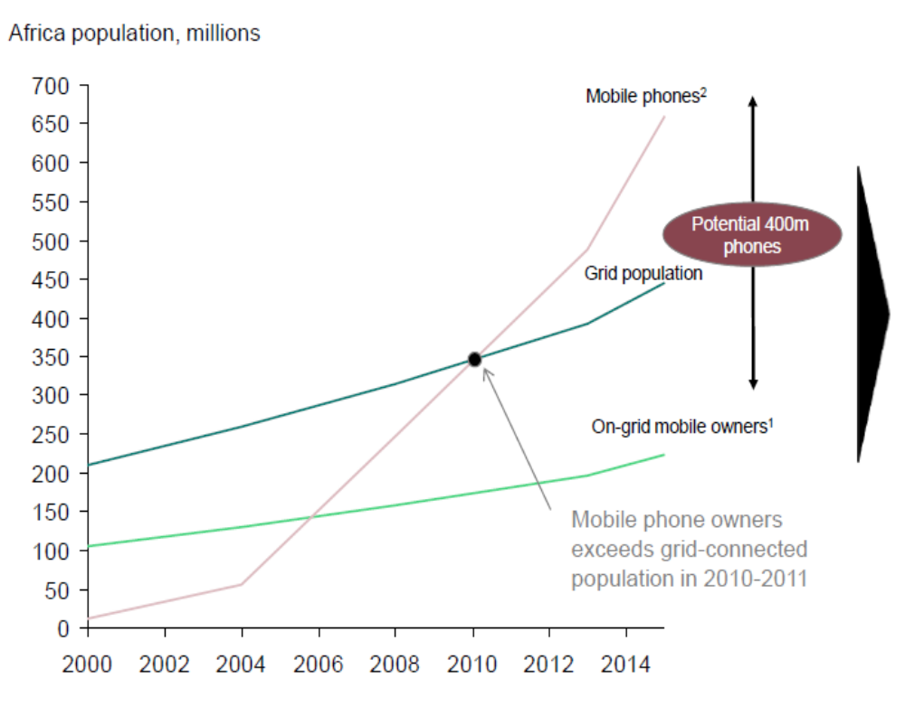
The Telecom Tower based Charging Services Opportunity for Operator
Off-grid mobile charging solutions result in ARPU increases by 10-14%*
More airtime usage and reduced customer expenditure on energy
Based on conservative ARPU increase for 500 million off-grid customers, direct revenue for MNOs could total up to US$ 3.2 billion per annum
Theft prevention - local community take care of the charging station
.
* Source Digicel

Slide 17
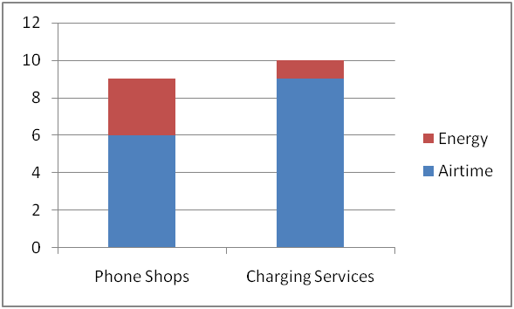
The Telecom Tower based Charging Services Opportunity for the Community
Community Benefits from Charging Services
Major cut-down in travel time and costs to charge phones, lanterns and other low power devices
Increased purchasing power for telecoms (handset, airtime) or lights - solar chargers needs not be purchased
Aids local economic development by creating local employment for managing the charging station
10-14% ARPU increase

Slide 18
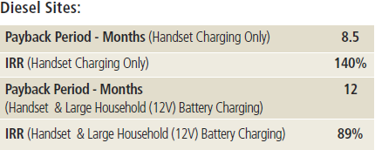
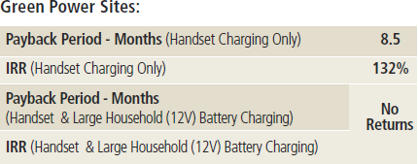
Strong Business Case for Charging Services Implementing Partner
Good business case exists for implementing handset charging and lantern charging applications from diesel generator-based off-grid sites
Good business case exists for implementing only handset charging but not lantern charging applications from green power-based off-grid sites
Source: GSMA Research

Slide 19
Agenda
CPM: Problem and Opportunity Statements
Off-grid Charging Services: Demand and Existing Solutions
The Telecom Tower based Charging Services Opportunity
CPM Charging Services Implementation Models

Slide 20
CPM Charging Services Value Chain & Implementation Options
CPM Charging Services Value Chain
Power Infrastructure Owner
Power Distribution Owner
Charging Services Operator
Consumer
Option 1
MNO/Tower Company
MNO/Tower Company
Telecom Managed Services Provider
Consumer
Option 2
MNO/Tower Company
Telecom Managed Services Provider
Telecom Managed Services Provider
Consumer
Option 3
MNO/Tower Company
Telecom Managed Services Provider
Third Party ESCo
Consumer
Option 4
MNO/Tower Company
MNO/Tower Company
Third Party ESCo
Consumer
Option 5 (Least Preferred)
MNO/Tower Company
MNO/Tower Company
MNO/Tower Company
Consumer

Slide 21
CPM Charging Services: Sample India Model
Partner 1 (Indian tower company) provides
Permission to use its off-grid site with excess power
Technical design support
Partner 2 (Off-grid energy provider) will
Build a charging station at a site with excess power owned by Partner 1
Hire locals as employees/franchises to provide charging services
CPM Charging Services Model
Power Infrastructure Owner
Power Distribution Owner
Charging Services Operator
Consumer
Partner 1
Partner 1
Partner 2
Consumer
Partner 1 benefits from increased ARPUs
Partner 2 benefits from revenues for providing charging services and from increased penetration of its energy/lighting products

Slide 22
CPM Charging Services: Sample East Africa Model
Partner 1 (Kenyan MNO) provides
Permission to use its site with excess power
Technical design support
Integration into mobile banking payment platform
Partner 2 (Off-grid energy provider) will
Build a charging station at a site owned by Partner 1
Hire locals as employees/franchises to provide charging services
CPM Charging Services Value Chain
Power Infrastructure Owner
Power Distribution Owner
Charging Services Operator
Consumer
Partner 1
Partner 1
Partner 2
Consumer
Partner 1 benefits from increased ARPUs and increased usage of M-PESA
Partner 2 benefits from revenues for providing charging services and from increased energy/lighting products

Slide 23
Thank You!
Questions?

