Slide 1
Mobinil Power Roadmap
restricted - Technology - N D 2011
The Egyptian Company for Mobile Services (Mobinil)
Mar 15th, 2011

Slide 2
Agenda
1
Green Power
2
Energy Saving
3
Carbon Credit & LEED Building

Slide 3

Green Power
Current Solar Project
GSMA assessment pure solar site
Hybrid sites

Slide 4
Objective
To study opportunities to transfer network sites in off grid areas powered by diesel generator to renewable green power (Solar System)
Why?
Noticeable reduction in solar system prices, that will leads to achieve better ROI & payback period
Fuel trend price is unpredictable, we do expect Sharpe increase in the coming 5 years reference to the below trend
175% increase Y03 to Y10
one liter =0.2$

Slide 5
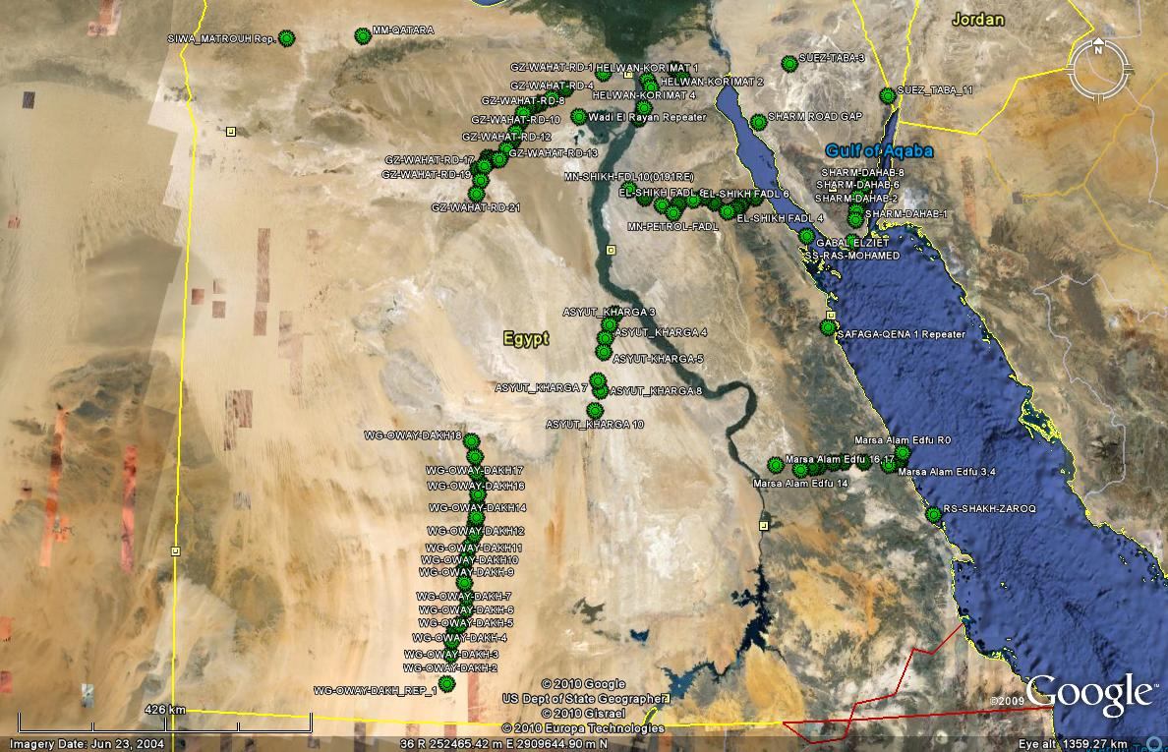
Solar Map for the achieved sites (100)

Slide 6
Green Power
Current Solar Project
GSMA assessment pure solar site
Hybrid sites

Slide 7
GSMA assessment
In progress:
  40 road sites planned to be launched during 2011
Future extensions:
150 sites have been initially identified as being most suitable for the use of renewable energy
These 98 sites consume a total of 2,189,214 Litres of fuel per year at a current cost of $634,845 and is likely to increase significantly in the coming years
  98 sites Ready potential for solar power deployment
  Releasing 145 genset
  Net savings of 12.6 M$ after 10 years
  Accordingly reducing carbon footprint (7,250 Ton)
  Payback for these 98 sites is as below:
Site power watt | No. of sites | Payback
500 | 13 | 1.7
600 | 4 | 2.7
700 | 47 | 2.9
800 | 15 | 3.7
900 | 19 | 4

Slide 8
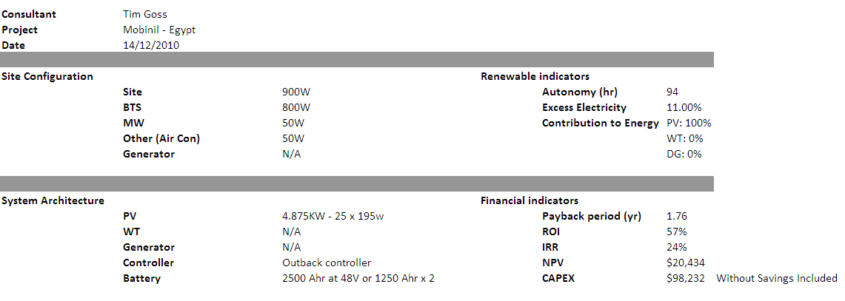
Model-900W
Solar Design – 20 Years

Slide 9
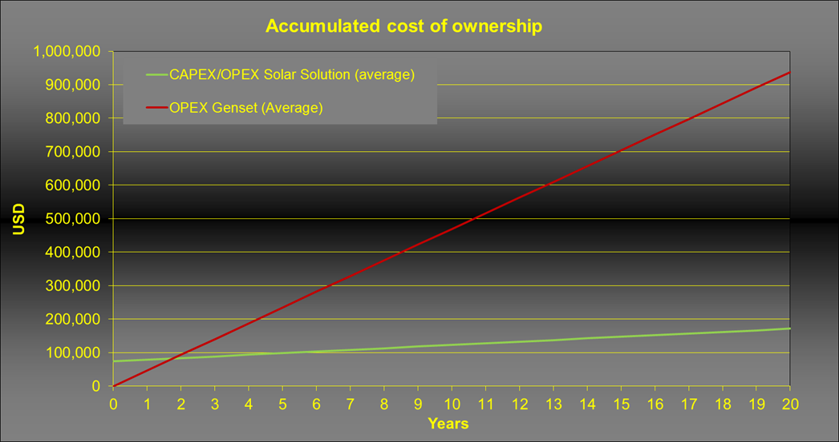
Solar Design – 20 Years
Model-900W

Slide 10
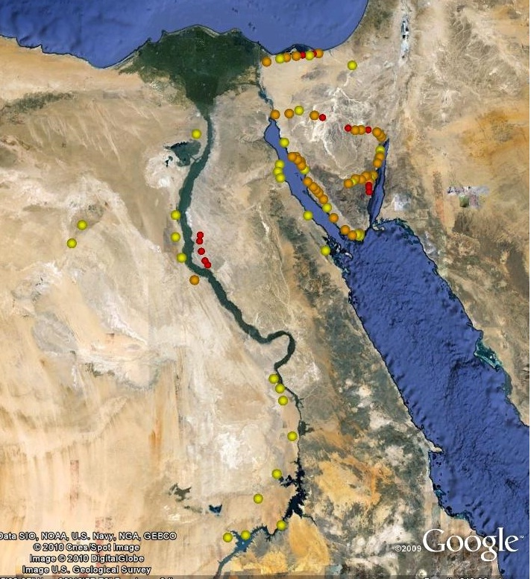
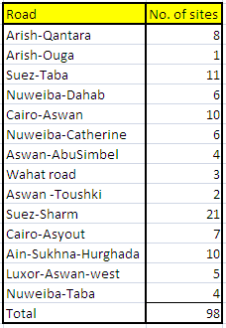
Potential solar sites
Priority 1 Sites
Priority 2 Sites
Priority 3 Sites

Slide 11
Green Power
Current Solar Project
GSMA assessment pure solar site
Hybrid (wind + batteries) sites

Slide 12
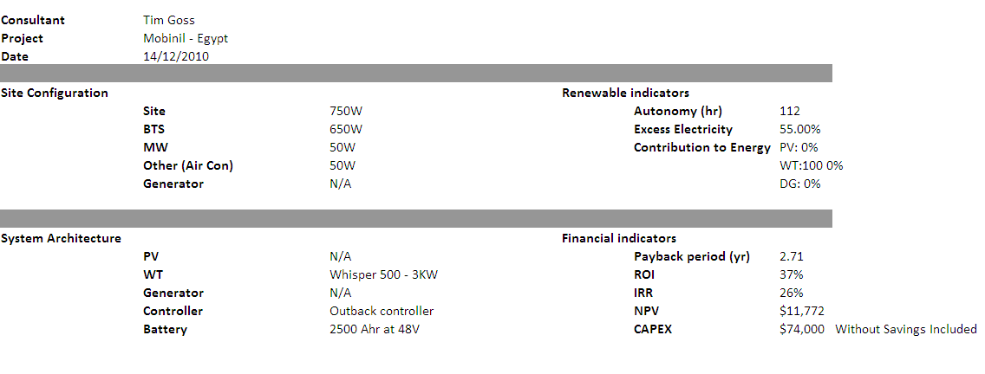

Slide 13
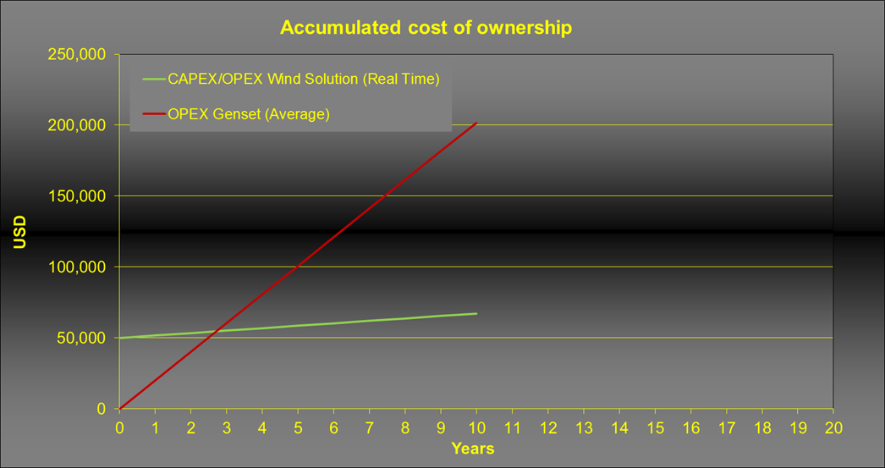
Wind + Batteries trial candidates
payback is 2.7 years for 750 watt site

Slide 14
Agenda
1
Green Power
2
Energy Saving
3
Carbon Credit & LEED Building

Slide 15

Energy Saving
Objective & Methodology
Saving opportunities
Cooling solutions trials
New technology/products

Slide 16
Overview on Telecom site Energy Consumption
40% of the site consumption will be almost eliminated if A/Cs are replaced with an alternative cooling solution.

Slide 17
Objectives:
Reducing Energy OPEX by using energy efficient solutions.
Moving towards Green solutions.
Smart energy management.
Methodology:
Tackling new and innovative solutions to reduce the energy consumption (applying on the highest sources of consumption first).
Taking advantage of the BSS Swap to modify the power design to be more efficient.

Slide 18
Energy Saving
Objective & Methodology
Saving opportunities
Cooling solutions trials
New technology/products

Slide 19
Saving Opportunities Box (Cooling):
Cooling Solutions
Shelter
Traditional A/Cs
Saving solutions
Outdoor
Outdoor Enclosure with indoor BTS
Outdoor BTS
1- Downgrade A/Cs (after BSS Swap)
2- Daikin A/C
3- Raising site temp, setting
4- Free Cooling
5- Replace A/Cs with HEX or ventilation

Slide 20
Cooling Solutions Savings Vs. existing:
I-Traditional A/Cs:
1- Downgrading A/Cs after the BSS Swap:
A/Cs can be downgraded to 2 HP instead of 3HP due to lower equipment dissipation.
30% saving in A/C cons., i.e.: 12% in total site cons.
2- DAIKIN A/Cs:
Trial has been conducted
50% saving in A/C cons., i.e.: 20 % in total site cons.
Almost no starting current, more efficient , uses eco-friendly Ferion.

Slide 21
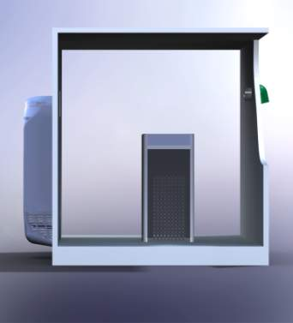
Cooling Solutions Savings Vs. existing:
II-Saving Solutions:
3- Raising shelter temperature to 32 C:
A trial has been conducted (batteries inside NSN cabinet).
62% saving in A/C cons., i.e.: 25 % in total site cons.
4- Free Cooling Solution:
A trial will be conducted.
Can be used with high temp setting (with battery cooler) or low setting (without battery cooler).
80% expected saving in A/C cons., i.e.: 32 % in total site cons.

Slide 22
Cooling Solutions Savings Vs. existing:
III-Outdoor Solutions:
5- Outdoor Enclosures:
The A/C on the enclosure to be replaced with HEX or ventilation system.
80% expected saving in A/C cons., i.e.: 32 % in total site cons.
Can be used on new enclosures or to replace for old enclosure doors

Slide 23
Energy Saving
Objective & Methodology
Saving opportunities
Cooling solutions trials
New technology/products

Slide 24
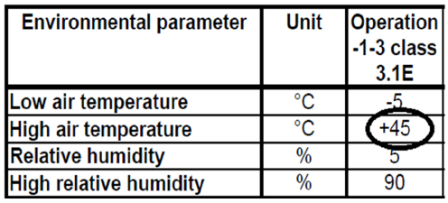
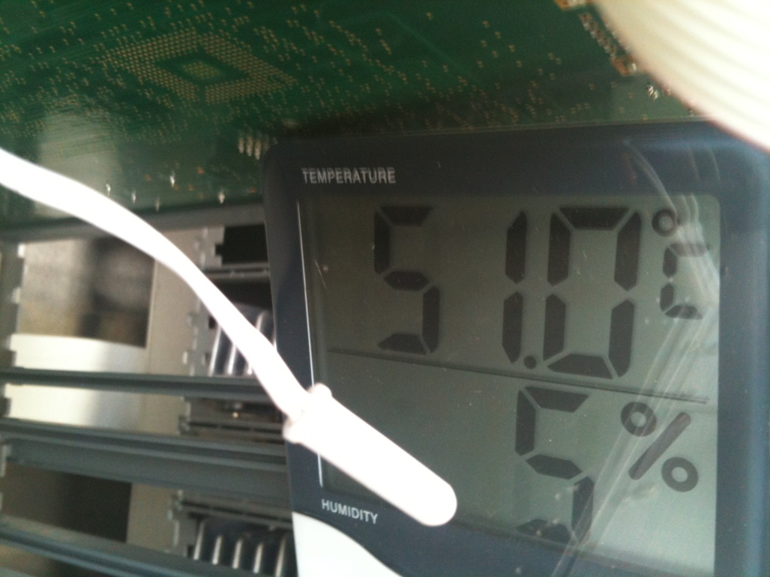
Ventilation system trial (Shram-Dahab 4)
Due to stock limitation of OD BTS for solar project
Indoor BTS installed in outdoor enclosure after the following preparation:-
Disconnect A/C
Replace existing DC fans (2 X 8Watt) with higher power (air flow) (2 X 60Watt)
Trial started during June 2010
Results was as follow:-
no high temperature was received during June
Measurement duration July 1st till July 13th
Max. high Temp. was 46Cº
Min. high temp was 31Cº
Conclusion:
indoor BTs can safely operate up to 45Cº with ventilation system (same concept of MBO & CBO with HEX)

Slide 25
NSN- Site star cabinet trial
Actual specifications for the site-star cabinet (battery cooling cabinet)
Reduction in energy consumption
Cabinet application:
  Using the site star as the battery cabinet instead of the existing battery enclosures which will consume 160 W instead of 940W (less CAPEX/OPEX)
  Using the site star cabinet in sites with high electricity fees, such as Telecom Egypt (TE) sites. Below, the expected savings (OPEX) from the application of the site star in Telecom Egypt sites.
 | Ambient Temp. °C | Inside temp. °C | Max. ΔT obtained | Cabinet consumption (W)
Actual measurements | 38.89 | 23.89 | 15 | 158
NSN's presented figures | 35 | 20 | 15 | 40
 | 55 | 20 | 35 | 158
Case | Energy consumed in 18 days (kVAh)
Trial site (NSN’s solution) | 1457
Dummy site (Existing condition 2 A/Cs working) | 1978
Percent decrease | 26.5%

Slide 26
Energy Saving
Objective & Methodology
Saving opportunities
Cooling solutions trials
New technology/products

Slide 27
Smart Site Monitoring
Problem Definition:
Only 4 alarm records are currently available in Mobinil OMC (Power , Rectifier, High temp, Fire alarm) which leads to the following issues.
Trouble shooting & Diagnosing problems:
The alarms are not sufficient to diagnose the problems and define adequate solution.
Power logging should be performed manually on site.
Data base & Planning problems:
There is no data base for the power (equipment or history).
Data base is collected via the L1 maintenance subcontractors are usually not updated or accurate.

Slide 28
Smart Site Monitoring
“If you can’t measure it, you can’t manage it.”
Objectives:
Provide easy and fast tool to trouble shoot power problems and enhance NUR.
Build a data base for sites equipment & measurements and hence:
  Diagnose the root cause of the problem & solve it (ex: stabilizers, cyclic batteries, generator, enhance battery backup.
  Optimize the power designs based on actual readings.
  Explore opportunities for green solutions.

Slide 29
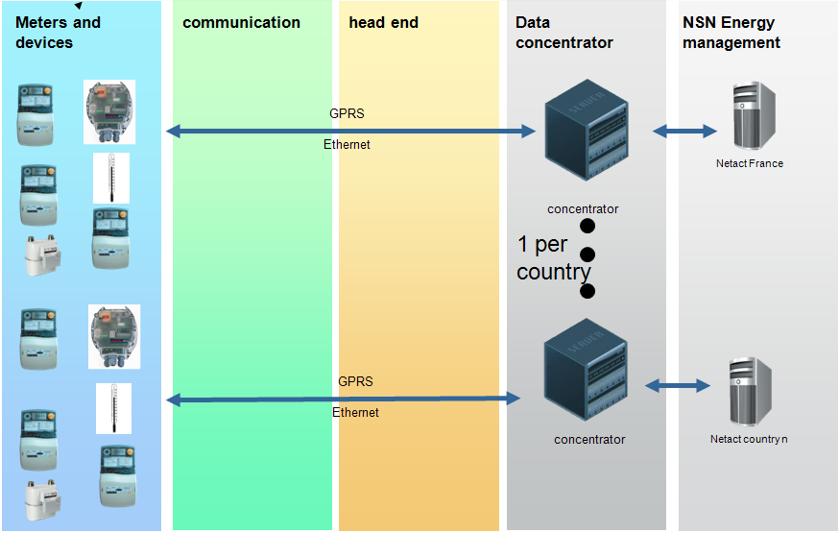
Smart Site Monitoring
Methodology:
Installing monitoring system to collect power & environmental data from each site.
Data will be sent via GPRS (USB modem) to a centralized server.
The available data will be used for analysis and network enhancement.
Progress:
Free trial will be conducted with NSN.
30 Solar sites will be installed with Alcatel monitoring systems.

Slide 30
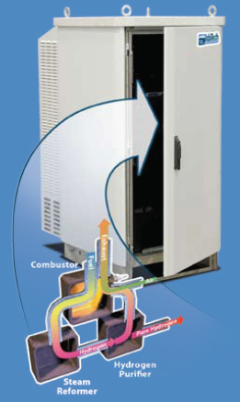
Fuel Cell
Why Fuel Cells?
Green Solution (fueled by methanol).
Produces DC current (-48 volt).
Can replace backup generator, rectifier and batteries.
250 Liter tank can operate a 5 KW site (24TRX,3G) for 2 days.
Application:
Can replace the generators installed in hazard areas.
Action:
Technical & commercial feasibility should be studied.

Slide 31
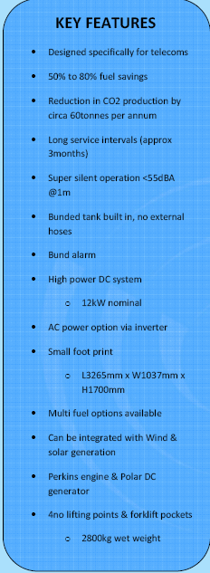
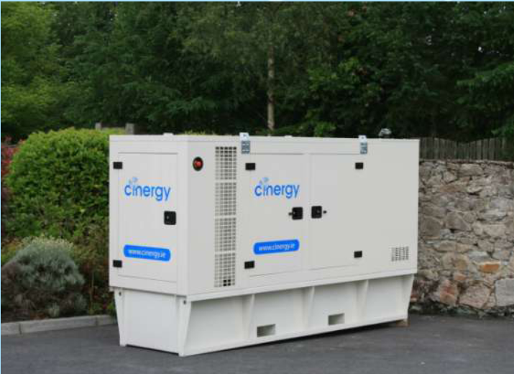
Smart Generator
Generator, controller & batteries in one skid

Slide 32
High efficiency Rectifiers
Rectifiers efficiency is currently around 92%.
New generations efficiency is around 97%.
This will save 5% of the BSS power, i.e. 3% in total site cons.

Slide 33
Agenda
1
Green Power
2
Energy Saving
3
Carbon Credit & LEED Building

Slide 34
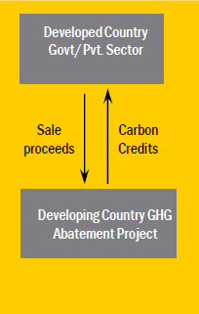
Carbon Credit Transactions
Clean Development Mechanism “CDM” is simply one of the flexible mechanisms defined in the Kyoto Protocol, that allows transaction of carbon credits (CERs and VERs)* between developed and developing countries.
CERs: Certified Emission Reductions
VERs: Verified Emission Reductions

Slide 35
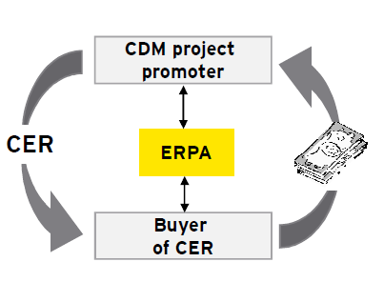
Mobinil engaged in a CDM project at which Ernst & Young will be providing advisory services for potential Green House Gases “GHGs” abatement projects.
The current GHGs abatement projects includes:
  Energy consumption reduction projects
  Alternative Energy projects

Slide 36
Mobinil phase 1 potential projects
BTSs/BSCs related:
  Grid power replacing generators
  Deployment of outdoor sites instead of indoor
  Fuel cells instead of standby generators
  Hybrid solutions for less fuel consumption
  Solar power systems for repeaters and BTS sites
  Swapping BTS sites into Single RAN (2G & 3G)
  Cooling solutions instead of A/Cs with much less power consumption
  Monitoring system for energy management through the network
  Sharing sites with other operators to use only one source of energy
    Ex: 27 KVA genset for 2 sites instead of 1 for each
MSCs/Data centers:
  IP/MPLS swap
  Swapping to soft switches
  Transcoders swapping after SingleRAN implementation
  IN swap
Facilities:
  Video Conferencing
  Turning off A/Cs and fade lighting after 7:00 pm
This will contribute positively in the green projects investments and will make investment in renewable and alternative energy solutions more attractive for Mobinil.

Slide 37

Mobinil always in the
LEED
An overview about Leadership in Energy and Environmental Design

Slide 38
What is LEED?...
An internationally recognized set of standards aiming to maximize energy efficiency in any building.
A certificate - that a building was designed and built using these performance improving standards.
It’s more of a design approach that sets the tone for what will come later on..
LEED is flexible enough to apply to all buildings... Commercial and residential. …
Works through the building lifecycle… from design to construction to operations and maintenance… even repairs and restoration.

Slide 39
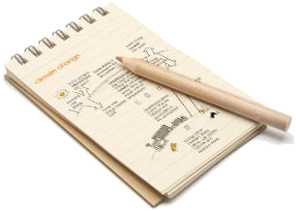
What does LEED measure?
Energy Savings.. Power consumption, insulation, lighting systems, IT and Data Center designs
Water Efficiency…
Carbon Emissions… Air-conditioning systems, cooling medium, type and source of power.
Indoor environmental quality… Daylight, ventilation, space, ambient temperatures, sound levels
Use of resources… Waste management system, nature of building materials

Slide 40
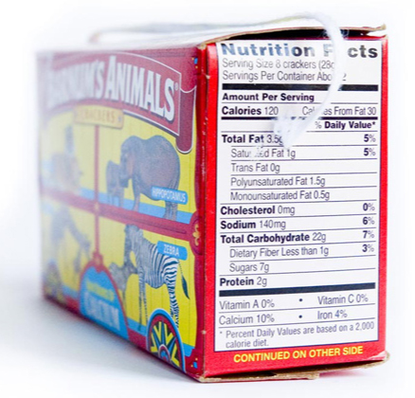
LEED Benefits
Substantial savings in operational costs.
Possibility to ‘cash-in’ on reduced carbon emissions
Happier employees, better morale…higher productivity
Better social image
More real estate value. LEED buildings are known to be assessed at higher prices.

Slide 41
About Mobinil’s new LEED building…
General information
Map snapshot
Layout and ground floor plan

Slide 42
General information
Complex Name: Pyramids Heights. Located along Cairo – Alexandria desert road. 22KM from October City
Lessor: Samcrete Development.
Lessee: The Egyptian Company For Mobile Services [Mobinil]
Building B[1]: Basement. Ground. First. Second and Third floors. Total lease area of 1250 ... Distributed over 5 floors:
…. To be used as offices and open work space. Plus an area of 2500M² basement to be used as a storage and public services for the building.
12500 M2
Expected capacity: 1550 seats

Slide 43
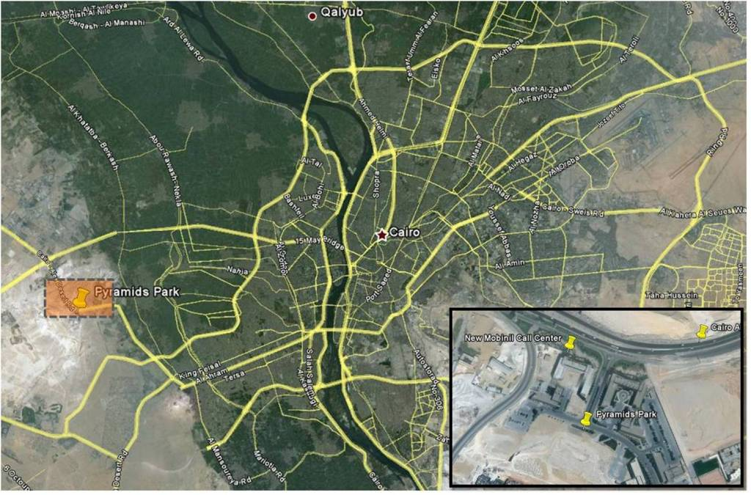
Geographical snapshot

Slide 44
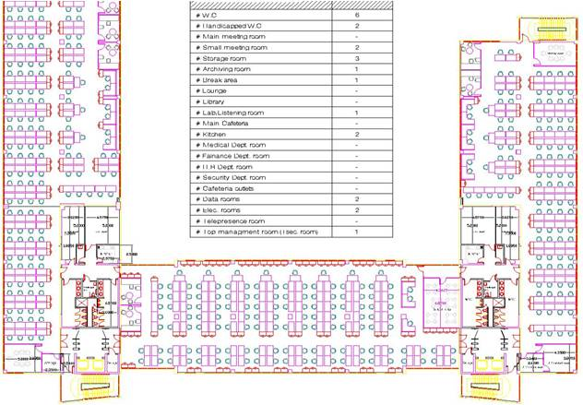
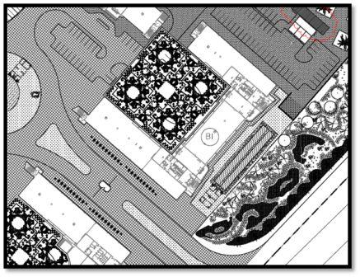
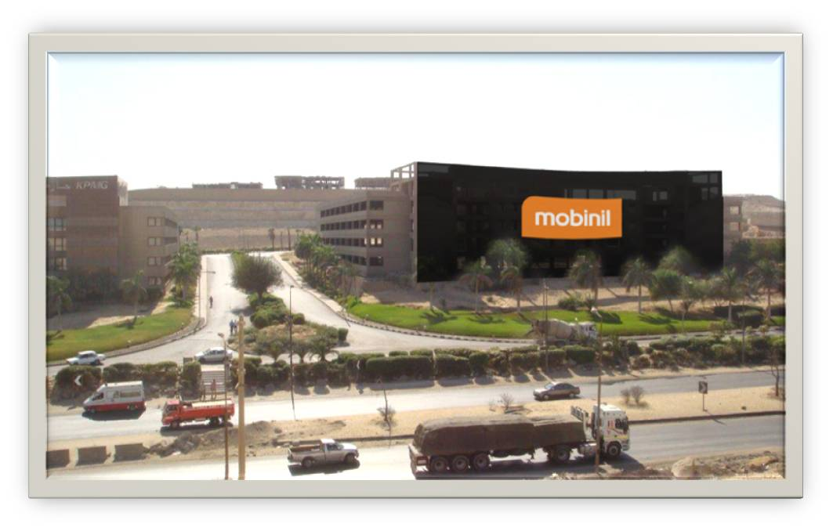
Layouts. Plans
Typical floor plan
Building layout

Slide 45
Thank You

