Slide 1
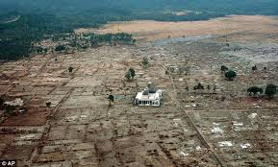
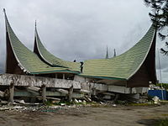
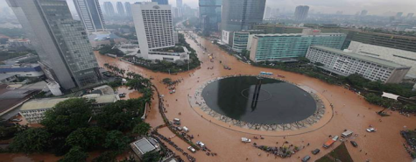
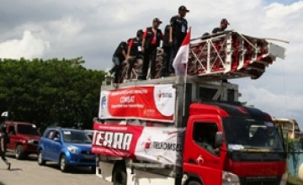
The role of mobile technology
during disaster
Hanang Setiohargo
Vice President Network Quality Management
Jakarta, 24 June 2014
A key note for GSMA South East Asia Regional Event
“A Spotlight on Indonesia”

Slide 2
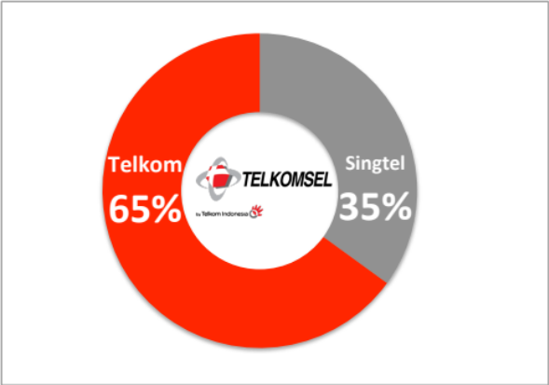
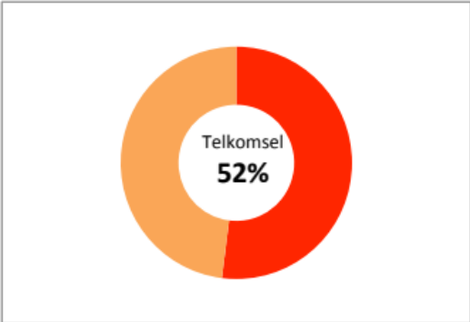

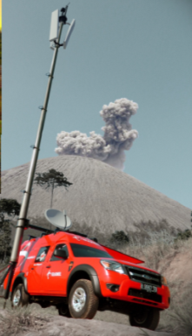
Telkomsel Profile
+133 million
customers
52% market shares
(among big 3)
Shareholders
TELKOMSEL as market leader in Indonesia and 6th rank in the world
more than
75,000 BTS
600 Cell on Wheel
1000 sites Telkomsel Special Telco Services
Coverage 95% of Indonesian Population
Notes:
Telkomsel is a leading cellular operator in Indonesia, which serves more than130 million customers, thus representing around 52% amongst big 3 cellular operators at the end of 2013.
Operating since 1995, Telkomsel is the subsidiary of PT Telekomunikasi Indonesia Tbk (65%) and Singapore Telecom Mobile Pte Ltd (35%).
Now with almost 70,000 BTSs and more than 4,700 employees operating in 11 regions in Indonesia, our services can cover the need of 95% of Indonesian population for telecommunication service.

Slide 3
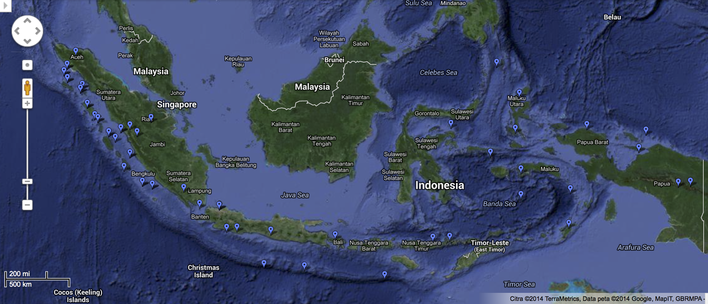

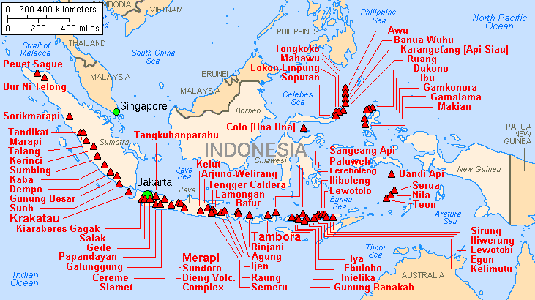
Earthquakes, Floods, & Volcanoes
2004
2010
2009
2013
2010
2010
Earthquakes
2006
Floods
Volcanoes
Recorded major earthquakes
from 1797
Natural Disasters 2004-2014
Aceh Tsunami Dec 2004
Yogyakarta Earthquake May 2006
West Sumatera Earthquake March 2007
Padang Earthquake 30 September 2009
Jakarta Floods 1996, 2002, 2007, 2013
Merapi Eruption 26 October 2010
Heavy flood Wasior October 2010
Mentawai Tsunami 25 October 2010
Sinabung Eruption August 2010, September 2013 , January 2014
Manado Flood 2013
Kelud Eruption February 2014
Source: Wikipedia Image

Slide 4
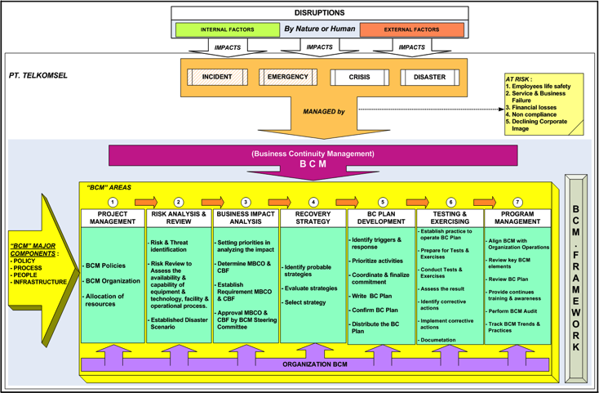
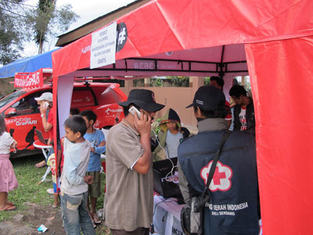
Telkomsel’s Preparation for
Disasters
A. Policies, Procedures and People
Telkomsel has been implementing Business Continuity Management (BCM) Policies, including organization
Establishing continues communication with Government and institution such as BNPB, BKMG, & PMI
Special Team : TERRA (Telkomsel Emergency Response and Recovery Activity)
B. Technology
Network Pooling
Geo-Redundancy
Disaster Recovery Center
Tier III Certified Data Center
Backup : Link, Electricity
Cell on Wheel “COMBAT” (COmpact Mobile Base STation)
Mobile Genset
C. CSR and Services
Short Message Services Warning and Disaster Info
“Posko”/Command Post to provide food, shelter, water, clothes, communication etc.
Telecommunication post “posko”
Notes:
Disaster recovery (DR) the policies, process and procedures that are related to preparing for recovery or continuation of technology infrastructure which are vital to an organization after a natural or human-induced disaster
Business Continuity Management (BCM) is defined as a holistic management process that identifies potential threats to an organization and the impacts to business operations those threats, if realized, might cause, and which provides a framework for building organizational resilience with the capability of an effective response that safeguards the interests of its key stakeholders, reputation, brand and value-creating activities

Slide 5
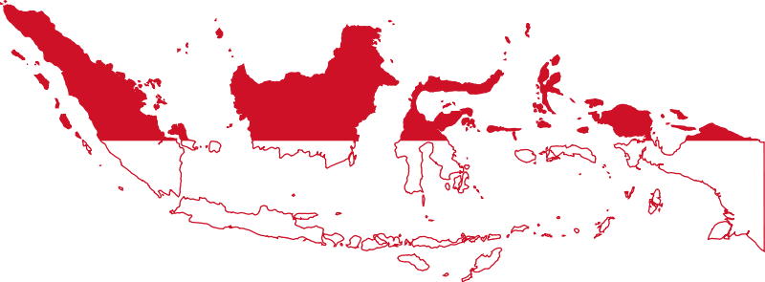
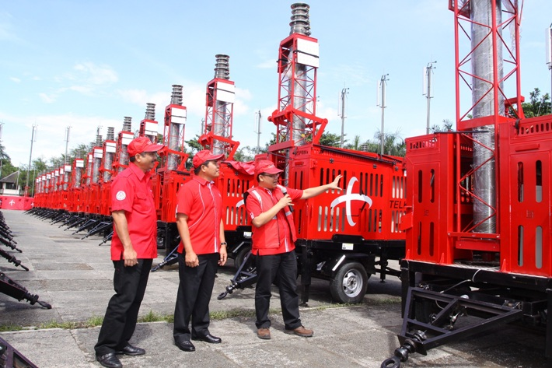
Telkomsel’s Resilient Network
Network Pooling 1
DRC
Geo-Redundant
DRC
DRC
CORE NETWORK RESILIENT INFRASTRUCTURE
Geo-Redundancy for Subscriber Data (HLR) cover in Medan – Palembang, Jakarta – Surabaya and Makasar – Balikpapan
Disaster Recovery Center for Charging System in Solo, HLR in Jakarta & Batam
Network Pooling in every Region (11 Regions) for Core Network
600+ Cell on Wheel “COMBAT”

Slide 6
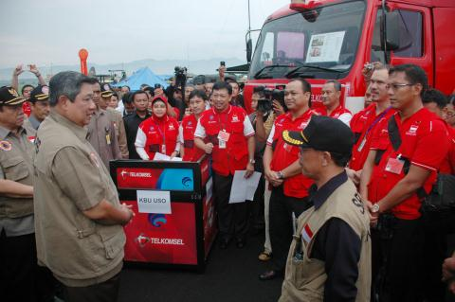
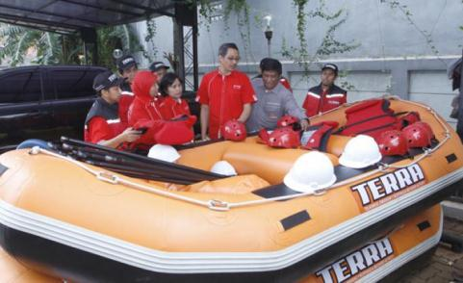
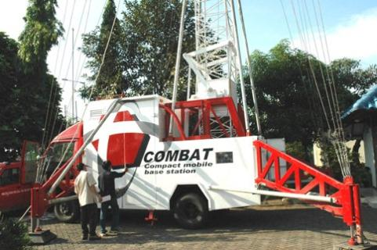
Our Challenges
Collaboration between operators, NGO, vendor etc led by Government to be more responsive, effective and efficient in disaster recovery
2. Restoring mobile network infrastructure during
and after disaster
to restore infrastructure after disaster is challenging; the biggest challenge is safety issues, lack of electricity/energy and isolated areas.
TELKOMSEL “COMBAT” (COmpact Mobile BAse sTation) is one of the important and fastest solution for telecommunication infrastructure recovery in disaster area
“COMBAT” can be installed within 5 hours.

Slide 7
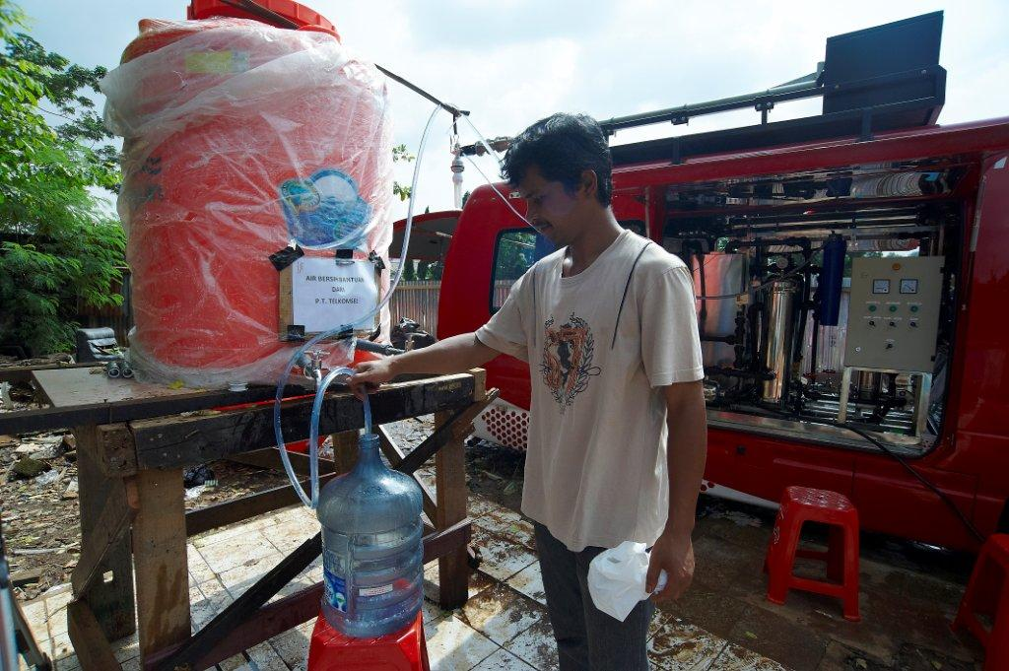
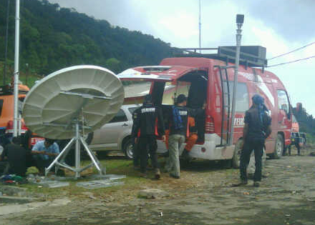
Lesson Learned
Telkomsel always try to do the best in providing excellent service even during disaster situation. To do this, we prepare:
  People : TERRA (Telkomsel Emergency Response and Recovery Activity) & Support team
  Technology : COMBAT, Disaster recovery Center, Geo redundancy
  Policy & Procedures : BCM (Business Continuity Management ) Policies
Telecommunication (network infrastructure) has a major role for disaster recovery area, GSMA can support and propose special standard to ETSI/3GPP for handling disaster such as special channel for alerting (SMS/USSD/Cell broadcast) or other standard for disaster.

Slide 8
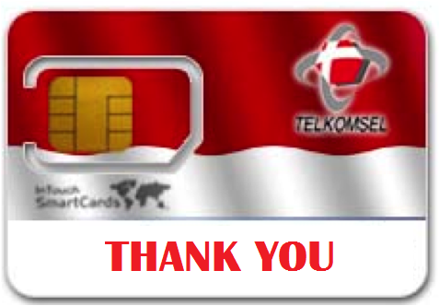
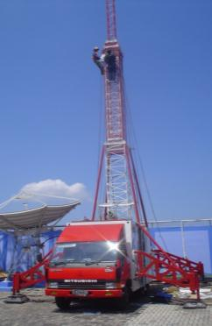
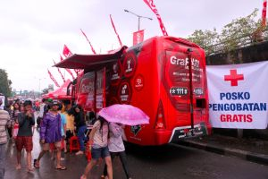
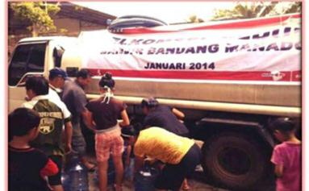
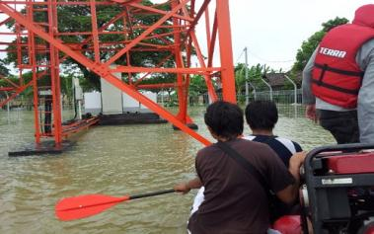
Attention please…
We will have our “COMBAT” Quick Installation DEMO @ 14.00

