Slide 1

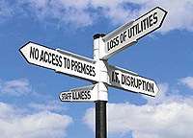
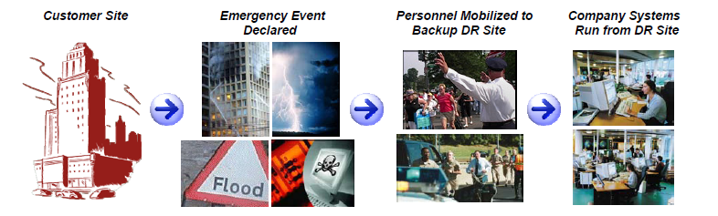
BUSINESS CONTINUITY MANAGEMENT (“BCM”) PT.TELKOMSEL
CHARLES MANKIN
General Manager of Network Operation Center (NOC)
Charles_mankin@telkomsel.co.id

Slide 2
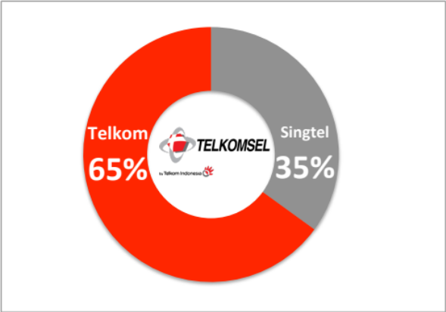
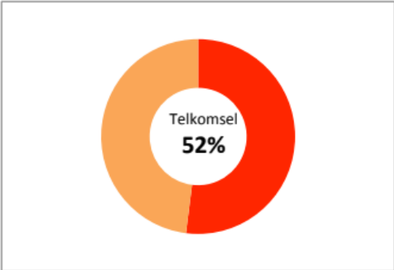


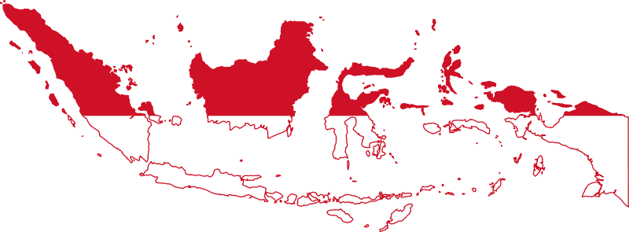
Telkomsel Profile
+133 million
customers
52% market shares
(among big 3)
Shareholders
TELKOMSEL as market leader in Indonesia and 6th rank in the world
more than
75,000 BTS
600 Cell on Wheel (COmpact Mobile BAse sTation “COMBAT”)
1000 sites Telkomsel Special Telco Services
Coverage 95% TELKOMSEL’s coverage is across Indonesia
from Sabang (Sumatera) to Merauke (Papua)
Notes:
Telkomsel is a leading cellular operator in Indonesia, which serves more than130 million customers, thus representing around 52% amongst big 3 cellular operators at the end of 2013.
Operating since 1995, Telkomsel is the subsidiary of PT Telekomunikasi Indonesia Tbk (65%) and Singapore Telecom Mobile Pte Ltd (35%).
We have consistently deployed more than 1,000 Base Transceiver Stations (BTSs) every month in 2013, of which 70% were 3G-based BTSs installed in around 300 cities nationwide.
Now with almost 70,000 BTSs and more than 4,700 employees operating in 11 regions in Indonesia, our services can cover the need of 95% of Indonesian population for telecommunication service.

Slide 3
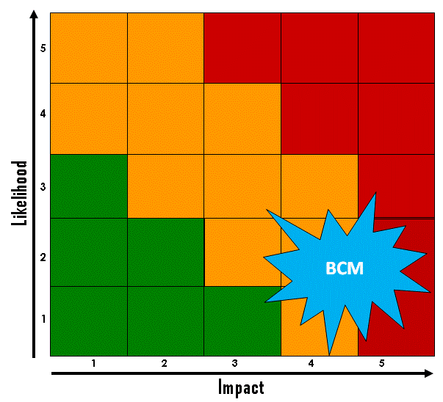
Business Continuity Management (BCM)
“A holistic management process that identifies potential threats to an organization and the impacts to business operations that those threats, if realized, might cause, and which provides a framework for building organizational resilience with the capability for an effective response that safeguards the interests of its key stakeholders, reputation, brand and value-creating activities” (SS-540)
Potential Disruption/Threat
EXTERNAL factor :
Natural Disaster and Other Accidents
Public Infrastructure Failure
Malicious Activities
Government Policy & Regulation Changes
Business Partner Boycott
Sue from other parties (company’s business related)
Low Likelihood but High Impact…
INTERNAL factor :
Massive failure of network and IT infrastructure, and/or major systems supporting the operational business activities.
Negligence / Employee crime, e.g. sabotage, technological attack , infrastructure & utility damage, etc.
Employee conduct class action/demonstration / sue or mass absence of key employees and in the long term.

Slide 4
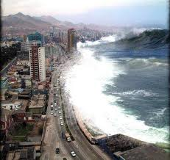
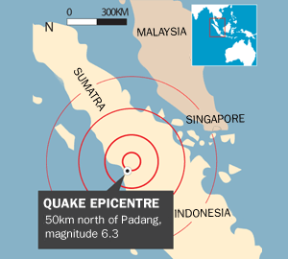
DISASTERS ARE UNPREDICTABLE....
Significant Infrastructure Network Failure
IN call gapping year 1999;
IN Failure Dec,31,2006;
Power outage in TB.Simatupang 2007; etc.
Natural Disasters
Aceh Tsunami Dec 2004;
Yogyakarta Earthquake may 2006;
West Sumatera Earthquake March 2007;
Jakarta Floods 1996, 2002, 2007.
Padang Earthquake 2009, etc
Political Unrest
National Riot May 20, 1998 (network overload & BTS assets were burned);
Aceh Military Goverment Emergency 1998-2005 (Employee hostage);
East Timor 1997 (assets lost & employee escape);
Ambon Riot 1999-2002 (assets lost & employee escape), etc
Business Disruption
Employee Strike (2011);
Content Business (2011);
Bankruptcy sue (2012)
4

Slide 5
FRAMEWORK BCM
(based on SS-540 & BCM Institute Singapore)
Project Management
Business Impact Analysis
Program Mgt.
Recovery Strategy
BC Plan
Dev’t
Testing & Exercises
Risk Analysis & Review
BCM AREA
BCM
Components :
POLICY
PROCESS
PEOPLE
INFRASTRUCTURE
Define & organize the project planning parameters & identify the resources needed to complete the BC Plan.
Identify existing risks & threats that the business organization is exposed to, particularly with respect to its geographic location, processes, and procedures.
Evaluate the critical operations for the business unit and determine the resources needed to run them.
- Develop interim recovery guidelines and procedures for business unit operating between
“time of disaster” and “ready for nomal business”.
- Arrange for alternate facilities and store backups of vital records in a safe place
- Determined the
procedures for notifying the right people, assessing the operational impact and activating the recovery.
- Develop specific steps for minimizing the risks of an outage, & restoring normal
operations after the
outage. Output from this steps is the BC Plan.
- Ensure that all staff members, who are involved in the recovery
process, understand the
recovery plan.
- Subject the developed
recovery plan & tools to tests to ensure that it
works.
Update & maintain the BC Plan constantly to reflect changed conditions in the business.
- Review & Audit the readiness and
completeness of the plans.
- Manage the overall BCM Programe.

Slide 6
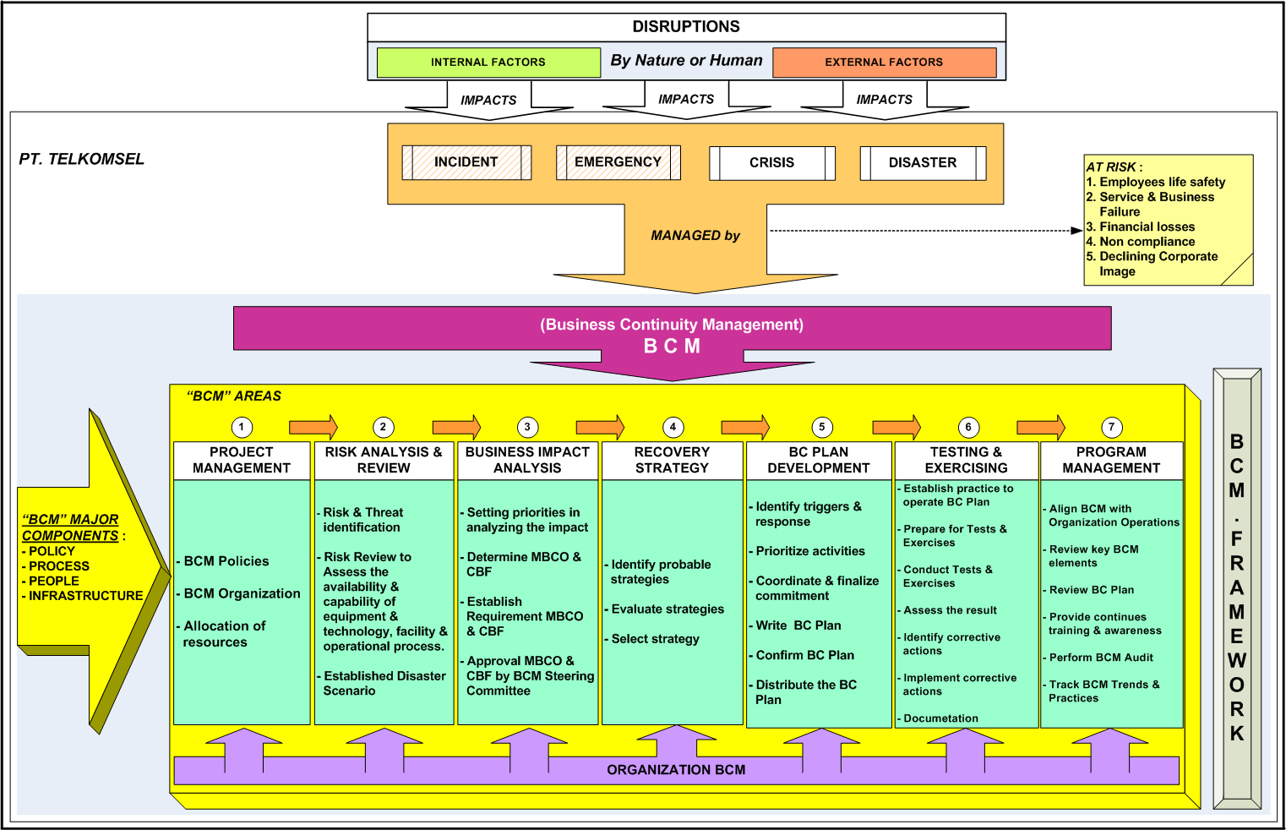
BCM Telkomsel in Summary

Slide 7
Perform Risk Analysis & Review and
Business Impact Analysis (BIA)
Threat
Earthquake
Tsunami
Flood
Fire
Volcano
Riots
Sabotage
Strike, etc.
Office
Long outage of function Head Quarter
Call Center
Infomedia
E-voucher System
Out of function Paradise & MKios
Main Infrastructure :
Core Network
IT Data Center
Transmission / Transport
Power system
Cooling system
TTC
TTC
TTC
Employee & Partnership
Stop support :
  3rd party
  Employee

Slide 8
Current Disaster Recovery System
M-Kiosk
OCS
MSS/ MSC
Outside Java
Inside Java
HLR
Huawei
Siemens
/NSN
IT Application
Jakarta
Mdn
Pkn Baru
S
C
P
Ericsson
NG
(
Plmbng
NG
Plmbng
(plan)
S
C
P
NSN
MSS
NG
(
Jkt
(
Jkt
S
C
P
NSN
MSS
IT DR CENTRE
Surabaya (Sigma)
(
Sby
(
Sby
S
C
P
NT
MSC 2G
Application :
Paradise
Prisma
SPR (ARS)
GTX (Cookies)
I-Charming
IRB (Geneva)
MD AMD (Mediation Device)
Payment Gateway
EAI
(
NT
Mks
(
Mks
S
C
P
MSC 2G
Amdocs
Huawei
NT
DR
DR
DR
MSC 2G
Buaran
TB Simatupang
Solo (plan)

Slide 9
TELKOMSEL BCM ORGANIZATION
Director
Steering Committee
BCM Coordinator
Director of Network
BC PLANNING PROJECT TEAM
CRISIS MANAGEMENT TEAM (CMT)
CRISIS CENTER PUSAT
Infrastructure
Group
Non Infrastructure Group
Prog Management, Test & Exercise Group
CRISIS CENTER REGIONAL
Pokja (Kelompok Kerja)
URC COMMERCE
URC NO
URC IT OPS
URC ASSET & CONS
URC HR
URC PROC
URC COMM
URC LEGAL
URC CSR

Slide 10
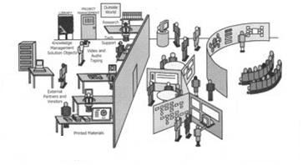
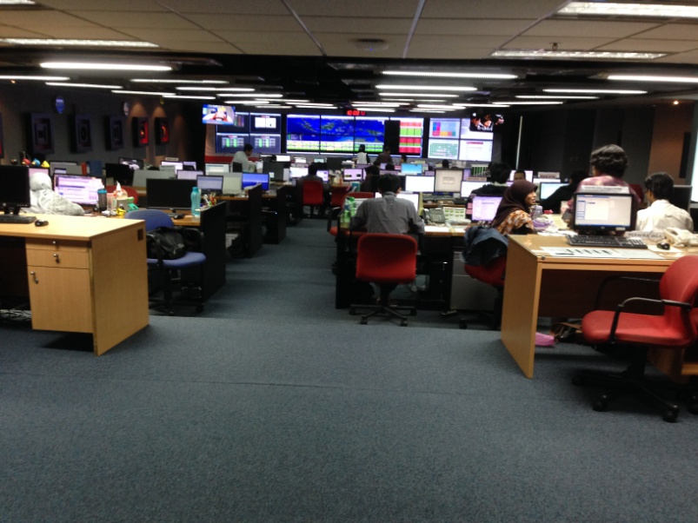
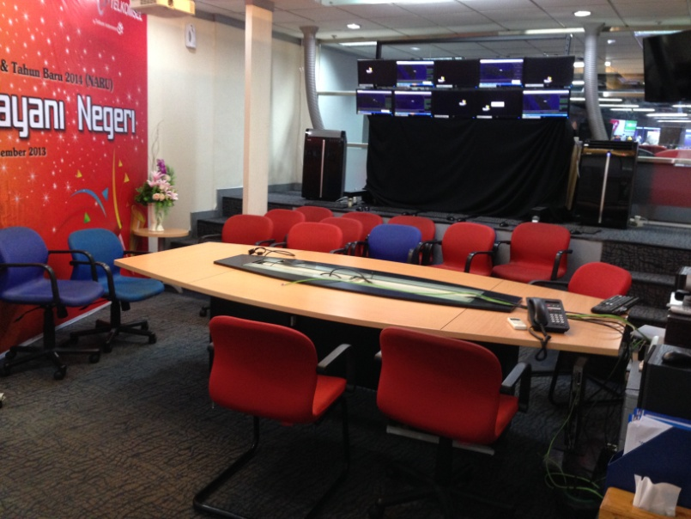
Example :
Crisis Centre Facility
Central location and off-site alternative
Suitable size with good security
Crisis Centre facility is equipped with:
  Special & Functioning Meeting Room
  Special Working Room
  Media Centre (Media Monitoring & Press Release)
  Internet & Computer Devices
  TV monitoring,
  Radio Satellites
  Fax, Printer
  Monitoring Network/ IT
  SIMcard all operator
  Other Supporting Facilities (Handphone Charger, GPS)
7/10/2014

Slide 11

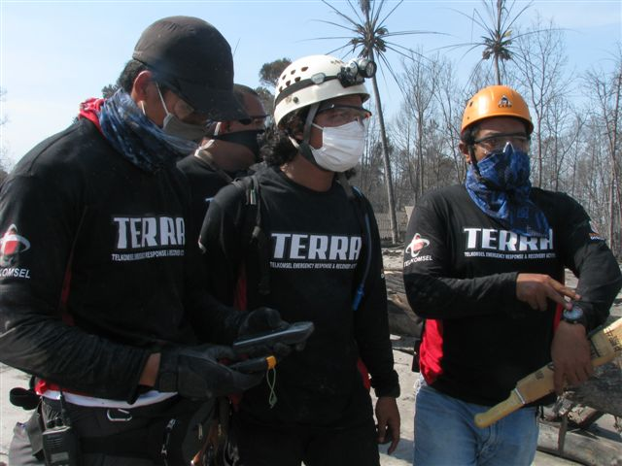

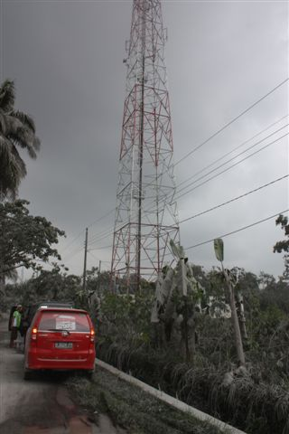
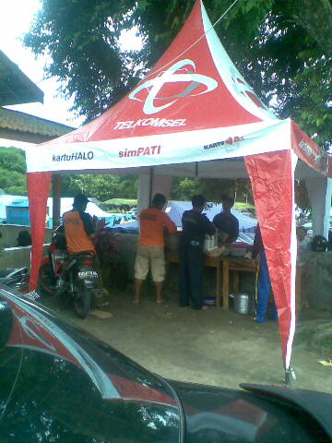
melayani negeri dengan hati dan teknologi
HIGHLIGHT
ABOUT..
A FRONT END TELKOMSEL DISASTER HANDLING PROGRAM
Program Penanggulangan Bencana Alam
TELKOMSEL EMERGENCY RESPONSE AND RECOVERY ACTIVITY
Strategic Initiatives → Manage ECOSYSTEM → Manage ENVIRONMENT

Slide 12
BACKGROUND TERRA
Based on reality and experience when Padang Earthquake happened, Telkomsel internally itself was facing several handicaps to rapidly react especially on its telco damaged infrastructures eventhough all necessary back up equipment for recovery was delivered
On the other sides, Telkomsel as leading mobile Telco Company which cover widest population based users, was highly requested immediate action both side in recovery actions on telco facilities as well as giving assistant and attention to surround society
PADANG EARTHQUAKE HAS TRIGGERED TELKOMSEL TO SET UP COMPREHENSIVE
DISASTER HANDLING MANAGEMENT
Concerns on Disaster Situation :
CLEAR SOP / COMMAND CENTER DAY ONE (AT LAST DAY TWO) TARGET HIGH MOBILITY HANDLING PROPER EXPERTISE & EQUIPMENT SUPPORT
UNPREDICTABLE - ANYWHERE DISFUNCTION LOCAL EMERGENCY SITUATION INFORMATION ON IMPACT / RISK | IMMADIATE EXIST OF POSCO & ADVANCE TEAM ASSESSMENT PROCESS RESCUE PEOPLE – EMPLOYEES RECOVERY TELCO FACILITIES
Then we build nation wide platform of..
With call sign namely..
FRONT END TELKOMSEL DISASTER HANDLING PROGRAM

Slide 13
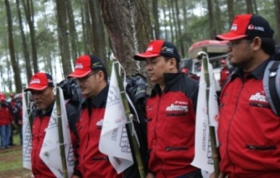
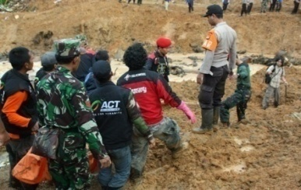
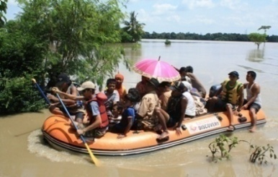
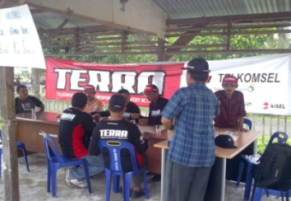
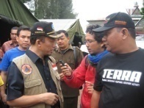

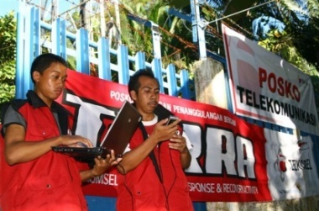
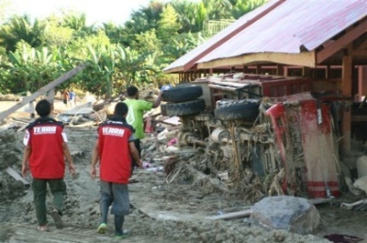
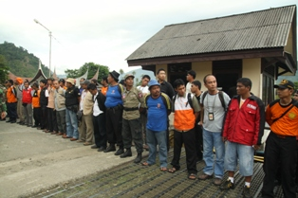
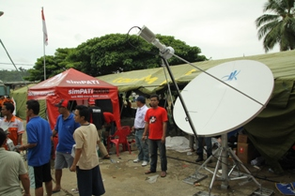
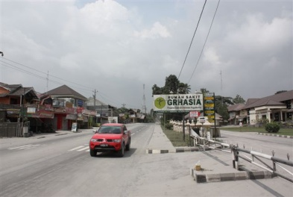
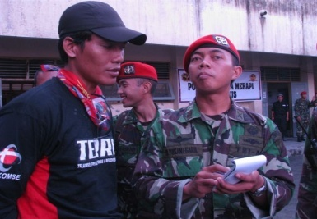
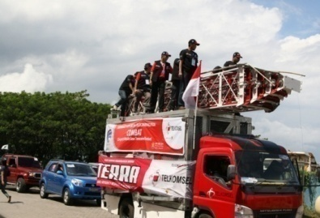
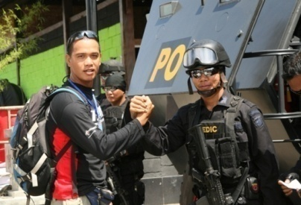

Activation..
..learning process → experiences → improvement → readiness..
ICT
Launch – Cikole Jan’10
Longsor ciwidey
Banjir Bale-endah
Banjir Kerawang
Gempa Aceh
Sinabung Medan
Banjir longsor Wasior
Tsunami Mentawai
Bencana Merapi
ARF DIREX Manado

Slide 14

BUILDING TERRA
TERRA IS LONGTERM PARTNERSHIP PROGRAM > Similar “Concerns and Aims”
Several Qualified Partners have been engaged as Company arm’s length on disaster handling situation
(Non Commercial based agreement- Front End Team Partners- Could be enhanced to support company regular activity)
  SAR activity – rescue people – employees
  Support on Recovery Telco Facilities
  Preliminary Assessment – assessment disaster impact
  Command Centre – “Pusat Komando Lapangan”
LEAD PARTNER
GADAMUSA DISCOVERY
“SEARCH AND RESCUE”
NGO - Collaboration of SAR expert (consist of SAR experts from various SAR institution, extreem community, etc) – Nation Wide Network
Disaster relief – public service, “dapur umum”, medical
Posco Management Support – media centre (pusat informasi dan data lapangan), volunteer management
Recovery program – trauma healing, rebuilding program
SUPPORTING PARTNER
Aksi Cepat Tanggap
NGO in disaster handling specially in relief & recovery
“RELIEF & RECOVERY”

Slide 15
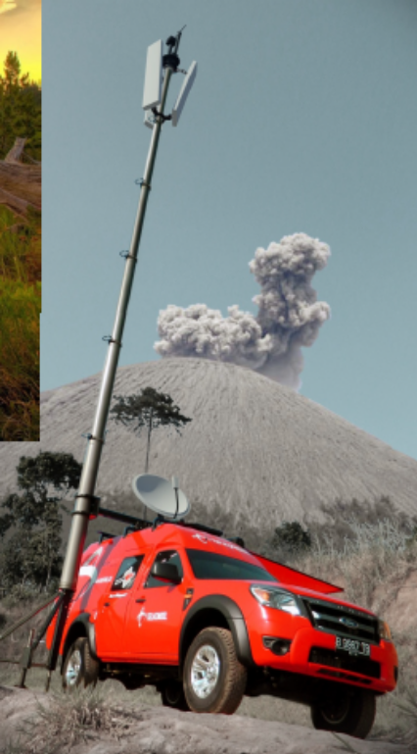
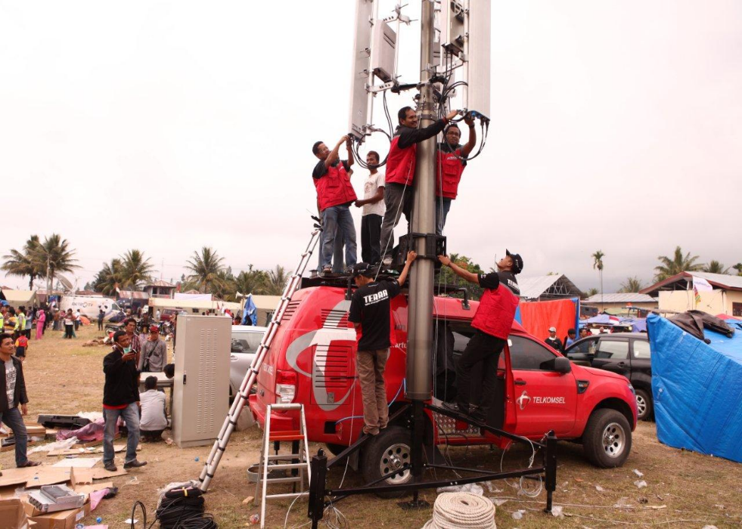
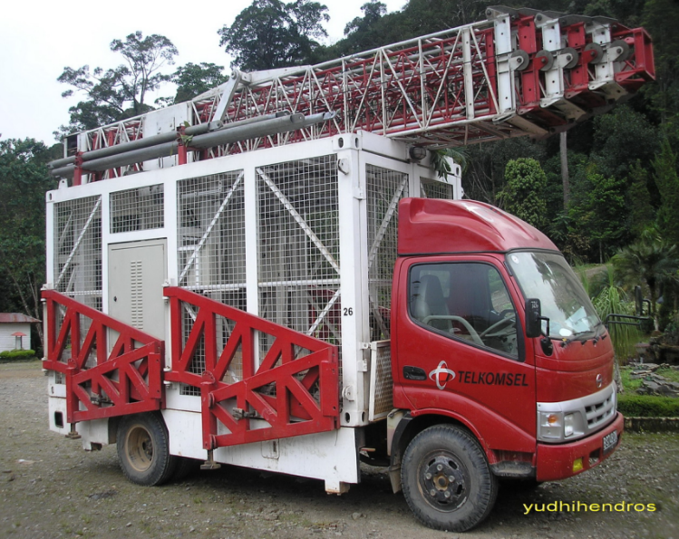
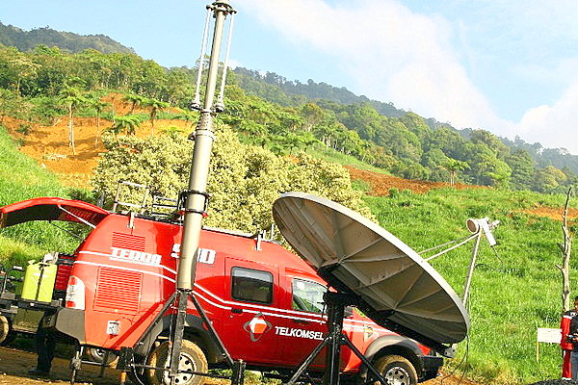
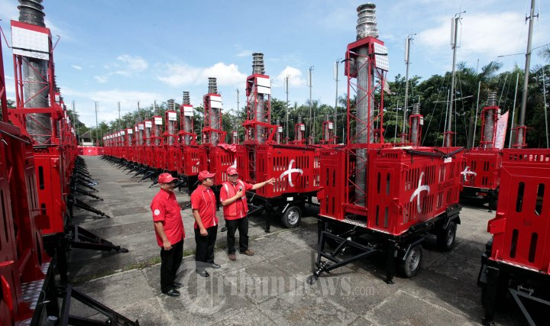
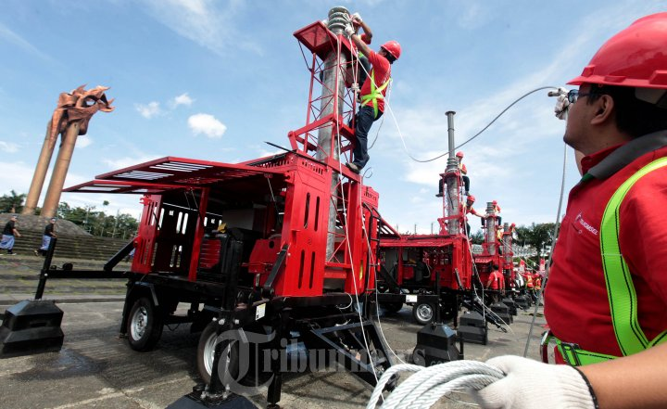
COMBAT (COMPACT MOBILE BASE STATION) TELKOMSEL
COMBAT VELOCE Installation.
Padang Earth Quake
COMBAT CRUISER
COMBAT VELOCE
Installation
COMBAT ARROW
COMBAT VELOCE Installation.
Mount Salak Sukhoi Superjet 100 crash

Slide 16
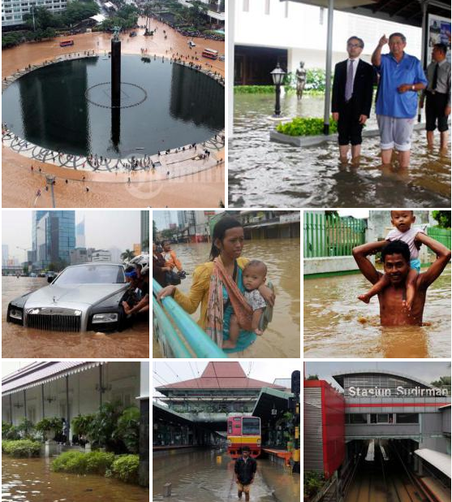
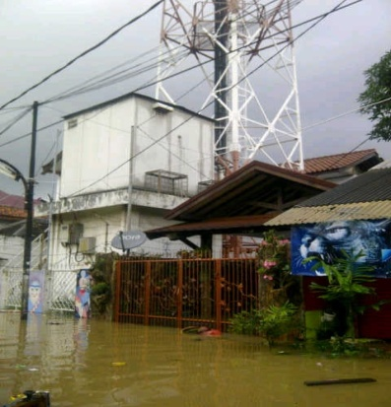
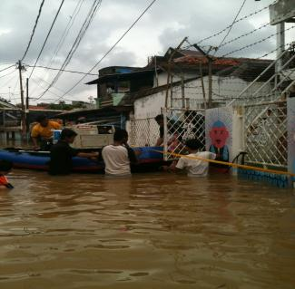
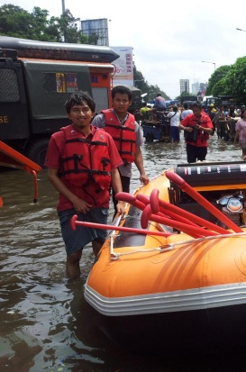
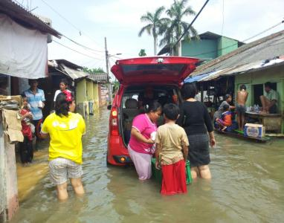
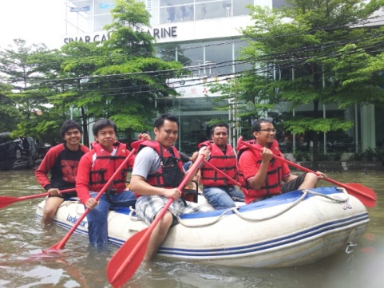
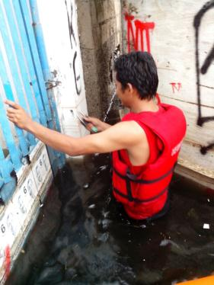
JAKARTA FLOOD DISASTER

Slide 17


