Slide 1
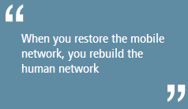
XL Experience
On Disaster Response
Quotes : www.gsma.com
Ari Tjahjanto
GM Service Partner Mgm – Audit
atjahjanto@xl.co.id
+62-818-868-528
PT XL Axiata, Tbk
24 – 25 June 2014

Slide 2
Summary
Recall – Indonesia surrounded by disaster. We need to be well prepared
The Three Principles of XL BCM
Clear framework, proses and learning from the past can help us for faster recovery after disaster
Coordination with Disaster Response Agency to anticipate big impact to people and business
What made us strong to deal with natural disaster. Sample of Gn Kelud disaster
We care to other – Customer is our family
Challenges and opportunities

Slide 3

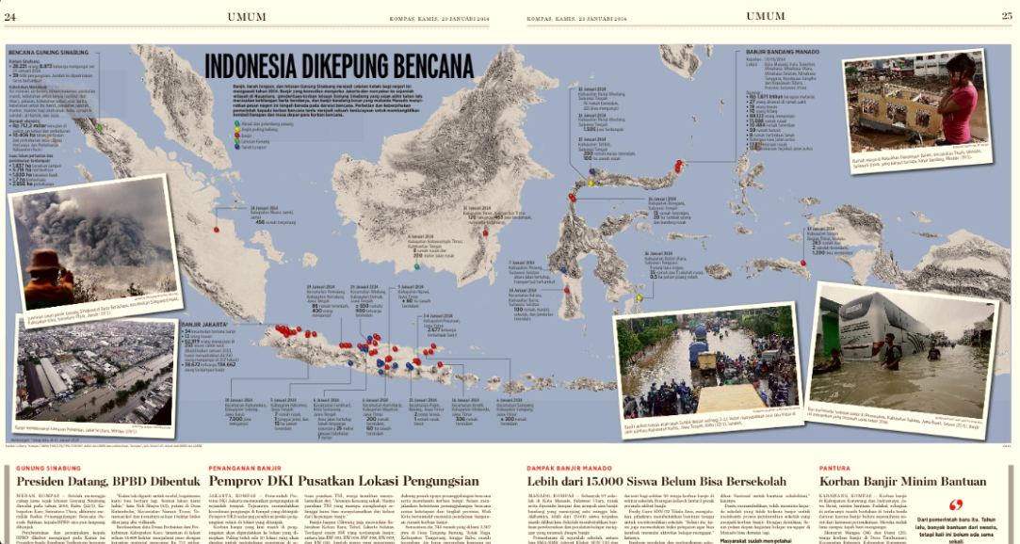
Recall – Indonesia surrounded by disaster
We need to be well prepared
Source: Kompas, Thur, 23rd January 2014

Slide 4
The Three Principles of XL BCM
XL BCM Principles
Ensure Employee Safety
Ensure Continuity of Business & Service
Minimize Company Losses
1
2
3

Slide 5
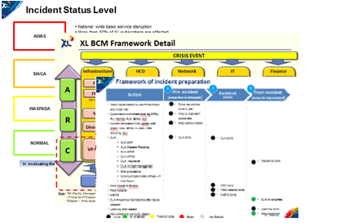
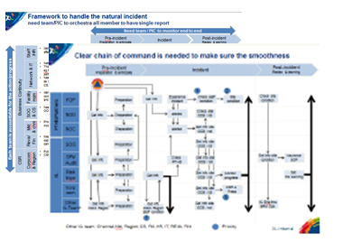
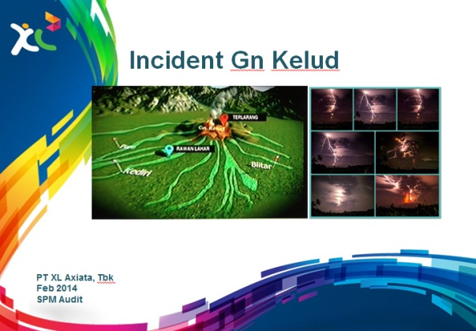
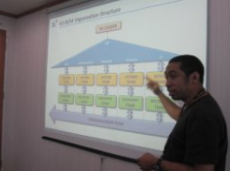
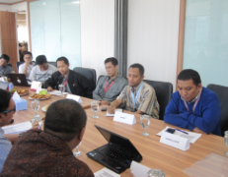
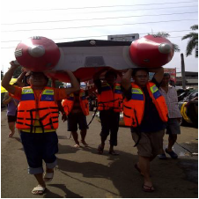
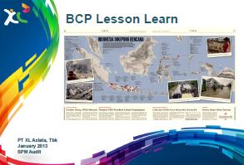
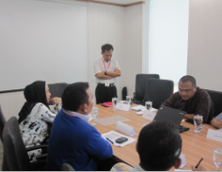

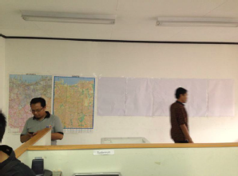
Clear framework, proses and learning from the past can help us for faster recovery after disaster
1
Clear framework
2
Clear responsibility and proses
3
Learning from the past
4
Practicing simulation & preparation

Slide 6



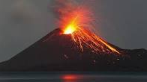
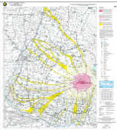
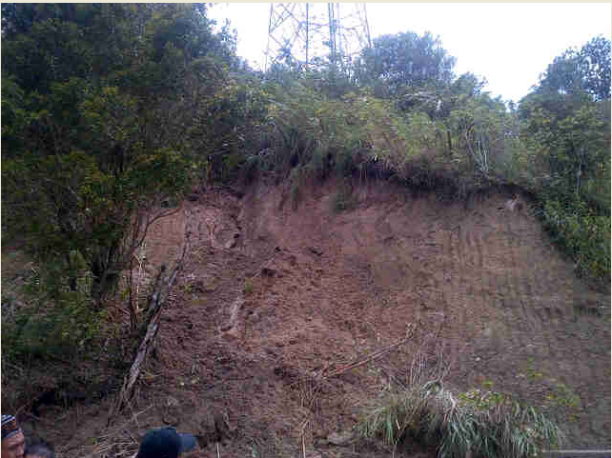
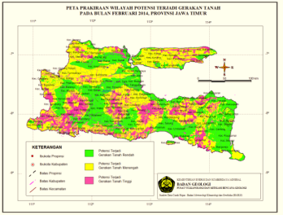
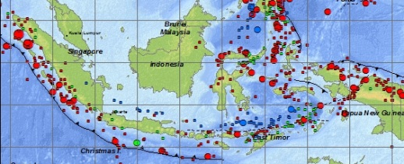
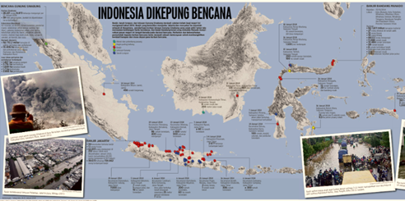
Coordination with Disaster Response Agency to anticipate big impact to people and business
Incident type
Agency need to be coordinated
Information needed
1
Volcano Eruption
Volcano status (Normal, Waspada, Siaga, Awas)
Map and radius dangerous area
Map of lava and ashes travel
Posko area
PVMBG
BNPB
BPBD
2
Land slide
Map of land movement
Posko area
PVMBG
BPBD
3
Earthquake & tsunami
Earthquake information & dissemination
Posko area
BNPB
BPBD
4
Flood & typhoon
Rainfall information(normally Q4 & Q1)
Water gate info (Normal, Siaga 3 – 1)
Maps flood impacted
Wind/typhoon information and dissemination
Posko area
BPBD
BPBD : Badan National Penanggulangan Bencana http://www.bnpb.go.id
PVMBG : Pusat Vulkanologi & Mitigasi Bencana Geologi http://www.vsi.esdm.go.id

Slide 7
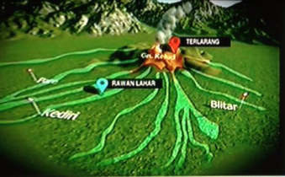
What made us strong to deal with natural disaster
Sample case on Gn Kelud eruption
Preparation from prior incident
Support from Management
Quick Action & Response
Good Cooperation & Coordination
Support from Partners
Lesson learn from Sinabung eruption shared by West Region
Get info from external parties, such as PVMBG, BMKG, BPBD, etc.
Network design to follow international standard
Regularly report update status of our network by PT HS
Dealer support to XL CSR program
Direct lead by CSMO as BC Leader
Support by VP East Region & GM FMS East Region
Support by HQ under coordination from SPM, Corp Com, FM & HCD
Close cooperation & coordination through out related unit:
  SPM with PT HS & XL Engineer
  FM & HCSS HQ with FM Region
  Corpcom HQ with Corpcom Region, Legal, Regulatory, Customer Service
  Etc
Open WAR Room at Grha XL & direct lead by BC Leader
Review & assess the main needs from region point of view
Prepare communication to customer, government & media

Slide 8
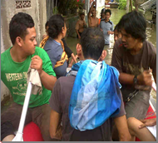
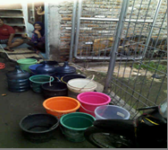
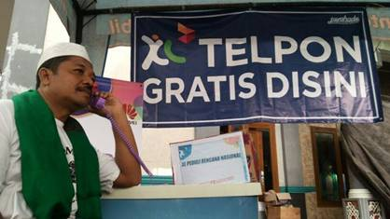
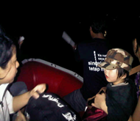
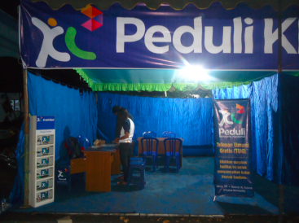
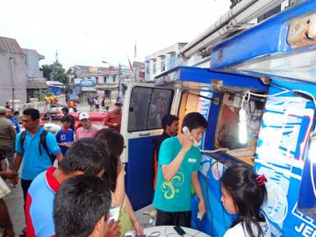
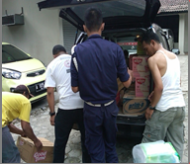
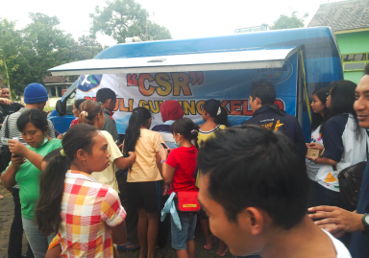
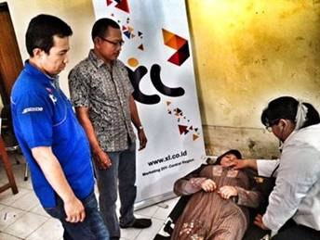
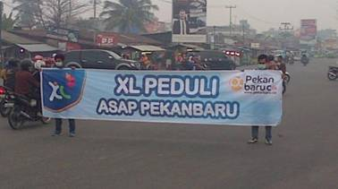
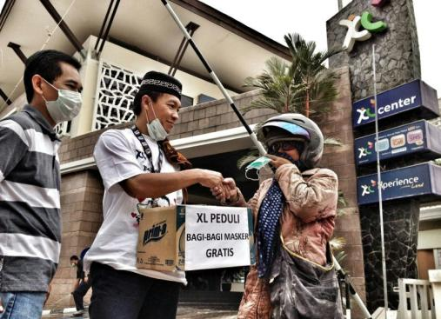
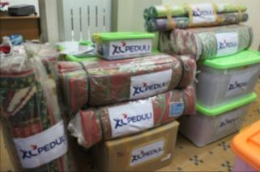
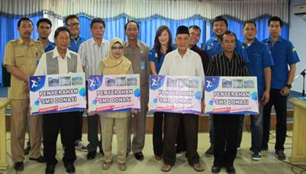
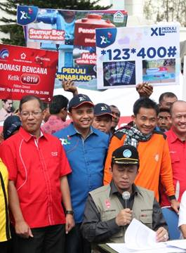

We care to other – Customer is our family
Public Facility
Injury and resident evacuation
Free electricity using mobile genset for HP charger and water jet pump
Posko/shelter
Toilet
Free call at Posko
Donation
Food, medicine, blanket, masker, posko/shelter, diaper, pampers, cloth, clean water, etc
Free SIM Card and voucher
Free internet connection
Insurance for victims
SMS Donation collaboration with PKPU/MTXL and ACT (Aksi Cepat Tanggap)
Device for “Relawan”
Helpdesk
08194000000 Help Desk number for Pemda tk1 Sulut Flood Q1 ‘14

Slide 9
Challenges and opportunities
Challenges
1
Disaster info
Need MNO to be proactive to get disaster info from gov/agencies or news
3
Refugees need
Need to be coordinated well by gov/agencies about the need for refugee, so that it can be more targeted and useful
2
Posko info
Need to be coordinated well by gov/agencies about area needed, so that it will be more targeted
4
Power availability
Need info from PLN about the power outage during disaster to manage mobile genset for priority area
Opportunities
1
Closer to customer
Customer is part of the family
Customer stickiness to MNO
3
Collaboration with Disaster Response Agency
Using MNO for information / alert dissemination to people
Participate in practicing to anticipate future disaster
2
Upon readiness, can get faster to business than others
Minimizing lost
Better image, as reliable MNO
Can get more market

