Slide 1

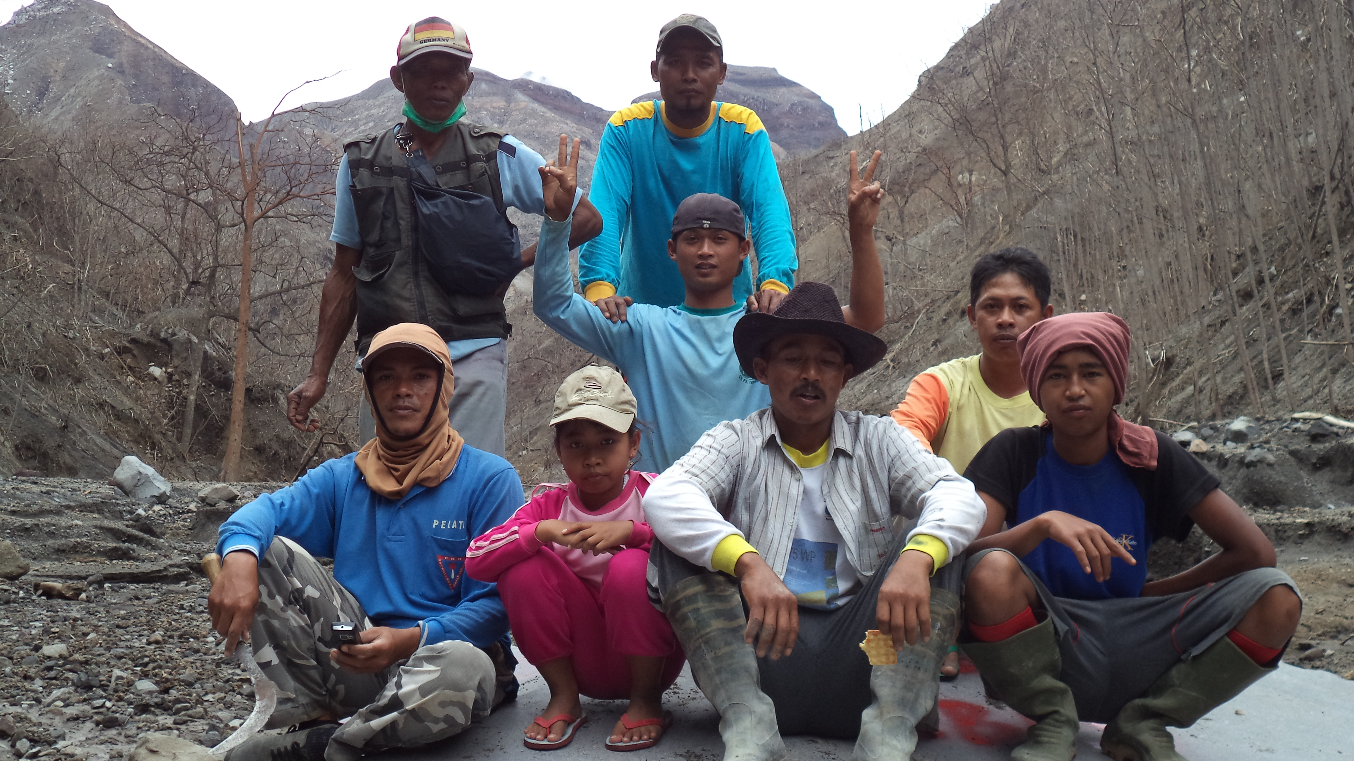
Lessons and approaches to disaster in Indonesia
- a community perspective
Agung Riyadi, Executive Director
Zulkifli, Head of Emergency Response Team &
Idris F. Sulaiman PhD, Advisor
Komplek Kejaksaan Agung Blok F-20
Jalan Raya Ragunan, Pasar Minggu
Jakarta Selatan 12520 Email: idrisfsulaiman@gmail.com

Slide 2
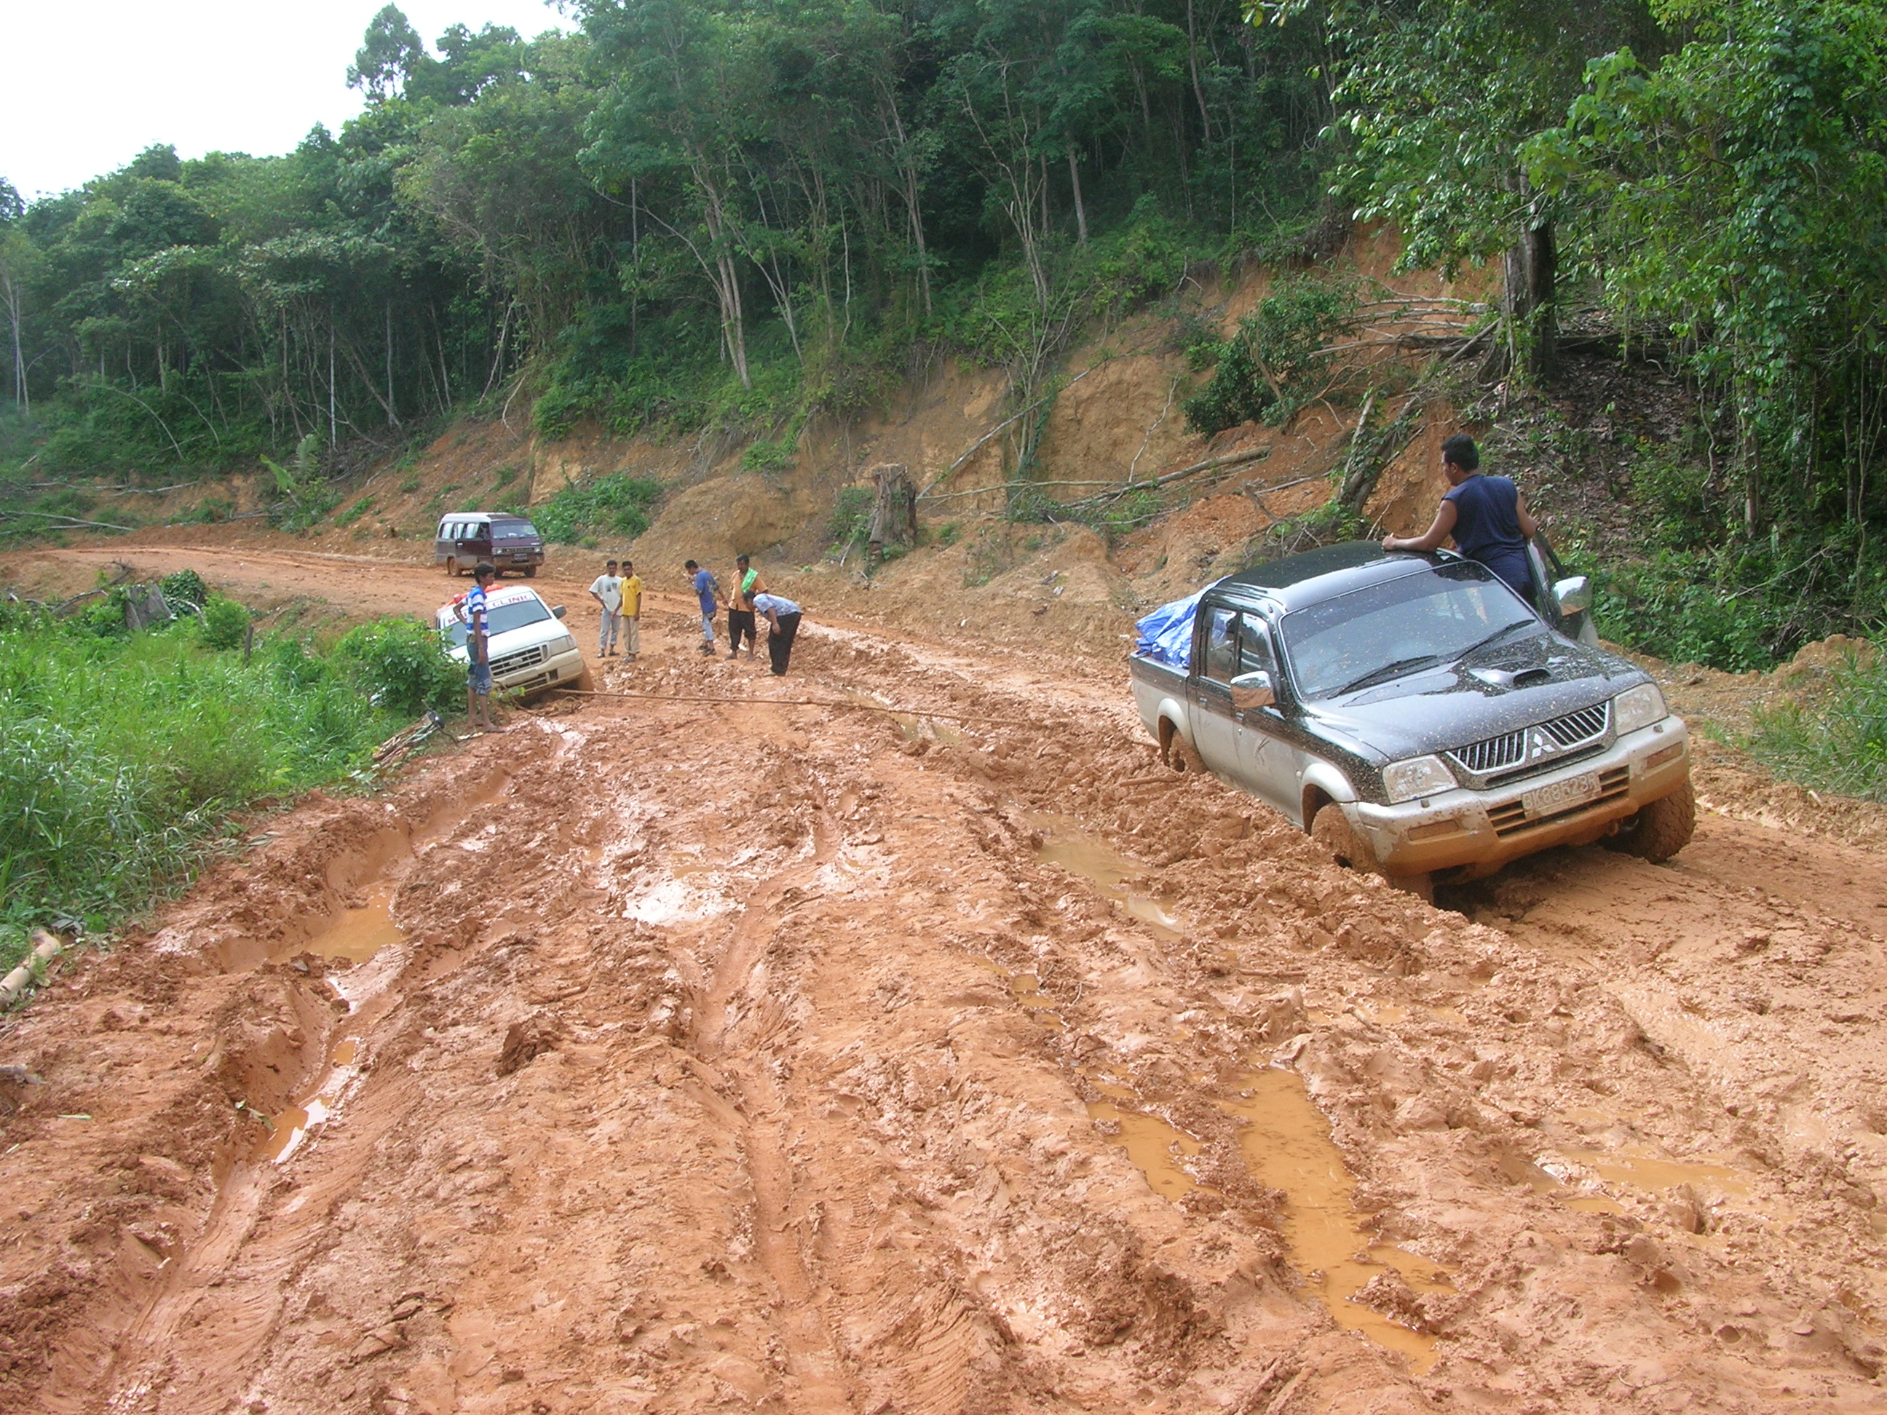
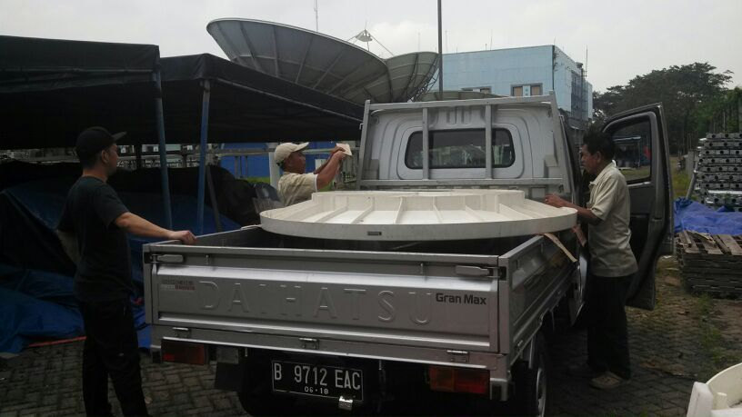
Contents
Lessons from 3 DRR
Activity Types:
1. ‘Tsunami’ Areas
2. ‘Volcanic’ Areas
3. ‘Flooded’ and Other*
Disaster Affected Areas
“Old C-tech” rules in the East
Final Remarks
AP’s ‘old’ challenges addressed by mobile & complementary ICTs with Local ICT DDR Groups
* Flooding, hurricanes, erosion,
forest / land fires, social conflict and others.
Notes:
Flooding, hurricanes, erosion, forest / land fires, extreme weather, social conflict.

Slide 3
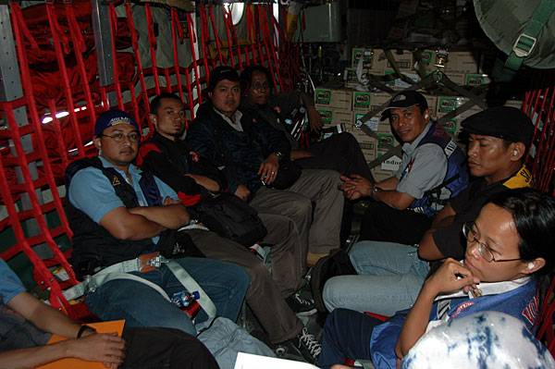

Our origins
AIR-PUTIH is a not-for-profit organisation primarily focused connecting the un-connected
and empowerment using ICTs.
- Started in 29 Dec. 2004 with activities on ICT disaster response work around Aceh Tsunami with the support from ISP Association-APJII, Indonesia IT Federation-FTII and many others
- Core group of professionals and volunteers from universities, IT/Linux groups and international sources
Vision: Empowering local people, gov’t agencies and NGOs to apply ICTs for disaster management, risk reduction and national resilience
Notes:
Complementary technologies to mobiles: Infrastructure

Slide 4
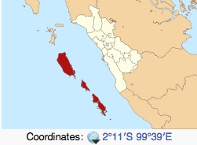
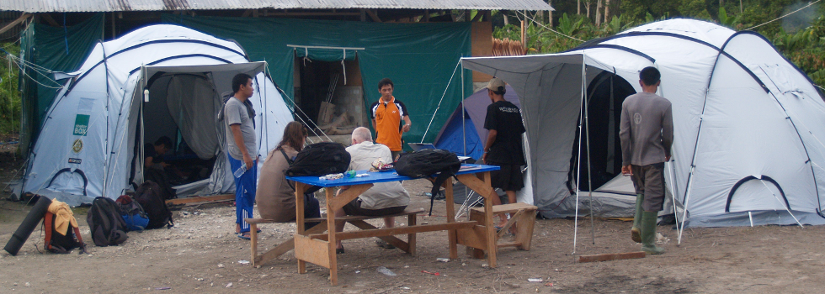
1. ‘Tsunami’ Areas
Example: AP was a ‘first-responder’ on two occasions (2007 and 2011) in Mentawai Islands - a chain of about seventy islands and islets off the western coast of Sumatra
First Response:
- Connecting (Vsat) the previously
un-connected: most of Mentawai had no BTS, some on capital-Tua Pejat on island of Sipura & Sikakap (N Pagai)
- Earthquake and tsunami activity has been high since 2004 Indian Ocean earthquake. On Oct 25, 2010, an earthquake in southern Sumatra led to a deadly tsunami that devastated villages in South and North Pagai
Key Lesson: Providing FR & training for local groups requires more resources in remote non-Java areas
VSAT installation team camps
- in North Pagai Island, 2007
Notes:
NON-JAVA LOCATIONS – CLASSIC EXAMPLE/ILLUSTRATION OF DIFFICULTIES
Area Total 6,011.35 km² (2,321.00 sq mi)
Population (2010)Total 76,421
Density 13/km² (33/sq mi)
10 Districts – many islands are in remote locations

Slide 5

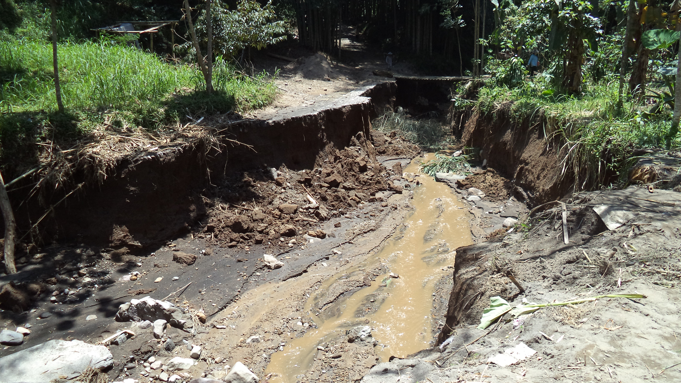
2. ‘Volcanic’ Disaster Prone Areas
First Response: On Java sites such as Mt. Merapi, AP may be a first responder but deals with many more experienced local NGOs and more local journalists who are “on the ground” than in non-Java locations.
Like wise in Mt. Ijen (2012), AP responded SMS-gateway deployment in local gov’t (sub-district/camat) office
Key Lesson: SMS can complement local drums & “word of mouth” chains
SMS gateway – helping to distribute information about damaged roads/bridges
BNPD – Mt. Lokon, near Gamalama, North Sulawesi has requested AP to assist with Mapping of Vulnerable Areas and preparations for Command Post (Posko)

Slide 6
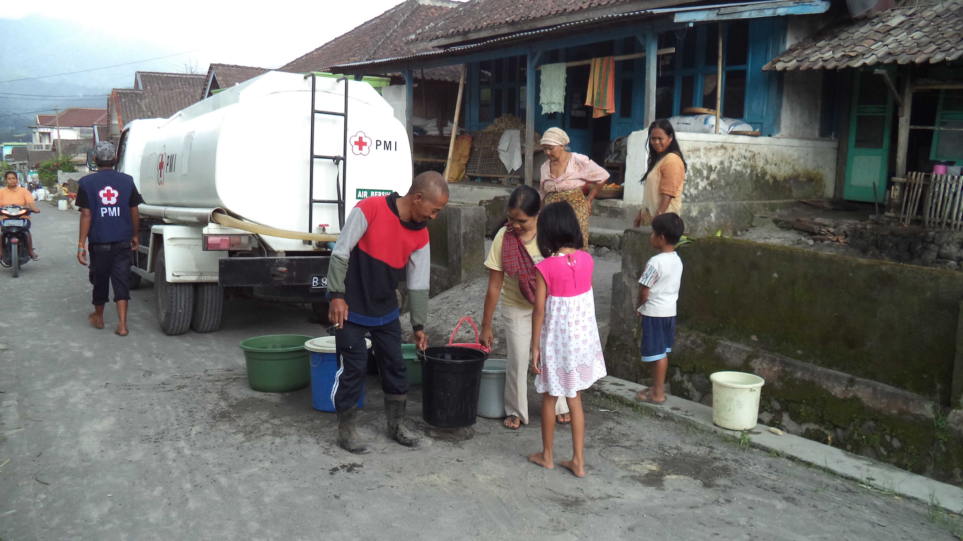
3. ‘Flooding & other*’ Areas
First Response: AP tended to play less prominent role, the larger/well-resourced cities, e.g. in Jakarta some people who have “fallen through the cracks” used AP’s twitter & SMS to report location to get evacuation (Jakarta, 2013)
In Wasior, Papua (Non-Java), AP where responded – entire villages damaged, needed to be relocate (more than 10,000 people relocated to another island ‘next door’)
Key Lesson: Better preparation required and greater collaboration with other NGO and local gov’t
MediaCentre functions differently to Op Control Centres for Regions (PUSDALOP)
Notes:
Pusat Pengendali Operasi Daerah

Slide 7
“Old C-Tech” Rules in the ‘wild’ East
- Profile of E-Indonesia’s typical gov’t agency
(BPBD Larantuka – regional disaster response) in
one of the “most disaster prone” region, East Flores
Key focus: Assessment of preparedness particularly in ICT
Est. in 2011 – a relatively many ‘young’ gov’t agency (BPBD - just established in last 2-4 years) like many in Eastern Indo.
Already working with other NGOs and gov’t agencies:
Friends of the Earth (Wahana), Oxfam/YPPS, Delsos-Cardinal’s Catholic Relief, Meteorology Function, Tagana NGO and
Local Disaster Volunteer Forum (PRB) Larantuka
No clear consultation process for ‘disaster indicative’ maps produced but no vulnerability assessment
Method of ommunications (no website):
- to citizens and others: radio, leaflet, SMS
- to other gov. agencies: fixed lines, faxes,
email, direct call and SMS-gateway
Notes:
Since its founding in 2005, has held AirPutih emergency response in some parts of Indonesia. Major disasters and require acceleration information that has been implemented in the 2005-2012 timeframe, among others, Emergency Response Team ERT in Aceh2004, Nias2005 Earthquake, Earthquake Bengkulu2007, and the latest areas are Sinabung 2013 and Kelud 2014

Slide 8
Final Remarks
Many roles of Complementary ‘older’ ICTs to mobiles – many play critical roles in post-disaster communication and needs to be incorporate in DRR planning particularly in the disaster prone regions
Local NGOs & gov’t still use many older tech and largely have less connectivity. Mobile tech must incorporate these in empowering them (pre, during and post disaster) – “walking on two legs”
AIRPUTIH incorporates C-tech in planning awareness & capabilities building based on
our DRR plan and program
Notes:
* Ridwan Djamaluddin (BPPT): GoI info sources sometimes is not as good as unofficial sources
BTS Merdeka, riset OpenBTS
EWS Gempa, aplikasi desktop peringatan dini gempa
Hosting gratis, layanan hosting gratis bagi lembaga/organisasi non-profit
Aplikasi Keterbukaan Info Public, aplikasi yang menjembatani pertukaran informasi publik
Interactive Voice Respon (IVR), teknologi pendukung citizen journalism
Aplikasi KIP | AirPutih www.airputih.or.id/layanan/aplikasi-kip
Aplikasi Keterbukaan Informasi Publik. Unduh Aplikasi Keterbukaan Informasi Publik
2. Plugin Aplikasi KIP untuk CMS WordPress.

Slide 9
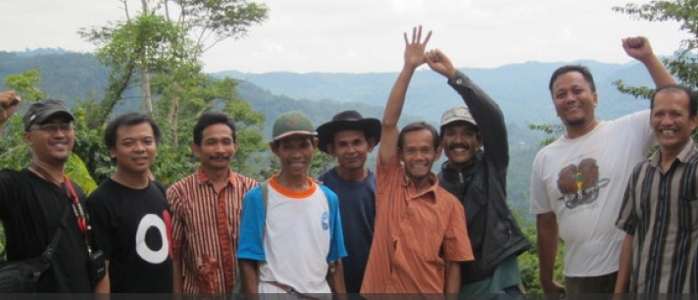
Terima Kasih
Thank You
Team AirPutih
http://www.airputih.or.id
http://www.mediacenter.or.id/
http://www.makeitfossible.web.id/
https://www.facebook.com/airputih.or.id
@AirPutihOrId

