Slide 1


Policy Implications
GSMA Mobile for Development
June 24, 2013
Jakarta, Indonesia

Slide 2
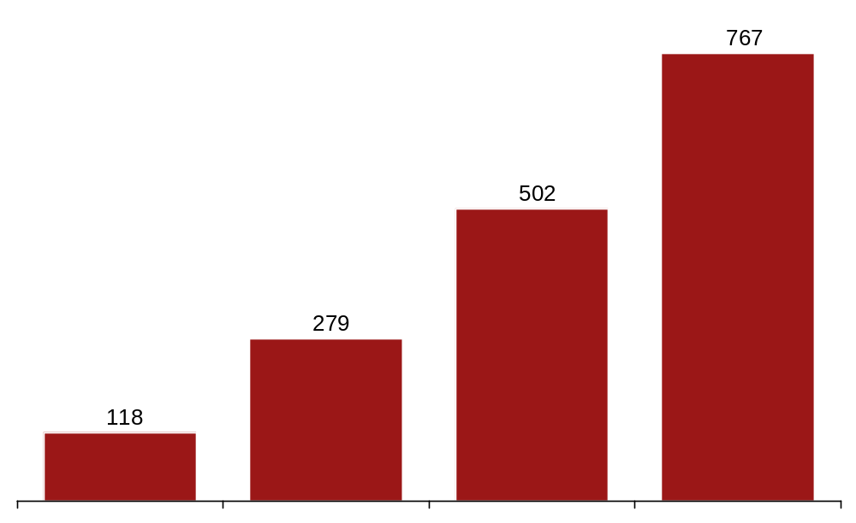
Frequency of disasters has grown significantly since the 1970s due to reporting enhancements and increased vulnerability
Disaster Growth Drivers
Avg # of Disasters per Decade
Drivers
Increased Observation & Reporting
+551%
Urbanization
Climate Change
Population Growth
Globalization
1970s
1980s
1990s
2000s
Source:; International Disaster Database (EM-DAT); A.T. Kearney; World Economic Forum

Slide 3
There are a number of critical solutions for responding and managing disastrous events
Critical Solutions for Disasters
Stage 1 - Mitigate
Stage 2 - Prepare
Stage 3 - Respond
Stage 4 - Recover
Long-term, large-scale projects to reduce disaster likelihood & impact
Equipment and procedures for use when a disaster occur
Actions immediately after event occurs
Recovery efforts to bring the affected area back to normalcy as quickly as possible
Disastrous
Event
Warning
Provided
Crisis
Subsides
Critical Solutions
Risk Transfer &
Pooling
Network
Resiliency
Big Data Solutions
Microfinance
Regulatory
Procedures
Early Warning
Systems
Commercial
Solutions
Sustainable
Rebuilding
Retrofitting
Geo Mapping
Source: A.T. Kearney

Slide 4















Multi-lateral bodies are needed to coordinate and deliver through the entirety of the disaster timeline
Critical Solutions for Disasters
Stage 1 - Mitigate
Stage 2 - Prepare
Stage 3 - Respond
Stage 4 - Recover
Public Sector
Private Sector
NGO / Foundations
Academia
Focus Today
Source: A.T. Kearney

Slide 5



Further efforts are required to build-out scalable and agile solutions for network resilience, big data, and commercial
Disaster Management & Response Solutions
Critical Solutions
Case Study
1
Network Resiliency Solutions
Project Tono: A SDN-based disaster-tolerant network system in Tono City, Japan
2
Big Data Solutions
CrisisNET: open-source platform that speedily aggregates social data in disaster situations
3
Commercial Solutions
…
Microsoft HelpBridge: mobile app to help or get help when a disaster happens
Source: A.T. Kearney

Slide 6
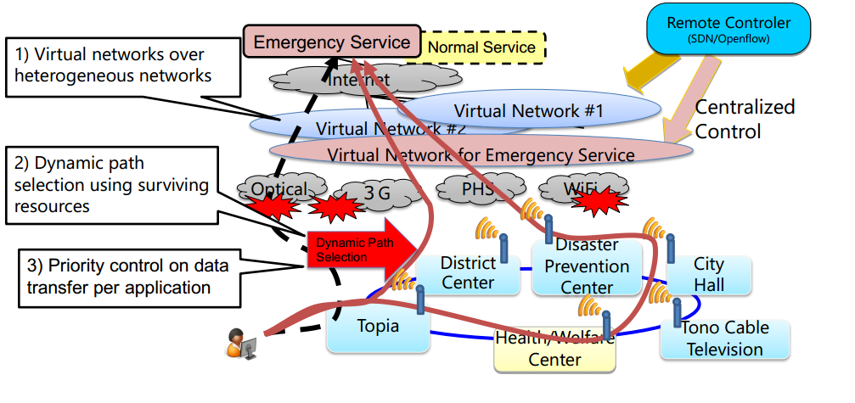
Project Tono is a joint project b/w NEC, NICT, & Tono City aimed at deploying a disaster-tolerant networking mechanism
1
Network Resiliency Solutions – Project Tono
Source: Eiji Kawai, Network Testbed R&D Lab, NICT – June 2014

Slide 7
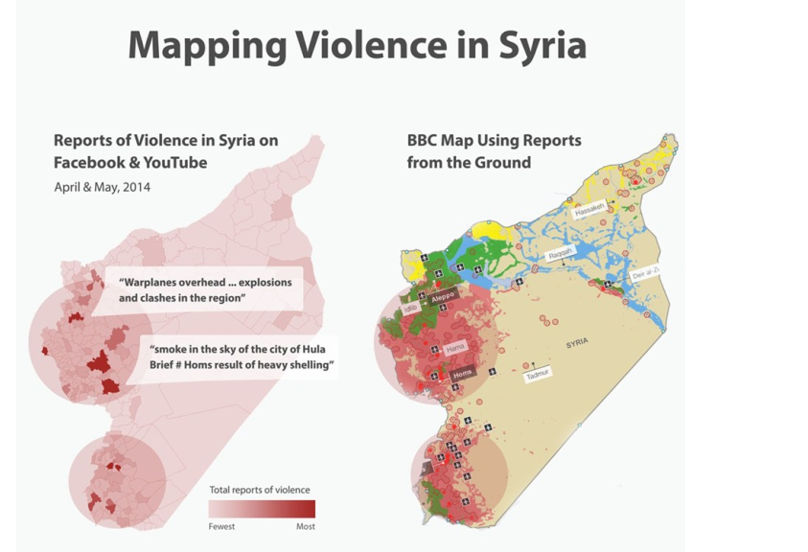


Not-for-profit software company Ushahidi has launched CrisisNET – “the fire hose of global crisis data”
2
Big Data Solutions – Ushahidi & CrisisNET
About Ushahidi
About CrisisNET
Aimed at reducing the amount of time that it takes journalists, analysts, and humanitarian organisations to get their hands on well-structured, crowdsourced data in the midst of conflict and disaster
Ushahidi helps people wield information to make a serious impact through open source technologies, cross-sector partnerships, and ground-breaking ventures.
How it works
Capture Data
Sanitize
Geo-tag
Create single stream of real-time data, by pulling from social media and non-profit websites
Translate all content into English and scan keywords and phrases
Process to identify location information within the metadata
Example output
CrisisNET vs. BBC on-the-ground map
Source: Ushahidi

Slide 8

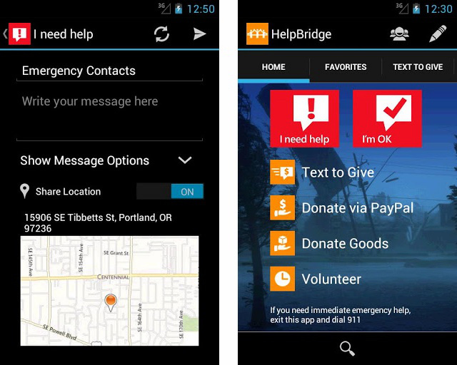
Microsoft HelpBridge is an example of a strong commercial solution, but more efforts are needed in this dimension
3
Commercial Solutions – Microsoft HelpBridge
Screenshots
Get Help: lets you notify your friends and family by SMS, email or a message to your Facebook wall that you are okay when a disaster happens. Those messages can include your location.
Give Help: partnered with numerous organizations to make it easier to donate and volunteer when a disaster strikes.
More commercial solutions – particularly in developing countries – are required
Source: Microsoft

Slide 9
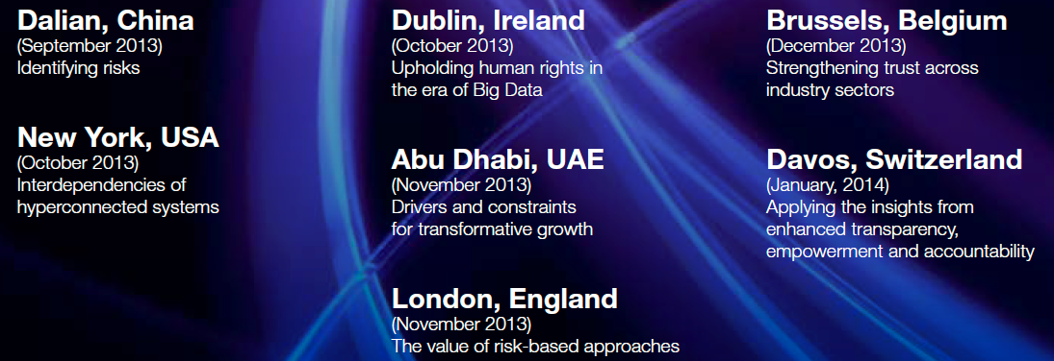
People involved, key meetings, key outputs … key conclusions. Take it out of press release.
Achievements from Rethinking Personal Data Initiative
Key Meetings
People Involved
Robert Quinn, Chief Privacy Officer, AT&T
Ray Baxter, SVP, Kaiser Permanente
Anoop Gupta, Distinguished Scientist, Microsoft
Augie Fabela II, Chairman, VimpelCom
Ellen Richey, Chief Legal Officer, Visa
Outputs
Transparency is a key component of trust, but is double-edged: too little transparency is detrimental to building trust for individuals; but overwhelming people with unworkable volumes of information is also ineffective. Meaningful transparency requires providing individuals with clear information and choices.
Accountability, a key tenet of personal data usage since the founding of the Fair Information Practice Principles in 1979, needs to be more clearly defined in order to drive more effective governance. Approaches to accountability need to more clearly articulate responsibilities for actors throughout the data value chain.
Individuals figure prominently in the report, strongly indicating that empowering individuals by giving them clear choices over the use of their data is at the core of building trust.
Value creation needs to be as clear a proposition for the individuals that provide the data, as it is for the organizations that collect it.
Source: A.T. Kearney; World Economic Forum

Slide 10
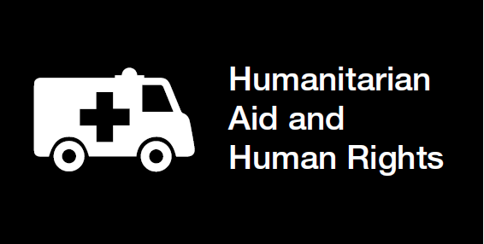
Implications from last WEF report
Key implications for Humanitarian Aid
Transparency
Articulation of humanitarian-specific context elements (e.g. crisis levels, immediate life-threatening situations) and the impact that these have on expressed preferences and controls for particular data types and uses
Construction of a framework for balancing the risk factors that individuals can be exposed to through personal data use with the risks faced during a humanitarian crisis
Mapping of dynamic permissions levels so that data access levels correspond with the stages of a humanitarian intervention (e.g. access levels are highest in the immediate aftermath of a disaster, but decline as the situation becomes less fluid)
Accountability
Creating frameworks for accountability that rebalance risk and responsibility for disaster-specific contexts
Establishment of codes of conduct that can be adopted by major multinational players (e.g. UNHCR, IFRC) as well as institutional capabilities to support those codes that are structured to flexibly incorporate smaller human rights responders
Risk-management procedures that are adaptive to humanitarianspecific risks, and include post-crisis closures to ensure that data leveraged for humanitarian purposes is not inappropriately transferred or used post-crisis
Empowerment
Clear communication of data use and benefits during crisis situations, as well as post-crisis closure tools and accountability mechanisms

Slide 11
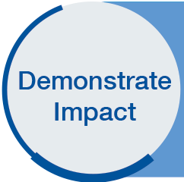
Moving from Rethinking Personal Data to Data Driven Development
Goals of Data-Driven Development Initiative
The overall objective of the Data-Driven Development initiative is to leverage the theories and insights from Rethinking Personal Data towards real-world outcomes
1
Establish a global multi-stakeholder alliance aimed at improving the coordination, governance, and trust of data-driven organizations and initiatives
Improve
Coordination
2
Advance the need for pragmatic, risk-based approaches which strengthen trust in the use of personal data within international development initiatives
Strengthen
Accountability
3
Articulate the emerging issues for strategic policies that strengthen, support, and establish human-centered and sustainable data ecosystems
Identify
Emerging
Issues
Source: A.T. Kearney; World Economic Forum

