Slide 1
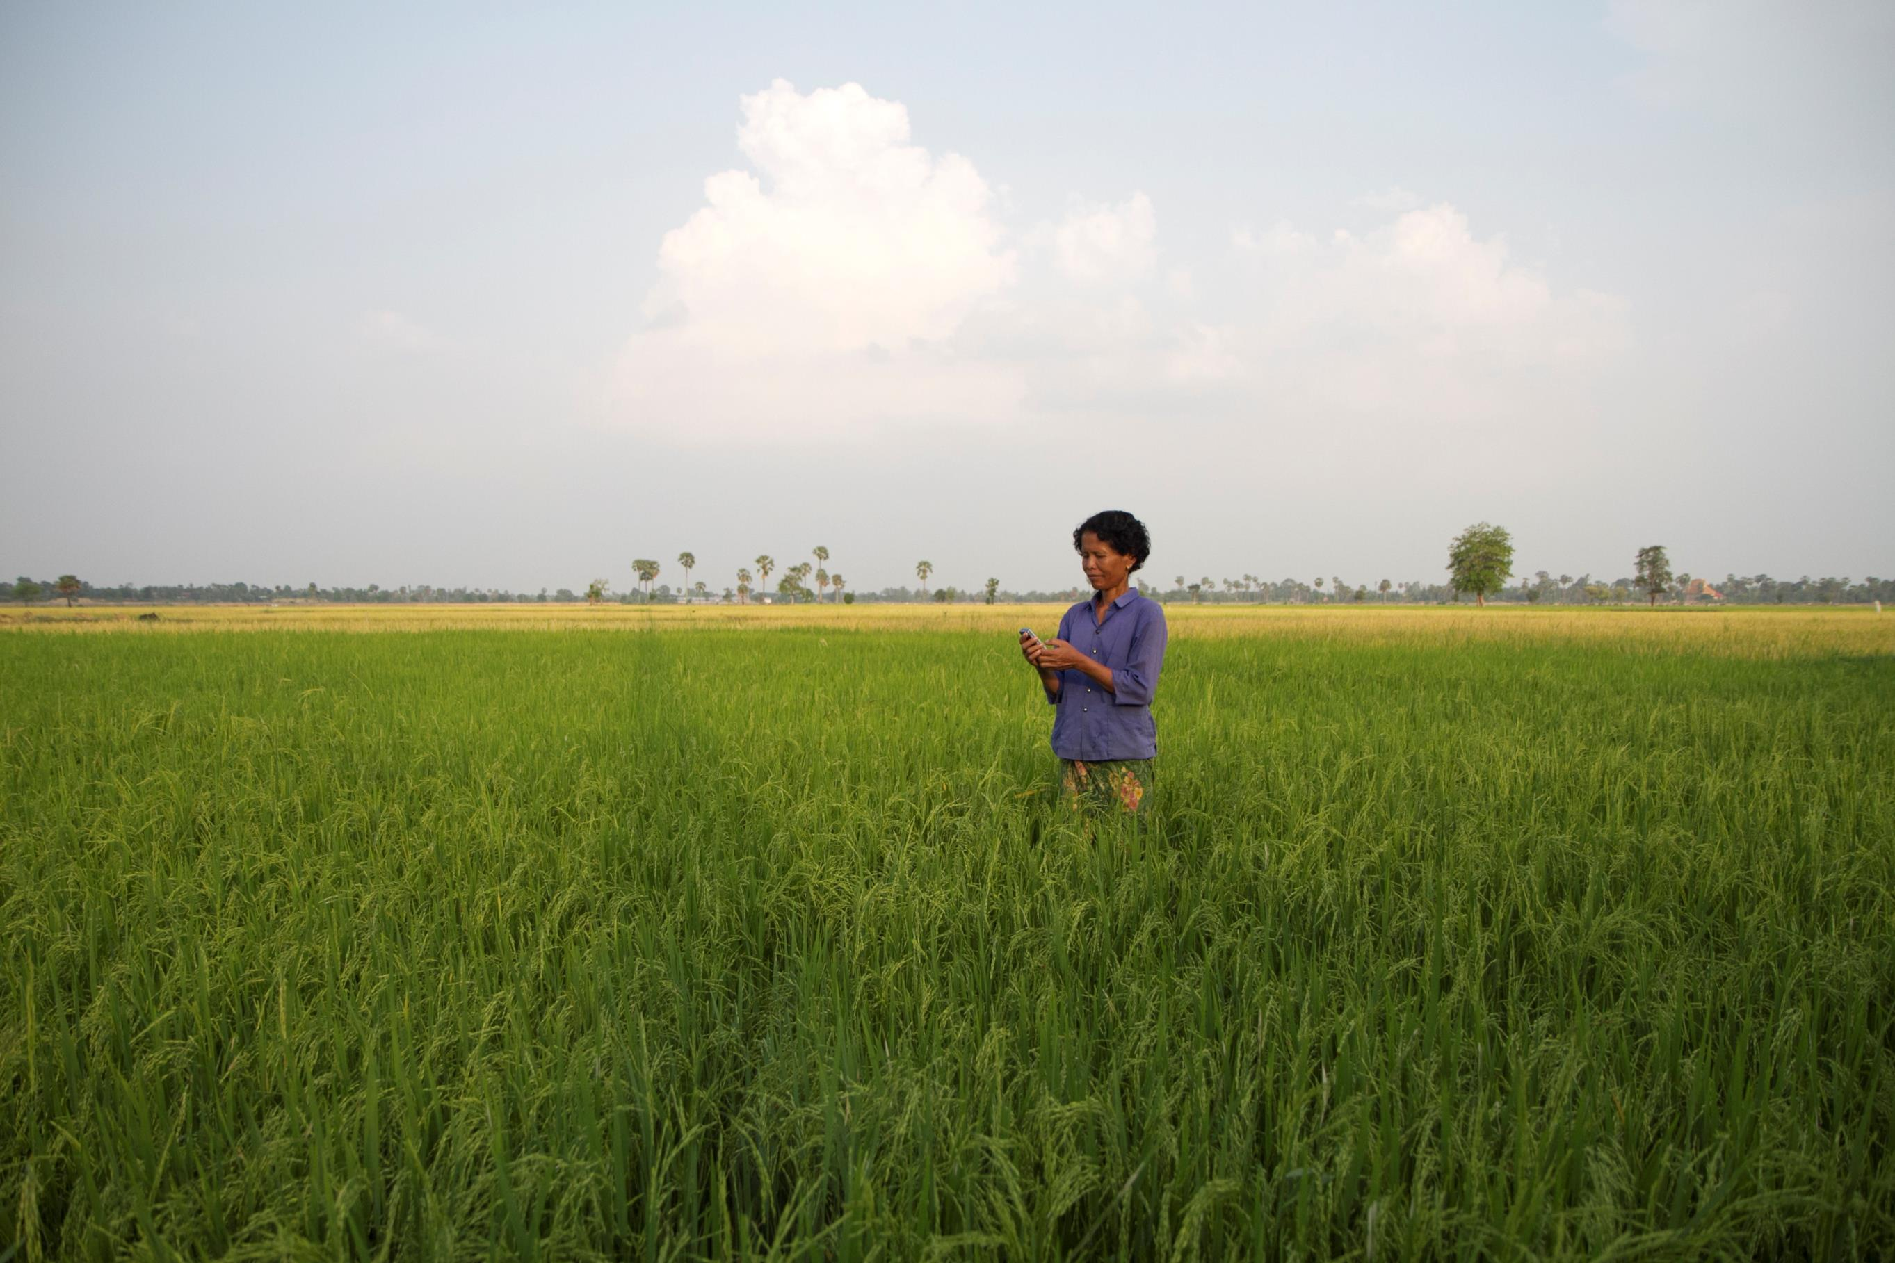

Spotlight on Indonesia
South-East Asia Regional Event
June 24th and 25th, 2014

Slide 2
Agenda
Day 1:
Combined event between Government & Regulatory Affairs, Disaster Response & Mobile Enabled Community Services
Networking dinner
Day 2:
Disaster Response Working Group & UNOCHA event
Mobile Enabled Community Services Working Group
Reminders:
Will you be joining the Disaster Response field trip?
Will you be joining us for networking and dinner?

Slide 3

Spotlight on Indonesia
South-East Asia Regional Event
June 24th and 25th

Slide 4

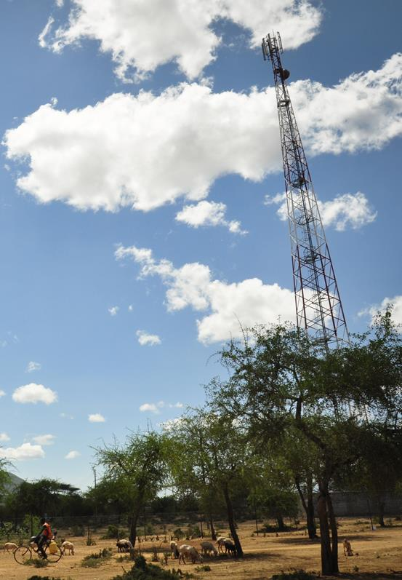
The GSMA represents the interests of mobile operators worldwide. Spanning 219 countries, the GSMA unites nearly 800 of the world’s mobile operators, as well as more than 200 companies in the broader mobile ecosystem, including
handset makers, software companies, equipment providers, Internet companies, and media and entertainment organisations.

Slide 5
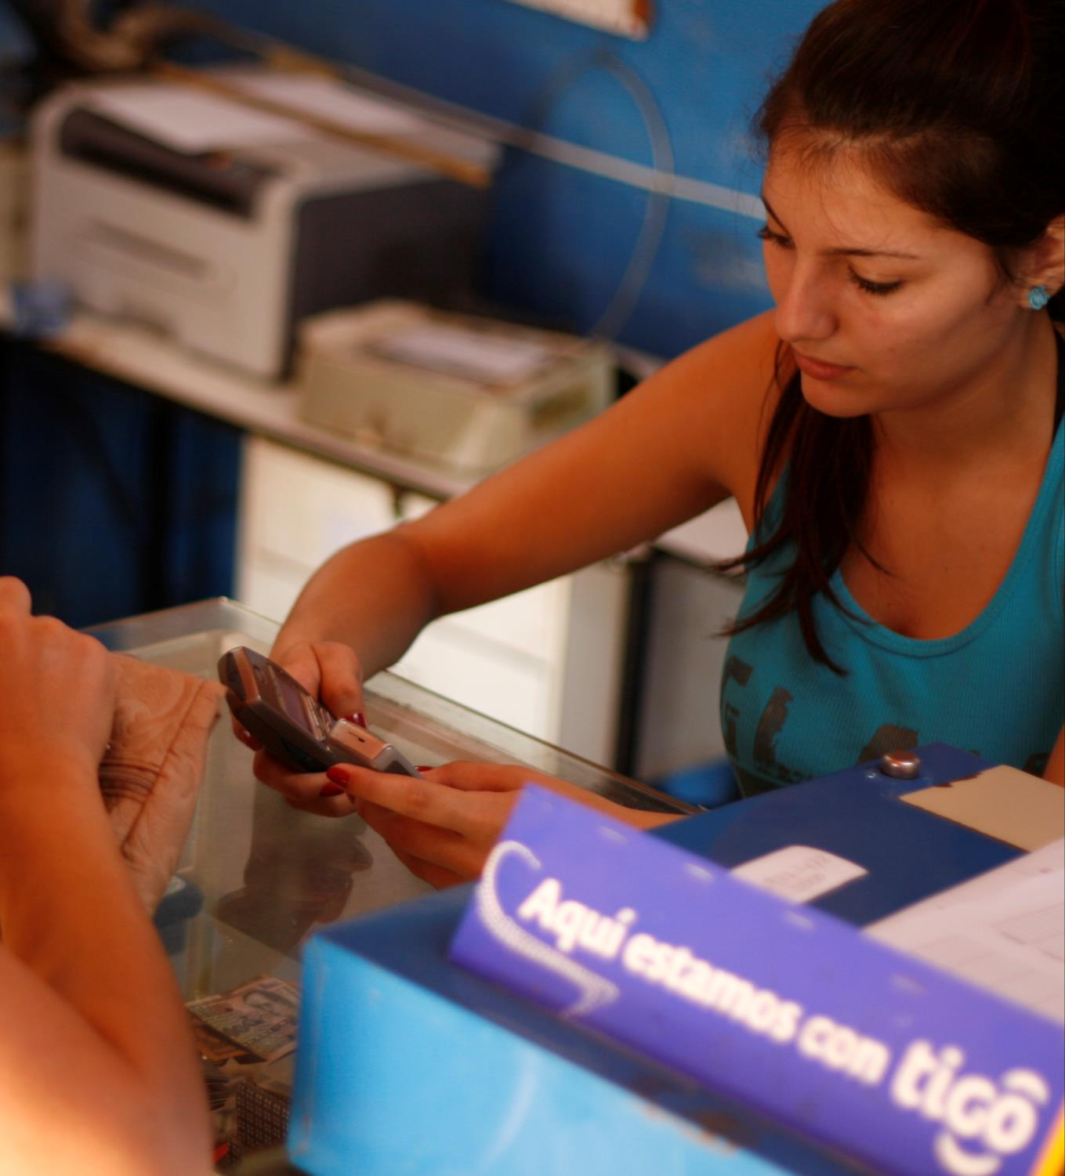
Supporting the industry to drive innovative mobile solutions for the underserved that deliver positive social and economic impact

Slide 6








How we work
Life-Enhancing Value Added Services
Financial Inclusion
Digital Inclusion
Notes:
Highlight our theory of change: starting with the importance of digital inclusion, with financial inclusion building on top of that and then additional life enhancing value added services, like mHealth, mAgri, MECS, etc.
Highlight the various activities that we undertake to help enable the above:
Research (e.g. consumer wants and needs, MMU adoption survey)
Grant mechanisms
Convening the right players together through working groups and other events
Business cases
Toolkits (e.g. go to market toolkits, market research toolkits)
Technical assistance and training
Knowledge sharing including case studies and best practices

Slide 7
How we work
Identify the opportunity
Stimulate activity
Scale for impact
Notes:
Highlight our theory of change: starting with the importance of digital inclusion, with financial inclusion building on top of that and then additional life enhancing value added services, like mHealth, mAgri, MECS, etc.
Highlight the various activities that we undertake to help enable the above:
Research (e.g. consumer wants and needs, MMU adoption survey)
Grant mechanisms
Convening the right players together through working groups and other events
Business cases
Toolkits (e.g. go to market toolkits, market research toolkits)
Technical assistance and training
Knowledge sharing including case studies and best practices

Slide 8




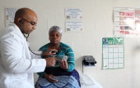
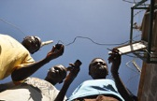
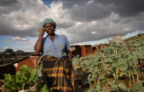
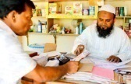
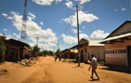
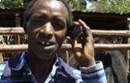

MDI
Our Programmes
Disaster Response
Mobile for Employment
mWomen
mHealth
Mobile Enabled Community
Services
mAgri
Mobile Money for the Unbanked
Green Power for Mobile
Emerging Markets Handset
Connectivity
2004 2005 2006 2007 2008 2009 2010 2011 2012
Notes:
Evolution of Mobile for Development. Began in 2008 with GPM.

Slide 9
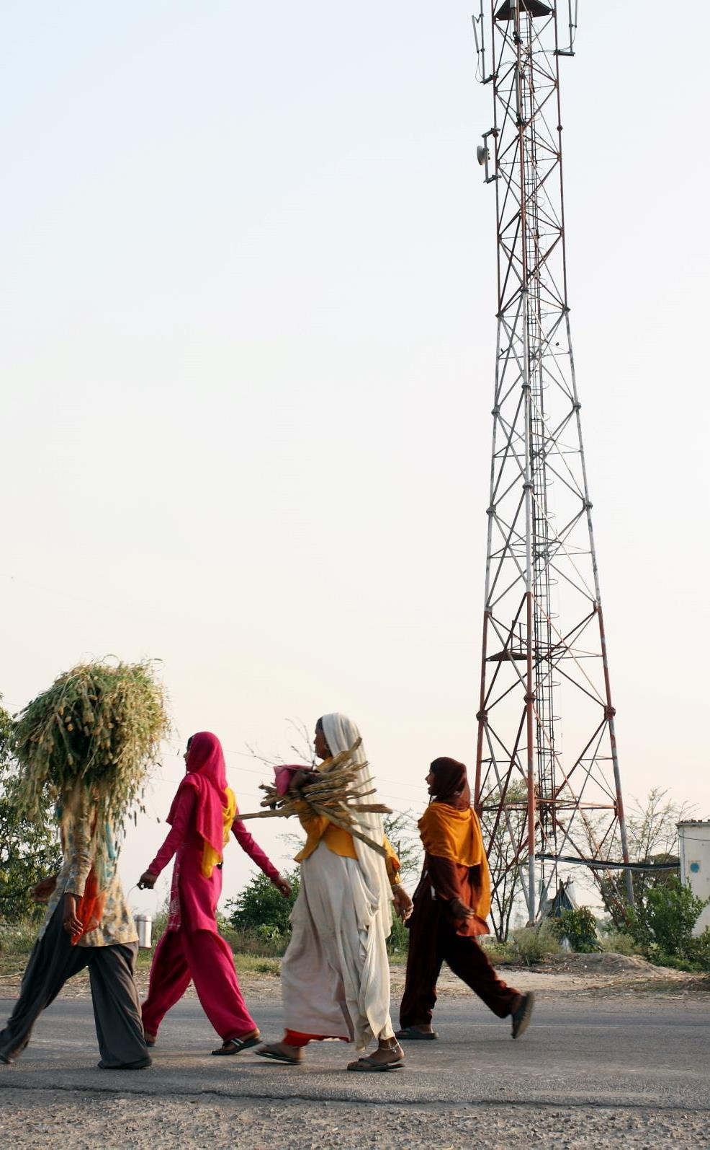
A more in-depth look at Mobile for Development

Slide 10
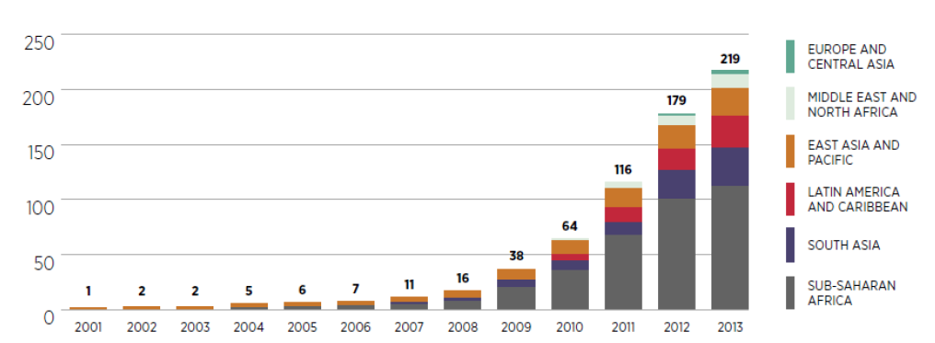
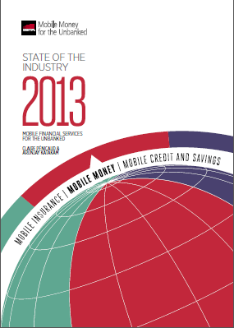
Growth of Mobile Money Services
219 services in 84 countries

Slide 11
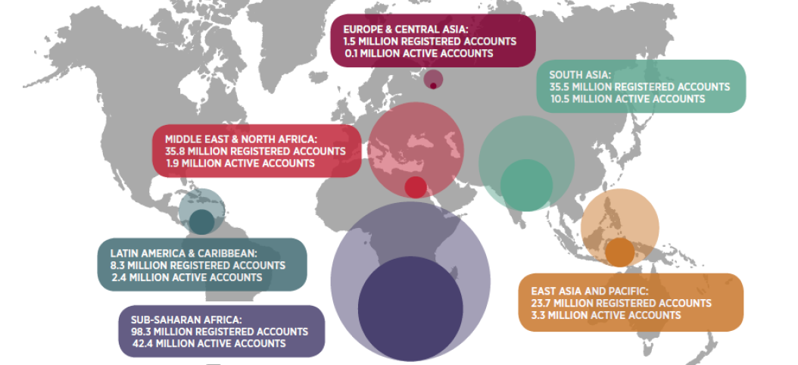
Growth of Mobile Money Services
There is a lot of diversity in terms of the number of registered and active accounts

Slide 12
Digital Inclusion
Objective: Expand connectivity by reducing the barriers to mobile internet adoption
Network Infrastructure & Policy
  Address the technological & regulatory factors which make mobile internet uneconomical in many areas
Taxation
  Address government taxes and fees to reduce total cost of ownership,
  increasing the take up and use of services
Consumer Barriers
  Reduce consumer barriers to adoption such as awareness & literacy
Locally Relevant Content
  Prompt locally relevant content to attract people to use the mobile Internet

Slide 13
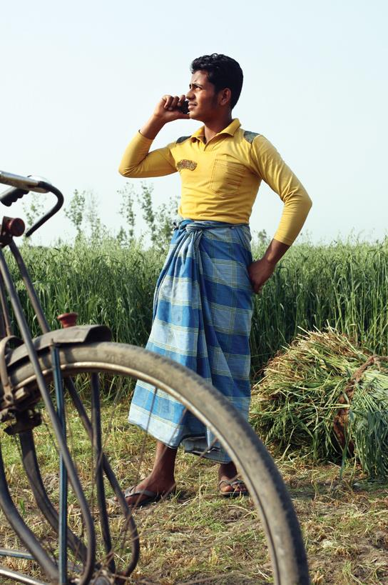
mAgri Challenge Fund
Seeks to support projects that provide:
Information and advisory services
Mobile financial services
Mobile transaction services.
The Fund is considering applications from 13 countries:
Africa: Cote d’Ivoire, Ghana, Malawi, Mozambique, Nigeria, Rwanda, Uganda and Zambia
South East Asia: Bangladesh, India, Myanmar, Pakistan and Sri Lanka

Slide 14
mWomen programme is conducting a global study to size mobile gender gap
What is the mobile gender gap?
12 countries selected for field research
The ‘mobile gender gap’ is the gap between the levels of access, ownership and usage of mobile between men and women
What will the study involve?
Turkey
Egypt
Iraq
This study will include
12,000 interviews in the field
84 focus groups
150+ interviews with MNOs, NGOs, executives and local experts
Mexico
Niger
China
Colombia
Nigeria
India
DRC
Kenya
Indonesia
12 countries selected for deep dive
Rest of low and middle income World
High income countries – not part of study

Slide 15
The study aims to provide valuable information for operators
Operators can support this study by providing…
…in return we will provide operators with:
Estimate of the global and regional gap in SIM ownership between men and women and the revenue opportunity in closing this gap
1
Gender data
Operators to provide gender data where possible (e.g. split between male and female subscribers)
Assessment of the drivers and barriers to SIM ownership and mobile usage from a demand and supply perspective
2
Expertise
Expert interviews with operators to assess the drivers and barriers to mobile usage
Practical recommendations on how to increase mobile ownership and usage amongst women in similar markets
3
Case studies
Case studies of successful ways operators have reached rural women
And for operators in the 12 focus countries:
Detailed country-level data and consumer insights from field interviews and focus groups
4
Note: All commercially-sensitive data will remain confidential

Slide 16

Disaster Response
The Disaster Response Program works to facilitate coordination and knowledge sharing between mobile operators, Governments and the humanitarian response community.
Our team supports the mobile industry in improving network and organizational resilience so that this technology can be depended on as a lifeline in disaster.

Slide 17
Disaster Response – work in Asia
MNO support: On the ground & remote coordination support for Filipino MNOs during Typhoon Haiyan response
Convening: Preparedness workshops held or upcoming in Philippines, Bangladesh, Nepal
Eco-system Engagement: Disaster Response Regulatory engagement (Regulatory officers meeting, Hong Kong, Mobile Asia Expo)
Case studies and Knowledge Sharing: (Philippines, Sri Lanka (forth coming), New Zealand
Our other Areas of Focus:
  Driving a long term view of preparedness for the industry
  Partnering with UN, World Food Programme and other humanitarian organisations to incorporate long term pre-standing frameworks for cooperation during disasters
  Capturing Best Practice in Communicating with Customers
  Providing regular updates and liaising with humanitarian partners about network outages, restoration activities and emergency communication services in the Philippines
  Advocating the unique role and contribution of mobile and MNOs in disaster preparedness and response through Spotlight Case studies on Vodafone Instant Network, Turkcell, Refugees

Slide 18
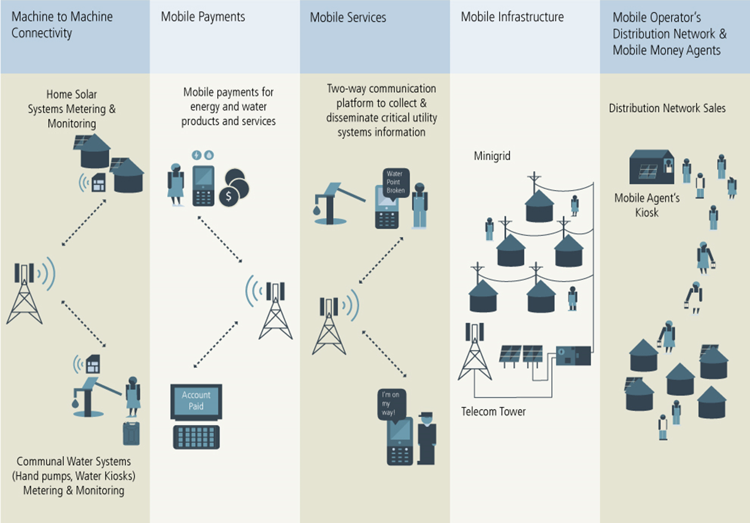
Mobile Enabled Community Services
  The GSMA Mobile Enabled Community Services (MECS) programme leverages mobile technology & infrastructure to improve access to basic energy and water services

Slide 19
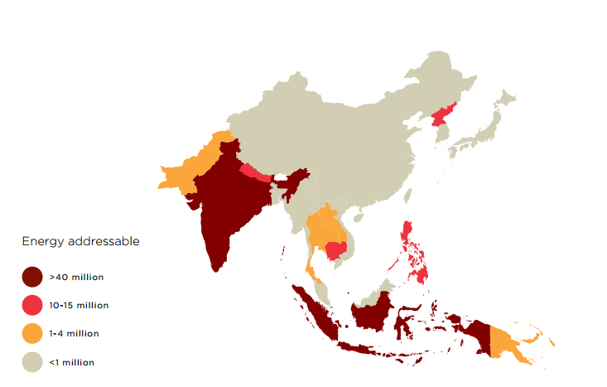
MECS Addressable Market- Energy
255 million people live with mobile coverage but lack access to energy

Slide 20
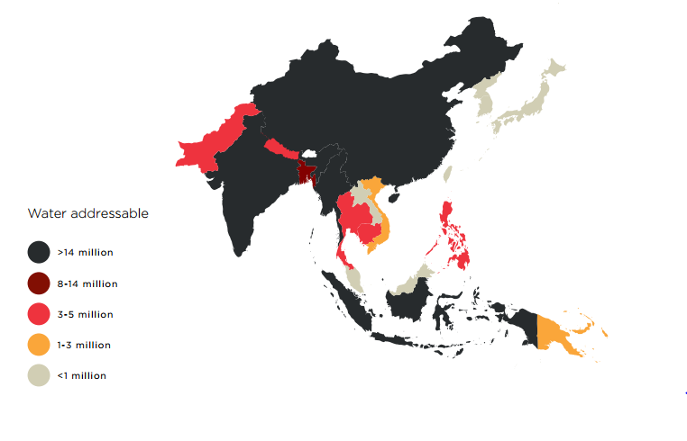
MECS Addressable Market- Water
99 million people live with mobile coverage but lack access to improved water

Slide 21
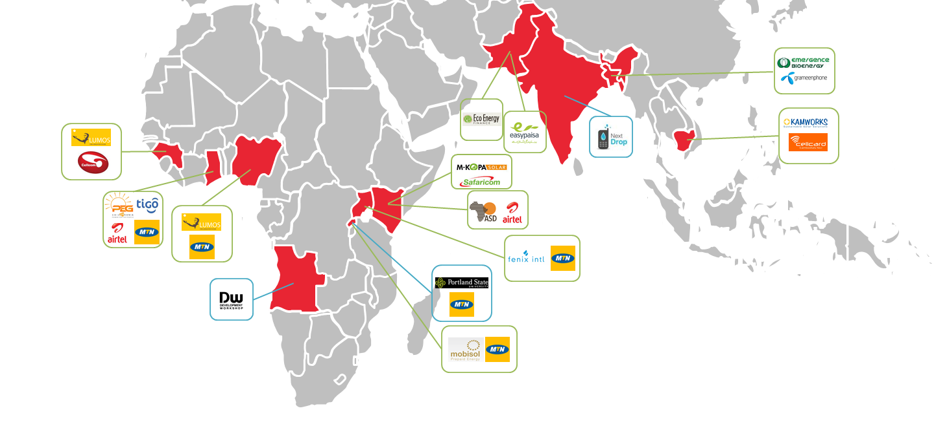
MECS Grantees
Water
Energy

Slide 22
Asia-Pacific & Indonesia

Slide 23
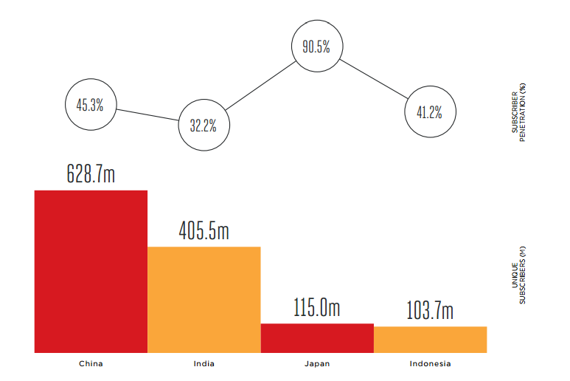
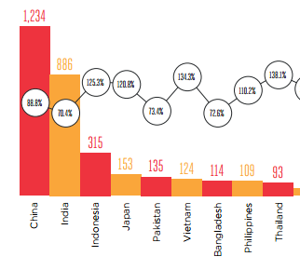
Asia Pacific Subscribers vs. Connections
Total connections (m) & penetration (%)
Unique subscribers(m) & subscriber penetration (%)

Slide 24
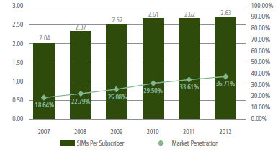
Indonesia Subscribers vs. Connections

Slide 25
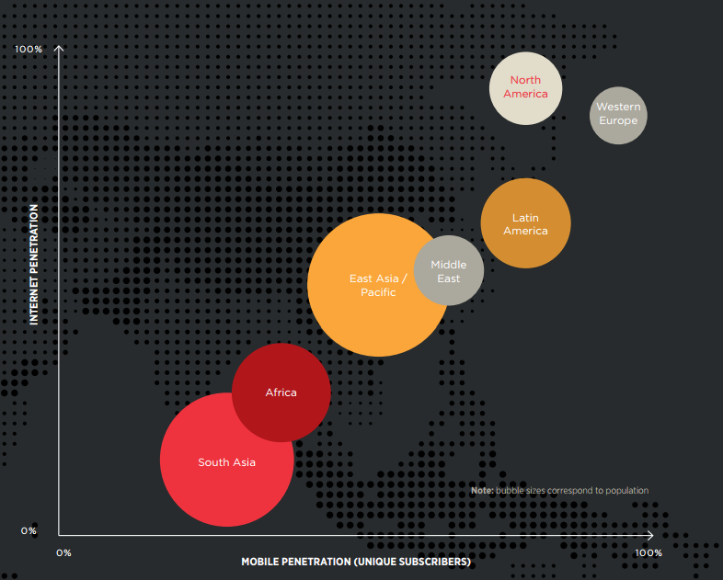
Potential for growth of mobile internet

Slide 26
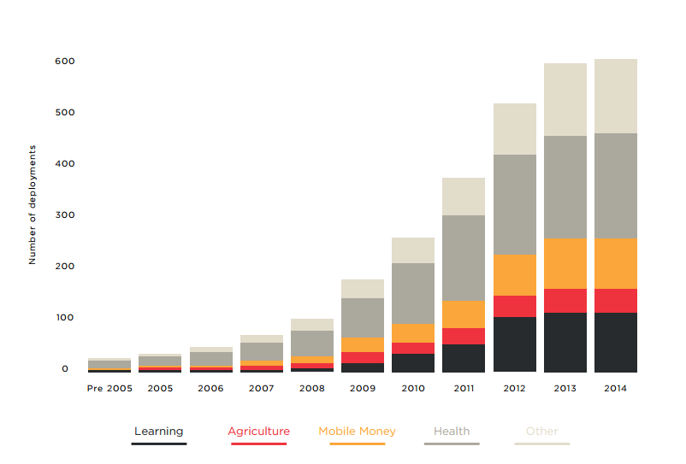
Mobile-enabled products & services in Asia Pacific

Slide 27
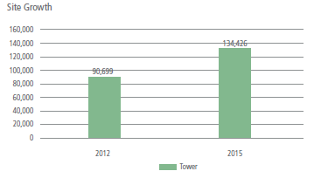
Indonesia Network Infrastructure
90, 699 towers for all islands
25,000 towers owned by Tower Companies with a tenancy ratio of 1.5-1.6

Slide 28
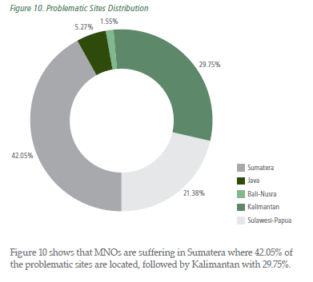
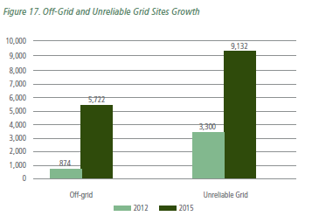
Indonesia Network Infrastructure
5% of total tower sites are off-grid and more than 4% have unreliable power

Slide 29
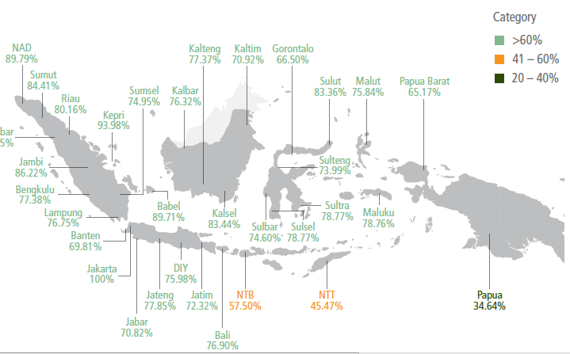
Indonesia Electrification Ratios by Provinces

