Slide 1
Inmarsat Roaming
Disaster Response Working Group
24/25 June 2014

Slide 2



Our business
Mission-critical communications where terrestrial networks are unreliable or don’t exist

Slide 3



About Inmarsat
The mobile satellite company™
    Inmarsat was born out of the need for communication to save lives at sea
    MSS Market leader 30+ years
    12 Geostationary satellites in operation, with additional 3 in delivery
    Global service coverage
      Broadband data, Voice, text and M2M
      Average 99.9% availability
    Trusted partner and sponsor of Telecoms Sans Frontier (TSF)
    Red Cross, UN, ANSUR (recently appointed by BNPB) etc...
Notes:
Some quick facts on Inmarsat, am considering removing this slide, too much detail

Slide 4
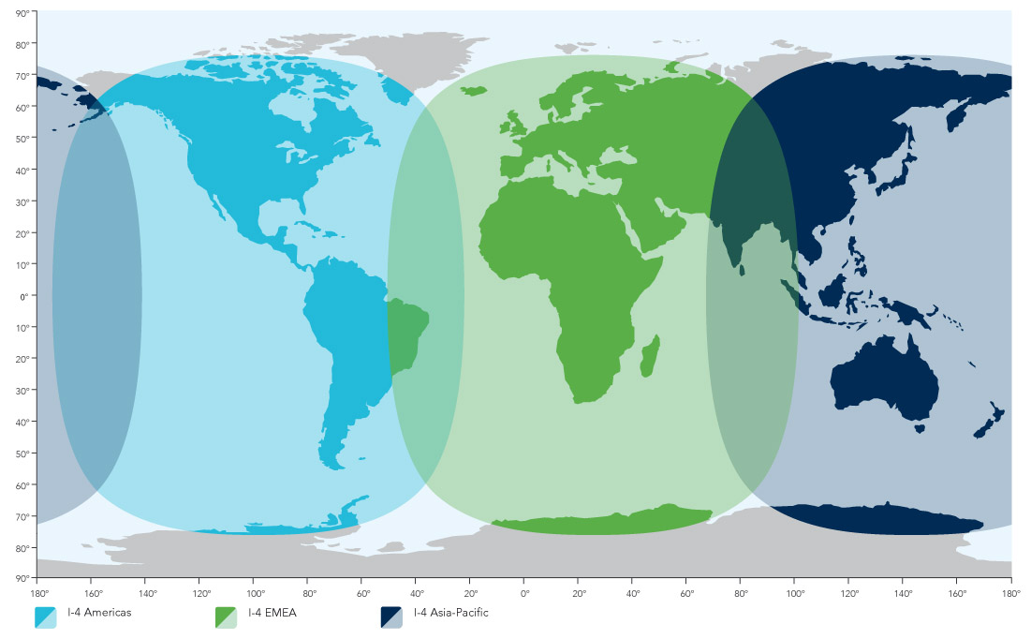
Global mobile broadband coverage
This map depicts Inmarsat’s expectations of coverage, but does not represent a guarantee of service. The availability of service at the edge of coverage fluctuates depending on various conditions.

Slide 5
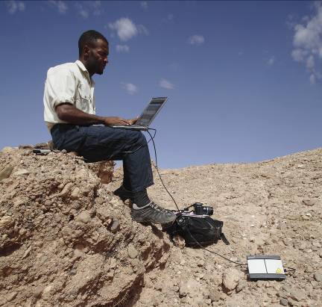
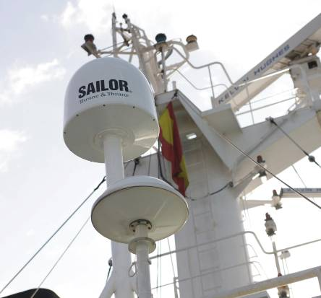

Our network services
Voice and broadband data communications
BGAN
FleetBroadband
SwiftBroadband
    Broadband data
    up to 768 kbps
    Simultaneous voice
    Through a single compact device
    Broadband data
    up to 492kbps
    Accessible through
    a compact antenna
    Broadband data
    up to 492kbps
    per channel
    GPRS and UMTS compatible

Slide 6
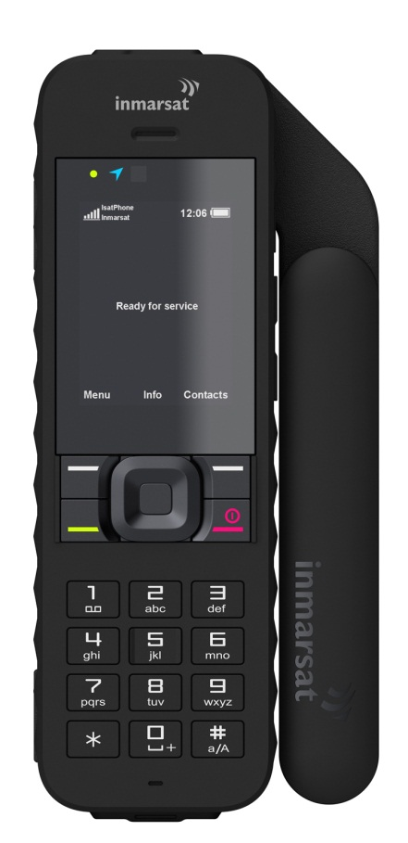
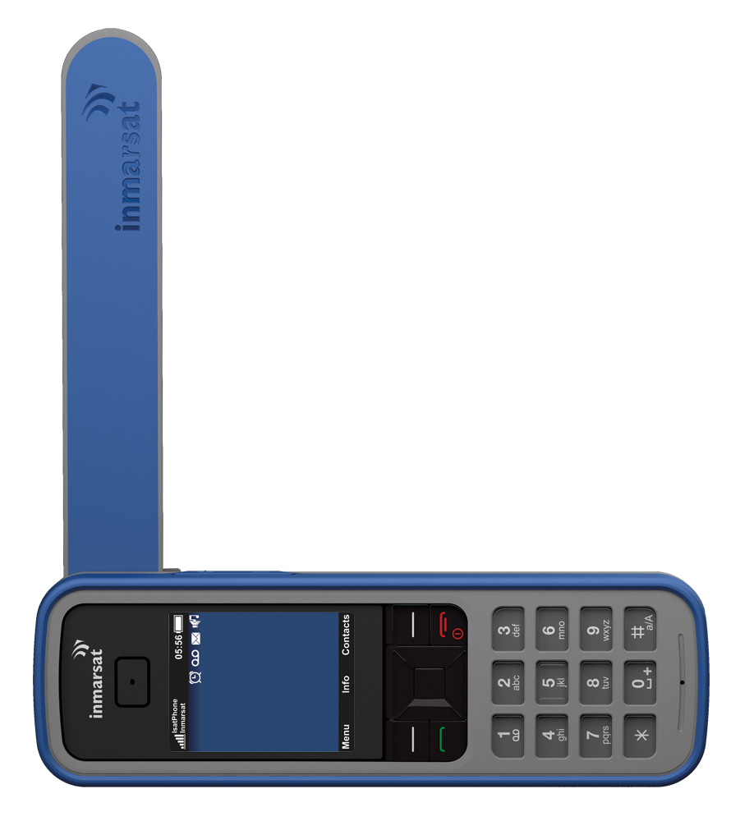
IsatPhone Pro 1 & 2
Our global handheld satellite phone
      Voice, text and email messaging, GPS
      Longest battery life in the market
      Only global handheld to support Bluetooth
      Competitively priced handset and airtime
      Full range of accessories and docking stations
      2G/3G based service

Slide 7

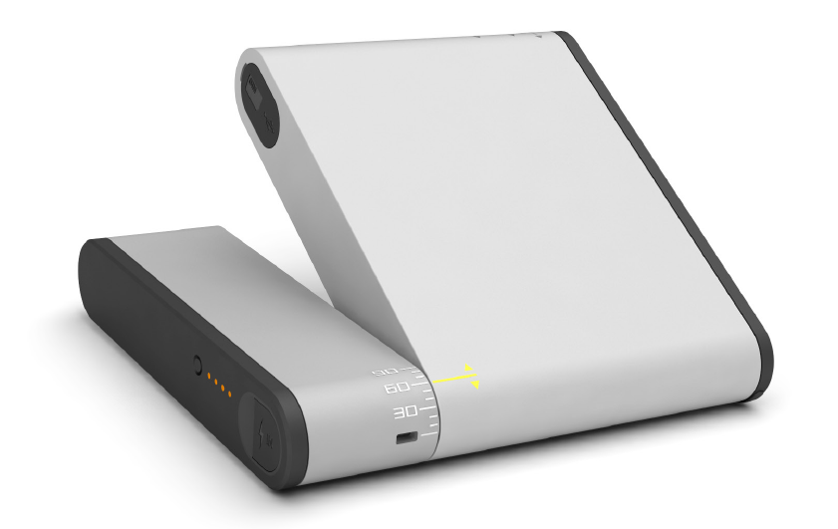

IsatHub (Q3 2014)
    Real-time IP data 384/240kbps
    Compact and lightweight
    Easy to use
    Android/Apple control & voice apps
    Multiple users, one device
Notes:
Latest Inmarsat innovation that will provide unrivaled data speeds through a small end-user device
5 hours usage, 72 hours stand by
Usage controlled by the main user through the control app, allowence per user, blocking of certain apps
Will be available as of July

Slide 8
Inmarsat Roaming

Slide 9
Inmarsat Roaming
Roaming Agreement Process
  MNOs can use own SIM cards in our terminals to access the Inmarsat Satellite network through a standard GSMA Roaming agreement
    AA12/AA13 etc...
  Result is ubiquitious and reliable coverage via satellite
  Most reliable and resillient communication available when the network is down due to disaster

Slide 10
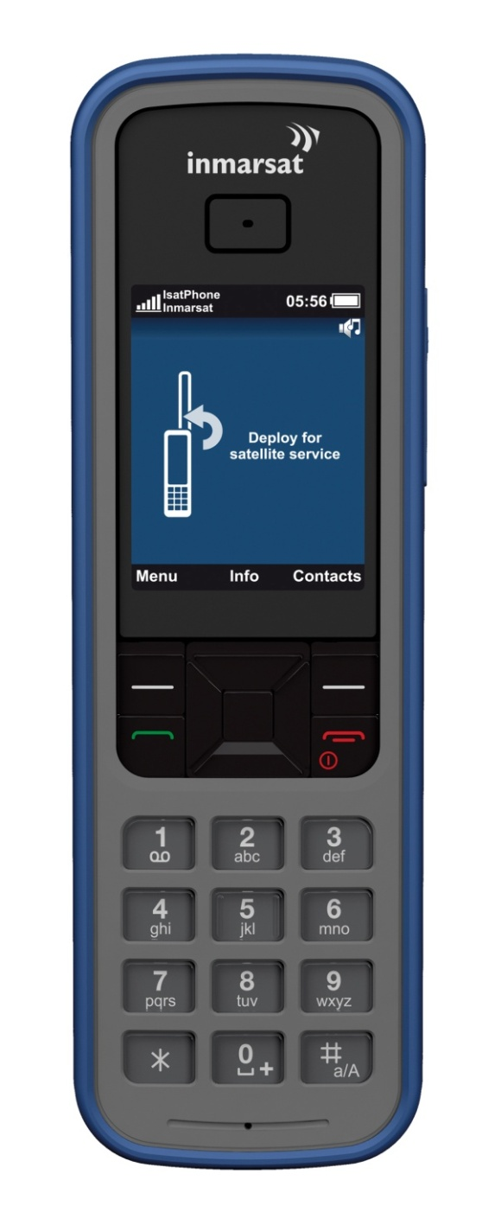
Inmarsat Roaming
Benefits
  MNOs can offer Emergency Response Communications for:
    First responder units that arrive on the scene at affected areas
    Set up communications hub in first critical days
    Emergency Communication kits for Governments/NGOs
    Etc...
  Ultimate back up communication kit, ready to be deployed at
  moments notice
  Maintain local Indonesian access numbers (+62...)
  Seamless and easy integration with existing MNO systems (TAP file, billing etc...)
  Can also be rolled out to rural, remote areas for development purposes

Slide 11
Inmarsat Roaming – Quick and Easy

Slide 12
Key2Roam agreement via Comfone Hub
Comfone Charges HPMN
based on Inmarsat prices
Comfone
Nrtde
HPMN
Invoice stream
TAP
Call Data
Signalling
Actual Call
Invoice to end-user
Roaming + margin
Inmarsat Charges CF Total
Roaming costs -/- %IOT
CDRs
IsatPhone
Physical call
Inmarsat
(VPMN)
OLO
(termination)
Physical call
OLO charges Inmarsat Termination

Slide 13
Bi-lateral Roaming agreement
Comfone invoices HPMN
on Inmarsat’s behalf
Nrtde
Invoice stream
Comfone
HPMN
Call Data
TAP
Actual Call
Signalling
Invoice to end-user
Roaming + margin
CDRs
$
IsatPhone
Physical call
OLO
(termination)
Inmarsat
(VPMN)
Physical call
OLO charges Inmarsat Termination

Slide 14

The Mobile Satellite Company
    The MSS market leader
    Widest portfolio of global communications solutions
    Across land, sea and air
    World’s most advanced commercial communications satellites
    Fully funded and financially healthy
    Roaming agreements for the benefits of MNOs

Slide 15
Thank you
Arno Vanderkraan
Regional Director Asia Pacific
Carriers & Operators
Inmarsat
M +65 9653 6740
E arno.vanderkraan@inmarsat.com
W inmarsat.com
15

