Slide 1

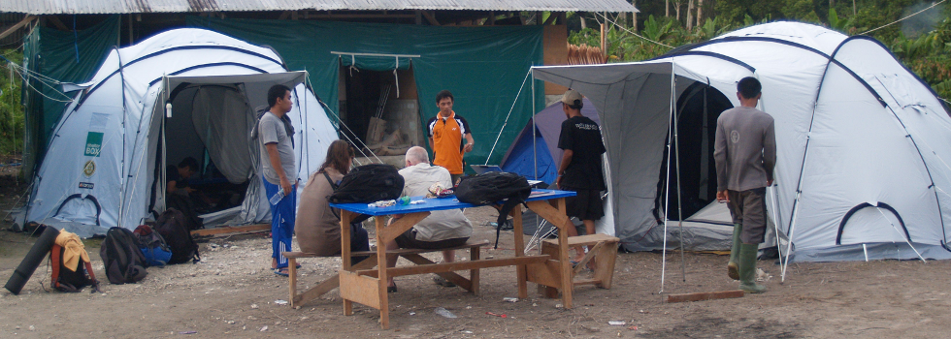
Powering disaster response
– past, present and future from
a community perspective (2004 - 14)
Agung Riyadi, Executive Director
Zulkifli, Head of Emergency Response Team &
Idris F. Sulaiman PhD, Advisor
Komplek Kejaksaan Agung Blok F-20
Jalan Raya Ragunan, Pasar Minggu
Jakarta Selatan 12520 Email: agung@airputih.or.id , idrisfsulaiman@gmail.com

Slide 2
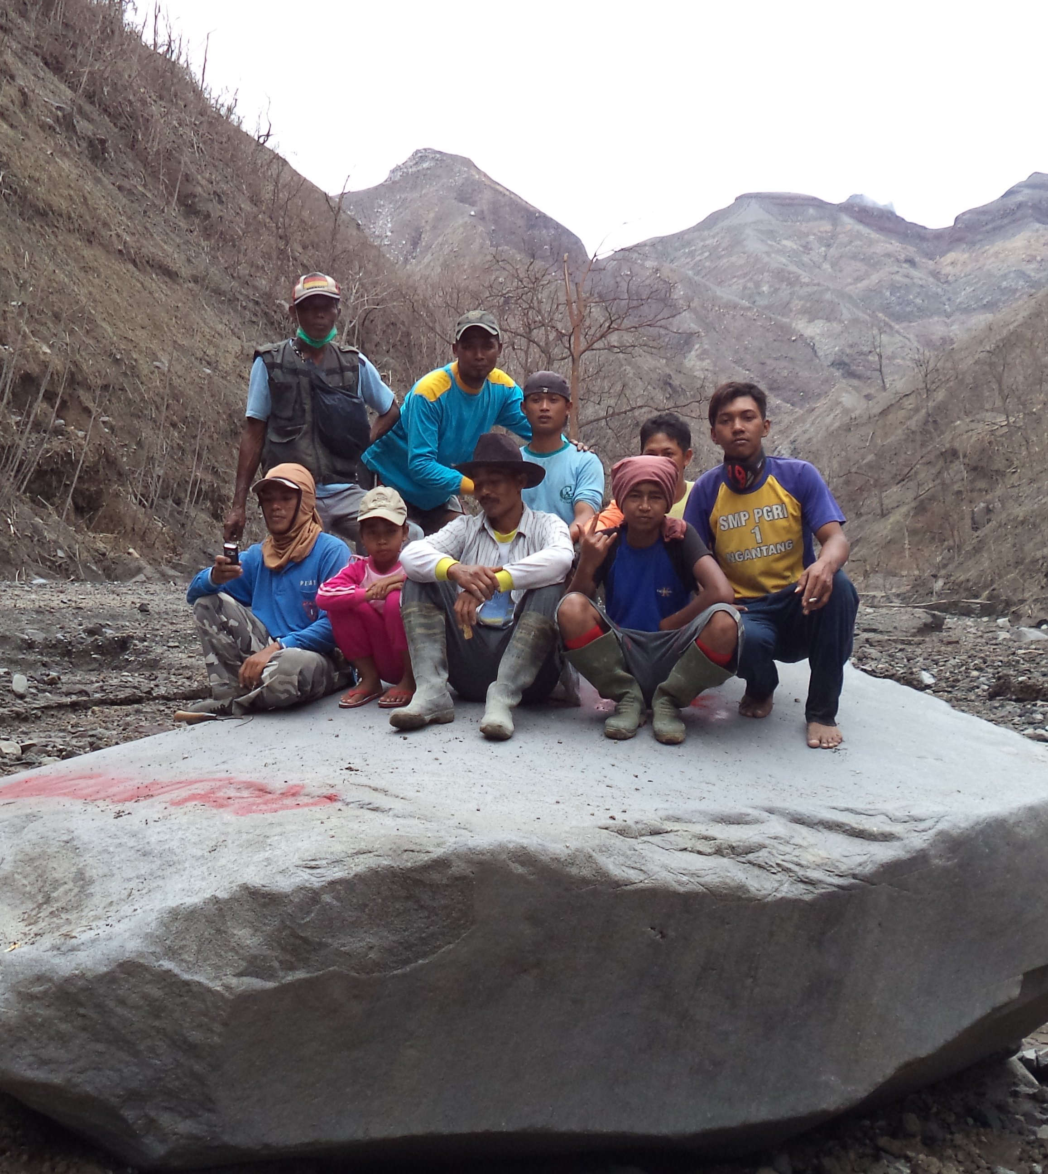
Contents
Profile
- Vision & Mission
- Activities
High risk Areas
“Trained” Areas
Gap Analysis
Final Remarks
AP’s Next-Generation Local ICT DRR Group
Notes:
The Group on the right is AP’s next-generation “future” local ICT DRR group – one from KELUD – Ngantru, March 2014.

Slide 3
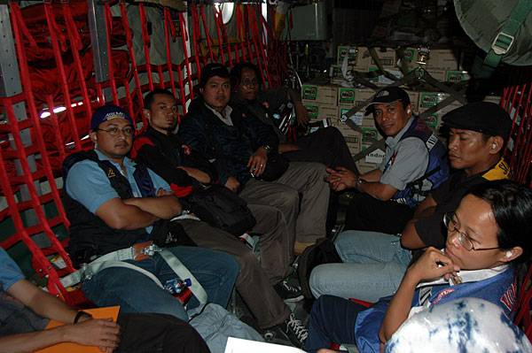
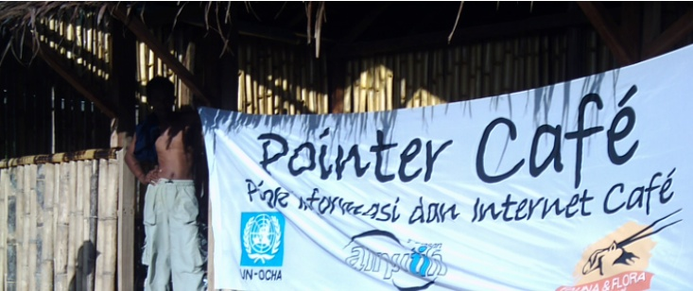
Our origins
AIR-PUTIH is a not-for-profit organisation primarily focused connecting the un-connected
and empowerment using ICTs.
- Started in 29 Dec. 2004 with activities on ICT disaster response work around Aceh Tsunami with the support from ISP Association-APJII, Indonesia IT Federation-FTII and many others
- Core group of professionals and volunteers from universities, IT/Linux groups and international sources
Vision: Empowering local people, gov’t agencies and NGOs to apply ICTs for disaster management, risk reduction and national resilience
Notes:
Only organisations

Slide 4


AirPutih’s Profile Now
AP is the only organisation of its kind in Indonesia (and one of few in the world – TSFI.org is another)
First response: in almost all major disasters in Indonesia since 2004
Key focus: Post-Disaster Recovery
- Information access & infra- provisioning including NGO hosting, setting up of Command Post (‘PosKo’)
- Training
Notes:
BTS Merdeka, riset OpenBTS
EWS Gempa, aplikasi desktop peringatan dini gempa
Hosting gratis, layanan hosting gratis bagi lembaga/organisasi non-profit
Aplikasi Keterbukaan Info Public, aplikasi yang menjembatani pertukaran informasi publik
Interactive Voice Respon (IVR), teknologi pendukung citizen journalism
Aplikasi KIP | AirPutih www.airputih.or.id/layanan/aplikasi-kip
Aplikasi Keterbukaan Informasi Publik. Unduh Aplikasi Keterbukaan Informasi Publik
2. Plugin Aplikasi KIP untuk CMS WordPress.

Slide 5
AP Routine Activities
First-response: set up infrastructure including set up of VSAT, wifi and if mobiles are used whenever there is mobile coverage - users: Red Cross, BPBD, NGO & local government agencies. And SMS-gateways to facilitate all stakeholders. Distribution of water, food and clothing
Reporting on AP’s “Mediacenter.or.id” website (Ushahidi-based) for more dynamic exchange of information about
disaster and coordinate responses
Post-Disaster: Training in recovery & preparation future disasters -earthquake, flooding & volcano and aviation
(from man-made disasters-Sukhoi 2012)
Applications dev’t - that can be used by
all stakeholders including government,
NGOs and the local community
Notes:
MediaCenter.or.id Update field considition: victims/affected locals, local current conditions,
In the after math disaster, villages physical and utilities (esp. water) infrastructure

Slide 6
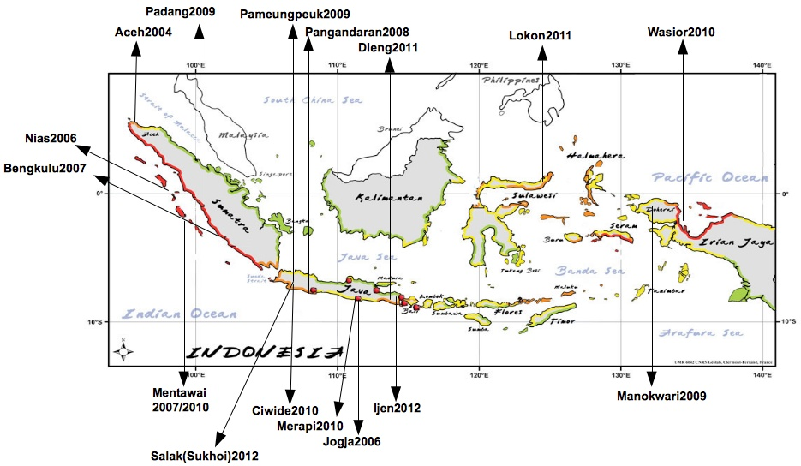
AP Activity Areas
Locon-N Sulawasi, Dieng 2011 Ijeng-E Java 2012 Sinabung-NSum 2013 Kelud-EJ 2014
Notes:
Since its founding in 2005, has held AirPutih emergency response in some parts of Indonesia. Major disasters and require acceleration information that has been implemented in the 2005-2012 timeframe, among others, Emergency Response Team ERT in Aceh2004, Nias2005 Earthquake, Earthquake Bengkulu2007, and the latest areas are Sinabung 2013 and Kelud 2014

Slide 7
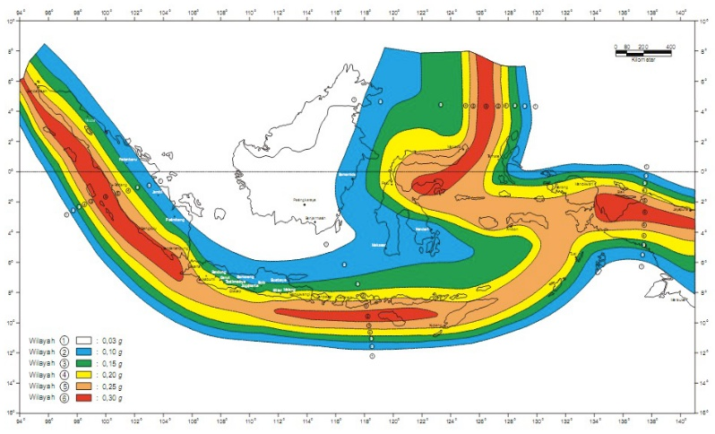
Volcanic Disaster Areas – Ring of Fire
Notes:
To improve readiness, there is a huge area to cover

Slide 8
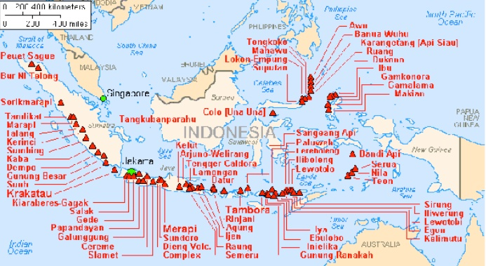
High Risk Volcanic Disaster Areas

Slide 9
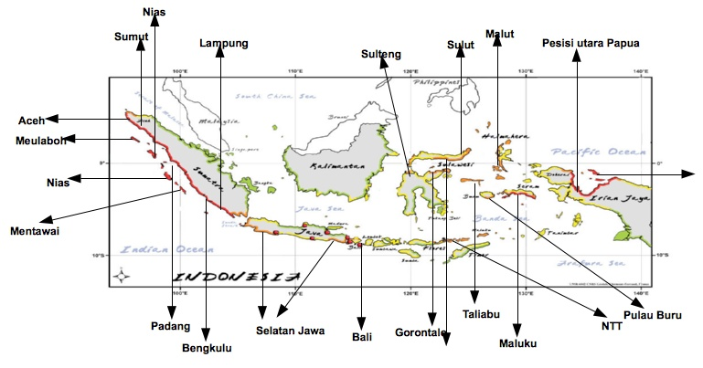
Potential High Risk Areas for ICT Training
Source:
Based on research by Indonesian Meteorological, Climate & Geomorpholy Agency/BMKG and US-Geological Survey
Notes:
Collated from research by BMKG and US-GS
Since its founding in 2005, has held AirPutih emergency response in some parts of Indonesia. Major disasters and require acceleration information that has been implemented in the 2005-2012 timeframe, among others, Emergency Response Team ERT in Aceh2004, Nias2005 Earthquake, Earthquake Bengkulu2007,

Slide 10
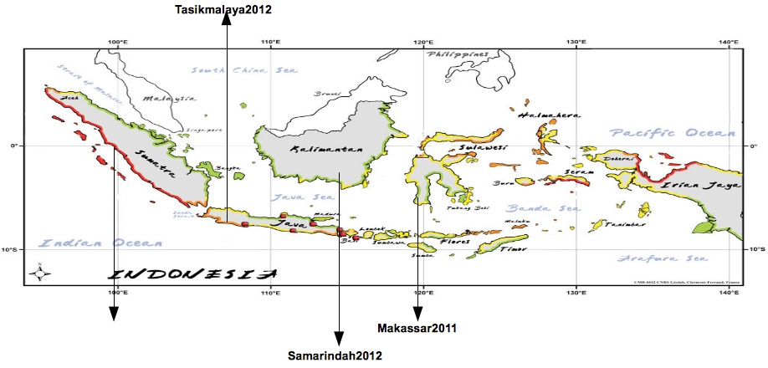
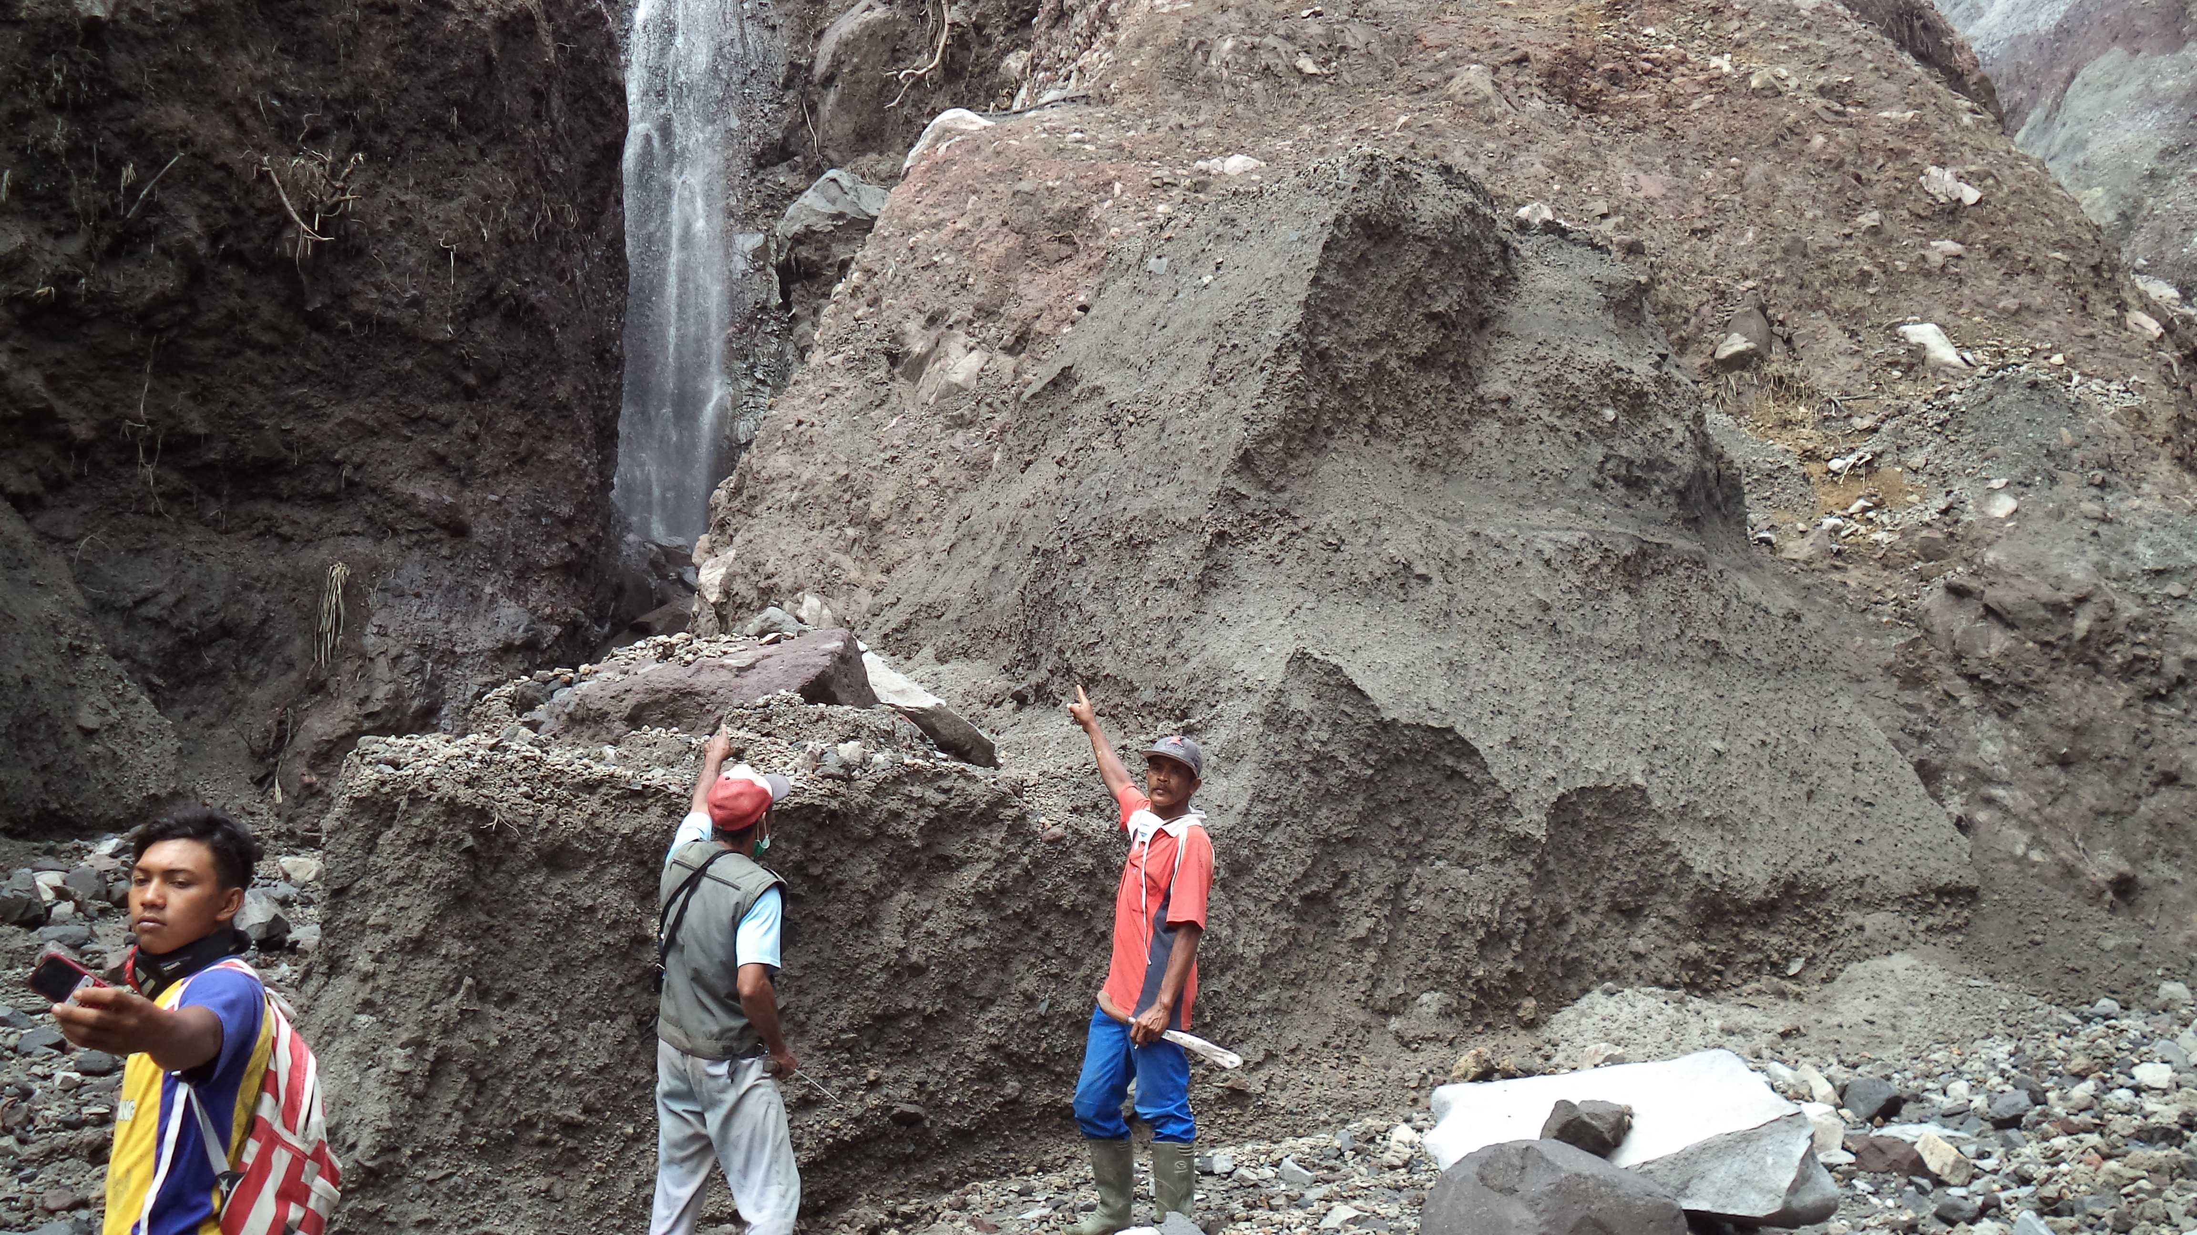
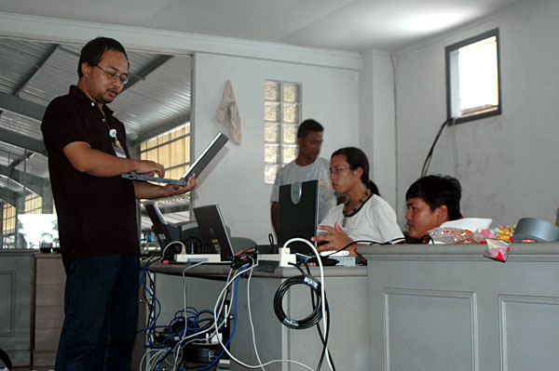
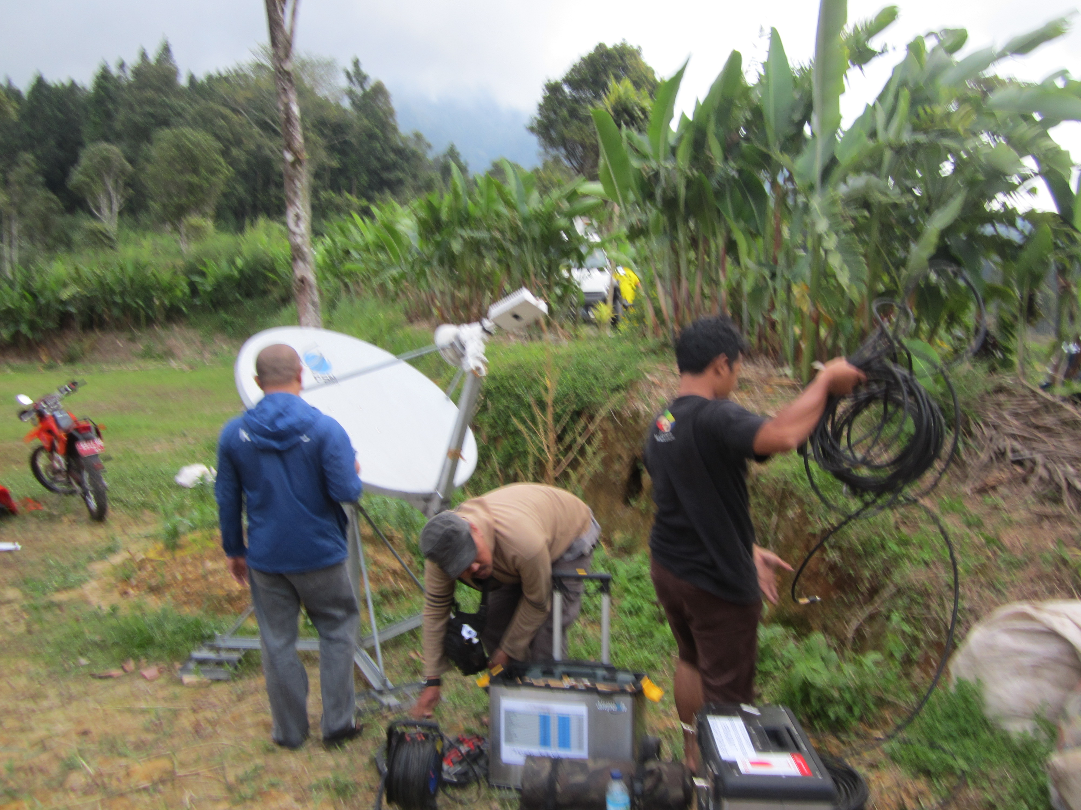
Areas with ICT Training by AP
Aceh 2005-08, Padang 2009-10
Kelud 2014

Slide 11
On-going Gap Analysis
Awareness of critical information – key components in DRR: Mobile operators can faciltate SMS-gateway (e.g. Indosat-”9731”, bulk SMS for initial reporting & follow-up, targetted to key local village heads, etc.)
Infrastructure set-up support (Vsat, Mobile Vsat/BTS, etc.)
Support for ICT-DRR Training program for local groups
- Three of Many Success Stories:
Pelita Community, Aceh trained since 2005 then playing a role in Aceh disaster in 2013. Similarly Sago Group-Padang 2009 and more recently in Ngantruk-Kelud Group, 2014
On-going support needed for local NGOs
and government agencies
- critical in DRR, still largely unmet

Slide 12
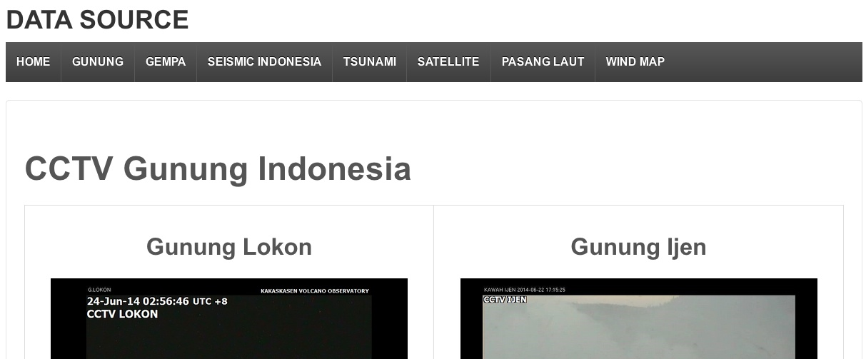
Real Time Information http://www.mediacenter.or.id/datasource/
Volcanic – Quake – Seismic – Tsunami – Satellite – Sea Tide – Wind Map
Flood-gates real time data for
flood monitoring?
Notes:
Need for Real time data for flood emergency response – in Jakarta’s 2013 floods, AP assisted many groups and people in North Jakarta with SMS, Twitter and Facebook

Slide 13
Final Remarks
Role of ICT is to provide critical information and communicate DRR stages in the disaster prone regions - urgent need: avoid recurrent “delay” !
To empower existing human resources including local communities to participate in the use of ICT to empower them in DRR (improving speed of information, mapping, data collection
- pre, during and post disaster) and
Takehome messages:
- Learning from past disasters (NGO-Operator links)
and
- Truly build local gov’t & NGO,
awareness and capacity
Notes:
Need for Realtime

Slide 14
Terimakasih
Thank You
AirPutih Team
http://www.airputih.or.id
http://www.mediacenter.or.id/
http://www.makeitfossible.web.id/
https://www.facebook.com/airputih.or.id
https://id.wikipedia.org/wiki/AirPutih/
@AirPutihOrId

