Slide 1


Slide 2
Outline
TELKOMSEL demo Mobile BTS “COMBAT”
(COmpact Mobile BAse sTation)
BACKGROUND
Telecommunication is one of SAR element ...
PURPOSES
TELKOMSEL has 5 (five) types of “COMBAT”
To show how to demonstrate TELKOMSEL Mobile BTS “COMBAT”
CHALLENGES
To mobilize mobile BTS “COMBAT” to the area of disaster
Set up mobile BTS “COMBAT” during disaster

Slide 3
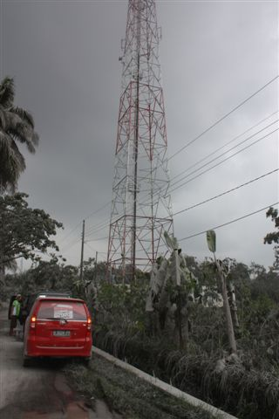
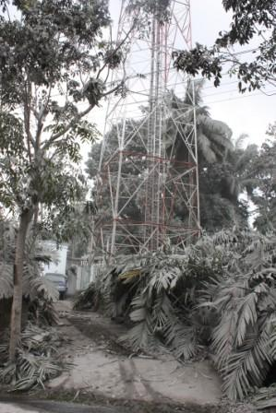
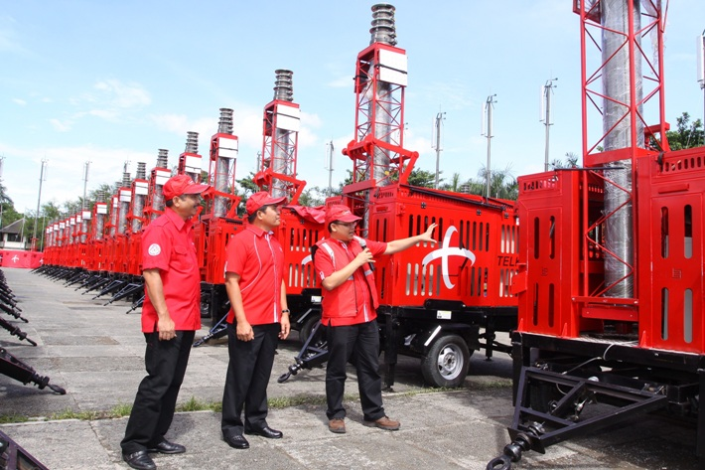
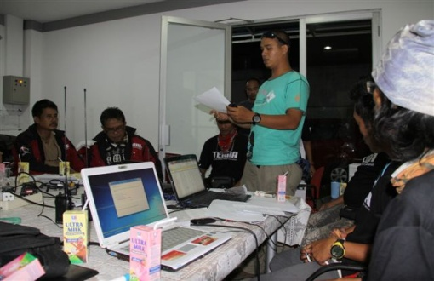
BACKGROUND
TELECOMMUNICATION IS ONE OF SAR ELEMENT...
“on such search and rescue action when disaster occured, telco facilities is one of the important element to support not only verbal communication and short messages but also data supply of image, report etc”
“We believe that beside telco function, emergency media center on site is one of the critical point to be improved, as well as other technology solution support”
400 unit COMBAT was launched on 18 November 2013
“RELIEF & RECOVERY”
Smart Deployment
COMBAT
(installation for Telco infrastructure
(COmpact Mobile BAse sTation)

Slide 4
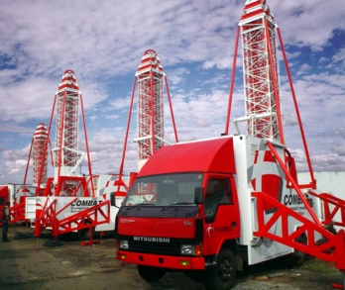
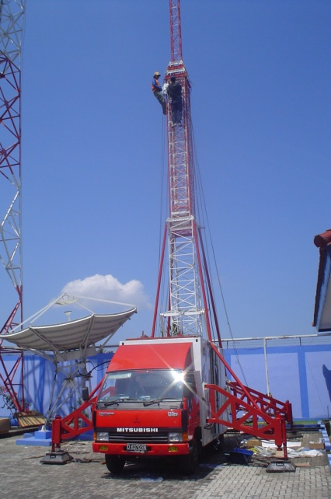
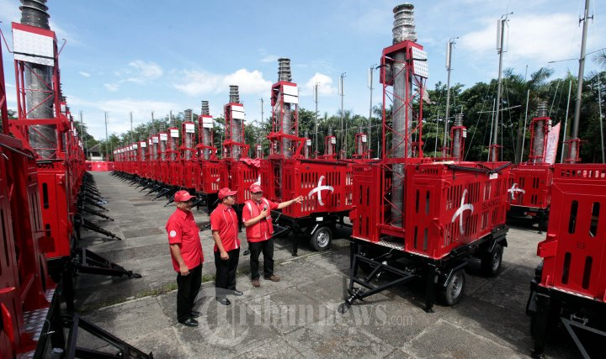
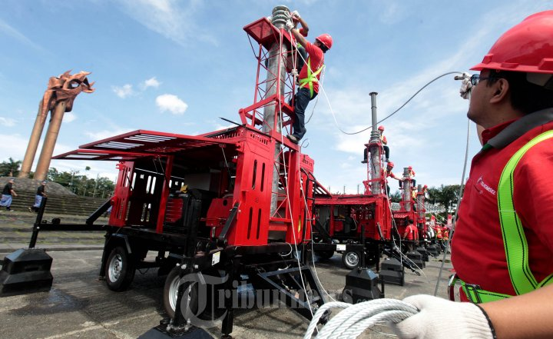
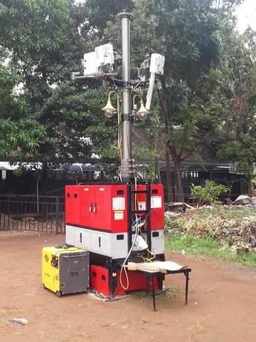
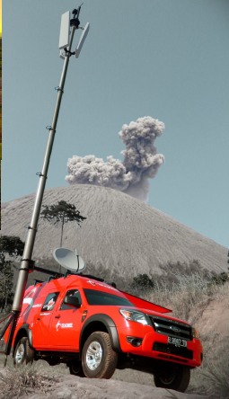
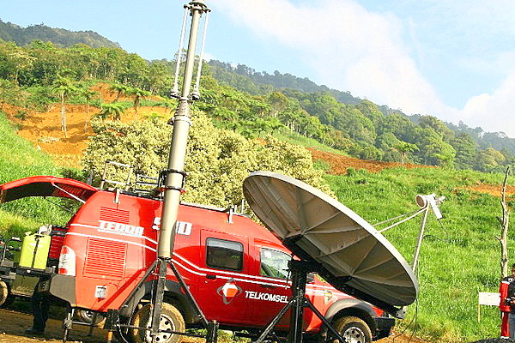
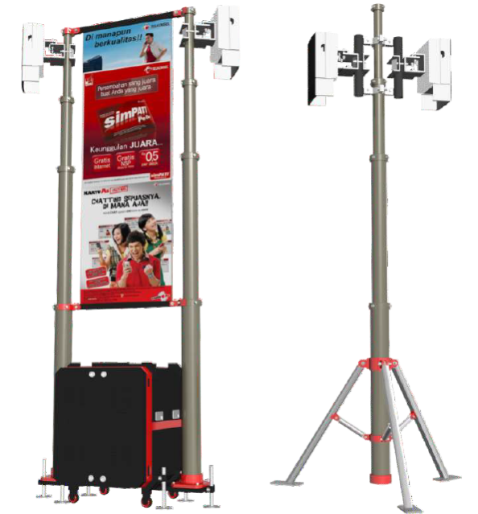
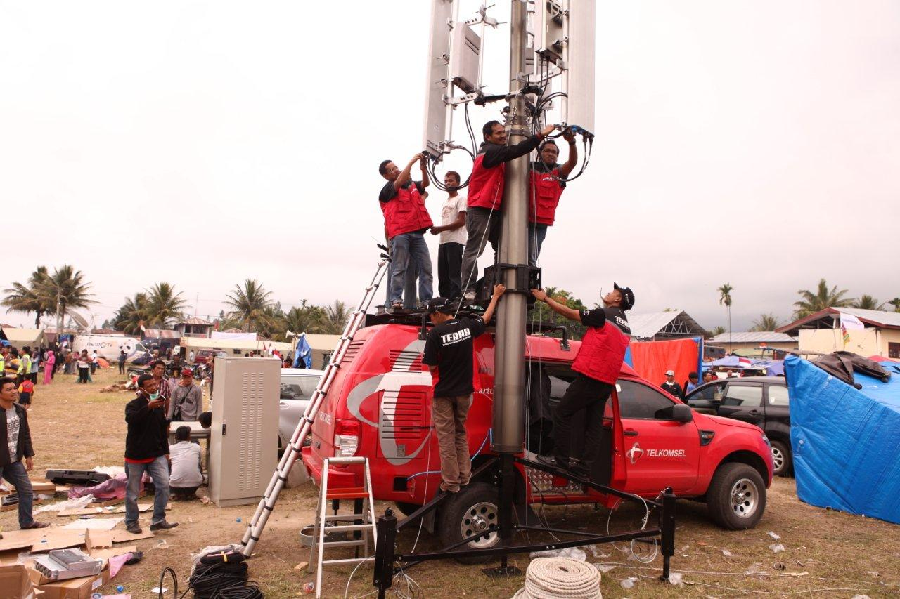
CRUISER (Compact Radio Unit Raised On Rig)
SMART Deployment with COMBAT
(5 types)
1
- Height of Tower : 42 Meter
- Tower structured : steel
- Mobilized : using car type truck.
3
ARROW (Adaptable Radio Unit On Wheels)
- Height of Pole : 15 Meter
- Pole structured : Alluminium Alloy
- Mobilized : using car type jeep (Ford Ranger)
2
VELOCE (Vehicle-Supported Cell)
4
RUSH (Rooftop Unit With Smart Handling)
- Height of Pole : 10 dan 15 Meter
- Pole structured : Alluminium Alloy
- Mobilized : using car type jeep (Ford Ranger)
- Height of Pole : 6 Meter
- Pole structured : Alluminium Alloy
- Mobilized : using car type jeep (Ford Ranger)
5
SPRINT (Smart Portable Radio Unit)
- Tinggi Pole : 6 Meter
- Struktur Pole : Alluminium Alloy
- Mobilisasi : Menggunakan Kendaraan Jenis ford Ranger/JIP

Slide 5
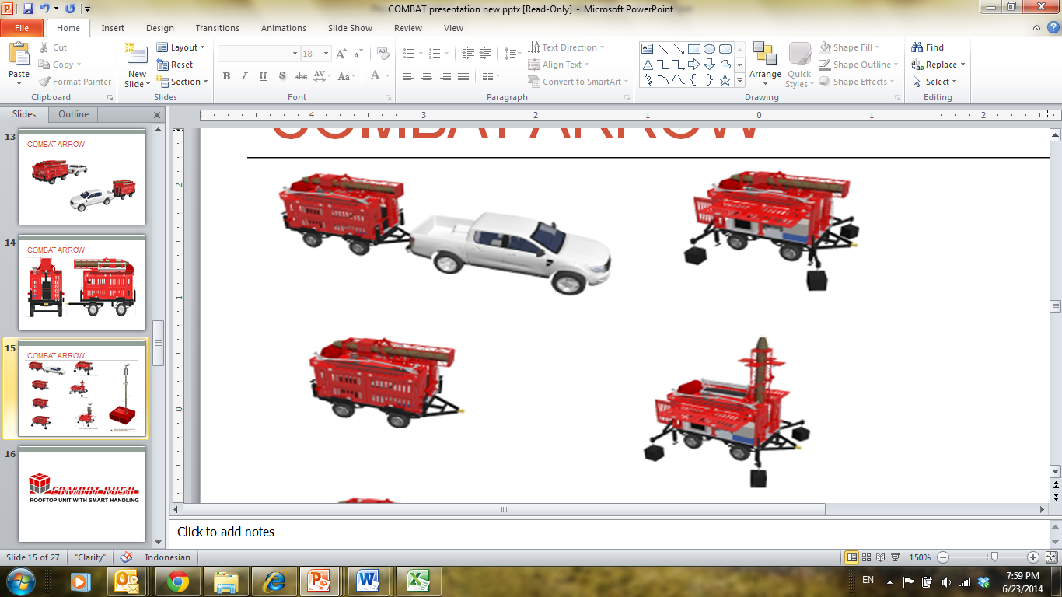
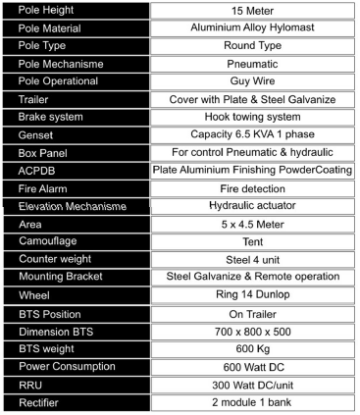
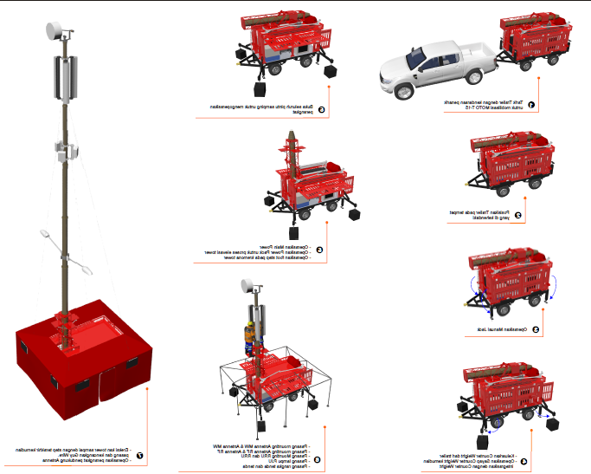
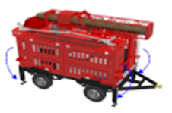

COMBAT ARROW Installation
1
Trailer coupled with Jeep/Truck for COMBAT mobilization
5
Open the side door to prepare operate the equipment
2
Put Trailer on right position
6
Operate Main Power
Operate Power Pack for Tower Elevation
3
Install Manual Jack to hold COMBAT on right position
Take out Counter Weight
Install Counter Weight, Wing, and join them
Install Transmission System
Install RF System (Sector, RRU, etc)
Install Accessories (Tent, Lamp, etc)
4
6
7
Install Guy Wire

Slide 6
CHALLENGES
CHALLENGES
To mobilize mobile BTS “COMBAT” to the area of disaster
e.g. transportation of telecommunication equipment
Set up mobile BTS “COMBAT” during disaster
e.g transmission link
Let’s have TELKOMSEL Mobile BTS “COMBAT” demo…

Slide 7
