Slide 1
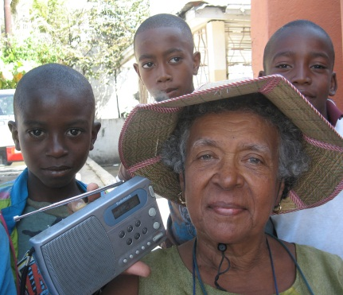
Notes:
Introduce BBC Media Action & UNOCHA
What is Communication with Communities?
Why is it different from public information or media relations?
Who is it for?

Slide 2
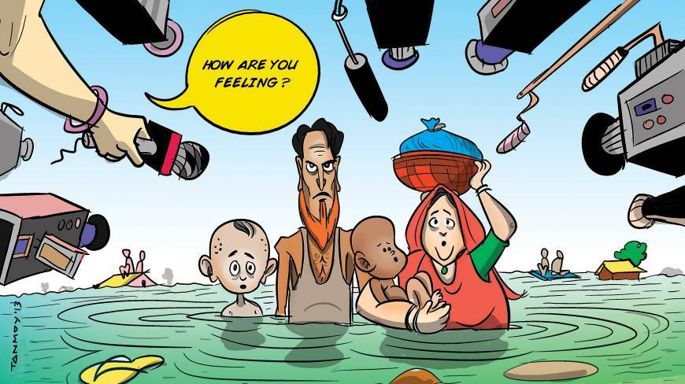
Notes:
Much of conventional communications around humanitarian emergencies – be it from the relief effort (usually media relations people) or from the media – is not focused on the affected people.
Of course, we want to inform unaffected people (internationally and domestically) about what is happening (for visibility, for fundraising, ...) but it is also important to focus on how media and communications can be used to help those directly affected by the disaster.
Let’s take a look at why that’s important...

Slide 3

Notes:
Infoasaid video

Slide 4
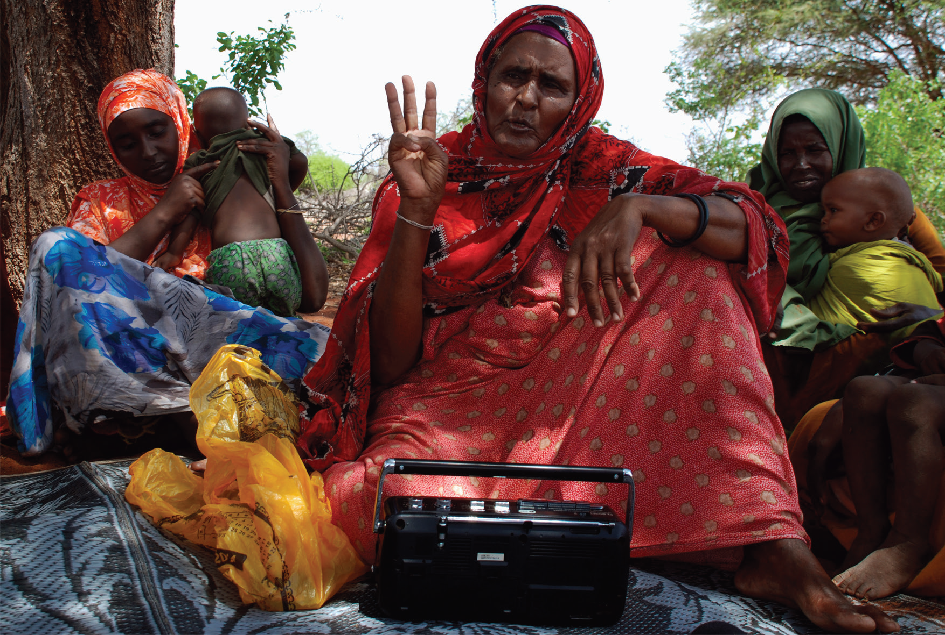
Why communicate with crisis-affected people?
Notes:
Ask question to the group

Slide 5
In times of crisis, communication can...
Save lives
Strengthen the relief effort
Give affected populations a voice
Manage community expectations
Help people help themselves
Hold relief providers to account
Provide pshycho-social benefits
Quash rumours and misinformation
Notes:
5
Some answers

Slide 6
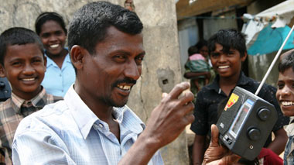
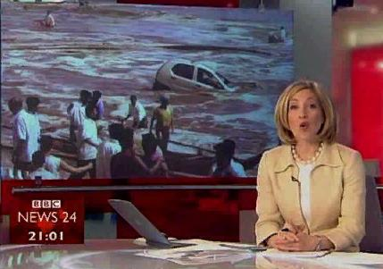
What
Communication with Communities
Information FOR affected populations, not ABOUT them
Communication WITH, Not only information TO
Notes:
6
This is the key.
So let’s have a try...

Slide 7
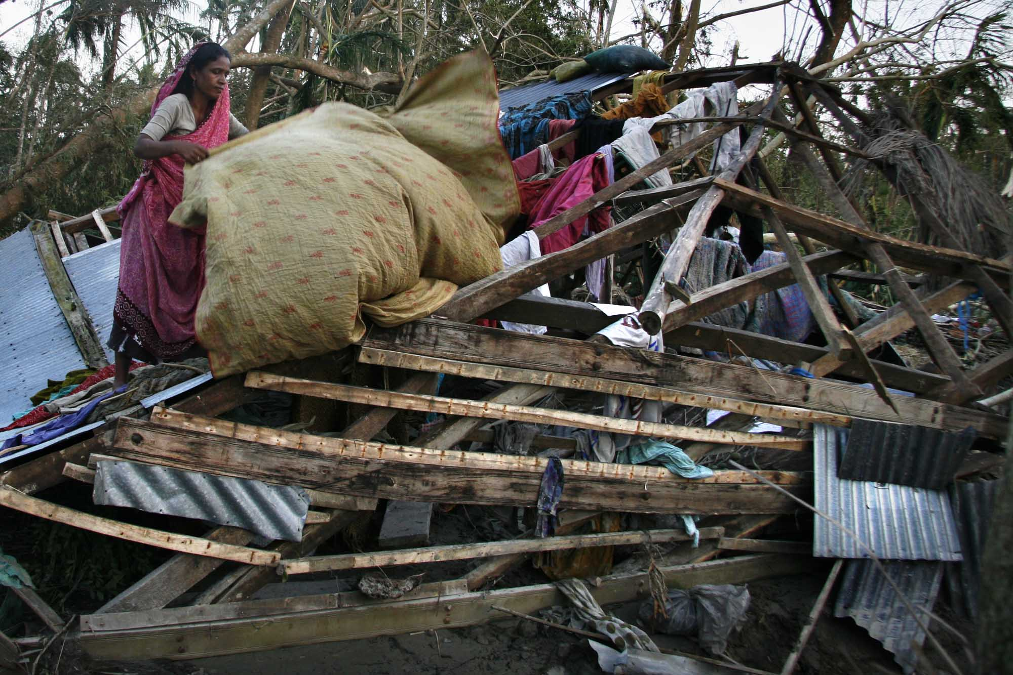
Shoronkhola village, Nov 2007
Photo: Tanvir Ahmed / IRIN
Notes:
Imagine you are the woman in the photo...
What might you want to know, as a result of the situation you are facing?

Slide 8
Practical, actionable information
What happened? What will happen next?
Who are those people in big 4x4s?
Is food coming? Where and how do I get it?
What should I do to stay safe and healthy?
How can I trace my missing family members?
Where is shelter and medical care?
What is happening back home?
Which roads are open?
Notes:
Here are some things that she (and others affected by a disaster) might want to know.

Slide 9
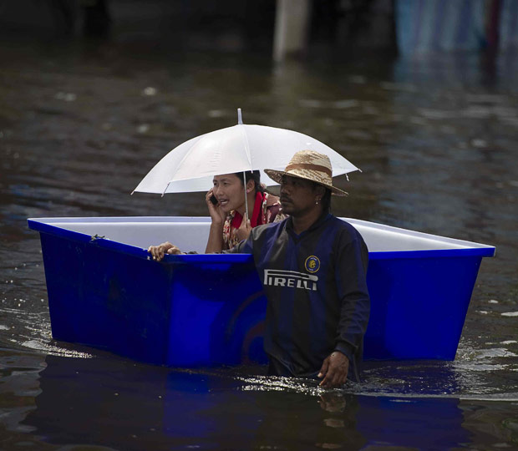
What makes good communication?
Needs-based
Clear
Consistent
Actionable
Positive
Two-way (& responsive!)
Engaging
Local
Multi-channel / platform
Notes:
And here are some key things that, in our experience, make communication work in these situations – not just after a disaster, but also before.
Consistency and coordination are vital, so we need to talk to our friends working in other areas of disaster preparedness and response all the time. Hand to Gerson to talk about how this coordination works in Bangladesh.

Slide 10
Humanitarian principles
We do what we do because it’s needed!
Humanitarian work is founded on:
Humanity,
Neutrality,
Impartiality and
Independence.
Notes:
What motivates humanitarian work is the duty to serve others

Slide 11



Importance of coordination
Religious Groups
Media
United Nations
Media
Red Cross / Red Crescent

Private
Companies
Disaster-affected country
Community Volunteers
Private Companies
Individuals
NGOs, NGOs, NGOs

Religious Organisations
Armed Forces
Government
Government
Notes:
What do we need to know when a disaster strikes? 1. Where (it happened) 2. Who (got affected) 3. What (do they need) 4. How (to respond) ? Too many questions in need of fast answers then coordination is vital!

Slide 12
Coordination success story
A place to share, plan and respond:
History of reducing casualties in cyclone management (early warning, evacuation, shelter),
Timely and appropriate response to floods and landslides in Jun / Jul 2012,
CwC post-cyclone Mahasen : actionable information for people in need of it
Notes:
The biggest success / achievement of a functioning coordination structure is to provide a known place for information sharing, solid planning for timely and appropriate response!

Slide 13
Coordination architecture in BD
STRATEGIC / DEVELOPMENT
18 LCGs
DER
Ag. & Food
Education
Health
WATSAN
Poverty
HCTT
Food Security
Education
Nutrition
Health
WASH
Early Recovery
HCTT composition:
Co-Chairs - DDM and UNOCHA
8 Cluster leads
3 INGO representatives
1 NGO representative
2 Donor representatives
Logistics
Shelter
Child Protection
HUMANITARIAN WORK
Notes:
Bangladesh is a country with clear development goals, and a structured framework to achieve these goals however “disasters” can place a major obstacle along the way,
Bringing humanitarian and development actors together provide an unique opportunity to work on immediate response as much as ensuring long term planning,
The HCTT acts as the operational coordination body for humanitarian preparedness and for the coordination of humanitarian response.

Slide 14
Communications coordination in BD
Communication with Communities Working group – since 2013
  Chaired by DDM
  Co-convened by BBC Media Action & UNICEF with UN OCHA
  Focal point from each cluster
Message library (global and national)
Links to government, UN and INGO systems

Slide 15
Useful contacts
BBC Media Action
  richard.lace@bd.bbcmediaaction.org
  razwan.nabin@bd.bbcmediaaction.org
UN OCHA
  Gerson Brandao (brandaoazevedo@un.org)
  Stewart Davies (davies1@un.org)
UNICEF
  Nance Webber (nwebber@unicef.org)
www.cdacnetwork.org – tools and resources

