Slide 1

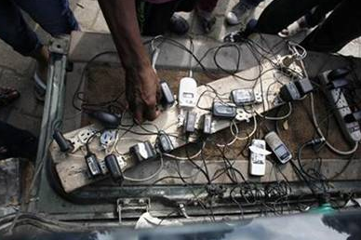
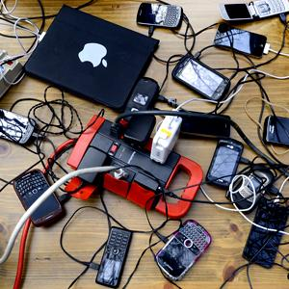
Coordination
Notes:
Some stats on mobile industry penetration and growth
DR programme intro
What this picture shows to me is 2 things- one from haiti and one from philippines- and that is that firstly the demand to communicate in crisis is ubiquitous whether it be via a feature phone or the latest Iphone. This is the technology affected people depend on and are increasingly demanding access to. It also reminds us that all disasters are local events, and that the dynamics and preferences and tools available will be different. Why is this important from a partnership perspective? Because it reminds us that we need to ENGAGE locally- understand these conditions, these players, the capacity and invest from a prepareness perspective the time, energy required to strengthen them. It’s fine for us to chat in luxembourg and barcelona, but it;s relationships at country- level and below that are going to be at the fore of a response for both private sector and the humanitarn communtiy.

Slide 2
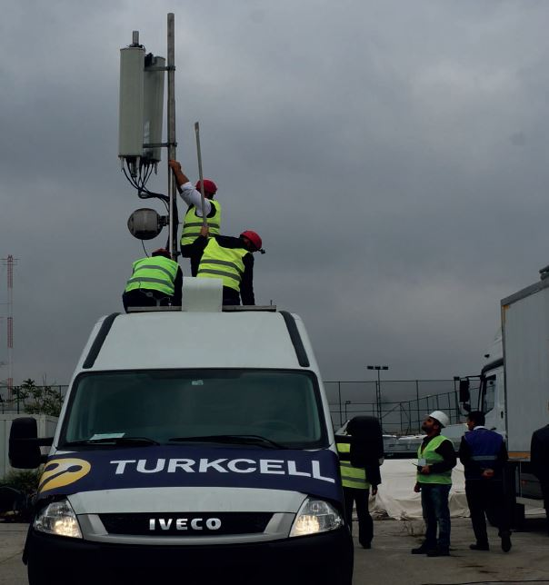
Notes:
One of the challenges to partnership is the perception that mobile operators aren’t doing things themselves in this space, or that their interests are so divergent from those of the humanitarian community that they aren’t dependable or appropriate partners.
Moving towards a better understanding of what these actors are ALREADY doing, what their capacity is and how the humanitarian community can enable and support. Tukcell is a great example of an MNO who under their own volition, has invested substantial resources in the continuity of their communciations in disasters for both financial and humanitarian purposes. They have 9 disaster coordinators within the company across their business functions, and run regular simulations with the national disaster management authorities and other key sectors like commercial power providers. They have also developed a range of customer facing tools and services- for example, if you’re roaming on their network in a country that experiences a disasters, they’re call centre will ring you to find out if you’re okay and send support and information. They’ve also developed an app for UNDP around disaster readiness for their staff.
There are going to be lots of future emergencies where an international presence isn’t requested, but where the expertise of the humanitarian community could be leveraged to improve existing plans to strenghthen and enable locally-led response from an ICT standpoint. There are probably lots of lessons from these kinds of examples that are relevant the other way around.
It also raises one of the final points I’ll make, and that is that like all disasters are different. While Turkcell may have 9 people trained interally in disaster management, and have a host of back up equipment and response procedures the same might not be true of other countries or operators. In order to have meaningful operational partnerships, work needs to be done on the front end to engage locally in –country and establish relationships. It will require stepping out of the humanitarian sphere at times and going to the private sector forums where industries and companies are having these discussions.

Slide 3
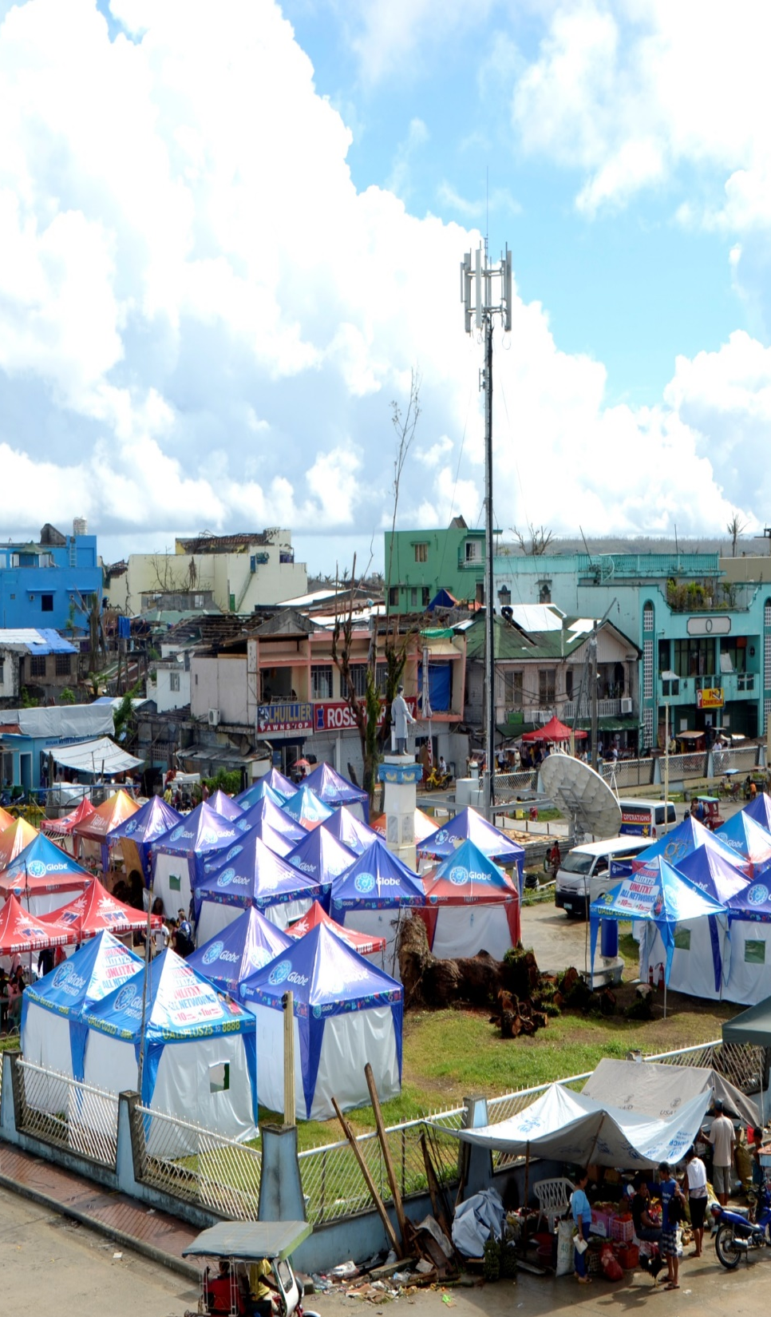

Coordination in Action: Philippines Deployment
Upon request, GSMA deployed to assist with coordination of local MNO’s and international operators and enable a streamlined approach to private sector support
GSMA represented MNOs at UN Cluster meetings and acted as liaison for SMS, mobile money and information requests during the early response
Approximately 1200 Mobile phones were donated by OCHA and Ericsson Response to communities, SIM cards and airtime and distribution provided by Smart and Globe Plc;
GSMA facilitated inter-industry knowledge sharing and support during crisis
Daily MNO signal reports produced by GSMA and shared with ETC, resulting in the provision of significant operational data which allowed for more effective resource planning;
On November 25, in Tacloban, the ETC decommissioned the satellite antennae that provided connectivity for the humanitarian community due to the restoration of SMART fiber optic connection. This has never previously been accomplished in any emergency response.
Notes:
The following activities and outcomes were achieved within the first 6 weeks of the onset of the emergency

Slide 4
What have we learned?
Even the best-prepared MNOs remain vulnerable to the impacts of natural disasters, and will continue to be
Successful coordination during an emergency is in large part dependant on pre-existing trust-based relationships
Mutual benefit, mutual gain is essential to solid partnerships for the mobile industry and its humanitarian partners- there is much untapped capacity/assets in both industries that could be capitalised on
It is easier to coordinate centrally through a few large institutional partners than with a multitude of actors
Commitment to DR activities is market/disaster-proximity dependant- it is likely to always ebb and flow
There is a huge, largely untapped advocacy opportunity to showcase positive steps taking by MNOs, the GSMA and the industry at large with potential for significant reputational uplift
Standardization is more difficult than it appears - All MNOs structure their DR activities differently, from international organisation to service provision and strategy
Restricted - Confidential Information © GSMA 2011

Slide 5
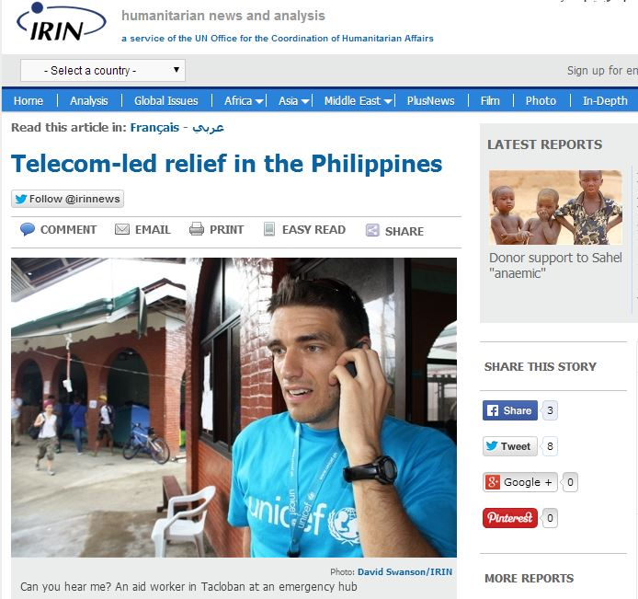
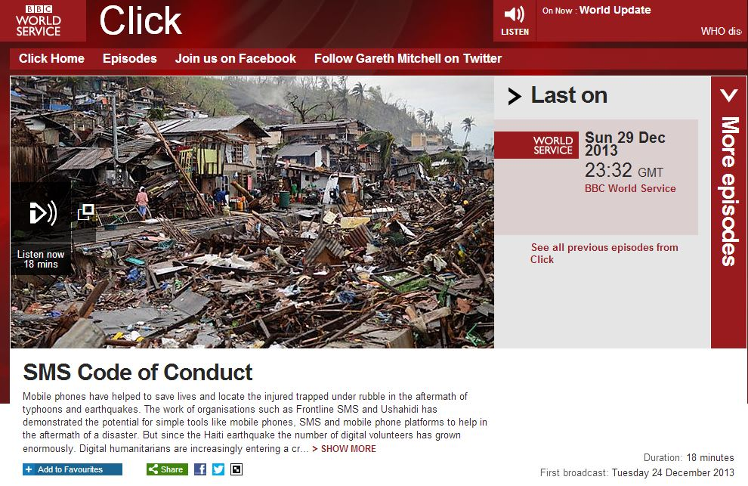
Notes:
- When it’s done right- and there is still a long way to go- the impact can be huge.

Slide 6
Best Practice Guidelines for Coordination
Relationships need to be developed AHEAD of a disaster and partnerships require REGULAR MAINTENANCE
Bi-annual simulations or workshops between partners should be undertaken
A Single Point of Contact with decision making authority on both the side of the humanitarian community and within Mobile Operators is necessary for efficiency and to prevent confusion
Mobile Operators should appoint someone to participate in National Disaster Management Authority Planning meetings and represent them in relevant humanitarian forums
Internal training for MNO-staff involved in disaster-activities should be undertaken
Humanitarian Organisations wishing to use mobile services should coordinate through a centralised function to prevent replication and bombardment
Information sharing needs should be identified ahead of time with standardised templates and channels developed for both directions
Restricted - Confidential Information © GSMA 2011

Slide 7
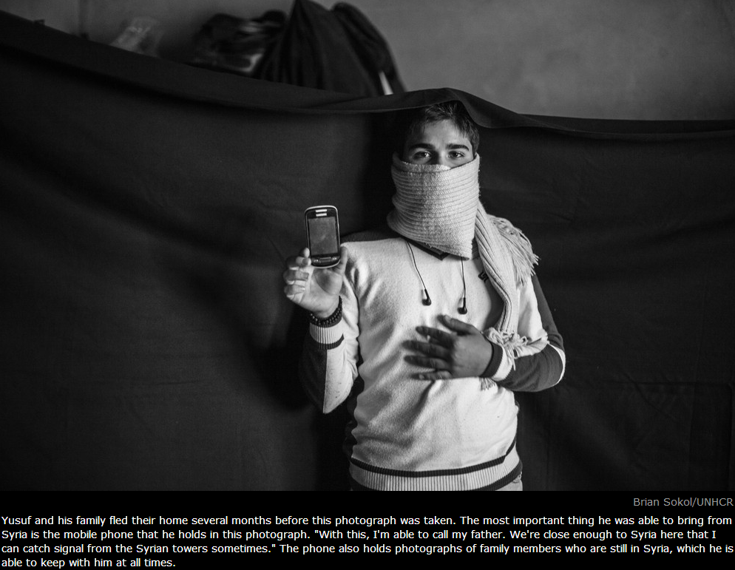
Humanitarian Connectivity Project

Slide 8
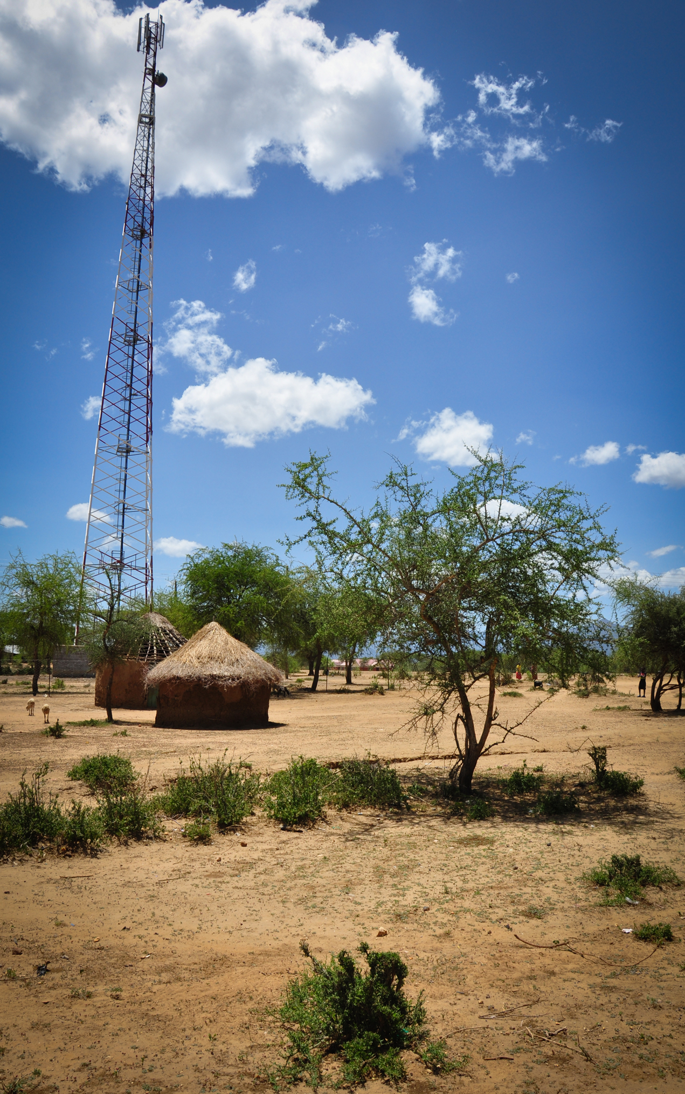

Notes:
You can have all the preparedness and response plans in the world, but I think most in this room know that they’re only as good as the capacity and partnerships that sit under them. If you’ve got a great programme for mobile vouchers, or an SMS needs assessment but there is no connectivity, you’re out of luck. Similarly, if you’re a mobile operator that has all the emergency equipment stockpiled, but you can’t get access to transport assets to move it to affected areas, you’re out of luck. If mobile access expands as we predict it will, and the next billion are afforded access to the internet for the first time through mobile broadband, demands for reliable connectivity and the information and services it supports will only proliferate, and have more of an impact on how we all work, and work together. If mobile is critical to humanitarian response and fundamentally to the capacity of affected populations to strengthen resilience and response capacity, than we need to think in broad terms about how we work together at the global, and more importantly at the local level to develop the partnerships required to meet these needs and opportunities- I’m glad to say that I feel confident that we’re heading in the right direction.

Slide 9
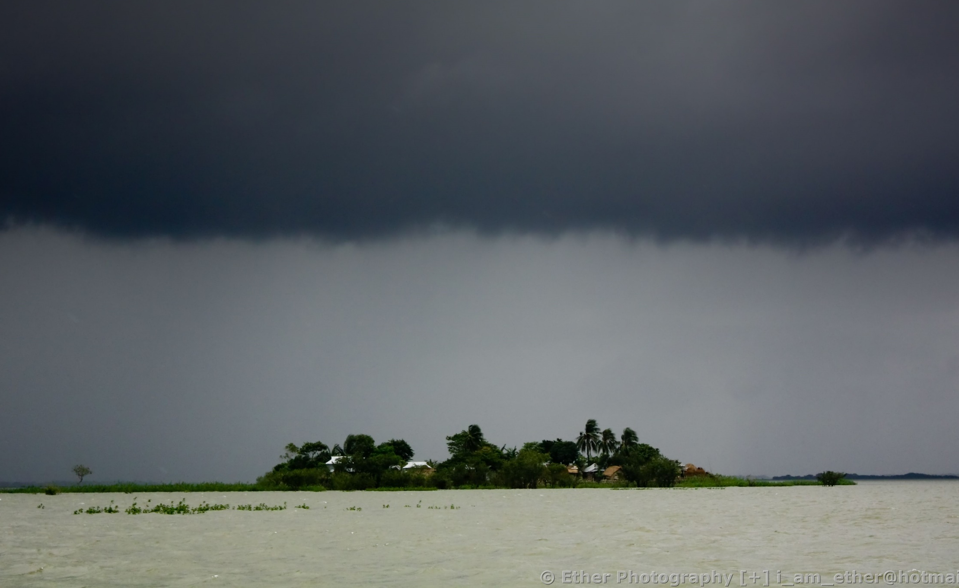
Bangladesh Workshop: Disaster Response
When you restore the mobile network, you restore the human network.

