Slide 1

Disaster Response task
A major cyclone hits Bangladesh. Commercial power has failed in some affected areas and 4 days later mobile networks, though initially disrupted in the worst hit regions have since largely been restored. 1 million people were evacuated from coastal areas and are residing in temporary shelters, schools, hospitals and community centres. 10 million people could face life threatening conditions. Humanitarian organisations and mobile operators are exploring how mobile can play a role in the response.
Further info:
Information is scarce
Cashpoints are offline
People generally still have their devices but limited charging facilities

Slide 2
Disaster Response scenario
In what ways could mobile be most impactful in preparedness and response? Please prioritise.
Format slides for task

Slide 3
Disaster Response scenario
What information needs would a) NGOs b) MNOs c) Governments need to determine which mobile services are most feasible?
Format slides for task

Slide 4
Disaster Response scenario
Who you would need to partner with?
What challenges/barriers would you anticipate encountering?
Format slides for task

Slide 5
Disaster Response scenario
What do you think are the most critical next steps for future disaster preparedness and response in relation to mobile?
Format slides for task

Slide 6
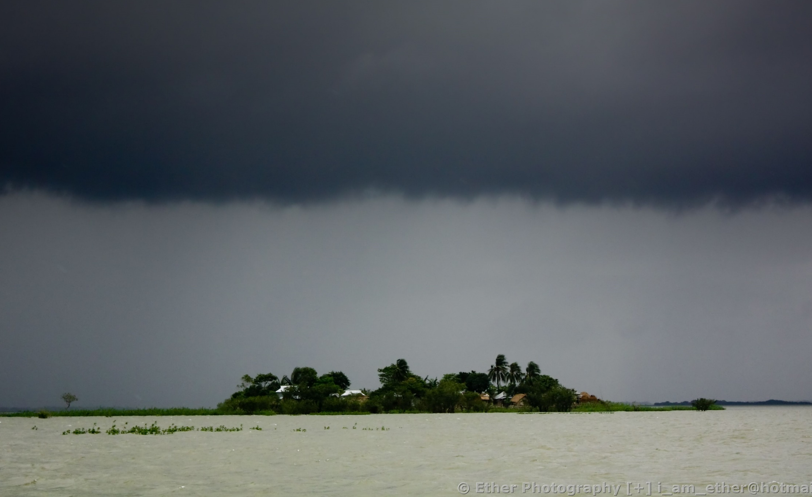

Bangladesh Workshop: Disaster Response
When you restore the mobile network, you restore the human network.

