Slide 1


Disaster Response at Grameenphone
Corporate Responsibility

Slide 2
Corporate Responsibility Strategy Framework
Externally Focused Initiatives
Responsible Business Practices
1. Business Integrated CR
Codes of Conduct
Suppliers Conduct Principles
HSSE
Human Rights
Labour Rights
Environment Management System
Supply Chain and other policies
Enable
Safe
Climate
eLearning
mHealth
2. Social Business
Owned by all the division of the company.
3. Disaster Response
3. Disaster Response

Slide 3
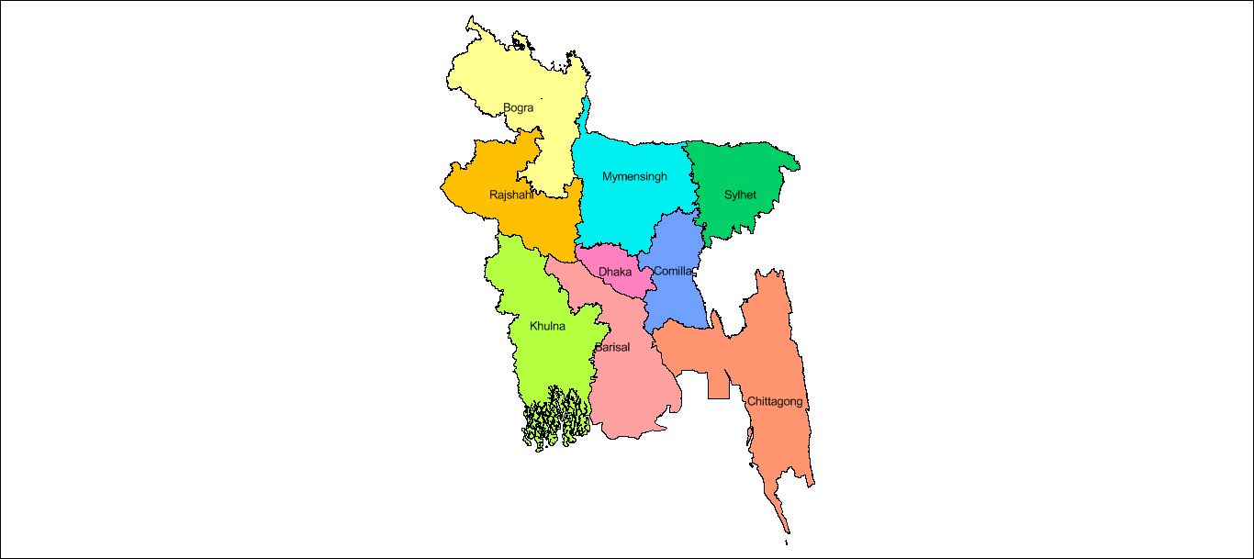
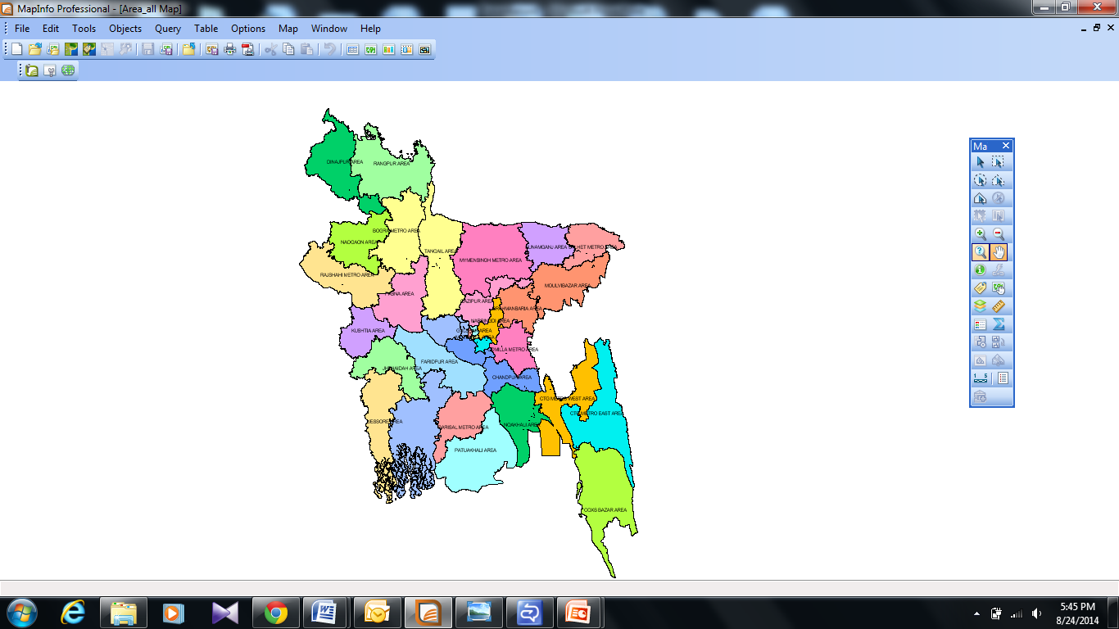
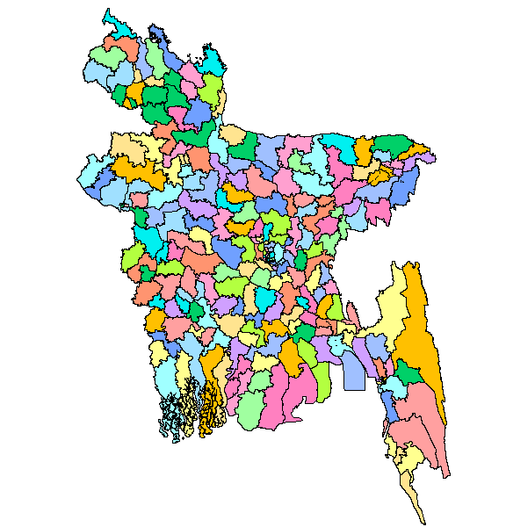
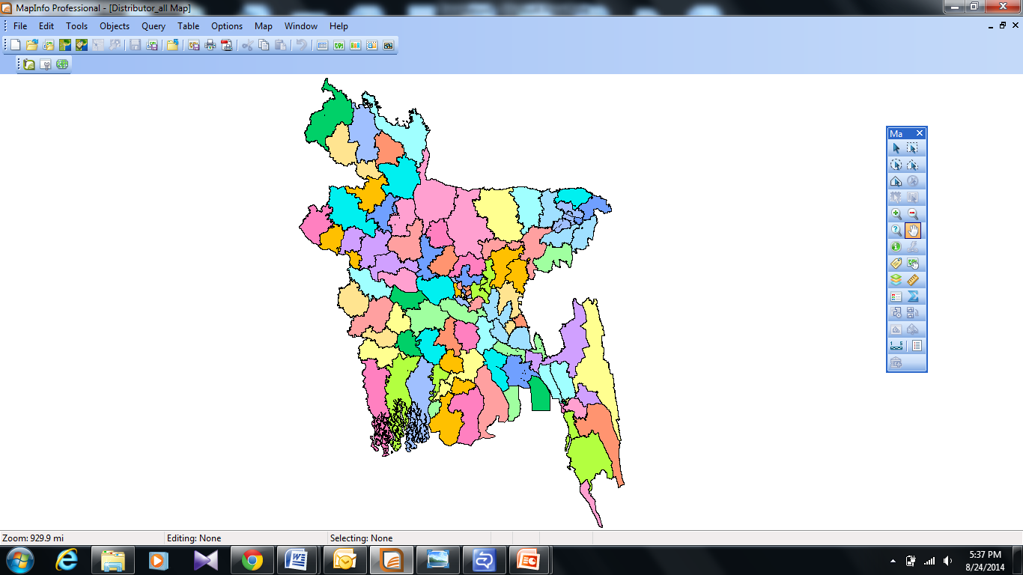
34 Area
9 Regions
Distribution Network
222 Territory
114 Distribution Houses

Slide 4
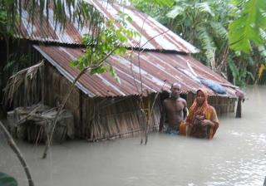
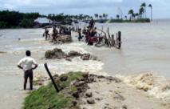
Recent Flood at Barishal (July – August, 2014)
Near about 30 villages in Bhola and Barisal District have been affected by flood where water from the overflowing Meghna River swept over broken dykes.
Houses, schools, mosques, farmland and fish enclosures were badly affected and in some areas went 5 feet under water.
Caused shortage of Pure drinking water, food and shelter.

Slide 5
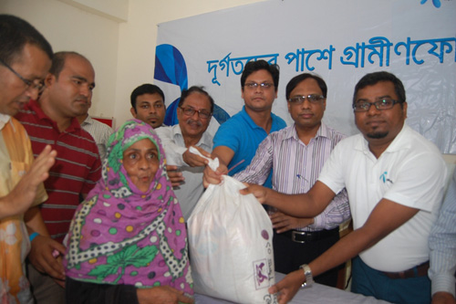
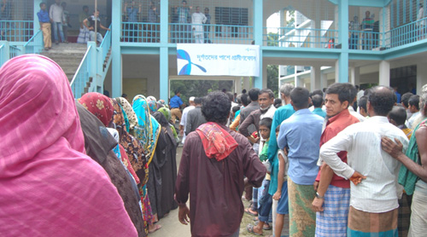
GP’s Intervention
Grameenphone distributed 5000 family packs at Dhonia, Rajapur, Char Madraj, Monpura, Hazirhat, North Sakuchia and South Sakuchia unions of Bhola under Corporate Responsibility initiative.
Each family pack contained
    Rice
    Lentil
    Edible oil
    Emergency medications (Oral saline, Water purification tablets etc.) &
    Pure Drinking Water

Slide 6
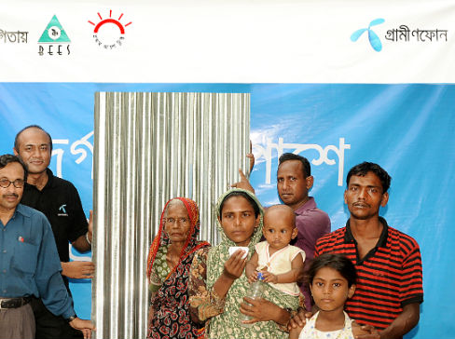
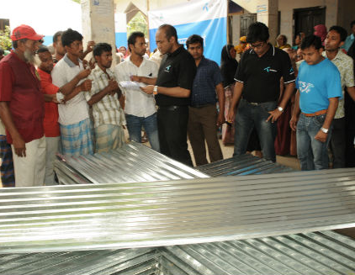
Corrugated Iron Sheets for Tornado Victims of Brahmanbaria (April, 2013)
Iron sheets, locally known as Tin were distributed among 100 families to help them to rebuild their houses.

Slide 7
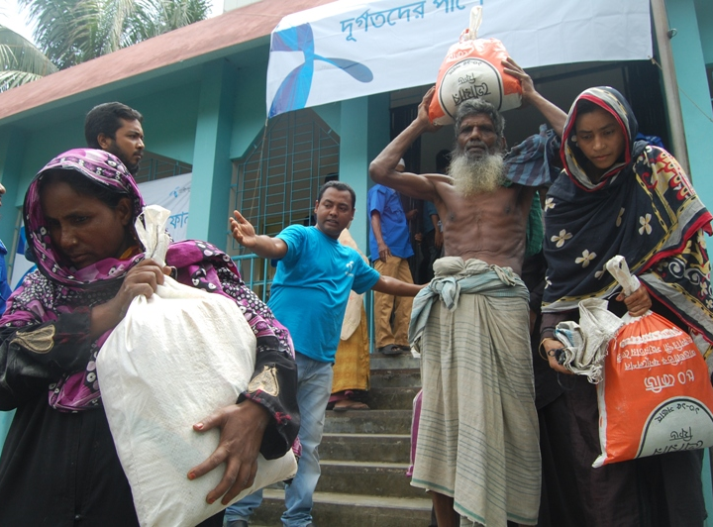
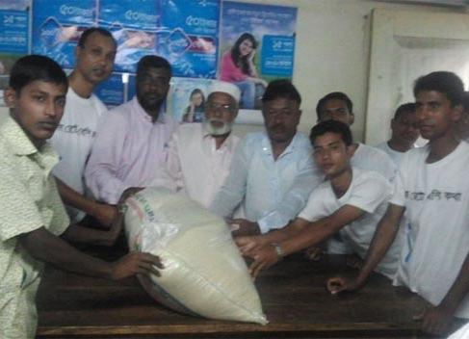
Support for Tornado Hit Coastal Belts of Noakhali
(October, 2012)
Relief distribution among tornado hit most affected victims at Hatiya and Subarnachar

Slide 8
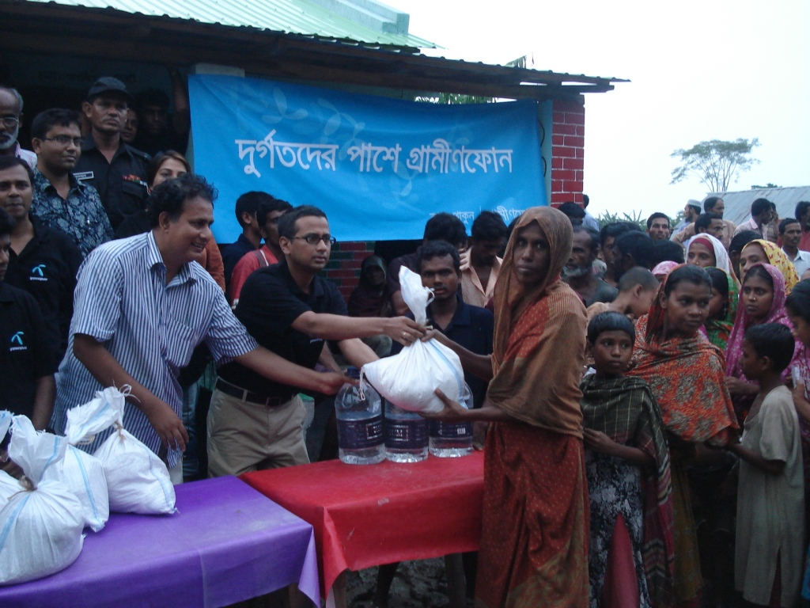
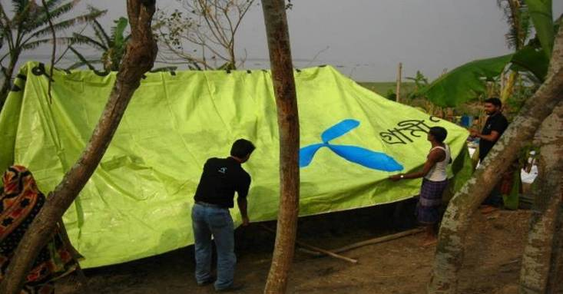
Cyclonic storm AILA and GP’s intervention (2009).
At least 178 people including five children died and over 6,700 people were reported injured in coastal districts after cyclone ‘Aila’ hit the coastal belt.
Hundreds and thousands of people became homeless while the cyclone washed away villages, roads and livestock.
  Relief effort:
  6000 family packs were distributed
  2600 people received treatments and medicine through 5 medical teams
  Temporary shelter had been provided with our used billboard wrapper

Slide 9
GP stands beside SIDR victims (2007)
At least 3,447 deaths have been reported suspected the death toll to reach as high as 10,000.
Over 3,000 other fishermen were reported missing on over 500 fishing boats.
Millions were homeless
Total damages came close to $450 million

Slide 10
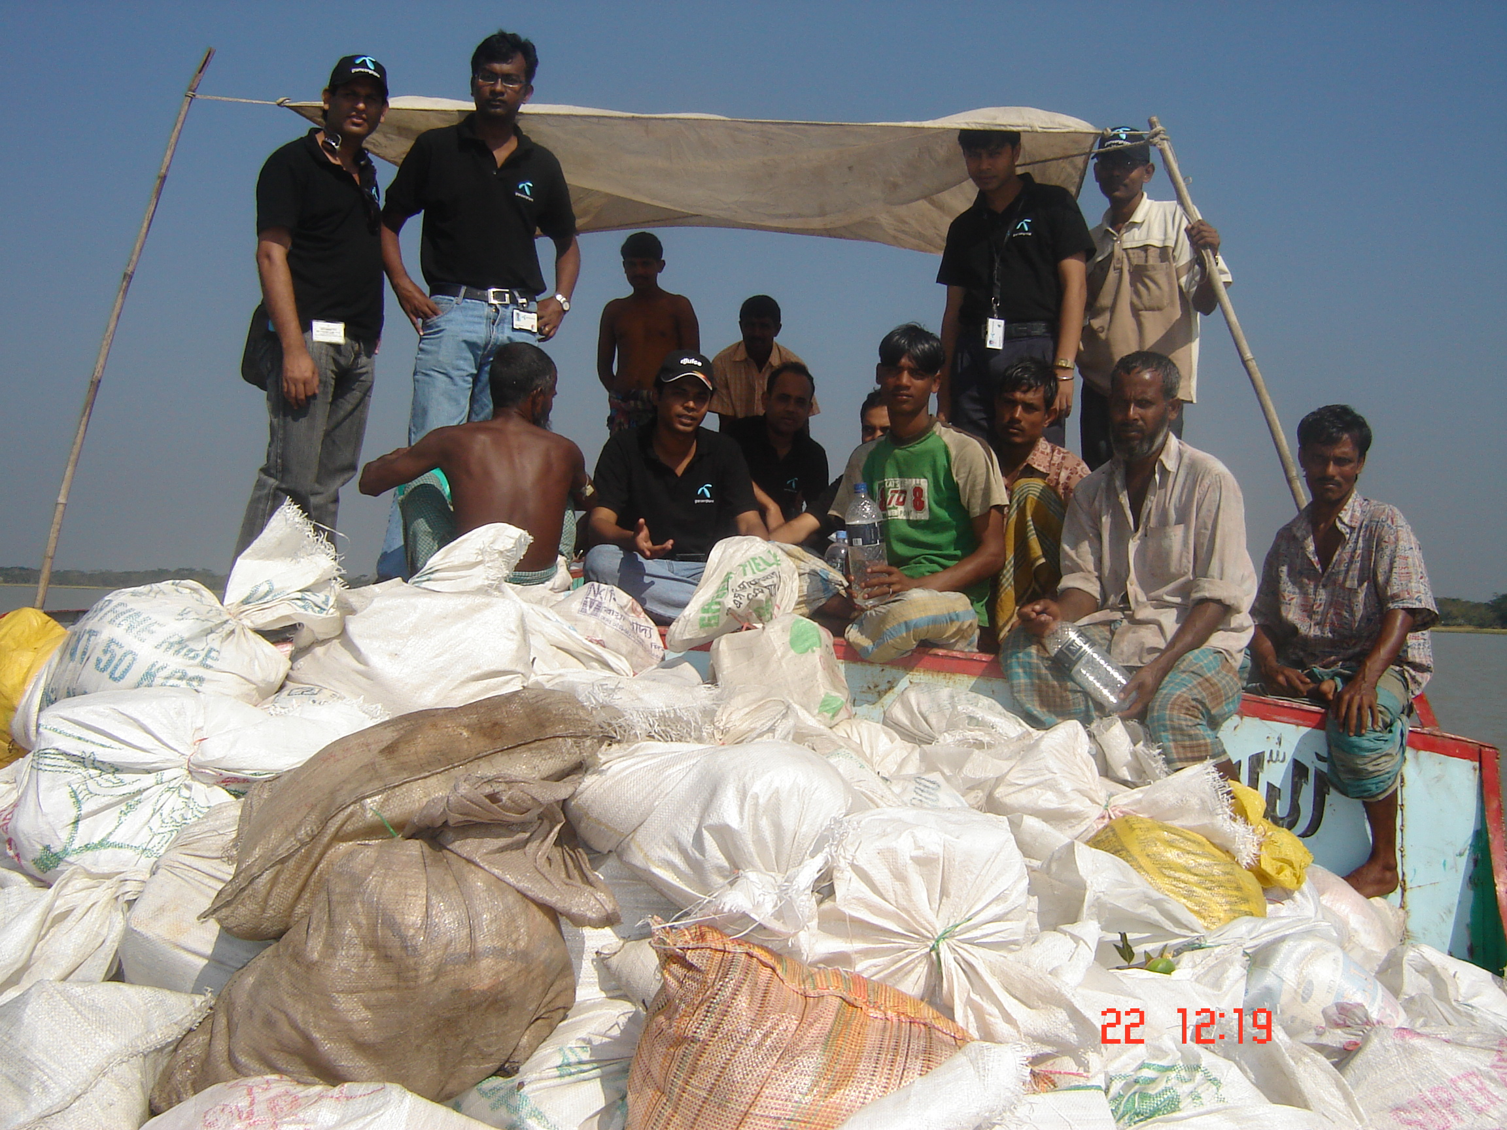
Almost 200 employees voluntarily participated in the relief effort

Slide 11
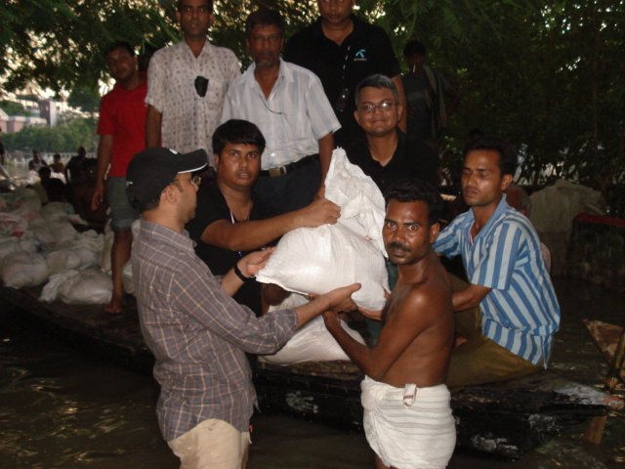
14,000 family packs were distributed

Slide 12
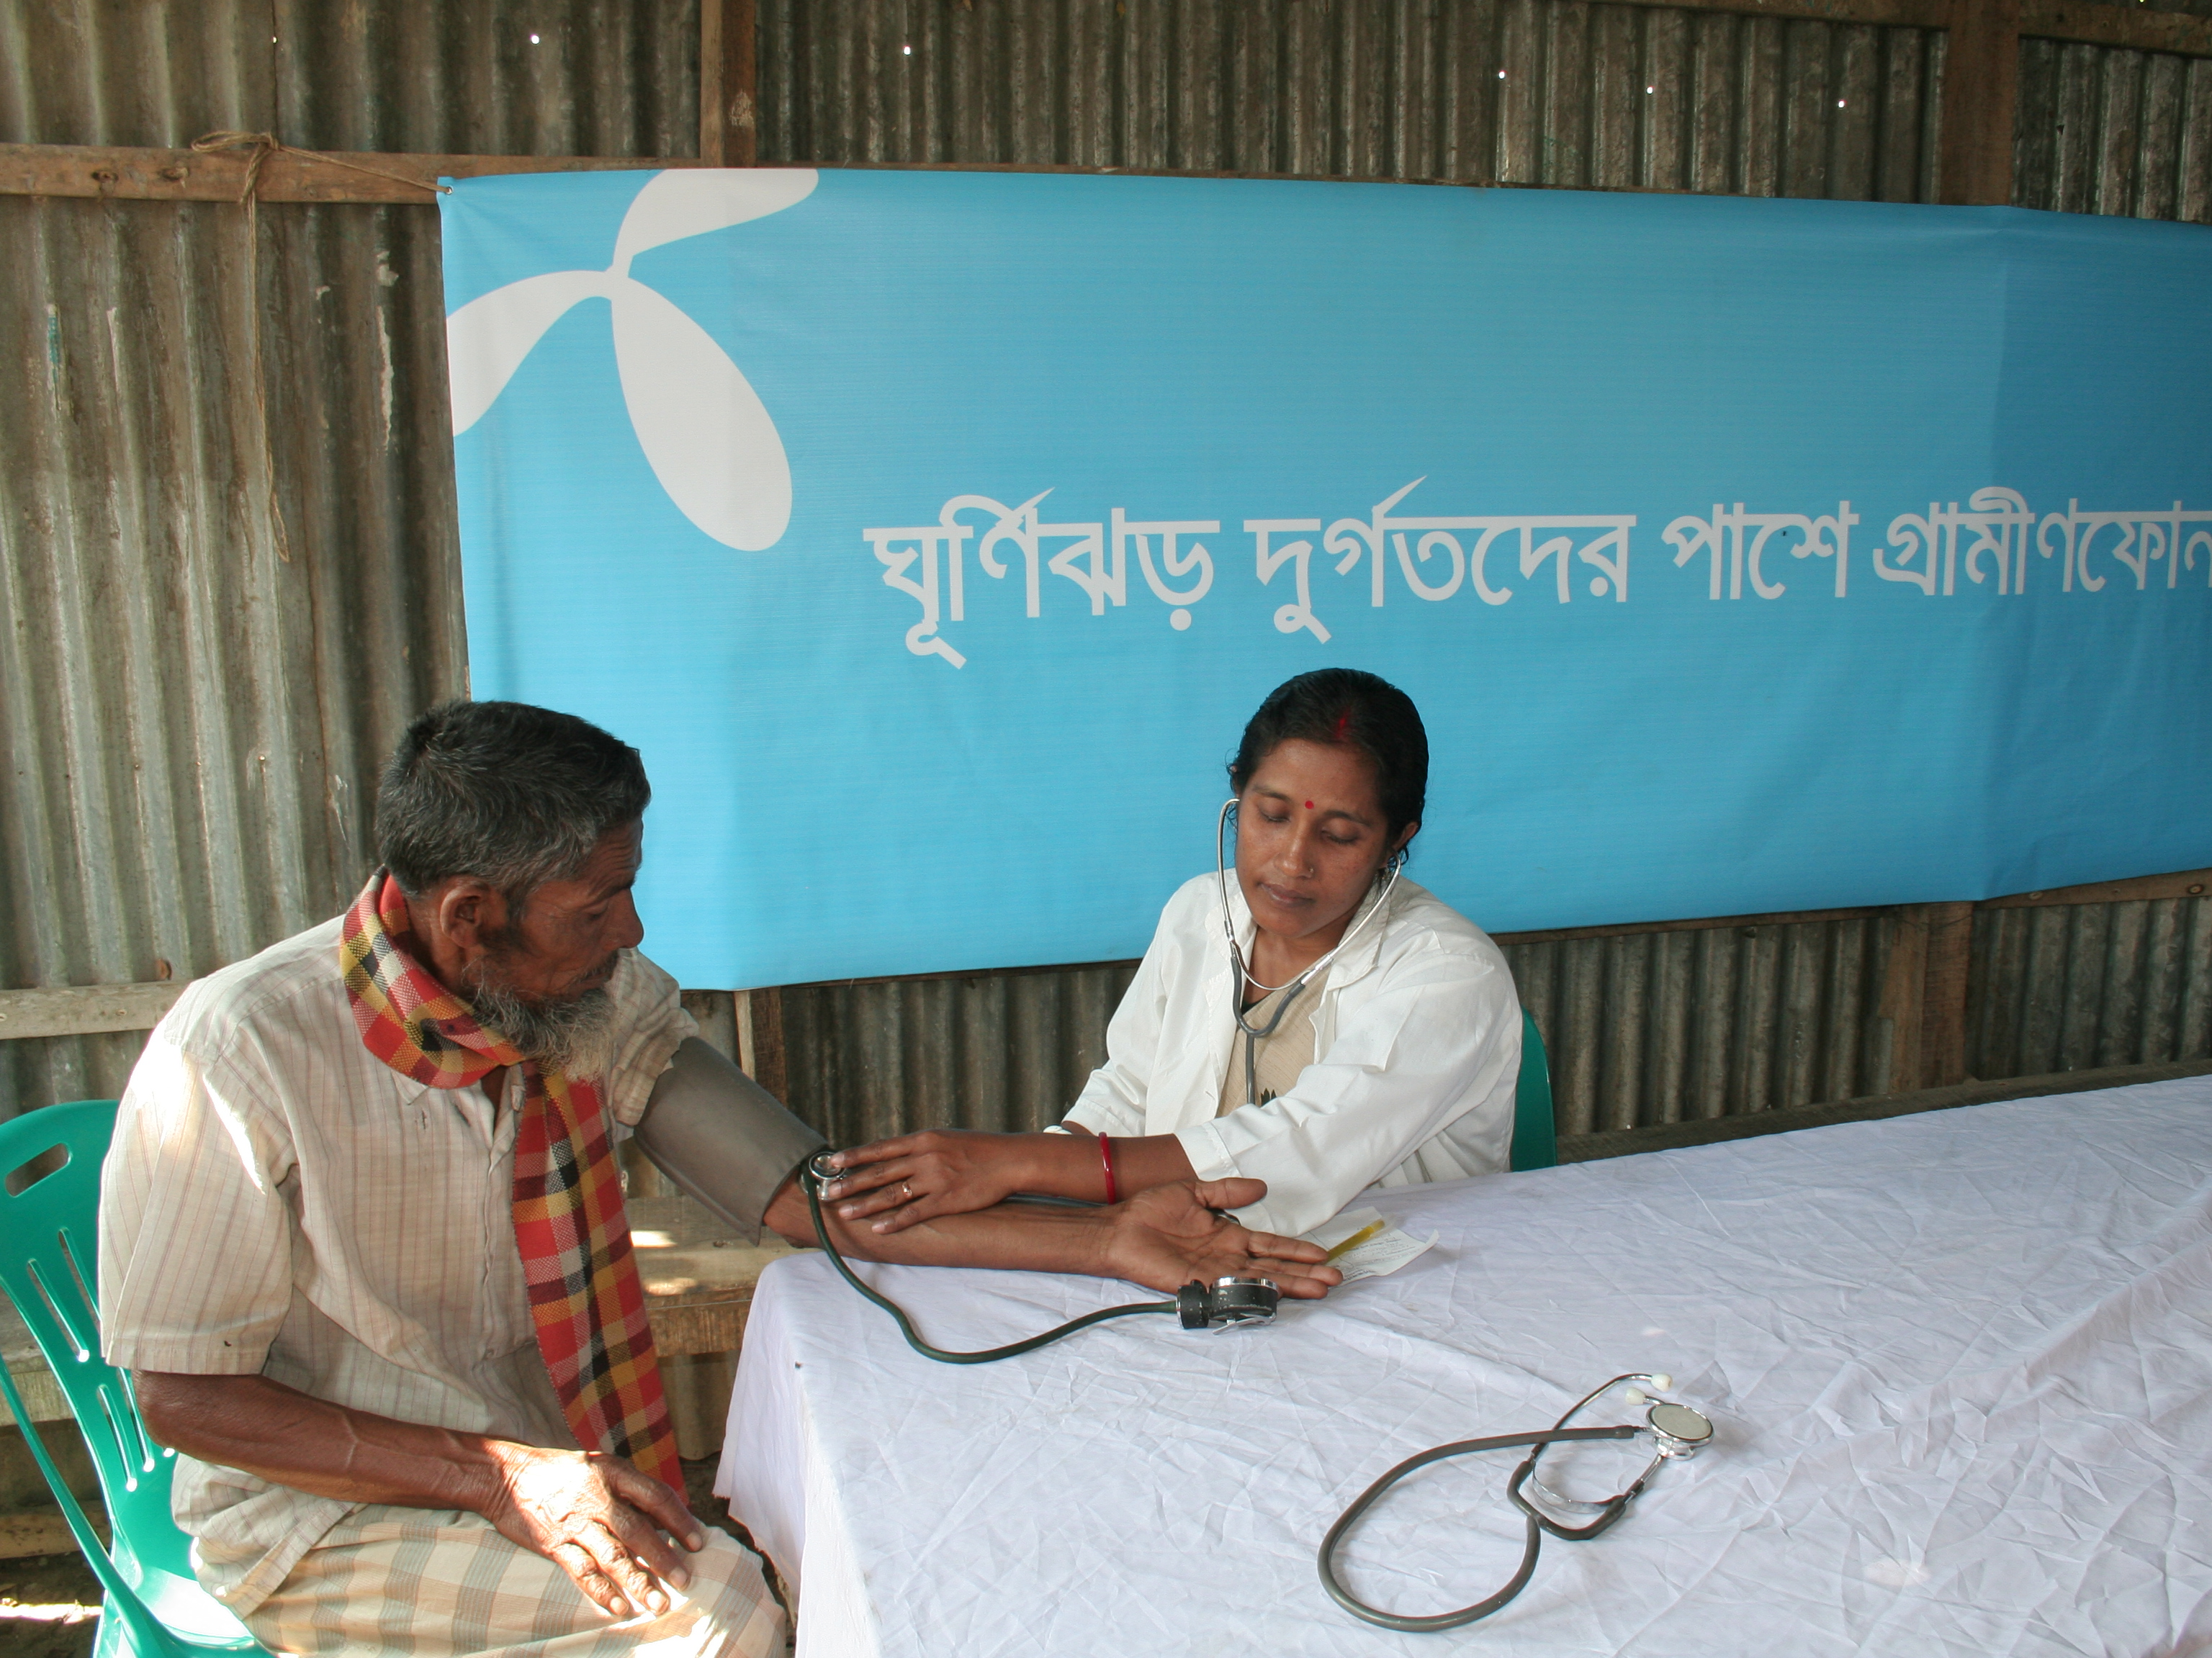
16,000 patients received treatment from 16 medical camps

Slide 13
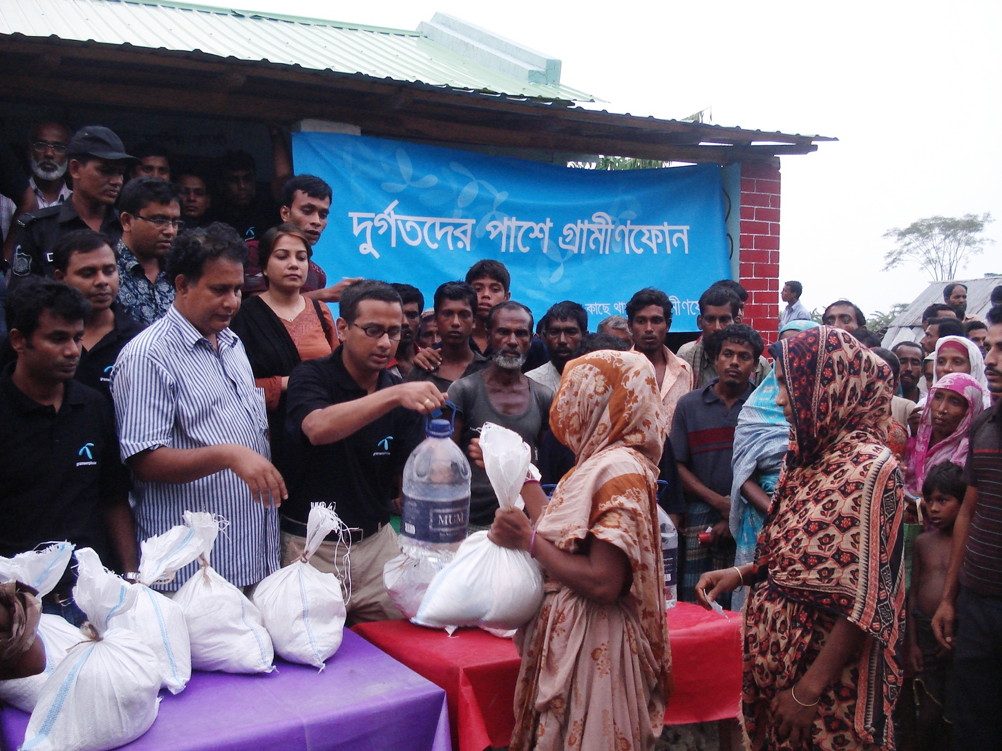
GP employees donate 1-day salary to help SIDR victims

Slide 14
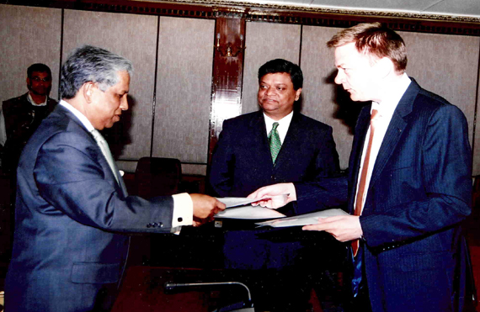
Financial contribution to Chief Advisor’s Emergency Relief fund

Slide 15
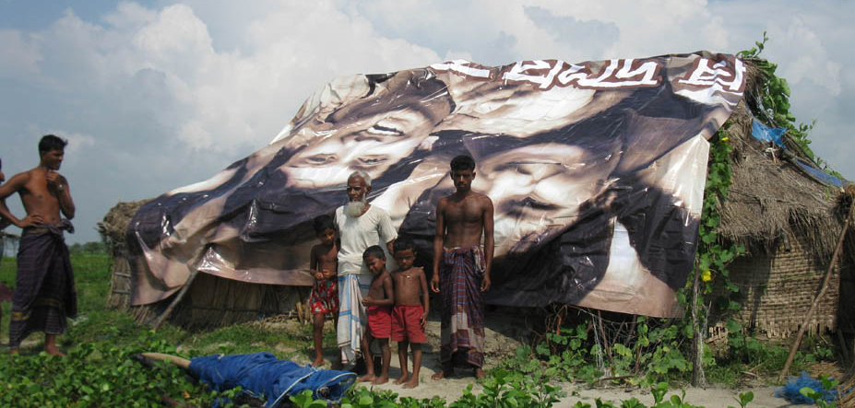
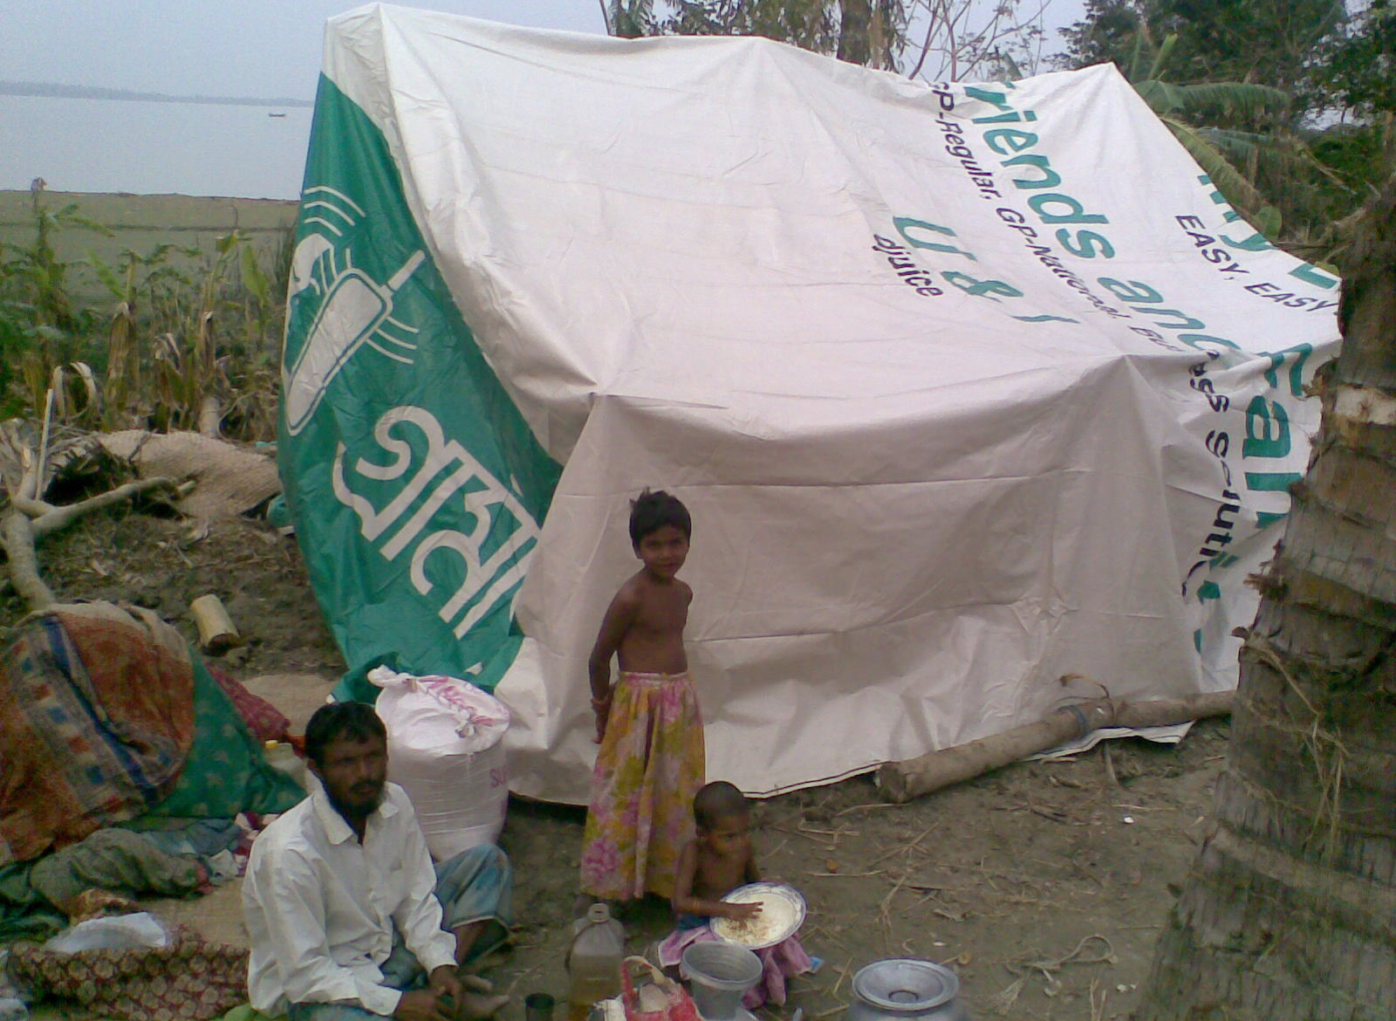
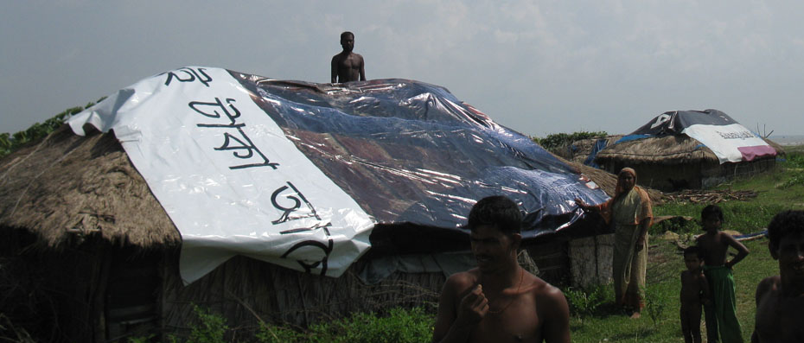
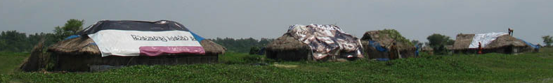
Used Billboard Wrapper as Temporary Shelter

Slide 16
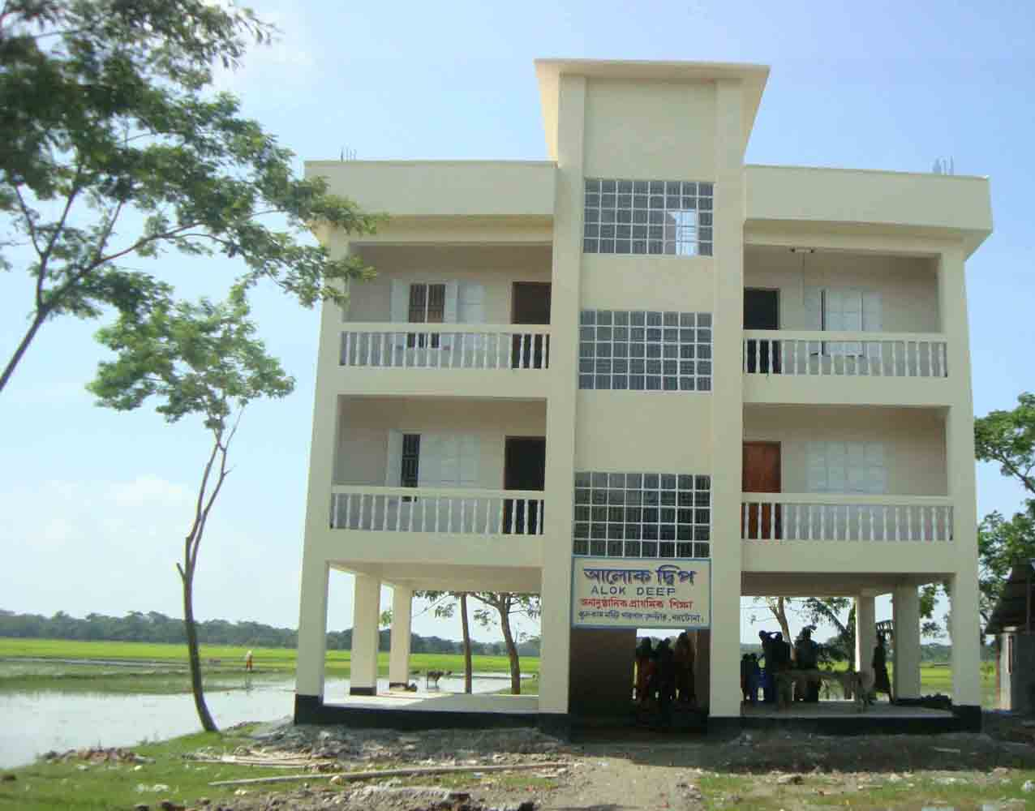
Constructed 4 Cyclone Shelters along the coastal belt (Pathorghata & Nishanbaria at Borguna and Southkhali & Shoronkhola at Bagerhat)

Slide 17
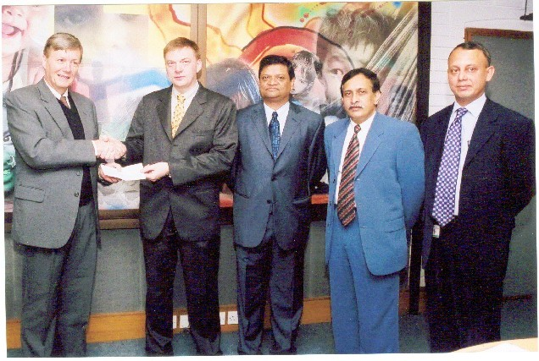
Extending Help for Tsunami victims (2004)
Touched by the suffering of the people in the neighboring countries, the GP users whole-heartedly participated in this fund-raising SMS drive, which surpassed all expectations.
Grameenphone matched the total amount generated from SMS traffic and donated the amount to UNICEF for Tsunami victims.

Slide 18
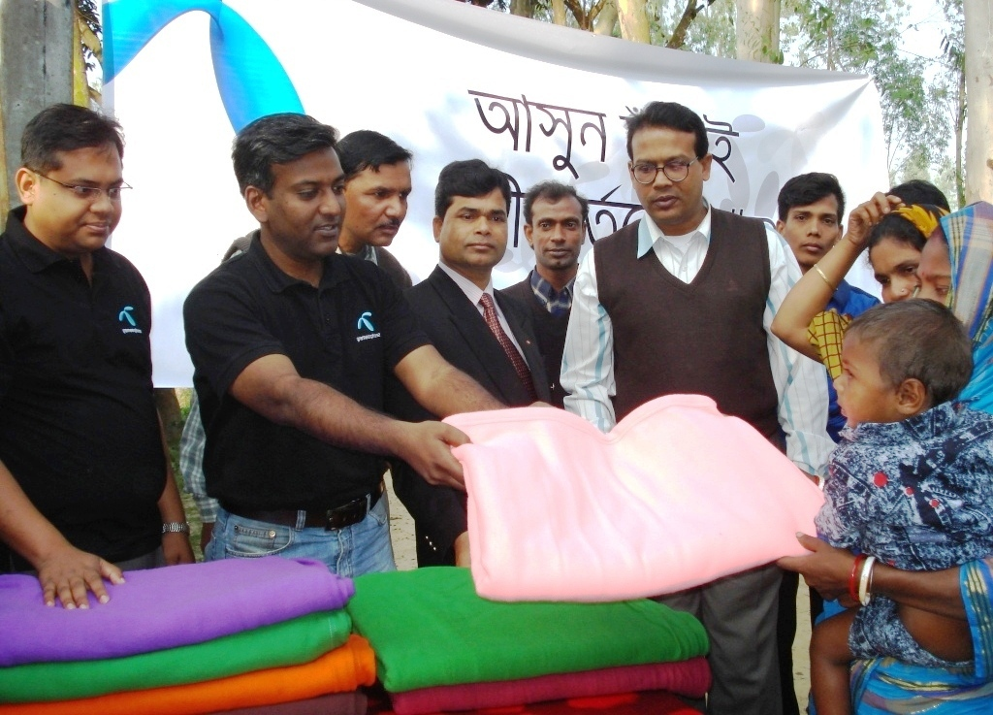
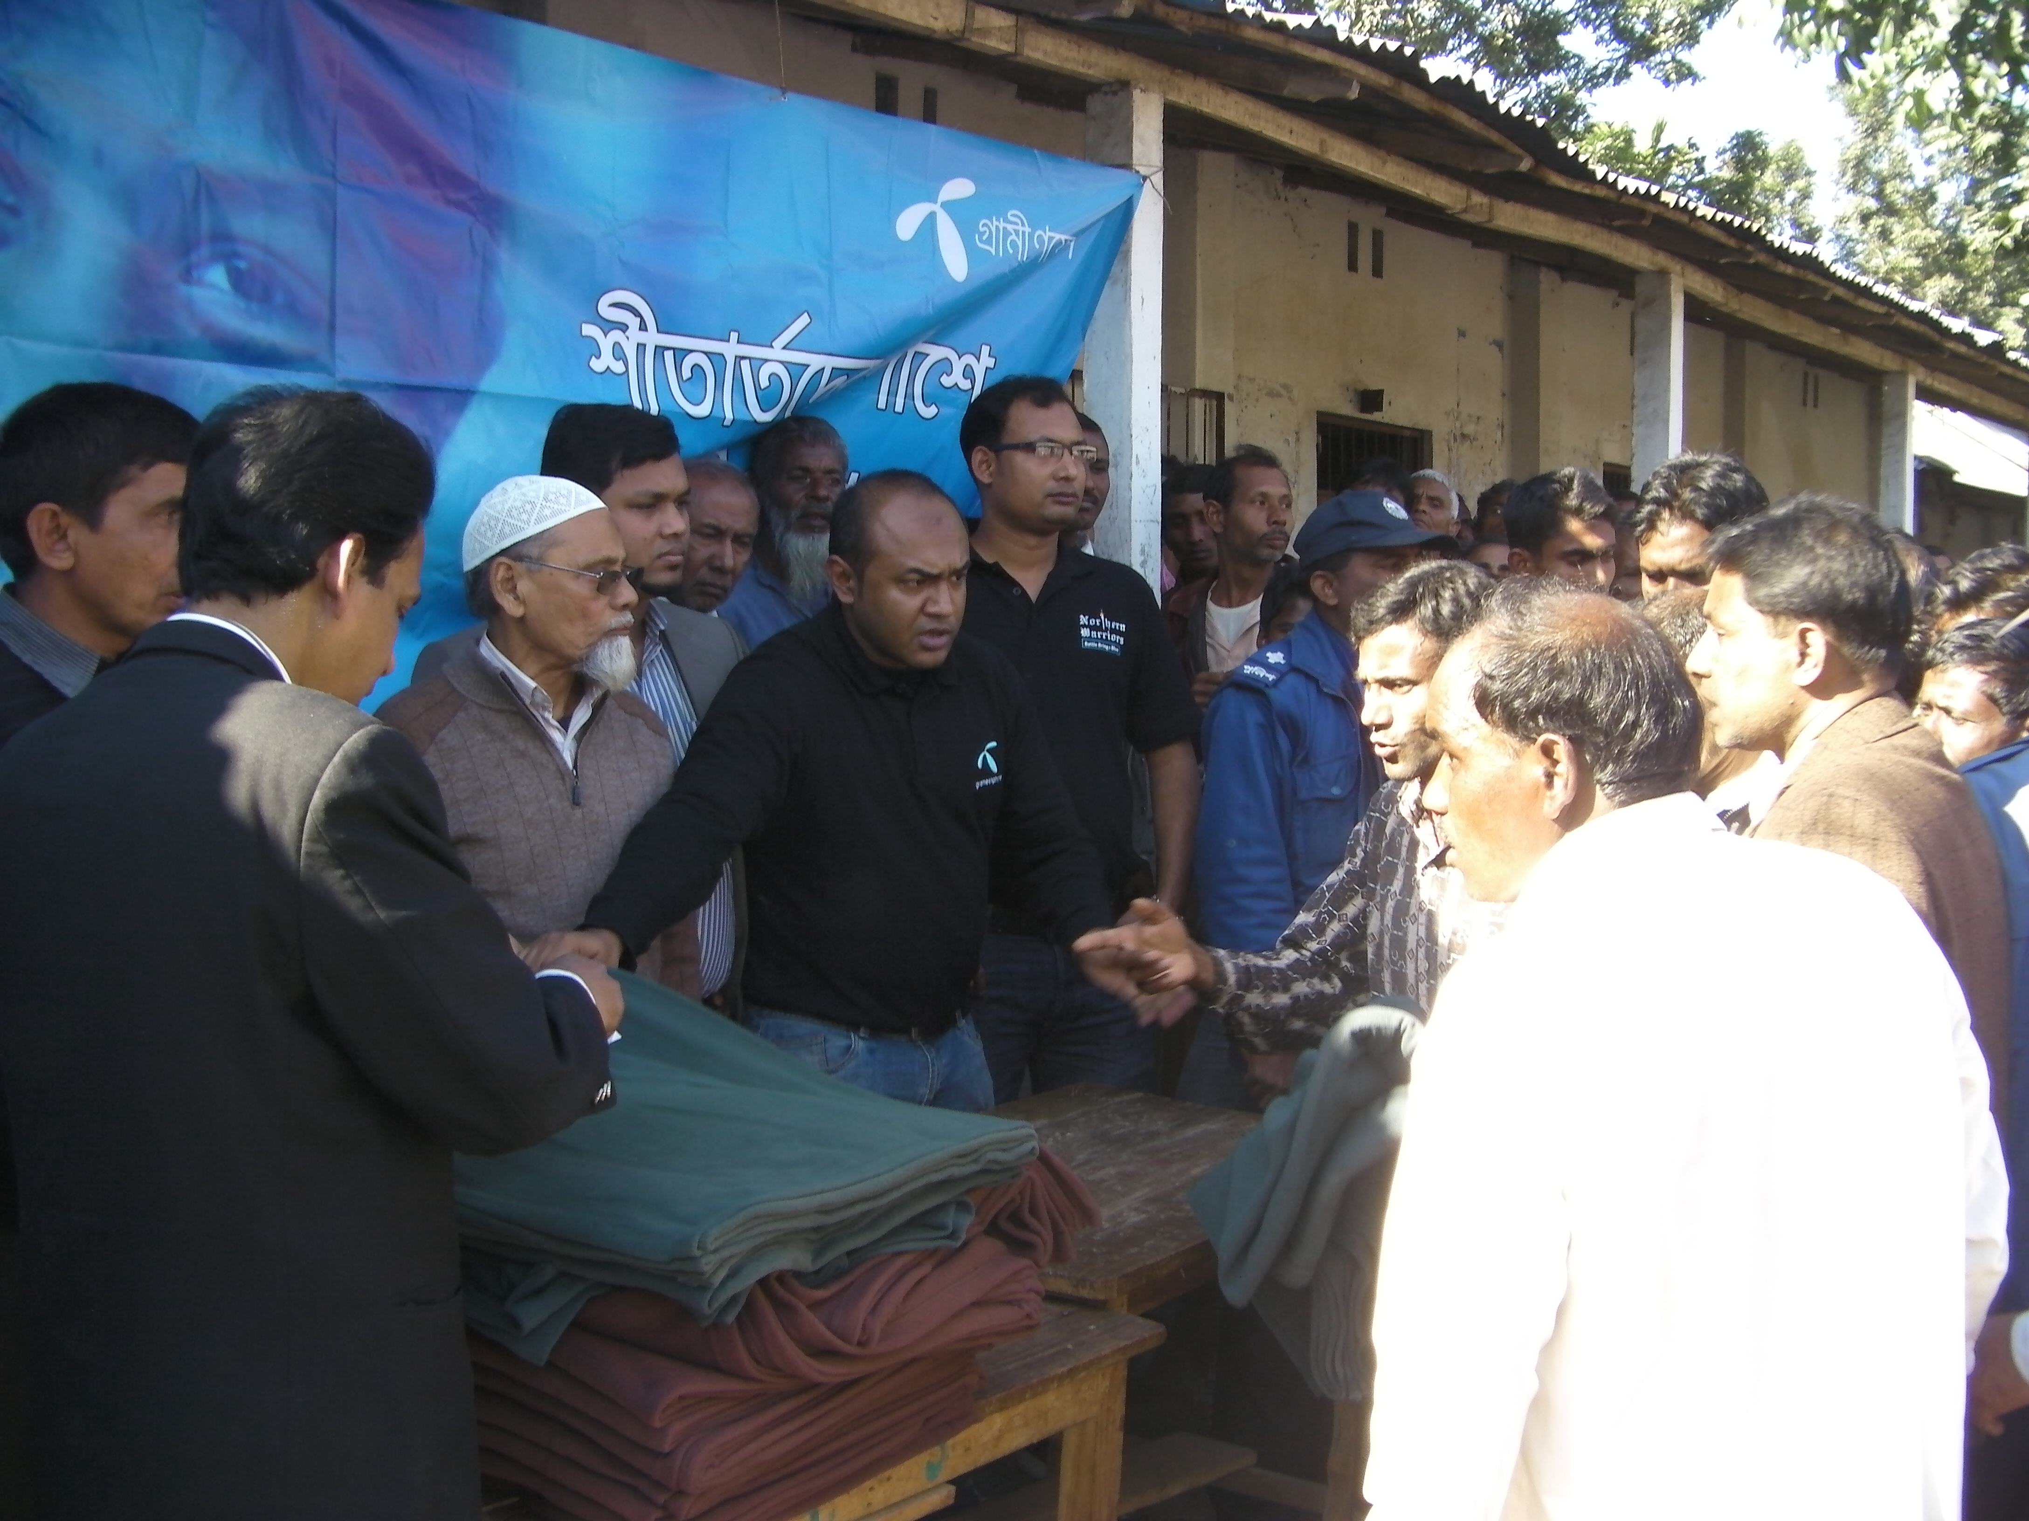
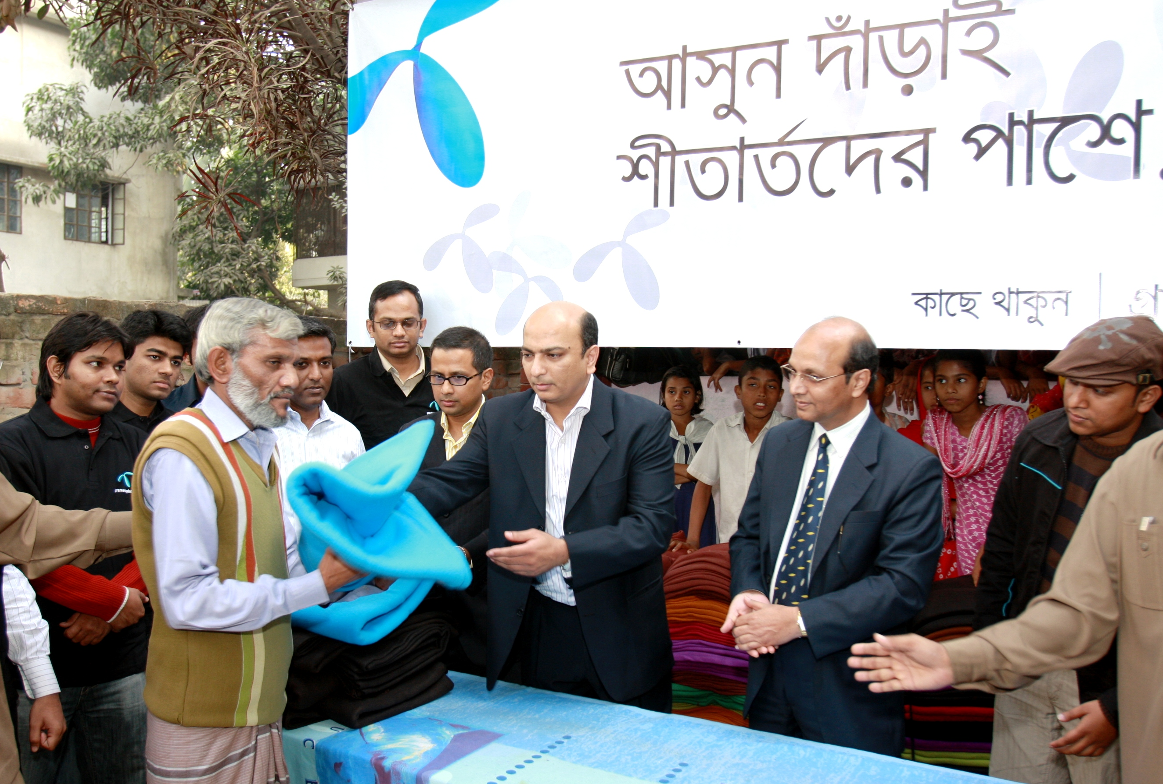
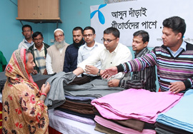
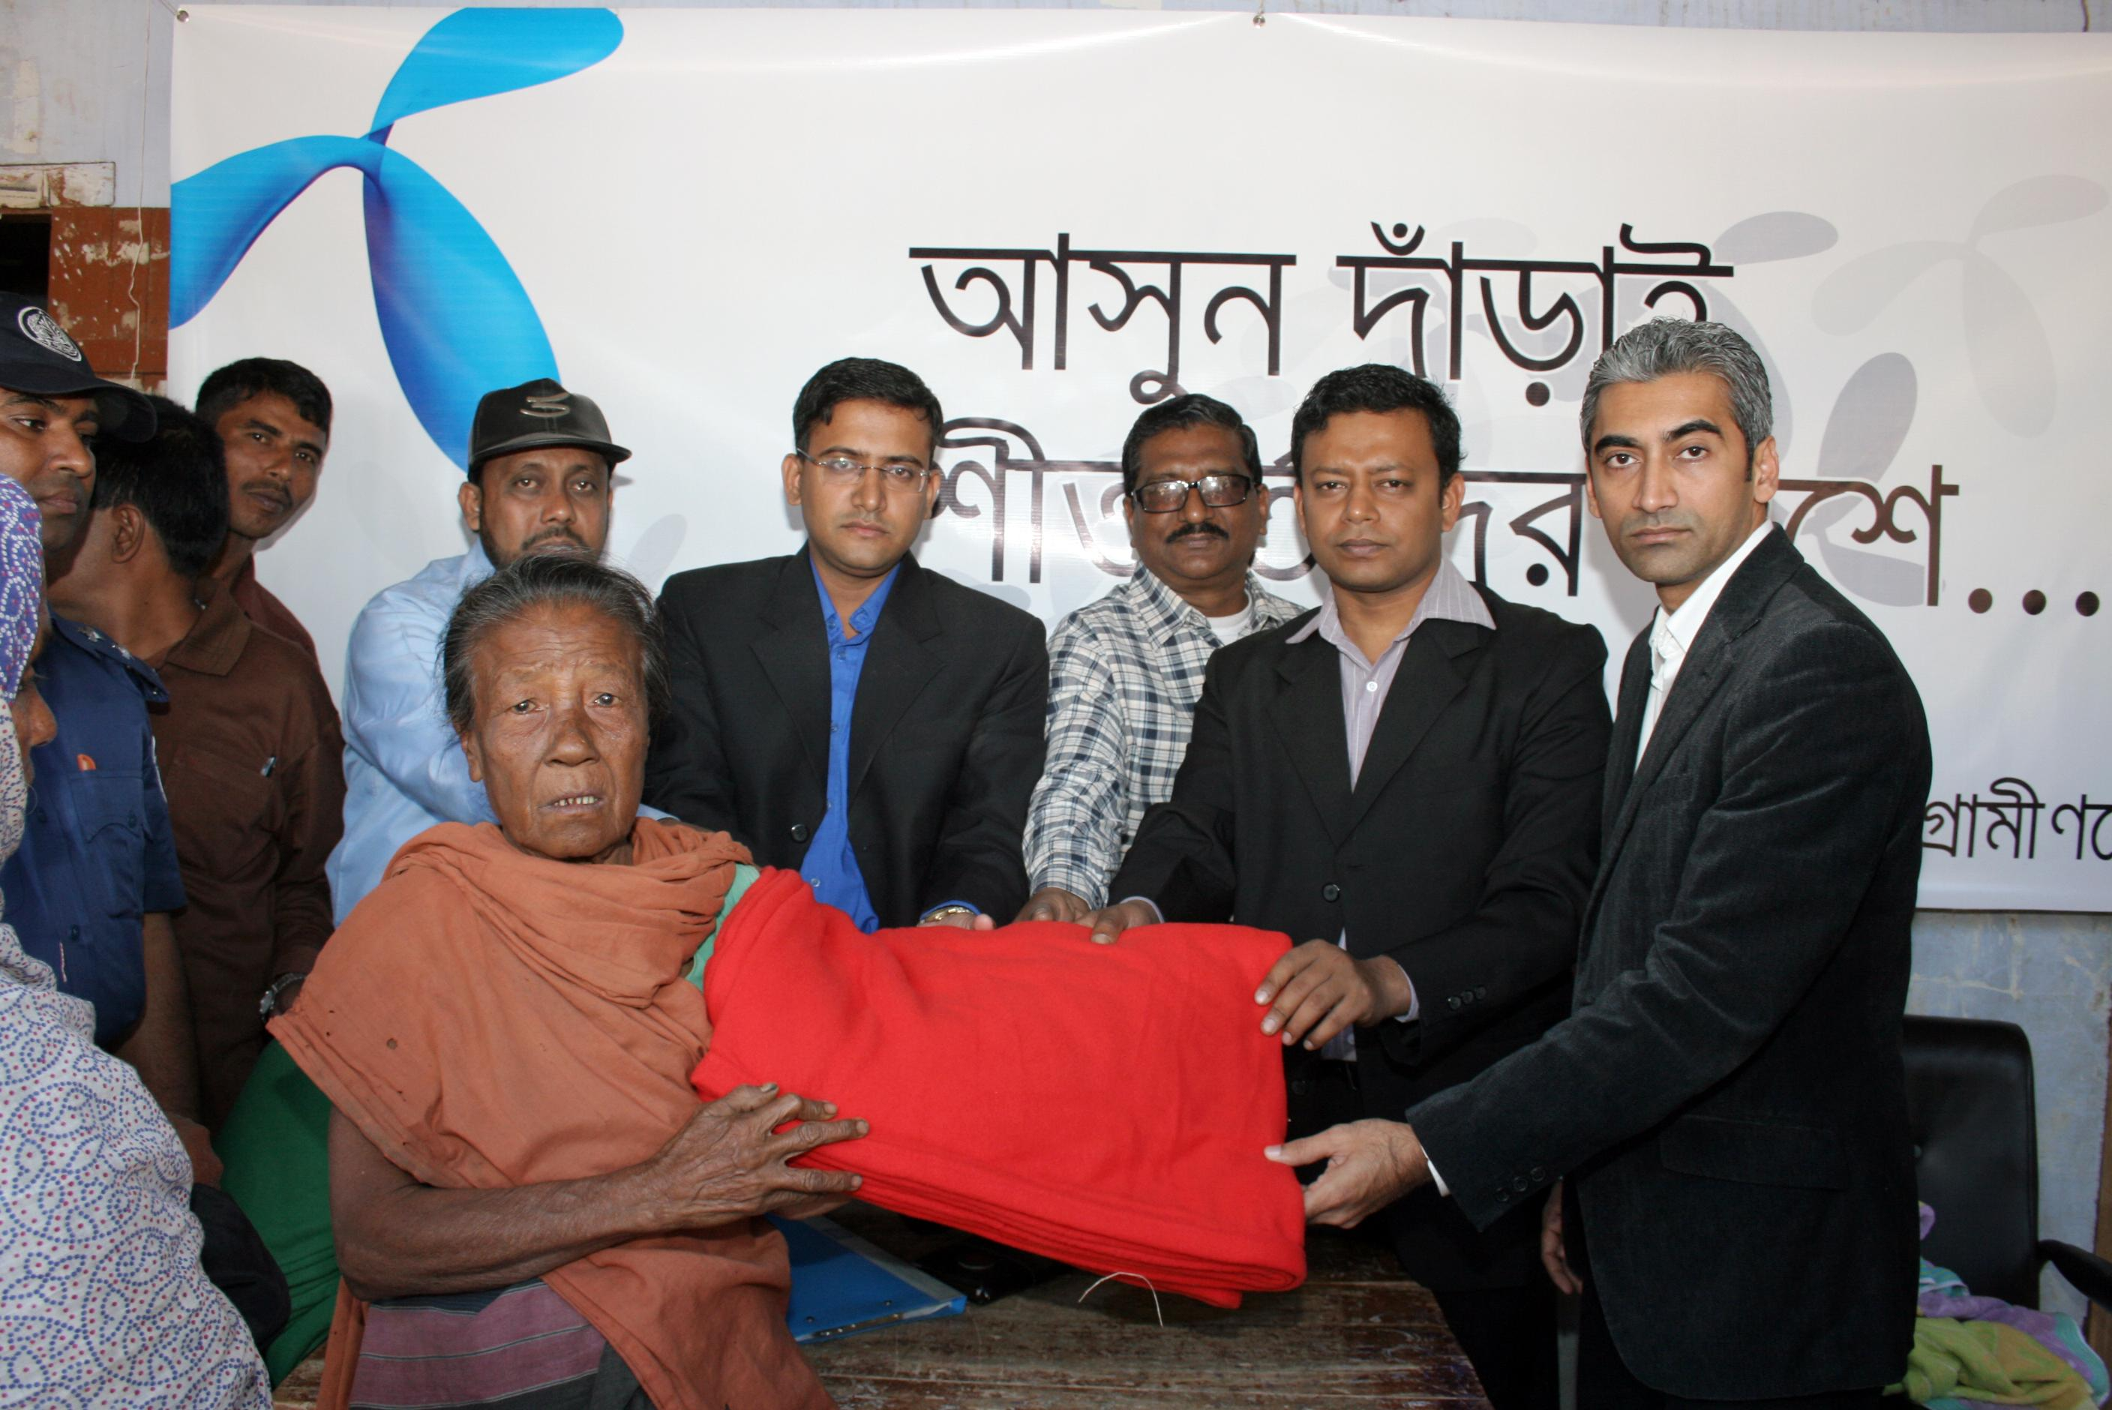
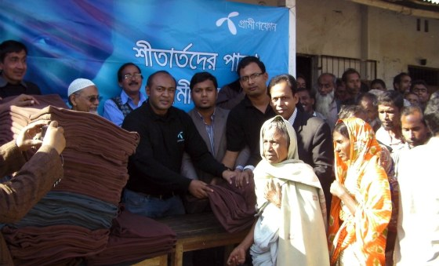
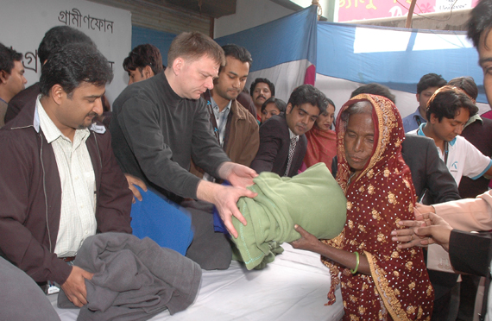
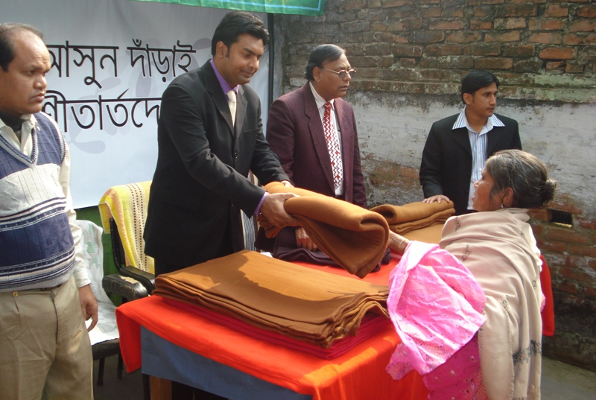
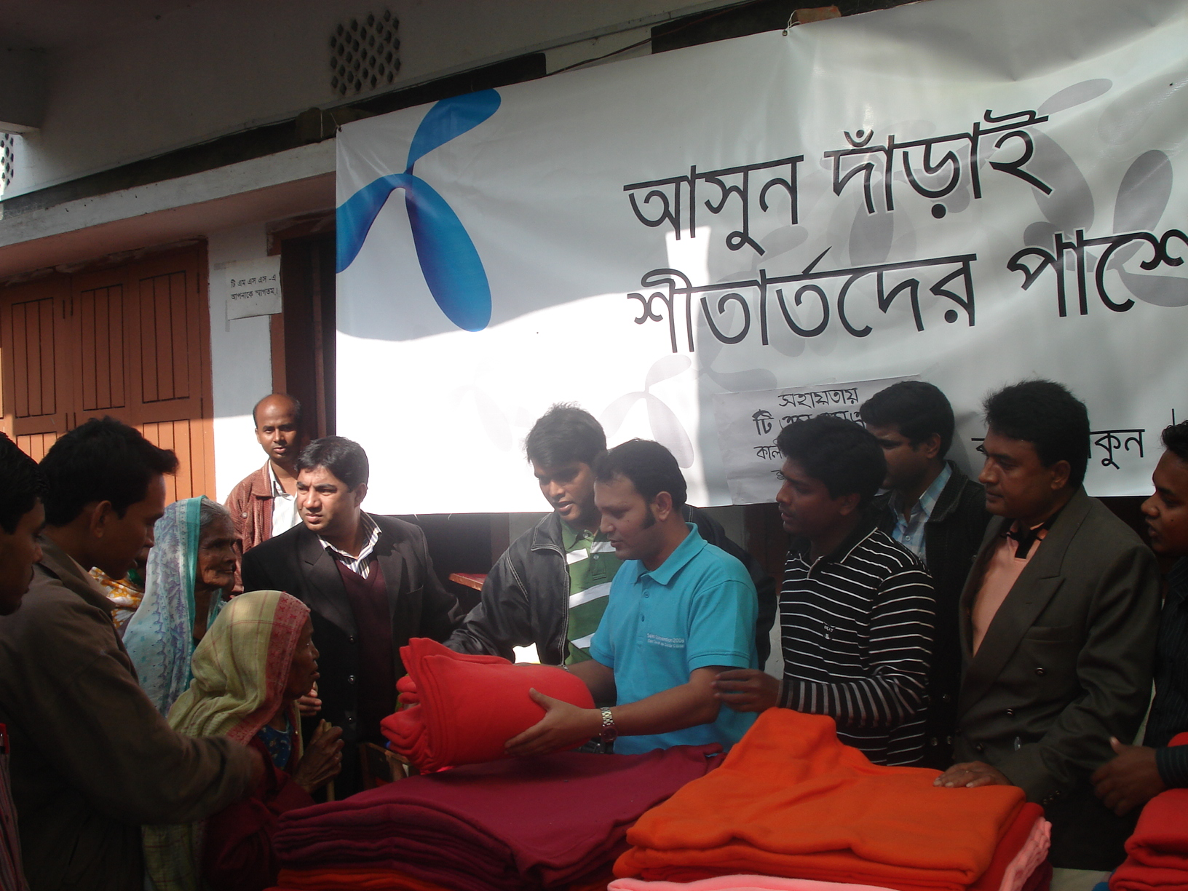
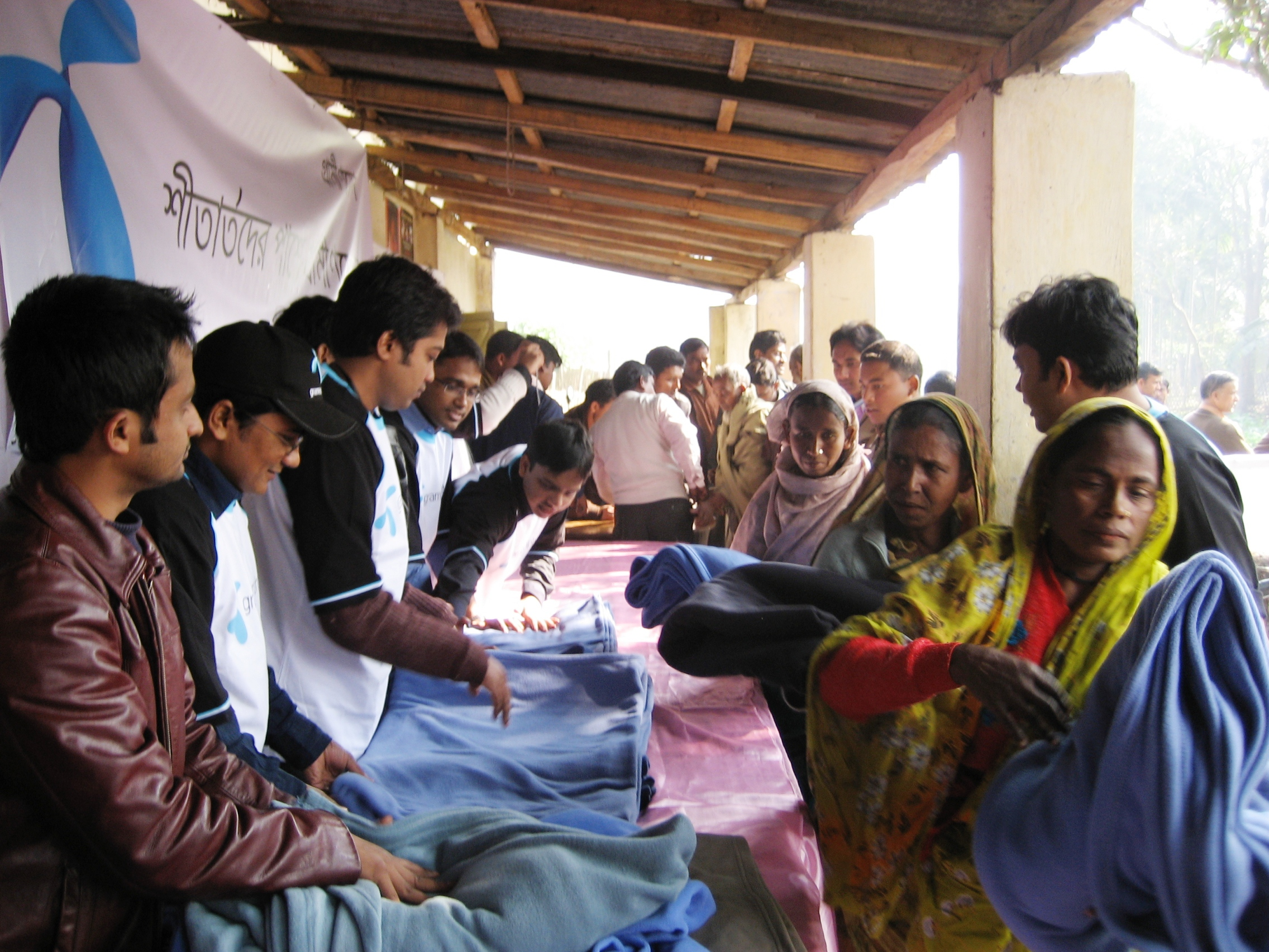
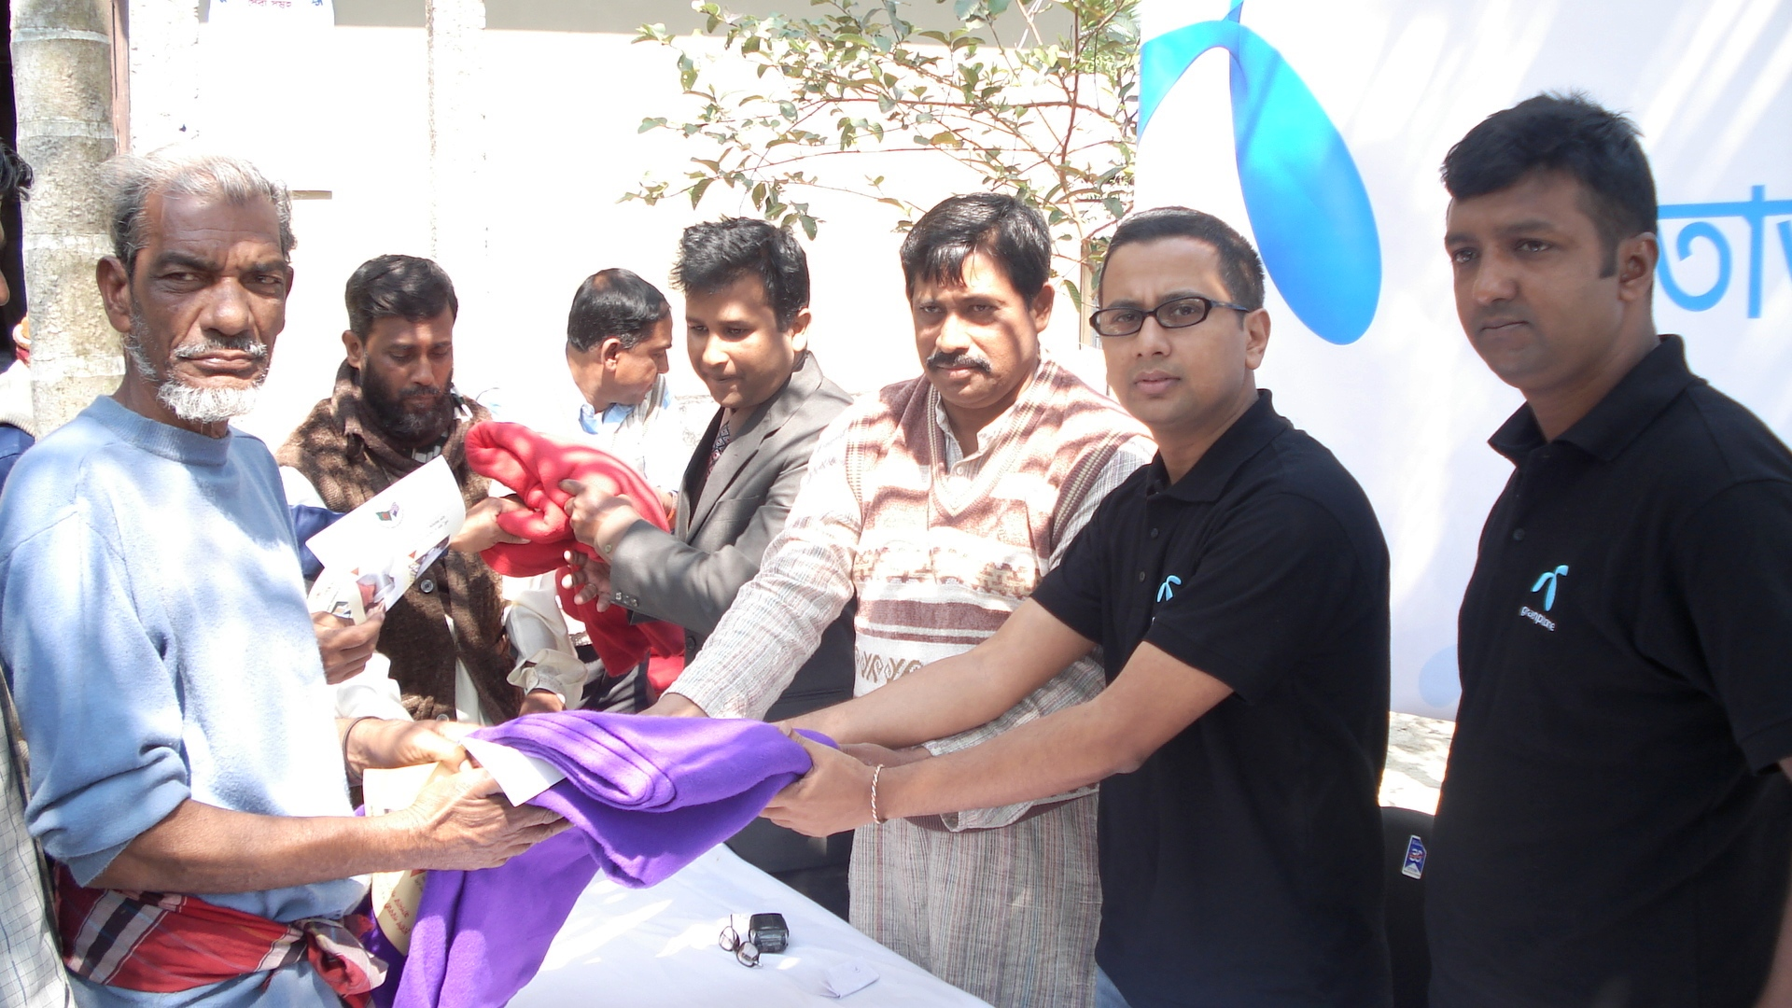
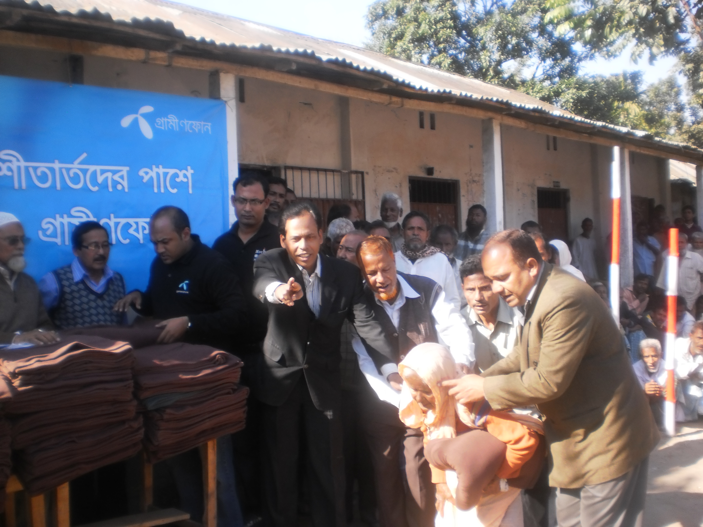
Blanket Donation in Different Times

Slide 19
Thank you

