Slide 1
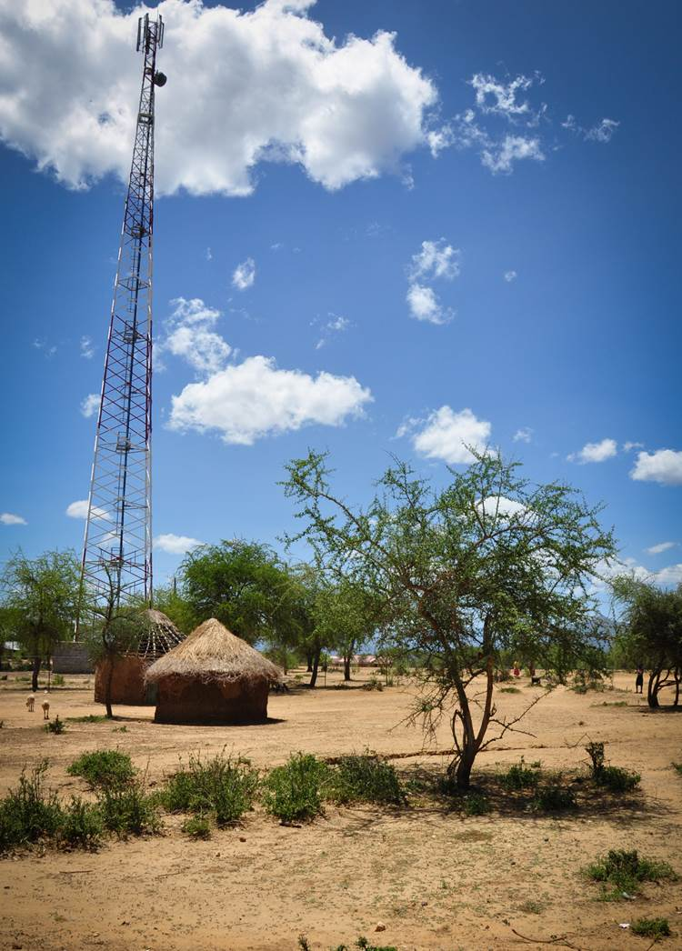

Business Continuity and Technical Resilience of Operators

Slide 2

Business Continuity Lifecycle
Identify
Analyse
Design
Execute
Measure
Identify – Find the Risk
Analyse – Analyse the Impact
Design – Select strategy to Mitigate
Execute – Put into Practice
Measure – Test & Learn
For an MNO the technology plays a role in each part

Slide 3
Technical Resilience
Role of Operator Technology in BCM Cycle
Identify
Which equipment & infrastructure is vulnerable?
Which disaster is part of the risk profile?
How would this affect operations & revenues?
Analyse
Run simulations with different scenarios
Map the results of each
Staff key resource and may not be available
Design
Tower Placement and Design
Building Codes for Switching Centres
Redundant Backhaul Network Design
Execute
Upgrade redundancy and fail-over plans
Improve the resilience of key sites
Establish a company wide education for BCM
Measure
Feedback the results into the plan
Ensure BCM staff are trained regularly

Slide 4
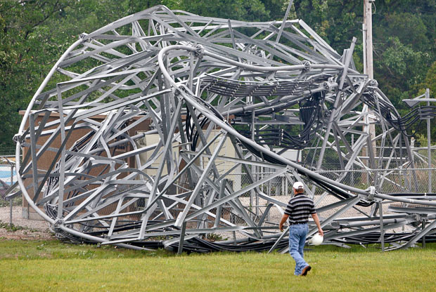
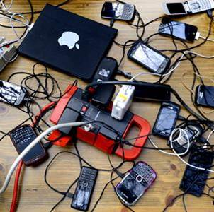
Operator Vulnerabilities
Internal Vulnerabilities
External Vulnerabilities
Staff
Buildings
Network Equipment
Cables
Network congestion
Access to sites
Power
Fuel
Transport & Logistics
Human Behaviour
Notes:
Staff - – AT&T assume only 40% of local staff available
Buildings - – Loss of data centres, switching capabilities, databases
Network Equipment - –cellsites, microwave, towers
Cables - – Optical fibres, electrical cable
Network Congestion - even more calls on a reduced network capacity
Access – sites can be covered in rubble or submerged (tsunami, typhoon)
Power – national grid often affected
Fuel – generators, depleted fuel stockpiles
Transport & logistics – roads blocked, reduced numbers of vehicles, helicopters required etc
Human Behaviour – can be erratic after a disaster and may also be a vulnerability

Slide 5
Standards for MNOs
Building Design
Base Isolation technology is designed to keep building & equip operational after an EQ
Building sits on a rubber isolator
Bracing to the steel structure to resist lateral forces
NEBS
Network Equipment Building System
Established by Bell Labs in the 1970s, now part of Ericsson
Level 3 is for Carrier Grade operations
This is a standard but not a legal requirement
ISO
BS
DHS PS-Prep
Standards for business process & incident management
Do not directly affect technology choice but indirectly impact on decisions made in BCM cycle
MNOs becoming increasingly certified
Notes:
DHS PS-Prep = Dept of Homeland Security (DHS) Private Sector Preparedness
FEMA (Federal Emergency Management Agency) is the well known agency (see on jackets in TV and movies etc) that sits in the DHS and runs the response
Side of homeland security

Slide 6
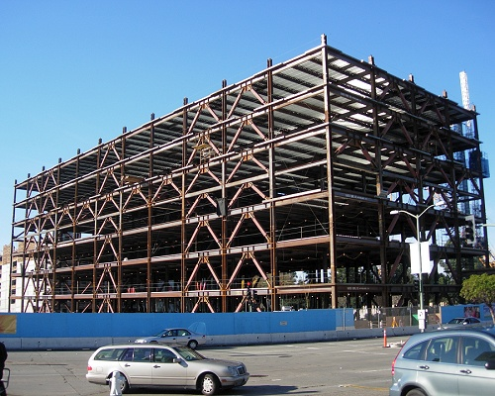
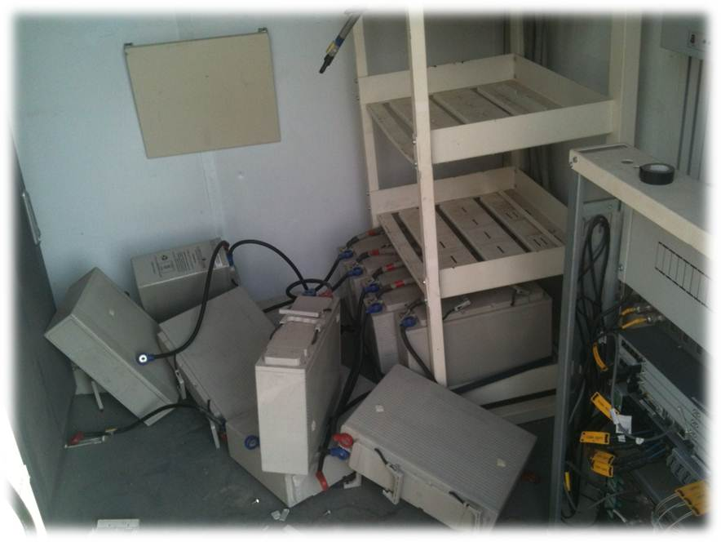
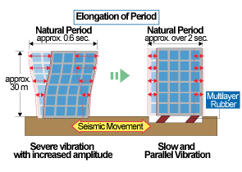
Standards for MNOs - Examples
Notes:
Top Left – Steel Bracing to reduce lateral force impact on building during EQ vibrations – Hospital in California
Top Right – Non-secured equipment in switching site in Turkey after an EQ – non-NEBS compliant at the time
Bottom – The addition of rubber isolation bearings to building foundations to reduce vibration amplitude

Slide 7
Major Earthquake - Impact Examples
Japanese Earthquake
March 2011
Van Earthquake Turkey
October 2011
NTT (DoCoMo)
Mobile and Fixed Operations
4, 900 Mobile cell sites off air
23 Switching Centres destroyed
18 Switching Centres submerged
1, 000 buildings without power
65, 000 Telephone Poles destoyed
250m USD in losses & costs
Turkcell
Mobile and BB Operations
Rural mountainous region
224 sites off air
120 employees affected
Network traffic 4x normal on that switch
7x BSC/RNC affected
12 Mobile BTS deployed for one month
110 sites generator powered

Slide 8
Major Earthquake - Impact Examples
Haiti Earthquake
January 2010
Christchurch New Zealand
February 2011
Digicel
Mobile and BB Operations
Building Codes - buildings collapsed with loss of towers (backhaul and cell site)
Cables – undersea fibre damaged
Partnerships - Replacement kit struggled to get into Haiti , not viewed as priority
Simulations – staff not ready for disaster, free credit added to congestion
Vodafone
Mobile & BB Operations
Power – many sites running on generator. Field ops running re-fuelling cycles
Access – sites cut-off by rubble
Cables - underground cables destroyed, backhaul and IP

Slide 9
Major Earthquake - Lessons Learned
Japanese Earthquake
March 2011
Van Earthquake Turkey
October 2011
Super power cell sites
Increased mobile fleet for:
Optical fibre splicing
Satellite BTS & Backhaul
Green power stations
Renewable energy sources
Network virtualisation
Cloud computing techniques
Disaster Messaging Service
Use packet switched network
Network Congestion
Reroute voice and signalling traffic
Rehome major sites to new switch
Pooled switching centres
Free up bandwidth in affected region by isolating traffic
Extra fuel storage for generators
New strategic locations for mobile fleet

Slide 10
Business Continuity Lifecycle
Network SPOFs
Critical sites (Urban?)
Key Products & Services
Identify
Analyse
Design
Execute
Measure
Feedback Loops
Key KPIs (MBCO, RTO)
Resource Location
Impact on Core Business
Need Certification?
Disaster Simulations
Training
Partnerships
CXO Buy-In & Influence
Add Redundancies
MBCO and RTO
Notes:
SPOF – Single Point of Failure
Need for certification – Should a standard be followed…..adds structure, good for reputation, attracts new business, reduces insurance premiums
CXO Buy-In: necessary to get the whole business involved…..this is very cross-functional and not just technical or network ops
MBCO – Minimum Business Continuity Objective……%age X of service Y to have recovered
RTO – Recovery Time Objective……..the time allowed for the MBCO
i.e. Have 95% of text messages reaching their destination within 24 hours of disaster impact
Disaster Simulations and Training – both of these are necessary to achieve a good standard generally but also a requirement for any disaster preparedness and response certification
Resource Location – refers to both staff and mobile fleet of network kit

Slide 11
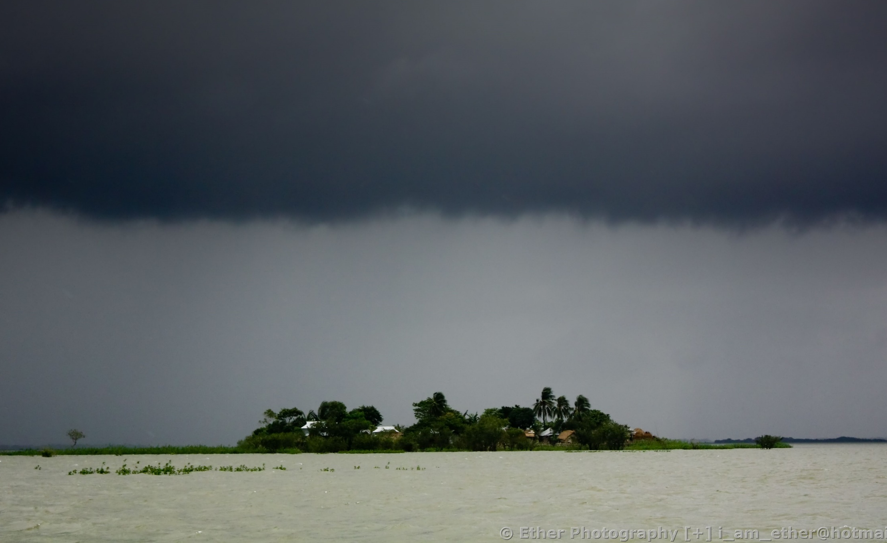
Bangladesh Workshop: Disaster Response
When you restore the mobile network, you restore the human network.

