Slide 1
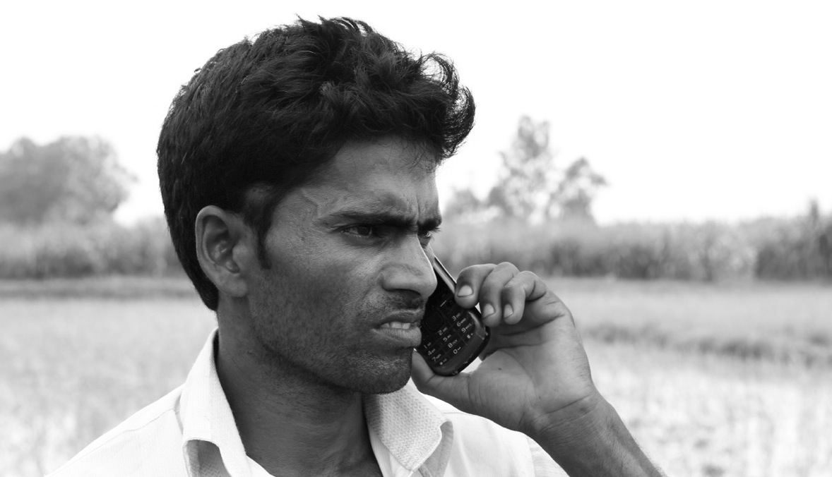

Insights from the mFarmer initiative
January 2015
We’re just waiting for participants to dial in and we’ll start the webinar shortly.
Please use the call back function to dial in to the webinar. This should appear as a pop up box, which invites you to share your phone number to receive a free call back that automatically joins you to the webinar audio.

Slide 2
Insights from the mFarmer initiative
January 2015

Slide 3
Sharing Insights from the mFarmer Initiative
Housekeeping:
Please use the call back function to dial in to the webinar. This should appear as a pop up box, which invites you to share your phone number to receive a free call back that automatically joins you to the webinar audio.
To ensure a clear line for everyone, all participant lines will be muted. Please ensure you DO NOT UNMUTE your line.
Please feel free to send any questions as a private message to Emma Nielsen– this can be done at any time via the chat function.
Questions will be answered during the Q&A following each presentation section.
Notes:
3 different topics to consider
Value prop
Usability
Marketing

Slide 4


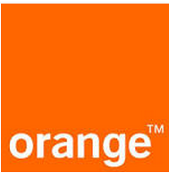

GSMA mFarmer grantees
Grantee | Country | Service name | Services currently offered | Channels | Number of users
 | Tanzania | Tigo Kilimo | Agronomy tips 1-5 day weather forecasts Market prices | USSD (pull) SMS subscription (push) IVR (pull) Helpline (pull) | ~ 390,000
 | Kenya | Airtel Kilimo | Agronomy tips 1 day weather forecasts | SMS subscription (push) / USSD/chat application | ~ 15,000
 | Mali | Sènèkèla | Agronomy tips Weather forecasts Market prices | USSD (pull) Helpline (pull) | ~ 150,000
 | India | mKisan | Agronomy and livestock tips Weather forecasts Market prices Non-agri content – health, educational, finance | SMS subscription (push) IVR (pull) Call centre (pull) | ~ 840,000
Notes:
Quickly describe 4 services from 2011 – altogether reached 1.4m users
Different levels of success (different launch dates) …There is demand for these services.
How do we monetize this demand? How do we meet the demand?
These services won’t be commercially successful if the number of users who adopt are low….

Slide 5

Let’s define adoption
Unaware
Aware
Engage
Adopt
A potential customer ….
Discovers the service through marketing…
Registers/ subscribes/
trials the service…
Trusts and uses as a regular source of agricultural information
Notes:
Defing adoption

Slide 6
Reaching scale
The majority of these markets are still untapped
~ 98% of addressable market
have not tried the services*
~ 2% of addressable market are the
user base for these services
Unaware
Aware
Engage
Adopt
*(range: 0.1 - 4.7% reach into addressable market based on number of smallholder farmers, local teledensity)
Notes:
Explain the range across different markets.
Markets are largely untapped – because 1) no-one knows about them, and

Slide 7
User base quality
Are users adopting the service?
~ 79% of the user base*
~ 21% of the user base**
Unaware
Aware
Engage
Adopt
* (range: 19 – 81% of the user base have registered, subscribed or trialled the service)
** (range: 19 – 81% of the user base have used a service multiple times)
Notes:
2) Because the services are of differing qualities
Repeat users are younger, more females, in TK. In OS more repeat call centre users are women. Educated and tech literate users have more capacity to act on information, to see benefit, to become regular users.

Slide 8
Encouraging adoption and scale
using the tools of the trade
Value proposition
What is the service offering?
How will the offering add value for users?
Usability
How easy is it for the user to get to the offering?
Marketing
How do you inform new users, and remind lapsed users, about the service?
Notes:
REMIND THEM TO THINK OF QUESTIONS!

Slide 9
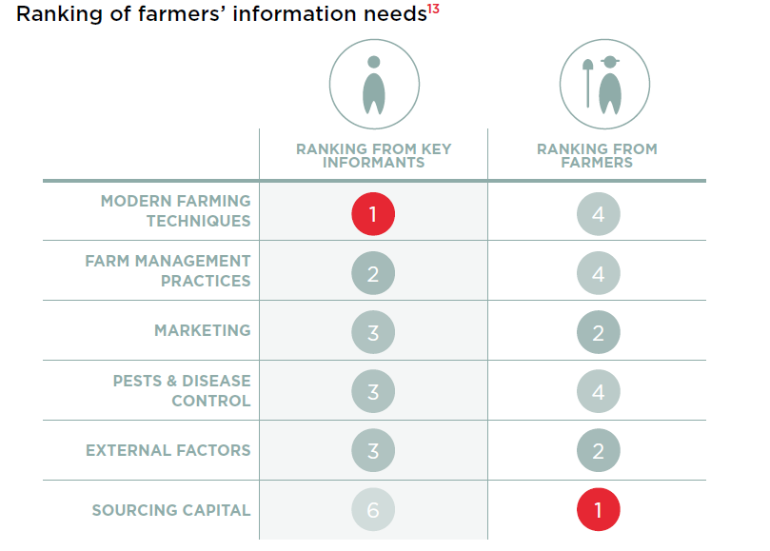
Value proposition
Understanding user needs
Value proposition
Unaware
Aware
Engage
Adopt
Notes:
Delivering high quality scientifically sound information is vital to a good agri service… but it doesn’t work in isolation. Unless carefully considered, using this information ‘raw’ can lead to a low value service for several reasons:
The content is not what the farmer wanted from an ag service (c.f. above e.g. from baseline in Kenya, where experts and farmers had almost completely opposing ideas of what farmers would find useful.
The voice of the service may not be right for the audience.
Field research at an early stage will help you to understand what users need from a service and what they are likely to use. (In both Kenya and Mali (where we’ve recently done baselines) finance and infrastructure were voted least sufficiently provided by farmers )
Top down research:
Agro-climatic zones
Leading crops in the area based on seasonal cycles
Bottom up research:
IKSL use a model of integrating content partners on the ground who work directly with farmers and know what they need. Ocean climatic info for communities of fishermen, purchasing standards for sugar beet farmers.
Talking to users
mNutrition grant will combine insights from the global content partner (CABI, ILRI, GAIN, OXFAM, BMJ) and user centred design from frog.

Slide 10
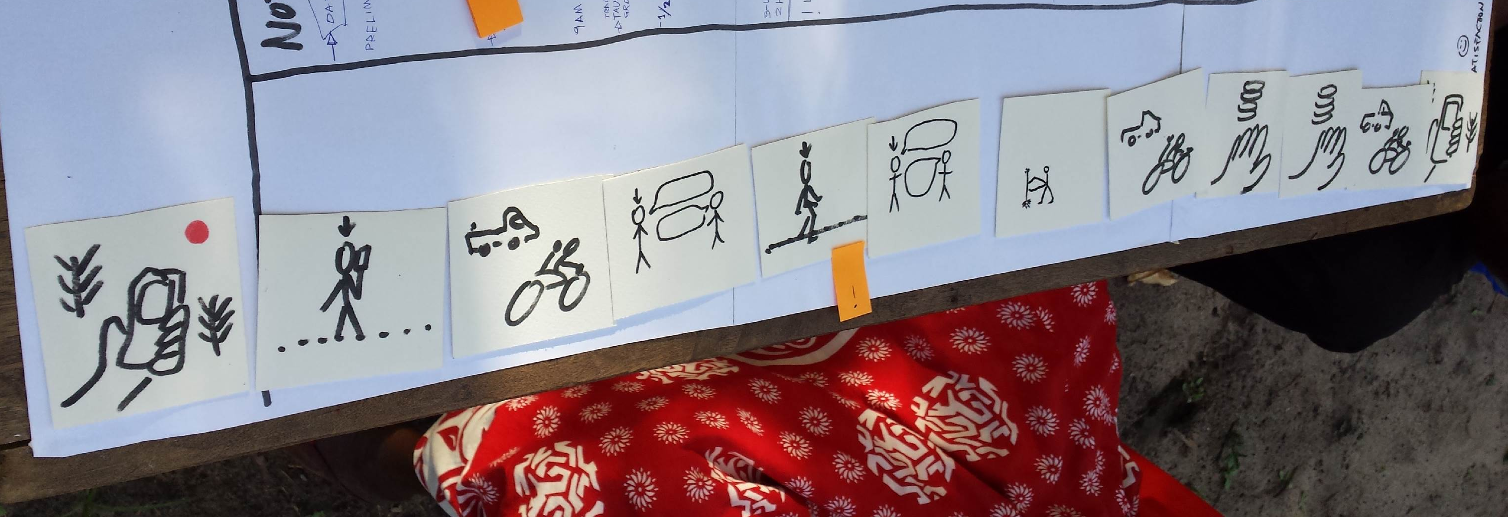
Content must be
Value proposition
Actionable, relevant and timely
Unaware
Aware
Engage
Adopt
Notes:
Actionable:
Affordable (IKSL find local remedies work well)
They know, from the information, how to implement it practically (problem of telephonic extension – IKSL combat this by linking with NGOs with on the ground presence; having Kisan Mitra who can demonstrate the practices)
Use consideration when advising new methods – if it’s too different from what people know they are unlikely to implement it without a certain level of trust:
I talked to an expert and he told me not to use chemical pesticides. Instead, I was advised to use halogen lamps that attract the flying pests, so the crop could be saved from this infestation… The use of halogen lamps was something new for me. I had never heard about it… It didn’t seem practical to me. So, I didn’t use it.
IKSL were able to promote this method successfully with the following changes:
Halogen lamps were replaced with a local, oil based alternative which were cheap and accessible.
The method was demonstrated by a local NGO.

Slide 11
Insight 5: Behaviour change is supported by a user-friendly interface giving access to actionable, compelling content
Content must be understandable
“The Hindi SMS is written using English alphabets. So, I am not able to read them.”
Repeat mKisan user
Content must be complete and instructive
“I didn’t find much information on organic fertilisers. I have been using the chemical fertilisers, so in order to make a shift to organic fertilisers I need to know the whole process of applying it to the crops… On some new things, like vermi-composting, it only gives information, so sometimes we face problems in learning these new techniques.“ Mukesh, Madhya Pradesh, India
Content must cover the crops, topics, markets and eco-regions of interest to users
“You can receive information on Dar-es-salaam market but you cannot transport to Dar. it should explain even nearby markets like Morogoro”
Sylvanus, Kilombero district, Tanzania
Content must be compelling, practical, convincing
“I talked to an expert and he told me not to use chemical pesticides. Instead, I was advised to use halogen lamps that attract the flying pests, so the crop could be saved from this infestation… The use of halogen lamps was something new for me. I had never heard about it… It didn’t seem practical to me. So, I didn’t use it.”
Mukesh, Madhya Pradesh, India
Notes:
Relevant:
Local (agro-climatic zones, markets) – top down
Something users actually need information about – traditional crops vs cash crops debate – top down/bottom up?
More than relevant – information should be integral to their practice (IKSL) – e.g. from Tanzania, the most important weather advice is when it will rain.
35% of TK users said service was not relevant to their needs; 16% could not find what they were looking for. Challenge – how to personalise services?
Timely:
Right time of the season (given agro-climatic zone)
Right time of the day (e.g. market prices)
CHALLENGE: how to balance top down – bottom up information to provide truly relevant information for users. IN some case this data simply isn’t avaulbale – although that hasn’t stopped some mFarmer grantees. Senekela in Mali, were unable to find a reliable source of market price information – so they built one, in collaboration with IICD (govt?)

Slide 12
What content is popular?
Value proposition
Unaware
Aware
Engage
Adopt
Notes:
Evidence from mKisan shows some patterning around the crop calendar – unfortunately a lack of data for repeating seasons makes it hard to draw conclusions. Market price data is most accessed in all seasons except q4 2013 which saw a peak in agronomy and livestock usage.
HG: Repeat users access more relevant content: In Jan-Mar 2014, 40% of repeat users pulled market price information for seasonal crops; only 5% for trial users;
100% of requests for the top 10 crops in that period
Weather forecasts are much more popular for repeat users (since July 2013)
TK: Repeat users request significantly more weather content than trial users; 10% of repeat users reported changing timing of farming activities based on weather forecasts

Slide 13
What content is popular?
Value proposition
Unaware
Aware
Engage
Adopt
Notes:
Throughout the season, users accessed proportionally more information on the planning stage of crops. ‘Emergency’is lowest
Conversely, the majority of livestock accesses across all customer segments are using information on disease.
MESSAGE AROUND TAGGING: if you tag data for these types of content categories, you can measure behaviours and
TK: More than half of repeat users joined the service to learn about new farming practices IMPACT: Users who subscribed for a specific purpose (not just curiosity) are 2.4 times more likely to become a repeat users
HG: Help to find farming inputs was cited most often by repeat users (21%)
TK: Repeat users far more likely to request advice on crops beyond the staple cereals of maize and rice: two-thirds of repeat users vs one-third of trial users

Slide 14
What content is actionable?
Value proposition
Unaware
Aware
Engage
Adopt
Notes:
Throughout the season, users accessed proportionally more information on the planning stage of crops. ‘Emergency’is lowest
Conversely, the majority of livestock accesses across all customer segments are using information on disease.
HG: 91% of repeat users reported behaviour change and improvements
TK: Around 1/3 of users report impact.
Why the difference?
HG has access to more regular, more diverse info on e.g. market prices – 29% reported this benefit, only 2% of TK users

Slide 15
What content is popular?
Value proposition
Unaware
Aware
Engage
Adopt
Notes:
Evidence from Tigo Kilimo shows little patterning around the crop calendar – market prices were the most popular content for the first 4 qs, with agronomy tips showing a surge of popularity during the period of increased marketing. This suggests that Tigo used this content stream to popularise the service. Interest in market prices increased again towards q3 2014. Interest in weather information is fairly stable at 30-40% of requests per month.
Q1 2014 was the mass market drive after service was made free and a bit better – spike in agronomy content then is likely to reflect marketing drive at this point

Slide 16
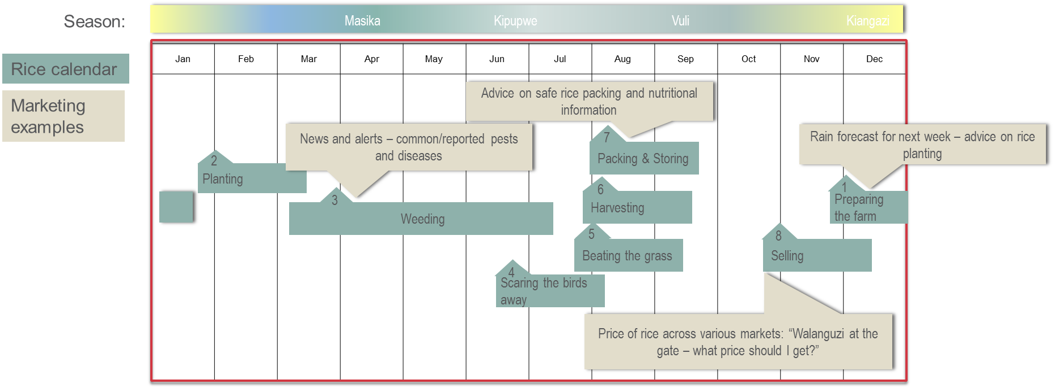
Show them what you know
Value proposition
Users need to understand the value of the service to adopt it
Unaware
Aware
Engage
Adopt
Notes:
Marketing efforts (especially blast SMS) often state only the name of the service, how to access and something generic (e.g. Tigo Kilimo: for agronomy information dial #148#148). SMS may be the only viable option available for e.g. VAS providers
Qualitative research (TK) suggested that showing users how the service could be useful to them through telling the story was the best was to get them invested in the value proposition.
Seasonal targeted marketing (e.g. telling farmers in Tanzania when Masika rains will likely come) may help to convince them to try the service.
This will also help to users to trust the information that MNOs send.
We haven’t seen this executed before, but we have occasions where the service wasn’t considered timely or relevant enough – these are absolutely essential characteristics of usable information.
One way of allowing users to try before they buy.

Slide 17
Users like to try before they buy
Value proposition
Service uptake for Tigo Kilimo increased when the service is offered for free – the user base grew exponentially (from 32,000 to 320,000 in 6 months)
Service free of charge
Unaware
Aware
Engage
Adopt
Notes:
IKSL have acknowledged this in their business model, which is an acquisition model which charges a network operator
Other B2B payment schemes should be considered
However, allowing customers to try before they buy helps a cost-conscious market to see the value of the service before they commit – instead of trying to sell them a taped up box.
A reasonably priced service is integral for users with very low expendable income. Both Tigo Kilimo (pictured) and Sènèkèla USSD service in Mali saw a strong increase in service use after access was made free of charge.

Slide 18
Will customers pay?
Value proposition
80% of surveyed Tigo users who have tried the service said they would pay for it
Unaware
Aware
Engage
Adopt
Notes:
During user testing in Kenya and Tanzania, individuals have also said that they would pay for good quality, timely information. However, paying service users (all except Tigo) overwhelmingly say they find the current price expensive.
Exploring B2B/other subsidy options would get around this difficult topic.
For a b2c approach, a freemium model would allow users to ‘open the box’ before purchasing. Various ways to do this – free for a month/ free basic content with premium charged content. We haven’t seen information as a free part of a bundled e.g. MFS package, so that would also be interesting to explore.
Making sure users understand what they are paying for is vital to their satisfaction.
Understanding of the pricing model is also a big issue with mKisan, a bundled model which include more than one channel as part of a subscription fee. People are willing to accept push content as part of a standard package, but don’t always understand that other channels are also available to them. Handygo suspect that this problem will fade as the service gets more established as ‘double confirmation’ regulations means users have to affirm twice that they understand the service and the pricing structure.

Slide 19
What makes a user value a service?
Ask them!
Choose relevant and actionable content for your target market
A freemium model to give users a taste of the service
A pricing scheme which the user understands and feels is good value
Marketing which relates the value of the service through story-telling
Notes:
Often the most requested channel by users who value having their questions answered directly - Users in all four countries stressed the value of being able to ask questions directly to an expert over the phone.
However, this service is both the most expensive and the hardest to scale, so can be difficult to execute well. Without proper investment, call centres lack the capacity to deal with all calls and lead to customer dissatisfaction

Slide 20
Think about the channels you offer
Usability
USSD/SMS services present a barrier to illiterate users
Unaware
Aware
Engage
Adopt
Notes:
Note that the data above is nationwide – literacy rates are likely to be lower in rural BOP.
Offer a range of channels with options for illiterate users

Slide 21
USSD
Usability
Timeout is a major problem
Average number of keystrokes: 41
Average number of timeouts: 4.5
Average number of keystrokes: 114
Average number of timeouts: 2
Unaware
Aware
Engage
Adopt
Notes:
Users have 2.5 minutes to: select their region (from 5 screens), district (from 3 screens) (scrolling is confusing), gender, age bracket (they don’t know the <> signs) – for new USSD users especially this takes a while, but even tech literate users struggle with this process. Important to note that they don’t know what USSD timeout is, so when the system cuts them off they assume it’s not working.
By the time they are seeking information, users are getting quicker with their fingers – but average number of keystrokes is over 100! This is especially true of the agronomy information, which takes 3 minutes longer on average than other information to access. It is like an encyclopaedia where you have to race through to find your page before the book snaps shut.
Understanding who the user is is valuable for M&E purposes – but here it may become a barrier to users registering or accessing information. Thinking of other ways to collect this information (e.g. through incentivised USSD attach, wider M&E) could improve uptake.
Services which cover a lot of ground offer much needed information to a wide audience – but they become unwieldy. This may be less of a problem where data can be utilised – however it does not seem a viable option in any of the mFarmer markets as yet (with the possible exception of India)

Slide 22
Users faced with a menu (USSD, IVR)
Usability
should browse as few sub-menus as possible
Unaware
Aware
Engage
Adopt
Notes:
It has been estimated that each consecutive sub-menu causes a third of the original cohort to drop off i.e. starting with 100, 66 get to menu 2, 33 get to menu 3, very few make it to menu 4. See SMS & IVR Best Practices paper on the website.
Handygo: “I had some difficulty in finding the information I was looking for, especially in the case of garlic and onions. I wanted some general information on seed varieties, fertilisers, irrigation, etc. but I could not locate this”
mKisan menus are not personalised to the farmer in any way, so each user has to navigate the same long menus to get to content. mKisan is by far the broadest of the mFarmer services, supplying over 50 different information points from planning to post harvest on each of the over 100 crops they service – and that’s just the agronomy menu.

Slide 23
Service design issues
Usability
Identify through usage analysis and user testing
Unaware
Aware
Engage
Adopt
Notes:
Tigo Kilimo initially had some problems with missing information in its USSD service. Using simple data analysis, we were able to identify the extent of the issue – delivery rates rose by 50% as a result
Give examples of how to test for these issues
Collect data on delivery success
Use it
Test with users to confirm it has worked
Do the user testing at the stage of paper prototyping and save money!

Slide 24
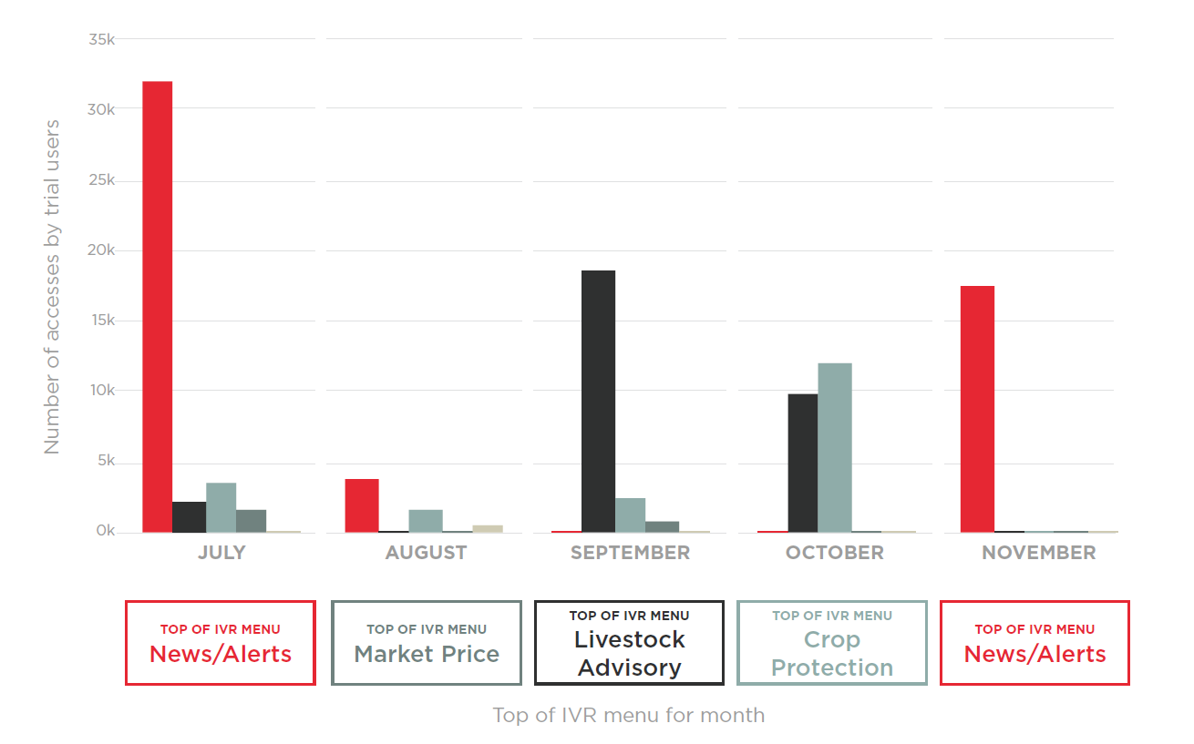
Service design influences
Usability
the content users reach
Unaware
Aware
Engage
Adopt
Notes:
Trial users of the mKisan IVR service overwhelmingly visited the first menu item available (which at the time rotated on a monthly basis depending on what the most popular content was in the previous month), despite a variety of stated ‘reasons for first accessing’. This suggests that users are not very adept at accessing information and are likely to be guided by the first menu option. Ensure that this option is seasonally relevant to give first time users a taste of relevant content. A further step would be to personalise menus, either according to stated preferences of users (they choose crops they are interested in to populate their own seasonal menu; Airtel Kilimo content functions something like this), or according to what they have accessed before, bringing crops they have accessed previously to the top of the menu. This would not improve the experience for first time users (whose accesses are shown on this slide) but would ensure gradual improvement of user experience over time.
Do users find it annoying to come back every month and find that info they knew how to get to before (i.e. what buttons to press) has moved?

Slide 25
Helplines
Usability
Can provide great value – but not scalable
“
I talked to an expert from mKisan about blight control in potato, because my crop was affected by it. The potatoes were not forming properly under the plant. It reduced my potato production significantly… The expert told me to use Zed-78. It is a fungicide. It helped in protecting my plant.
I never got an opportunity to have a direct conversation with the experts. It never happened.
”
Unaware
Aware
Engage
Adopt
Notes:
Usability, value, costs
Too expensive to use as an offset for literacy
Users who try the service because they have a problem drop Use for very particular use cases e.g. only under the pests and diseases menu – immediately demonstrates value for users who have
Often the most requested channel by users who value having their questions answered directly –
Users in all four countries stressed the value of being able to ask questions directly to an expert over the phone.
However, this service is both the most expensive and the hardest to scale, so can be difficult to execute well.
Without proper investment, call centres lack the capacity to deal with all calls and lead to customer dissatisfaction
(Quote from a Handygo user)

Slide 26
What makes a service usable?
Choose channels which are appropriate for your target audience
Remember the limits your technologies when designing your service
Keep menus short by personalising the service as much as possible
Test your service with users to ensure they are able to find what they’re searching for
Helplines can deliver great value, but need to be carefully positioned due to high costs
Notes:
Often the most requested channel by users who value having their questions answered directly - Users in all four countries stressed the value of being able to ask questions directly to an expert over the phone.
However, this service is both the most expensive and the hardest to scale, so can be difficult to execute well. Without proper investment, call centres lack the capacity to deal with all calls and lead to customer dissatisfaction

Slide 27
Four stage marketing strategy
Marketing
Unaware
Aware
Engage
Adopt
along the customer journey
Awareness
stage: teaching the users that phones do more than make calls. Communicating little information, raising interest.
Face to face campaigns (e.g. at farmers fairs)
National campaigns (e.g. TV, radio)
Education
stage: teaching the audience how to use the product they have heard about
Face to face campaigns
Leaflets, posters, TV/ radio/ newspaper advertorials
Trial stage:
once you have a user base, keep them engaged
Freemium models
SMS, OBD
Life cycle management: keep people on the service and make them ambassadors
Bundles
Deals
Loyalty rewards
Methods of viral marketing
Use a combination of marketing methods for different stages of the process

Slide 28
Raising awareness
Marketing
using targeted campaigns
Unaware
Aware
Engage
Adopt
Notes:
TV, radio and print media campaigns have a place in raising customer awareness about the service.
These methods are costly – so maximise their effectiveness for a difficult target audience e.g. Orange Mali bought radio spots around popular agricultural programming
Wide geographical reach - builds trust and spreads awareness
Also useful: presence at farmer’s events

Slide 29
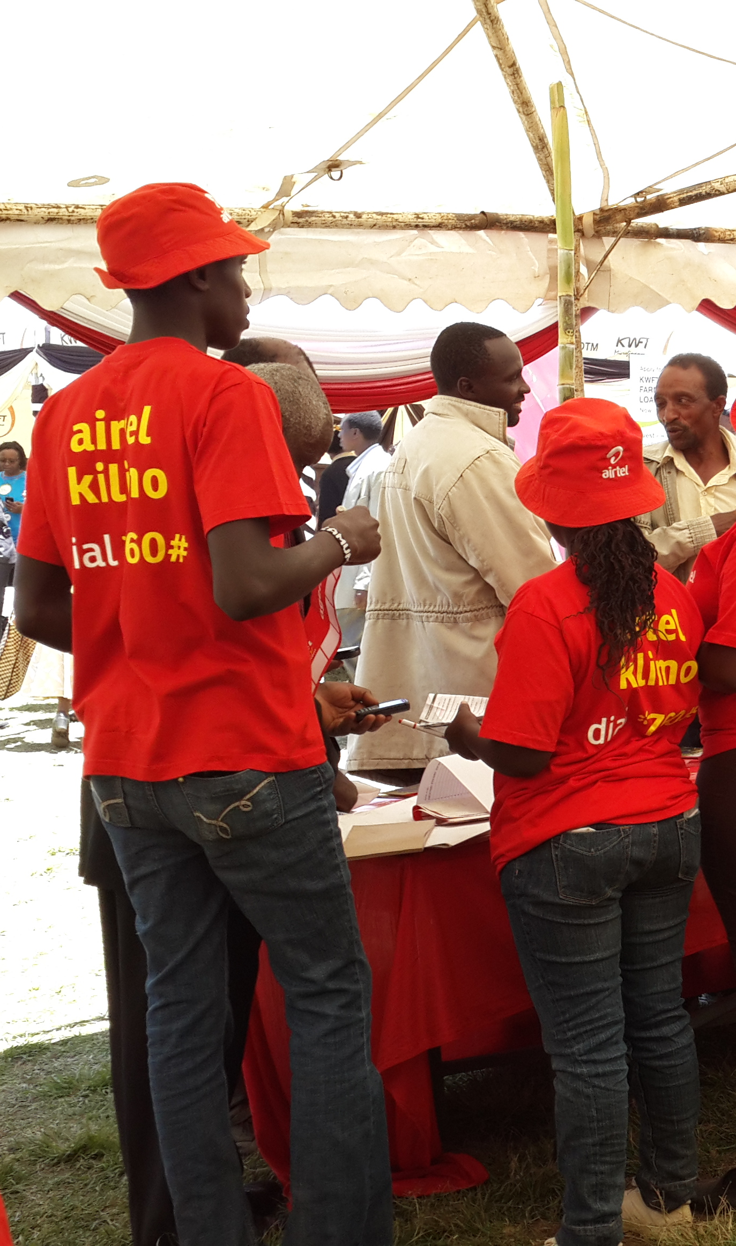
Education
Marketing
Unaware
Aware
Engage
Adopt
Notes:
Face-to-face marketing has the best potential for educating users – and Allows cross-selling of different products – SIMs, mobile money, VAS
IKSL reach out to NGOs and other organisations who do this for them.
In the example about the event led to 13% more users engaging with the service – but there are other examples from the same service where SMS blast was the more successful method
Why haven’t we seen great success through face-to face marketing?
Because incentivising agents to sell such a service must be part of an integrated plan – in some cases agents were not incentivised in such a way to encourage them to spend time gaining quality customer
Ensure that agents are trained and properly incentivised to train farmers how to use the product – otherwise you may not see a return on investment
Leaflets can be useful with literate audiences, but must be readable- in Kenya the font was too small for older users
Poor incentive schemes for agents (which don’t reward agents enough/ reward the wrong agent behaviour/don’t push usage of the service) have stopped them selling the service
Service design problems impede sign-ups
MEMORY TECHNIQUES – TELL THE STORIES! Keywords, photos

Slide 30
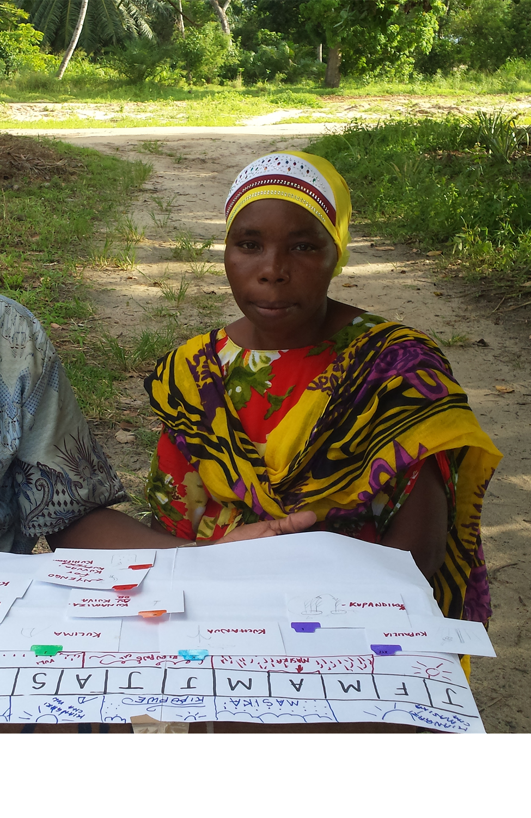
Trial and use
Methods: Blast SMS/USSD attach/OBD
Marketing
Unaware
Aware
Engage
Adopt
Notes:
On the slide:
After the SMS blast in the previous slide, the average length of days before accessing information on the service was 10. However, we can see a band of users who were re-engaged around the 75 day mark.
Using blast SMS/OBD for this purpose is great because users are already aware of and educated about the service by this point. Short messages can thus communicate to them.
Show them what you know
As an acquisition method:
SMS as a method of raising awareness has limitations – depends on the existing level of trust/understanding of mobile outside of voice channels which already exists in your market. As well as regulations, there is potential reputational damage from ‘spamming’ customers with too many SMS.
VAS providers without marketing budget and no distribution network can only really do this;
However, recent regulations in India (July 2013) now require ‘double confirmation’ (a user must confirm that they understand the service and its associated costs twice before signing up) which halved the number of sign-ups per month . There are also regulations around the number of promotional SMS MNOs can send out per day in India, and services must compete to use these SMS for their purposes.
Getting SMS scheduled has been a problem in India and Tanzania.
Pictyure from Tanzania to remind me to talk about crop calendars##

Slide 31
Brand ambassadors
Marketing
Unaware
Aware
Engage
Adopt
Notes:
One service uses a refer a friend method to recruit new users. This option is part of the setting menu which is not often discovered by users, so number of users referred by a friend are in the thousands rather than the hundreds of thousands. However less of these users fail to try the service, and more of them go on to become repeat users, than in the user base a as a whole. This method borrows the trust users feel for other farmers to endorse the service.

Slide 32
What marketing methods acquire quality customers?
A scheduled blend of marketing methods:
Well researched traditional marketing
A trained and properly incentivised agent workforce to educate users
Partnering with an organisation who already has agents and farmer groups in the right areas
Complementary SMS/USSD/OBD marketing to engaged lapsed customers
Recruit brand ambassadors who will evangelise the service for low costs
Notes:
Understand what’s not working for your users
Fix it
Tell everyone!

Slide 33
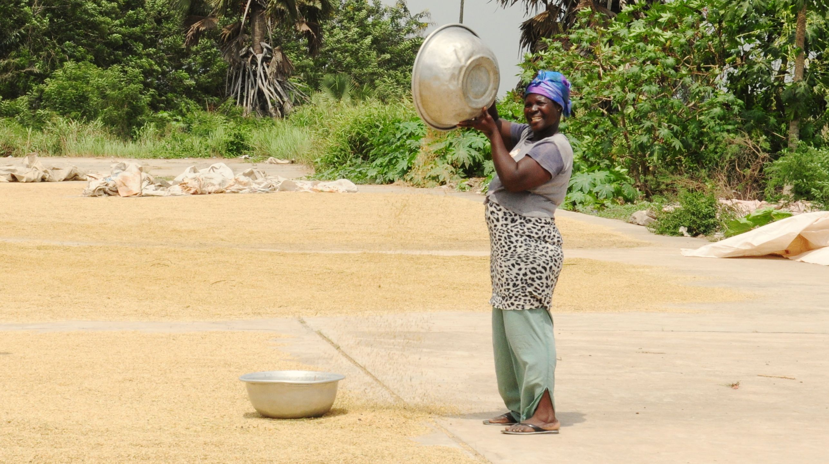
mAgri resources:
http://www.gsma.com/magri/
mAgri deployment tracker update

