Slide 1
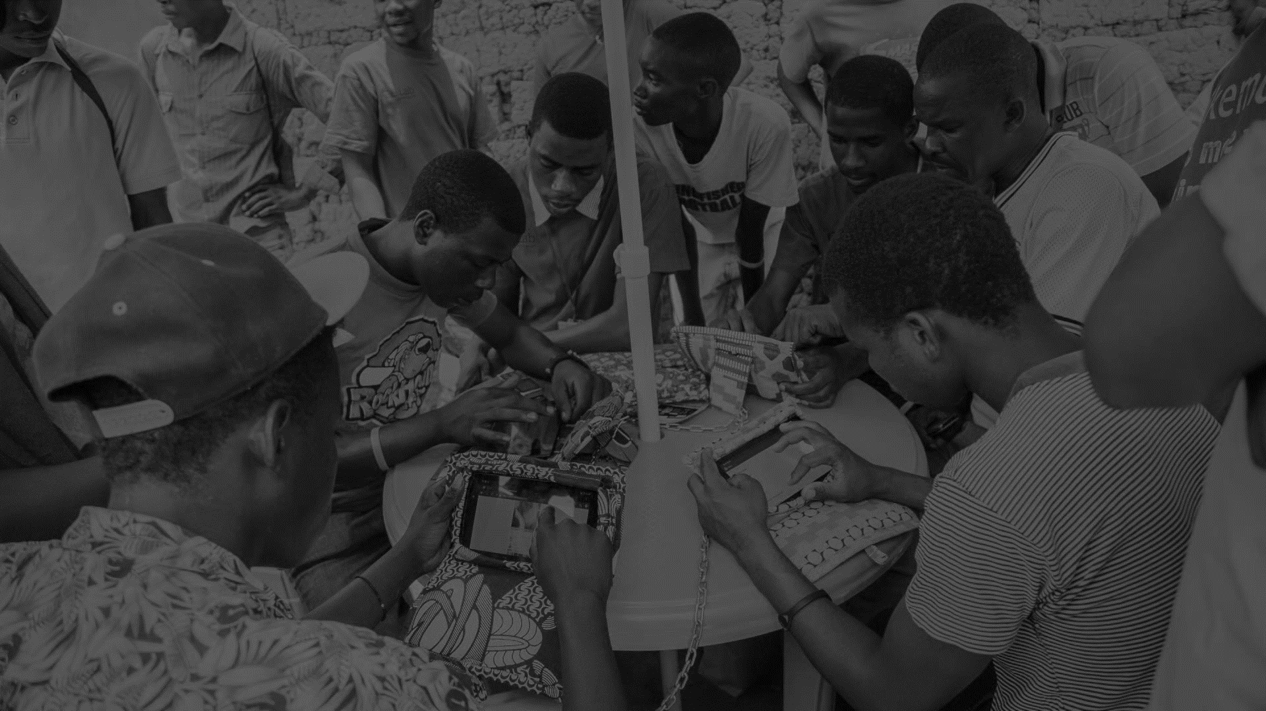

Investor Roundtable : Funding Platforms
17th November 2016

Slide 2


Table of Contents
Introduction
Kiva
Lendahand
Q & A
1
2
3
4

Slide 3

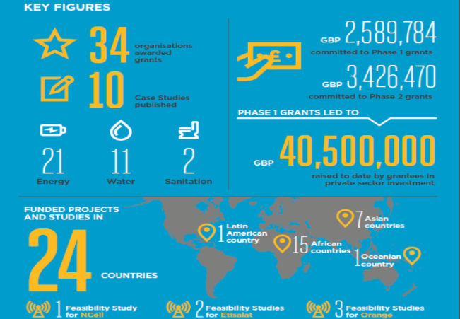
GSMA Mobile for Development Utilities
  Our mission is to unlock commercially sustainable business models that leverage mobile to deliver affordable and improved energy, water and sanitation services in emerging markets.
Programme Activities
  Knowledge Sharing and Convening
  Advisory Services
  Innovation Fund
  Market Building
M4D Utilities programme is supported by the UK Government

Slide 4
Why is M4D Utilities hosting the investor roundtable series?
To facilitate better communication between entrepreneurs (leveraging mobile) and funders, the webinar series aims to:
Highlight the differences between funders
Emphasise the need for entrepreneurs to research and know more about funders
Improve the understanding of the investment process
This is the last webinar in the series. The other webinars focussed on Foundations and Impact Funds. Webinar recordings are available on the GSMA website.

Slide 5
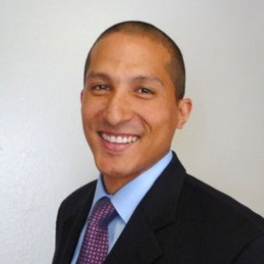
Carlos Pierre, Senior Manager,
Strategic Initiatives, Kiva.org
Before joining Kiva in 2012, Carlos worked for nearly a decade in investment banking in Tokyo, London and New York for both Deutsche Bank and Citigroup. He grew up seeing firsthand the extreme social inequality of Mexico and developed a passion for economic development.
Carlos’ focus is expanding the Kiva crowdfunded loan model to better serve social enterprises.
Notes:
Please use this to describe your

Slide 6

Background
Mission statement & impact
Mission: Connecting people through lending to alleviate poverty
Kiva’s Direct to Social Enterprise (DSE) program aims to finance the “missing middle” for social enterprises - too big for microfinance but too small for traditional financing.
Geography
Sectors
HQ in USA
Lending in Chile, Guatemala, Burundi, Tanzania, Colombia, Honduras, Ghana, Uganda, Costa Rica, Mexico, Kenya, Zimbabwe, Dom Republic, Nicaragua, Mozambique, Ecuador, Panama, Rwanda, Indonesia, El Salvador, Peru, South Africa, Philippines
Clean Energy,
Agriculture,
Financial Inclusion,
Education
ICT,
Environmental Conservation
Notes:
Explain how DSE is different from standard Kiva model

Slide 7



Investment Mandate
Stage
Duration
Size & structure
Kiva requires sales revenue. Profitability is a plus.
Maximum Tenor is 18 months.
Kiva is looking for working capital/short terms loans.
Loan range is USD 10k to 50k.
Repayments are tailored to underlying cash flows.
Grace period up to 6 months.
Successful campaigns - Started in July 2016
Return expectation
8 Enterprises Supported (Total - USD 337,000)
0% financial return.
Socially, Kiva expects the loan to help scale innovative business model that impact the base of the pyramid.
Notes:
Please explain your model ie source of funds, repayment model, how are business operations funded etc.

Slide 8


Finding Deals
What are the main things you look for in an organisation before initiating discussion?
Referral from Kiva Partner Organization (e.g. Village Capital, Echoing Green, GSBI, GACC, Root Capital, Vital Voices, Ashoka, Bankable Frontier Associates…)
Clear social impact in application
Clear loan use and repayment logic
What advice would you like to give entrepreneurs to help them avoid common mistakes?
Make sure to measure your impact.
Your revenues should prove you can meet our short term loan tenors.
Be as specific as possible when detailing the use of the loan.
Expert Advice
Notes:
What is the best way for an entrepreneur to approach Kiva?
Do you only consider organisations which are referred through your partner organisations?

Slide 9
Process
1 weeks - 1 month
Up to 30 days
Loan Term
Does borrower fit Kiva criteria?
Activate your social networks
Leverage the 1.6m Kiva lenders to raise funds on Kiva
Provide updates on your business and the loan
Pre-campaign
Campaign
Post-campaign
Resources:
One Pager
FAQs
Resources:
Website
Resources:
Notes:
Do you reject organisation? What are some of the reasons?
Example of type of updates required? How does Kiva use this information

Slide 10

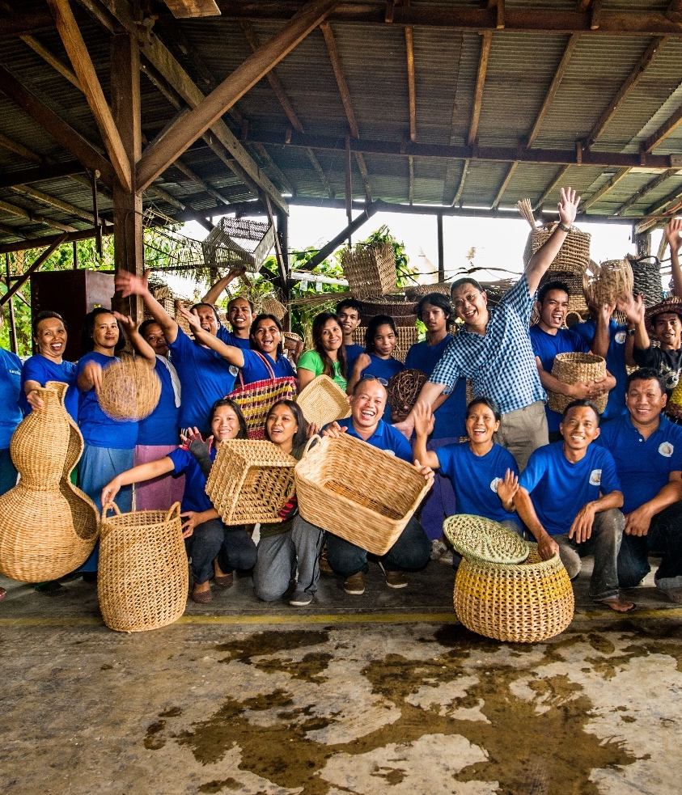
Tobias Grinwis
Investment Ranger @ Lendahand
A self proclaimed wildlife ranger…
Now part of the impact investment team at Lendahand, and thus…..

Slide 11

Background
Mission statement & impact
Lendahand is an online lending platform where socially minded savers & investors can fund SMEs and sustainable initiatives in emerging economies.
We want to create value for all stakeholders, but more than that we want to alleviate poverty.
Geography
Sectors
HQ in the Netherlands
Lending in Kenya, Zambia, Ghana, Mongolia, Cambodia, the Philippines, India and Colombia.
None in specific, we have funded many sectors on the platform
As of recently, we have increased our focus on renewable energy and clean drinking water campaigns
Notes:
A few notes:
Investors can come from all over the world, we currently have 17 nationalities, but as we have our license as an investment firm, we will soon launch our platform in other European countries from an investor perspective.
From a company perspective, we hope to become active in many more emerging markets. But there is no real formal strategy to which country comes first, hence any country can become the first new country we onboard ☺
Investors from NL mainly, soon UK as well, and since we have credit cards, they can come from anywhere. The countries that we’re active in, is growing as well, so even if you are not on this list, that doesn’t mean you’re not eligible.

Slide 12






Investment Mandate
Stage
Maturity of loans
Size & structure
2-3 years, ready to scale up
Looking for working capital
6 – 48 months
Semi annual repayments
We offer flexible funding and hope to see investees come back for more
Campaign size up to EUR 250K
Max per year per organisation EUR 2.5m
Loans in EUR, USD and GBP (soon)
Debt only
Successful campaigns
Return expectation
Over 1,300 campaigns; cassava farmers, to SHS, to mini grids
100% got fully funded and 100% has been repaid.
Over EUR 11m in total volumes and growing fast
Between approx. 6-12%
But more importantly, we expect shiploads of impact!
Partners:
Notes:
Please explain your model ie source of funds, repayment model, how are business operations funded etc.
Give examples of the type of companies you have invested in

Slide 13


Finding Deals
What are the main things you look for in an organisation before initiating discussion?
Ambitious and skilled management team
Solid social impact, while having a valid business model
Strong track record and ambitious but realistic projections
What advice would you like to give entrepreneurs to help them avoid common mistakes?
Make lots of (small) mistakes
Seek out partnerships with like minded people/organizations, but seek advice from parties with a totally different mindset
Your team is your everything
Expert Advice
Notes:
Why would you reject an organisation? I will mention those.
Type of organisation for whom this is not suitable

Slide 14
Process
1-3 months
A few days
Loan Term
Skype calls
Data room access for us and our due diligence partner
Term sheet agreement
Credit committee approval
Signing of contracts
We take care of it. On basis of the data and information available we set up the campaign which you can fine-tune.
Lendahand has an active lender base, we do not expect you to actively market the campaign
Quarterly KPI update
Semi annual repayments
The option to draw more from the facility
Pre-campaign
Campaign
Post-campaign
Resources:
Time and due diligence costs of our independent partner
Resources:
Admin and marketing burden quite low
Resources:
Fairly limited
Notes:
Please give examples of KPIs
Both social and financial KPIS’s, and I’ll explain what we’ll do with them!

Slide 15
Q& A
Q&A
Twitter
@GSMAM4D
Website
gsma.com/mobilefordevelopment
Mail
M4Dutilities@gsma.com
utilities_grants@gsma.com

