Slide 1
Investor Roundtable : Impact Funds
13th October 2016

Slide 2
Table of Contents
Introduction
Acumen
Global Innovation Fund
Q & A
1
2
3
4

Slide 3
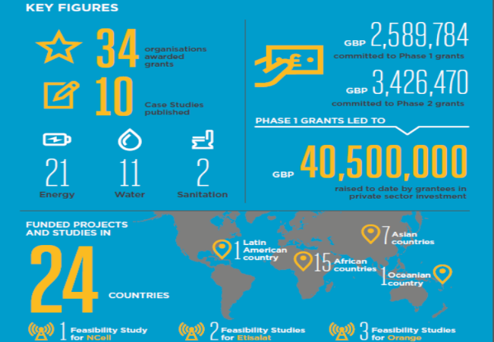
GSMA Mobile for Development Utilities
Our mission is to unlock commercially sustainable business models that leverage mobile to deliver affordable and improved energy, water and sanitation services in emerging markets.
Programme Activities
Knowledge Sharing and Convening
Advisory Services
Innovation Fund
Market Building
M4D Utilities programme is supported by the UK Government

Slide 4
Why is M4D Utilities hosting the investor roundtable series?
To facilitate better communication between entrepreneurs (leveraging mobile) and funders, the webinar series aims to:
Highlight the differences between funders
Emphasise the need for entrepreneurs to research and know more about funders
Improve the understanding of the investment process

Slide 5
Sean Moore
Associate Director, Portfolio
Acumen
Sean works in Acumen’s New York office where he focuses on sourcing new investment opportunities, securing global portfolio partnerships, and developing new investment strategies and investment vehicles. Sean has spent the majority of the last two years working on investments and issues in the off-grid energy sector.

Slide 6
Background
Acumen’s mission is to change the way the world tackles poverty by investing in companies, leaders and ideas.
Acumen invests patient capital in early-stage, innovative business models that serve the poor and have the potential to scale over time, achieve financial viability, and helps transform systems which keep people in poverty.
Geography
Sectors
Agriculture
Education
Energy
Healthcare
Notes:
Please explain what are impact funds, where do they raise money from etc.. how is acumen different

Slide 7
Investment Mandate
Stage
Duration
Size & structure
Venture stage. Post-seed stage, typically post-pilot and post revenue generation. Typically Series A or pre-Series A transaction.
Patient capital with long-term time horizon (8-10 years). Ability to lead rounds and co-invest with other investors.
Typically invest preferred equity, but have the flexibility to invest convertible debt and term debt.
Investment size ranges from $250k - $1M for first investment with potential to provide follow-on investment.
Investees
Return expectation
72 active portfolio companies.
Invested approx $15M-$20M per year over the last few years in new investments and follow-on investments.
Invested in 12-20 companies per year over the last couple years.
Acumen seeks to achieve a 1.0x cash on cash return on its portfolio of investments. Return expectations per investment vary on a case by case basis.
Notes:
Please explain the stages in terms of revenue/ value etc.

Slide 8
Finding Deals
How do you scout for deals?
Acumen has offices in each of the regions in which it invests and also an office in NY that sources pipeline opportunities. Sourcing of deals includes local professional networks, business plan competitions, incubators and accelerators, inbound submissions, and co-investor referrals.
What are the main things you look for in an organisation before initiating discussion?
Fit with geographic and sector focus
Focus on Acumen’s target market
Stage of enterprise and capital required

Slide 9
Investment Process
1 week
2-3 weeks
2-3 months
1-2 months
Meet entrepreneur and discuss pitch deck and/or business plan
Discuss idea, plan, and team
Speak with Entrepreneur to get information to write the Preliminary Investment Memo (“PIM”)
Details on financial projections, contemplated deal structure, and market dynamics
Includes financial, legal, operational and impact diligence.
Site visits and customer interviews
Timeline dependent upon company preparedness and resources
Deals are typically approved with agreed upon term sheet and structure.
Post IC approval includes finalizing legal documentation and disbursement
Initial Meetings
Initial Due Diligence
Formal Due Diligence
IC Approval and Closing
Decision Makers
Portfolio Manager
Decision Makers
Portfolio Manager & Deal Team
Decision Makers
Portfolio Leadership Team (“PLT”)
Decision Makers
Investment Committee
Notes:
Please only highlight the key points

Slide 10
Red Flags
What are the main reasons for deals not materialising?
Deal team doesn’t believe in potential for financial viability of the enterprise
Deal team and management can’t agree on investment terms
Company receives capital from other investors
What advice would you like to give entrepreneurs to help them avoid common mistakes?
“Don’t try to boil the ocean”. Pitches should balance a grand vision with some level of practicality of what needs to be achieved in the first 12-18 months.
Raising capital is an arduous process and will take longer than expected
Don’t be afraid to pivot, the initial business plan will almost certainly change in multiple ways as progress is made
Expert Advice
Notes:
Please explain financial viability and how cana a start-up communicate it better

Slide 11
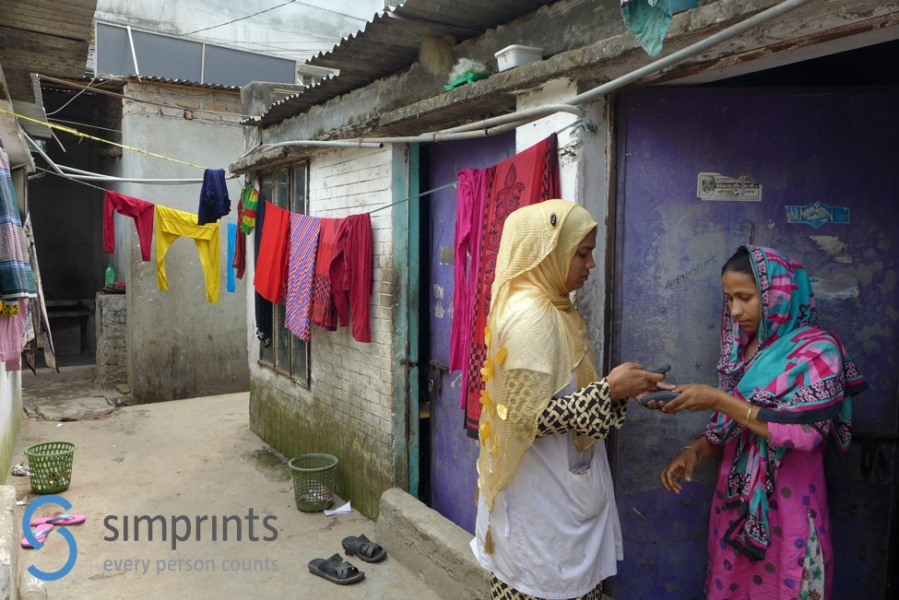
Tat-Seng Chiam, Investment Director, Global Innovation Fund
Tat-Seng is a Director at GIF, with experience in impact investing, strategy consulting and investment banking. Responsibilities include deal sourcing, due diligence and portfolio management, including board roles for investments such as Simpa Networks. Tat-Seng’s portfolio at GIF spans a broad range of sectors including energy access, food security, and domestic resource mobilisation, deploying multiple forms of capital (debt, equity and grants).

Slide 12
Background
Mission statement & focus
The Global Innovation Fund invests in social innovations with the potential to improve the lives and opportunities of millions of people in the developing world
Through grant and risk capital investments, we support new approaches to global development challenges
Geography & sectors
Our scope is global: we seek innovations in all sectors and in all developing world countries where there are significant numbers of those living on less than $5/day.
Notes:
How is GIF different from other Impact Funds/Acumen

Slide 13
Investment Mandate
Stage
Size & structure
GIF uses staged finance to test and grow development innovations
Pilot - Providing seed capital to support the start up and field-testing of innovations (can be pre-revenue)
Test and Transition - Funding innovations that have already demonstrated success at a small scale
Scale - Supporting the expansion of innovations that have already demonstrated viability & impact
The fund offers a range of financing types, including grants, loans (including convertible debt), and equity investments.
Pilot up to $230,000
Test & Transition up to $2.3million
Scale up to $15million
Investees
~20 deals to be closed by end of 2016, building upon an initial set of 8 investments closed in 2015.
Notes:
Please talk about the RoI expectation and timeline for exit

Slide 14
Finding Deals
How do you scout for deals?
Rolling application window, via GIF’s website: www.globalinnovation.fund
Strategic sourcing/referrals from GIF’s network
What are the main things you look for in an organisation before initiating discussion?
Innovation and impact - significant comparative advantage versus existing solutions, benefitting those living on less than $5/day (PPP)
Potential to scale up to millions of people, nationally or across countries
Measuring success - existing – or an intention to generate – rigorous evidence of social impact
Team with relevant expertise and capabilities to achieve success
Notes:
could you please talk about social impact
Can you please expand on GIF network.

Slide 15
Investment Process
5-7 months
Essentially summary business plans or project proposals - short online form and supporting 4 page document
Focus is on initial fit with four criteria
More in-depth discussions with shortlisted applications
Focus is on key potential ‘deal-breaker’ questions identified during initial review
Full plan with budgetary projections and financial plans – scope for co-creation
GIF undertakes due diligence (including soliciting external, expert review)
Decision panel considers investment materials, interviews applicant team by phone, and votes
Key yes/no decision point
Final contracting, including negotiation of terms and ESG diligence
Initial applications
Follow-up calls
Full applications
Decision panel
Contracting
Notes:
Please talk about the different teams a potential investee will interact with
Please only highlight the main points

Slide 16
Red Flags
What are the main reasons for deals not materialising?
Unclear articulation of why proposed innovation is better than standard development practice
Lack of potential to reach scale (millions of people)
Lack of rigorous evidence
Insufficient GIF additionality
What advice would you like to give entrepreneurs to help them avoid common mistakes?
Be clear about the competitive landscape for your innovation and why your product/service is better
Be clear on vision of success from the start – who will fund and implement this at scale
Be clear about the evidence base to date that supports your innovation, or your plans to collect such evidence
Please also refer to our blog post: 2000+ pitches later: how to improve your odds
Expert Advice

Slide 17
Q& A
Q&A
Q& A
Twitter
@GSMAM4D
Website
http://www.gsma.com/mobilefordevelopment/programmes/m4dutilities
Mail
M4Dutilities@gsma.com
utilities_grants@gsma.com

