Slide 1
State of the Mobile Money Industry in Sub-Saharan Africa
2018

Slide 2

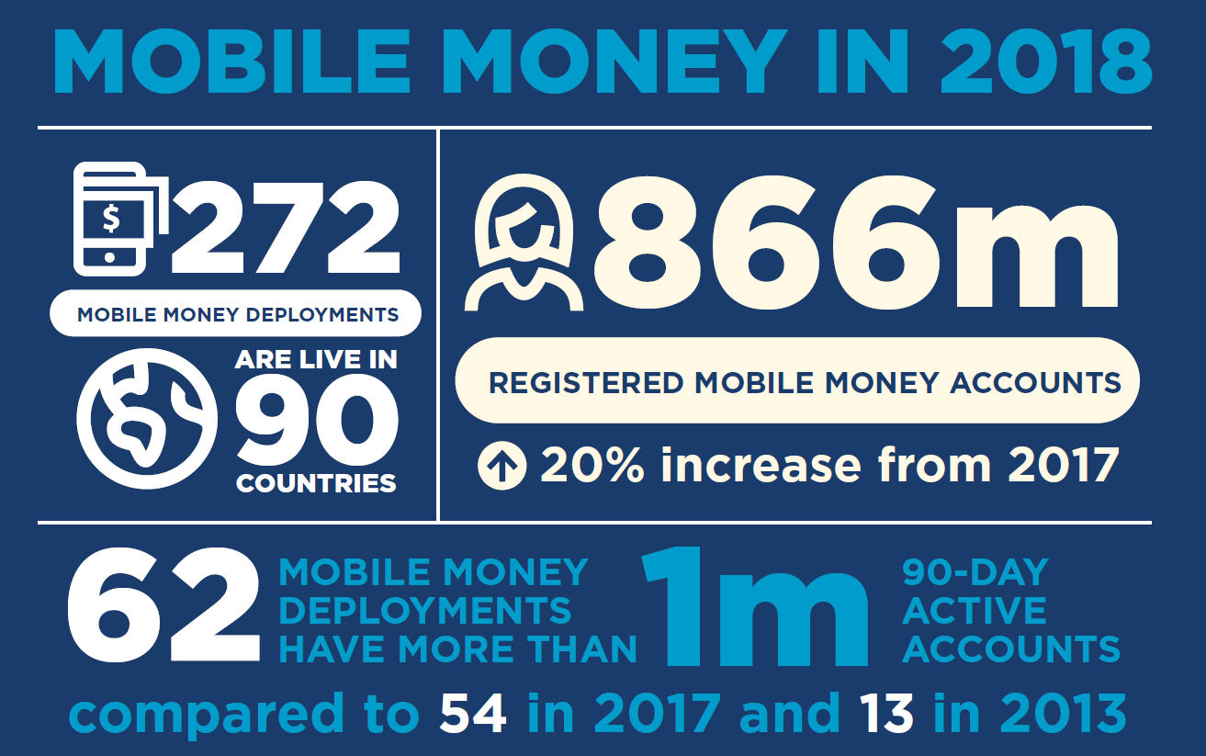

Slide 3
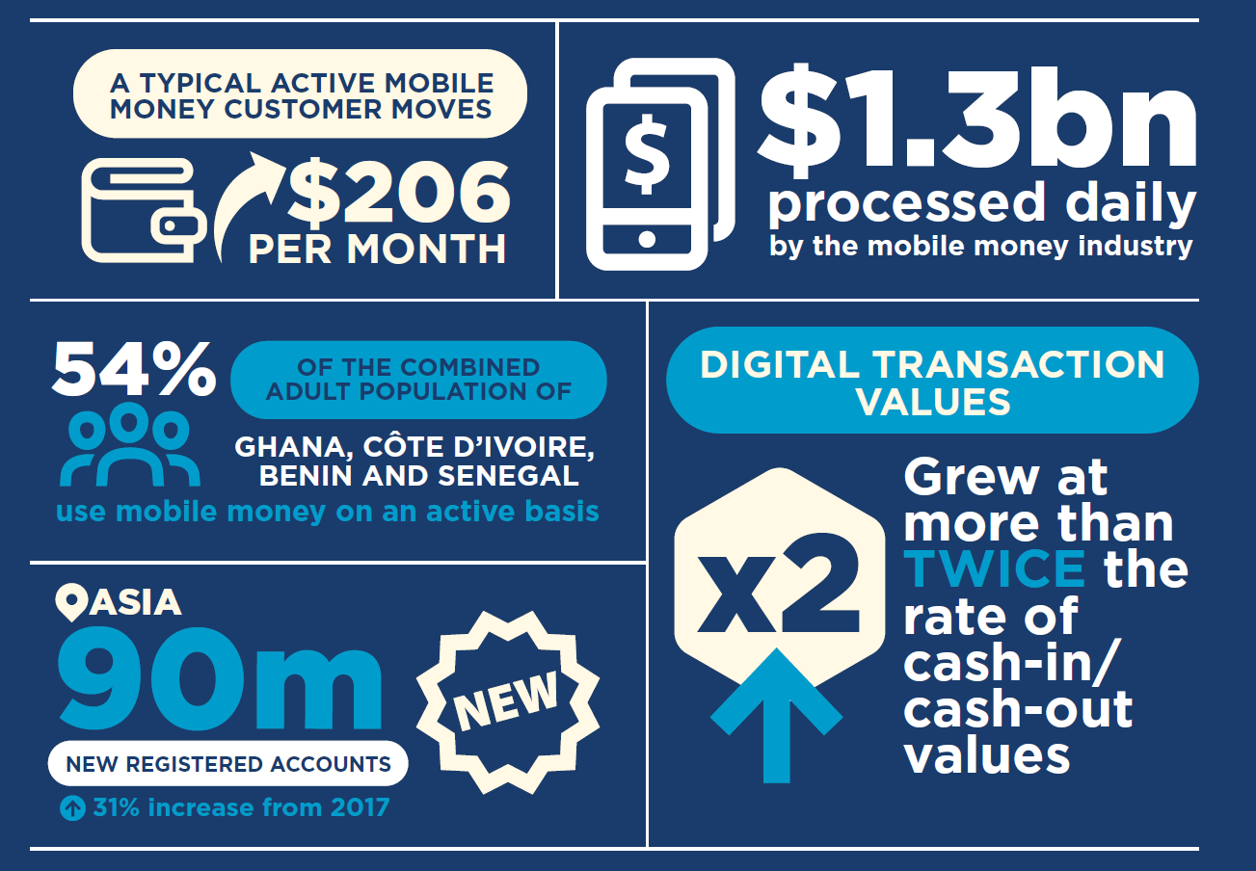

Slide 4
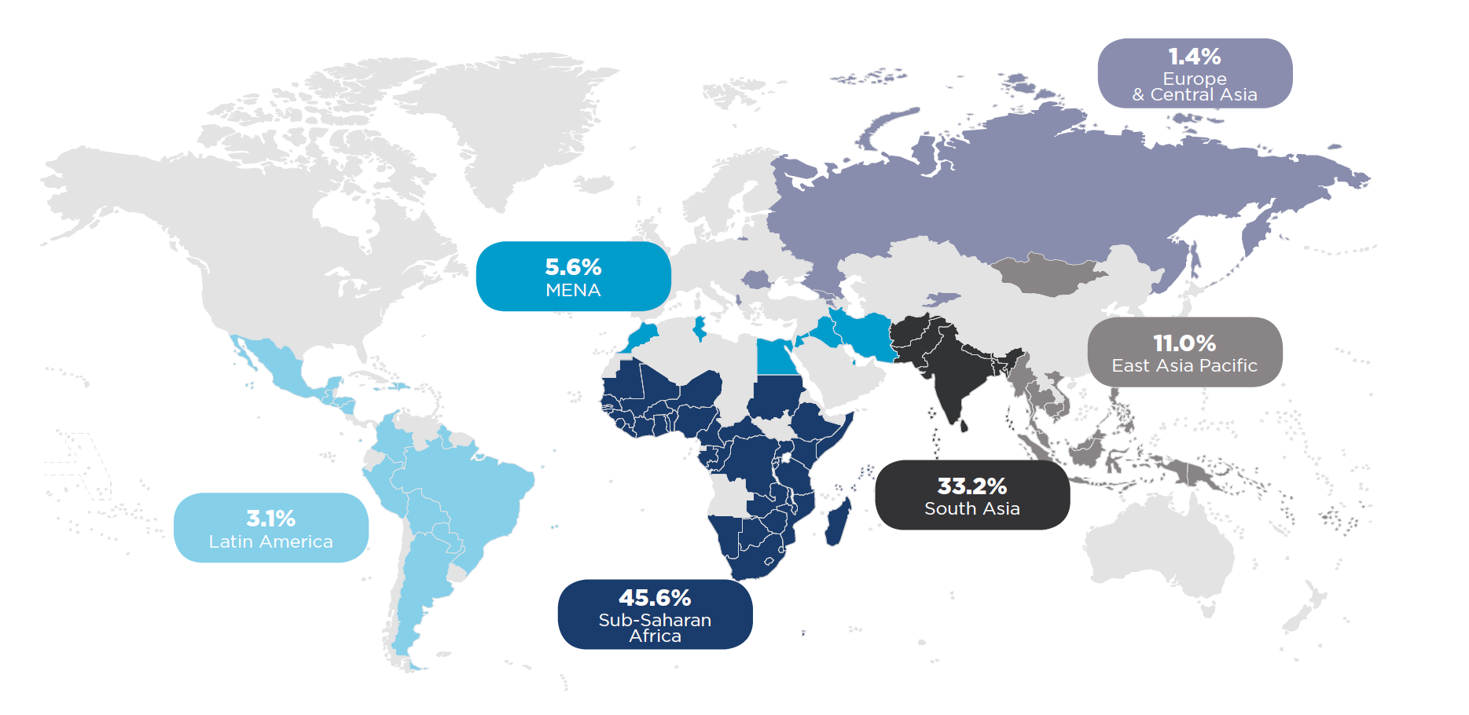
Host to almost half of all mobile money registered accounts globally,
Sub-Saharan Africa remains the epicentre of mobile money.

Slide 5

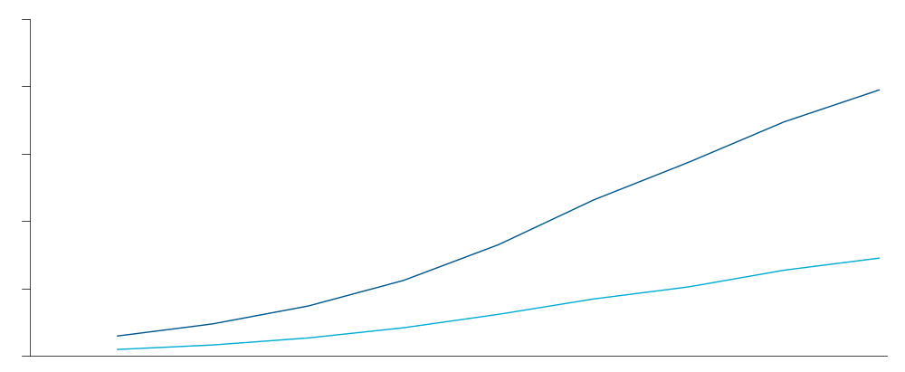
The number of registered customer accounts in Sub-Saharan Africa has reached 396 million, with activity rates of 37% as of December 2018.
Number of registered and active mobile money customers – Sub Saharan Africa
34%
37%
38%
36%
37%
500M
400M
Although regional activity rates have only slightly increased, 57 out of 132 services in the region are achieving activity rates higher than the regional average, with 27 providers driving impressive activity rates of well above 50 per cent.
300M
200M
100M
0M
Dec-10
Dec-11
Dec-12
Dec-13
Dec-14
Dec-15
Dec-16
Dec-17
Dec-18
Registered customers
Active customers
Activity rates

Slide 6
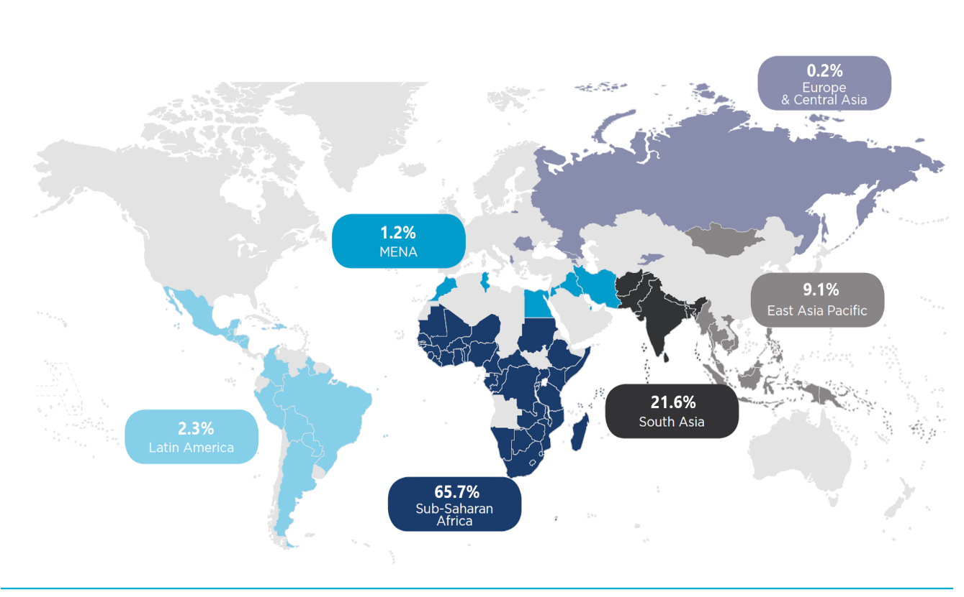
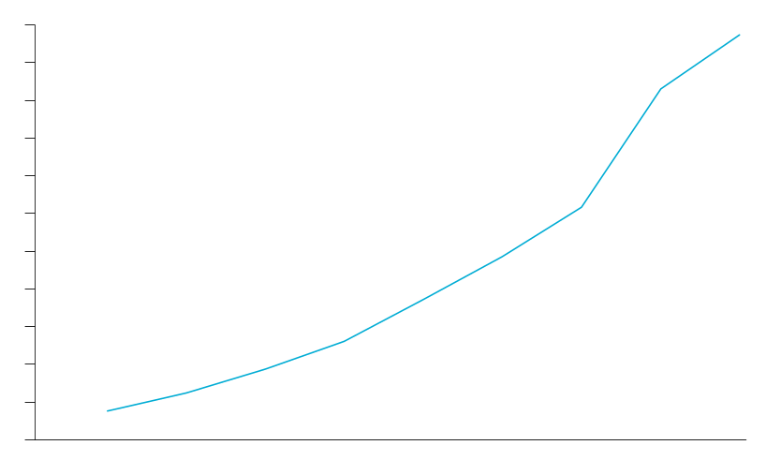
Sub-Saharan Africa is driving around two thirds of total global mobile money transactions, with values exceeding $25bn in December 2018.
Total value of mobile money transactions on a monthly basis – 2010–18 ($ US)
$27.5Bln
25x
$25.0Bln
$22.5Bln
$20.0Bln
$17.5Bln
$15.0Bln
$12.5Bln
$10.0Bln
$7.5Bln
$5.0Bln
$2.5Bln
$0.0Bln
Dec-10
Dec-12
Dec-14
Dec-16
Dec-18

Slide 7
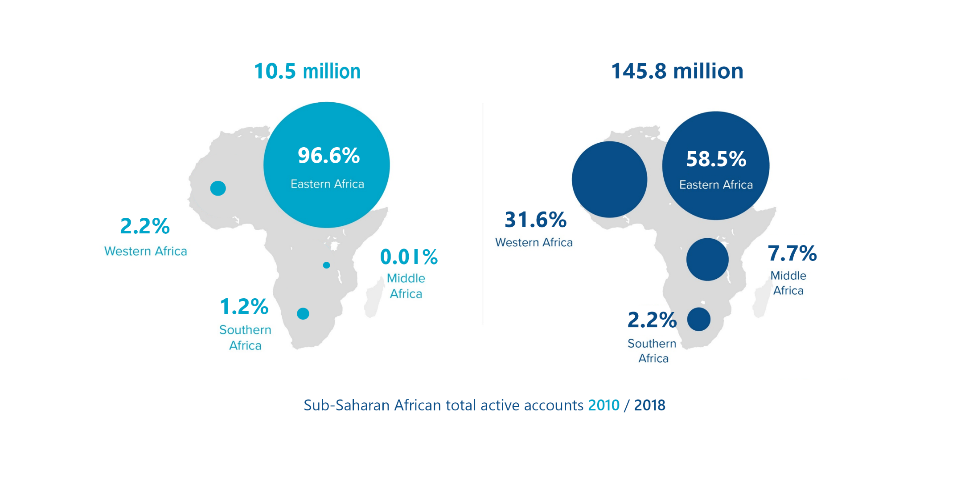
Since 2010, customer distribution across the region has become more diverse, with sub-regions such as Western and Middle Africa growing their market shares.

Slide 8



Mobile money agents have played a key role in driving customer adoption and enhancing financial inclusion in Sub-Saharan Africa.
1.4 million active agents
58k ATMs¹
19k bank branches¹
Very high density agent network with 60 agent outlets per 1000 km²
Low density ATM network with 2 ATMs per 1000 km²
Very low density bank branch network with 1 branch per 1000 km²
1. Data from IMF Financial Access Survey

Slide 9
The mobile money transaction mix across the region has become more diverse, and ecosystem transactions have quadrupled in value and more than doubled in volume.
SSA
Volumes 2010
SSA
Volumes 2018
SSA Product Mix*
2010 vs 2018
26%
Volume:
0.9 bn
37.6%
Volume:
19.1 bn
4%
0.24%
Ecosystem:
6%
0.02%
Ecosystem:
24%
4%
17%
3.5%
1.0%
1.2%
Airtime top-ups
SSA
Values 2010
SSA
Values 2018
2.9%
2.2%
8.9%
10.8%
Bill payments
Ecosystem
transactions
2.5%
3.9%
Bulk payments
Value:
$22.6 bn
0.1%
Value:
$305.1 bn
8.2%
International Remittances
60.8%
2.2%
Merchant Payments
Ecosystem:
15%
Ecosystem:
36%
15.1%
P2P transfers
82.5%
*Note: Excluding cash-in and cash-out

Slide 10
The digitisation of payments reached new heights across Sub-Saharan Africa in 2018.
Incoming transactions
Circulating transactions
Outgoing
transactions
Up from 11.2% in 2017
Up from 2.4% in 2017
2%
4%
1%
2%
Total Value
$10.3bn
Total Value
$6.1bn
Total Value
$8.5bn
International remittances
Bank-to-mobile
Merchant payments
Cash-out
Airtime top-ups
Bulk disbursements
Cash-in
P2P transfers
Bill payments
Off-net transfers
Wallet-to-bank
International remittances

Slide 11
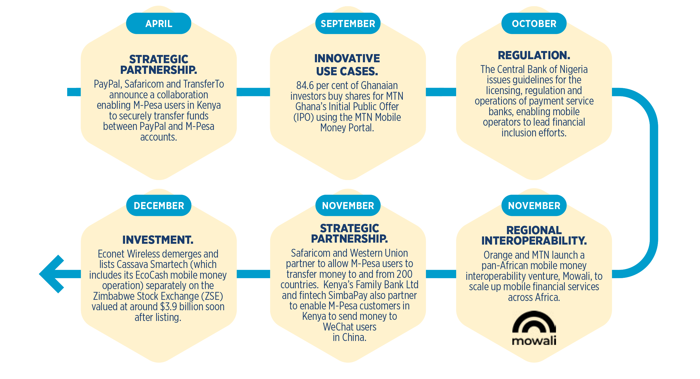
2018 saw advancements in investments, strategic partnerships, regional interoperability and regulation across the Sub-Saharan African region.

Slide 12
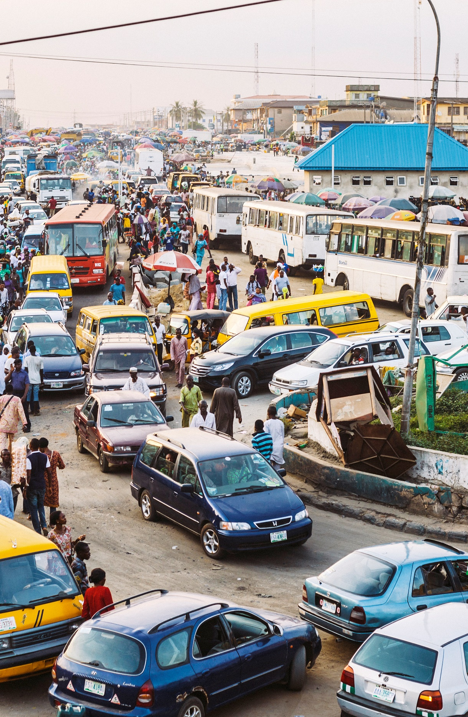


Looking ahead, we see three key areas of future growth in mobile money across
Sub-Saharan Africa:
1
Africa’s mobile money sleeping giants
2
Sectors on the cusp of transformation: MSME and e-commerce
3
The untapped smartphone opportunity
4

Slide 13
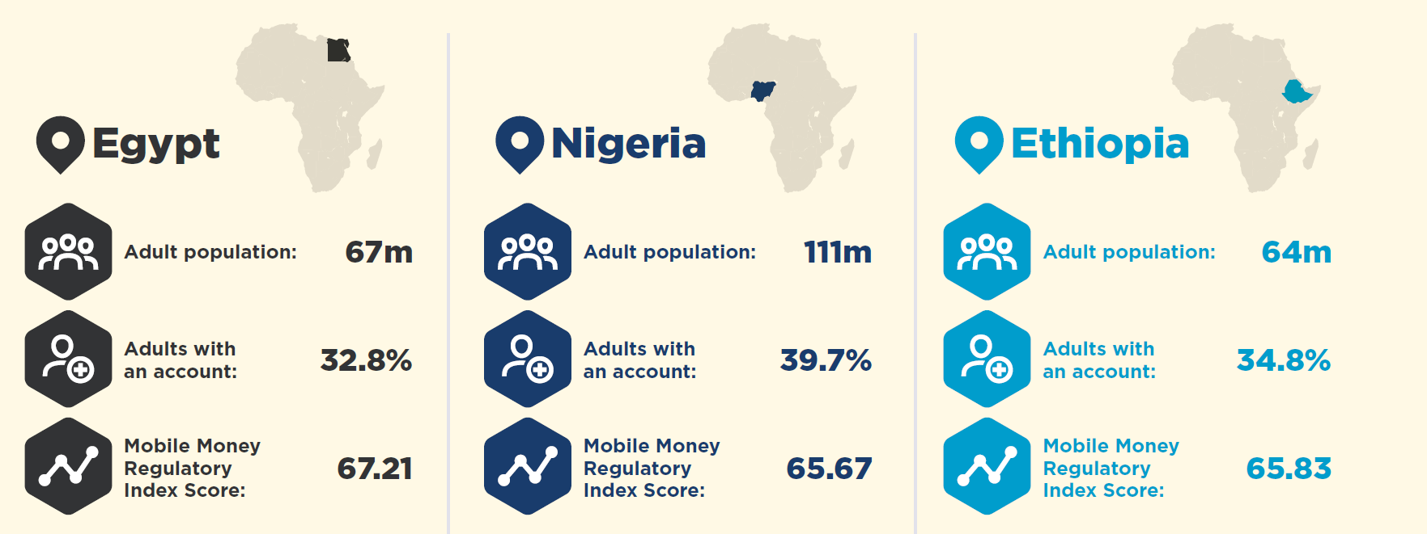

Africa’s mobile money sleeping giants: Egypt, Ethiopia and Nigeria, have the potential to unlock over 110m accounts in the next five years.

Slide 14
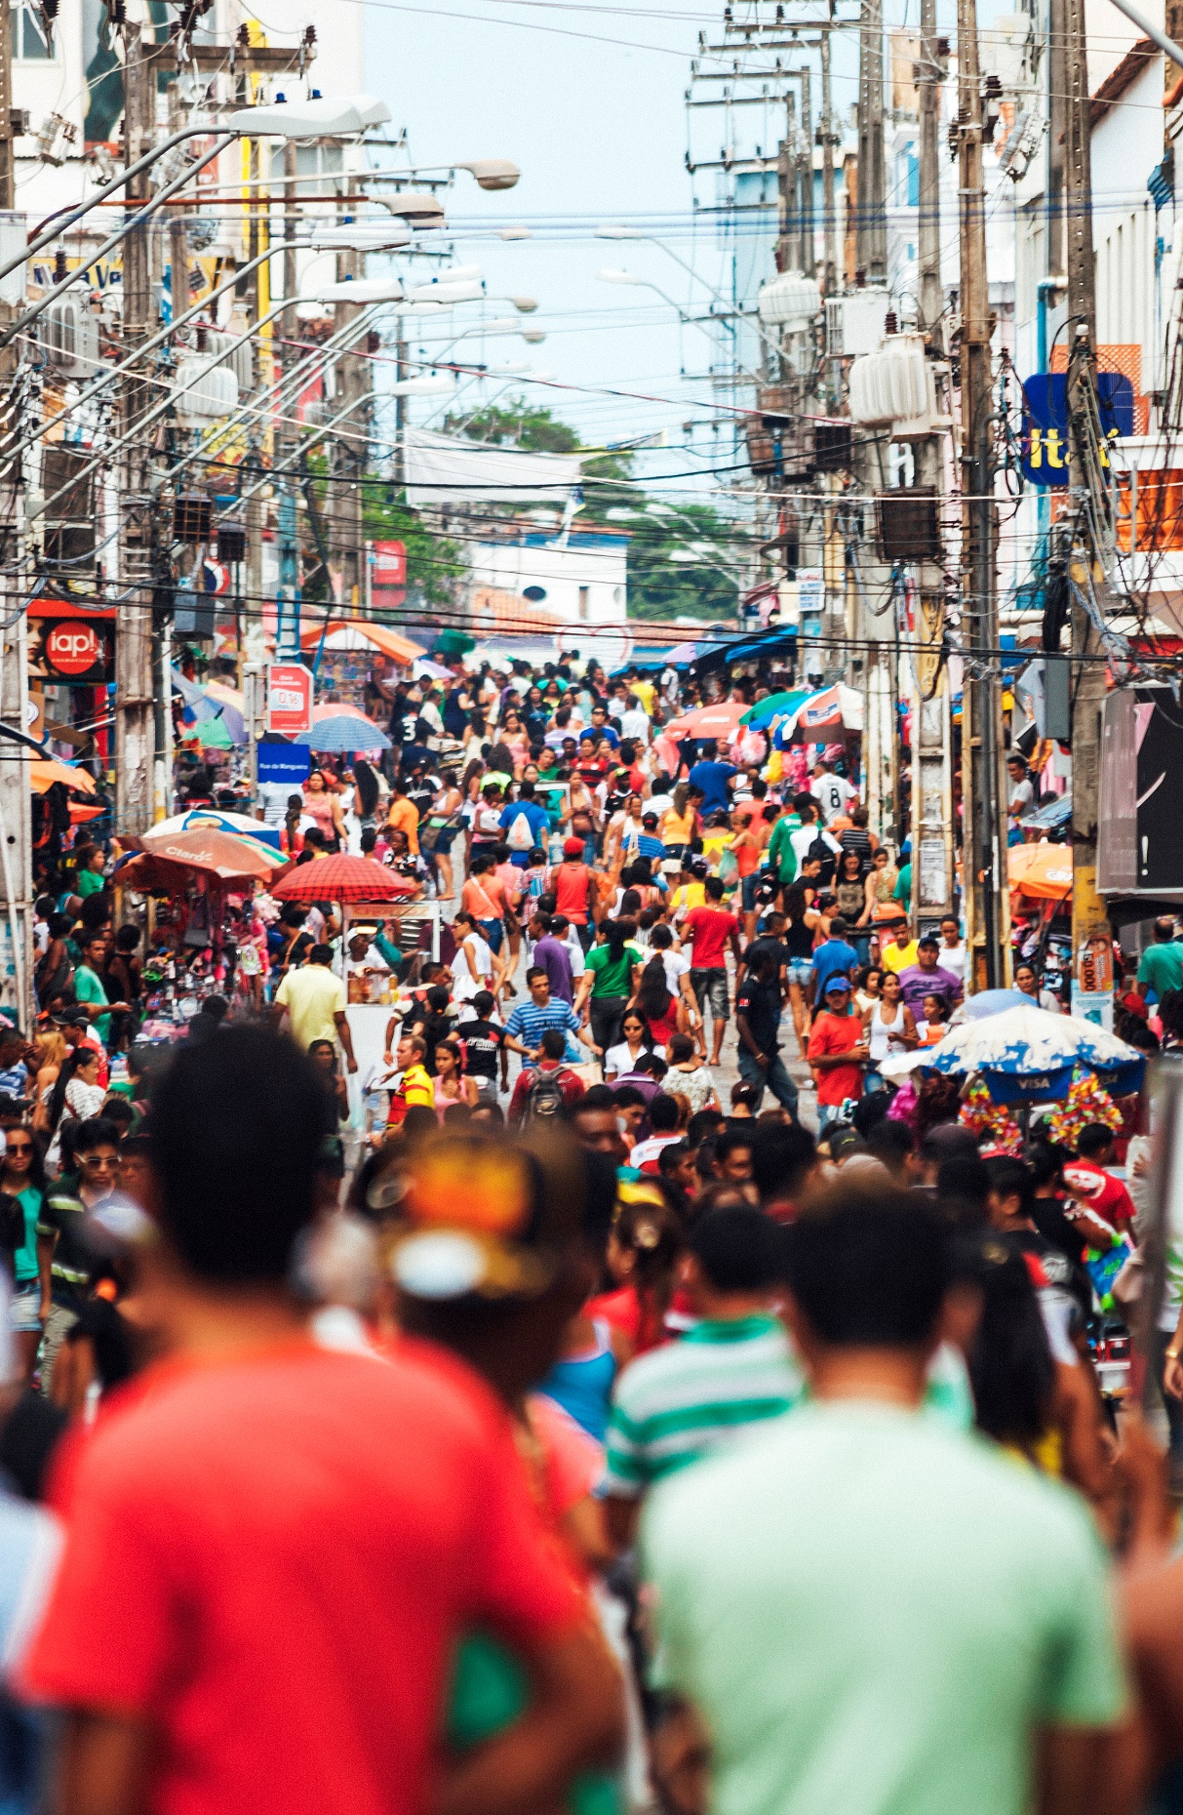


Sectors on the cusp of transformation: MSME and e-commerce
MSMEs
A large number of formal and informal MSMEs in Sub-Saharan Africa have already adopted mobile money for business purposes
46% of Sub-Saharan African respondents to our 2018 Global Adoption Survey highlighted building enterprise solutions as one of their top three strategic priorities
E-commerce
More MSMEs across the region are moving towards marketing and selling their products across digital channels
In 2018, value of e-commerce transactions facilitated by mobile money more than doubled across the region.

Slide 15
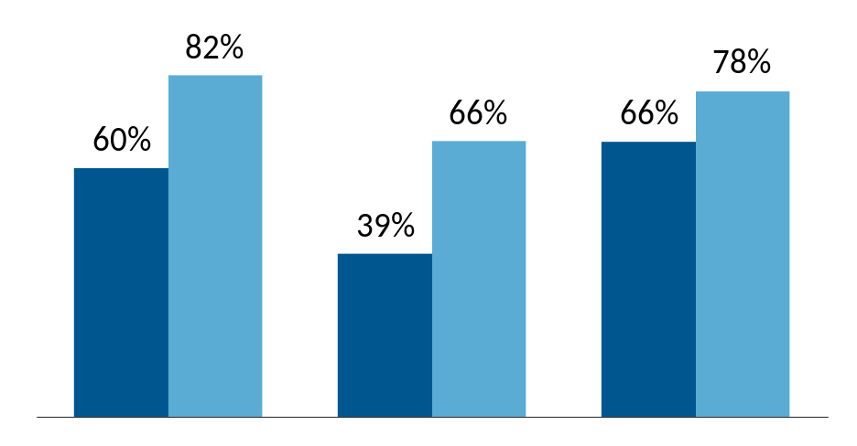
Growth in smartphone adoption unlocks access to a broader customer base and allow providers to offer an enhanced user experience and a wider range of products and services.
SMARTPHONE PENETRATION (2018 & 2025)
USSD remains the dominant channel today:
  Over 90% of mobile money transactions in Sub-Saharan Africa are still processed via USSD
Dramatic uptake in smartphone adoption and mobile internet is on the horizon:
  Smartphone adoption in Sub-Saharan Africa: 39% by end of 2018, set to rise to 66% by 2025
  Mobile internet access in Sub-Saharan Africa: an estimated 280 million new mobile internet subscribers coming online by 2025
Asia
Sub-Saharan Africa
Latin America and the Caribbean
2018
2025

