Slide 1

SECTOR DEEP DIVE: PLASTICS AND WASTE MANAGEMENT
JUNE 2021

Slide 2
Session Agenda
10:00 – 10:05 Welcome and Introduction to the GSMA
10:05 – 10:15 Introduction to the GSMA Innovation Fund for Digital Urban Services
10:15 – 10:25 Introduction to Plastic & Waste Management
- Our view of the challenge
- Insights from new research
- Learning Agenda for the Innovation Fund
10:25 – 10:45 Discussion with Clean City Africa
Michael Munawa, General Manager
10:45 – 11:00 Q&A and Wrap-Up
- Audience questions
- Fund application details and resources

Slide 3
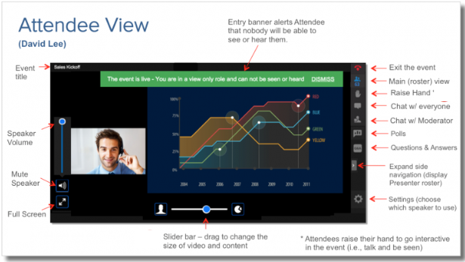
Questions
TYPE QUESTIONS HERE

Slide 4






About the GSMA
GSMA Membership:
750+
mobile operators
400
companies in the broader ecosystem
Nearly 200,000 attendees worldwide come to our events
In 2016
we're the first sector to commit to the SDGs
30 million data points included in GSMA Intelligence’s database
94 million+
lives impacted
through Mobile
for Development
5.2 billion+
unique mobile subscribers

Slide 5



























About Mobile for Development
We drive innovation in digital technology to reduce inequalities in our world.
Mobile for Development unlocks private sector action to launch and scale transformative digital technology.

Slide 6
Our Programmes
Our Digital Utilities programme supports urban resilience in low- and middle-income countries by enabling access to essential utility services through digital solutions
Our ClimateTech programme unlocks the power of digital technology to create a low-carbon and climate-resilient future.
Key Activities:
De-risking and catalysing Innovation
Research and Insights
Partnership facilitation and convening
Technical advisory to stakeholders

Slide 7

The GSMA Innovation Fund
The GSMA Innovation Fund supports innovative digital solutions in emerging markets.
The GSMA has 10 years of experience running innovation funds on a multitude of topics within Mobile for Development.
Notes:
Mobile for Development has 10 years of experience running innovation funds on a multitude of topics and our approach has always been to fund projects that are inclusive, have a clear socio-economic impact, are working towards commercial sustainability and have the potential to reach end users at scale.

Slide 8
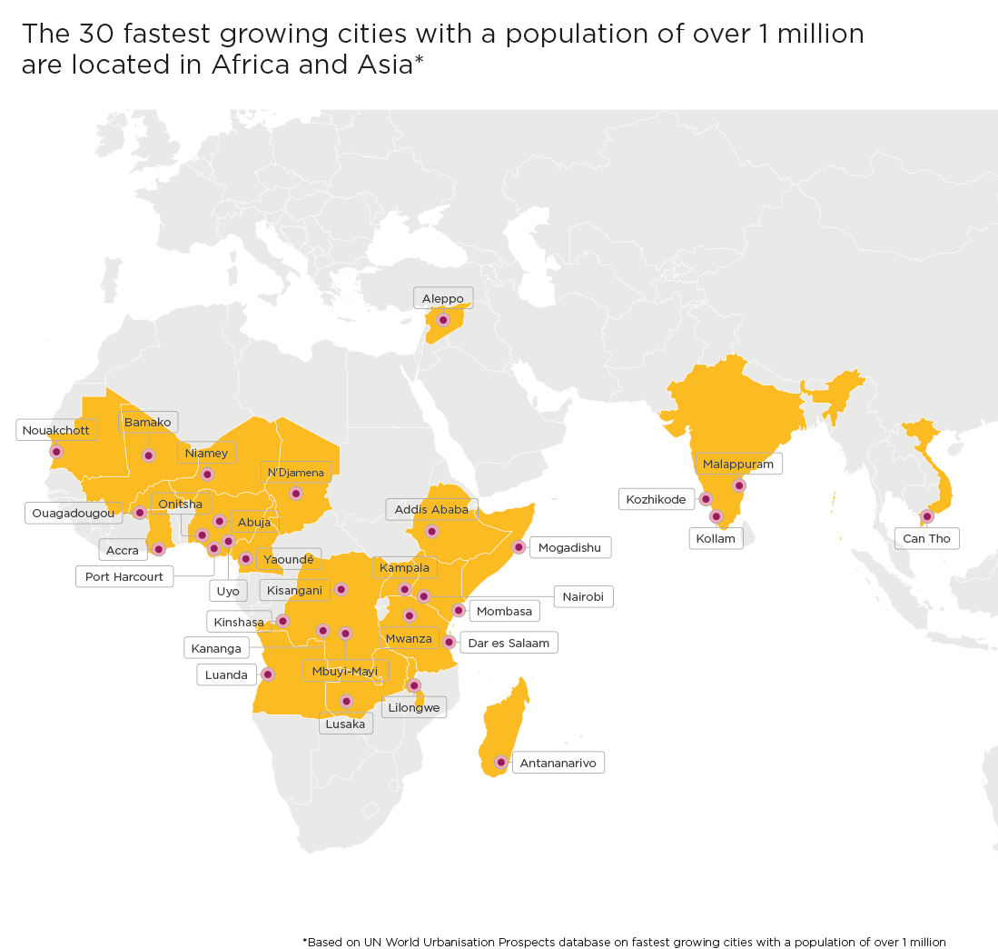




The GSMA Innovation Fund for Digital Urban Services
The GSMA Innovation Fund for Digital Urban Services will test, scale and extract insights from innovative urban services that are inclusive and impactful.
Essential urban services
PLASTIC AND
WASTE MANAGEMENT
ENERGY
WATER
SANITATION
Notes:
The current round of innovation fund which we announced last month is The GSMA Innovation Fund for Digital Urban Services, which seeks to scale digital solutions that provide essential urban services to underserved populations from low- and middle-income countries in Africa, South and Southeast Asia.
Why this particular focus?
Urban services such as, energy, water, sanitation and plastics and waste management are essential to the well-being of city dwellers and the resilience of cities, particularly amidst a changing climate.
While there has been a historic rise in mobile connectivity in low- and middle-income countries, and particularly in cities, billions of people still lack access to these basic services.
And, with rapidly expanding informal settlements across Africa and Asia, where 90 per cent of global urban growth from now until 2050 will be concentrated, water shortages, unsanitary conditions, unreliable power provision, and inadequate waste management could remain a defining reality for many.
To tackle these challenges, the local private sector can play an important role in leveraging digital technology and working with mobile operators and the public sector to deliver sustainable and equitable services.

Slide 9
Objective of the Innovation Fund
The Innovation Fund will aim to demonstrate:
How digital technology, including mobile, can support and scale the delivery of urban services to underserved populations;
The socio-economic, commercial and environmental/climate impact of digital urban services;
The business and/or partnership models required to enable digital urban services to be adopted at scale; and
How partnerships with mobile operators and other technology companies can improve the scale and sustainability of digital urban services.

Slide 10





Support Provided to Grantees through the Innovation Fund
Support provided to grantees will include:
Grant funding between £100,000 - £250,000 to support projects over 15 to 18 months;
Bootcamp (a programme of expert-led sessions and targeted networking) and regular online clinics on topics such as product or service improvement, human-centered design and usability testing;
Learning exchange opportunities with other grantees and networking opportunities with other GSMA partners;
Monitoring and evaluation support to evidence socio-economic impact and promote product improvement;
Facilitation of relationships with mobile operators and public sector organisations where relevant;
Opportunity to increase your visibility and raising your profile to potential investors and partners through profiling in GSMA publications, social media and events.

Slide 11
Eligibility Criteria for the Innovation Fund
Key eligibility criteria:
Start-ups, small to medium sized private sector companies, and social enterprises;
Can demonstrate the long-term sustainability and scalability of the innovation beyond the lifespan of the grant; and
Have active users and revenue in at least one eligible low- or middle-income market.
These types of organisations will not be eligible to apply to the Innovation Fund: Governments (or appointed government agencies); Mobile Network Operators; University or Academic organisations; start-up accelerators and incubators.
Geography: ​
Low- and middle-income countries in Africa, South Asia and Southeast Asia; some exclusions apply – see Terms and Conditions

Slide 12
Innovation Fund Key Dates
17 May 2021
ANNOUNCEMENT & OPEN OF APPLICATIONS
Press Release to announce the fund; Release of Terms Sheet; Applicants will have ​7 weeks ​
to submit a pitch via​
an online form
2 June 2021
LAUNCH WEBINAR
The GSMA will host a webinar to explain the fund, the eligibility criteria and the application process
7 - 10 June 2021
SECTOR DEEP DIVES
Virtual sessions on Plastic and Waste Management, Water, Sanitation and Energy to understand sector challenges and the Innovation Fund learning agenda
2 July 2021
APPLICATIONS CLOSE
The Pitch Submission Stage closes
2 Aug – 5 Nov 2021
PROPOSAL STAGE
Shortlisted applicants ​
submit a full project proposal including:​
Technical proposal ​
Project implementation plan ​
Budget ​
The selection will be made in late November, with contracting completed by March 2022
Notes:
Start of Announcement Activities:
1. Press release to announce fund launch (and release the term sheet)
2. Internal Blogs to promote the fund and link to term sheet
3. Blogs with external stakeholders (strategic partners) to further spread the word
4. Launch Video (the Assistive tech video for reference https://www.youtube.com/watch?v=Y9OFe9zxK3c)
5. Email our strategic partners or stakeholders about the fund (can have one-on-one calls with a few in case they have extensive reach)

Slide 13

Introduction to Plastic and Waste Management

Slide 14
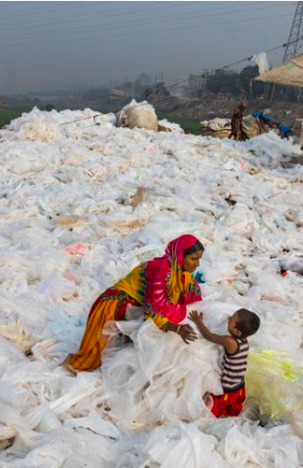
Plastic and Waste Management
The total amount of waste generated will triple in Africa and double in Asia by 2050. In many cities found in these regions, formal waste management systems are underdeveloped or non-existent, and 70% of waste is mismanaged. This has negative impacts on socio-economic development, public health and our climate.
Plastic waste is particularly problematic. It is estimated that less than 10% of the plastic ever produced has been recycled, and waste that is ’leaked’ into the environment chokes waterways and affects vital climate processes. By 2050, the production of virgin plastic could account for one fifth of the world’s oil consumption.
What is contributing to the plastic and waste management crisis:
A rapid increase in single-use plastic;
Waste management (collection, sorting and recycling) is dominated by the informal sector;
Limited willingness among municipalities to prioritise or pay for waste management solutions;
Low levels of public awareness and citizen apathy on environmental, economic and public health risks;
A lack of, or poorly enforced, Extended Producer Responsibility (EPR) policies; and
Low levels of coordination and digitization in the waste management value chain.
Source: www.nationalgeographic.com

Slide 15





How digital solutions can improve service delivery
Raise public awareness
Drive behavioural change
Identify sources or hotspots of waste pollution, and quantify waste flows
Common technologies used: Mobile apps, interactive content, mobile payments, satellite, drones, GIS mapping
Improve citizen engagement
Help match waste generators (households, businesses) with waste collectors
Help integrate informal waste collectors into the value chain
Optimise collection and recycling activities
Automate waste segregation
Common technologies used: Mobile apps, mobile payments, AI (including machine learning), IoT
Drive operational efficiencies
Connect all actors in the value chain
Create high levels of transparency in the supply chain
Common technologies used: Mobile apps, supply chain management software, blockchain, data visualisation software
Increase transparency

Slide 16
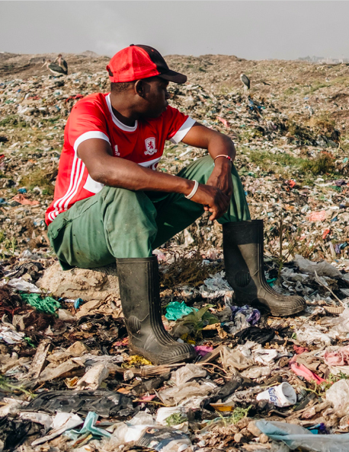
Plastic and Waste Management
The GSMA Innovation Fund will seek to:
Develop, pilot or scale digital tools and business models that support the transparency, sustainability and profitability of plastic (including both ‘downstream’ and ‘upstream innovations’) and/or broader waste management services;
Test how mobile operators and other technology organisations can leverage their digital platforms, services and expertise to support new recycling and waste management models;
Identify how improved traceability can increase the commercial and social impact of plastic recycling for all stakeholders in the value chain; and
Promote and showcase best practice.
Source: https://theintercept.com

Slide 17
Discussion with Clean City Africa

Slide 18
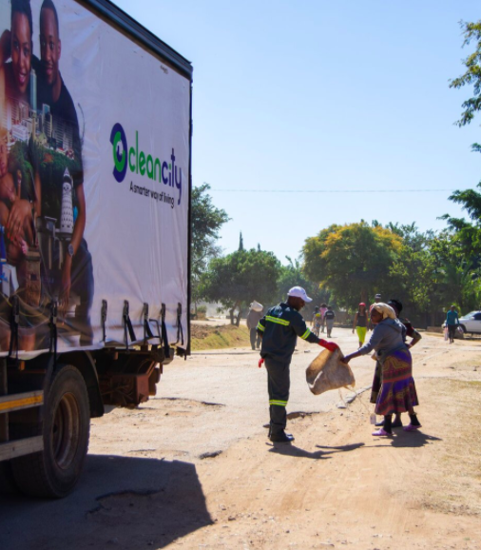
Discussion with Clean City Africa
During the 2018 cholera outbreak, it was recognised that waste piling up around the city was exacerbating the health crisis.
In response, an Econet subsidiary, Cassava Smartech, created Clean City Africa. The ultimate aim of Clean City is to provide waste collection and disposal services that divert recyclable waste away from landfills and prevent leakage into the environment by helping to connect various actors in the value chain.
Through the Vaya Clean City mobile app, households and businesses that are generating waste are easily matched to waste collectors and aggregators.
The app collects each customer’s personal details, their location and their estimated amount of waste. This information is used to estimate a collection charge, which the customer can pay through Econet’s mobile money interface, EcoCash.
To ensure that everyone in the value chain was benefiting from Clean City’s operations, Econet proposed a model whereby fees are shared between collectors, franchisees, the City of Harare and Clean City.

Slide 19
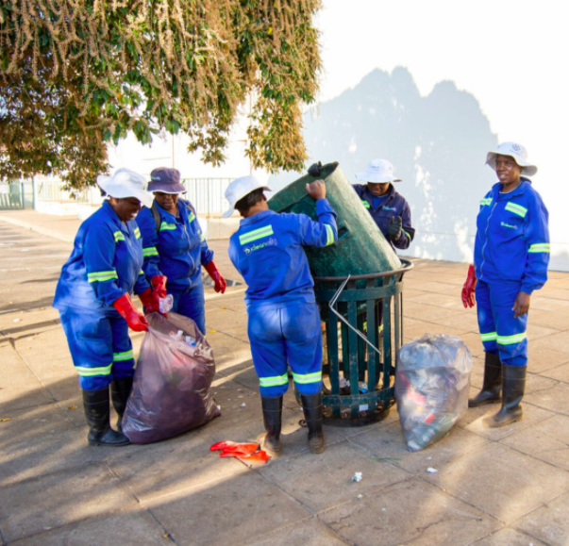
Discussion with Clean City Africa
IMPACTS:
5% of revenue goes to a Community Environmental Service (CES) fund, which covers the cost of cleaning streets and public places. Over 500 people are deployed through CES to clean public spaces every day.
Over 40 franchisee waste collectors in Clean City’s network have collectively created over 5,000 jobs, most of which are at material recovery centres, where much of this work is done by individuals who previously worked as waste pickers.
Clean City franchisees now cover over 500,000 households in Harare and its suburbs (300,000 of which are regular customers), and over 50 illegal dump sites have been shut down across Harare since the company launched.
The service has led to over 10,000 households separating materials at source.

Slide 20
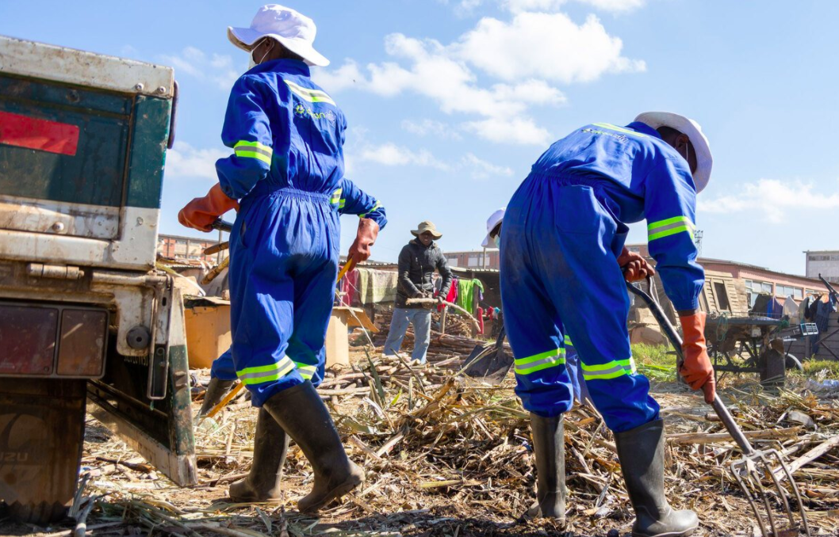
Discussion with Clean City Africa
Discussion Questions
What digital trends are you seeing in plastic and waste management in Zimbabwe and other LMICs?
What’s next for digital innovation in plastic and waste management and where are the gaps?
What do we still need to learn?
What advice would you have given yourself 3 years ago?
What advice would you give to innovators to make the best use of the grant opportunities (including how to work with MNOs)?
What do innovators need to do to prepare themselves to scale?

Slide 21
Q&A

Slide 22

For more information:
Review Terms and Conditions and Apply: https://bit.ly/2QhYnSr
Read the fund launch report and view FAQs
For questions, contact us at: GSMAIF@gsma.com
This initiative has been funded by UK aid from the UK government and is supported by the GSMA and its members.
The views expressed do not necessarily reflect the UK government’s official policies.

