Slide 1

June 2021

Slide 2
Session Agenda
10:00 – 10:05 Welcome and Introduction to the GSMA
10:05 – 10:15 Introduction to the GSMA Innovation Fund for Digital Urban Services
10:15 – 10: 25 Introduction to digital innovation in energy
- Our view of the challenge
- Insights from use cases
- Learning Agenda for the Innovation Fund
10:25 – 10:50 Panel discussion
- Andron Mendes, Co-Founder and CFO, KopaGas
- Emma Stephenson, Sustainable Mobility Lead, Shell Foundation
- Daniel Kitwa, Manager - Energy, Climate Change & Agriculture practice, Intellecap
10:50 – 11:00 Q&A and Wrap-Up
- Audience questions
- Fund application details and resources

Slide 3
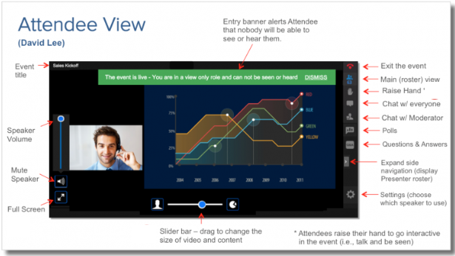
Questions
TYPE QUESTIONS HERE

Slide 4






About the GSMA
GSMA Membership:
750+
mobile operators
400
companies in the broader ecosystem
Nearly 200,000 attendees worldwide come to our events
In 2016
we're the first sector to commit to the SDGs
30 million data points included in GSMA Intelligence’s database
94 million+
lives impacted
through Mobile
for Development
5.2 billion+
unique mobile subscribers

Slide 5



























About Mobile for Development
We drive innovation in digital technology to reduce inequalities in our world.
Mobile for Development unlocks private sector action to launch and scale transformative digital technology.

Slide 6
Our Programmes
The Digital Utilities programme supports urban resilience in low- and middle-income countries by enabling access to essential utility services through digital solutions
The ClimateTech programme unlocks the power of digital technology to create a low-carbon and climate-resilient future.
Key Activities:
De-risking and catalysing Innovation
Research and Insights
Partnership facilitation and convening
Technical advisory to stakeholders

Slide 7

The GSMA Innovation Fund
The GSMA Innovation Fund supports innovative digital solutions in emerging markets.
The GSMA has 10 years of experience running innovation funds on a multitude of topics within Mobile for Development.
Notes:
Mobile for Development has 10 years of experience running innovation funds on a multitude of topics and our approach has always been to fund projects that are inclusive, have a clear socio-economic impact, are working towards commercial sustainability and have the potential to reach end users at scale.

Slide 8
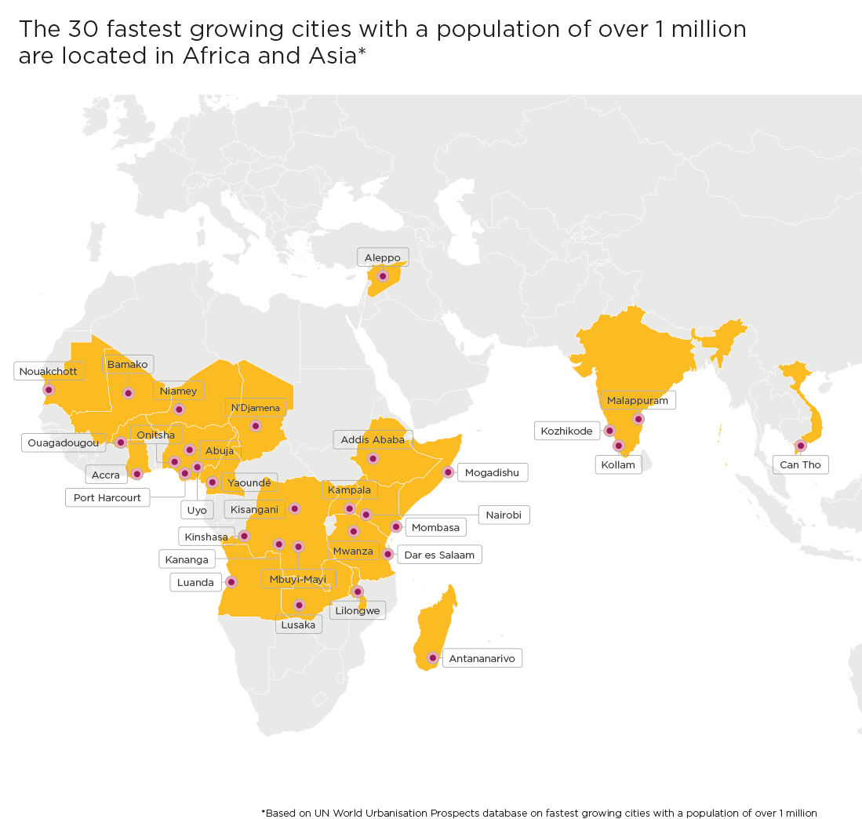




The GSMA Innovation Fund for Digital Urban Services
The GSMA Innovation Fund for Digital Urban Services will test, scale and extract insights from innovative urban services that are inclusive and impactful.
Essential urban services
PLASTIC AND
WASTE MANAGEMENT
ENERGY
WATER
SANITATION
Notes:
The current round of innovation fund which we announced last month is The GSMA Innovation Fund for Digital Urban Services, which seeks to scale digital solutions that provide essential urban services to underserved populations from low- and middle-income countries in Africa, South and Southeast Asia.
Why this particular focus?
Urban services such as, energy, water, sanitation and plastics and waste management are essential to the well-being of city dwellers and the resilience of cities, particularly amidst a changing climate.
While there has been a historic rise in mobile connectivity in low- and middle-income countries, and particularly in cities, billions of people still lack access to these basic services.
And, with rapidly expanding informal settlements across Africa and Asia, where 90 per cent of global urban growth from now until 2050 will be concentrated, water shortages, unsanitary conditions, unreliable power provision, and inadequate waste management could remain a defining reality for many.
To tackle these challenges, the local private sector can play an important role in leveraging digital technology and working with mobile operators and the public sector to deliver sustainable and equitable services.

Slide 9
Objective of the Innovation Fund
The Innovation Fund will aim to demonstrate:
How digital technology, including mobile, can support and scale the delivery of urban services to underserved populations;
The socio-economic, commercial and environmental/climate impact of digital urban services;
The business and/or partnership models required to enable digital urban services to be adopted at scale; and
How partnerships with mobile operators and other technology companies can improve the scale and sustainability of digital urban services.

Slide 10





Support Provided to Grantees through the Innovation Fund
Support provided to grantees will include:
Grant funding between £100,000 - £250,000 to support projects over 15 to 18 months; matching component required
Bootcamps and regular online clinics on topics such as product or service improvement, human-centered design and usability testing;
Learning exchange opportunities with other grantees and networking opportunities with other GSMA partners;
Monitoring and evaluation support to evidence socio-economic impact and promote product improvement;
Facilitation of relationships with mobile operators and public sector organisations where relevant;
Opportunity to increase your visibility and raising your profile to potential investors and partners through profiling in GSMA publications, social media and events.

Slide 11
Eligibility Criteria for the Innovation Fund
Key eligibility criteria:
Start-ups, small to medium sized private sector companies, and social enterprises;
Can demonstrate the long-term sustainability and scalability of the innovation beyond the lifespan of the grant; and
Have active users and revenue in at least one eligible low- or middle-income market.
These types of organisations will not be eligible to apply to the Innovation Fund: Governments (or appointed government agencies); Mobile Network Operators; University or Academic organisations; start-up accelerators and incubators.
Geography: ​
Low- and middle-income countries in Africa, South Asia and Southeast Asia; some exclusions apply – see Terms and Conditions

Slide 12
Innovation Fund Key Dates
17 May 2021
ANNOUNCEMENT & OPEN OF APPLICATIONS
Press Release to announce the fund; Release of Terms Sheet; Applicants will have ​7 weeks ​
to submit a pitch via​
an online form
2 June 2021
LAUNCH WEBINAR
The GSMA will host a webinar to explain the fund, the eligibility criteria and the application process
7 - 10 June 2021
SECTOR DEEP DIVES
Virtual sessions on Plastic and Waste Management, Water, Sanitation and Energy to understand sector challenges and the Innovation Fund learning agenda
2 July 2021
APPLICATIONS CLOSE
The Pitch Submission Stage closes
2 Aug – 5 Nov 2021
PROPOSAL STAGE
Shortlisted applicants ​
submit a full project proposal including:​
Technical proposal ​
Project implementation plan ​
Budget ​
The selection will be made in late November, with contracting completed by March 2022
Notes:
Start of Announcement Activities:
1. Press release to announce fund launch (and release the term sheet)
2. Internal Blogs to promote the fund and link to term sheet
3. Blogs with external stakeholders (strategic partners) to further spread the word
4. Launch Video (the Assistive tech video for reference https://www.youtube.com/watch?v=Y9OFe9zxK3c)
5. Email our strategic partners or stakeholders about the fund (can have one-on-one calls with a few in case they have extensive reach)

Slide 13

Introduction to urban energy

Slide 14

Energy
According to the World Bank, over 600 million people are expected to still be without electricity in 2030. Due to rapid urbanisation and the growth of informal settlements, which are often cut off from the national electricity grid, low-income households are particularly affected by unreliable energy access.
Some critical sector challenges include:
Rising energy demand in cities across LMICs - additional attention needs to be placed on urban energy provision, especially on transition from dirty to clean fuels.
Affordability and reliability – lack of planning puts several countries at risk of not only failing to meet SDG 7, but also depressing the economic potential of emerging cities.
Access to clean cooking solutions has increased slowly – Where SE4All estimates that $4 billion is required annually to ensure universal access to cleaner cooking options
Electric mobility (e-mobility) holds high promise in Africa and Asia - but governments need to facilitate e-mobility solutions through policies, regulations, standards for charging, and basic consumer protection frameworks with low fiscal costs.
How digital solutions can improve service delivery:
Unlock new business models that compliment grid services, or make new energy solutions viable for low-income populations to live healthy and productive lives;
Digital payments make renewable and safe energy services affordable for low-income households and small businesses through smaller instalments; and
Enable real-time remote monitoring to maintain and optimise services to provide them reliably and efficiently.

Slide 15




Digital solutions use cases in Energy
Pay-as-you-go business models
PAYG services enable low-income customers to make micropayments and guarantee revenue collection for providers.
IoT/ M2M connectivity
Smart monitoring of system performance can improve operational efficiency and are essential technologies in the deployment of real-time data systems
Improved data can contribute to better service monitoring and planning
Voice, SMS, and USSD functions
Communications bridge between utilities and customers
Essential for maintaining service quality
Big data, AI and machine learning
The use of large data sets to improve decision making
Implement automation to optimise operations

Slide 16

Energy
Previously:
The Digital Utilities programme has supported 30 energy grantees in 20 countries
Grants supported digital solutions in areas such as PAYG Solar, Mobile Payments, Smart on-the Grid metering, M2M connectivity
More than £295 million has been raised by these grantees in follow-on funding
The GSMA Innovation Fund will seek to:
Support the replication and expansion of digitally-enabled clean cooking (PAYG LPG, electric cooking);
Explore the role of digital solutions to drive innovative electric mobility services through battery monitoring and optimising logistics;
Test and scale generation/storage solutions for urban small enterprise to replace diesel generators;
Test and scale synergistic models between energy service providers and mobile operators
Source: https://www.theglobalist.com/

Slide 17
Panel discussion

Slide 18



Meet the speakers
Daniel Kitwa
Manager - Energy, Climate Change & Agriculture practice, Intellecap
Emma Stephenson
Sustainable Mobility Lead, Shell Foundation
Andron Mendes
Co-Founder and CFO, KopaGas

Slide 19
Q&A

Slide 20

For more information:
Review Terms and Conditions and Apply: gsma.com/digitalurbanservices
Read the fund launch report and view FAQs
For questions, contact us at: GSMAIF@gsma.com
This initiative has been funded by UK aid from the UK government and is supported by the GSMA and its members.
The views expressed do not necessarily reflect the UK government’s official policies.

