Slide 1

JUNE 2021

Slide 2

Session Agenda
10:00 – 10:05 Welcome from GSMA & Introduction to the GSMA Innovation Fund
10:05 – 10:20 Introduction to digital innovation in Sanitation
- Our view of the challenge
- Relevance of digital solutions
- Learning Agenda for the Innovation Fund
10:20 – 10:45 Panel discussion
- Virginia Gardiner – CEO, Loowatt
- Venugopal Gupta – Director Accelerator Programme, Toilet Board Coalition
- Mwansa Nachula Mukuka - Sanitation Specialist, Lusaka Water Supply and Sanitation Company
10:45 – 11:00 Q&A and Wrap-Up
- Audience questions
- Fund application details and resources

Slide 3
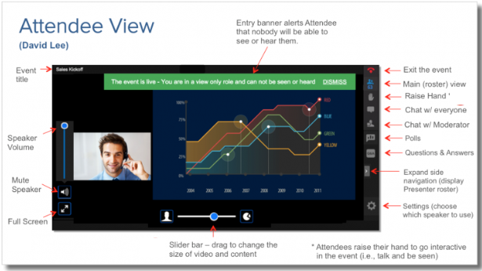
Questions
TYPE QUESTIONS HERE

Slide 4






About the GSMA
GSMA Membership:
750+
mobile operators
400
companies in the broader ecosystem
Nearly 200,000 attendees worldwide come to our events
In 2016
we're the first sector to commit to the SDGs
30 million data points included in GSMA Intelligence’s database
94 million+
lives impacted
through Mobile
for Development
5.2 billion+
unique mobile subscribers

Slide 5



























About Mobile for Development
We drive innovation in digital technology to reduce inequalities in our world.
Mobile for Development unlocks private sector action to launch and scale transformative digital technology.

Slide 6
Our Programmes
The Digital Utilities programme supports urban resilience in low- and middle-income countries by enabling access to essential utility services through digital solutions
The ClimateTech programme unlocks the power of digital technology to create a low-carbon and climate-resilient future.
Key Activities:
De-risking and catalysing Innovation
Research and Insights
Partnership facilitation and convening
Technical advisory to stakeholders

Slide 7

The GSMA Innovation Fund
The GSMA Innovation Fund supports innovative digital solutions in emerging markets.
The GSMA has 10 years of experience running innovation funds on a multitude of topics within Mobile for Development.
Notes:
Mobile for Development has 10 years of experience running innovation funds on a multitude of topics and our approach has always been to fund projects that are inclusive, have a clear socio-economic impact, are working towards commercial sustainability and have the potential to reach end users at scale.

Slide 8
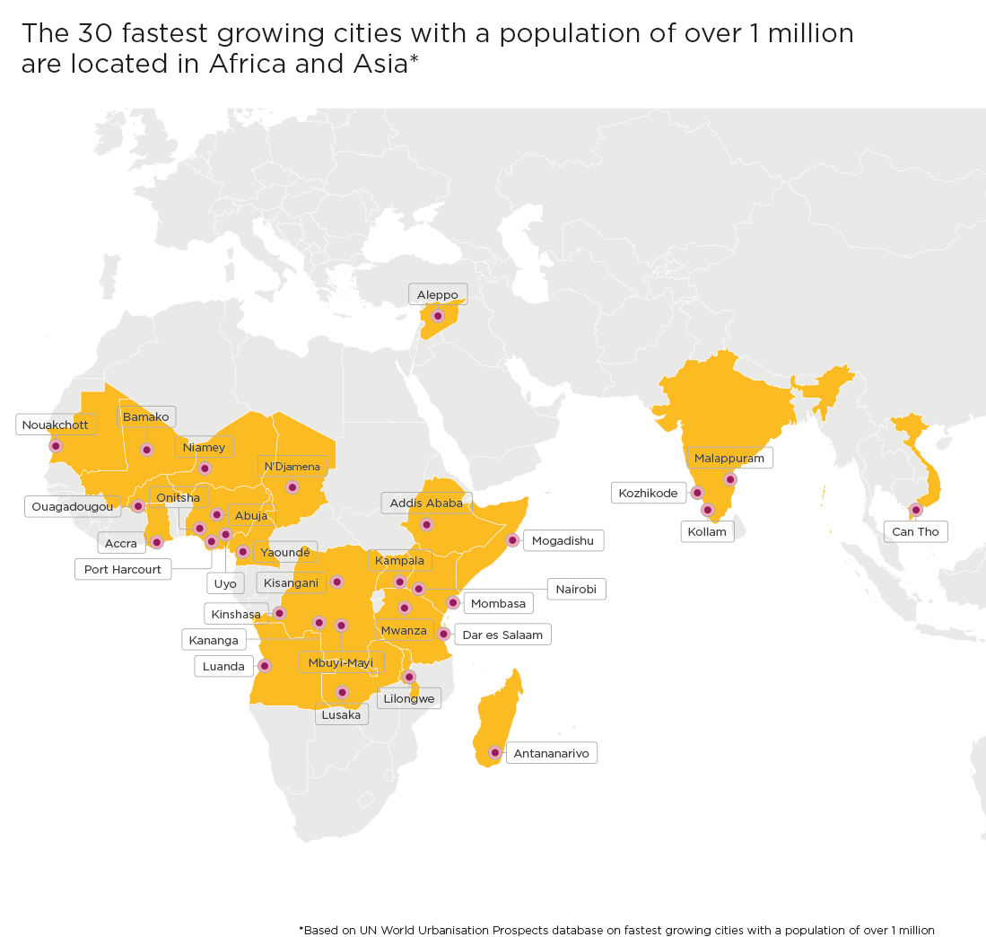




The GSMA Innovation Fund for Digital Urban Services
The GSMA Innovation Fund for Digital Urban Services will test, scale and extract insights from innovative urban services that are inclusive and impactful.
Essential urban services
PLASTIC AND
WASTE MANAGEMENT
ENERGY
WATER
SANITATION
Notes:
The current round of innovation fund which we announced last month is The GSMA Innovation Fund for Digital Urban Services, which seeks to scale digital solutions that provide essential urban services to underserved populations from low- and middle-income countries in Africa, South and Southeast Asia.
Why this particular focus?
Urban services such as, energy, water, sanitation and plastics and waste management are essential to the well-being of city dwellers and the resilience of cities, particularly amidst a changing climate.
While there has been a historic rise in mobile connectivity in low- and middle-income countries, and particularly in cities, billions of people still lack access to these basic services.
And, with rapidly expanding informal settlements across Africa and Asia, where 90 per cent of global urban growth from now until 2050 will be concentrated, water shortages, unsanitary conditions, unreliable power provision, and inadequate waste management could remain a defining reality for many.
To tackle these challenges, the local private sector can play an important role in leveraging digital technology and working with mobile operators and the public sector to deliver sustainable and equitable services.

Slide 9
Objective of the Innovation Fund
The Innovation Fund will aim to demonstrate:
How digital technology, including mobile, can support and scale the delivery of urban services to underserved populations;
The socio-economic, commercial and environmental/climate impact of digital urban services;
The business and/or partnership models required to enable digital urban services to be adopted at scale; and
How partnerships with mobile operators and other technology companies can improve the scale and sustainability of digital urban services.

Slide 10





Support Provided to Grantees through the Innovation Fund
Support provided to grantees will include:
Grant funding between £100,000 - £250,000 to support projects over 15 to 18 months; matching component required
Bootcamp and regular online clinics on topics such as product or service improvement, human-centered design and usability testing;
Learning exchange opportunities with other grantees and networking opportunities with other GSMA partners;
Monitoring and evaluation support to evidence socio-economic impact and promote product improvement;
Facilitation of relationships with mobile operators and public sector organisations where relevant;
Opportunity to increase your visibility and raising your profile to potential investors and partners through profiling in GSMA publications, social media and events.

Slide 11
Eligibility Criteria for the Innovation Fund
Key eligibility criteria:
Start-ups, small to medium sized private sector companies, and social enterprises;
Can demonstrate the long-term sustainability and scalability of the innovation beyond the lifespan of the grant; and
Have active users and revenue in at least one eligible low- or middle-income market.
These types of organisations will not be eligible to apply to the Innovation Fund: Governments (or appointed government agencies); Mobile Network Operators; University or Academic organisations; start-up accelerators and incubators.
Geography: ​
Low- and middle-income countries in Africa, South Asia and Southeast Asia; some exclusions apply – see Terms and Conditions

Slide 12
Innovation Fund Key Dates
17 May 2021
ANNOUNCEMENT & OPEN OF APPLICATIONS
Press Release to announce the fund; Release of Terms Sheet; Applicants will have ​7 weeks ​
to submit a pitch via​
an online form
2 June 2021
LAUNCH WEBINAR
The GSMA will host a webinar to explain the fund, the eligibility criteria and the application process
7 - 10 June 2021
SECTOR DEEP DIVES
Virtual sessions on Plastic and Waste Management, Water, Sanitation and Energy to understand sector challenges and the Innovation Fund learning agenda
2 July 2021
APPLICATIONS CLOSE
The Pitch Submission Stage closes
2 Aug – 5 Nov 2021
PROPOSAL STAGE
Shortlisted applicants ​
submit a full project proposal including:​
Technical proposal ​
Project implementation plan ​
Budget ​
The selection will be made in late November, with contracting completed by March 2022
Notes:
Start of Announcement Activities:
1. Press release to announce fund launch (and release the term sheet)
2. Internal Blogs to promote the fund and link to term sheet
3. Blogs with external stakeholders (strategic partners) to further spread the word
4. Launch Video (the Assistive tech video for reference https://www.youtube.com/watch?v=Y9OFe9zxK3c)
5. Email our strategic partners or stakeholders about the fund (can have one-on-one calls with a few in case they have extensive reach)

Slide 13
Introduction to sanitation

Slide 14
Sanitation
Over half of the world’s population, 4.2 billion people, currently do not have access safely-managed sanitation services. The consequences of poor sanitation are far reaching, affecting health, wealth, education, and gender equality. Across many LMICs, urban population growth continues to outpace growth in sewer access with many cities and utilities struggling to provide sanitation services to informal settlements.
Some critical sector challenges include:
Unequal access – many households – particularly those living in informal settlements - do not have access to at least basic sanitation services
Fragmented sanitation value chain (containment, emptying, transport, treatment)– effective fecal sludge management and urban sanitation systems are complex, and require significant logistics and communication between different stakeholders, from households to pit emptiers and municipalities
Lack of accountability – this is driven by the overlapping spheres of authority, funding challenges, and regulatory uncertainty underlying urban sanitation service provision
How digital solutions can improve service delivery:
Digital solutions such as GIS-based mapping and tracking tools to enable urban sanitation service providers to reduce their operational costs and increase customer reach
Digital payment solutions to improve revenue collection and affordability
Digital tools to provide municipalities and donors with better data about the state of sanitation services in cities and enable evidence-based planning for service expansion

Slide 15




Digital solution use cases in Sanitation
Voice, SMS, and USSD functions
Mobile services enable communication between providers and customers.
Mobile services can also be used to raise public awareness and drive behavioural changes when introducing new service models, or product offerings
IoT/ M2M communication and GIS tracking
Smart monitoring of system performance can minimise technical losses and improve operational efficiency
Digital payments can reduce collection costs for providers, increase revenue, and enable new business models such as pay-as-you-go (PAYG)
PAYG services allow low-income customers to make micropayments
Digital Payments
Big data, AI and machine learning
The use of large data sets to improve decision making
Geospatial data coupled with other innovative data sources to plan for service expansions in the context of rapidly changing contexts

Slide 16
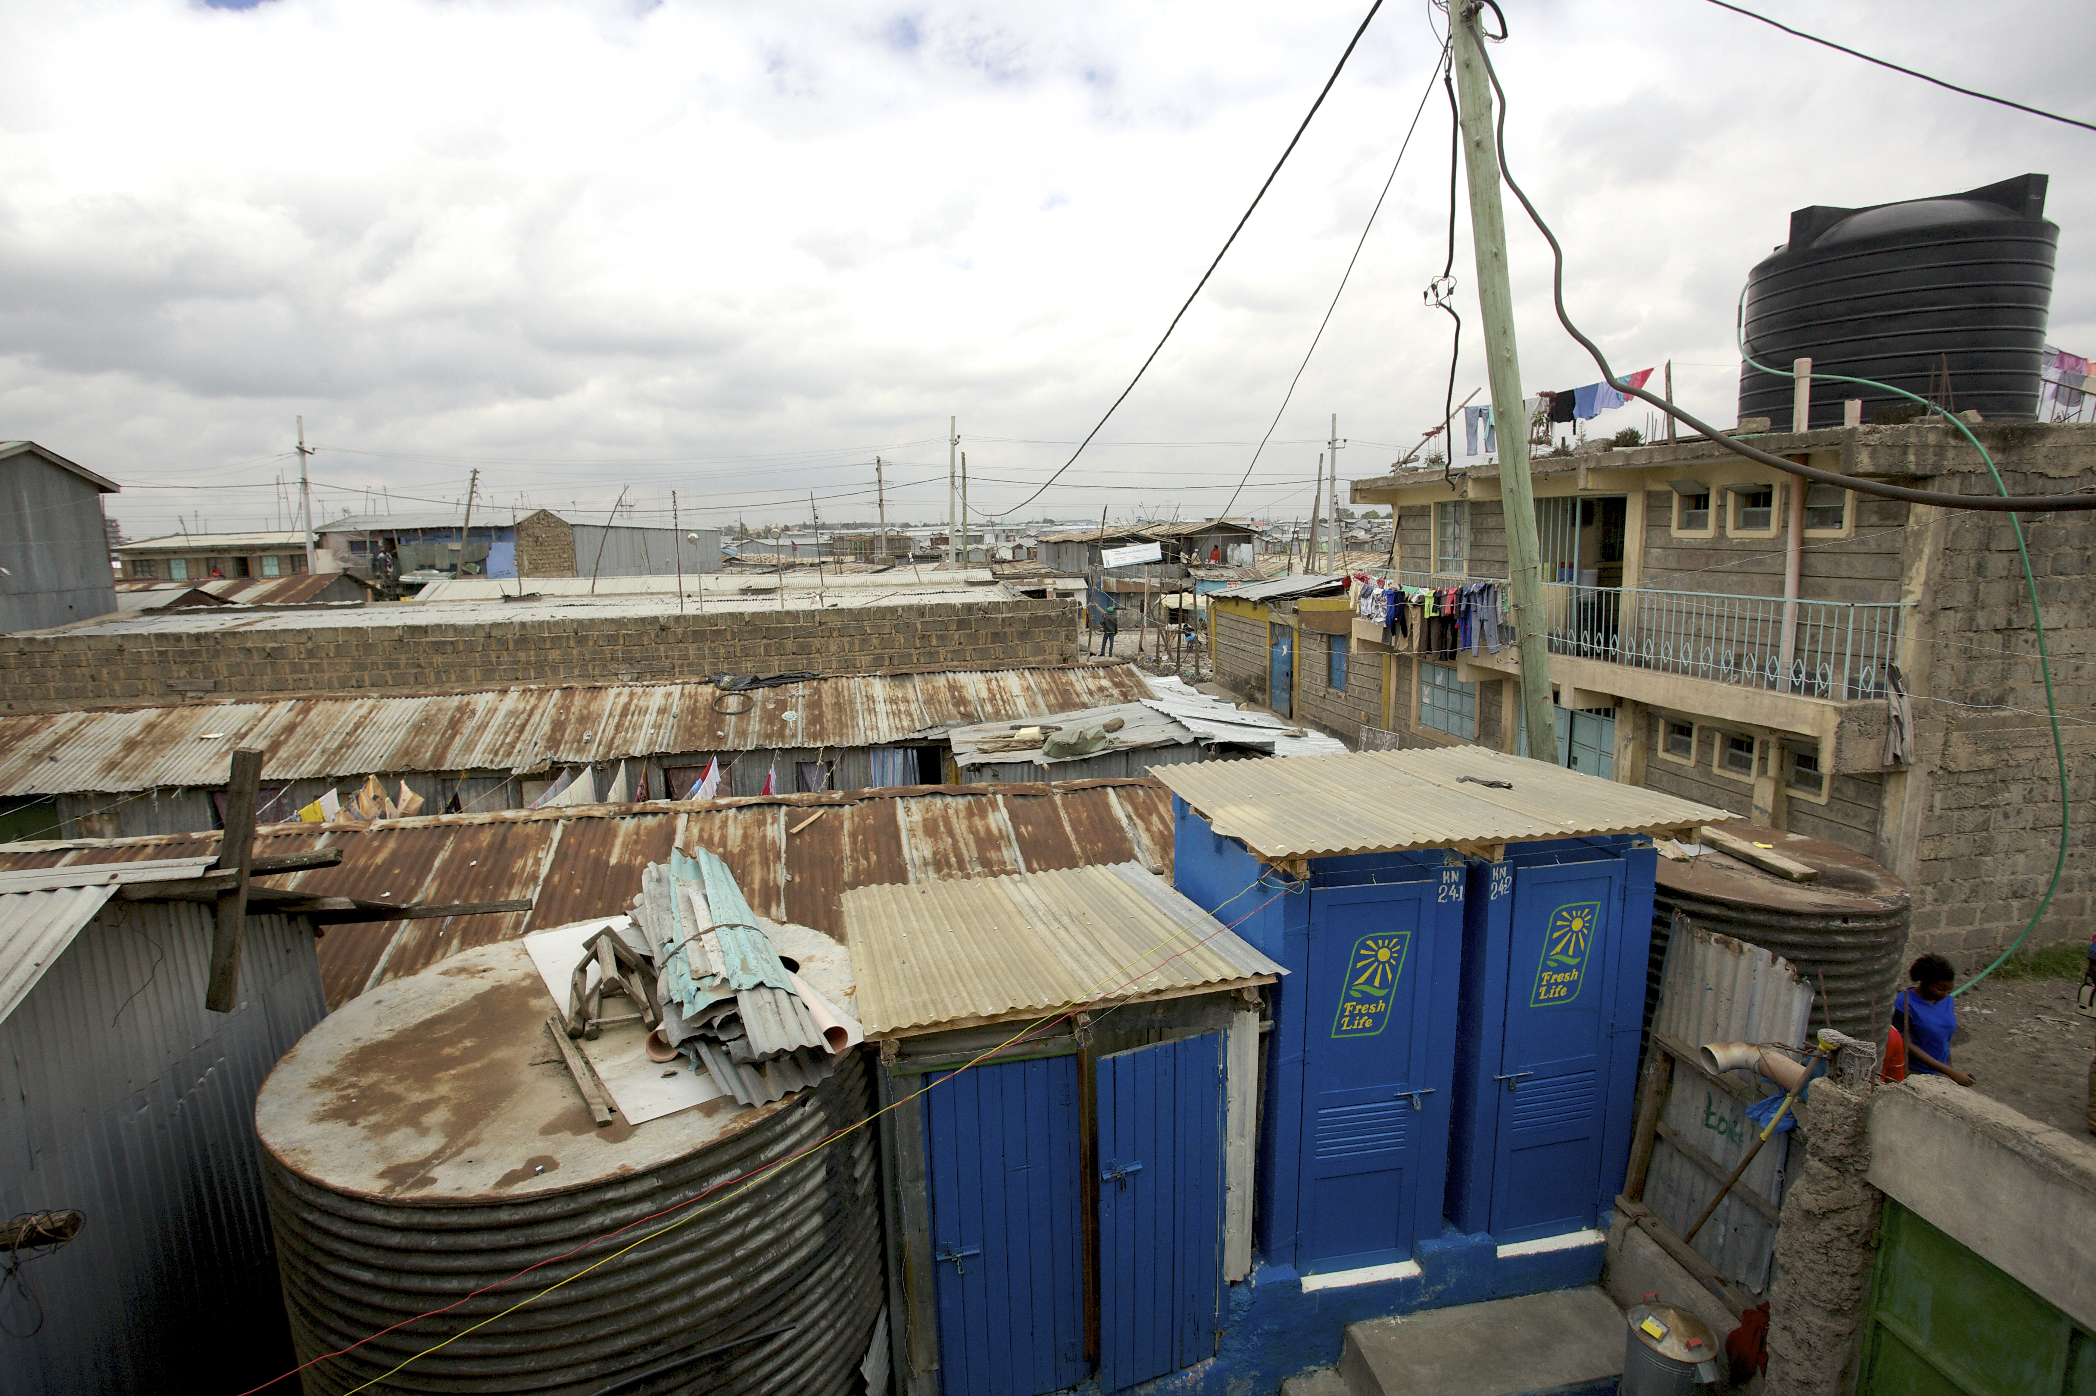
Sanitation
In sanitation we have previously:
Supported 6 sanitation grantees in 4 countries
Grants supported digital solutions in areas such as digital payments, mobile applications, and GIS tracking
More than £4.4 million has been raised by these grantees in follow-on funding
The GSMA Innovation Fund will seek to:
Support technologies that substantially lower the operating costs of sanitation providers;
Trial business models that integrate digital payments;
Drive potential synergies between sanitation and other core services such as waste management; and
Explore the use of unconventional data sets and big data to support more effective planning and regulation in the sector.

Slide 17
Panel Discussion

Slide 18



Virginia Gardiner
Chief Executive Officer, Loowatt
Meet the speakers
Venugopal Gupta
Director Accelerator Programme, Toilet Board Coalition
Mwansa Nachula Mukuka Sanitation Specialist, Lusaka Water Supply and Sanitation Company

Slide 19
Q&A

Slide 20

For more information:
To access more information on the GSMA Innovation Fund, please see our website:
gsma.com/digitalurbanservices
Or contact us at: GSMAIF@gsma.com
This initiative has been funded by UK aid from the UK government and is supported by the GSMA and its members.
The views expressed do not necessarily reflect the UK government’s official policies.

