Slide 1

June 2021

Slide 2
Session Agenda
10:00 – 10:05 Welcome and Introduction to the GSMA
10:05 – 10:10 Introduction to the GSMA Innovation Fund for Digital Urban Services
10:10 – 10: 20 Introduction to digital innovation in water
- Our view of the challenge
- Learning agenda for the Innovation Fund
10:20 – 10:50 Panel discussion and Q&A
- Rodney Chapin - Imagine H₂0 Asia and CEO of Ardurra International
- Minhaj Chowdhury - CEO of Drinkwell
- Odete Muximpua - Water Supply & Sanitation Specialist, World Bank
10:50 – 11:00 Wrap-Up
- Remaining questions on the fund application

Slide 3
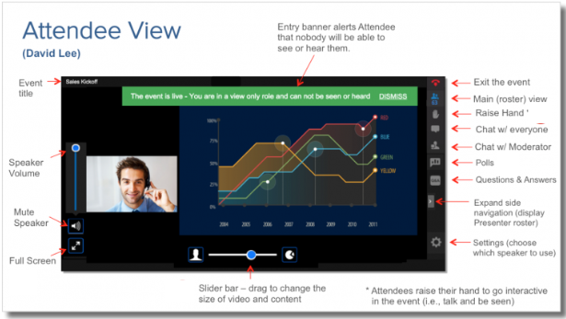
Questions
TYPE QUESTIONS HERE

Slide 4






About the GSMA
GSMA Membership:
750+
mobile operators
400
companies in the broader ecosystem
Nearly 200,000 attendees worldwide come to our events
In 2016
we're the first sector to commit to the SDGs
30 million data points included in GSMA Intelligence’s database
94 million+
lives impacted
through Mobile
for Development
5.2 billion+
unique mobile subscribers

Slide 5



























About Mobile for Development
We drive innovation in digital technology to reduce inequalities in our world.
Mobile for Development unlocks private sector action to launch and scale transformative digital technology.

Slide 6
Our Programmes
The Digital Utilities programme supports urban resilience in low- and middle-income countries by enabling access to essential utility services through digital solutions
The ClimateTech programme unlocks the power of digital technology to create a low-carbon and climate-resilient future.
Key Activities:
De-risking and catalysing Innovation
Research and Insights
Partnership facilitation and convening
Technical advisory to stakeholders

Slide 7

The GSMA Innovation Fund
The GSMA Innovation Fund supports innovative digital solutions in emerging markets.
The GSMA has 10 years of experience running innovation funds on a multitude of topics within Mobile for Development.
Notes:
Mobile for Development has 10 years of experience running innovation funds on a multitude of topics and our approach has always been to fund projects that are inclusive, have a clear socio-economic impact, are working towards commercial sustainability and have the potential to reach end users at scale.

Slide 8
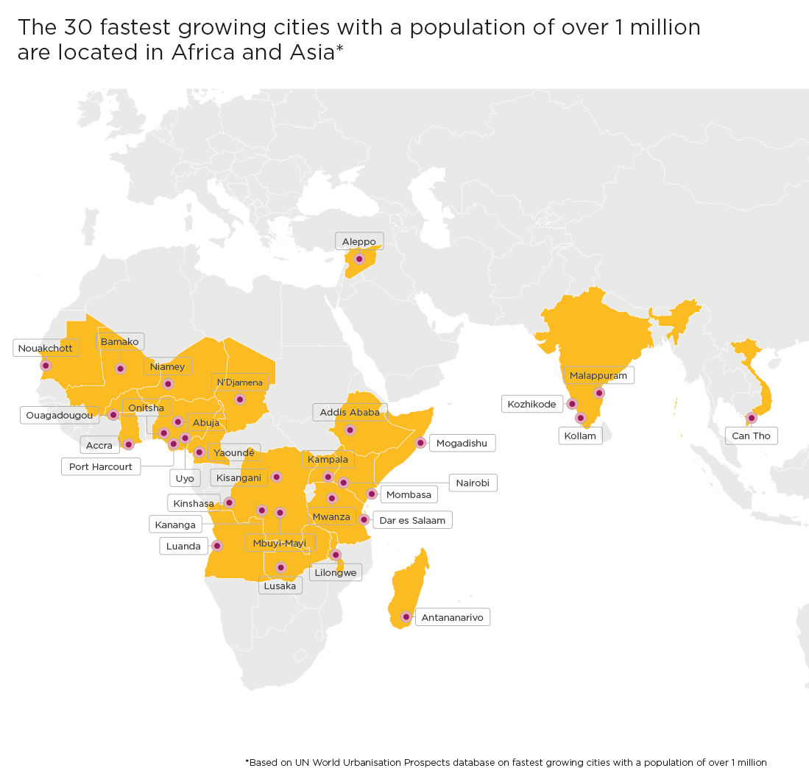




The GSMA Innovation Fund for Digital Urban Services
The GSMA Innovation Fund for Digital Urban Services will test, scale and extract insights from innovative urban services that are inclusive and impactful.
Essential urban services
PLASTIC AND
WASTE MANAGEMENT
ENERGY
WATER
SANITATION
Notes:
The current round of innovation fund which we announced last month is The GSMA Innovation Fund for Digital Urban Services, which seeks to scale digital solutions that provide essential urban services to underserved populations from low- and middle-income countries in Africa, South and Southeast Asia.
Why this particular focus?
Urban services such as, energy, water, sanitation and plastics and waste management are essential to the well-being of city dwellers and the resilience of cities, particularly amidst a changing climate.
While there has been a historic rise in mobile connectivity in low- and middle-income countries, and particularly in cities, billions of people still lack access to these basic services.
And, with rapidly expanding informal settlements across Africa and Asia, where 90 per cent of global urban growth from now until 2050 will be concentrated, water shortages, unsanitary conditions, unreliable power provision, and inadequate waste management could remain a defining reality for many.
To tackle these challenges, the local private sector can play an important role in leveraging digital technology and working with mobile operators and the public sector to deliver sustainable and equitable services.

Slide 9
Objective of the Innovation Fund
The Innovation Fund will aim to demonstrate:
How digital technology, including mobile, can support and scale the delivery of urban services to underserved populations;
The socio-economic, commercial and environmental/climate impact of digital urban services;
The business and/or partnership models required to enable digital urban services to be adopted at scale; and
How partnerships with mobile operators and other technology companies can improve the scale and sustainability of digital urban services.

Slide 10





Support Provided to Grantees through the Innovation Fund
Support provided to grantees will include:
Grant funding between £100,000 - £250,000 to support projects over 15 to 18 months; matching component required
Bootcamp and regular online clinics on topics such as product or service improvement, human-centered design and usability testing;
Learning exchange opportunities with other grantees and networking opportunities with other GSMA partners;
Monitoring and evaluation support to evidence socio-economic impact and promote product improvement;
Facilitation of relationships with mobile operators and public sector organisations where relevant;
Opportunity to increase your visibility and raising your profile to potential investors and partners through profiling in GSMA publications, social media and events.

Slide 11
Eligibility Criteria for the Innovation Fund
Key eligibility criteria:
Start-ups, small to medium sized private sector companies, and social enterprises;
Can demonstrate the long-term sustainability and scalability of the innovation beyond the lifespan of the grant; and
Have active users and revenue in at least one eligible low- or middle-income market.
These types of organisations will not be eligible to apply to the Innovation Fund: Governments (or appointed government agencies); Mobile Network Operators; University or Academic organisations; start-up accelerators and incubators.
Geography: ​
Low- and middle-income countries in Africa, South Asia and Southeast Asia; some exclusions apply – see Terms and Conditions

Slide 12

Innovation Fund Key Dates
17 May 2021
ANNOUNCEMENT & OPEN OF APPLICATIONS
Press Release to announce the fund; Release of Terms Sheet; Applicants will have ​7 weeks ​
to submit a pitch via​
an online form
2 June 2021
LAUNCH WEBINAR
The GSMA will host a webinar to explain the fund, the eligibility criteria and the application process
7 - 10 June 2021
SECTOR DEEP DIVES
Virtual sessions on Plastic and Waste Management, Water, Sanitation and Energy to understand sector challenges and the Innovation Fund learning agenda
2 July 2021
APPLICATIONS CLOSE
The Pitch Submission Stage closes
2 Aug – 5 Nov 2021
PROPOSAL STAGE
Shortlisted applicants ​
submit a full project proposal including:​
Technical proposal ​
Project implementation plan ​
Budget ​
The selection will be made in late November, with contracting completed by March 2022
Notes:
Start of Announcement Activities:
1. Press release to announce fund launch (and release the term sheet)
2. Internal Blogs to promote the fund and link to term sheet
3. Blogs with external stakeholders (strategic partners) to further spread the word
4. Launch Video (the Assistive tech video for reference https://www.youtube.com/watch?v=Y9OFe9zxK3c)
5. Email our strategic partners or stakeholders about the fund (can have one-on-one calls with a few in case they have extensive reach)

Slide 13

Introduction to digital water

Slide 14


Water sector overview
Globally, 2.2 billion people rely on non-piped water sources for survival. Additionally, there are still 144 million people in the world reliant on surface water. In many countries access to safe water is highly inequitable, with wealth and location key determinants of who has access to safe water.
Some critical urban water challenges include:
Inequity – low income customers often pay more for lower quality water, and many rely on informal providers that are liable to price gouge;
Scarcity – strained water resources due to climate change, combined with population growth will place an ever greater stress on urban water infrastructure;
Financial pressure – many utilities struggle to collect sufficient revenue, while at the same time safe water can be unaffordable to many; and
Inefficiency – stubbornly high non-revenue water in many cities means the available resource is not always used most effectively.
How digital solutions can improve service delivery:
Digital tools give water utilities real-time information on leakages and consumption to better plan and maintain services;
Digital payment solutions to improve revenue collection and increase connections to low-income households with more affordable pay-as-you-go services; and
Digital monitoring for urban kiosk services enables providers to reach unconnected households most efficiently.
Source: https://www.theglobalist.com/
Notes:
Inequity
Centralised services often benefit from subsidy. While informal providers charge more.
Tanker water costs on average 10 times more than government-supplied pipeline water, according to a World Resources Institute study of water access in 15 cities across the developing world, a figure that rises to 52 times more in Mumbai.
WB report on water subsidies in 10 LMICs found that 56% of subsidies were captured by the top wealth quintile, while only 6% reached the lowest.
Price gouging common in times of scarcity
Scarcity
WRI’s Aqueduct tool finds 17 countries, home to ¼ of the worlds problems already face extremely high baseline water stress (80% of available supplies are drawn each year for agriculture and municipalities).
We are increasingly seeing ‘Day Zero’ situations more frequently, and in many small towns and cities this happens without the attention Cape Town saw in 2018.
Urban population growth compounds the pressure on infrastructure, particularly in African cities. The African urban population is set to double 2015-2050, from 567 million to nearly 1.2 billion in 2050. As of 2015 just under 450 million people had access to services and only 112 to piped water. There is the need to rapidly expand infrastructure.
Inefficiency
- Regional aggregates for NRW are hard to compute. But many utilities have NRW rates of 30-50%. Addressing technical losses (leaks) or commercial (water not billed for) are both priorities. And address the separate challenges of preserving resources and addressing utility financial issues.

Slide 15





Digital solution use cases in water
Voice, SMS, and USSD functions
Communications bridge between utilities and customers
Essential for maintaining service quality
Pay-as-you-go business models
Models integrating micro-payments can contribute to improving affordability
Benefits for providers in terms of enhanced revenue collection
IoT/ M2M communication and GIS tracking
Smart monitoring of system performance can improve operational efficiency and are essential technologies in the deployment of real-time data systems
Improved data can contribute to better service monitoring and planning
Big data, AI and machine learning
The use of large data sets to improve decision making
Implement automation to optimise utility operations
Augmented and virtual reality tools
Combined with the tools above can be used to create ‘digital twins’ that eliminate the need to travel to a site to identify and resolve issues, and allow remote management of network infrastructure in real time

Slide 16
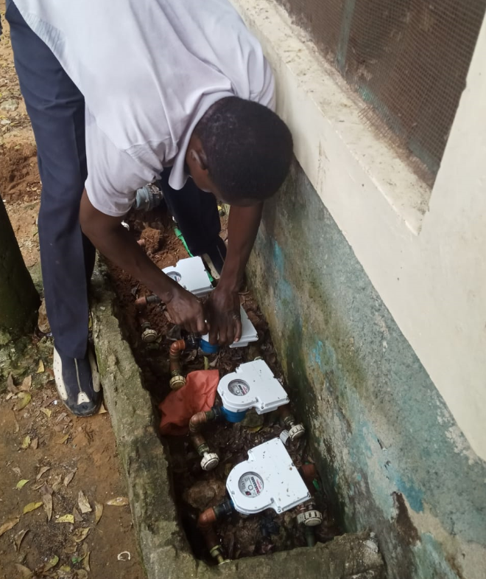
GSMA innovation funding in water
In water GSMA innovation funding has previously:
Supported 14 water grantees in 11 countries
In areas including: introducing digital payments to the sector, developing PAYG business models, digitally enabled service monitoring, and developing tools to support utility digitalisation.
More than £9.6 million has been raised by these grantees in follow-on funding within two years of the grant.
The GSMA Innovation Fund for Digital Urban Services seeks to:
Tackle the barriers for digital solutions to scale including partnerships with utilities and mobile operators, and strengthening business models;
Build a greater breadth and depth of evidence for the value that these solutions provide to support follow-on financing opportunities; and
Explore new innovations such as the use of big data for improved water service planning and response.
Source: CityTaps
Notes:
The GSMA DU programme has previously:
£9.4 million to 50 grantees
$309 million has been raised by these grantees in follow-on funding within 2 years
48 direct partnerships with mobile operators.
6.5 million people have benefited from improved services as a result of these grants

Slide 17
Panel

Slide 18

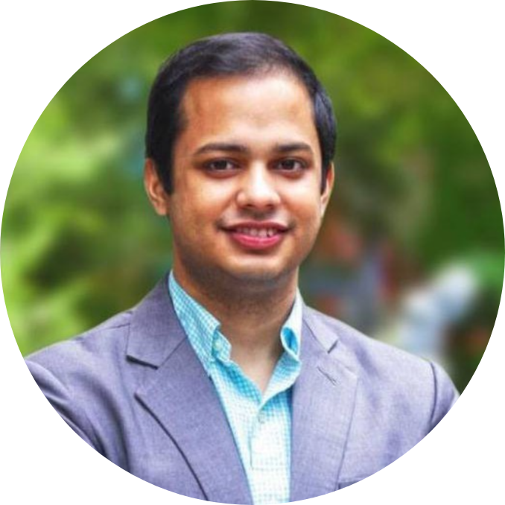
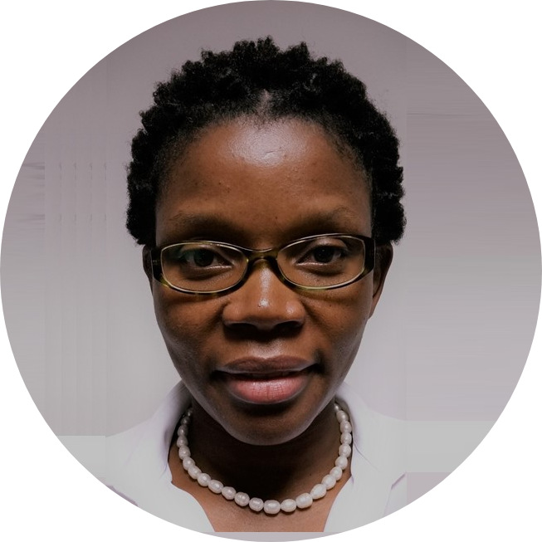
Meet the speakers
Rodney Chapin
CEO of and founder of Ardurra International and Imagine H₂0 Asia Advisory Council
Minhaj Chowdhury
CEO and founder of Drinkwell
Odete Muximpua
Water and sanitation specialist, World Bank Global Water Practice

Slide 19
Q&A

Slide 20

For more information:
Review Terms and Conditions and Apply: gsma.com/digitalurbanservices
Read the fund launch report and view FAQs
For questions, contact us at: GSMAIF@gsma.com
This initiative has been funded by UK aid from the UK government and is supported by the GSMA and its members.
The views expressed do not necessarily reflect the UK government’s official policies.

