Slide 1


State of the Industry Report on Mobile Money
2022
Copyright © 2022 GSM Association

Slide 2
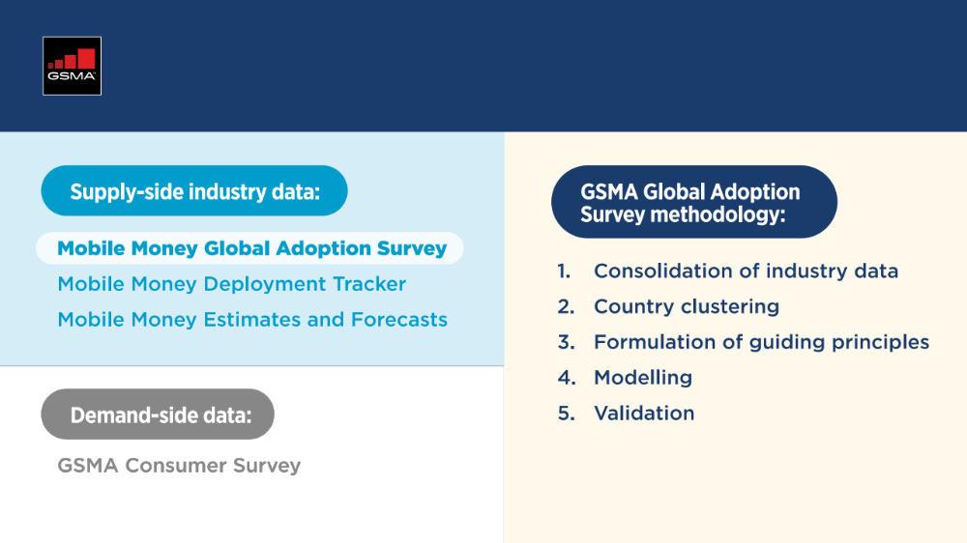
Methodology

Slide 3
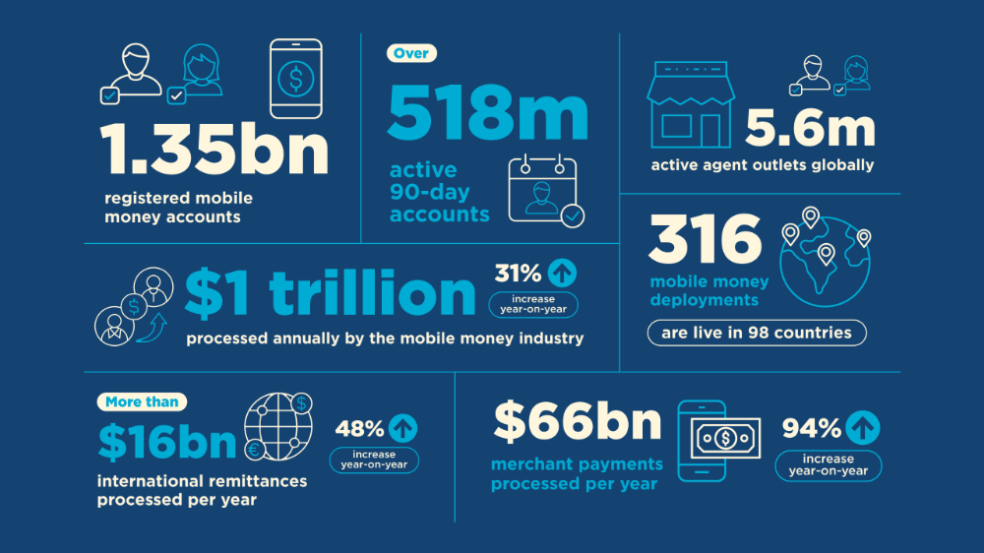

Slide 4


The Numbers

Slide 5
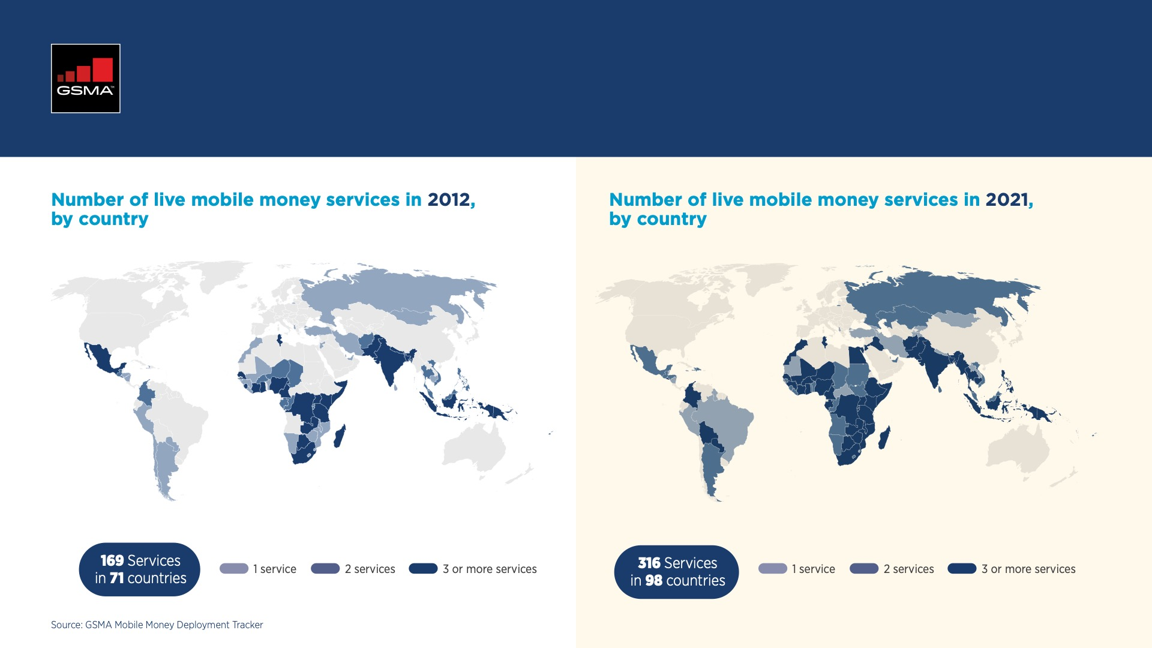
Mobile Money Deployments, 2012 vs 2021
Notes:
AA

Slide 6
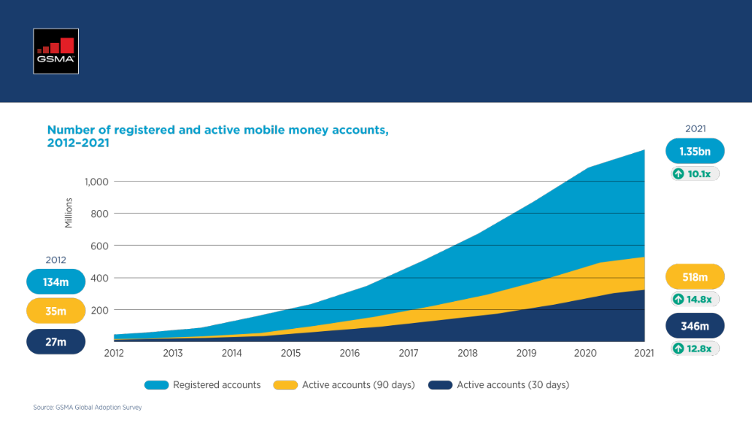
Registered and active accounts, 10 year trends
Notes:
AA

Slide 7
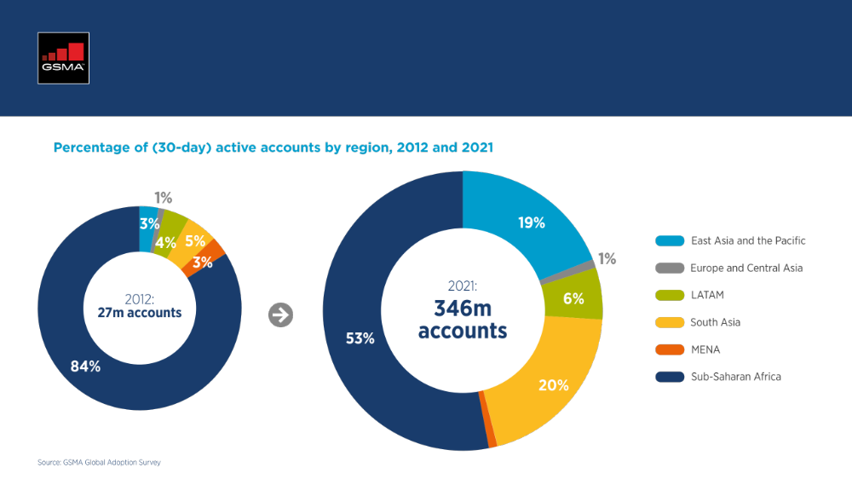
Registered and active accounts, 2012 vs 2021
Notes:
AA

Slide 8
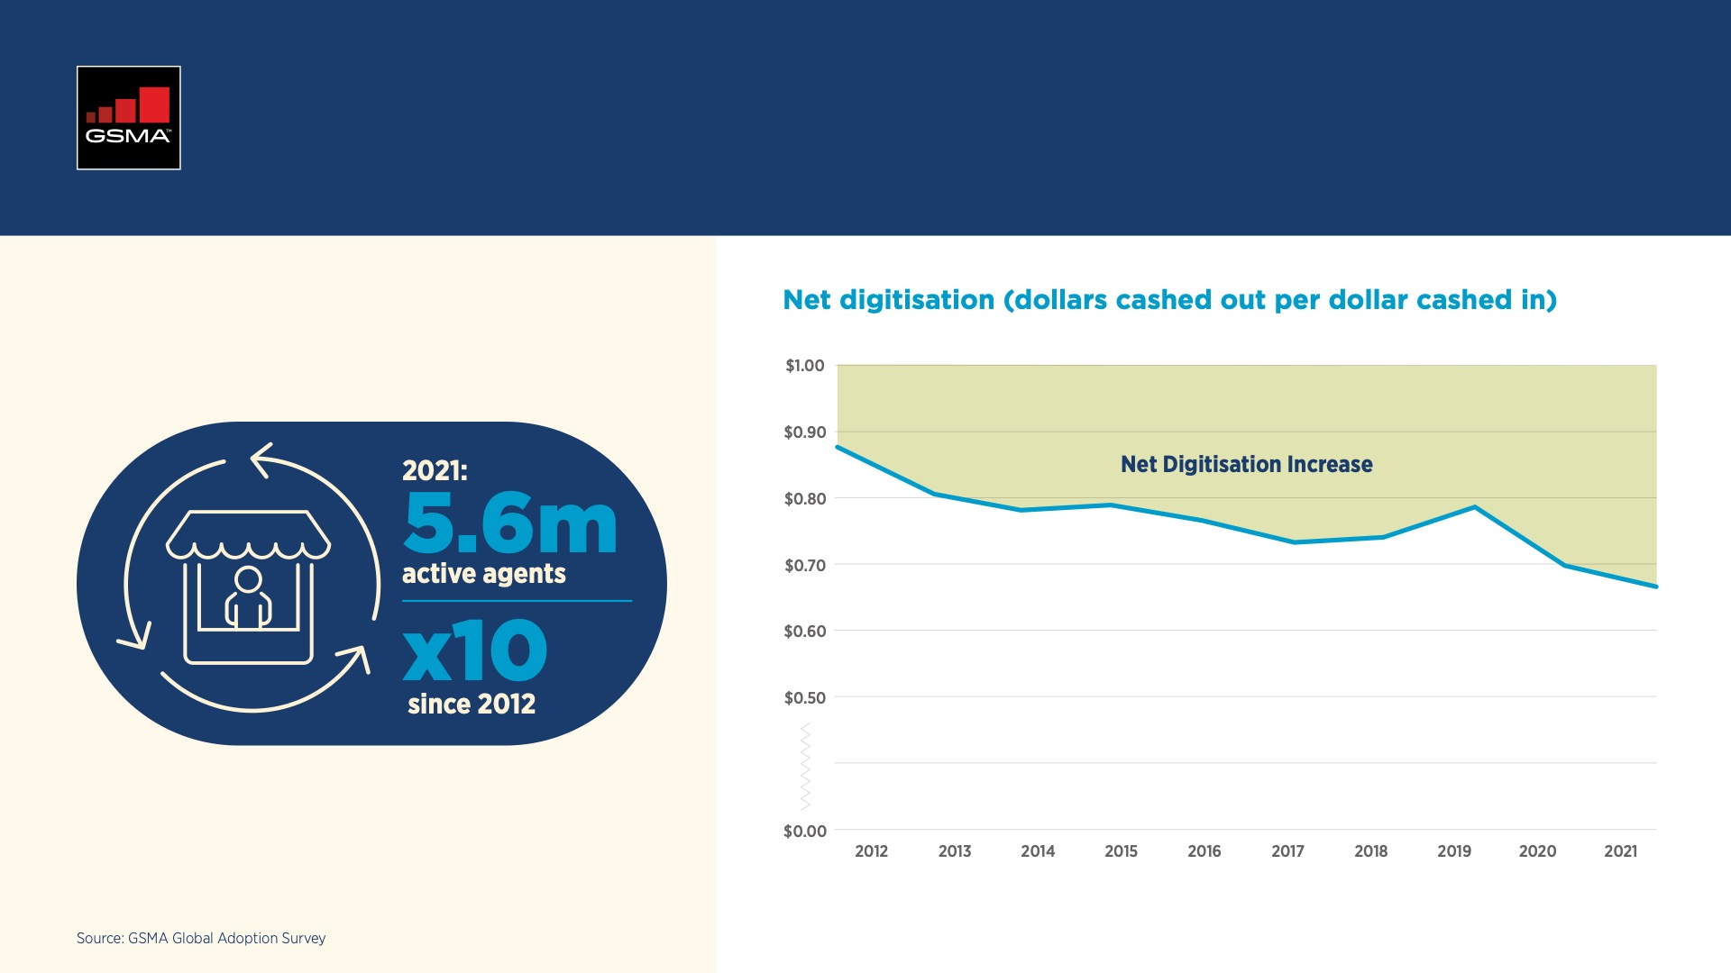
Agents, 10 year trends
Notes:
CL

Slide 9
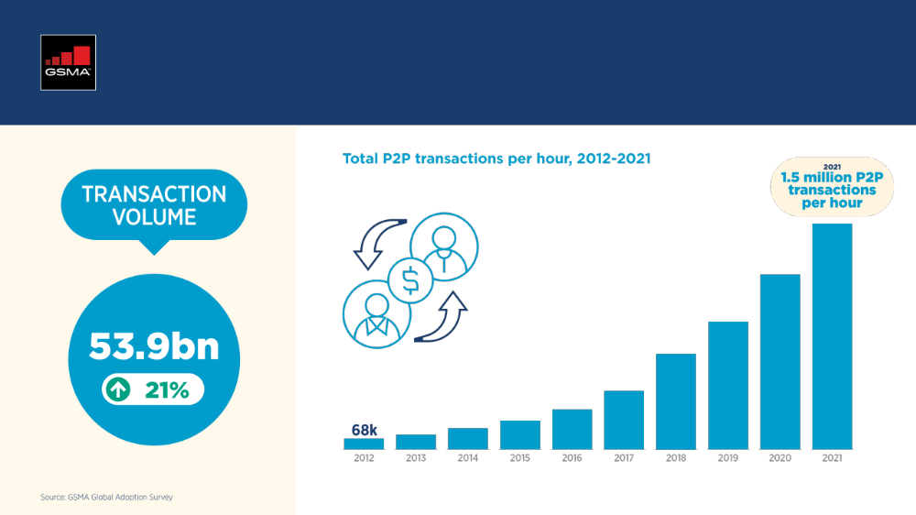
Transaction volumes
Notes:
CL

Slide 10
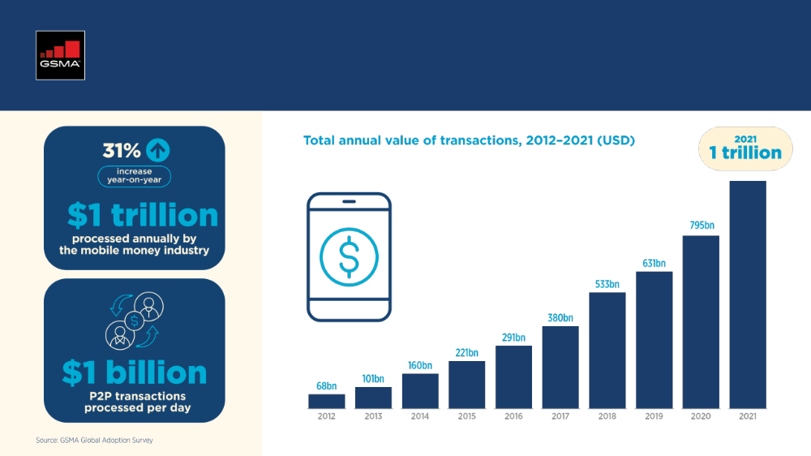
Transaction values
Notes:
AA

Slide 11
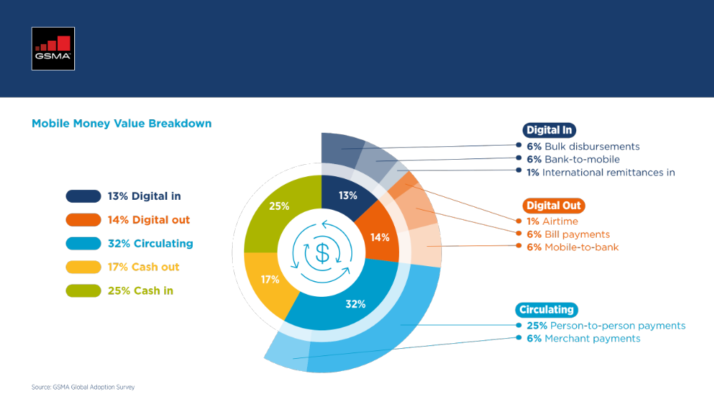
Transaction values
Notes:
AA

Slide 12
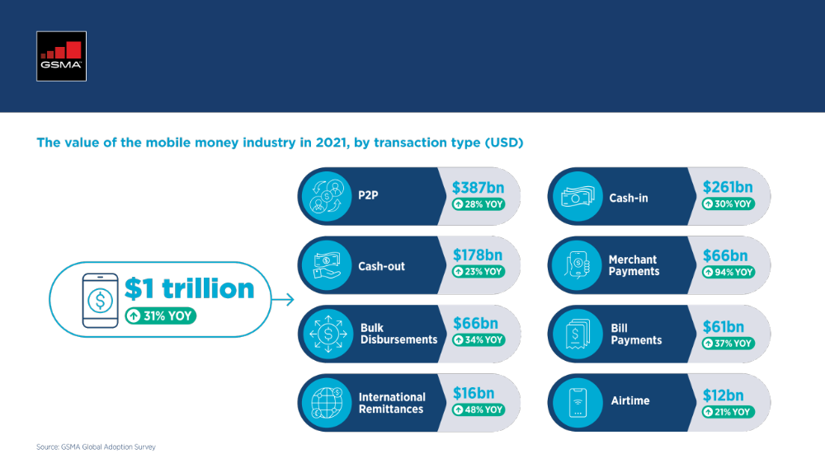
Transaction values
Notes:
AA

Slide 13
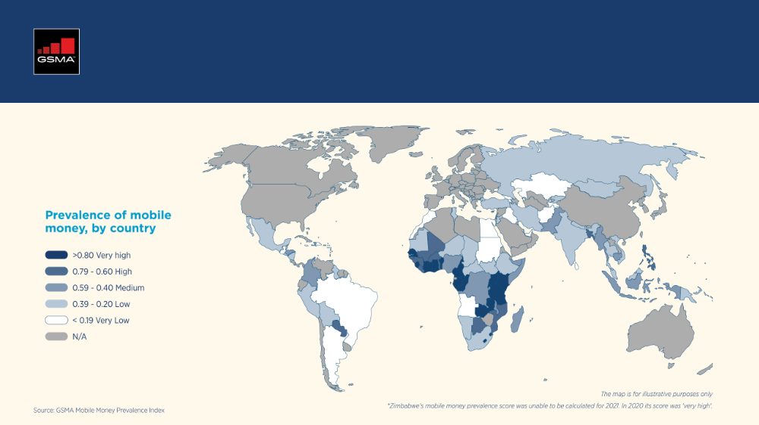
Mobile Money Prevalence
Notes:
CL

Slide 14
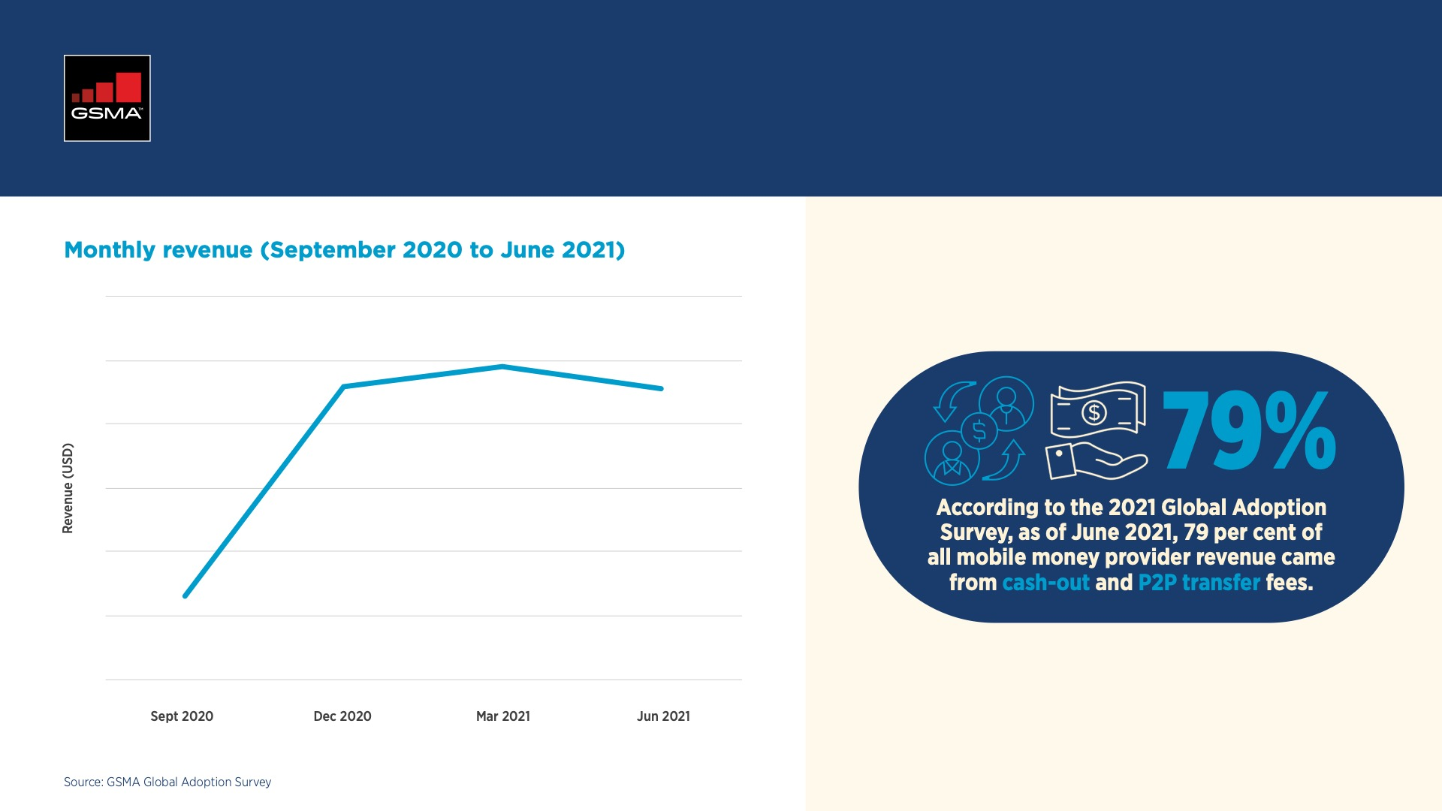
Provider revenues and profitability
Notes:
AA

Slide 15
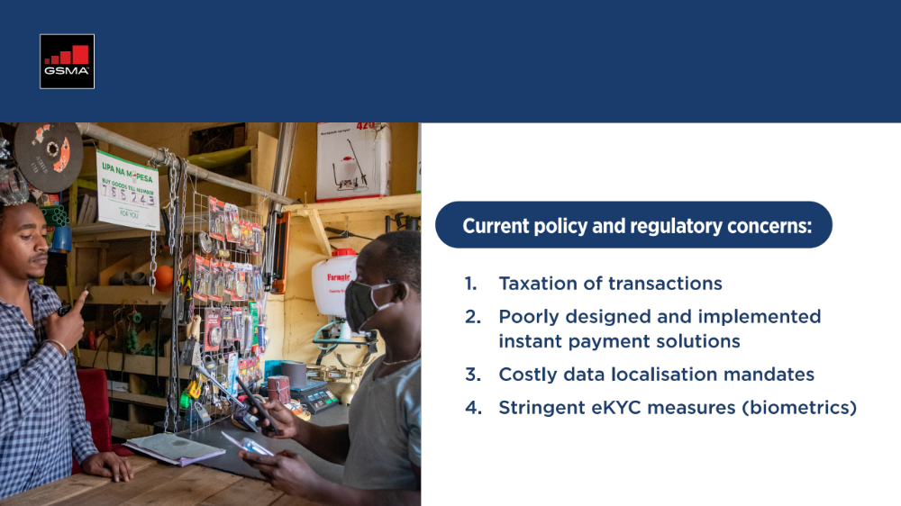
Policy and regulation

Slide 16
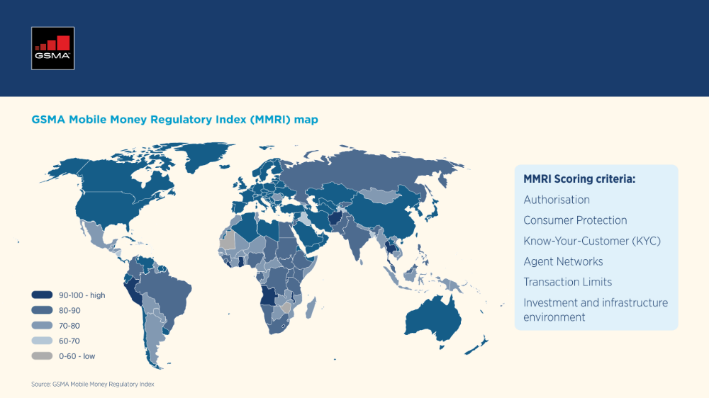
Policy and regulation

Slide 17

Ecosystem transactions and adjacent services

Slide 18
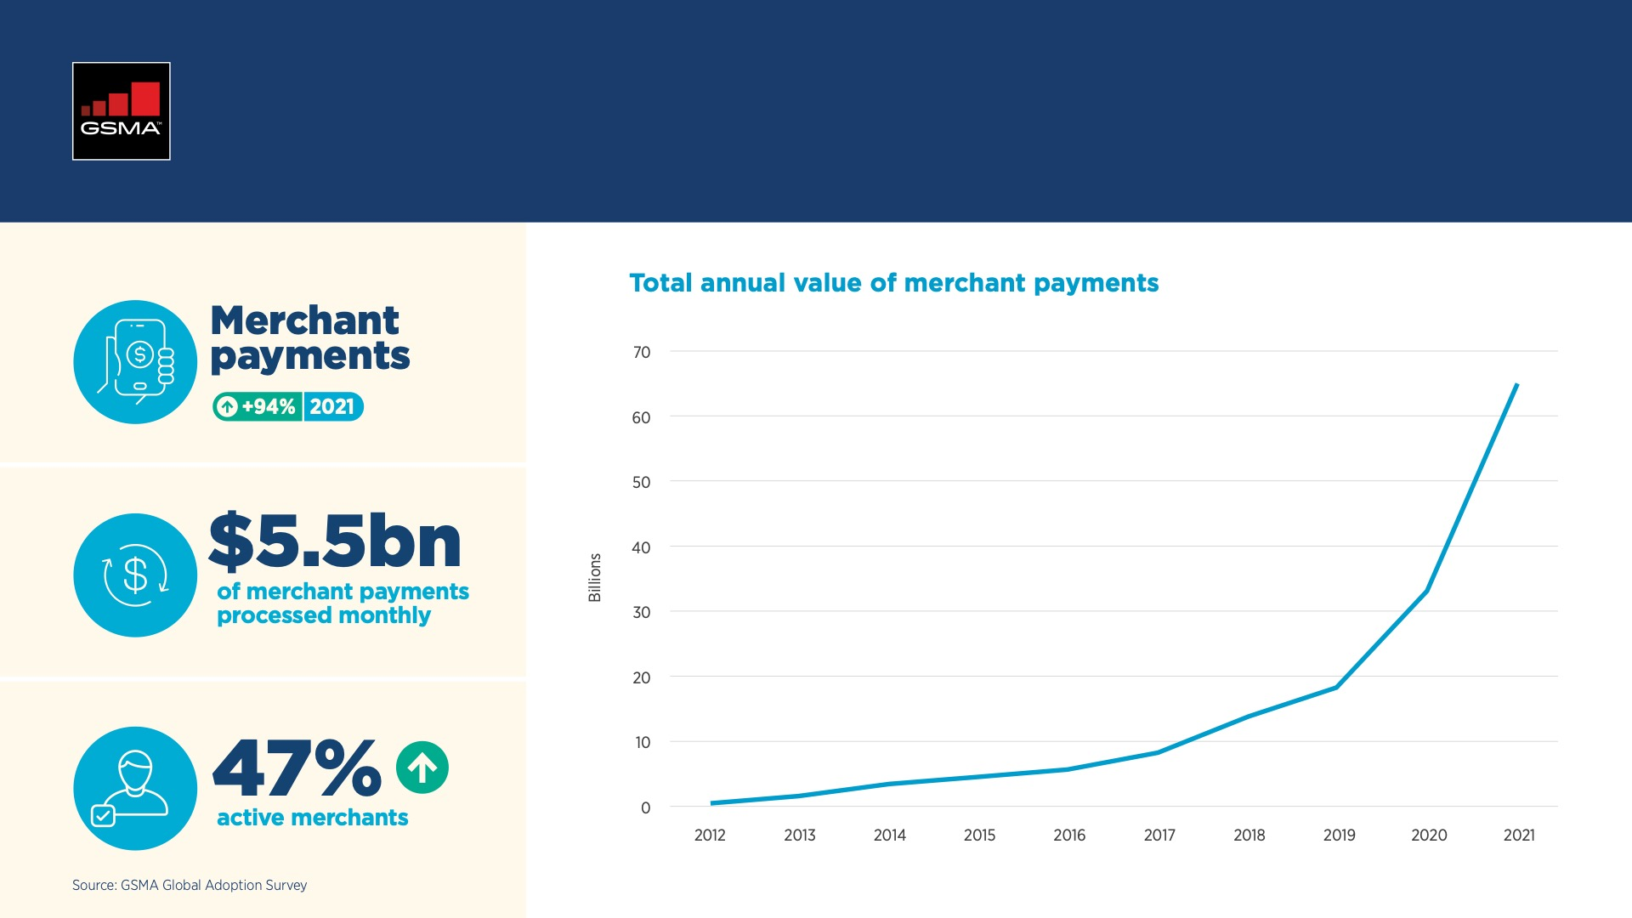
Merchant payments

Slide 19
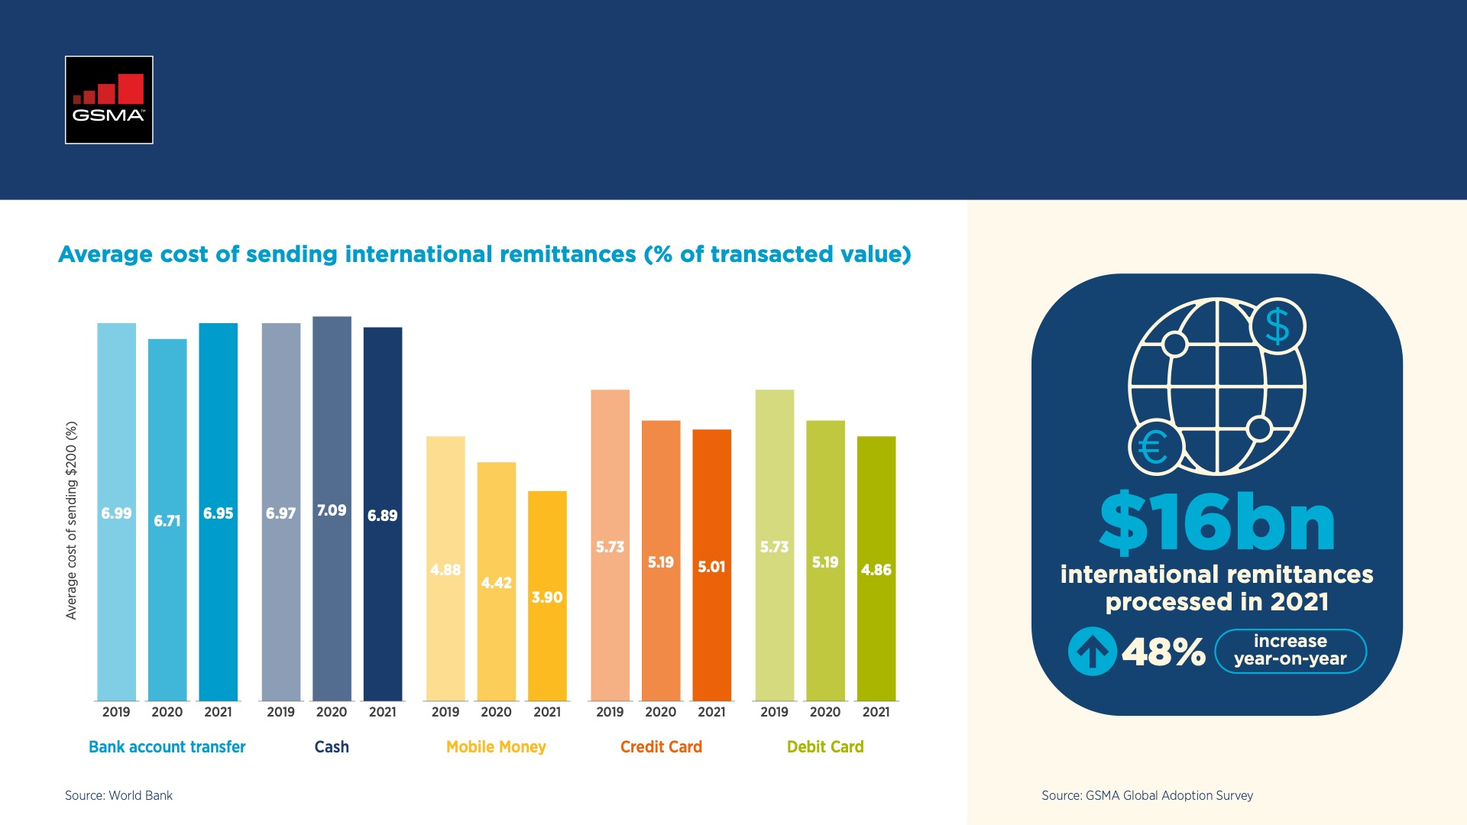
International remittances

Slide 20
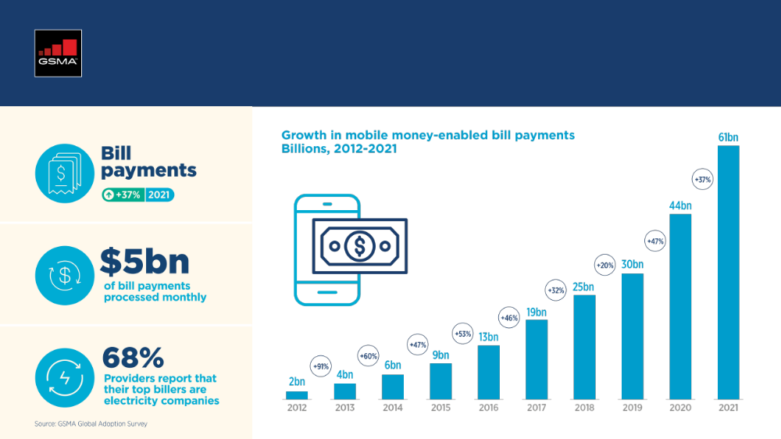
Bill payments

Slide 21
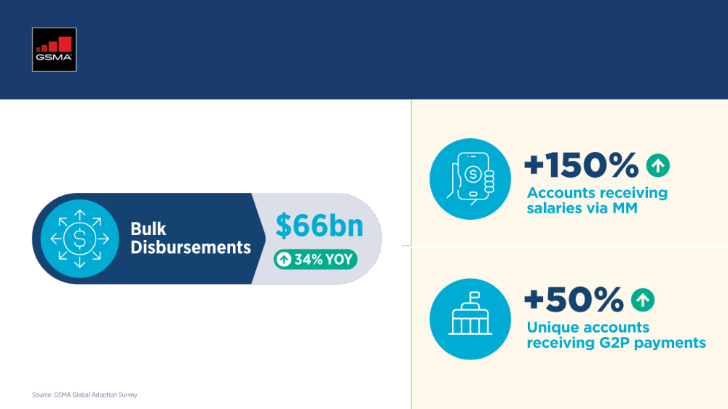
Bulk payments

Slide 22
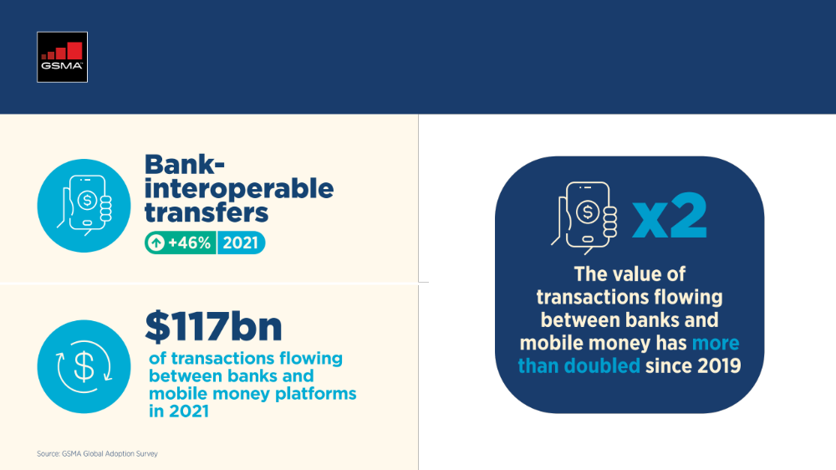
Interoperability

Slide 23
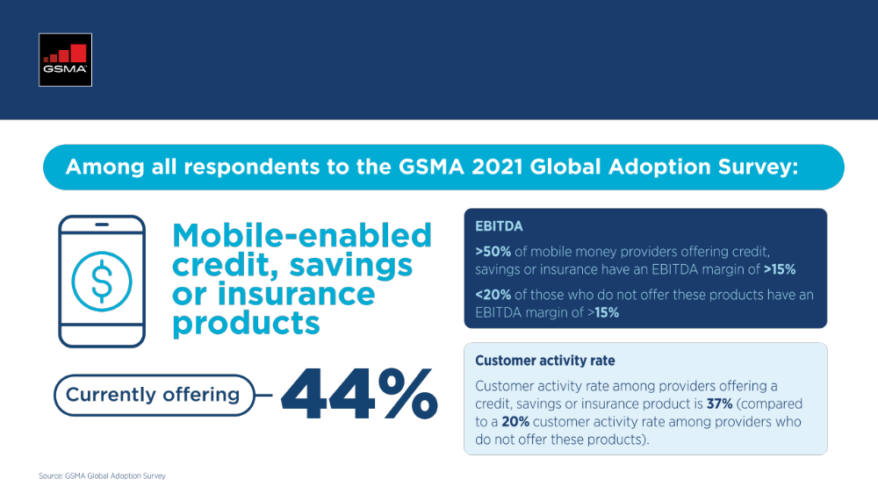
Credit, savings and insurance

Slide 24

Addressing the mobile money gender gap

Slide 25
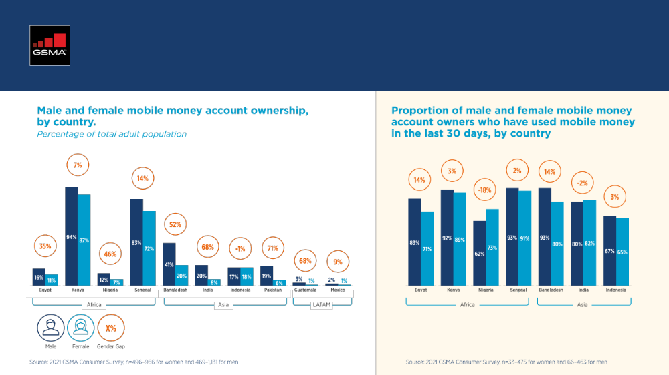
Addressing the mobile money gender gap

Slide 26
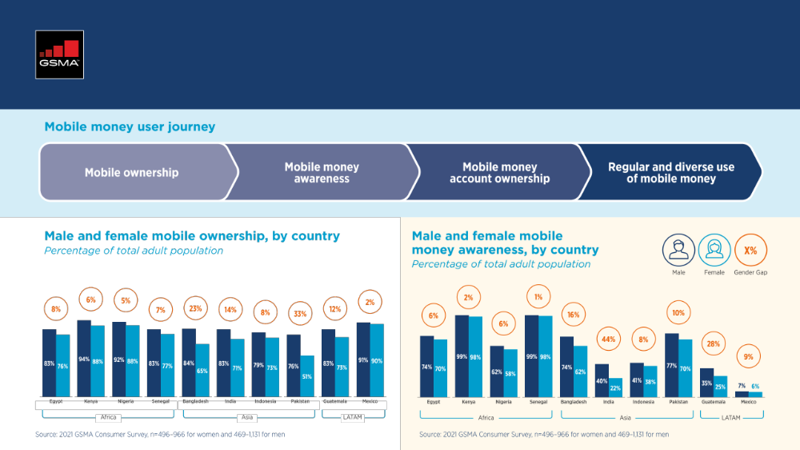
Addressing the mobile money gender gap
Notes:
Use some quotes from Arame’s and Dom’s SOTIR gender blog – why is gender important?

Slide 27
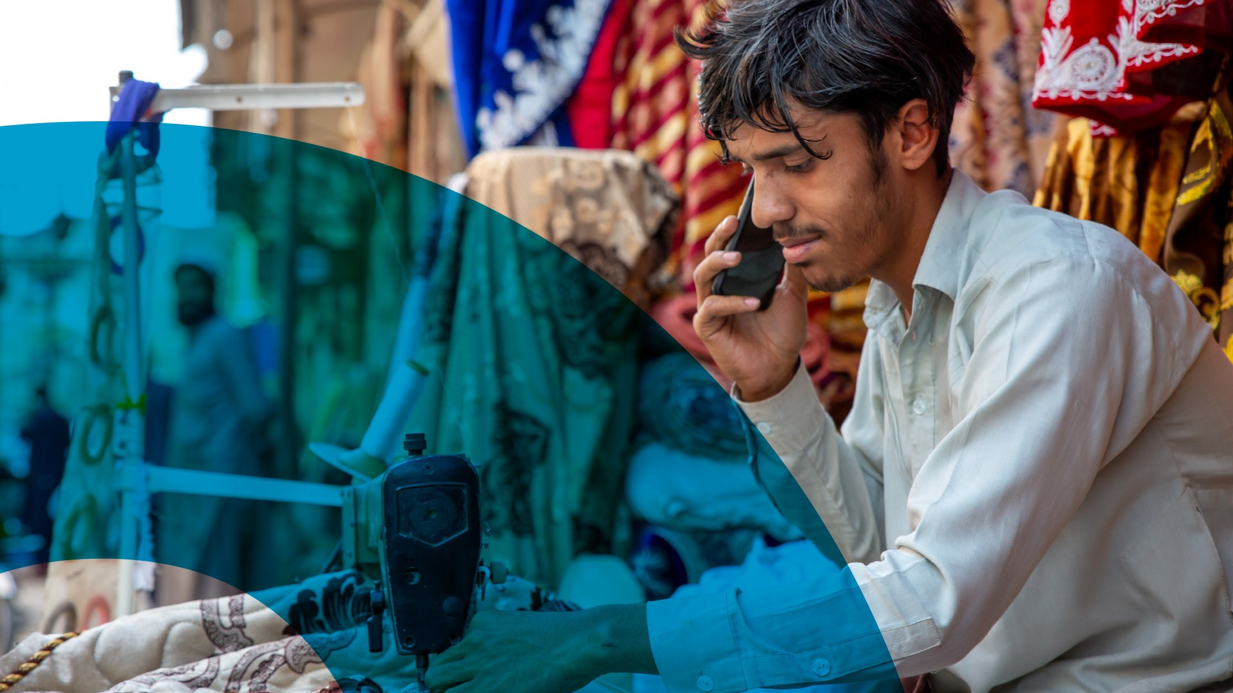
Solving socio-economic and environmental challenges
Notes:
Financial inclusion has a purpose / greater / higher purpose

Slide 28
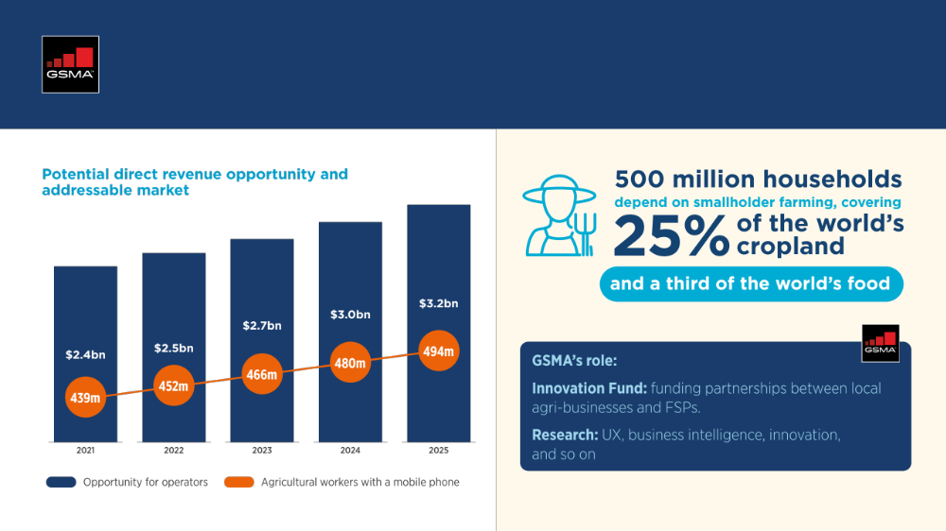
Agriculture & climate resilience

Slide 29
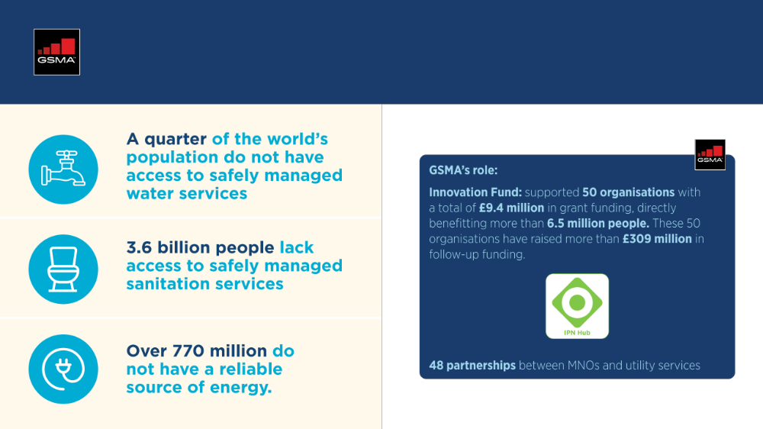
Essential utilities and clean energy

Slide 30
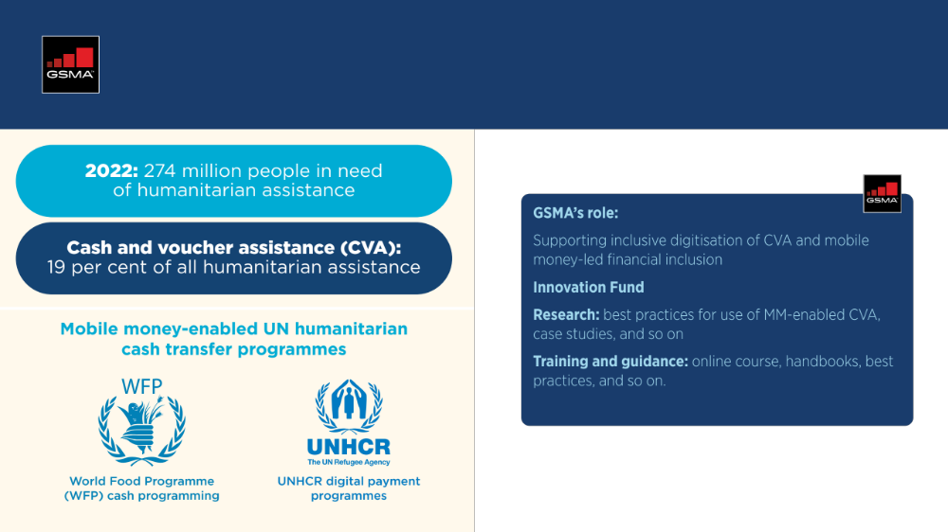
Humanitarian and disaster response

Slide 31


