Slide 1

Train the trainer session:
Mobile internet skills training toolkit

Slide 2
A note for master trainers
Preparing for the ToT session
Review these slides and the training materials (videos and learner handouts) before the session.
Setting up the ToT session
Schedule 2 hours for the ToT session.
Try to limit the group size to ~20 participants per session.
Put trainers with similar roles or locations together in one training group.

Slide 3
A note for master trainers
During the session
Start with an ice-breaker activity, either with the whole group or in smaller groups.
Show the actual videos and handouts throughout the session. For example:
  Show P1M1 and P2M1 videos and handouts after p7
  Show P1M2, P1M3 and P1M4 videos and handouts after p11
  Show P2M2, P2M3 and P2M4 videos and handouts after p14
  Show the safety module after p16
Make space for questions, reflections and discussion throughout. At the end of the training, dedicate 20 mins for final discussion and Q&A (see p18 for prompts).
Share the videos, handouts and this deck with trainers as soon as the session is complete.

Slide 4
Purpose of the ToT session
Introduce the new digital skills training materials
Learn how to use and adapt these new training materials to run a training session with customers
Share tips and advice to ensure the training is as engaging as possible

Slide 5
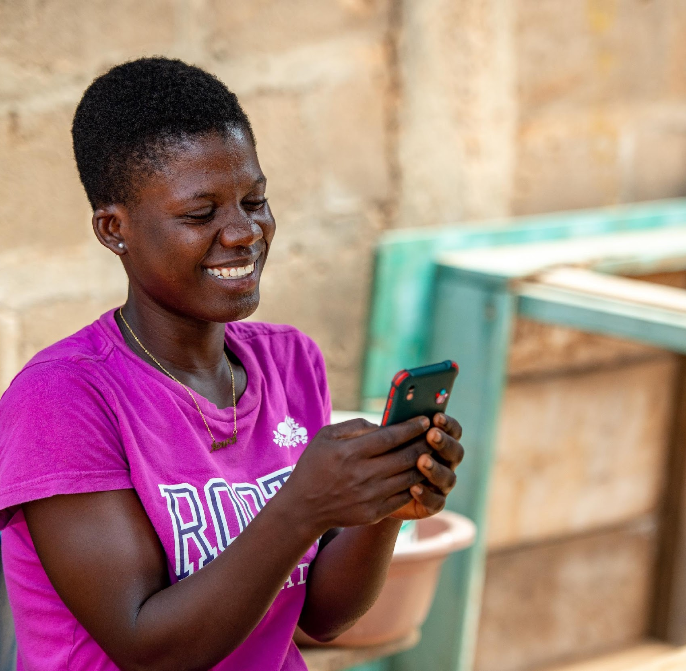
Agenda
What is the mobile internet skills training toolkit?
How is the training structured?
What are the training materials?
Training approach
Recap
Discussion and Q&A

Slide 6

What is the mobile internet skills training toolkit?
A flexible set of resources to train customers on the basics of mobile internet, in ways that are most useful and relevant to them.
A GSMA and MTN collaboration to develop new digital skills training materials that put customers’ needs first
Notes:
MTN Ghana will be the first to pilot these materials
After the pilot, the materials will be updated, to be as useful as possible for MTN trainers and customers

Slide 7




How is the training structured?
There are two “learning pathways” consisting of 4 modules each. Each module has a video and customer handout and teaches a skill. There is also an additional module on safety.
PATHWAY 1: CONNECTING
1
2
3
4
How can I send voice messages and photos on WhatsApp?
How can I share photos and videos with a group of people on WhatsApp?
How can I set up an account to start using Facebook?
How can I find interesting information on Facebook?
SAFETY
How can I avoid scams when using the internet?
PATHWAY 2: SEARCHING
1
2
3
4
How can I search for information on the internet?
How do I look through search results to find useful information?
How can I download photos and videos that I find on the internet?
How do I know if the information I find on the internet is reliable?
Notes:
Training materials are framed around two customer needs, or ‘pathways’
For each customer need, there are four video modules
Each module teaches a use case
You can progress customers through the modules in each pathway, or you can teach them any module that is relevant and interesting to them (because each module also begins from the mobile home screen)
These pathways and modules have been chosen based on research with customers and MTN staff, who told us that these were some of the things that they most wanted to learn about

Slide 8
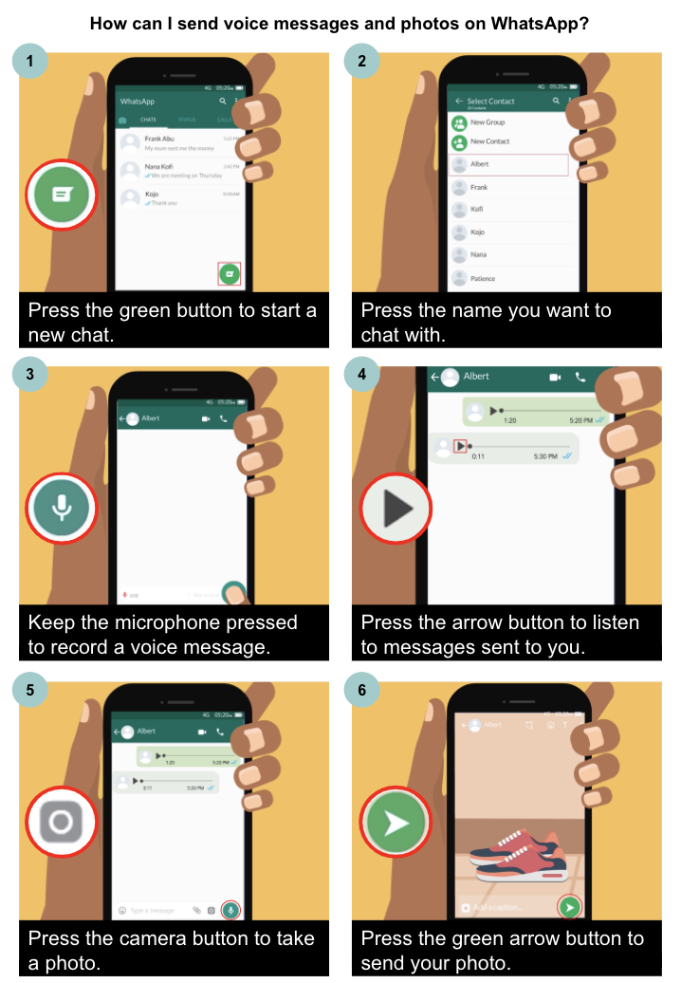
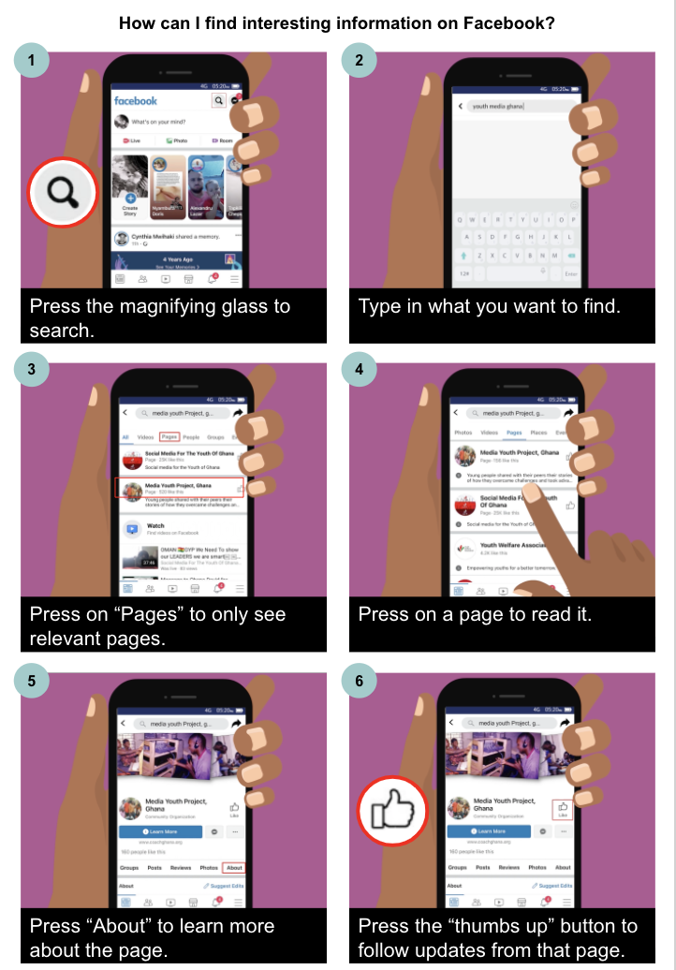
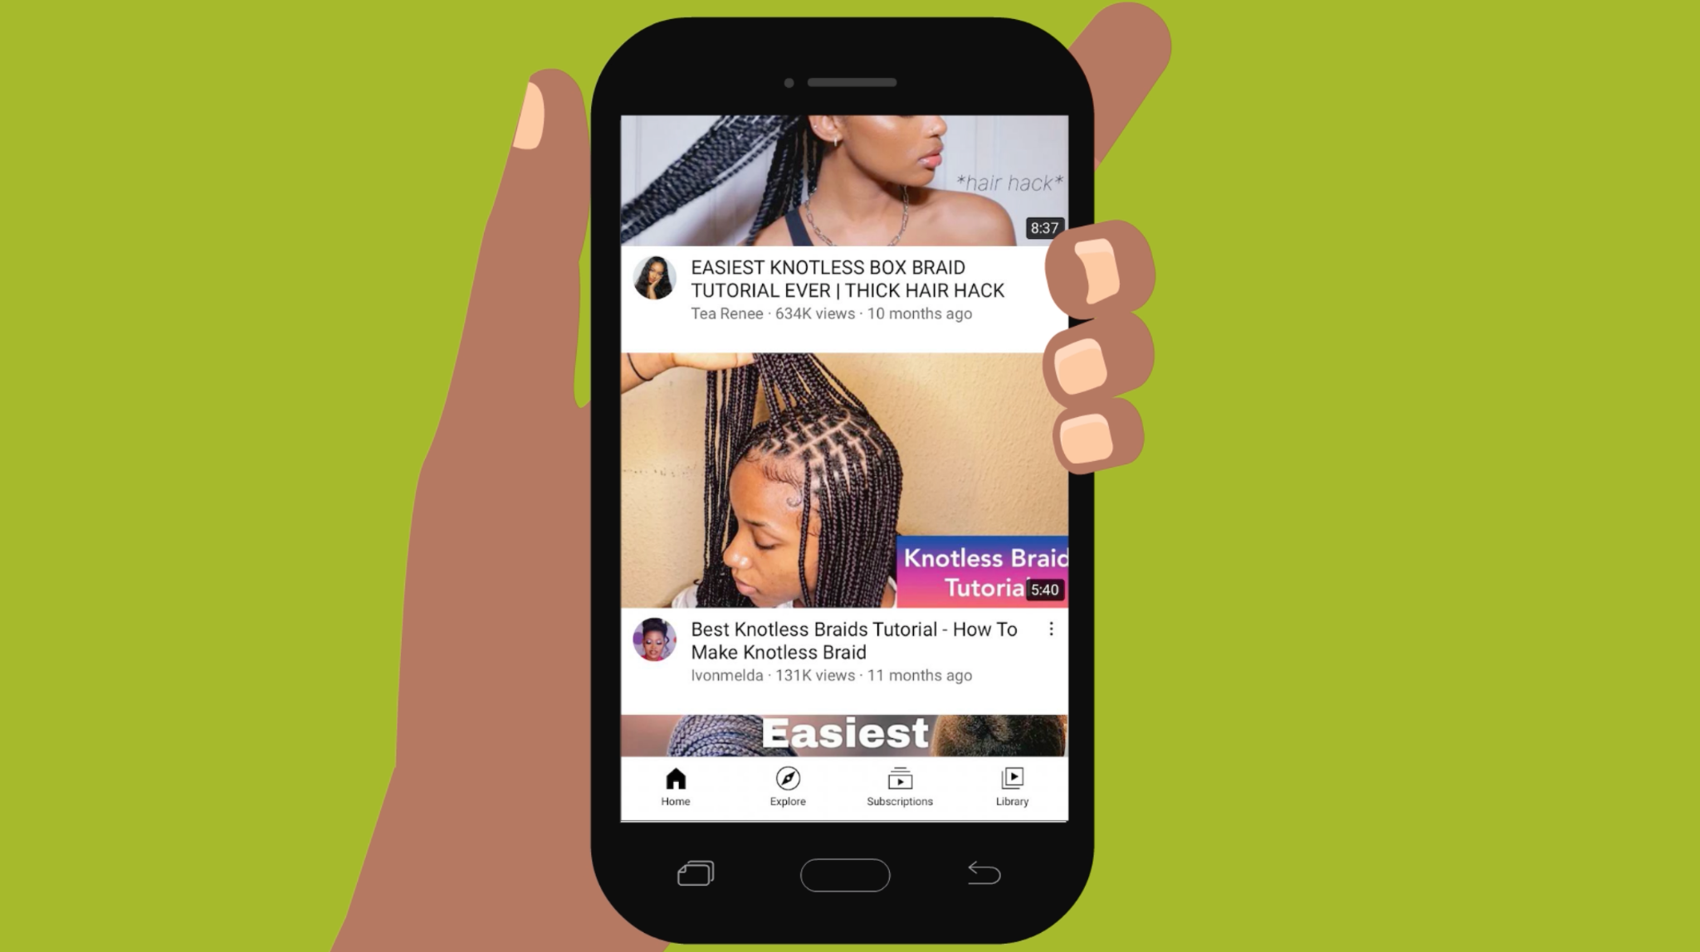
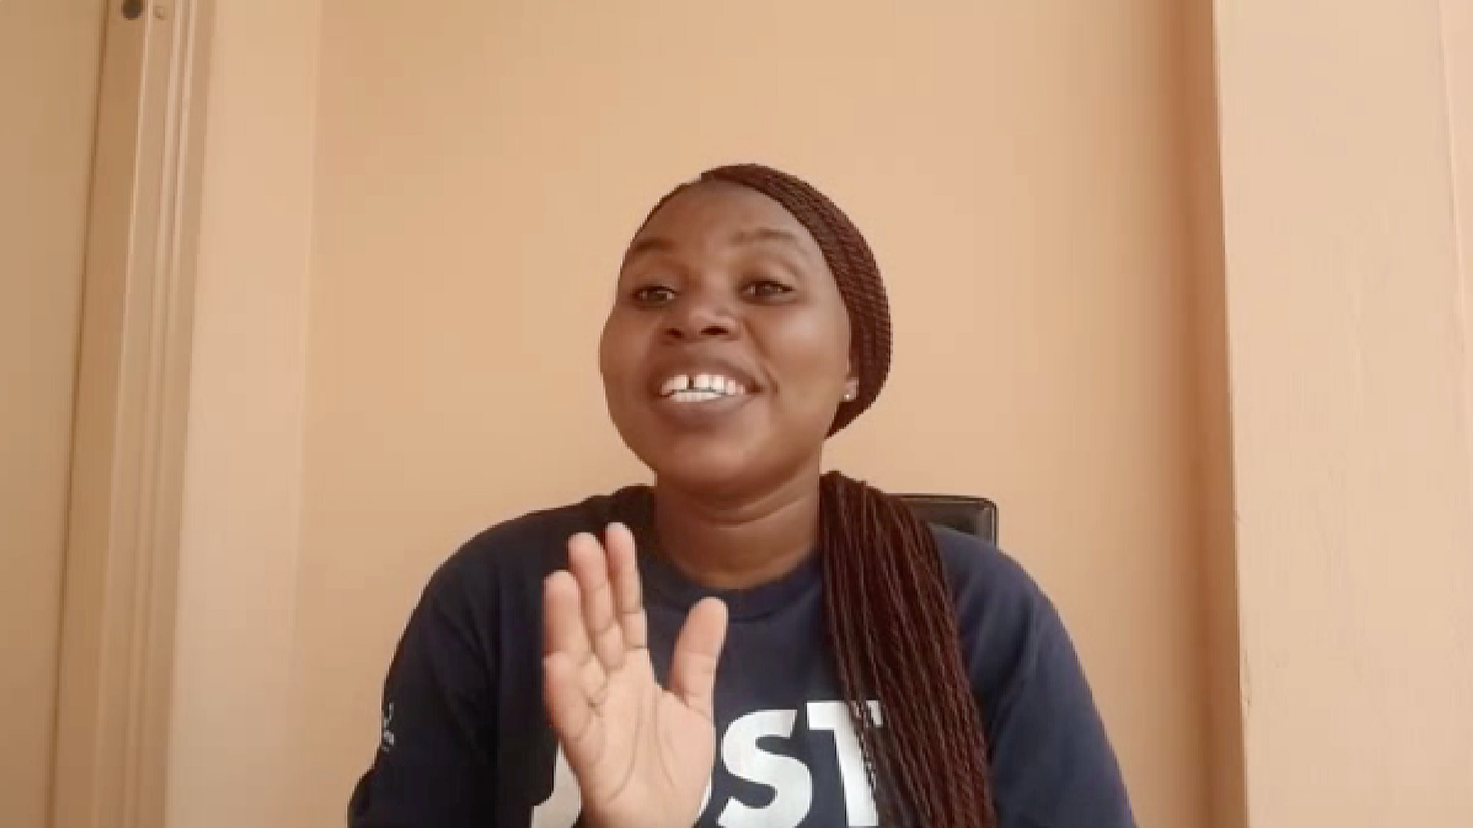
What are the training materials?
1
Training videos
2
Customer handouts
9 short training videos, each available in English, Twi and Ga
9 digital handouts available in English
REMEMBER: These training videos and customer handouts are to be shared with your customers.
Download them in advance to your phone so you can easily share.

Slide 9
Training approach
Assess the customer’s needs
Provide customer training
Share the videos and handouts
Choose the module based on the customer’s needs and interests
Plan the training around the customer’s preferred time and location
Ideally, show the video to your customer(s)
If you prefer, you can use the handouts or do your own demonstrations on yours or the customer’s handset instead
Share the video(s) with the customer to watch afterwards
Share the handouts with the customer if they prefer not to watch videos

Slide 10
Choose the module based on the customer’s needs and interests
Assess the customer’s needs
If the customers has a specific question, look at the module titles and decide which looks most similar or relevant.
If they are complete beginners or just want to learn about the internet on their phone generally, start with the first module of the first pathway (“Connecting”).
If they are interested in a specific app, start with the first module that includes that app.

Slide 11
Plan the training around the customer’s preferred time and location
Assess the customer’s needs
Pick a time for the training that suits the customer (e.g., evenings after work, during mid-day breaks).
Be ready to wait, repeat yourself or return to a customer if they get busy with their own work during a training session.
Connect the training to the needs each customer has, particularly in relation to their work.
Mention any incentives at the start of the training (e.g., free data bundles).
Additional considerations for training women:
Explore using local women’s groups to do the trainings or to share the videos and handouts.
Deliver the trainings in places that women go to often or work at (e.g., market places)

Slide 12
Ideally, show the video to your customer(s)
Provide customer training
If possible, show the video on your own phone, so the customer won’t incur any data costs.
Show the video in the language the customer is most comfortable with (English, Twi or Ga).
After showing the video, ask the customer if they have any questions about what they saw in the video. Clarify the steps if there are any misunderstandings.
Help the customer understand how they can apply the skills shown in the video, to their own lives. Emphasize that the uses in the video are only examples - there are many more uses
If customers are interested in an app that is new to them, help them download it.

Slide 13
If you prefer, you can use the handouts or do your own demonstrations on yours or the customer’s handset instead
Provide customer training
You can fast forward the opening 20 seconds of the video (to the beginning of the animation).
Or you can use the handouts instead of the videos to teach customers. But remind customers that there are also videos that include more guidance.
Or if you prefer not use the materials during the training, you can demonstrate the skill yourself. You can do this in your own way, but ensure to:
  Describe what the app and skills are;
  Describe what you can use them for;
  Show how it works on your phone or the customer’s;
  Encourage practice.

Slide 14
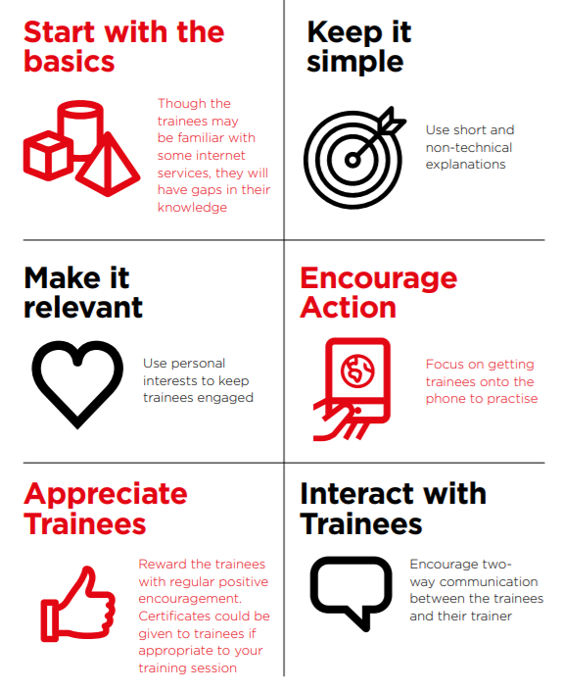
Training tips
If customers have limited familiarity with an app, start with that module rather than advancing to a later module
Use short and non-technical explanations as much as possible
Refer to the customer’ personal and work interests to make the training relevant
Put the phone in the customer’s hands, and encourage them to practise themselves
Reward customers with regular positive encouragement, to boost confidence
Encourage customers to ask any questions they have, and discuss any challenges
Notes:
Make it relevant - integrate the training into existing activities:
When you’re selling an internet enabled device, tell the customer you also offer free training on how to use the internet
If a customer comes to top up their phone, you can tell them you are also offering free training on some of the basics of mobile internet and then provide some info on data bundles and promos.
If you have a bonus, e.g. 50MBs for taking the training, mention this as well.
Any questions?
- You know your customers best… but here are some tips to support training….
- Let’s role-play! Would anyone like to volunteer?

Slide 15
Share the video(s) with the customer to view and practise afterwards
Share the videos and handouts
Inform customers that there are multiple videos for them to learn from.
Share the link to the MTN website with the videos, so the customer can pick the videos they are most interested in, in the language they prefer.
Inform customers that downloading a video from the website will use data, but watching it once it’s downloaded will not.
Tell customers how to make space on their phone if they have concerns about storage.
Encourage customers to practise and share the videos with their family and community.
Note: If it is possible to share the videos directly with customers (via Bluetooth, Xender or WhatsApp), you are welcome to do so.

Slide 16
Share the handouts with the customer if they prefer not to watch videos
Share the videos and handouts
Share the handouts with customers via WhatsApp.
Emphasize that while the handouts are useful as reference, the videos include more examples, tips and guidance.
Encourage customers to practise and share the handouts with their family and community.

Slide 17
Recap: Training approach
Assess the customer’s needs
Provide customer training
Share the videos and handouts
Choose the module based on the customer’s needs and interests
Plan the training around the customer’s preferred time and location
Ideally, show the video to your customer(s)
If you prefer, you can use the handouts or do your own demonstrations on yours or the customer’s handset instead
Share the video(s) with the customer to watch afterwards
Share the handouts with the customer if they prefer not to watch videos

Slide 18
Discussion and Q&A
What training approaches have you found works best?
How have you adapted past training materials for customers?
What have you found works best to keep customers engaged in the training process? How do you suggest applying that to this training?
What in your experience would be the best way to share the videos and handouts? What do you suggest for these training materials?
What strategies have you used when your time is short?
What questions do you have for us about this training approach and materials?

Slide 19
Thank you!

