Slide 1

WEBINAR
December 2022
Notes:
- Needs UK aid logo added

Slide 2

The GSMA Innovation Fund for Anticipatory Humanitarian Action is funded by UK aid from the UK Foreign, Commonwealth & Development Office (FCDO) and is supported by the GSMA and its members.

Slide 3

Please don't hesitate to ask questions in the conversation/chat panel throughout the webinar. The team will address them as soon as possible.
If you have any issues, please flag it in the conversation/chat panel.

Slide 4
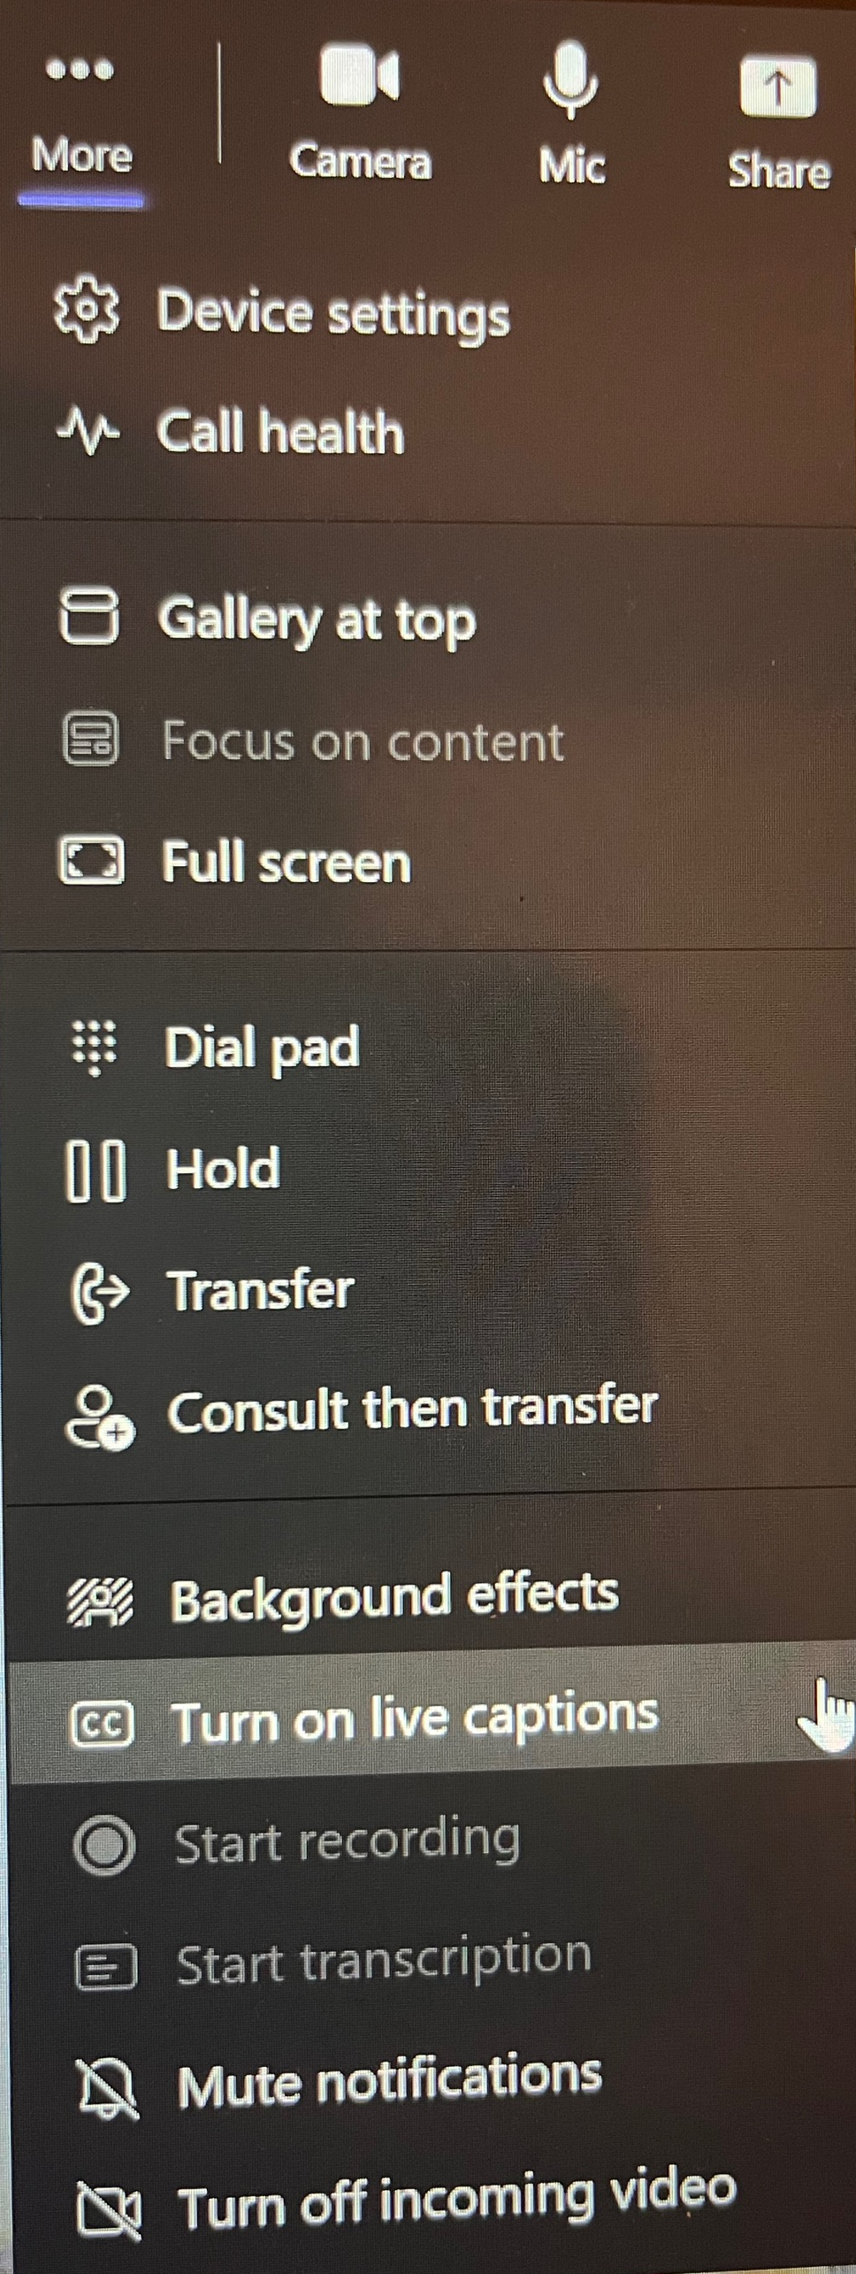
Please feel free to use the live captions feature, if you would like to see live subtitles on the screen.

Slide 5
Session agenda
11:00- 11:05 Welcome and introduction
11:05 – 11:30 Key concepts and information
          Humanitarian Aid, Principles, Definitions
          Innovation journey
          Innovation Fund for Anticipatory Humanitarian Action
          Essential details to include in your application
11:30 - 11:40 Grantee support & eligibility
          Funding and other support available
          Eligibility criteria
          Application process, including key dates
11:40 - 12:00 Q&A with the audience

Slide 6


Kimberly Brown
Head of Mobile for Humanitarian Innovation
GSMA

Slide 7

The GSMA
unites
the mobile industry
unlocking the power of connectivity, so that people, industry and society thrive
Notes:
The GSMA is a member led global organization representing mobile operators and organisations across the mobile ecosystem and adjacent industries
We exist to unlock the full power of connectivity so that people, industry and society thrive
We were the first industry to commit to the UN Sustainable Development Goals

Slide 8




We bring together
Mobile
ecosystem
International
partners
Start-ups
to build
partnerships and
inspire action
Governments
Notes:
Mobile for Development brings together the mobile industry and a diverse range of international partners to drive innovation in digital technology to reduce the inequalities in our world and contribute to achieving the SDGs
We are unique in that we sit at the intersection of mobile ecosystem and development sector, and our in-market expertise allows us to inform and build partnerships between the mobile industry, tech innovators, governments and the development sector
Our convening power allows us to get conversations started and inspire action
* To date our programmes have impacted 126 million lives around the world
And we’re just getting started…

Slide 9






Mobile for
Humanitarian Innovation
Accelerating
digital humanitarian assistance
10+ million people
reached to date
Building partnerships
to deliver safe, efficient and dignified humanitarian assistance
Investing in innovation to target humanitarian challenges with 20 solutions delivered to date
Enabling life-saving information to reach those in crisis
Notes:
In times of crisis mobile connectivity is a lifeline, enabling affected communities to seek and share information, communicate with loved ones, and access humanitarian assistance.
Through our M4H programmes we have reached over 9 million people with improved access to and use of life-enhancing mobile-enabled services
274 million people expected to require humanitarian assistance and protection in 2022
M4H Innovation Fund has provided more than 20 grants, totaling over GBP 6 million, to projects which are implementing across 27 countries, supporting new innovations targeting humanitarian challenges

Slide 10

Guy Peggram
Senior Market Engagement Manager
Mobile for Humanitarian Innovation
GSMA

Slide 11
Disaster response
GSMA Mobile for Humanitarian Innovation
3 / 15
Previous GSMA Innovation Funds
Complex emergencies and forced displacement
Anticipatory humanitarian action
Supporting mobile and digital solutions which help people and organisations prepare for humanitarian crises.
Long-term sustainability & scalability
Mobile internet adoption & digital inclusion
Assistive tech
Digital urban services
Climate resilience and adaptation

Slide 12
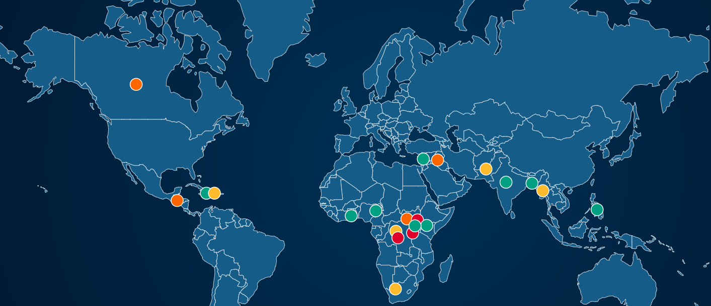
Past GSMA Mobile for Humanitarian Innovation Fund grants

Slide 13

Jenny Thornton
Market Engagement Manager
Mobile for Humanitarian Innovation
GSMA

Slide 14
Key concepts and information

Slide 15

Humanitarian Aid
“‘Humanitarian aid’ is aid and action designed to save lives, alleviate suffering, and maintain and protect human dignity during and in the aftermath of emergencies.”
Development Initiatives’
Global Humanitarian Assistance

Slide 16
Humanitarian Principles
Humanity
Human suffering must be addressed wherever it is found. The purpose of humanitarian action is to protect life and health and ensure respect for human beings.
Neutrality
Humanitarian actors must not take sides in hostilities or engage in controversies of a political, racial, religious or ideological nature.
Impartiality
Humanitarian action must be carried out on the basis of need alone, giving priority to the most urgent cases
of distress and making no distinctions on the basis of nationality, race, gender, religious belief, class or political opinions.
Independence
Humanitarian action must be autonomous from the political, economic, military or other objectives that any actor may hold with regard to areas where humanitarian action is being implemented.
OCHA Humanitarian Principles
Core Humanitarian Standards on Quality and Accountability (2014) SPHERE Humanitarian Charter and Minimum Standards (2018 edition)
For a concise summary of the above resources and their relevance to humanitarian innovation, see: https://higuide.elrha.org/humanitarian-parameters/humanitarian-principles-and-standards/

Slide 17

Definitions
Innovation
Humanitarian Innovation
“The successful application of new ideas that add value”
“An iterative process that identifies, adjusts and diffuses ideas for improving humanitarian action.”
Success
Ideas
Applied
Value
Doing something different at a sector/ system level
Seeking improvement for the sector/system
Iterative
The Oxford Handbook of Innovation Management
HIF/ALNAP More Than Just Luck

Slide 18
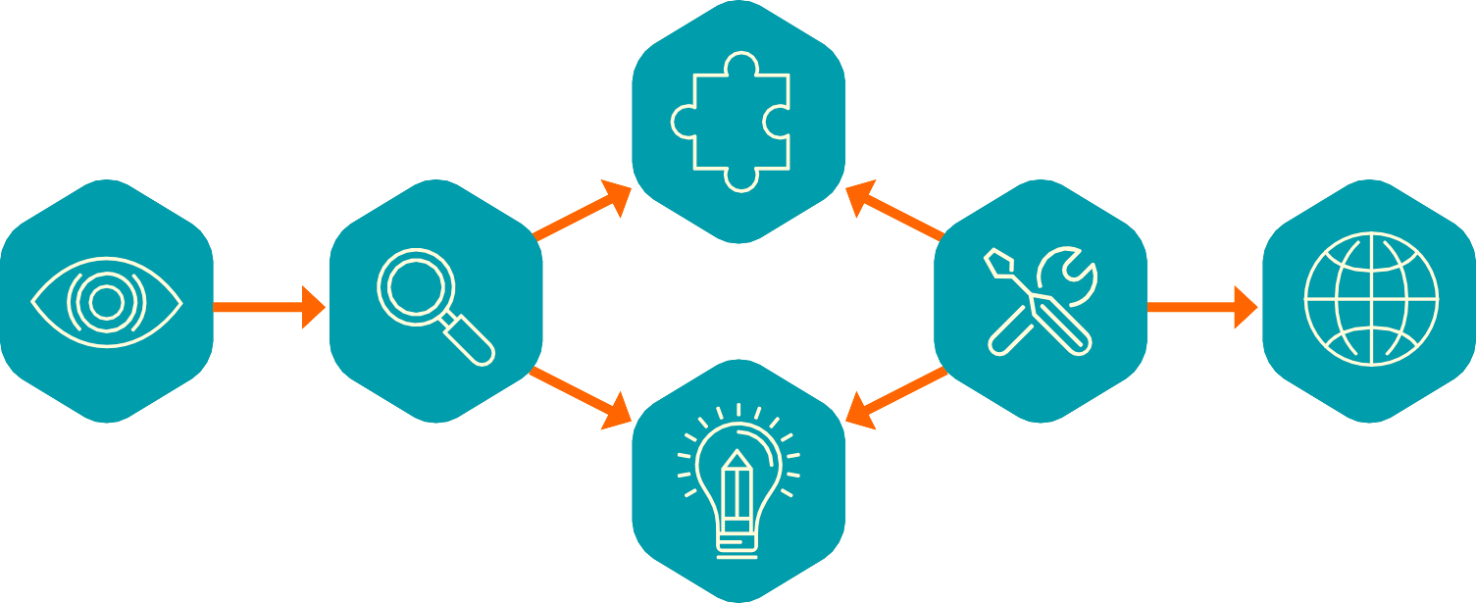
Innovation Journey
Humanitarian Innovation Guide
3. Adaptation
1. Recognition
2. Search
3. Adaptation
4. Invention
5. Pilot
6. Scale
1. Recognition
2. Search
5. Pilot
6. Scale
4. Invention
Source: Humanitarian Innovation Guide, ELRHA

Slide 19
Map your process
3. Adaptation
Where do you consider your innovation to be at in this process?
Has your project followed this route?
Have you skipped any steps?
1. Recognition
2. Search
5. Pilot
6. Scale
4. Invention
Source: Humanitarian Innovation Guide

Slide 20


The GSMA Innovation Fund for Anticipatory Humanitarian Action
The GSMA Innovation Fund for Anticipatory Humanitarian Action is funded by UK aid from the UK Foreign, Commonwealth & Development Office (FCDO and is supported by the GSMA and its members.

Slide 21

What is ‘Anticipatory Humanitarian Action’
What is ‘Anticipatory Humanitarian Action’
Definition
Given the broad and far-reaching potential of anticipatory action, we expect to see a diverse range of solutions including but not limited to:
Pre-Positioning and Early Deployment Activities
Early Action, preparedness & resilience-building
Dissemination of Early Warning Messages
Systems that will Enhance Communication
Anticipatory action is acting ahead of predicted hazardous events to prevent or reduce acute humanitarian impacts before they fully unfold.
Knox Clarke, P. (2022) Glossary of Early Action Terms 2022 Edition, Risk Informed Early Action Partnership.

Slide 22
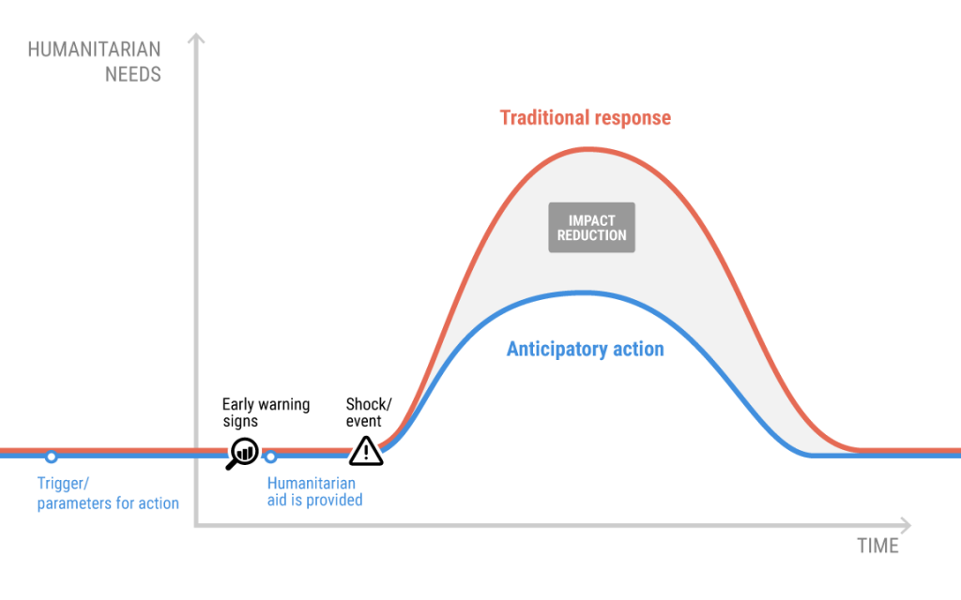
What is ‘Anticipatory Humanitarian Action’
What is ‘Anticipatory Humanitarian Action’
Figure: The Centre for Humanitarian Data

Slide 23




Examples of ‘Anticipatory Humanitarian Action’
Pre-Positioning and Early Deployment Activities, for example, a mobile-enabled system that triggers the payment of support when a threshold of risk is passed, such as a mobile cash payments sent to families living in a flood plain when the river level passes 2-meter mark indicating a forthcoming flood.
Early Action, Preparedness & Resilience-Building focusing on communities vulnerable to and/or at risk from crises. For example, providing data generated by mobile to enable a real-time picture of the mobility and movement of people impacted by crises, helping decision makers plan interventions in advance by understanding and assessing scale and location of displaced people.
Dissemination of Early Warning Messages, focusing on the adaptation of existing early warning systems that enhances inclusion of different group. For example, ensuring that persons with disabilities are successfully reached and their needs are catered for when distributing an earthquake early warning message.
Systems that will Enhance Communication between organisations and affected communities, anticipating the increased demand and need for information. For example, two-way communication channels between at-risk populations and humanitarian organisations so communities impacted can report damage caused by a tsunami and organisations can actively respond in a timely manner.
Notes:
Pre-Positioning and Early Deployment Activities (for example, a mobile-enabled system that triggers the payment of support when a threshold of risk is passed)
Early Action, preparedness & resilience-building focusing on communities vulnerable to and/or at risk from crises
Dissemination of Early Warning Messages, focusing on the adaptation of existing early warning systems that enhances inclusion of different groups
Systems that will Enhance Communication between organisations and affected communities, anticipating the increased demand and need for information (for example two-way communication channels between at risk populations and organisations)

Slide 24


Slide 25
What do we expect to see in the application’?
That you have a strong sense of your user base.
Summary of the humanitarian problem or challenge you are addressing.
How your innovation uses mobile/digital technology.
The ideal outcome of your solution.
That you have match funding available (at least 25% of grant requested).
Awareness of your project’s risks/unintended consequences and how to mitigate them.
What makes your solution unique/different from competitors.

Slide 26

Grantee Support & Eligibility

Slide 27






Support provided to grantees through the Innovation Fund
Support provided to grantees will include
Grant funding between £100,000 - £250,000 to support projects over 15 to 18 months.
Learning exchange opportunities with other grantees and networking opportunities with other GSMA partners.
Monitoring and evaluation support to evidence, measure and promote product impact.
Facilitation of relationships with mobile network operators.
Opportunity to increase visibility and raising profile to potential investors and partners through GSMA publications, case studies, social media and events.

Slide 28
Eligibility criteria for the Innovation Fund
Key eligibility criteria
Non-profit organisations, including non-governmental organisations (NGOs, either local or international), humanitarian agencies and social enterprises and for-profit organisations, including start-ups, small-to-medium enterprises (SMEs) and social enterprises.
Leveraging digital technology, especially mobile, to deliver innovative solutions.
Can demonstrate the long-term sustainability and scalability of the innovation beyond the lifespan of the grant.
Identify active users in at least one eligible country.
Geography:
Africa, Middle East, South Asia and South East Asia, Pacific, Caribbean, Latin America; some exclusions apply – see Terms and Conditions.

Slide 29
Eligibility criteria for the Innovation Fund
Match contributions
Applicants must provide a match contribution of at least 25% of requested grant amount between £100,000 to £150,000. For instance, if an applicant is requesting £100,000 from the Fund, a contribution of at least £25,000 from other sources is required.
Applicants must provide a match contribution of at least 50% of requested grant amount between £150,001 to £250,000. For instance, if an applicant is requesting £200,000 from the Fund, a contribution of at least £100,000 from other sources is required.
Match contributions must be secured and evidenced as such by the time final proposals are submitted and must then be used towards the proposed project and spent in full across the 15 to 18 month project cycle.

Slide 30
Strongly encouraged for the Innovation Fund
We particularly encourage the following applicants to apply
Organisations that are women-led.
Strong presence in their country of implementation and a commitment to supporting/upskilling and promoting local staff.
International organisations who do apply, should have a strong localised presence and demonstrate a strong commitment to diversity of voices and representation.
Clear understanding of how the solution improves the resilience and adaptive capacity of vulnerable communities and have proactively taken steps to set targets and systematically measure these impacts.
Applicants that have not received prior FCDO grant funding through the GSMA.

Slide 31
24 Nov 2022
APPLICATIONS OPEN
Fund announced; Release of Terms & Conditions Applicants will have ​~9 weeks ​ to submit a pitch via​ an online form.
GSMA Mobile for Humanitarian Innovation
3 / 15
Innovation Funds Key Dates
19 Jan 2023
APPLICATIONS CLOSE
The pitch submission stage closes at 23:59 UTC on 19 January 2022.
27 Feb – 12 May 2023
PROPOSAL STAGE
Shortlisted applicants ​
submit a full project proposal including:​
Project proposal
Budget
The GSMA will conduct:
Due diligence assessment
Field visit (if possible)
June 2023
FUND PANEL
Independent panel of experts (‘Fund Panel’) will appraise proposals based on the submitted material as well as recommendations from the GSMA and the Fund Manager
Oct 2023
PROJECTS
COMMENCE
Successful grantees will begin project implementation.
Innovation Fund grantees will be announced by GSMA

Slide 32
Q&A

Slide 33

Review Terms and Conditions, FAQs and apply: www.gsma.com/InnovationFund
For questions, contact us at: GSMAIF@gsma.com
Thank you for joining us for this webinar!
The GSMA Innovation Fund for Anticipatory Humanitarian Action is funded by UK aid from the UK Foreign, Commonwealth & Development Office (FCDO) and is supported by the GSMA and its members.

