Slide 1
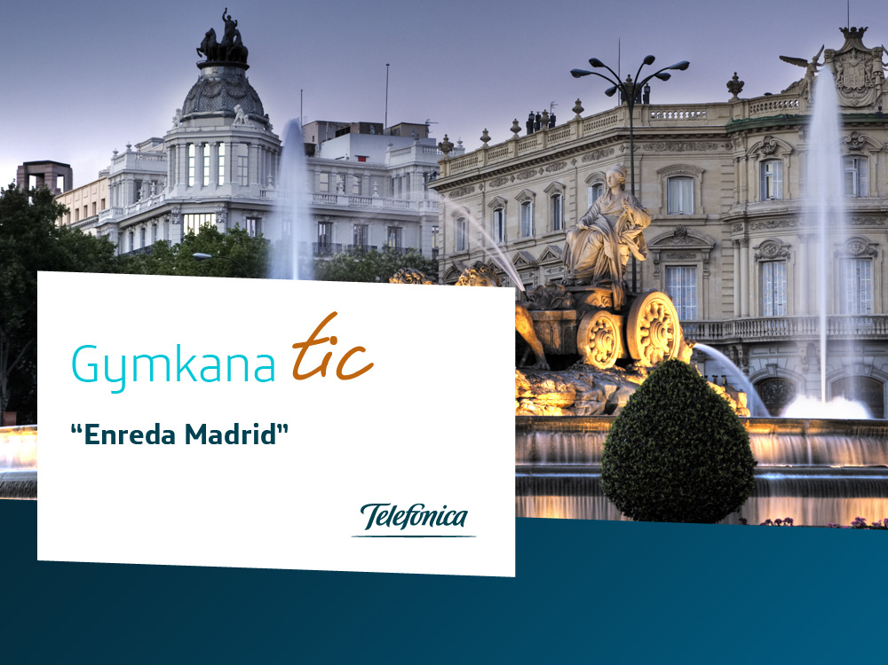



Slide 2

01
Enreda Madrid
02
Methodology
03
Environment and multimedia resources

Slide 3

01
Augmented Reality
Treasure Hunt

Slide 4

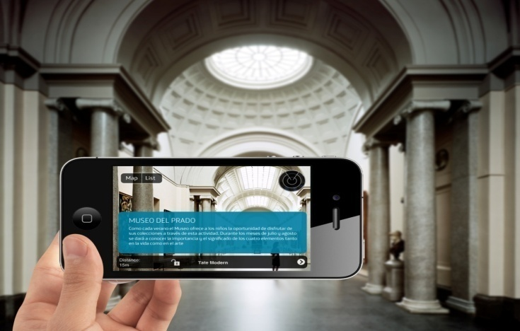
Augmented Reality Treasure Hunt
This activity brings together culture and new technologies through theme-based learning, and is used to deliver information of general interest via different mobile devices and technologies. The idea is to integrate the latest technologies into a sociocultural context in order to bring universities “up to speed”.
This activity is designed for:
UNED (National Distance Learning University) students. Students will receive free/elective credits for this activity.
  The general public (adults aged 18 and older).

Slide 5

Objectives
The main objectives of Enreda Madrid are:
To offer students new learning strategies that combine culture and new technologies as an innovative alternative to acquiring free/elective credits.
To become familiar with the latest technologies, Web 2.0 and social networks associated with theme-specific subjects of general interest.

Slide 6
How the activity works
The activity involves following a course program combining culture and new technologies. Students interact with the technology and learn about a specific theme as they pass a series of “tests”.
In addition to passing these tests, students must post ongoing commentaries about the activity on a blog. Students will be able to use a web-based learning environment to access materials and any information they may need to complete the activity successfully.

Slide 7
Activity Context
Classroom
Travel around Madrid going from one test to another, combining audio-visual technology and cultural immersion.
OnLine
Multimedia materials,
blogs,
collaboration,
etc.

Slide 8
Development
The idea is to develop a ICT Gymkhana using a series of theme-based course programs that will deliver information of general interest through the use of different technologies.
The routes set up will take participants from one point to another in Madrid, allowing them to discover information of interest via their mobile devices.
All activities will be centralized on a collaborative Web 2.0 environment in which students will participate in creating a travel notebook (blog), with the support of different 2.0 tools, such as Flickr and Youtube.
Students enrolled at the UNED who participate in this activity will receive 1 credit, and all participants will be eligible to receive one of the “Enreda Madrid” awards.

Slide 9
02
Methodology

Slide 10
Game-Based Learning
This methodology uses learning through discovery and applies the Game-Based Learning technique.
A learning environment will be developed as a hub to integrate information from a variety of curricula related to ICTs, in compliance with free/elective credit requirements, and at the same time will incorporate innovative solutions to reinforce the collaborative 2.0 concept.

Slide 11
Methodology
Web 2.0 Environment
Theoretical content associated with course programs and gaining proficiency in ICTs
Course programs with practical activities developed through different devices including mobility

Slide 12
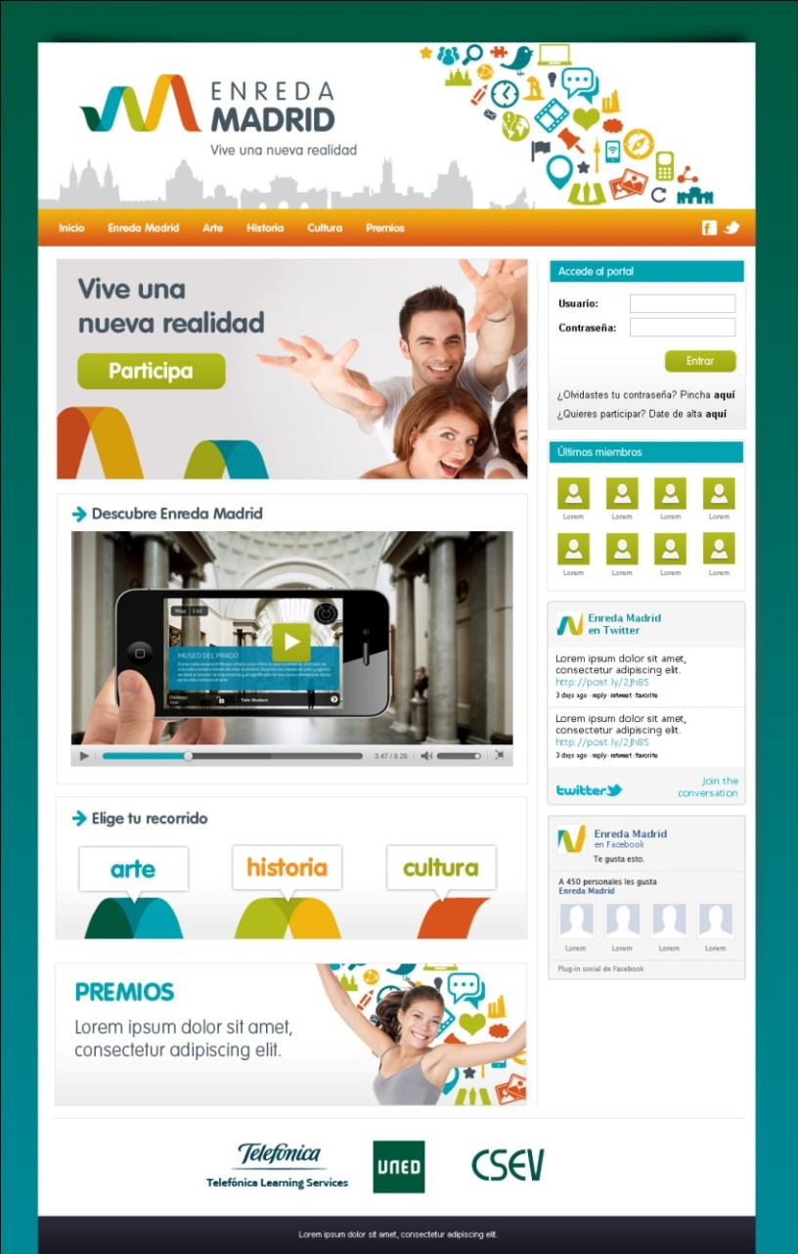
Environment
A pivotal part of this environment will be to create a Travel Notebook (blog). Participants will be able to upload photos, videos and original contents to show they participated in the practical activities which will then be assessed by teachers.
The environment creates a collaborative setting for students and teachers, and gives them the opportunity to explore new ways of learning.
It is a meeting point in which teachers and students can share experiences and information so that participants can pass the “tests” that make up the activity.

Slide 13
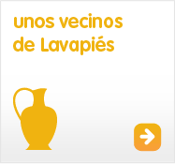


Content
The theme of each course program should be defined , and contents developed by an expert in the subject tied into the activities, enabling teachers to give an assessment later on.
This section will include contents that will equip participants to use Web 2.0 tools to facilitate their work in the Gymkhana.

Slide 14
Duration and dates of the activity
Duration of the activity: approximately 25 hours, the equivalent of 1 free/elective credit. 8 hours of classroom study and the rest of the work via the Web environment.
Pre Treasure Hunt
1.5 weeks
Treasure Hunt
1 day
Post Treasure Hunt
1.5 weeks

Slide 15
 | Before 1,.5 weeks = 8 days “Learn how to…, and study the subject matter.” |  | During 1 day = 8 hours “Complete the tests and collaborate.” |  | Afterwards 1.5 weeks = 7 days “Show proof of your work and collaborate.”
Individual work | 4 hours of ICT content | 3 hours of theme content | 2 hours of ICT content | 5 hours of theme content | 6 hours to create the blog
 | What you will come across in this environment Creative writing for the Web YouTube + Flickr Facebook y Twitter Geolocaltion | One day in 1651 in the life of… “El cronista de la Villa” “Un matrimonio de nobles” “Vecinos de Lavapiés” | 3 thematic unit stages 2 entertainment stages 1 stage at FlagShipStore |  | Participants show proof of their work and put what has been learned into practice.
Collabora-tive work | 30 minutes | 30 minutes | 1 hour |  | 1 hour to assess other blogs

Slide 16
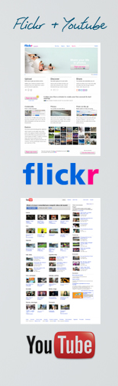
ICT CONTENTS
You Tube y Flickr:
Step-by-step simulation guide of these two environments. How to create an account, record a personal video presentation/photograph something you like and upload it to your account.
Facebook y Twitter
Step-by-step simulation guide of these two social networks , since they will have an important role within the activity. How to sign up, and how to use them.
Geolocation
Google / Simulation
Creative Web writing
Multimedia content: Content development and authorship passwords, and how to reutilize other authors’ materials…
Define your blog titles
What you will find in this environment:
Video that explains environment spaces and tools, with instructions on how to interact with them.

Slide 17

03
Environment and multimedia resources

Slide 18

Portal
Home pública

Slide 19
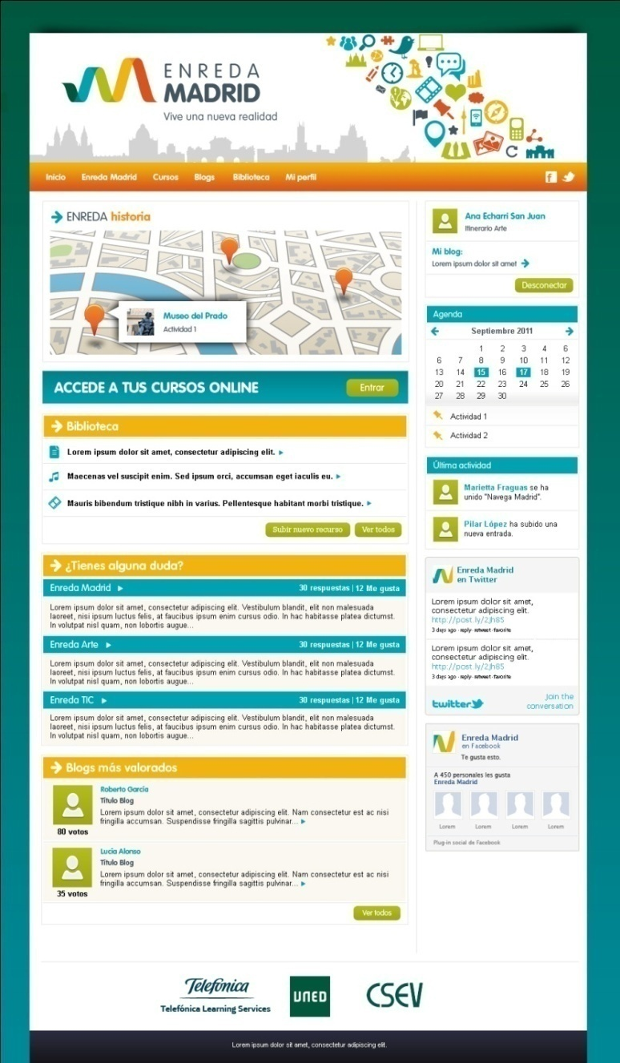
Portal
Course Program

Slide 20

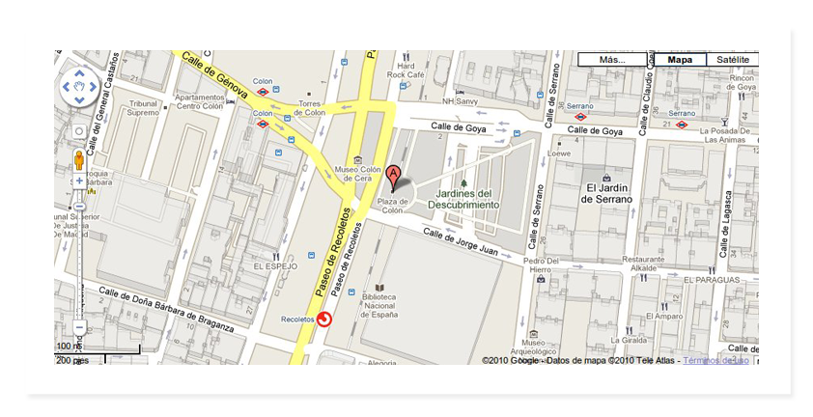
Geolocation

Slide 21

Augmented reality
A specific content for each key point in the program will be generated and can be accessed with a Smartphone.
Each content will be viewed through an application that allows participants to mix multimedia content with the reality they are viewing.

Slide 22
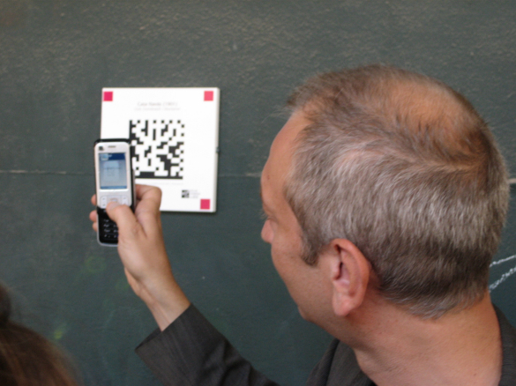
Contextual information
QR codes will be used to show contents associated with the program’s key point in a video format in those places in which alliances can be established.

Slide 23
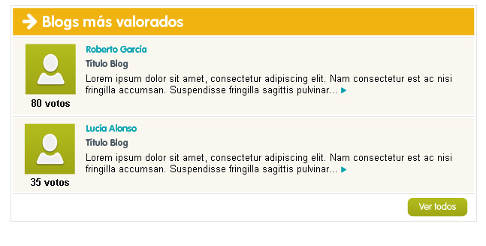
Collaboration and Blog
Users should actively participate at all times within the environment, both to publish contents that show the extent to which they have made progress in the program of their choice, and to comment on other participants’ contents.
Flickr and Youtube are the tools participants should use to document their progress and to show proof of tests completed during the Gymkhana .

Slide 24
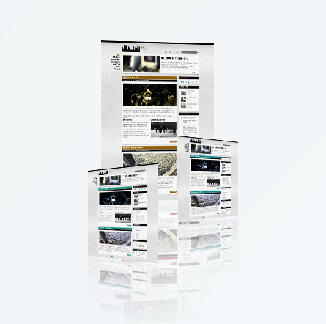
Collaboration and Blog
Collaborating in real time allows students to share experiences and show what they have learned during this process.

Slide 25
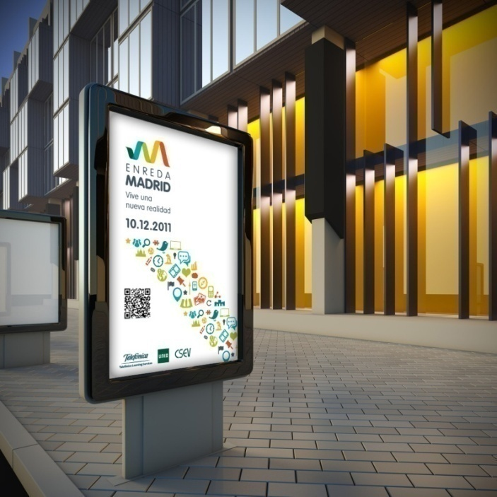
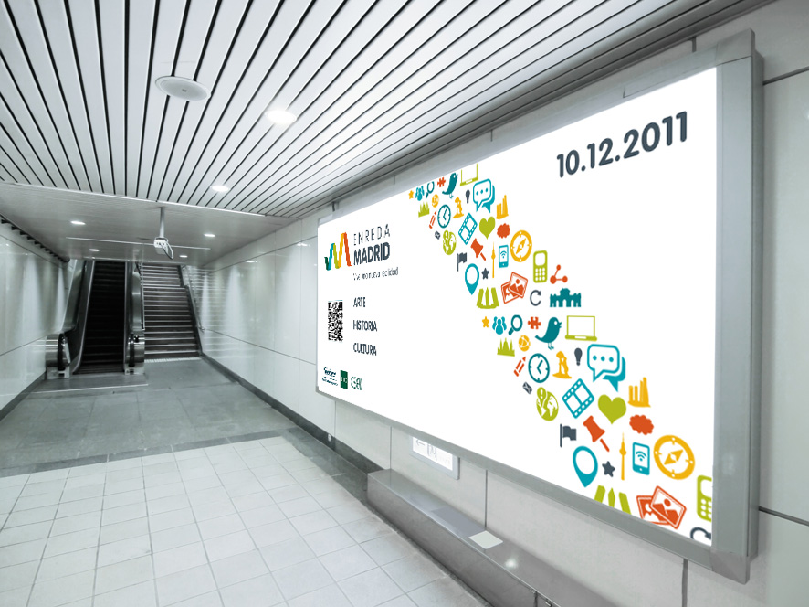
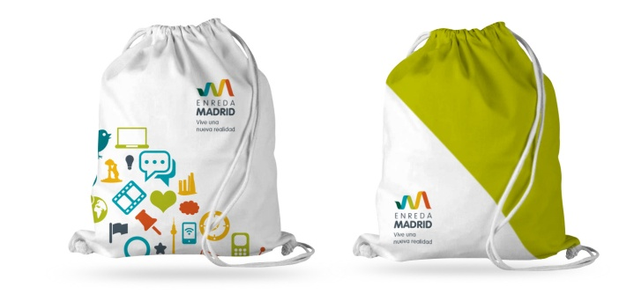

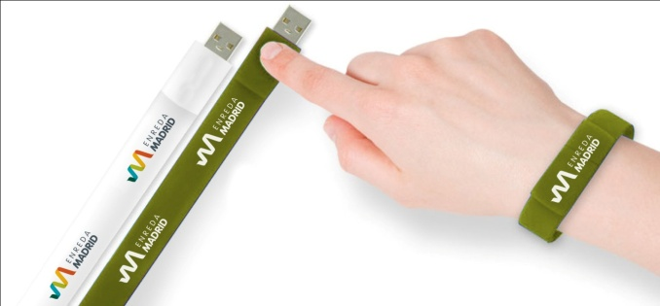
Identity

Slide 26
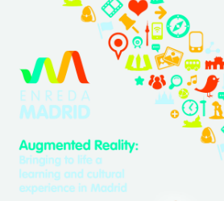
Video

Slide 27



Notes:
26

