Slide 1
Learning with Vodafone - In the Classroom and Beyond
M-Education Pilot in INDIA
Marc Tastayre
Global Business Development Manager
M2M Consumer electronics

Slide 2
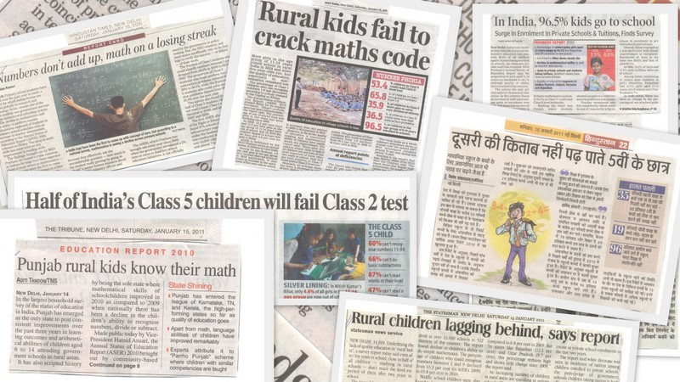
Indian Education System (IES) – Inefficient, ineffective
Over 572M in the age group of 0 – 24, the largest youth population in the world
School network, vast yet inefficient
  1M+ Schools in total
  75K private
  18K providing Higher Education
High levels of illiteracy
  Avg. Indian spends only 2.9 years schooling
  40% drop out rates
  Net enrolment @ 37%
Lack of quality in Public education
  40% of student population in 7% of the private schools
Typical student – teacher ratio = 40:1, often higher in rural
Lack of capability & experience, affecting quality of students
  44% of teachers are not graduates in urban, 57% in rural markets
Notes:
Vodafone Group Plc - FY 09/10 Interim Results
10 November 2009
2

Slide 3
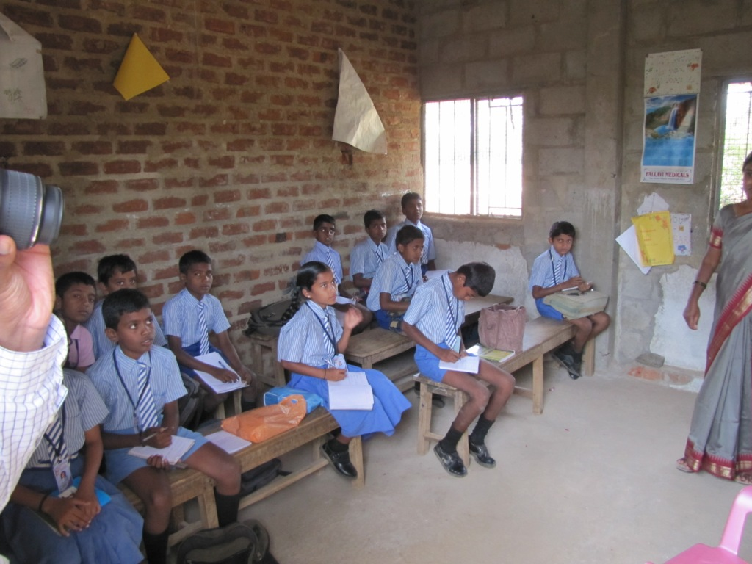

Slide 4
CLASSROOM, SCHOOL , COMMUNITY – HOW CAN VODAFONE MAKE A DIFFERENCE?
ADD ECONOMIES OF SCALE AND SCOPE TO THE MICRO MODEL
How can technology and multimedia content enrich the classroom learning experience?
School
Classroom
Community
How can we improve efficiency of the school operations?
Can mobile / internet based tools solve problems like student / teacher absenteeism, parent / teacher communication?
How can we enable continuous engagement between stakeholders – parents, teachers, school administration towards improving student experience?

Slide 5
Vodafone: Enabling access to quality education content and enhancing the learning experience
Current Challenges
  Classroom-centric solutions
  Limited/No student interactivity
  High Cost of Ownership limits it to schools
  Scalability challenge
Vodafone Opportunity
  Enabling learning in classrooms & beyond
  Continuous engagement and interactions
  Affordable for schools & personal use
  Cloud architecture & simple edge devices enables scale

Slide 6
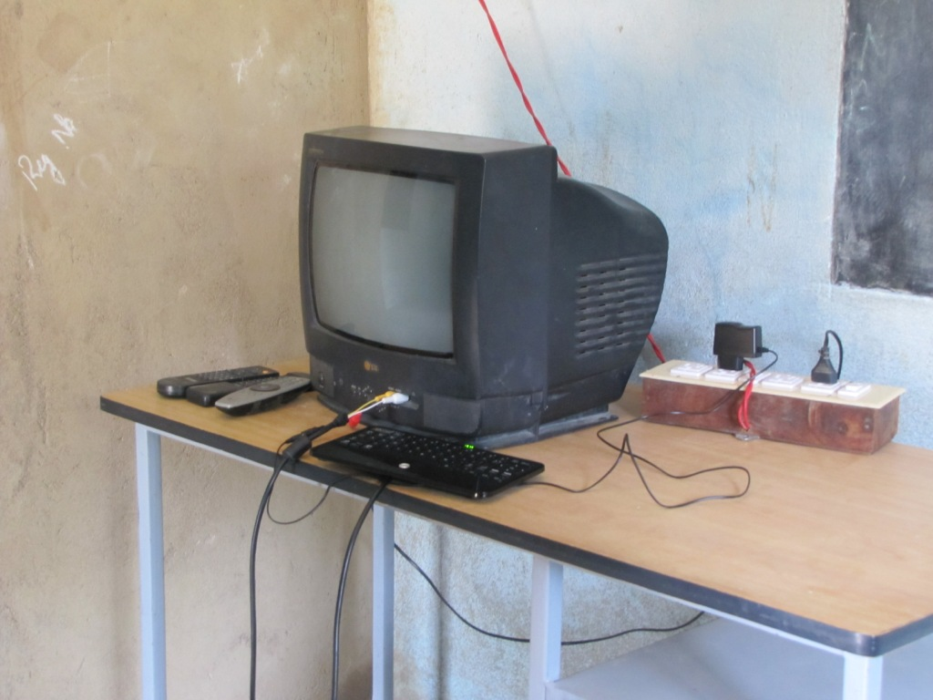

Slide 7
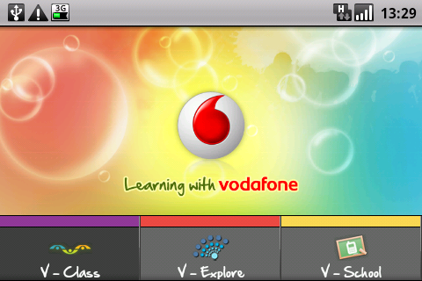
“Learning with Vodafone” integrates Classroom Curriculum with Long Tail content from the Web & Student Interactivity
Learning with Vodafone V1
  Math and Science for Class 6 & 7
  English content
  State School Syllabus
  Delivered via a WebBox/Tablet
  For use in Classroom
  SMS interactivity with students
Delivers content that’s aligned with official curriculum
Facilitates teacher →student →parent → school interactions
Enables teachers /students to access related text, images & video from the Internet

Slide 8
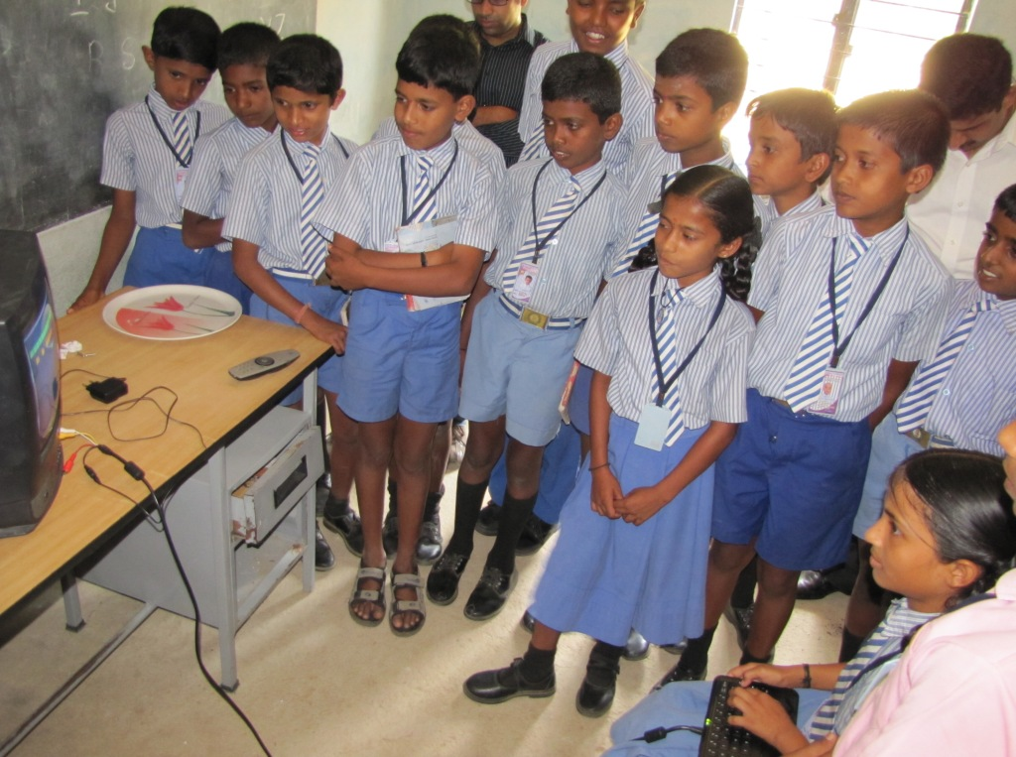

Slide 9
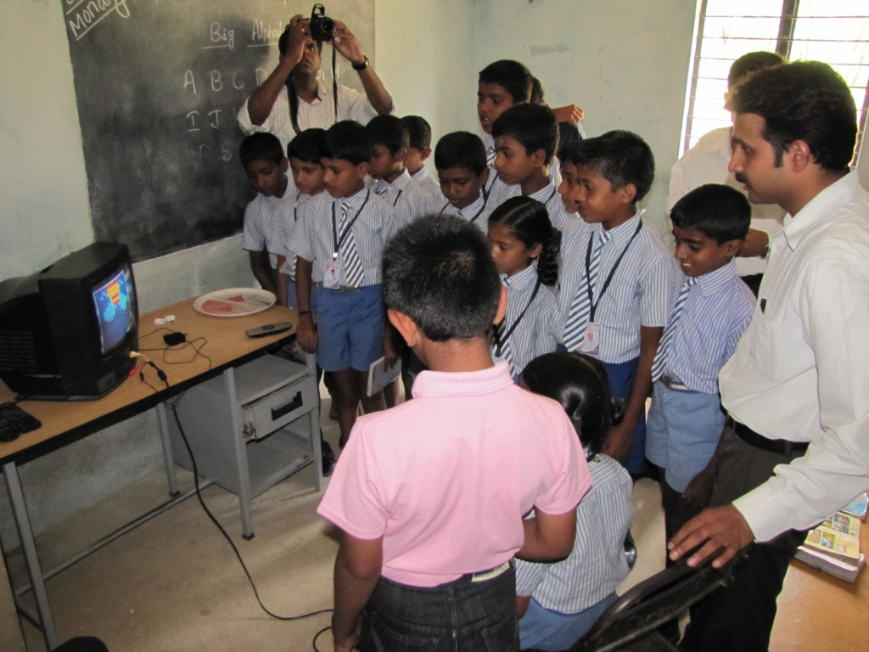

Slide 10
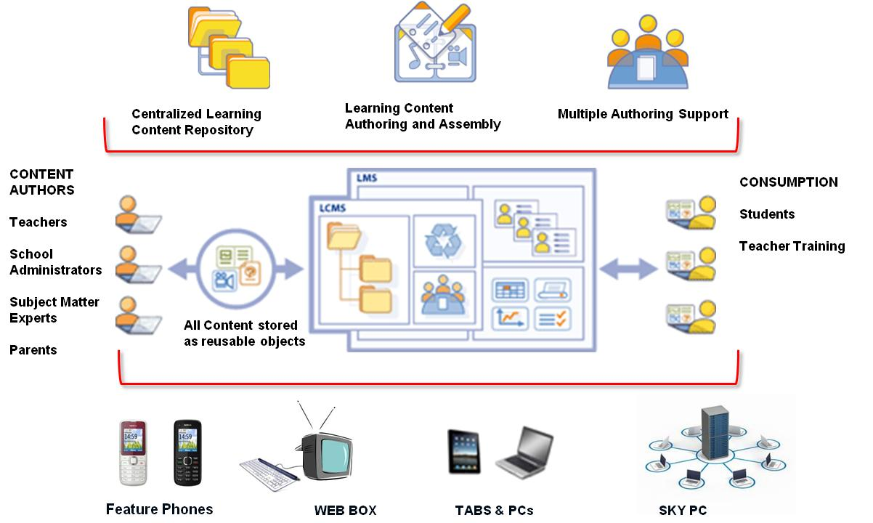
Learning With Vodafone – A complete solution that includes Cloud infrastructure, Content, Mobile Broadband, Devices

Slide 11
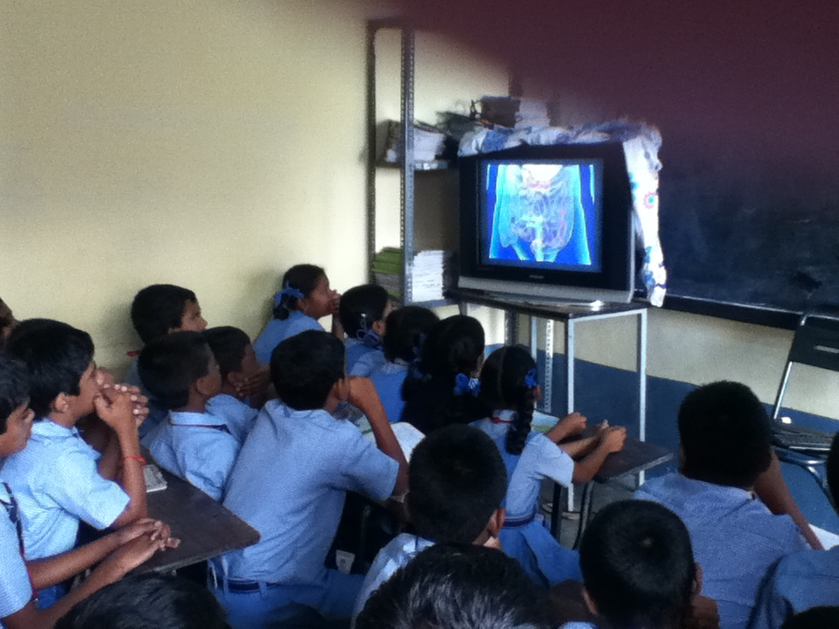

Slide 12
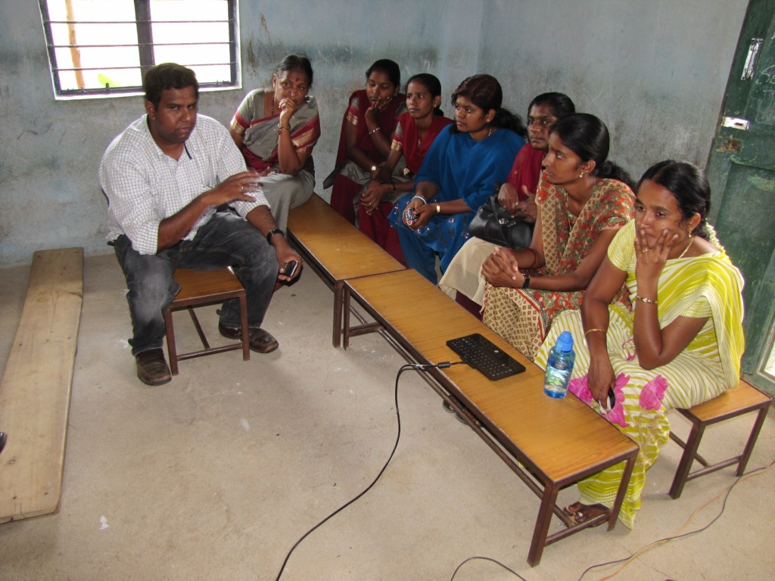

Slide 13

Mumbai, April 26, 2012
Vodafone Foundation Partners with Pratham to Digitize Classrooms
Vodafone Foundation Revolutionizes Learning in 1000 Schools across India
‘Learning with Vodafone Solution’ to digitize classrooms for over 50,000 underprivileged children

Slide 14
Thank you

