Slide 1
mAutomotive: Visioning for the Future
Francesca Forestieri, Director mAutomotive, GSMA

Slide 2
How important an opportunity are commercial telematics & infotainment services…?
More Ways to Provide Connectivity
More Variety of in-Vehicle Services
More Service Usage by Consumers
Global Telematics Services Forecasts
More Connected Cars

Slide 3
Contents
GSMA mAutomotive Evolution
Key Trends
Key Questions for the Future
Panel

Slide 4
GSMA mAutomotive: Evolution in Activities
Stakeholder Interviews/ Strategy Definition 2010
Formation of Connected Car Forum with Operators and Automakers 2011
Mapping of Obstacles 2012
Identification of Opportunities 2012
Launching of Trials 2012

Slide 5
Who Participates in the Connected Car Forum?
Operators:
Automakers:
AT&T, Bell Canada, China Unicom, Deutsche Telecom, KDDI, KPN, KT, NTT Docomo, Orange, Rogers, Softbank, Sprint, Telecom Italia, Telefonica, Telenor, Telstra, Teliasonora, Turkcell, Verizon Wireless, Vodafone;
Audi, BMW, Chrysler, Fiat, Ford, GM, Honda, Hyundai, Jaguar Land Rover, Mazda, Nissan, Peugeot, Renault, Toyota, Volvo, VW;
Global Connected Car Forums:
London: 06/11, 09/11; 11/11; 02/12; 05/12; 09/12
Past Regional Events include:
North America 06/12
Japan 09/11; 10/1
China 12/11
Past Events:

Slide 6
Topics for Joint Collaboration…..
Enablers
Billing
Security
Roaming
Remote provisioning of SIM
Operational Improvements
Optimising data usage
Defining common requirements for telematics services
Improved service delivery by different connectivity
eCall deployment (EU)
New Business Development
Joint APIs
Business modelling
Location based services
Future services enabled by high bandwidth technologies (such as LTE)
How has this changed since last year?
How will this change over three years?

Slide 7
GSMA mAutomotive:
Realising Enablers & Growing Opportunities
Priority Themes 2012 | Activities
 | Workshops to Id. Barriers & Opportunities | Requirements & Use Cases | Specifications/Guidelines | White Paper | Trial / Proof of Concept
Remote Management of SIM: Proof of Concept |  |  |  |  | x
Service Awareness & Roaming: Requirements for Telematics & Infotainment Services |  | x
Charging & Billing: Split, Service Based Charging for Telematics and Infotainment |  | x |  |  | x
Tethering: Tethering White Paper; Interoperability Requirements for PAN/DUN | x | x | x | x
High Bandwidth Enabled Services: Looking Towards the Future | x
eCall: Beyond pan-European eCall | x |  | x

Slide 8
Contents
GSMA mAutomotive Evolution
Key Trends
Key Questions for the Future
Panel

Slide 9
Key Trends: Connected Cars -
Part of Everything Connected Everywhere?
Computers
Phones
Tablets
TVs
Cars???
Evolution of Services and Apps to Multiple Devices…will the car be “just one more device” for services?

Slide 10
Key Trends: Connected Cars -
Part of Everything Connected Everywhere?
Technology Drivers
Evolution in consumer demand: Flexibility and SERVICES
HTML5 – changing the services offered in the car
Using Any device
Services covering all consumer needs and environments
Continuous throughout the Day
Constant Innovation and New Products
Cloud based services
Shift from solely proprietary to mixed solutions (native OS and Html)
High bandwidth cellular network deployment

Slide 11
Service Deployment Changes: Past vs. Today
Safety & security
Telematics
Navigation
Infotainment
Navigation & Basic Infotainment
More Complex Infotainment
(Telematics /Safety and security – depends on geography)
Past Service Evolution – Mostly Incremental
Today’s Service Deployment – Different Services & Larger Service Offerings Bundled

Slide 12
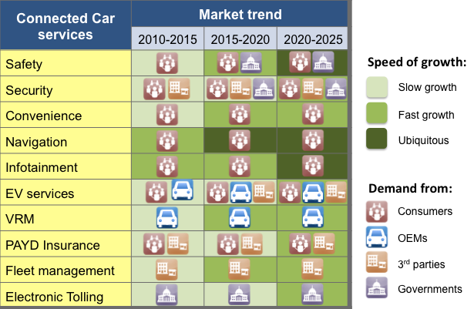
Forecasted Changes in Services
Source: 2025 Every Car Connected: Forecasting the Growth and Opportunity

Slide 13
Contents
GSMA mAutomotive Evolution
Key Trends
Key Questions for the Future
Panel

Slide 14
Potential New Topics ???
Connectivity Enablers
Operational Improvements
Business Development Enablers
Billing & Charging
Privacy
Security
Roaming
Future Proofing Embedded Systems
Service Awareness
High Bandwidth Enabled Services (which services, which business models)
Cloud-based Services
HMTL5 based Services
New Business Models (advertising, selling data, third party content, reverse charging)
Leveraging Apps Development
Big data
Optimising current tethering / defining next generation
Regulatory Fitment Mandates and ensuring value-add opportunities for new services
Over the Air Provisioning of Operator Credentials
Optimising data usage (avoiding unnecessary network load from services)

Slide 15
Broadening ???
Regional Focus: China, Brazil, South-East Asia
Vehicle Type: Trucks, Construction Equipment,
Value Chain Stakeholders: 1st Tier, Module Manufacturers, TSP, SIM mnfr, etc
After-market – Retro-Fit Devices/Services
Expansion of Telematics & Infotainment Focus

Slide 16
Where do we position on ourselves on the domain?
ITS
Telematics and Infotainment
Cooperative Systems
Smart Cities

Slide 17
Contents
GSMA mAutomotive Evolution
Key Trends
Key Questions for the Future
Panel

Slide 18
Today’s Panel will discuss…
Connected Vehicle Services: Hot Topics for the Future
Trends within In-Vehicle Connected services
Role of Automotive and Transport in a Smart City
ITS and Cooperative Systems
Connecting Vehicles and Transport to the Cloud
David McClure, SBD
Jan Unander, Telematics Valley
Magnus Lundgren, Ericsson
Mattias Brannstrom, Volvo Cars
Andreas Mai, Cisco Systems
David Levine, Vodafone
Magnus Johansson, Wireless Car
Johan Gentzell, Microsoft
mAutomotive Survey Results
Priority Topics for the Future
Neil Dawson HMDG
All

Slide 19
Thank you!
For more information:
http://www.gsma.com/connectedliving/mautomotive
/www.gsma.com

Slide 20
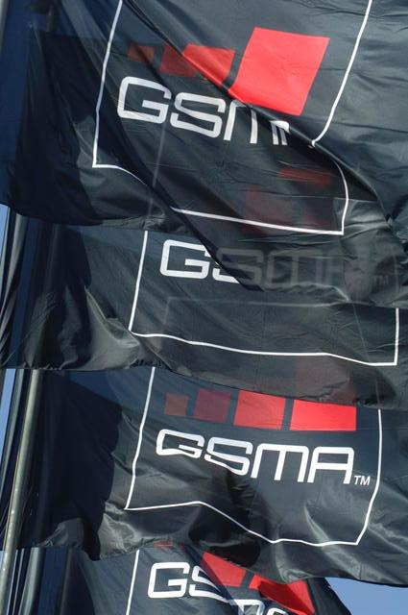
What is GSMA?
Founded in 1987 by 15 operators committed to the joint development of a cross border digital system for mobile communications
In 25 years, GSMA membership has grown to nearly 800 of the world’s mobile operators and over 200 companies in the broader mobile ecosystem, from 219 countries
GSMA represents over 4.5 billion connections around the world
GSMA runs the Connected Car Forum, bringing together operators and automakers to overcome connectivity barriers and to foster in-vehicle service deployment

Slide 21
All: Panel Questions 1/2
What is the role of brought-in connectivity (tethering /smartphone integration) for connected in-vehicle services? Can tethering be a winning business model for both OEMs and operators? What are the risks associated to brought-in connectivity?
What are the key business case challenges for commercial connected car services?
What strategic role does connectivity play in realising commercial services? In terms of choices: Embedded vs. Tethered vs. Smart Phone Integration; in terms of company strategy: must have, leaders, etc.
What is key connectivity functionality needed to enable viable commercial in-vehicle services? Charging & Billing? Embedded SIM? Security?
How can early cooperation between operators aid OEMs help in strategically shaping the deployment of commercially viable in-vehicle services?
Will LTE bring tangible benefits to consumers for new in-vehicle services?

Slide 22
Panel Questions 2/2
What is the biggest challenge in determining/developing apps for connected vehicle services?
How do you measure the benefits from telematics services? Since the business cases for services depend upon the quantification of direct CRM benefits (as well as indirect benefits), has your organisation put in dedicated mechanisms to measure these benefits?
How critical is future-proofing embedded connectivity, when considering commercial viability of services? What options do you believe prove most promising?
Network technology evolution: what guidance can you provide to OEMs as they plan for embedded services? How important is it to be planning already for LTE for embedded connectivity?
From an operator perspective, what do you believe that you bring to the table beyond the “dump pipe” providing sole connectivity?
How important are value-add connectivity elements in when deploying in-vehicle services?
What would be your closing message to the ITS World Congress on bringing commercial in-vehicle services to market?
Notes:
2016: 7% of global mobile connections will be LTE. Over 200 LTE networks to go live globally, compared to just under 100 to date
2020: 3G HSPA, LTE connections to reach half of the global market

Slide 23
Guidelines for presentations
What is Your Telematics Strategy? For OEMS also: Why are connected vehicle services important? (M2M embedded vs. consumer connectivity)
What are the key business case challenges for commercial connected car services?
What strategic role does connectivity play in realising these commercial services?
What is key connectivity functionality needed to enable viable commercial in-vehicle services?
What are the greatest challenges to realising commercial services from a connectivity perspective?
What are the greatest opportunities provided by cellular technology to realise commercial services?
What are the greatest market challenges in realising commercial services?

Slide 24
Automotive Problem Statement
Historic cooperation difficulties across operators and automakers
Data mining possibilities increase and have implications on business models
Evolving market demands, as more data intensive services are expected to be deployed on massive scales requiring new technologies, business models and cooperation
Market Evolution
Fear of roaming costs have reduced the utilisation of telematics services (switched off to avoid risks in border areas)
Security & privacy issues are given increased importance as deployment of connected cars increases with increased attention of hackers
Current business models have few proven track-records for directly covering costs of services
Driver distraction concerns impose specific, unique obligations on services for deployment
Services are often not seamless, given fragmented connectivity approaches
Service Delivery Challenges
Closed Ecosystem
After-market expected to grow significantly in near future
Fragmented market of services and devices
Market dominated by relatively few automakers wanting global solutions
Market Structure
Regulatory changes have stagnated development in recent years (EU)
First telematics services often resulted in acrimonious relationships
MNO assets will need to meet these evolutions in order to maximise opportunities and be active players in the value chain (beyond connectivity).
Flexible, and articulated payment and billing services are an example

Slide 25
How Can I Get Involved?
Join the Connected Car Forum (operators and automakers only)
Join the GSMA mAutomotive Workstream, in the Connected Life Programme
Participate in External Events: Extended CCF or CLP Summits

Slide 26
Regional Focus: China, Brazil, South-East Asia
Vehicle Type: Trucks, Construction Equipment,
Value Chain Stakeholders: 1st Tier, Module Manufacturers, TSP, SIM mnfr, etc
After-market – Retro-Fit Devices/Services
Expansion of Telematics & Infotainment Focus

Slide 27
Where do we position on ourselves on the domain?
ITS
Telematics and Infotainment
Cooperative Systems
Smart Cities

Slide 28
Why mAutomotive?
Connected Living Programme, began in 2009, Founded in 1987 by 15 operators committed to the joint development of a cross border digital system for mobile communications
In 24 years GSMA membership has grown to nearly 800 of the world’s mobile operators and over 200 companies in the broader mobile ecosystem, from 219 countries
GSMA represents over 4.5 billion connections around the world
GSMA runs the Connected Car Forum, bringing together operators and automakers to overcome connectivity barriers and to foster in-vehicle service deployment
GSMA
Connected Living Programme
mAutomotive
Connected Car Forum
Mobile Network Operators
Automakers

Slide 29
Connected Living strategic objectives 2013
Agreement to change the roaming model reflecting vertical market requirements
Stimulate/ follow 21 service trials or launches in Health, Automotive and Education where mobile plays a leading role (connectivity and value added services)
Promote the role of mobile in the connected world and support Barcelona to become a world class Mobile World Capital
mHealth
mAutomotive
mEducation
Operator Leadership
Service Awareness & Roaming
Board Sponsors
KT, Telenor, Vodafone
Programme Leadership Group
AT&T, KT, Telenor, Vodafone
Smart Cities Demonstrator
(Mobile World Capital)
Connected Experiences Campaign

Slide 30


How complicated can it be to bring together automakers and operators to deploy in-vehicle services?
Historic Cooperation Difficulties
Different Development Timeline & Lifetime
Rapid Evolution in New technologies
Current Ecosystem Fragmented, Closed
Finding Sustainable Business Models
Leveraging value chains, strategic alliances
Service Delivery Challenges
…All leading to reasons why cross-industry cooperation for successful service deployments is important….
Notes:
Historic cooperation difficulties across operators and automakers
First telematics services often resulted in acrimonious relationships
Regulatory changes have stagnated development in recent years (EU)
Market Structure
Market dominated by relatively few automakers wanting global solutions
Fragmented market of services and devices
After-market expected to grow significantly in near future
Closed Ecosystem
Service Delivery Challenges
Services are often not seamless, given fragmented connectivity approaches
Driver distraction concerns impose specific, unique obligations on services for deployment
Current business models have few proven track-records for directly covering costs of services
Security & privacy issues are given increased importance as deployment of connected cars increases with increased attention of hackers
Fear of roaming costs have reduced the utilisation of telematics services (switched off to avoid risks in border areas)
Market Evolution
Evolving market demands, as more data intensive services are expected to be deployed on massive scales requiring new technologies, business models and cooperation
MNO assets will need to meet these evolutions in order to maximise opportunities and be active players in the value chain (beyond connectivity).
Flexible, and articulated payment and billing services are an example
Data mining possibilities increase and have implications on business models

