Slide 1
Connecting Vehicles and Transport to the Cloud
GSMA Connected Living - mAutomotive
Johan Gentzell. Industry Market Development Manager,
Microsoft Corporation

Slide 2
Topics
Technology trends
Industry view
Microsoft role

Slide 3





Today’s Technology Megatrends
Mobility
Social
Big data
Cloud
After fire and the wheel, cloud is the new game changer.
– Montreal Gazette, November 2011

Slide 4

Customer Needs Driving Shift to the Cloud
Reduce Capital Expenditures
Focus Spend on Core Business
Departmental Agility
Globalization
  “IT
  as a Service”

Slide 5



Cloud Drivers
Improved
agility
Better
economics
Growing expectations

Slide 6





IT Continuum
Evolution toward highly-virtual and beyond to cloud
Physical
Virtual / Private
IaaS
PaaS
SaaS

Slide 7
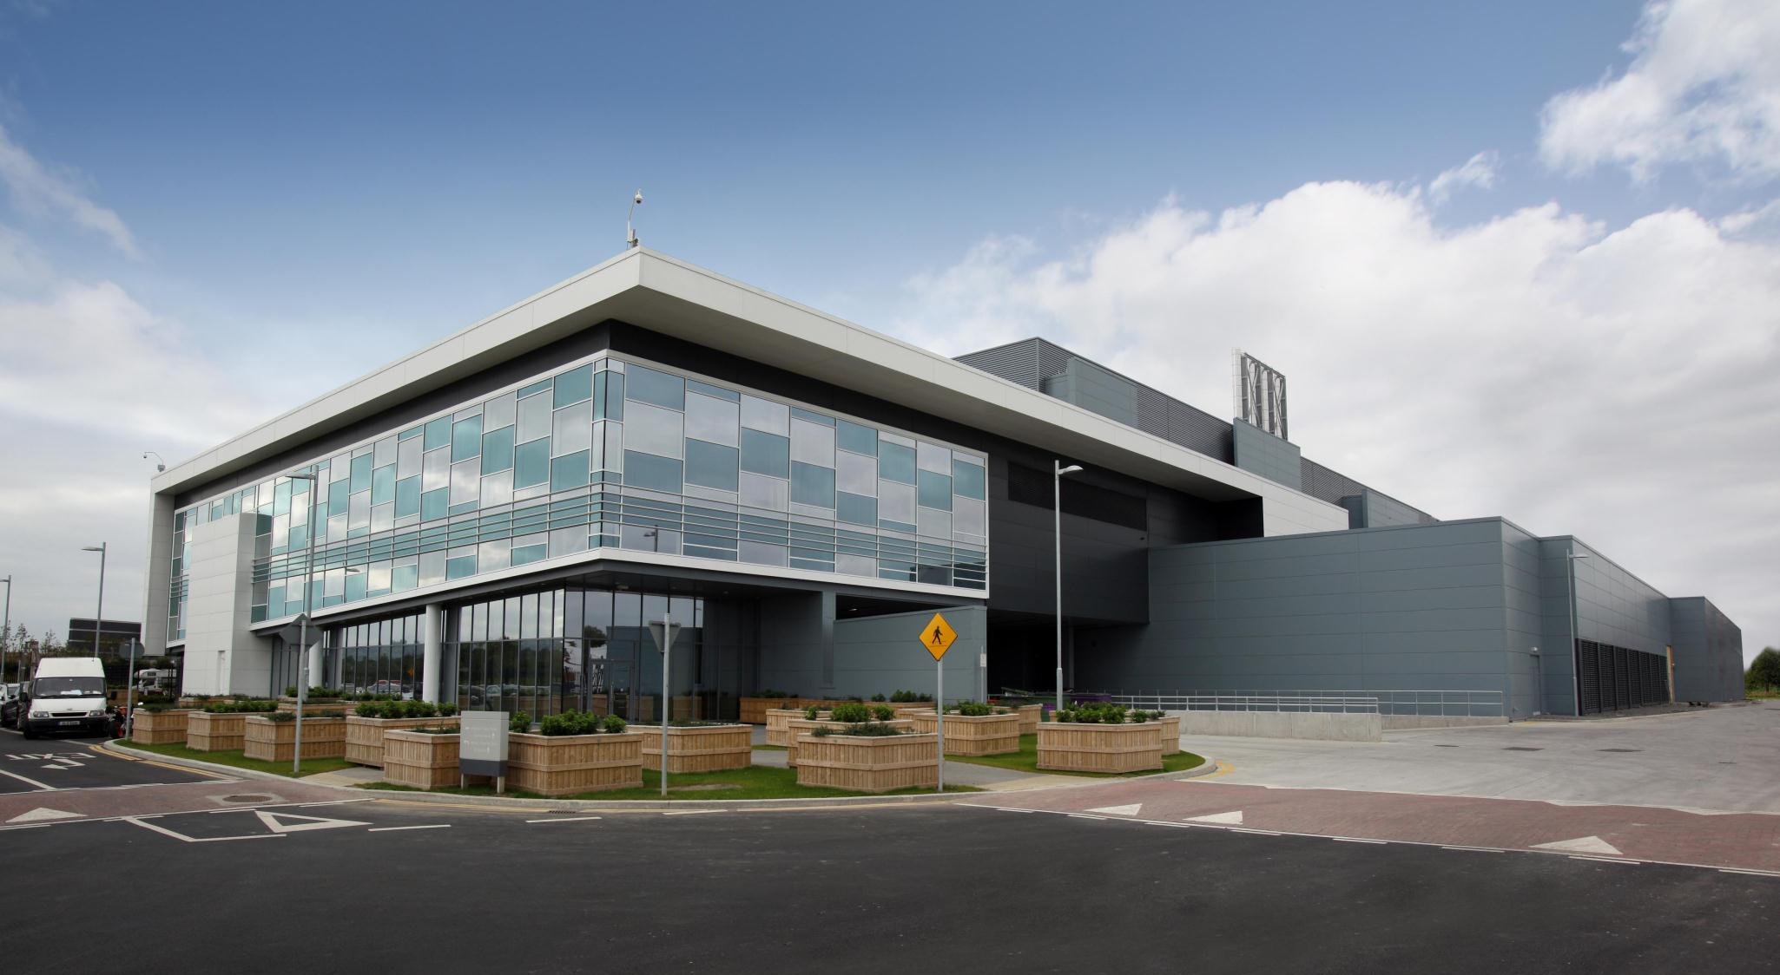
Delivering Cloud Infrastructure
Data Centers
Design, Build, Operate
Global Capacity
Modular Strategy
Global Network
Dark Fiber
Operation Centers
MOC/Global Ticketing
Security & Compliance
Standards & Certifications
Tools & Automation
Utility Pricing

Slide 8

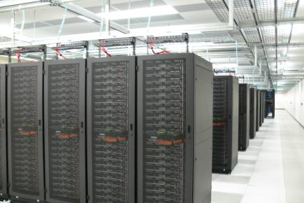
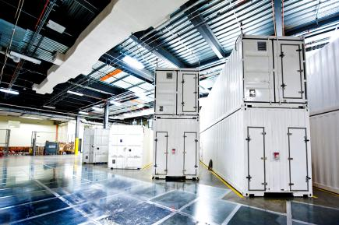
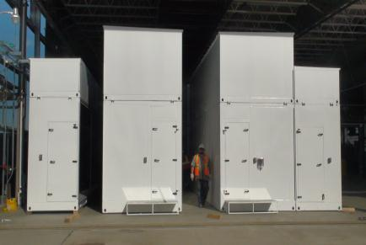
Microsoft’s Data Center Evolution
1989-2005
2007
2008
2011+
Generation 1
Generation 2
Generation 3
Generation 4
Colocation
Density
Containment
Modular
Containers, PODs
Scalability & Sustainability
1.2 – 1.5 PUE
Air & Water Economization
Differentiated SLAs
ITPACs
Reduced Carbon, Rightsized
1.05 – 1.20 PUE
Faster Time to Market
Air Cooled
Server
Capacity
~2 PUE
20 year Technology
Rack
Density and Deployment
1.4 – 1.6 PUE
Minimized Resource Impact

Slide 9


















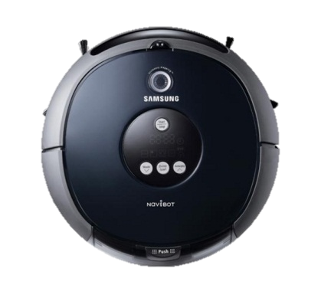


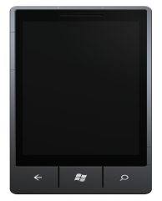
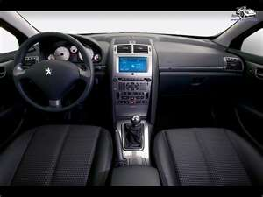
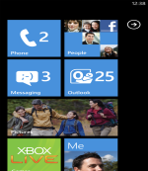

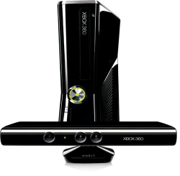


530M Active Windows Live IDs
368M People Using Hotmail
Over 4B WW Queries Each Month
Over 459M Unique Users
Over 2B Unique
Calls Per Year
Over 303M Users Each Month
Over 6M Songs In The Catalog
25M People
On Xbox Live
14B Ads
Per Month
Over a petabyte/month to about 1 bn PC’s
CLOUD SERVICES
PC
MOBILE
CAR
APPLIANCE
TV/HOME

Slide 10

The Big Shift: Forces driving a transformation in Automotive
Power
Shift To
Consumers
Connected Experiences
Globalization
& Emerging Economies
The Big Shift
From Product to Products, Services & Content
New Growth Markets Global Manufacturing Reverse Innovation
Increasing influences of Social Communities
Changing Demographics
Sustainability
Complex
Regulations
The Digital Generation Aging Workforce
Sustainability Driven Growth
Impact of Changing Regulations

Slide 11



Enabling the core capabilities required for success
Perform
Accelerating product development
Differentiating brand through Telematics 2.0
Building agile & flexible global ops
Extended PLM, innovation process management
End-to-end Connected Vehicle Platform
Plant & supply chain visibility,
Intelligent Systems
Developing scalable MS&S platforms for new markets
Innovate
Grow
Scalable marketing and sales systems

Slide 12



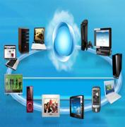







Connected Business Networks
Connected Consumer Experiences

Slide 13


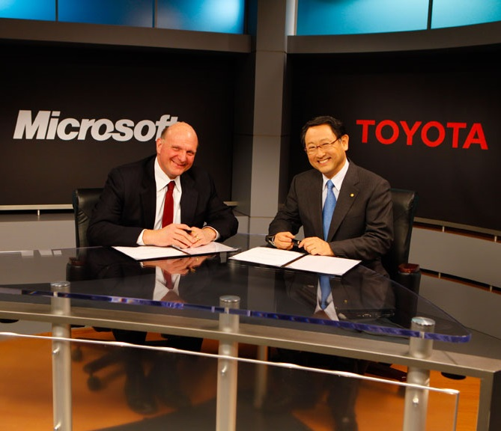

Solution strategies & priorities connected vehicle services
End-to-end connected vehicle platform
Extensible and
In-vehicle
Platforms
Scalable and
Global Cloud Platforms
Customer Experience Management Platform
Big Data and
Real-Time
Analytics

Slide 14





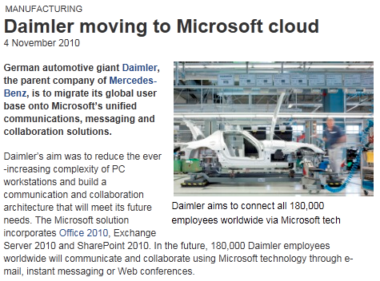





The Transformation Is Happening TODAY!
Microsoft To Work With Toyota To Put Cars In The Cloud
Microsoft And Nissan Establish Strategic Relationship For Next-Generation Dealer Management System
Delphi adopts Windows Azure platform for in-car services

Slide 15
Q&A

Slide 16

© 2012 Microsoft Corporation. All rights reserved. Microsoft, Windows, Windows Vista and other product names are or may be registered trademarks and/or trademarks in the U.S. and/or other countries.
The information herein is for informational purposes only and represents the current view of Microsoft Corporation as of the date of this presentation. Because Microsoft must respond to changing market conditions, it should not be interpreted to be a commitment on the part of Microsoft, and Microsoft cannot guarantee the accuracy of any information provided after the date of this presentation. MICROSOFT MAKES NO WARRANTIES, EXPRESS, IMPLIED OR STATUTORY, AS TO THE INFORMATION IN THIS PRESENTATION.

